Slide 1
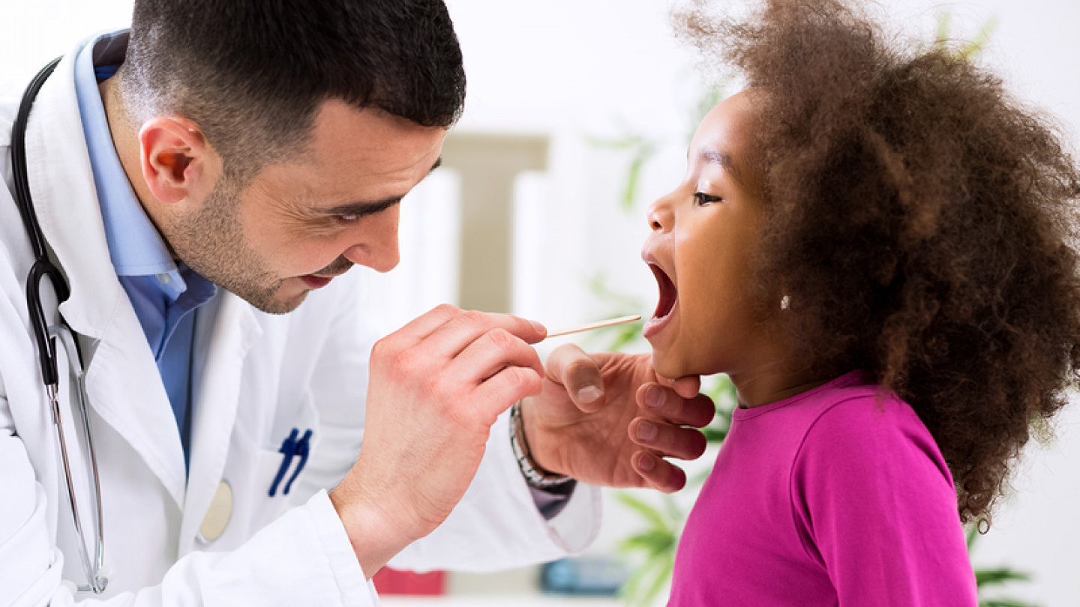
General physical examination
Dr Nada Abdelrahman

Slide 2

Learning objectives
By the end of this lecture the students should be able to
Outline the steps of performing general examination
Perform a general physical examination
Recall common abnormalities encountered during general physical examination
This Photo by Unknown Author is licensed under CC BY-SA

Slide 3

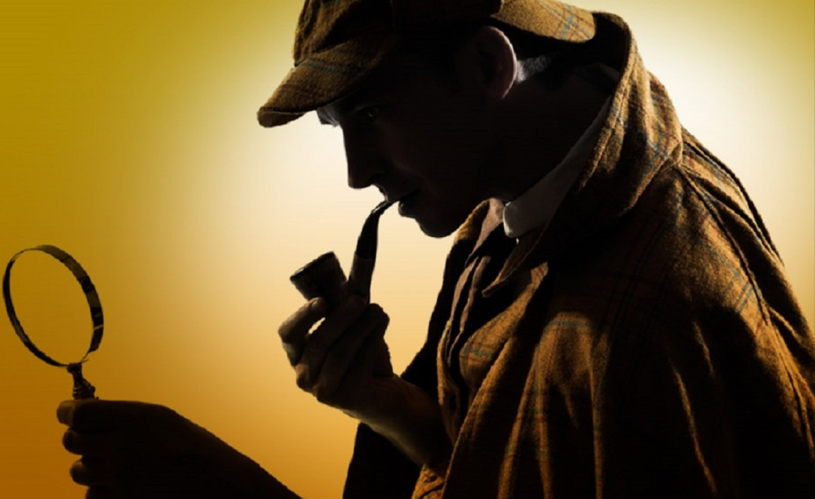
Physical examination
The clinician is the detective, gathering clues, and the physical assessment of a patient is the investigation itself!
This Photo by Unknown Author is licensed under CC BY-NC-ND

Slide 4
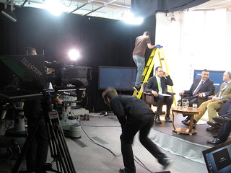


Prepare the scene
Purpose of General Physical Examination
Prepare your equipment
Provide Chaperones
Prevent Infection
Preparing the Patient for an Examination
Position the patient
Perform the right sequence of examination
This Photo by Unknown Author is licensed under CC BY

Slide 5


Why do we assess patients ?
Purpose of General Physical Examination
Formulate a differential diagnosis
Diagnose a medical problem
Assess overall state of health
Record a baseline values for vital signs
Standardised approach to obtain a reproducible findings
Correlate the physical findings with investigation
Spot diagnosis
Usually focuses on organ system based on patient’s chief complaint: Remember Signs Vs Symptom
Notes:
Sign – objective information
Symptom – subjective information

Slide 6
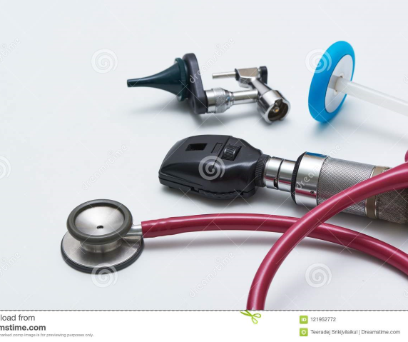
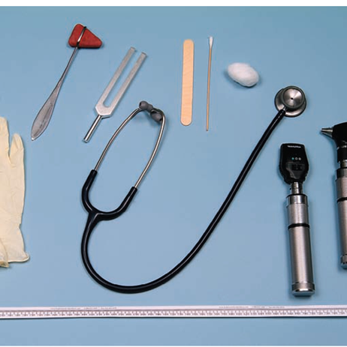
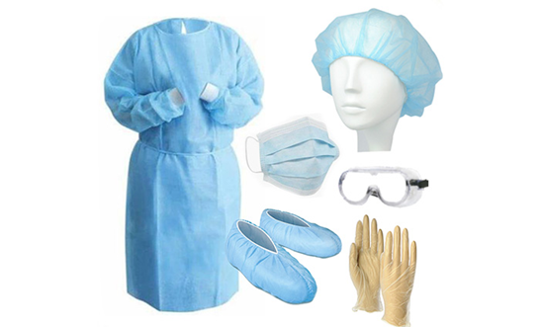
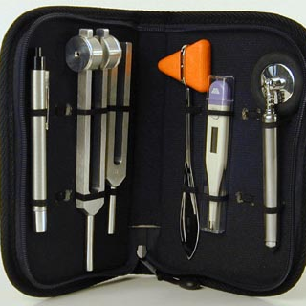
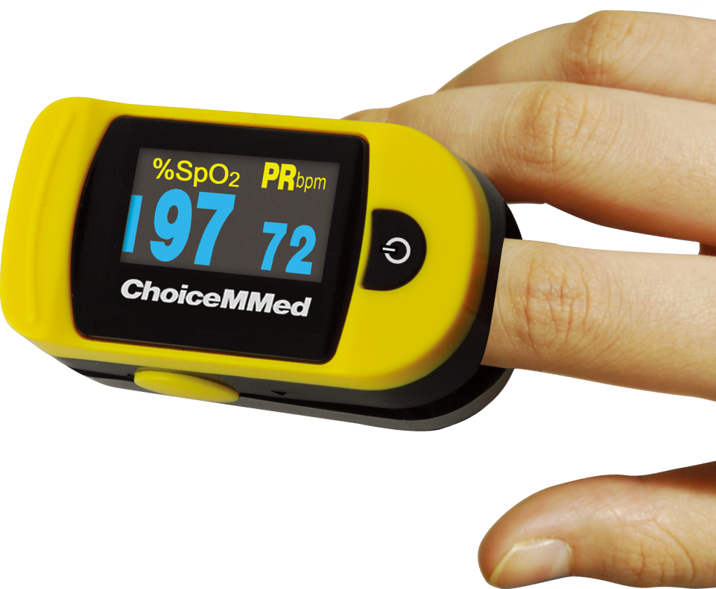
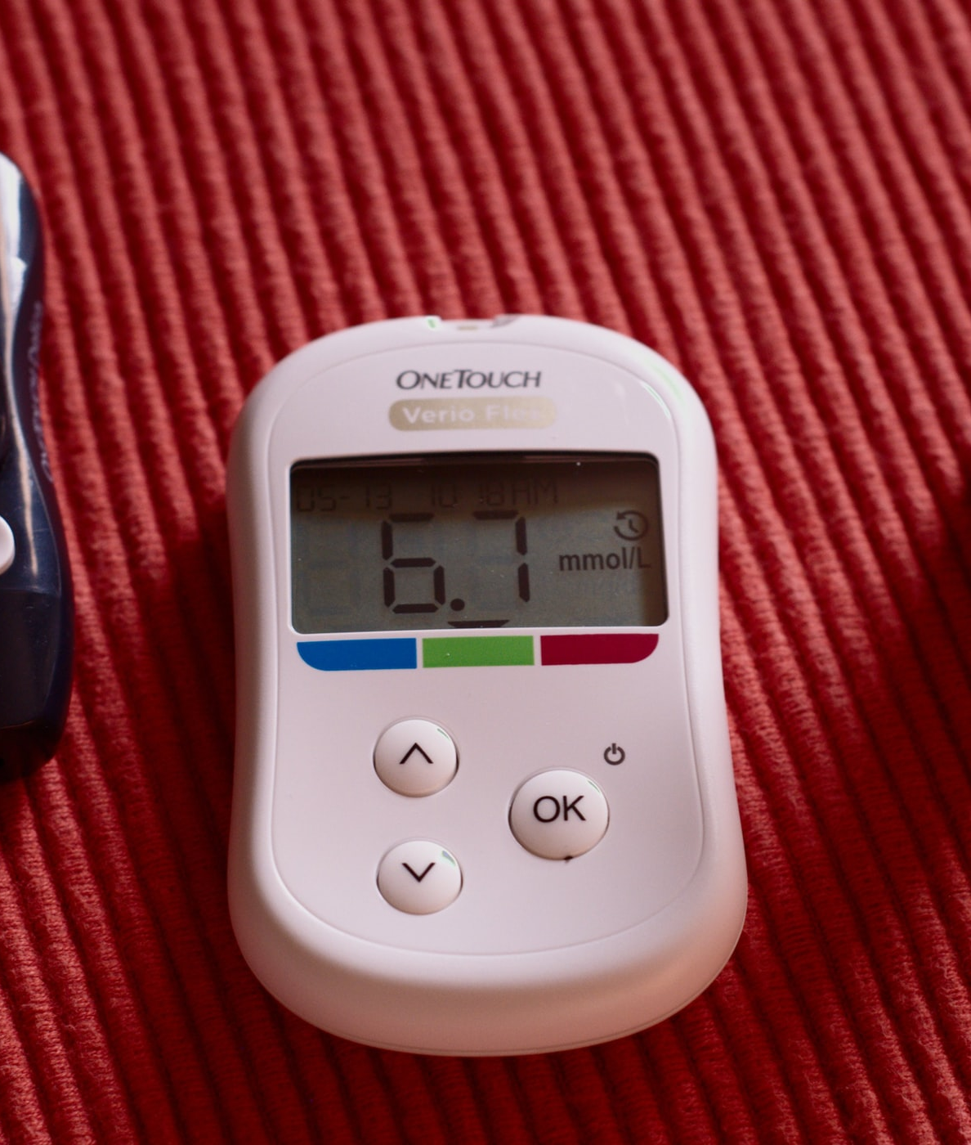
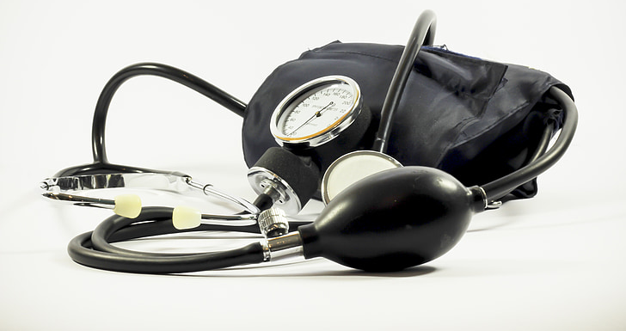
Equipment
This Photo by Unknown Author is licensed under CC BY
This Photo by Unknown Author is licensed under CC BY-SA-NC

Slide 7
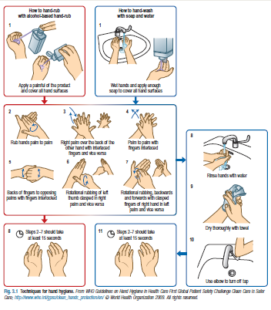
Hand hygiene

Slide 8
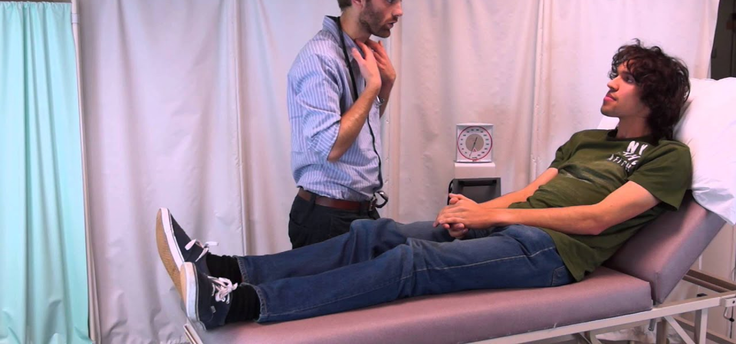
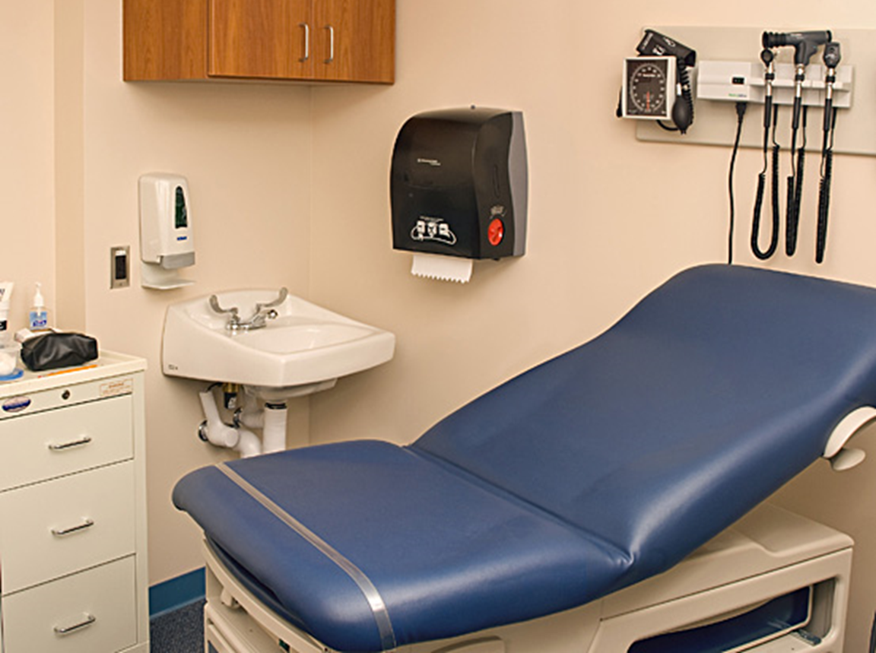
Preparing the Patient for an Examination
Remember WIPER
W ash hands (before and after)
Introduce yourself to the patient and seek his or her consent
Position the patient correctly.
Expose the patient as needed
Right side of the bed
Ensure privacy
Emotional – explain exactly what will occur
Physical – offer the bathroom; instruct the patient on how to undress.
Patient comfort is a priority ; cover with appropriate drape, Keep warm.

Slide 9
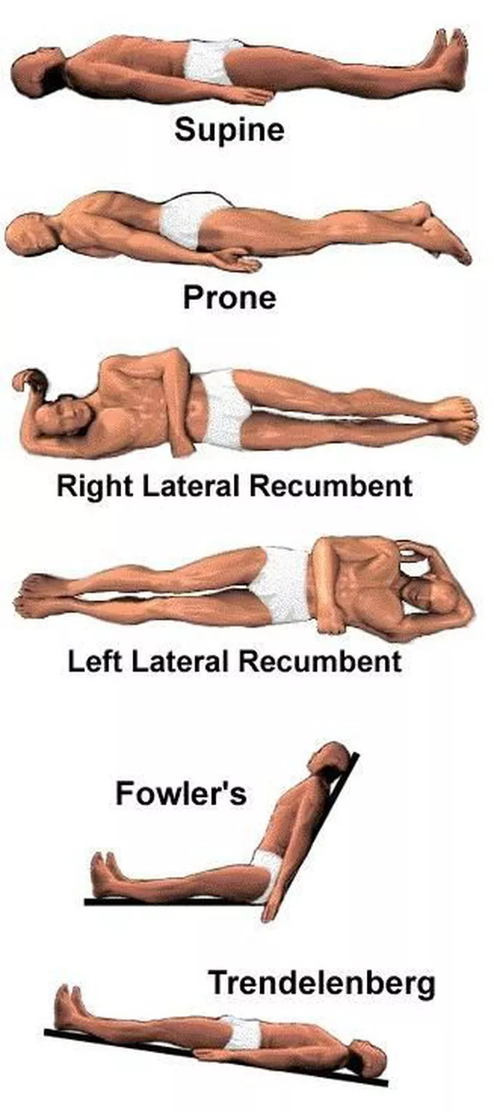
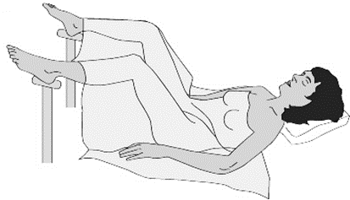
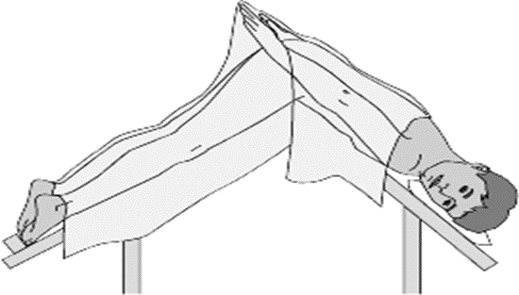
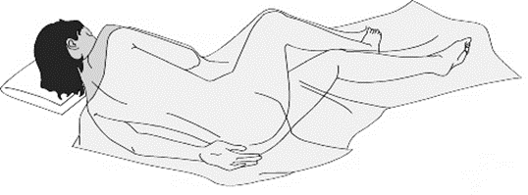
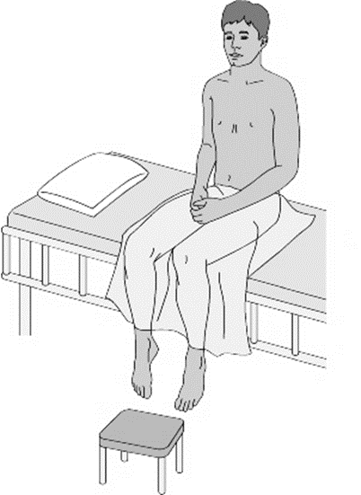
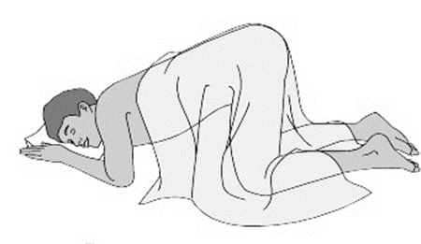
Position
Positions facilitate physician’s examination
Proctologic
Lithotomy
Sims’
Sitting
Knee-Chest

Slide 10
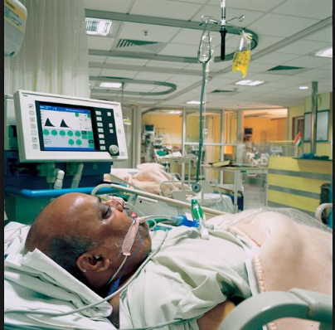
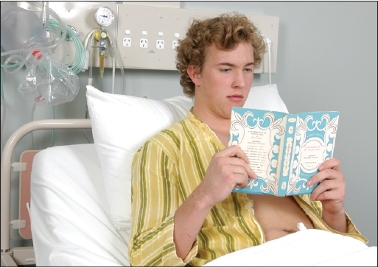
First, decide how sick the patient seems to be: that is, does he or she look generally ill or well?
Sequence for performing a physical examination
First impression:
Gait and posture
Facial expression and speech
Body habitus and nutrition
Hydration
Spot diagnoses
Vital signs
Hands
Head & Neck, Eyes, ENT
Lymph-nodes
The body
- Chest and lungs, heart, breasts
- Abdomen, genitalia, and rectum
- Musculoskeletal and neurological systems

Slide 11

Examination Methods
Inspection
Visual examination
Assesses posture, mannerisms, and hygiene
Size, shape, color, position, symmetry
Presence of abnormalities
This Photo by Unknown Author is licensed under CC BY-SA-NC

Slide 12
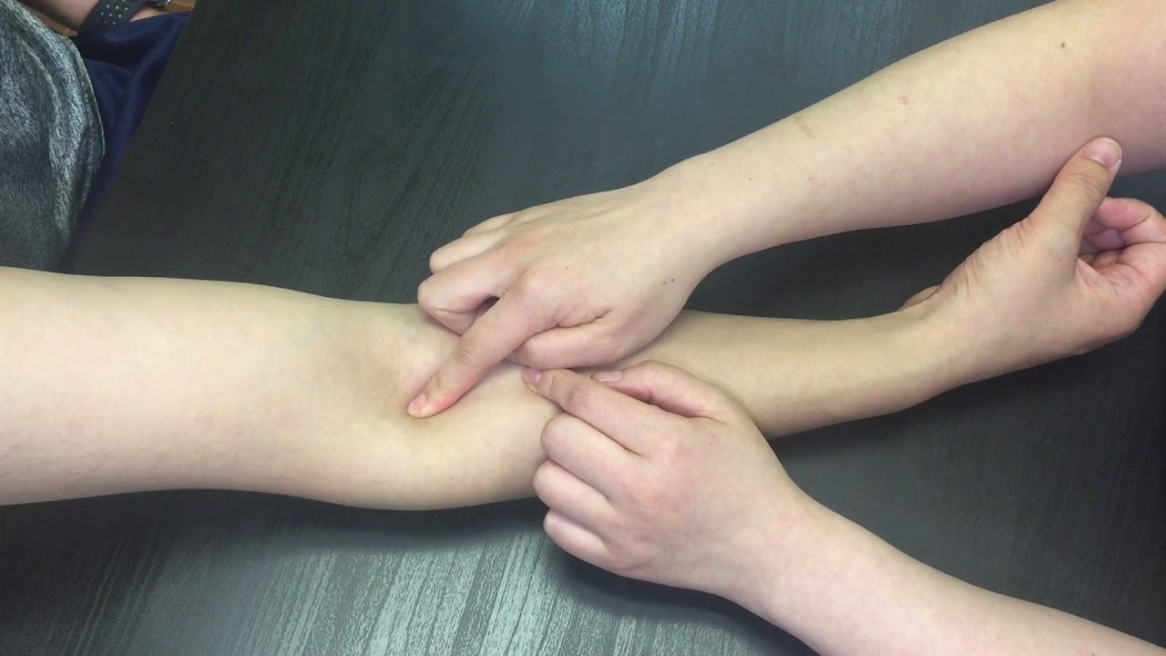
Examination Methods
Palpation
  Touch texture, temperature, shape
  Presence of vibration or movements
  Superficial or with additional pressure

Slide 13
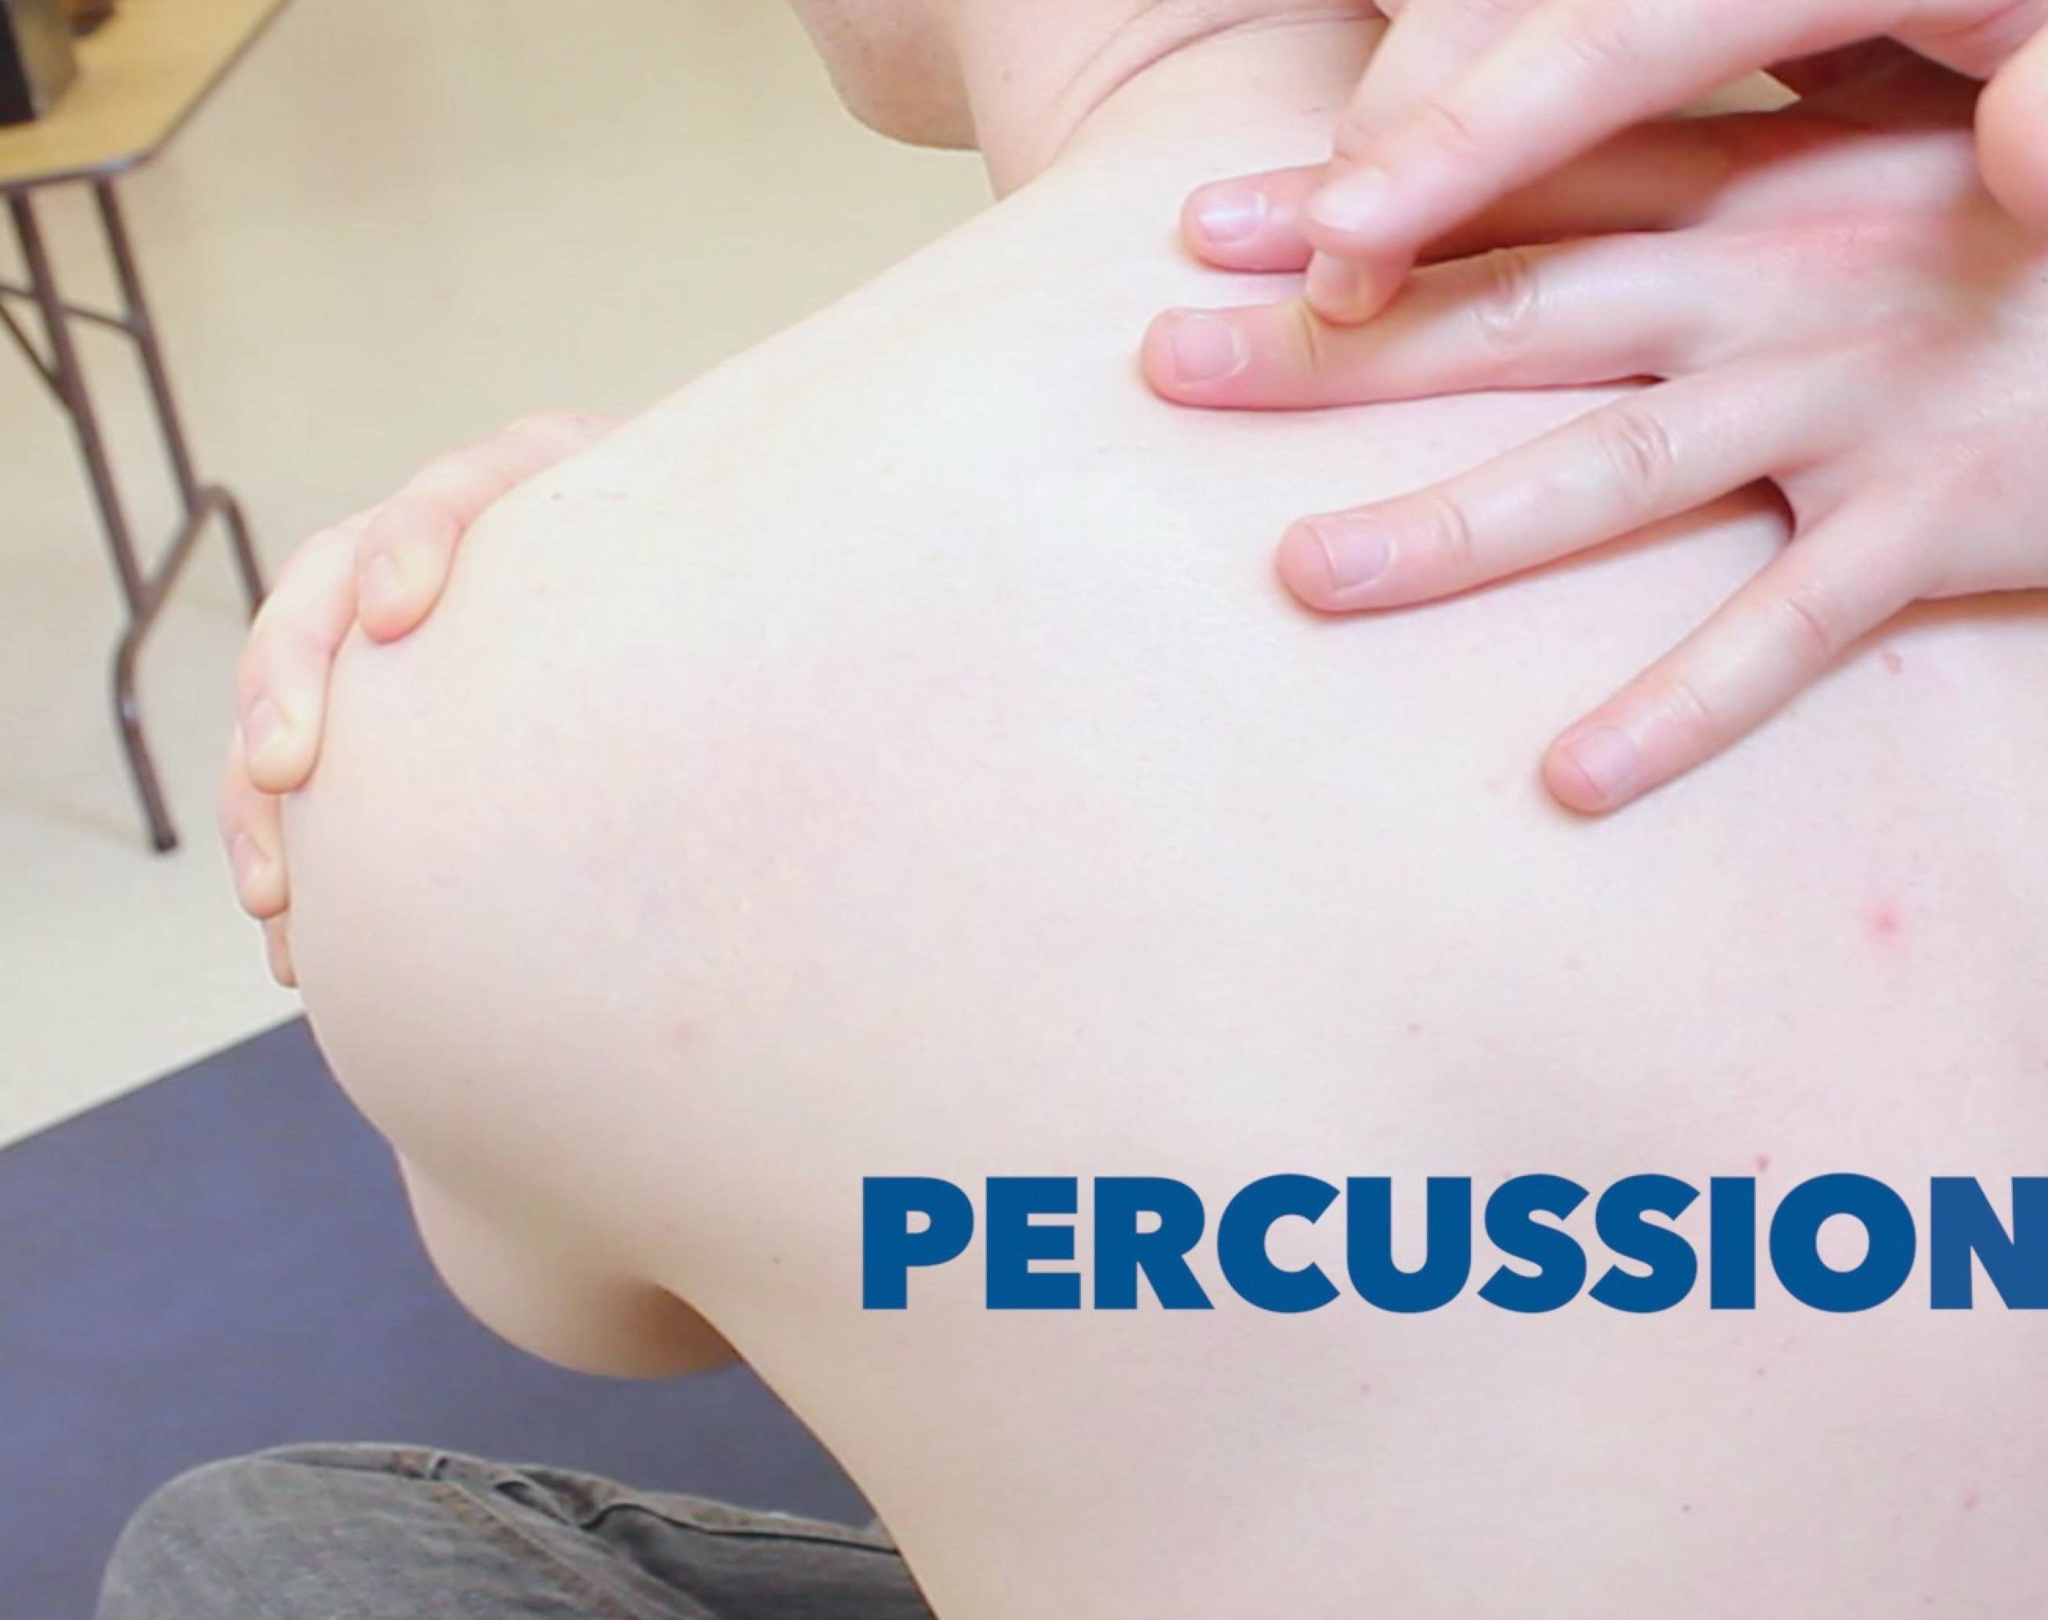
Examination Methods
Percussion
  Tapping and striking the body to hear sounds or feel vibrations
  Determine location, size, or density of structure or organ.

Slide 14
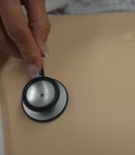
Examination Methods
Auscultation
  Listening to body sounds
  Assess sounds from heart, lungs, and abdominal organs
This Photo by Unknown Author is licensed under CC BY

Slide 15
VITAL SIGNS
PULSE
BLOOD PRESSURE
TEMPERATURE
RESPIRATORY RATE
BMI
They provide important basic physiological information.
GCS : Glasgow Coma Scale

Slide 16
Components of the General Physical Examination
General appearance
  Skin – a good indicator of overall health
  Hair – pattern of growth and texture
Head
  Abnormal condition of scalp or skin
  Puffiness
  Abnormal growths

Slide 17
Components of the General Physical Examination
Mouth impression of overall health and hygiene
  Throat
    swelling or redness

Slide 18
Components of the General Physical Examination
Ears
  Outer ear
    Symmetry and size
    Presence of lesions, redness, or swelling
  Inner ear structures
    Canals
    Eardrums
Nose and sinuses
  Nasal mucosa
  Structures of nose
  Palpation to check for tenderness in sinuses

Slide 19
Components of the General Physical Examination
Neck
  Lymph nodes and major blood vessels
  Thyroid:
  Inspection
  Palpation Percussion
  Auscultation
Eyes
  The presence of disease or abnormalities
  Pallor and jaundice
  Pupils for light response

Slide 20

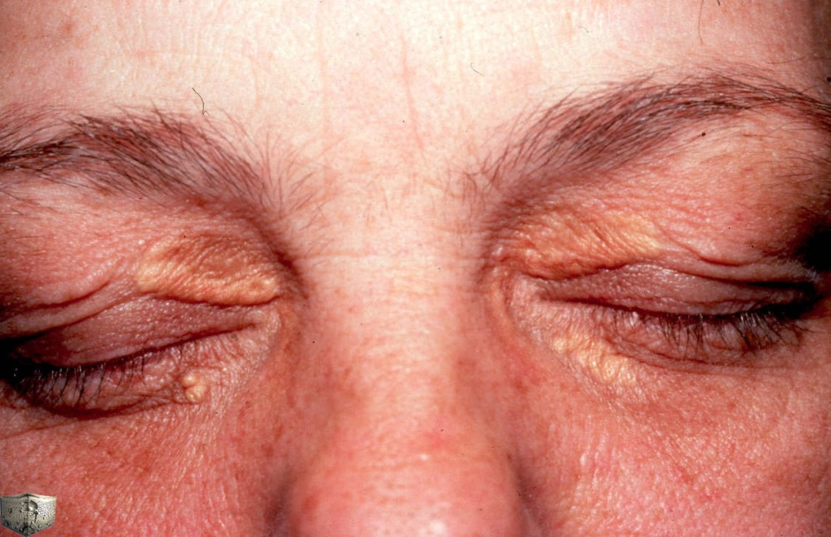
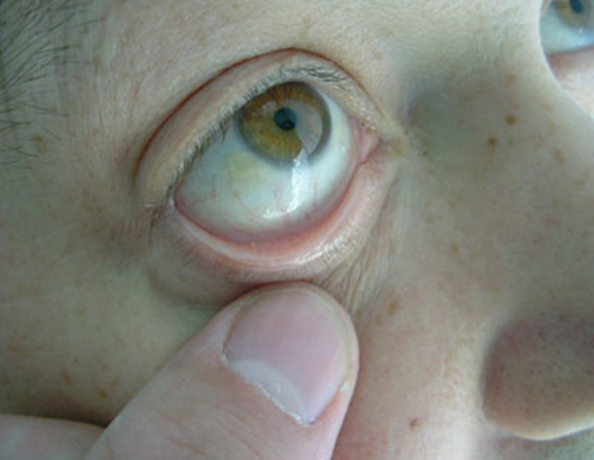
XANTHELASMATA
CORNEAL ARCUS
Anemia
Anxiety
Shock
Pallor

Slide 21
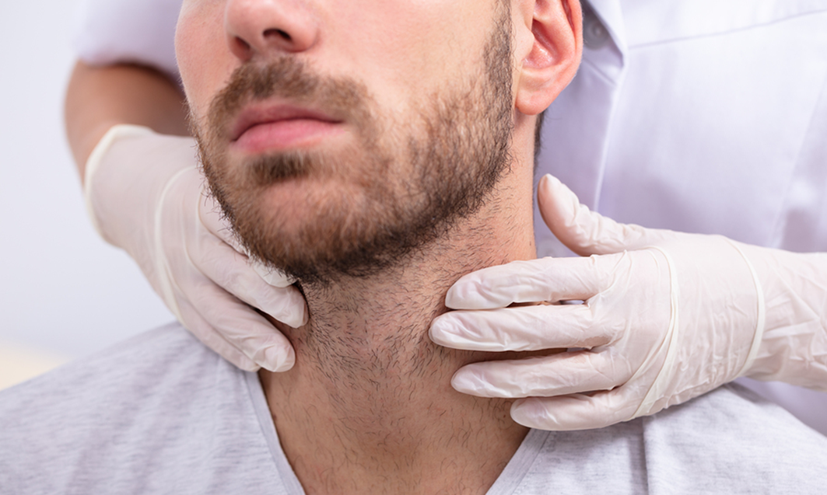
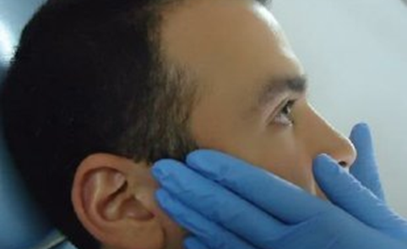
Lymph node Examination

Slide 22
Hydration
Mild-2.5L deficit
- mild thirst, dry mucous membranes, concentrated urine
Moderate – 4L deficit
-as above with moderate thirst, reduced skin turgor(especially the arms, forehead,chest and abdomen) , tachycardia
Severe – 6L
-great thirst, reduced skin turgor and decreased eyeball pressure
-collapsed veins, sunken eyes, postural hypotension, oliguria

Slide 23
Body Built
Factors affecting the body built :
Racial
Familial
Genetic
Endocrine
Malnutrition in young age
Child hood disease.

Slide 24
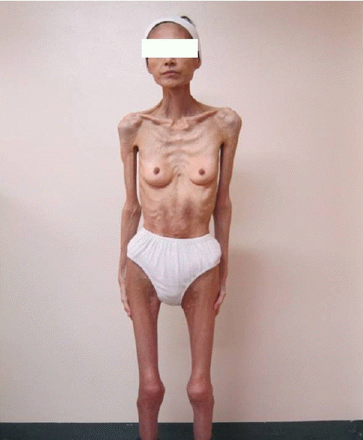
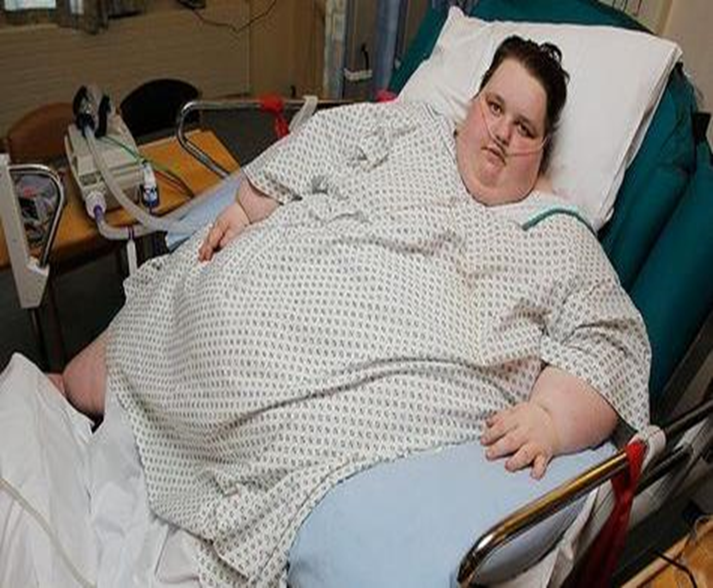



Slide 25
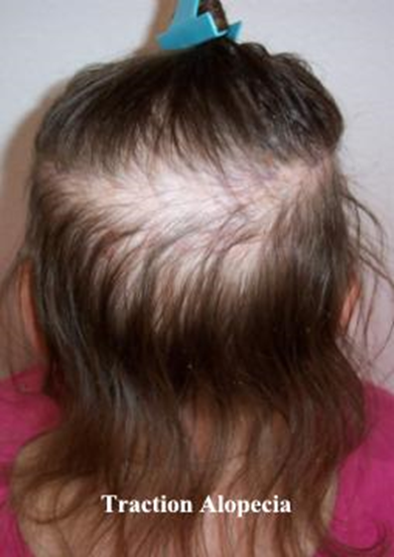
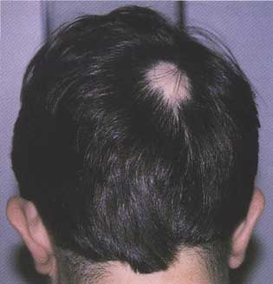
Alopecia areata

Slide 26
Examination of the
HEAD & FACE

Slide 27
Head:
Size
Shape:
Localized swelling. Look for scars, lumps, rashes, hair loss, or other lesions
Palpate to identify any areas of tenderness or deformity.
Face :
Expression
Edema and swelling
Complexion
Color change ( pallor - cyanosis - jaundice)
Individual organs
Asymmetry:Look for facial asymmetry, involuntary movements, or edema.
Malar flush ------

Slide 28
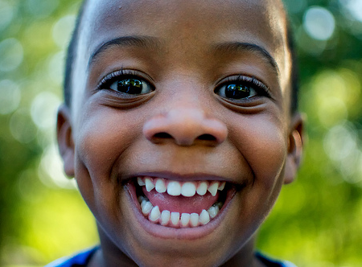
Diagnostic facies

Slide 29
Important Facies
Acromegalic
Cushing’s syndrome
Myxoedematous (severe hypothyroidism)
Thyrotoxicosis
Agitated faces—anxiety, mania or hyperthyroidism
Depression—flat expression
Paget’s disease
Parkinson’s disease
Myopathic
Myotonic
Rickets
Risus sardonicus* (tetanus)
SLE facies
Turner’s syndrome
Down syndrome
Marfan’s syndrome
Mitral facies
Uraemic (chronic renal failure)

Slide 30
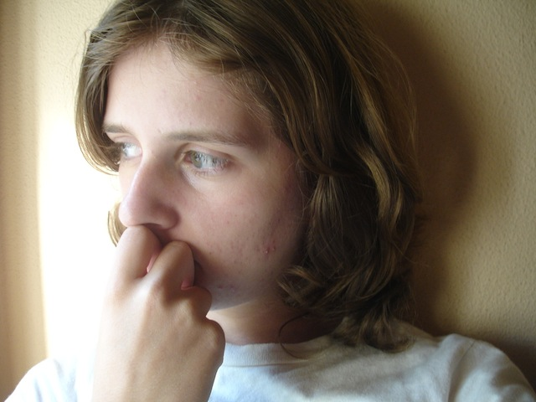
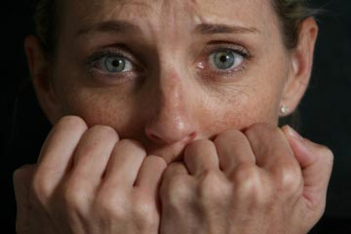
Depression
Anxiety

Slide 31
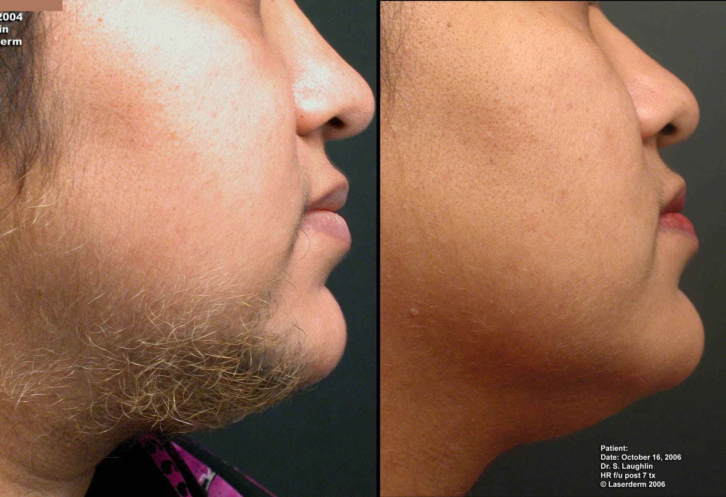
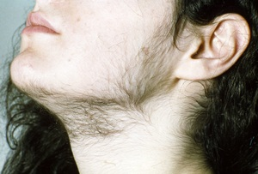
hirsutism

Slide 32
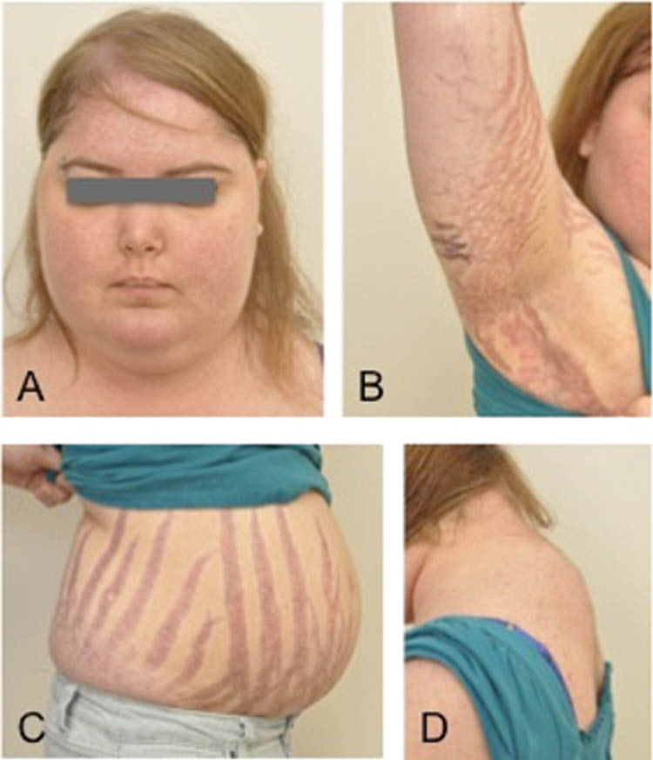
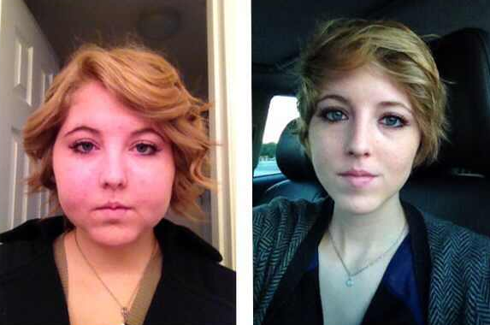
CUSHING’S SYNDROME
Moon like facies
buffalo hump.
Abdominal striae

Slide 33
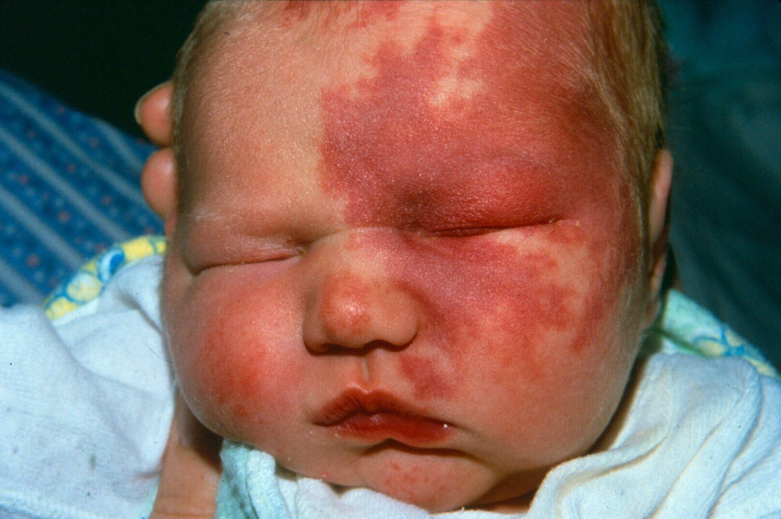
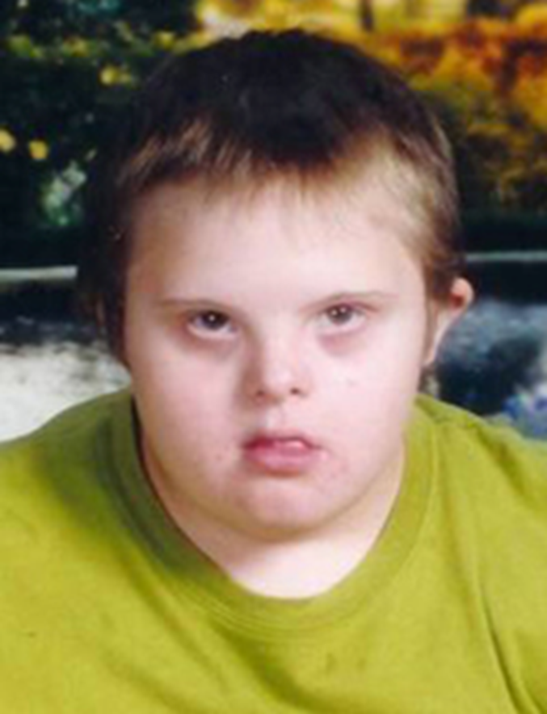
Sturge Weber: Port Wine Stain

Slide 34
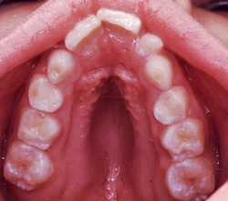
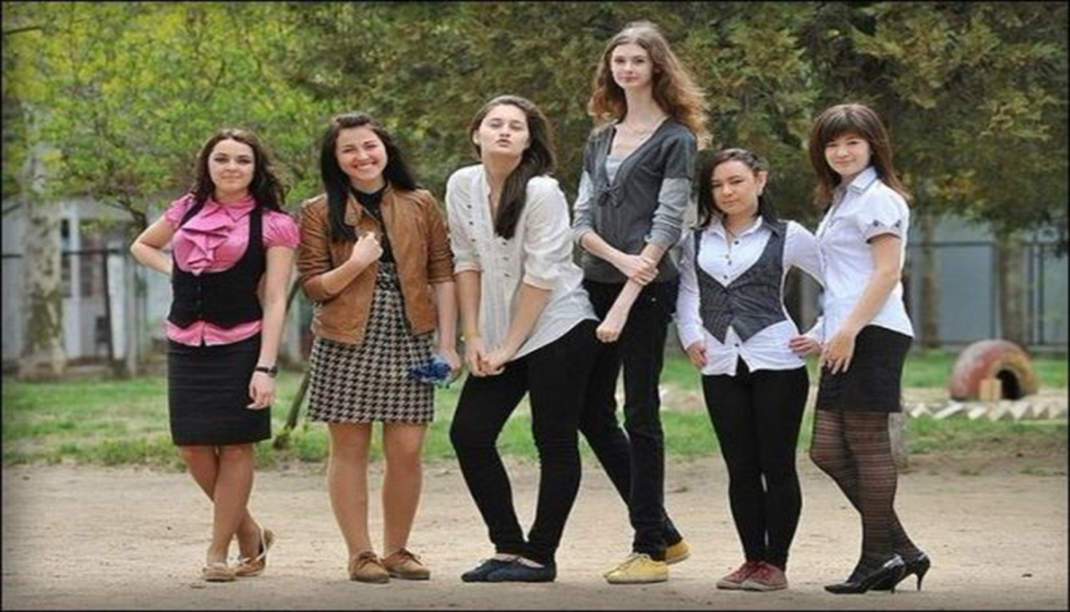
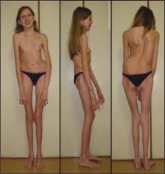
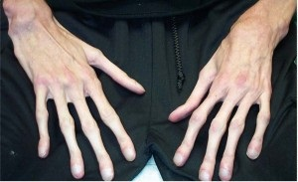
Marfan’s syndrome

Slide 35
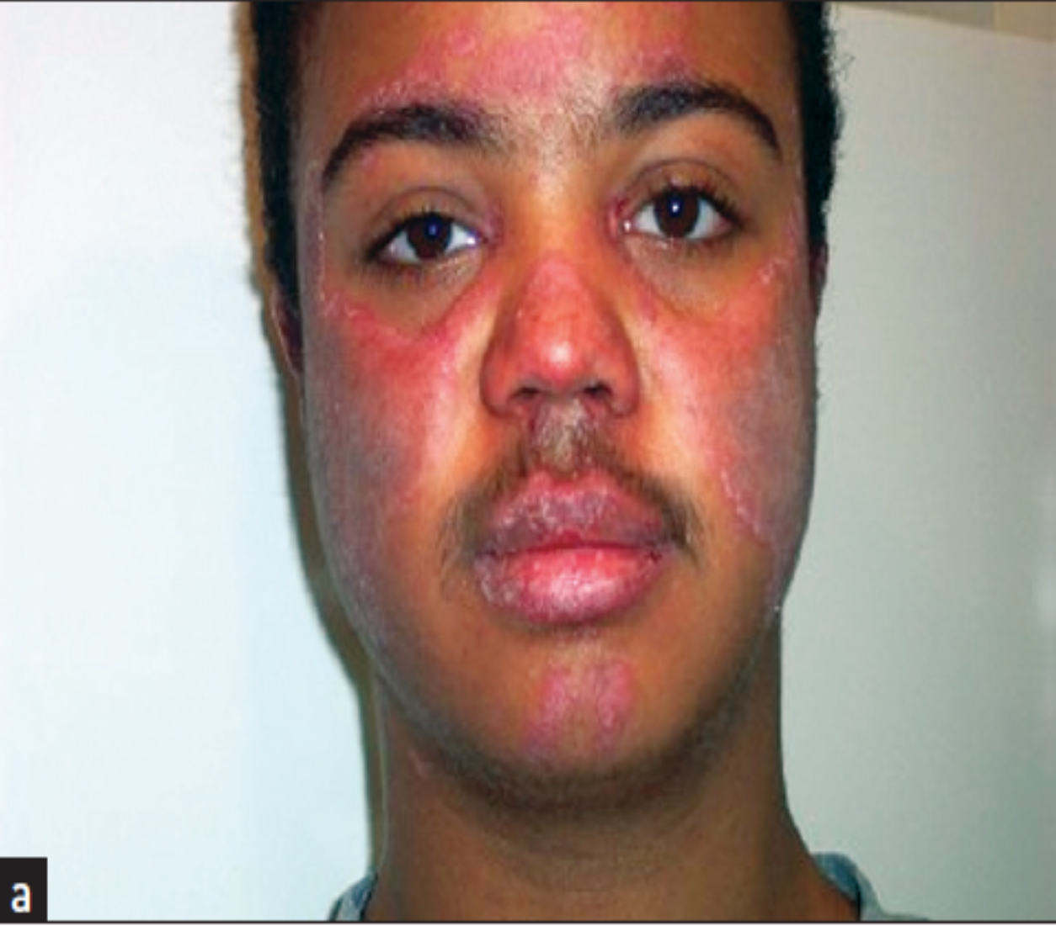
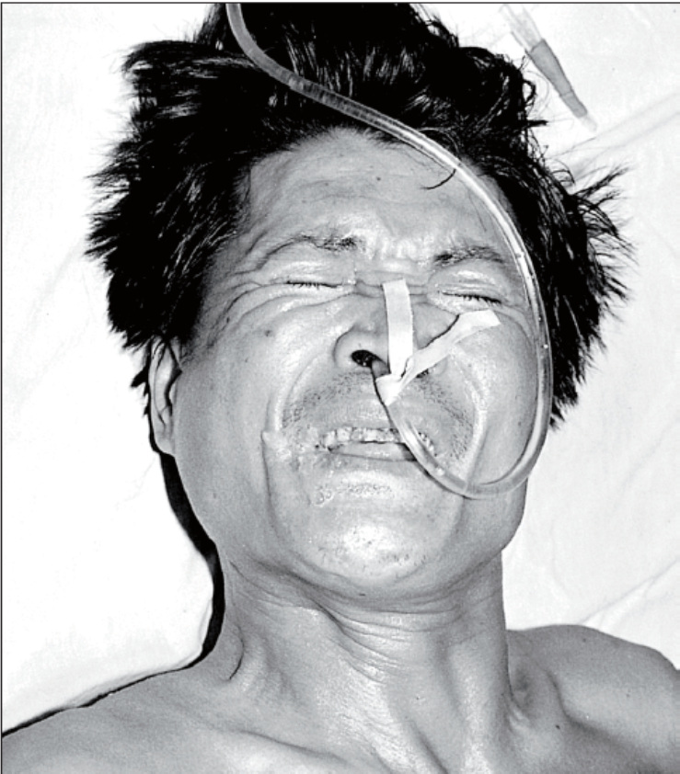
Myotonia dystrophica
SLE
Risus sardonicus

Slide 36
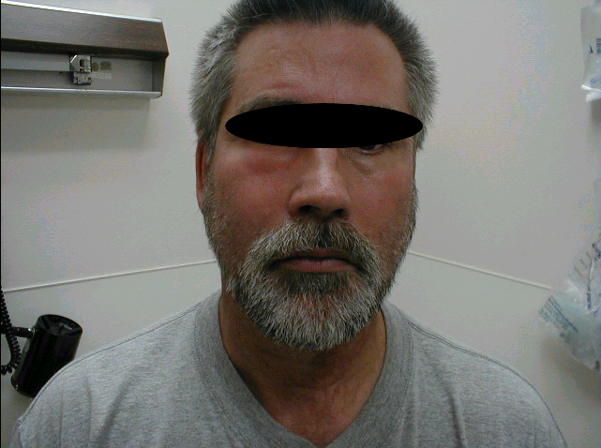
Facial
swelling
Facial swelling causing asymmetry

Slide 37
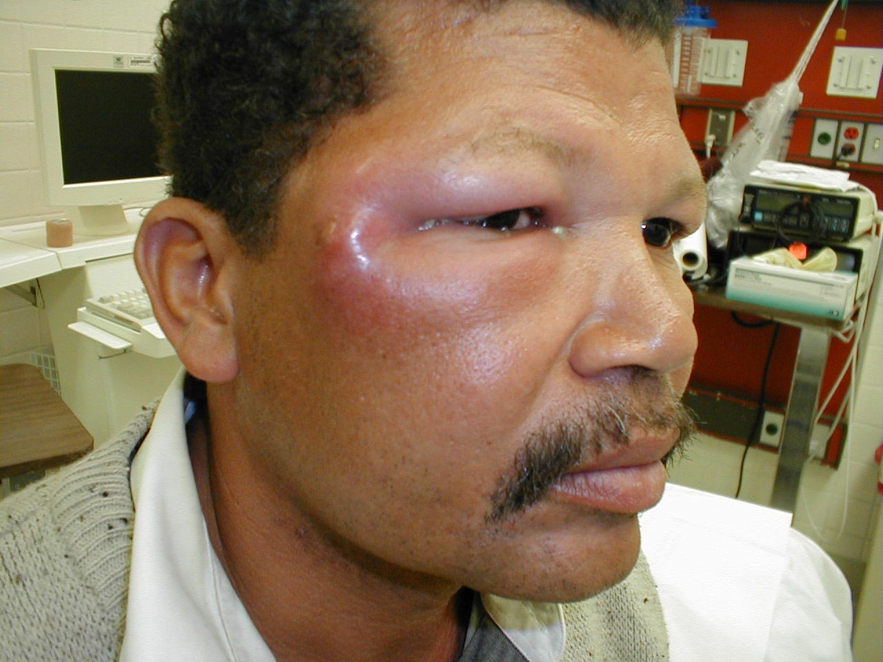
Facial swelling:Rt periorbital

Slide 38
Eyes
Inspect lid lag, ptosis, exophthalmoses, lacrimation, peri-orbital edema and nystabmus
Inspect conjunctival pallor, hemorrhage, scleral colour.
Examine the fundi by using ophthalmoscope

Slide 39
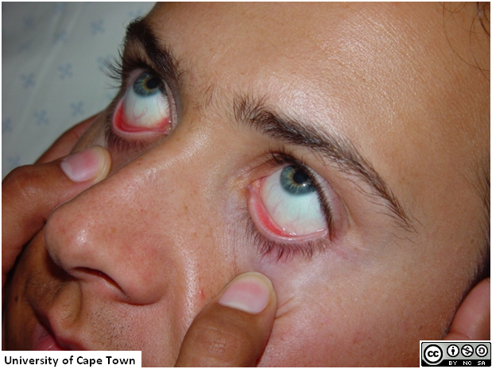
Normal Eye

Slide 40


Slide 41

Jaundice

Slide 42



(anaemia)
Notes:
PALLOR
A deficiency of haemoglobin (anaemia) can produce
pallor of the skin and should be noticeable, especially
in the mucous membranes of the sclerae if the
anaemia is severe (less than 70 g/L of haemoglobin)

Slide 43

Myathenia gravis

Slide 44


Ptosis

Slide 45

Edema of the eye lids

Slide 46

Xanthelasma

Slide 47

Panda eye sign

Slide 48

Congenital retraction

Slide 49
arcus senile

Slide 50
Pupils : size – equality - light reaction
Small pinpoint pupils
Bilateral small pupils |  | Unilateral
( 1- 2.5 nm ) | < 1mm
Sympath. Damage Hypothalamic Metabolic | pontine Hge Drugs: morphine, heroin , narcotic | Horner syndrome
Mid position fixed pupil: (4-6mm) slightly dilated with no light reaction → Mid brain damage

Slide 51

Horner syndrome

Slide 52


Large” dilated pupils

Slide 53

Subconjunctival hemorrhage

Slide 54

Conjunctivitis

Slide 55
Ear
Tophi
Discoloration
Ochronosis
Discharge

Slide 56
References
Nicholas J Talley: clinical examination. A systematic guide to physical diagnosis 8th edition: 37-56
HUTCHISON’S CLINICAL METHODS 24th edition . Page 15-40
Macleod’s Clinical Examination : 15 edition Page 21-41

