Slide 1


Slide 2
History & Examination
Of the Neck
Omar Alaidaroos MSc, MD, FRCS
Associate Prof. of General Surgery

Slide 3
Common Neck Swellings

Slide 4
Anatomy:
The anterior triangle is situated at the front of the neck.
It is bounded:
  Superiorly
    Inferior border of the mandible (jawbone).
  Laterally
    Anterior border of the sternocleidomastoid.
  Medially
    Sagittal line down the midline of the neck
    from the chin to the manubrium .

Slide 5
The posterior triangle is situated posterior to SCM
Its boundaries are as follows:
  Anterior
    Posterior border of the SCM.
  Posterior
    Anterior border of the trapezius muscle.
  Inferior
    Middle 1/3 of the clavicle.

Slide 6
Which triangle of the neck is involved
Does it move with swallowing?
This indicates it is deep to the pretracheal fascia and likely to be thyroid.
Does it move with protrusion of the tongue?
This applies to upper anterior neck lumps, and the physical sign refers to thyroglossal cysts.
Notes:
Swelling that are fixed to the trachea will mover when the trachea moves. The Trachea is pulled upward during swelling.
The hyoid bone ascend when the tongue is protruded. (So, if swelling move with tongue movement, it must be fixed to the hyoid bone)

Slide 7
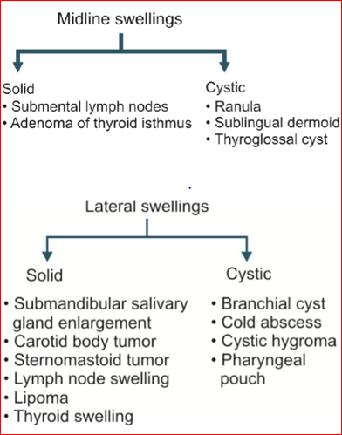
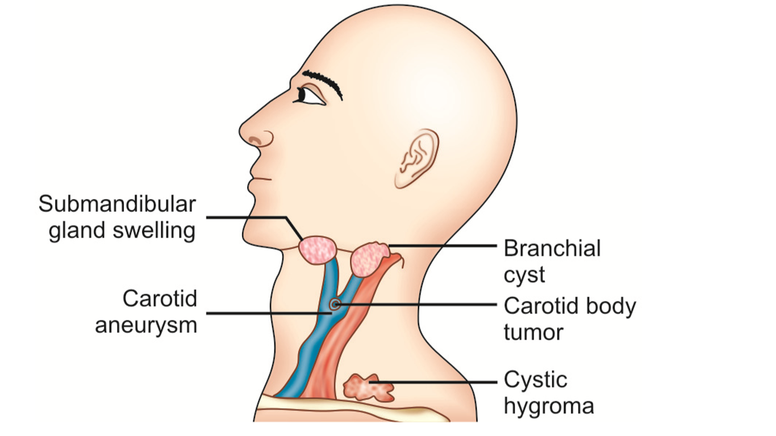
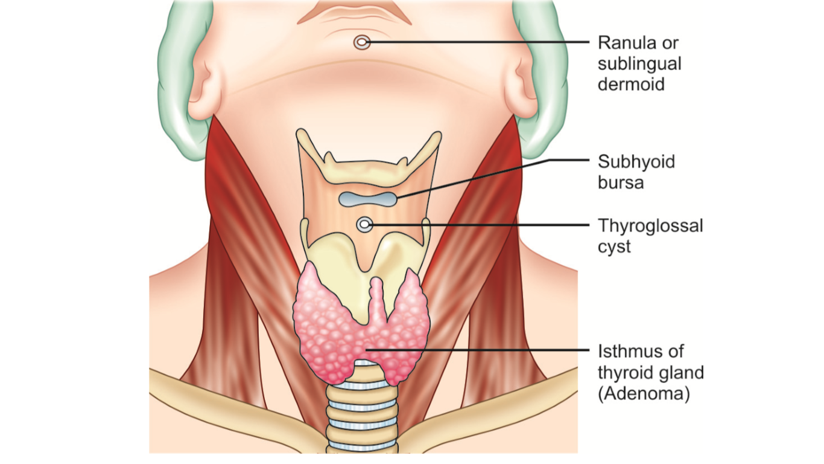

Slide 8
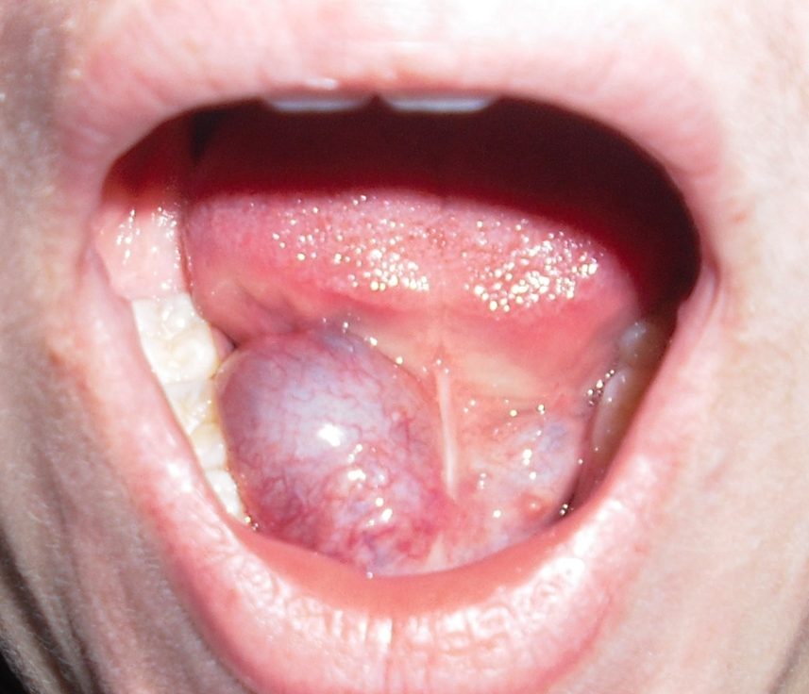
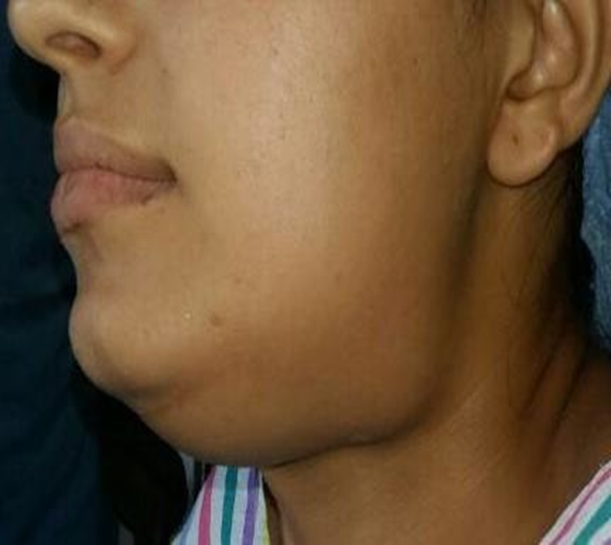
Ranula
It arises from a damaged sublingual gland .
Diagnosis: A child or young adult , Bluish in color, in the floor of the mouth, soft, fluctuant and transilluminate
Plunging ranula :
So called when extends into the neck, passing beyond the floor of mouth and appears in the submandibular region
Diagnosis—by bidigital palpation (one finger in the oral cavity and the other on the neck).
Notes:
Plunging ranula: when large ranula pass to the upper neck through the mylohyoid bone

Slide 9
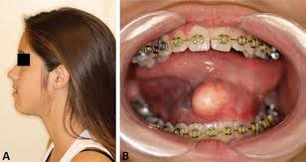
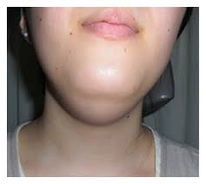
Sublingual , Cervical Dermoid Cyst
It is a congenital sequestration dermoid cyst.
Cystic swelling in the floor of mouth
Transillumination– Negative.
Notes:
Dermoid cyst is a cyst that is deep to the skin and lined by skin, can be congenital or acquired
can occurs at any point in the mid-line of the trunk

Slide 10
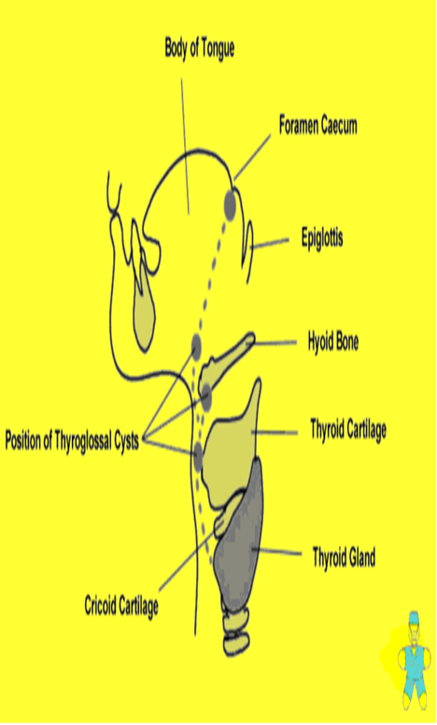
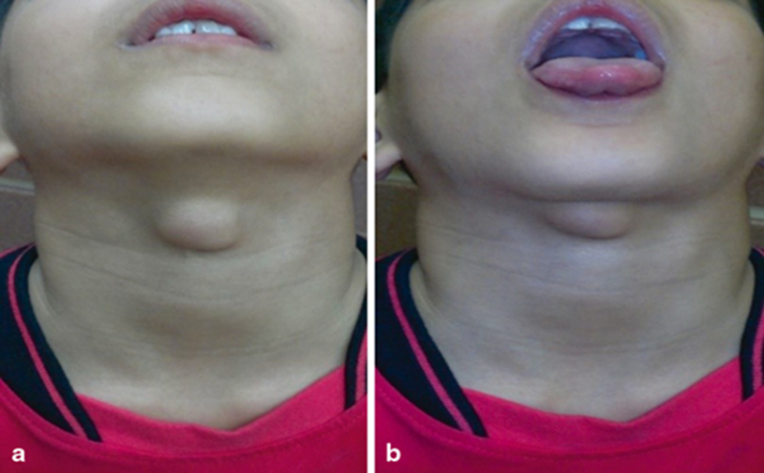
Thyroglossal cyst (tubuloembryonic Dermoid cyst)
Structures which move up with deglutition:
1. Thyroid swellings
2. Subhyoid bursitis.
3. Pretracheal and prelaryngeal lymph nodes.
4. Thyroglossal cyst.

Slide 11
Branchial cyst
Age: Although congenital, it first appears around 20 to 25 yrs or more as the fluid it contains, accumulates slowly.
Site—In the anterior triangle of the neck, partly under cover of the upper 1/3rd of anterior border of SCM
Notes:
Read about pathophysiology p.521 (principles & practice of surgery)

Slide 12
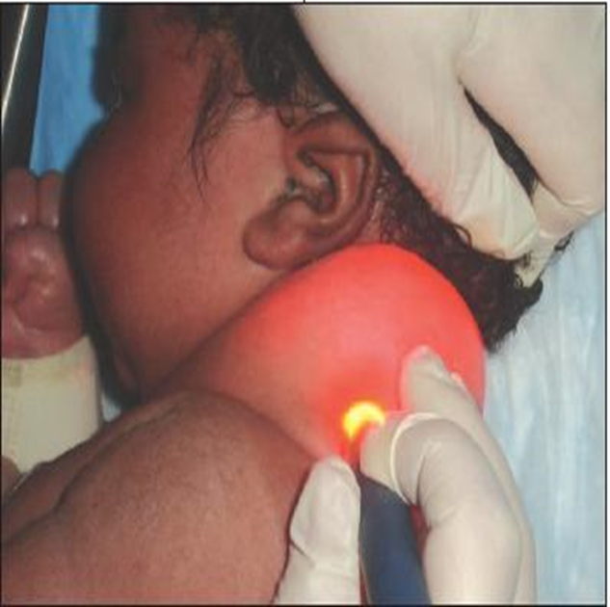
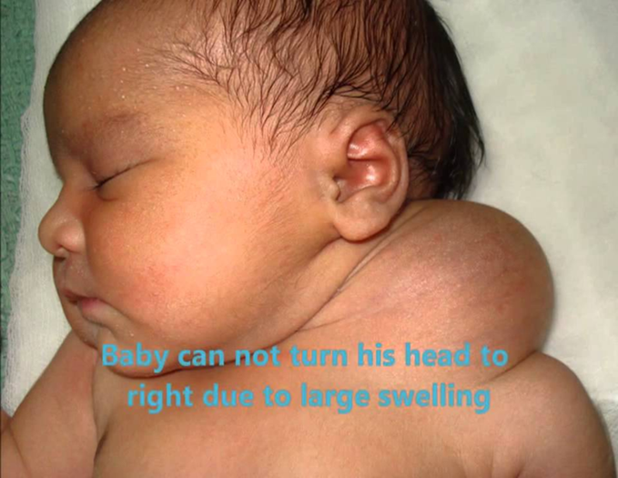
Cystic Hygroma
Definition: It is a collection of lymphatic sacs, contain clear colorless lymph.
Site: At the base of the neck, in the posterior triangle. It may extend up to the jaw above and down over the anterior chest wall and axilla.
Other Sites :Axilla, inguinal region, mediastinum, tongue and buccal mucosa of the cheek.

Slide 13
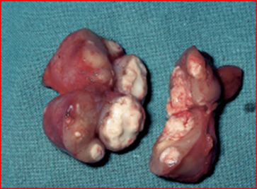
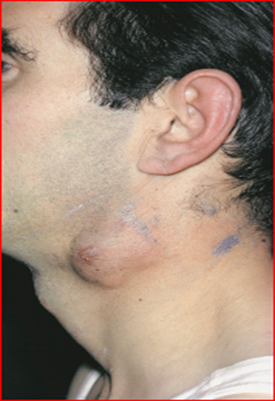
Cold Abscess
Caseation necrosis of cervical lymph nodes.
Why so called ? Has no signs of inflammation.
Due to TB lymphadenitis or TB spine (cold abscess
in the posterior triangle of neck).

Slide 14
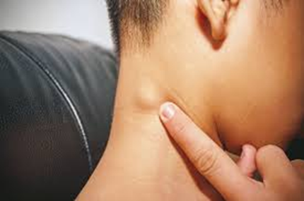
Cervical Lymphadenopathy
Causes
1. Acute:
a. Acute pyogenic lymphadenitis.
b. Acute lymphatic leukemia.
c. Acute infectious mononucleosis. (E.B. virus)
2. Chronic: A. Inflammatory a. Nonspecific—Chronic pyogenic lymph adenitis.
b. Specific—TB, syphilis, sarcoidosis.
B. Neoplastic (malignant) I. Primary: Lymphoma Hodgkin’s disease
Lymphosarcoma.
Reticulum cell sarcoma.
II. Secondary –Metastatic lymph node from a primary growth.
C. Autoimmune disorders, e.g. SLE, juvenile rheumatoid arthritis (Still’s disease).
Investigations: Blood—Complete blood count,
chest -X­ray.
FNAC and biopsy of the enlarged lymph nodes.

Slide 15
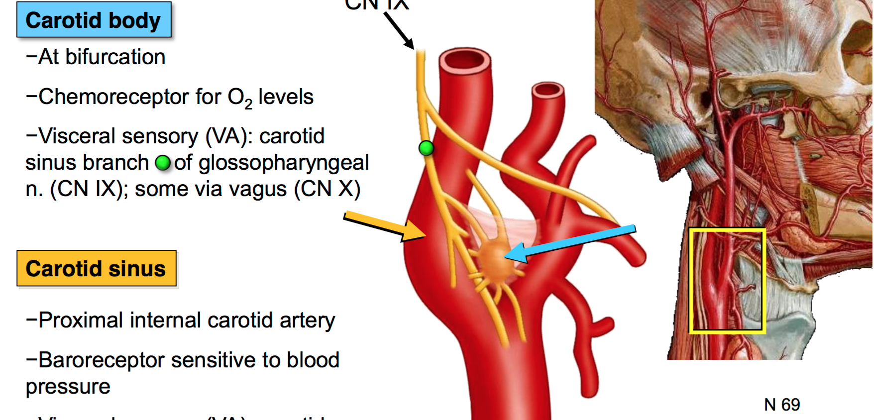

Slide 16
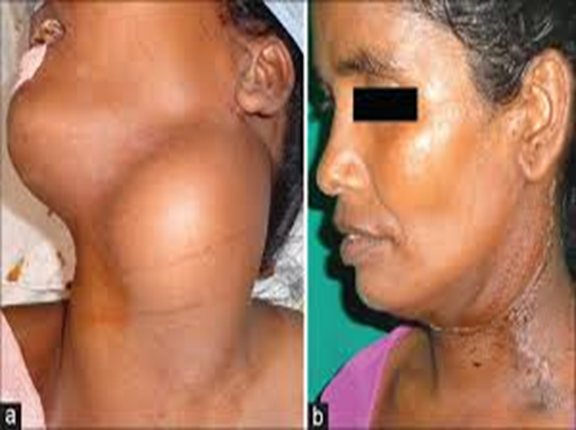
Carotid Body Tumour (Syn. Chemodectoma, Potato Tumor)
It is a slow growing tumor which arises in the carotid body at the carotid bifurcation, 2 – 10 cm, in size, well ­capsulated
A chemoreceptor organ which is stimulated by the rise in PCO2 or H+ ion concentration of arterial blood or a decline in its PO2.
Clinical Features:
Firm, homogeneous and compact tumor, like a potato.
Highest incidence is between the ages 40 and 60 years of life.
Slow growing painless swelling at the bifurcation of the common carotid artery.
Pressure on the carotid sinus from the tumor produces attacks of faintness.
Notes:
What is Lyre sign in CT scan?

Slide 17
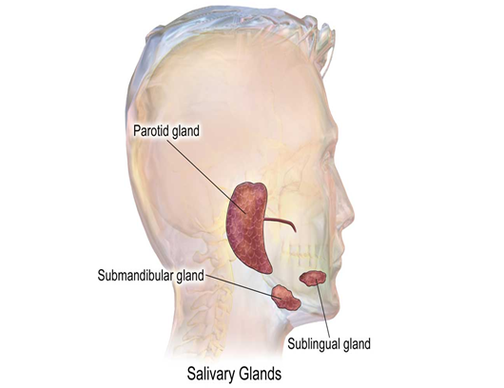

Salivary gland swellings
Viral infections (Mumps)
  Common among children.
  Usually affects parotid, occasionally submandibular
  Painful swelling, fever and headache.
  Resolves in 5-10 days.
  Treatment- symptomatic

Slide 18
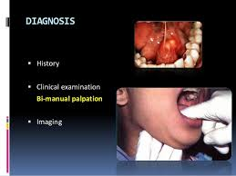
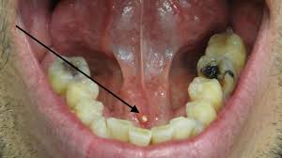
Calcular disease (Sialolithiasis):
  Painful swelling of submandibular gland during eating
  Swelling resolves/ reduces 1-2 hours after meals
  Enlarged submandibular gland on bimanual examination
  Stone in the duct- palpable in the floor of mouth
  Treatment:
    Stone in the duct- extraction by direct incision over the duct
    Stone in the gland- excision of the gland

Slide 19
Thyroid diseases
Congenital- Thyroglossal cyst, Lingual thyroid
Structural- Non-toxic goitre, MNG, STN, Cyst
Functional disorders- Hypothyroidism Hyperthyroidism- Grave’s disease, Toxic adenoma, Toxic MNG, Thyrotoxicosis factitia
Thyroiditis- Hashimoto’s disease, acute/ subacute thyroiditis, Riedel’s thyroiditis
Neoplasm: Benign: Follicular adenoma
Malignant: Papillary, Follicular, MTC, Anaplastic, Lymphoma, Metastatic

Slide 20
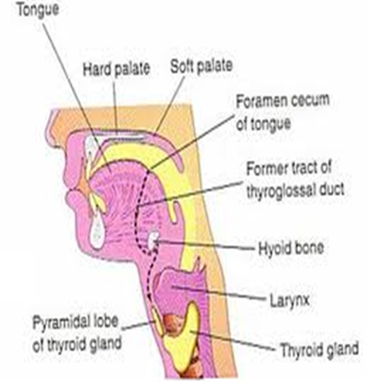
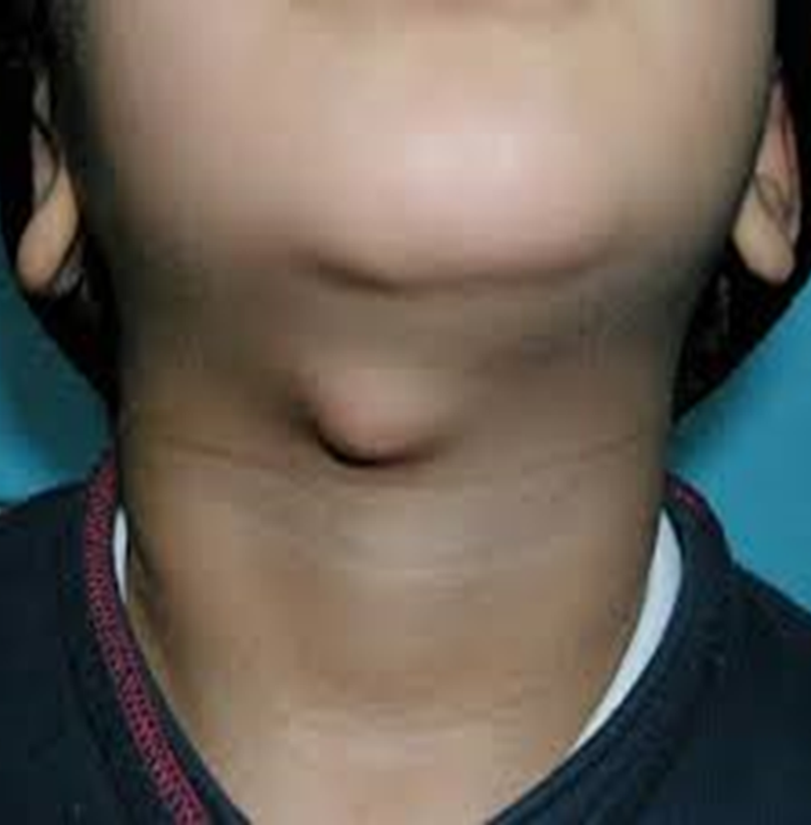
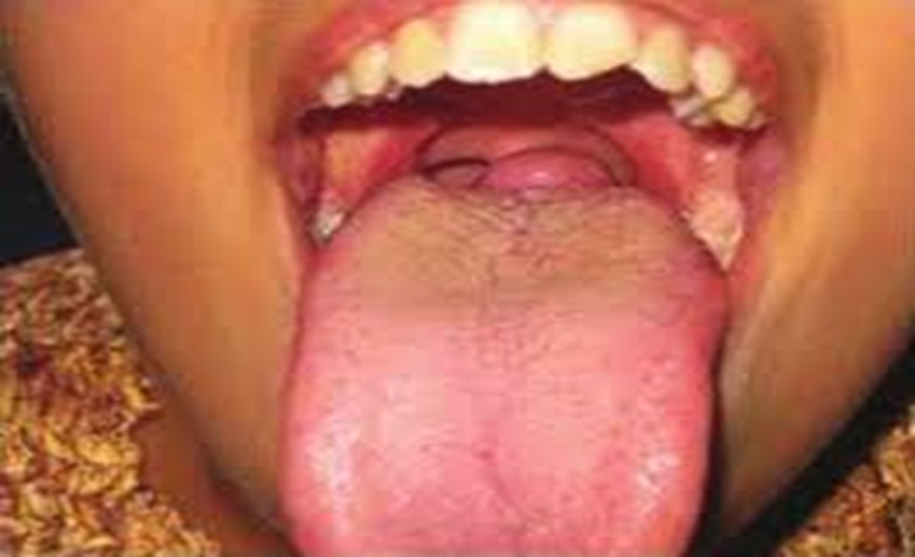
Congenital

Slide 21
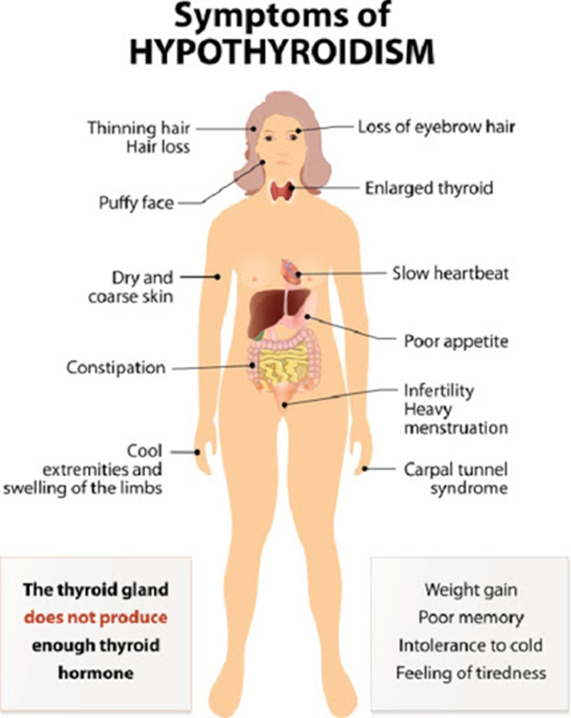
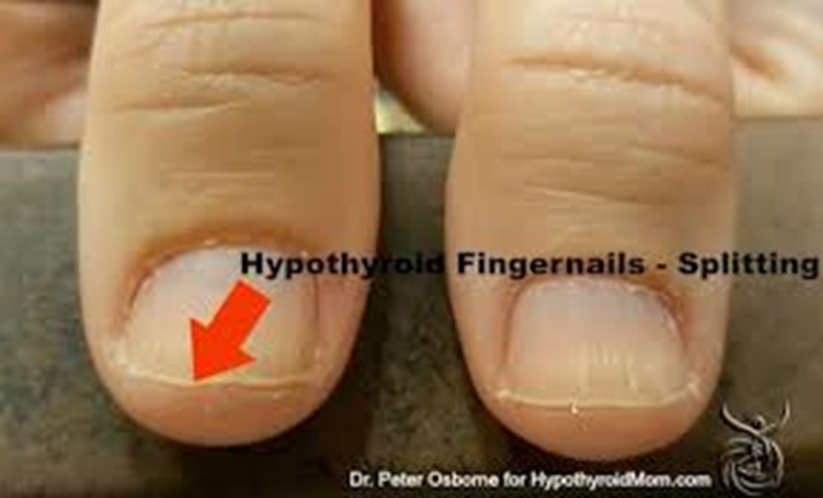
SIGNS OF HYPOTHYROIDISM
•• Obese
•• Dry inelastic skin
•• Macroglossia
•• Mask like facies
•• Loss of hair in lateral eyebrow
•• Hoarseness of voice
•• Pseudomyotonic reflex (delayed ankle jerk); also called ‘hung up’ reflex

Slide 22
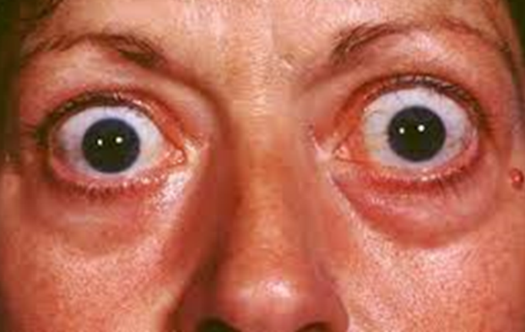
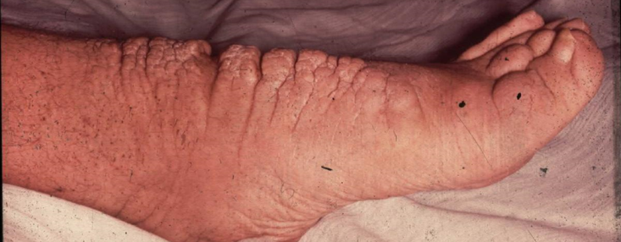
Grave’s Disease
Most common form of thyrotoxicosis (60-80 %)
Any age, common in 20-40 age group
5 times > in females
Autoimmune disease
Disease consists of one or more of the following:
- Thyrotoxicosis
- Goitre (diffuse enlargement, ± bruit)
- Ophthalmopathy (exophthalmos, lid-lag, lid retraction, chemosis ophthalmoplegia)
- Dermopathy (pretibial myxedema – only 2%)

Slide 23
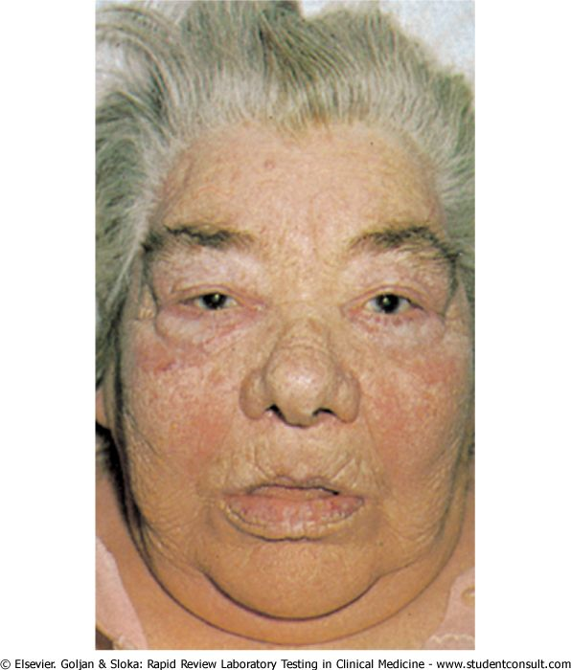
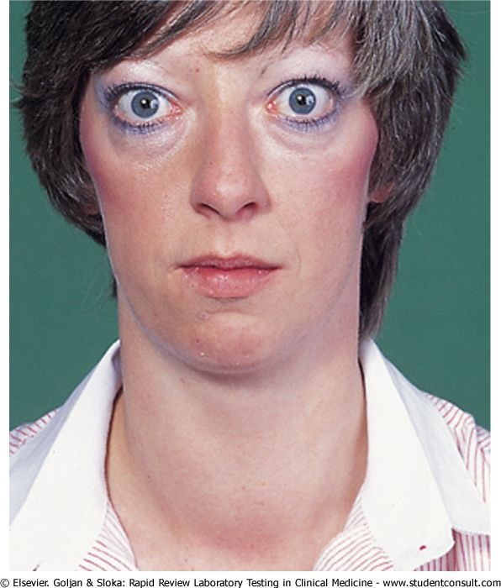

Slide 24
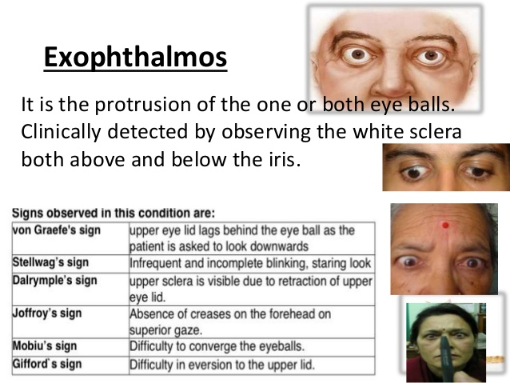

Slide 25
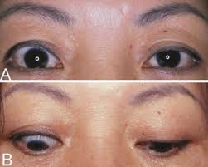
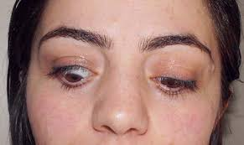

Slide 26
Features of thyrotoxicosis (Grave’s Disease)
Heat intolerance, excessive sweating
CVS: tachycardia, palpitation, atrial fibrillation, CHF
GI: Wt. loss, increased appetite, diarrhoea
Neuromuscular: anxiety, nervousness, tremor, proximal myopathy
Reproductive: amenorrhea, infertility

Slide 27
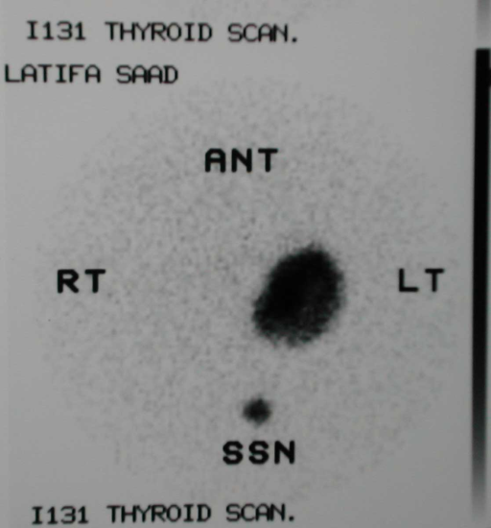
Toxic MNG (Plummer’s disease): Long history of MNG. Older women. Develops from multinodular goiter
Nodules become autonomous i.e., become hyper active- independent of TSH
Cardiac symptoms more common, eye symptoms-rare
Toxic adenoma: Single nodule, hyperactive, independent of TSH
Radioactive scan: ‘Hot’ one/ more nodule, rest suppressed

Slide 28
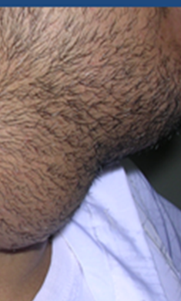
History
History & examination- follows the standard pattern
Most common presenting symptom: Swelling / lump
    Goiters
    Lymphadenopathy
Goiters & Lymphadenopathy - local & systemic complains

Slide 29
History of swellings
How noticed? - Self / others
Duration- Acute or chronic
Pain- acute lymphadenitis, thyroiditis, bleeding in goitre, Submandibular salivary gland stone
Painless- chronic lymphadenopathy, goitre, branchial cyst, neoplasms
Change in size: Rapid increase- infection, bleeding, Slow increase- neoplasms
Single or multiple? multiple- lymph nodes

Slide 30
Associated local symptoms with neck swellings
Voice change (malignant invasion)
Dysphagia (pressure on esophagus)
Dyspnea (pressure on trachea)
Eye symptoms
Throat pain / Oral ulcer
Nasal symptoms
Scalp lesion/ Loss of hair

Slide 31
Systemic symptoms - Goitre
Nervousness
Weight loss/ gain
Palpitation
Preference to cold / warm weather
Muscle fatigue
Sweating

Slide 32
Systemic symptoms- Lymphadenopathy
Fever
Night sweating
Contact with infectious disease
Weight loss
Change in appetite
Respiratory / gastrointestinal symptoms

Slide 33
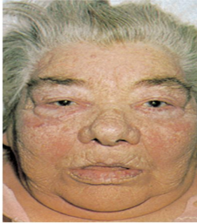
General Systemic inquiry
GI – appetite, wt. change, bowel habit (thyroid, LN)
RS- dyspnea on exertion, (retrosternal extension)
CVS- palpitation, ankle swelling
GU- amenorrhea
CNS- nervousness, irritability, insomnia (thyrotoxicosis)
Endocrines- preference to warm or cold weather

Slide 34
PH- medical / surgical
Medications
Allergies
Social history
Family history - MTC, MEN 2 (MTC, pheochromocytoma, HPT)
Other parts of history

Slide 35
. Personal History as usual
II. Complaint
swelling in lower part of front of neck.
Present history
1.Swelling: How started , suddenly or gradually
Its course increasing or decreasing
Duration
2.؟ Pain:
3. Disturbance of function :
General
a- Fever
b- Metastasis:
c- General Manifestations: Toxicity or hyperthyroidism & we must comment on it even if –ve.
Local:
a. VAN: pressure on Recurrent Laryngeal nerve causing hoarsness.
b. Local manifestations:
Dysphagia: usually not as it occurs in Retrosternal goiter or malignancy
Dyspnea:

Slide 36
Example for History Taking
• ----------------, 25 years, mechanic, not married, living in ----, takes 20 cigarettes per day for 10 years.
• He is coming complain of swelling in lower part of neck since 6 years.
• The condition started 6 years ago with swelling in lower part of front of neck, gradual onset, and progressive course.
• He had toxic manifestations in the form of palpitation, Nervousness. Irritability, insomnia, loss of weight inspite of good appetite, exophthalos , polyuria.
• The patient did hormonal assay & was told that he is toxic.
• He had surgery since five & half years.
• After one 7 half month, the swelling appeared again, exophthalmos & he developed hoarsness of voice.
• He is now on course of Indral.
• There is no history of pain.
• There is no history of metastasis in the form of ……
• There is no history of hypothyroidism as gain of weight, slurred speech, intolerance to cold weather, puffy eyelids & lost 1/3 of outer eyebrow, constipation
• No history of Dyspnea or Dysphagia.
• No history of Discharge.
• No history of Psychological trauma.
• No past history of operations, drug intake, D.M. or hypertension
• No family history of similar conditions or D.M. or hypertension.

Slide 37
Preparation for Examination
Permission
Privacy
Nurse presence
General precautions
Observe while taking history
General health
Mental state- anxiety, nervousness, agitated

Slide 38
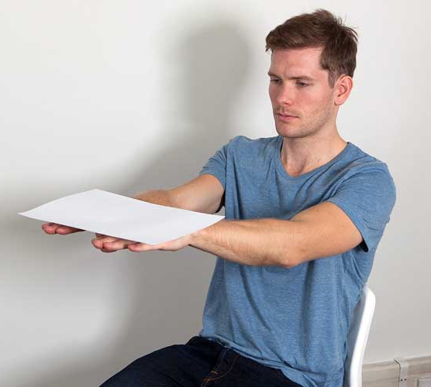
General Examination
Agitated, nervous or lethargic patient
Temperature
Pulse: Tachycardia, bradycardia, water hammer pulse
BP & RR
Palm: Moist, sweaty (hyperthyroid)
Skin: Dry (hypothyroid)
Tremor: Arm out in front, elbow & wrist straight, finger straight & separated ( out stretched hands)
Protruded unsupported tongue.
Thyrotoxicosis- fine fast tremor

Slide 39
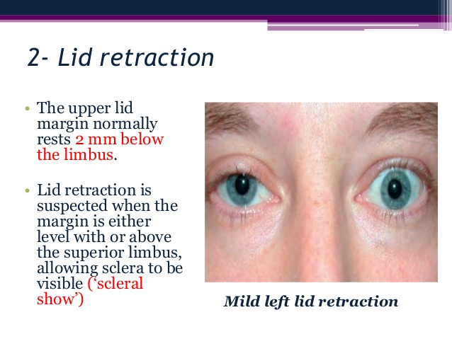
3- Eye Manifestations:
Signs How to detect it?
A- Infrequent blinking. By Inspection
B- Apparent rim of sclera above cornea. By Inspection
C- Staring look & Lid lag (von Graefe’s sign): upper eyelid fails to follow the eye ball moving downwards
Lid retraction: Upper lid- higher than normal.
Lower lid- normal position
D- Lack of wrinkling of forehead on looking up.
E- Lack of convergence:
In brief: How to examine eye signs?
Inspect & comment on infrequent blinking & Exophthalmos.
Then fix patient head & move your finger to detect lid lag, lack of wrinkling on looking upwards& lack of convergence.
N.B: Also, you must examine the scalp for metastatic masses.

Slide 40

Eye signs in thyrotoxicosis (hyperthyroidism):
From front: Sclera becomes visible above & below or only below
A. Ruler test:
Ruler cannot touch both Supra orbital & infra orbital ridges
B. Navzenger’s method:
Stand behind the patient and look to his eyes from above , normally you cannot see patient’s eyes
C. Russel Frazer test:
Normally, there is a groove between eye ball & supra orbital margin, Loss of this groove → True exophthalmos.

Slide 41
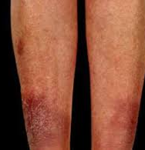
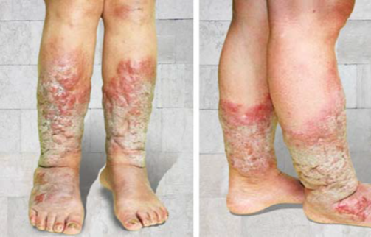
Complete General Examination
CVS- sinus tachycardia/ fibrillation
Respiratory system: Tumor, TB
Abdomen: Hepatomegaly, splenomegaly, other mass, testis
Extremity- proximal muscle weakness, pretibial myxedema (thyroid dermopathy) –
localized lesions of the skin
from the deposition of
hyaluronic acid

Slide 42
Techniques
INSPECTION
PALPATION
PERCUSSION
AUSCULTATION

Slide 43
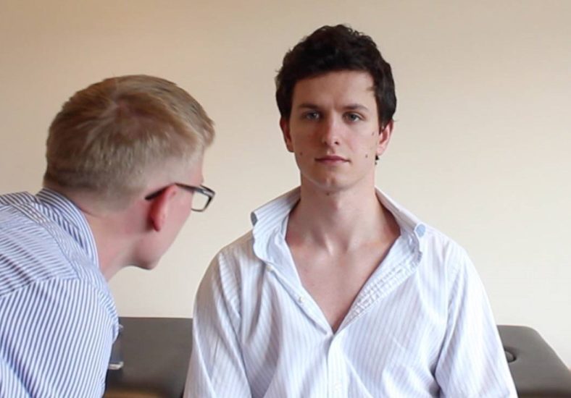
Examination of the neck
Patient sitting
Exposure- down to upper chest
Stand in front & behind of the patient

Slide 44
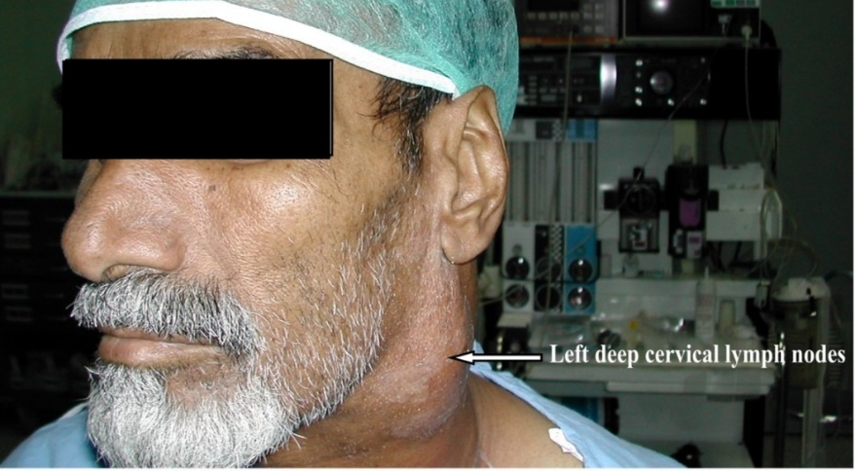
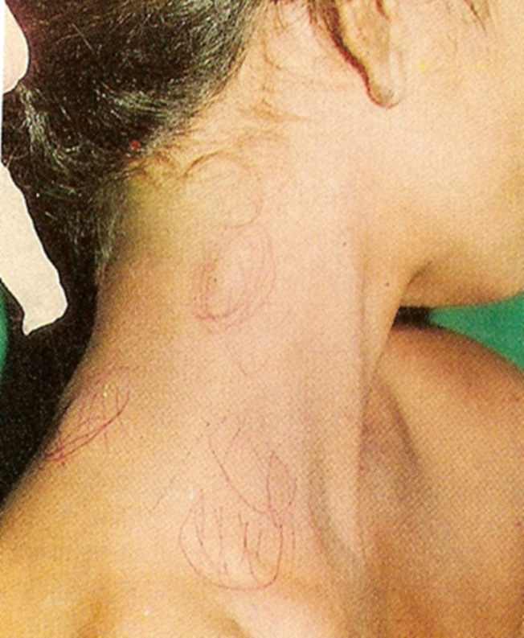
Lateral neck swellings
Anterior & Posterior

Slide 45
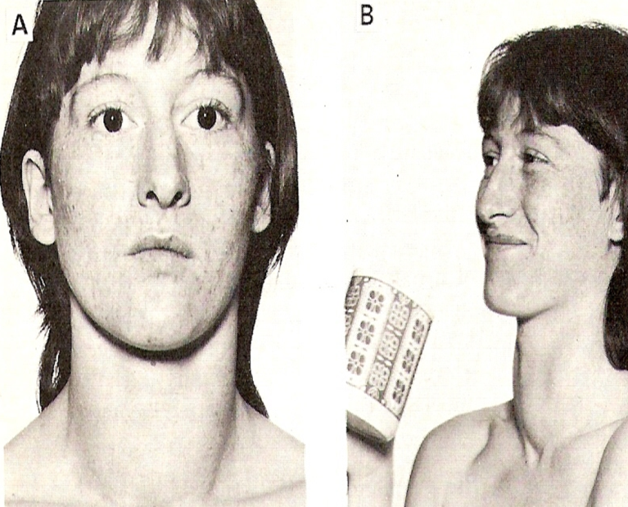
Inspection (from front & sides)
Lump or lumps: location- anterior / posterior triangle
Unilateral/bilateral
Single/ multiple
Shape, size (butterfly shaped-thyroid)
Ask to swallow- goitre moves

Slide 46
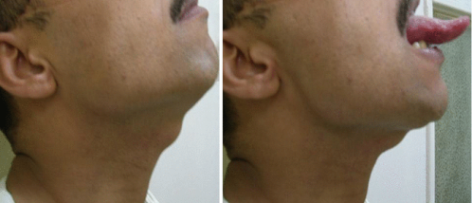
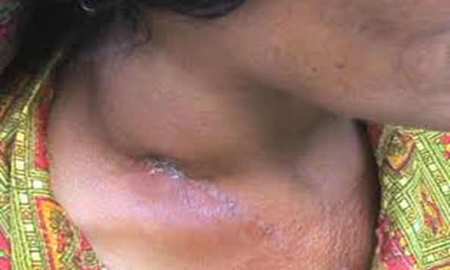
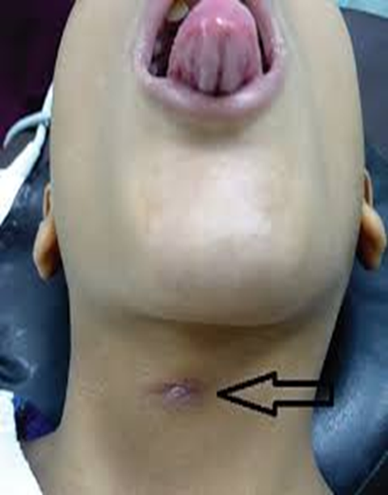
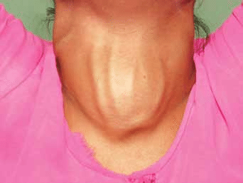
Inspection- neck swellings
Tongue protrusion: Thyroglossal cyst - moves up Thyroid, LN- no movement
Skin changes: discoloration
Sinuses- tuberculous / scar
Neck veins distension- Pemberton's sign
retrosternal thyroid extension

Slide 47
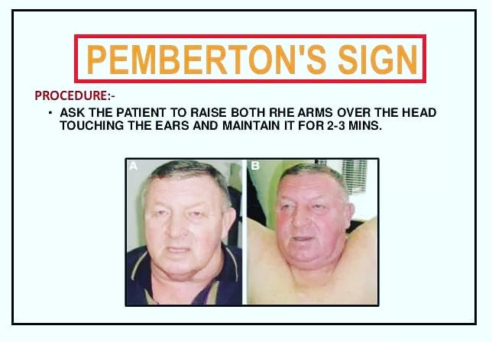
Pemberton's sign is used to evaluate venous obstruction in patients with goiters. The sign is positive when bilateral arm elevation causes facial plethora. It has been attributed to a “cork effect” resulting from the thyroid obstructing the thoracic inlet, thereby increasing pressure on the venous system.

Slide 48
Local examination:
1- Inspection: inspect thyroid while deglutition.
8 S (site, size, shape, surface, skin overlying, surrounding structures, special characters,
other swellings).
N.B: inspect for pulsation tangentially (it is pulsating in case of toxic goiter).
Thyroid Comment on Inspection
• Swelling in the lower part of the front of the neck.( site)
• Moves up & down with deglutition.( special character)
• Deep to Sternomastoid. (relation to surrounding structures)
• Butterfly in shape. (shape)
• Size 3 × 1 cm.
• Smooth surface.
• Skin show no D.V or a scar of pervious thyroidectomy
• Pulsating.

Slide 49
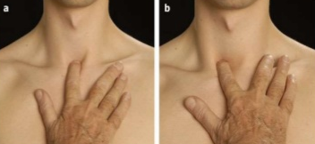
Palpation of neck
Standing in front of patient:
Trachea : tip of one finger in suprasternal notch- Trachea is normally central
Tenderness over swelling
Carotid pulse: one side at a time TWO fingers placed between larynx & sternomastoid

Slide 50
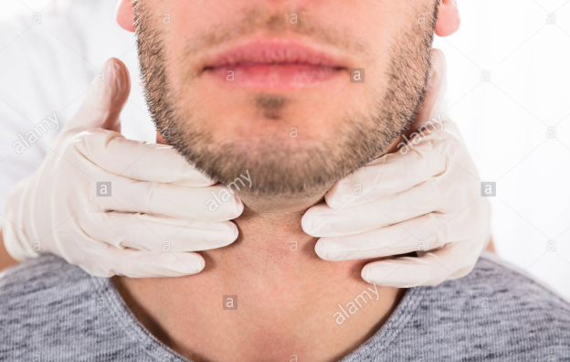
Palpation of neck
Standing behind the patient with both hands:
Flex the neck slightly
Palpate with the palmer surface of fingers
Determine characteristics of swellings: Site, size, shape, number, tenderness, temperature, consistency, attachment, movement, pulsation, borders, transillumination

Slide 51
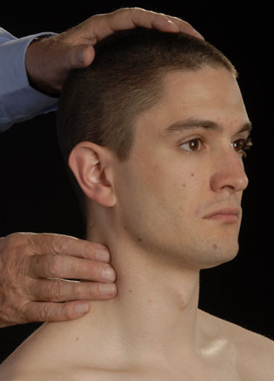
Palpation of neck
Movement: swallowing/ tongue protrusion Hold lump & check movement
Carotid body tumour: move horizontally
Lymph nodes:
Superficial group- from behind, bimanual
Deep group - one side at a time along sternocleidomastoid
Levels: 1-6

Slide 52


Palpation - Thyroid gland
Reconfirm- moves upward on swallowing
Small lobe- palpate by pressing on the opposite side
Shape, size, lower border
Nodular / smooth
Types of thyroid enlargment
Single nodule- neoplasm, cyst
Multiple nodule- MNG, Hashimoto’s
Diffuse- Grave’s dis.
Consistency- firm or hard
Lymphadenopathy- cervical, supraclavicular

Slide 53
Palpation: Classic Method:
• You stand behind the pt.
• Your thumb on his nape & rest of fingers in front.
• Flex neck to relax muscles & fascia of neck.
Palpate for: TT 4S CE 3S
Tenderness , Temperatre , Site, size, shape, surface, consistency, edge (8 lower edges for retro sterna extension), other swellings (Cervical L.Ns), special characters (move up & down with deglutition).
Relation to Surrounding Structures
Structure Technique
Skin: Pinch the skin over thyroid gland
Sternomastoid:Moves up & down not attached. Doesn’t move Up 7 down attached.
Carotid artery pulsation:
May be displaced in large benign lesions.
Absent in malignancy.
Trachea:
Detect whether it is deviated or not:
When you stared to comment on thyroid, you must begin with:
Swelling in the lower part of the front of the neck.
Moves up & down with deglutition.
Butterfly in shape.
Deep to Sternomastoid.

Slide 54
Comment Example for Palpation
• Swelling in the lower part of the front of the neck.( site)
• Moves up & down with deglutition.( special character)
• Deep to Sternomastoid. (relation to surrounding structures)
• Butterfly in shape. (shape)
• Surface is nodular. ( surface)
• Not worm, not tender. ( TT)
• Mass about 3 × 1 cm. (size)
• Firm in consistency. (consistency )
• Well defined edge, lower edge is felt, No thrill.
• No palpable cervical L.Ns. ( Other swellings)
• Skin is not attached. ( surrounding structures )
• Not attached to the surrounded. ( surrounding structures )
• Not attached to trachea. ( surrounding structures )
• No displaced or absent carotid. ( surrounding structures )

Slide 55
Percussion
Define the lower extent of the swelling
Percuss over the sternum and along the clavicles

Slide 56
Auscultation
Auscultation over the swelling.
Ask patient to hold breathing
Carotid / thyroid bruit

Slide 57


