Slide 1
HISTORY AND EXAMINATION OF BREAST
Dr. Sangrasi Ahmed Khan MBBS,FCPS
Assoc. Prof. Surgery

Slide 2
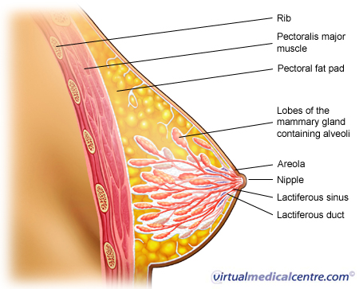

Slide 3
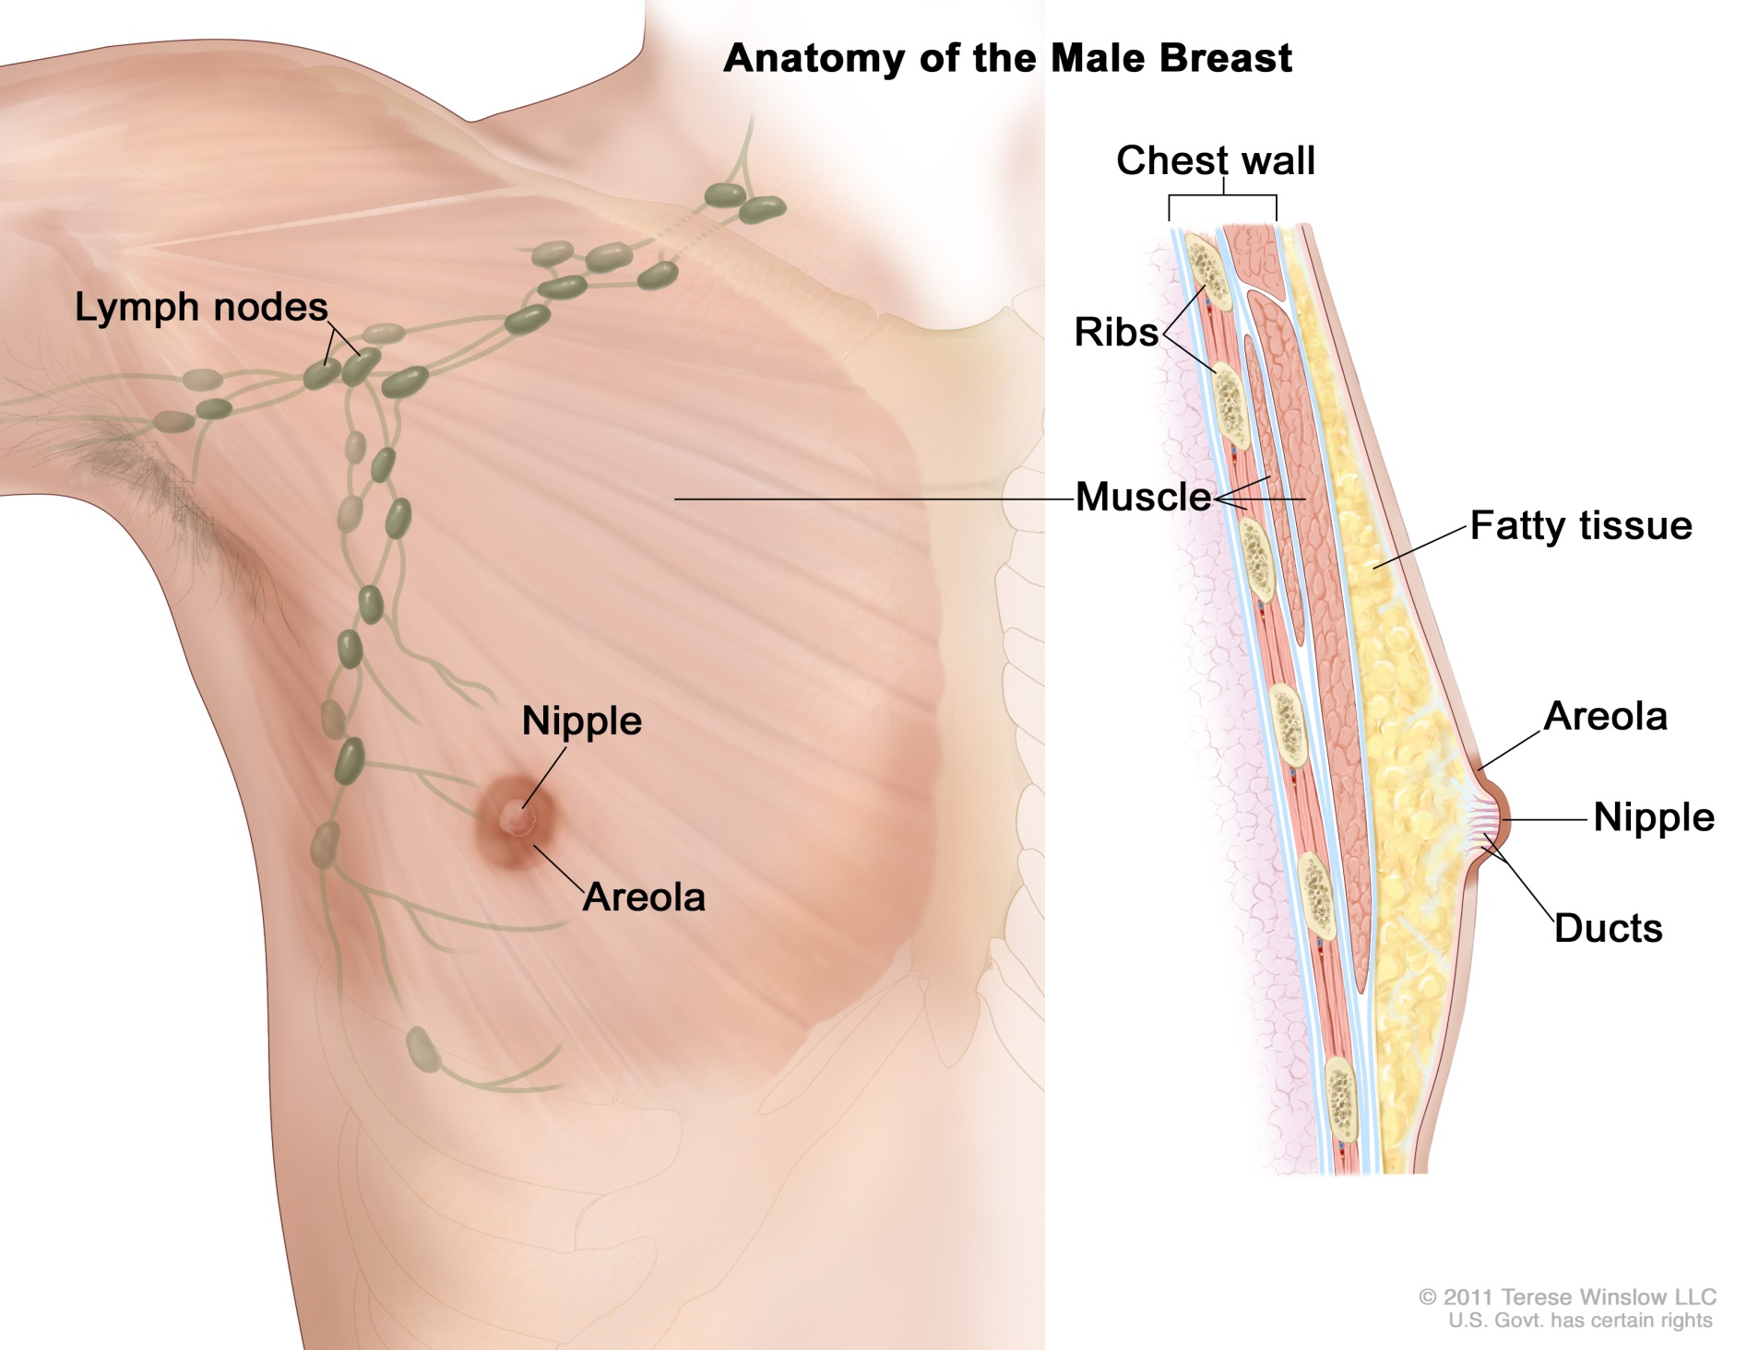

Slide 4
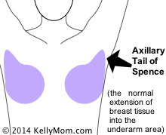

Slide 5
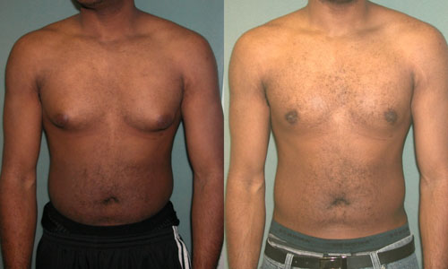

Slide 6
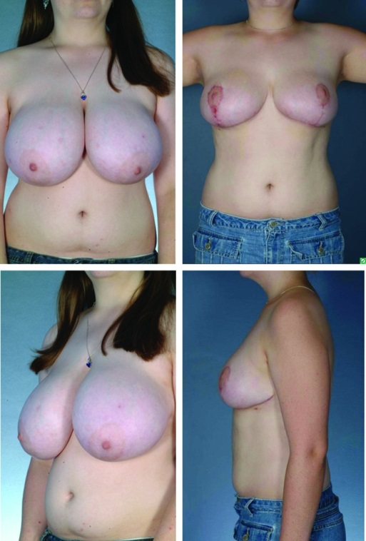

Slide 7
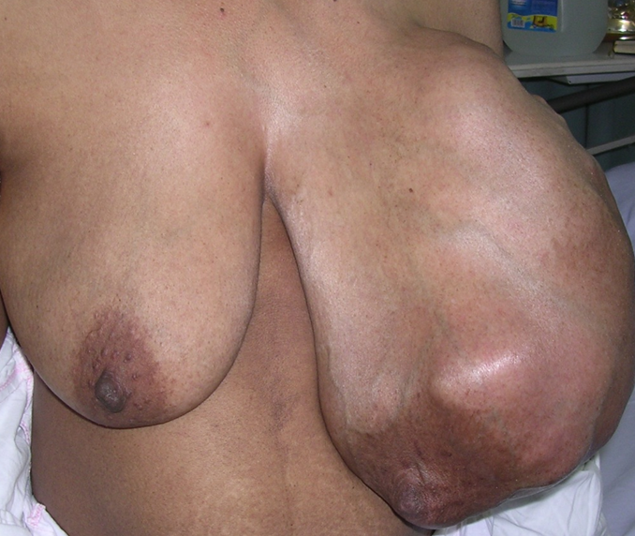

Slide 8
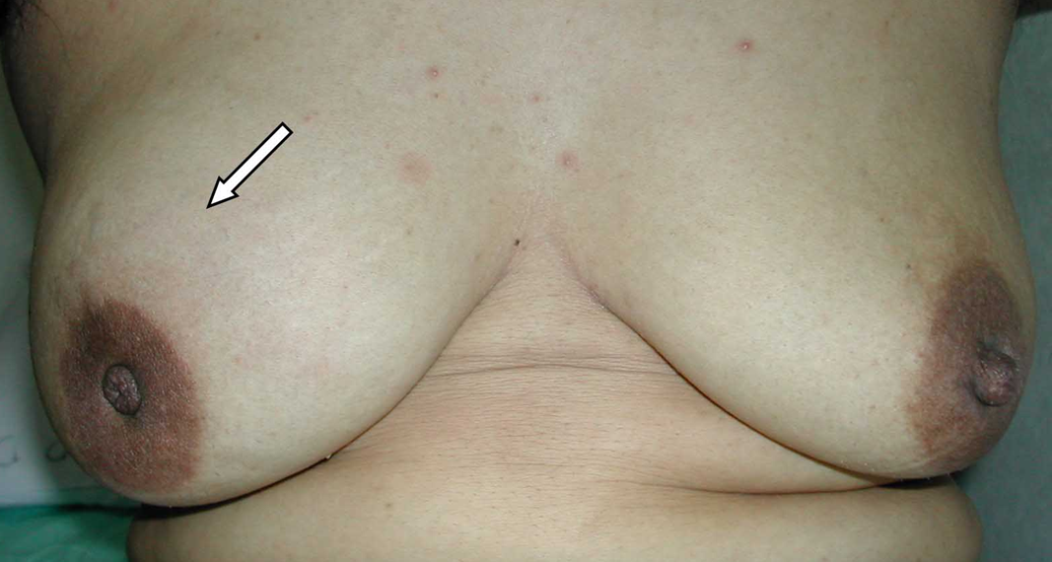

Slide 9
History
Common complaints:
Lump ( most common)
Pain/ tenderness (Mastalgia)
Change in the breast size
Change in the nipple
Discharge from the nipple

Slide 10
History
History taking follows the standard pattern
Detailed analysis of complaints
Important areas of history:
- menstrual ,
-pregnancy,
- lactation,
- family & previous breast problems

Slide 11
History of a Lump
When noticed (duration)?
How noticed?
Any change in the lump since first noticed?
Any change in the breast/ nipple?
Any associated symptom ? Pain, discharge
Any relationship with menstrual cycle?
Any history of trauma?

Slide 12
History of Pain
Site
Duration
Onset and severity
Relationship to menstrual cycle (cyclical or non-cyclical)
Aggravating factors
Relieving factors

Slide 13
History of Discharge
Duration
Colour of discharge: blood (red), serum (brown, green, straw coloured), pus, milky
Spontaneous or on pressure
Unilateral/ bilateral
Any change in the nipple
Other symptom (pain)

Slide 14
Past Medical/ Surgical History
Breast problem
Mammogram
Breast biopsy
Exposure to radiation (face, chest)- risk factor
Other medical /surgical history
Obesity (BMI >25) - risk factor

Slide 15
Menstrual History
Age of menarche
Age at menopause
*early menarche (<12 year) , late menopause (>55 year)- increases risk for carcinoma
Last menstrual period
Regularity of menstrual cycle
Breast changes during menstrual cycle

Slide 16
History of Pregnancy
Age at 1st pregnancy- younger age (<18) is protective - >30 years- increased risk
Number of pregnancy- protective
Lactational history- protective

Slide 17
Medications
Oral contraceptives- not known risk
Hormone replacement therapy- increased risk
Other medications

Slide 18
Family History
At least two generations
Breast, gynecologic, colon, prostate, gastric, or pancreatic cancer
Their Age at diagnosis of these tumours.

Slide 19
Clinical Examination
Explain to your patient
Patient’s permission
Privacy
Nurse’s presence
Semi-recumbent position (45°) , supine, sitting
Expose upper half of the patient, both breasts exposed
Arms by the sides , pressed firmly at her waist & elevating the arms above the head

Slide 20
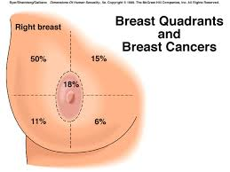

Slide 21
Inspection of the Breast
Stand in front of the patient
4 quadrants
Symmetry & size of breasts (underlying lump)
Any obvious mass or lump
Skin changes- redness (infection, inflammatory carcinoma), edema (peau d’orange), dimpling, ulceration (carcinoma)

Slide 22
Physical Examination of the Breasts
A systematic approach includes both inspection and palpation
Position : patient in the seated position
Exposure: Both breasts should be exposed to allow for full inspection and assessment for any:
- breast asymmetry,
- skin changes (e.g., retraction or erythema), or
- nipple-areolar abnormalities (e.g., scaling of the
nipple or nipple inversion)

Slide 23
Palpation of the breasts: (Discouraged in sitting, Done in semi recumbent or supine with arm resting comfortably above the head, breast tissue is evenly distributed out over the chest wall, to allow more accurate detection of abnormalities)
Sev. methods of palpation, the vertical strip/circular technique is a reliable, shown to have the lowest incidence of missed abnormalities
Encompass all breast tissue and
cover the perimeter bordered by the clavicle, sternum, axilla, and inframammary crease
Use vertical strip pattern covering the entire breast using overlapping dime-sized circular motions of the
increasing pressure (light, medium, deep).

Slide 24
The pads (not the tips) of the index, middle, and ring
fingers are used
Irregularities are palpated between the skin and the chest wall, not between the two hands of the examiner.
The size of any palpable abnormality should be described with the use of a measuring instrument.
Note additional features including :
- mobility,
- texture/consistency, (soft, firm ,Hard) and
- tenderness
The precise location of any abnormality should be described using the clock-face position and distance from the nipple is helpful (eg. right breast mass at 12:00, 4 cm from the nipple).

Slide 25
Examination Of axilla
Examined (in sitting position), with the pt’s arm resting over the forearm of the examiner
Lymph nodes are best detected as you push sup. in the axilla, and then moves the finger tips inf. against the chest wall, trapping lymph nodes
Palpation in the supraclavicular fossae imp.

Slide 26
Examination of nipple if history of spontaneous nipple discharge,
the source of the discharge: localized with systematic palpation from the outer breast to the nipple
circumferentially around the areola
color whether bloody,
Single or more than one duct is involved
Whether it is Uni. Or bilateral

Slide 27
Examination of the Breasts
(b) Ask the patient to raise her hands above her head. This exaggerates asymmetry and skin tethering.
(a) Look at the breast for asymmetry and for
changes in the skin and nipple.

Slide 28
Examination of the Breasts
(c) Feel the breast with the flat of your fingers.
(d) Test the mobility of every lump in two directions, with the pectoralis muscles relaxed and tense. Tense the muscles by asking the patient to place her hands on her hips and press inwards.

Slide 29
Examination of the Breasts
(e) When you palpate the axilla, hold the patient’s
arm to relax the muscles that form the axillary folds.
(f) Compare the axillae simultaneously.

Slide 30
THANKS

