Slide 1

History taking skills
Dr Nada Abdelrahman
Associate professor of internal medicine
This Photo by Unknown Author is licensed under CC BY

Slide 2

Learning outcome
By the end of this lecture, the student should be able to
Describe the importance of building a doctor-relationship.
Outline a general frame for taking a history

Slide 3

What is medical history?
• Medical history is a chronological record or account of the patient's symptoms from the onset (start) of their illness until the time of presentation to his doctor
• It includes the significant past illnesses, and the effects of the social, family and occupational environments on the present’s illness (and vice versa), in addition to previous therapeutic procedures and current drugs taken
This Photo by Unknown Author is licensed under CC BY-SA

Slide 4

History helps in:
▪ Establishing a rapport (mutual trust and respect)
with the patient.
Reaching a diagnosis of patient’s health problem
▪ Or listing possible causes of his problem
(differential diagnosis)
▪ Guiding focused examination, investigations and
even the plan of management
▪ Assessment of the impact of disease on the
patient’s family.

Slide 5

Introduction
Skilled history taking is reported to be declining.
      core art of patient care
      vital piece of the physician-patient encounter
      Helps lead to the final diagnosis about 75% of the time
      Listening is in and of itself a major therapeutic act and the physician himself is a great therapeutic instrument.
      What triggers patients to come?

Slide 6





Present yourself as a caring, competent, and confident health care professional.

Slide 7

Building Trust
When you introduce yourself to the patient, shaking hands or offering a comforting touch will help build trust.
Patient Rapport

Slide 8

Angry doctor
Use appropriate language.
Use an appropriate level of questioning, but do not appear condescending.
When encountering communication barriers, try to enlist someone to help.
Actively listen.

Slide 9
1. Clinician-centered approach
the clinician dictates the interaction to meet his or her own needs – eliciting symptoms and other data to facilitate making a diagnosis.
Using closed-ended questions.

Slide 10
Deficiencies
Failing to allow patients to express personal concerns.
Patients do not have the opportunity to lead the encounter (meeting/interview).
Patients are interrupted.

Slide 11
2. Patient-centered approach
Validating
Validating the importance of a patient’s concerns.
Allowing
Allowing the patient to develop comfort with the provider as he/she leads the conversation.

Slide 12

3. Integrated approach
Personal data
chief complaint
history of present illness
past medical history
past surgical history
past obstetric and gynecologic history
Family history
Drug history
Social history
other health issues/behaviours /hazards,
Review of systems.

Slide 13

Skills of patient-centered communication
open-ended questioning.
non-verbal communication skills such as purposeful silence or non-verbal encouragement.
Attentive listening.
summarizing or paraphrasing.

Slide 14
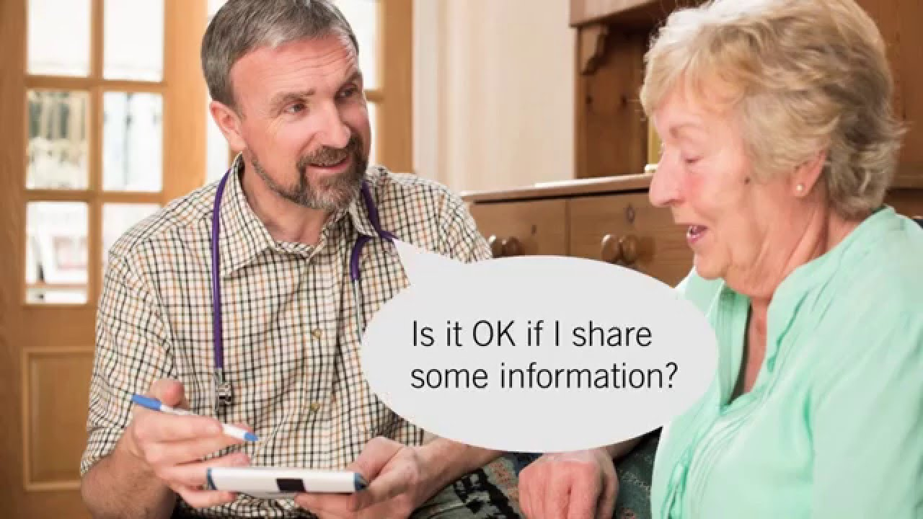
Steps | Description | Actions to be taken
1 | Set the stage for the interview | Welcome patient, use patient’s name, clinician introduction of him/herself. Ensure patient readiness and privacy Remove communication barriers. Establish patient comfort.
2 | Elicit (work out) the chief complaint and set an agenda for the visit. | Indicate available time. Obtain list of issues patient wants to discuss. Summarize/finalize agenda, prioritize items for current encounter versus future encounter.
3 | Open the history of present illness (non-focused) | Ask open-ended questions to elicit problems. Use active listening, which includes silence and non-verbal encouragement.
The “Five-Step” model (for patient-centered communication)

Slide 15
Steps | Description | Actions to be taken
4 | Continue the patient-centered history of present illness (focused) | Use focused (clear), but open-ended, questions to obtain description of physical symptoms. Explore patient description of symptoms, emotional or social context of symptoms.
5 | Transit to the clinician-centered process | Summarize conversation, confirm accuracy of information Inform patient that style of questioning will now change (“I’m now going to ask you several specific medical questions about your symptoms”)
The “Five-Step” model (for patient-centered communication)

Slide 16

Frames of history taking

Slide 17

Components of history
Establishing rapport.
Demographic data.
Chief complaint.
History of the present illness.
Past medical history.
Family history
Drug history
Psychosocial history- Allergy
Review of systems.

Slide 18
Preliminary Data: Demographic
Date and time
Age
Sex
Race
Birthplace
Occupation
DOA

Slide 19
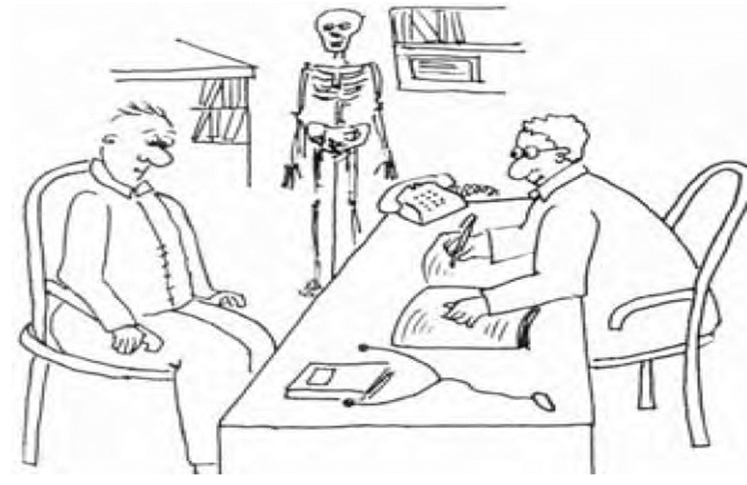
Presenting/ Chief complain
This is defined as the major symptom(s) that prompted the patient to present to hospital, or his doctor, and their duration.

Slide 20

Questions
What's the problem today?
Can you tell me what your symptoms are?
Have you ever had these complaints before?
When did you start feeling poorly?
Does anyone else in your family have the same problem at the moment?
Do you have any children?

Slide 21
Presenting complain
Shortness of breath/ 1 hour
It should be:
Short and specific
In one clear sentence for each symptom, in a separate line
Include the duration

Slide 22
Presenting complain
Chest pain/6 hour
Shortness of breath/ 1 hour
More than one: list acc to their duration; the earlier comes first
• If all simultaneous: list in order of severity; the more severe
comes first

Slide 23
Presenting complain
Is a known case of CRF on haemodialysis
State-known chronic clinical problems:
diabetes, hypertension….etc. and their
durations
• Some patients present to hospital for a follow-up of a certain disease or to do surgery.

Slide 24
History of the present illness (HPI)
This is a well-organized full elaboration (analysis) of the major symptoms from the start of disease (onset) until the time of presentation to doctor

Slide 25
History of present Illness
Each symptom should be analysed (in a separate paragraph) according to the following characteristics:
Site
Onset ---- duration
Course
Character/ Quality
Region/Radiation
Provocative & palliative factors
Time
Severity
Associated symptoms
Review of concern system
Notes:
Duration/mode of onset: how a symptom did come on (abrupt, acute or chronic)
Course of symptoms:
▪ Progressive: continuous deterioration of the disease, e.g. degenerative
diseases, untreated infections, malignancies
▪ Stable: no significant change since start
▪ Intermittent: symptoms on and off; e.g. multiple sclerosis; state duration and frequency
of attacks
▪ Improving: as in self-limiting diseases such as a common cold
Character (nature) of the symptom, e.g. for pain: colicky, aching, stabbing (severe, sharp, short), squeezing, burning
5. Severity
▪ Severity of pain is judged by the patient
▪ How symptoms affect work or daily physical activities, wakes him up at night…etc
▪ State things that one cannot do now, or do them with difficulty

Slide 26
History of the present illness (HPI)
Identifying the major body system(s) involved: ask about and analyze its (their) main symptoms that are not mentioned by the patient.
This is different from 'Review of System' which includes systems not involved in the current illness.

Slide 27
An example to illustrate a proper HPI: myocardial infarction
Mr X complain of chest pain (symptom), mainly in the retrosternal area (site), felt also in the arm and chin (referral), of 40 minutes (duration), was severe 9/10 (severity), brought out by exertion and relieved by sublingual tablets (aggravating and relieving factors), the patient also complained of sweating and SOB (relevant symptoms).

Slide 28

Guidelines for a proper HPI
Initially, let the patient talk freely about his problems by asking him an open question to describe his problem since the start.
Then, open and specific questions can be asked to have more details about important and relevant aspects of the patient's problem, e.g. what colour of vomitus?, what degree of effort causes SOB?
Avoid leading questions that suggest the answer (e.g. Tell me about your sleep instead of do sleep well)
Focus on the main problem, without wasting time on unhelpful and irrelevant details.

Slide 29
Guidelines for a proper HPI
Make sure you understand what the patient is describing, especially in regard to controversial symptoms such as syncope, dizziness…etc
Negative answers may sometimes be very important; e.g. absence of fever in a patent with swollen leg may exclude cellulitis. So it is important to ask about and record relevant symptoms
In a lengthy HPI, summarise the essential points from time to time, so as not to forget any point, and to ensure understanding of the patient’s story.

Slide 30
Past History
Past Medical History
- Childhood diseases
- Adult diseases
- Psychiatric illnesses
Past Surgical History
- Surgeries or admission
Accident and Trauma

Slide 31
Family History
Similar disease
Common medical disorders
Drug History
Current used medication
Allergy
Drugs or Food

Slide 32
Drug History
You should take your patient’s medications with you to the hospital, when practical.
Current and past
Allergies

Slide 33
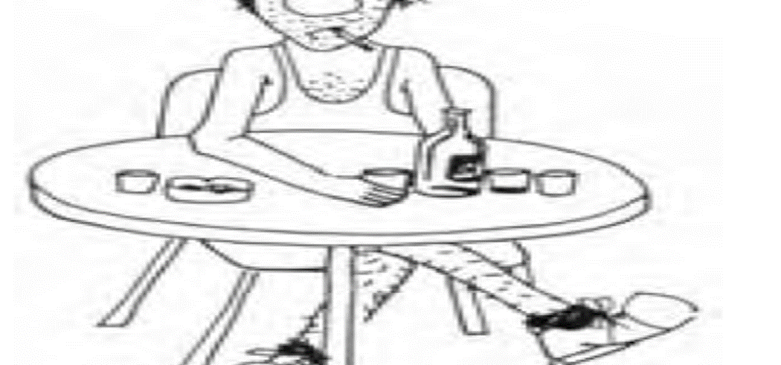
Psychosocial History
Job including work schedule
  and stress
  Smoking
  Drugs abuse
  Alcohol intake
  Socioeconomic status

Slide 34

Questions
a) Are you employed?
b) Is it an office job or are you on your feet all day?
c) How much do you smoke a day?
d) Do you ever drink any alcohol?
e) What are your living conditions like?

Slide 35
(Review of Systems)
Skin
Head
Eyes
Ears
Nose
Mouth/Throat
Respiratory
Cardiovascular
Gastrointestinal
Genitourinary
Musculoskeletal
Neurologic
Psychological
Endocrine
Hematologic

Slide 36
ideas, concerns, expectations
Do you have any other information for me?
Do you have any questions for me?

Slide 37
Special Challenges
Silence
Over talkative
Multiple symptoms
Anxiety
Depression
Sexually attractive or seductive patients
Confusing behaviors or symptoms

Slide 38
Special Challenges
Patients reassurance
Anger and hostility
Intoxication
Crying
Language barriers
Limited intelligence
Hearing problems
Blindness
Talking with families or friends

Slide 39

Patient unable to talk!!!!

Slide 40
Complete the questions using the words or phrases in the slide below.
Symptoms, major health problem, in hospital, up–to–date, childhood diseases
1. Have you ever had any ...............like measles or chicken pox?
2- Have you ever been ....................for more than a week?
3- Do you have a .............................such as diabetes or high blood pressure?
4- Are you .......................................with your immunizations?
5- What were the first .....................of your overactive thyroid?

Slide 41
Which question from each pair is more polite?
1- A: Is there anyone in your family who is crazy?
B: Is there anyone in your family who suffers from mental illness?
2- A: At what age did your father die?
B: How old was your dad when he popped off?

Slide 42
Match up those phrases which have the same meaning.
a) as far as you know
b) to be on a diet
c) insulin injections
d) illnesses that run in the family
e) to suffer from a disease
1- to be very ill with something
2-injections for people with diabetes
3- in your opinion
4- to eat carefully
5- medical problems among relatives

Slide 43
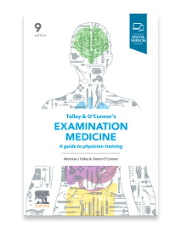
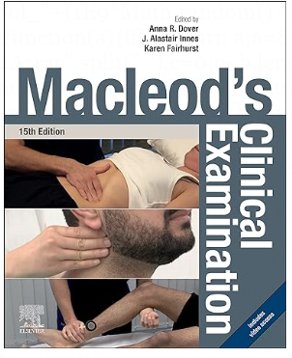

Recommended books
Assignment
Systematic enquiry: cardinal symptoms
Page: 1-35
Page: 3-14
Page: 3-20

Slide 44


