Slide 1
History & Examination of Lump & Ulcer
Shaher Abbarah, SBIS
Assistant professor general surgery
Associate consultant general surgery

Slide 2

History taking
Introduce your self
Explain your procedure (what you will do?) (consent)
Confirm your patient
Assure privacy

Slide 3
History taking is an art
History taking is not science, but rather, art, because it requires interpretation and clarification.

Slide 4
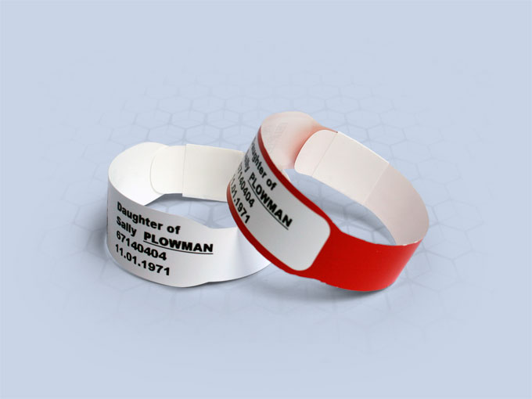
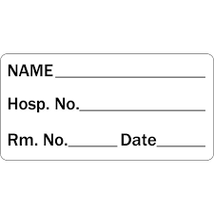
Demographic data
Chief complain
Name, age, gender, nationality, marital status, occupation, address,
? Eligibility
? Insurance
Always, read the patient’s past records (if available)
Notes:
Chief complain: by patient’s own ward, should be short, (Ask the patient; what are you complaining from? How can I help you today Mr… ? What brought you to the hospital today?)
if there is more than one, list them by duration or severity.

Slide 5
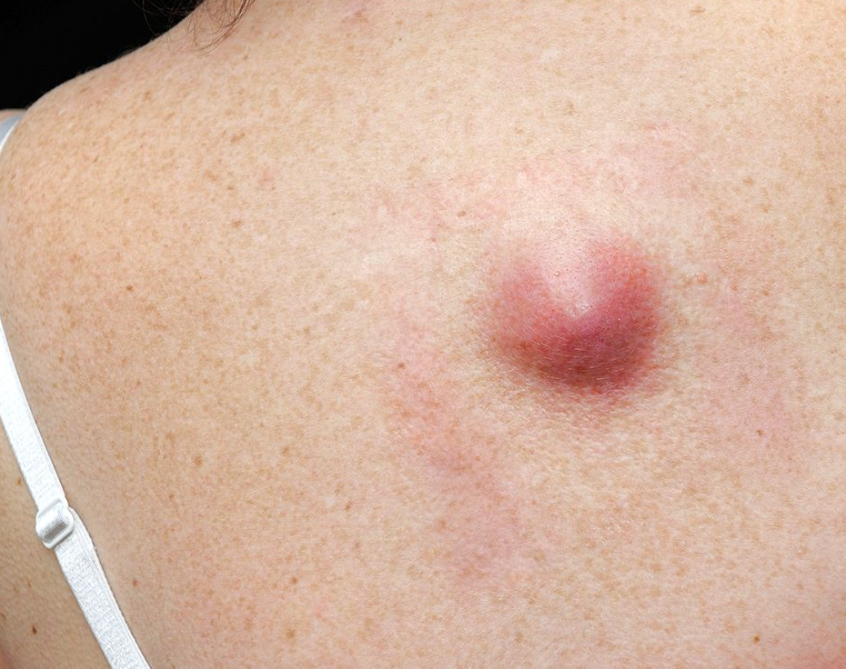
History of Presenting Symptom
When did you notice the swelling?
How did you noticed the lump? (? Pain, incidental, noticed by some one else, …)
Where? (in general)
Onset? (ex; after trauma, wound, spontaneous, …)
Duration (rapid & recent swelling usually inflammatory)
Size of the swelling
Associations (pain, discharges, skin changes over it, movement limitation)
Is there any other swellings?
Changes with time? (size, shape, color, pain, …)
Discharges (if positive; ask about color, quantity, consistency, smell)
Notes:
General examples:
Short duration, sudden onset, rapid progressing → acute infection
Slow onset & slow progress → benign neoplasm
Slow onset & rapid progress → malignant neoplasm
Painfull lumps → acute abscess
Painless lumps → neoplasm

Slide 6
Demographic data
Chief complain
History of presenting symptoms
Past medical History
Past surgical History
Medication History
Family History
Social History
Systemic review

Slide 7

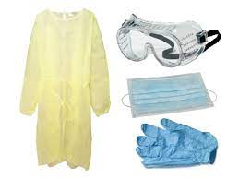
Examination:
Wash your hand & protective equipment
Introduce your self & confirm patient name
Privacy
Chaperon (nurse presence)
Explain the procedure / what you will do
Take the permission / consent
Position
Exposure

Slide 8
Local Examination
Inspection
Palpation
Percussion
Auscultation

Slide 9
Inspection
Site (ex, Anterior of the left upper limb)
Shape (ex; spherical, hemispheric, asymmetrical shape, or like kidney, heart ,…)
Size (approximate)
Surface (Color, Skin changes, discharges)

Slide 10
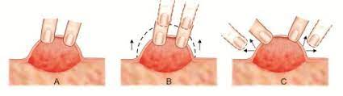
Palpation
Confirm the inspection (site –use the bone prominence as landmark, shape)
Tenderness (the swelling and surroundings) (and look to the patient face)
Temperature (mass and the surrounding tissue) (by the dorsum of the hand, and compare up/down, Rt/Lt)
Size: measure by ruler in 2 dimensions
Attachment (superficial-skin or deep-muscle, how to defrentiate? )
Mobility (up/down)
Consistency (Vary from soft to stony) , Fluctuation
Edges (regular/irregular, sharp/rounded)
Surface (ex; smooth, rough, cobblestone)
Pulsation (expansile pulsation or transmit pulsation . ex: ? )
Transillumination (should be in drak room)
Compressibility / Reducibility (comprssible: lump disappear on pressure and reappear on release , Reducible: lump reappears only after application of another force ex, inguinal hernia)
Notes:
in terms of comparisons: hard is like your chin, firm is like your nose, soft is like your ear-lobe
Positive transilumination means: lump contains clear fluid like water, plasma, serum , ex: hydrocele

Slide 11
Auscultation
Auscultate for vascular bruits
Bowel sound in hernia
Bruits over enlarged thyroid = hypervascularity = like, Grave’s disease

Slide 12
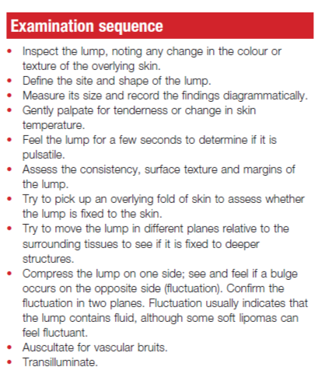

Slide 13
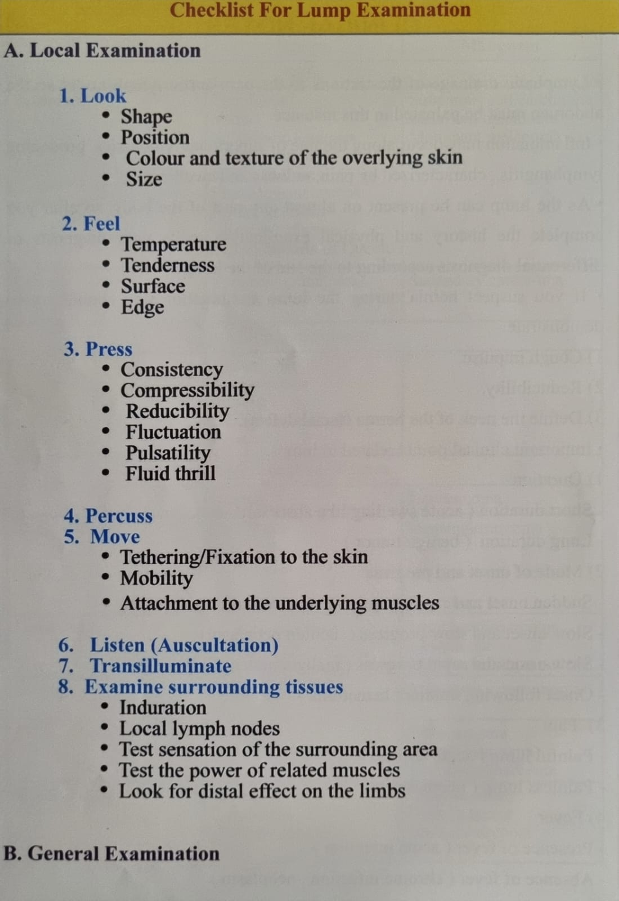

Slide 14
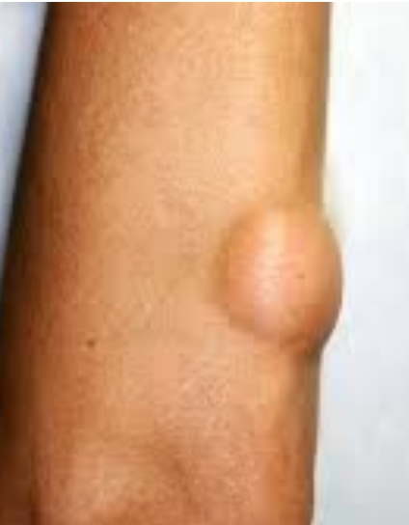
Lipoma
Very common, slow-growing and benign tumor of fat
Soft, mobile subcutaneous mass (not attached to the skin) enclosed in a thin fibrous capsule, slippery edge, and no skin changes
Most are asymptomatic.
Treatment?

Slide 15
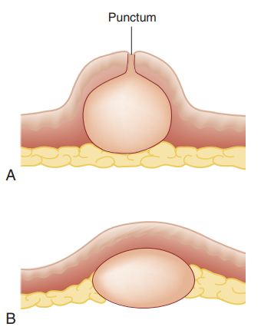
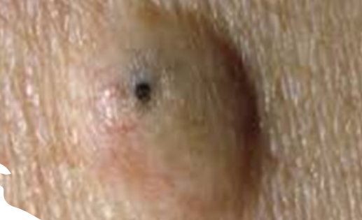
Epidermoid Cyst
common subcutaneous unilocular swellings
Arising from inflammation in a pilosebaceous unit,
Fixed to the overlying skin (not mobile)
where a small central punctum is often visible.
Thin wall of flattened epidermal cells and contain keratin and its breakdown products that appear cheesy-white and resemble sebum
Treatment by simple excision.
Notes:
On the scalp or scrotum, they are known as ‘pilar’ or tricholemmal cysts.

Slide 16
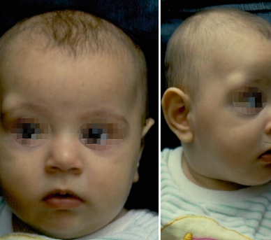
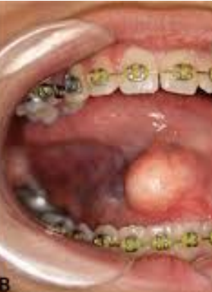
Dermoid cyst
Dermoid cysts arise from nests of epidermal cells that have been sequestered in the dermis during development or implanted as a result of trauma
Congenital dermoid cysts are found at the sites of embryonic fusion, commonly at the mid-line of the body
They are Firm tense cyst.
lined by squamous epithelium and contain sebum, degenerate cells and, in some cases, hair.

Slide 17
Abscess
Subcutaneous infection
Abscess is a pocket of pus (dead cells, exudate, bacteria) surrounded by granulation tissue; any organism can cause it (Staph. Aureus is common)
Demographic data: no specific age, Hygiene
Symptoms: throbbing pain worsening and awake the patient from night, patient notice red area of thickening then turn to be hard mass, +/- discharges, ? duration
PMH: Diabetes.

Slide 18
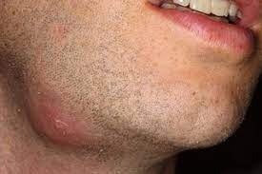
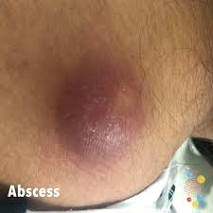
Four classic sign (swelling, redness, heat, pain)
site
Shape
Size
Surface
Color
Tempertaure
Tenderness
Edge
Consistency
Relations
Surrounding tissue
Lymph node assessment

Slide 19
Ulcer

Slide 20
Ulcer: is a persistent discontinuity of an epithelial surface that can occur in the skin or mucosa of the elementary and respiratory tracts
Causes:
1- recurrent physical injury
2- recurrent chemical injury
3- Ischemia
4- neoplastic changes
5- poor healing (malnutrition / systemic disease)

Slide 21
Differential Diagnosis
Venous ulcer
Arterial ulcer
Traumatic (Neuropathic,
Infective
Neoplastic

Slide 22
History similar to the lump
Duration of the current symptoms (when & How noticed)
What drew the patient attention? (discharges, bad smell, bleeding, …)
Course of the ulcer since appearance (size, shape, discharge, if healed and broken down now)
Associated Sx?(fever, sensation changes)
Any other ulcers elsewhere?
Hx of previous Trauma / burn / bare foot
Any Tx had been suggested or administered?
DM controlled?

Slide 23
Examination:
Wash your hand & protective equipment
Introduce your self & confirm patient name
Privacy
Chaperon (nurse presence)
Explain the procedure / what you will do
Take the permission / consent
Position
Exposure

Slide 24
Look:
Location
shape
Size (at least 2 directions
Floor (Colour & Depth)
Discharges (pus, blood, quantity)
Edge
The Floor:
- Granulation Tissue (Red Pink):
Collagen, fibroblast, capillary, Inflammatory cells and bacteria
- Eschar: (Black)
Layer of dead tissue, become dehydrated and form dark eschar
- Scab: (yellow)
Sloughed and dried small amount of discharges may dry to become scab
Edge:
Flat sloping ( healing / venous)
Punched out (Syphilis / DM / Ischemic)
Undermined (pressure necrosis, carbuncle, Tuberculous)
Rolled (BCC)
Everted (SCC / Ulcerated AdenoCA)
Serous discharge – healing ulcer
Purulent discharge – inflamed and spreading ulcer.
Serosanguinous discharge – tubercular ulcer, malignant ulcer.
Greenish discharge – infection
Notes:
Sloping edge: pale/pink consistent of new healthy epithelium growing over the base of the ulcer
Floor is what you can see , Base is what you can feel

Slide 25
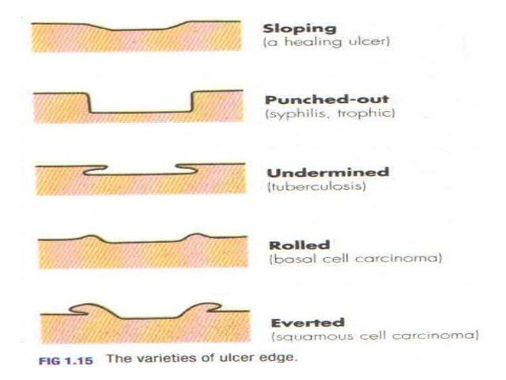
Edges:

Slide 26
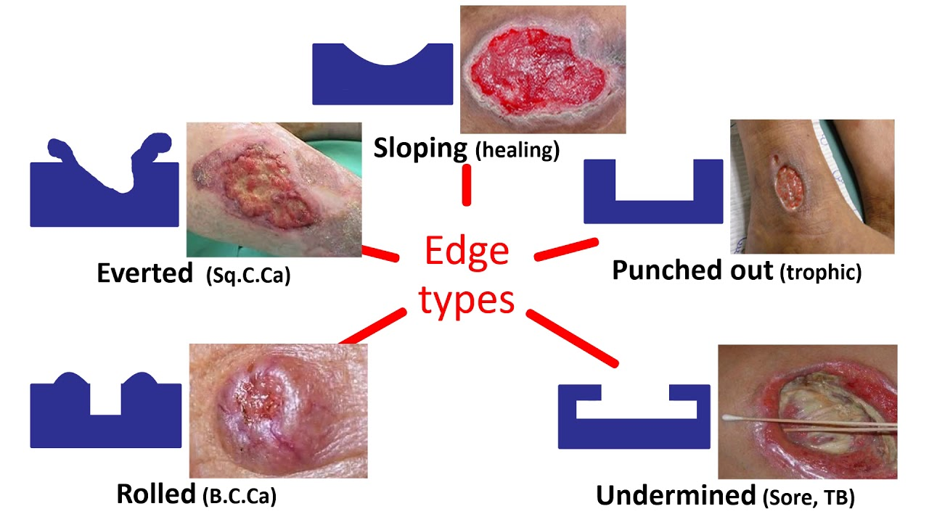
Edge:

Slide 27
Feel:
Tenderness
Temperature
Base

Slide 28
Examine Surrounding Tissue:
Induration (Infection, Trauma)
Pigmentation
Scaring
Edema
Vascular Assessment
Neurosensory Assessment
Lymph nodes
Local (lymphatic / venous obstruction)
General (Liver, Cardiac, Renal, low Alb)

Slide 29
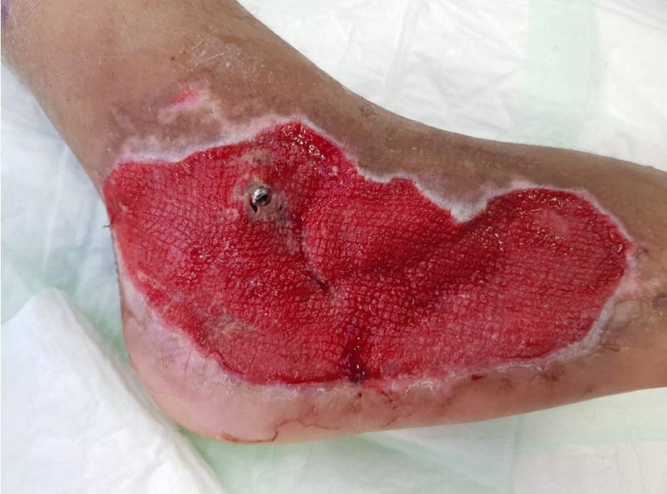

Slide 30
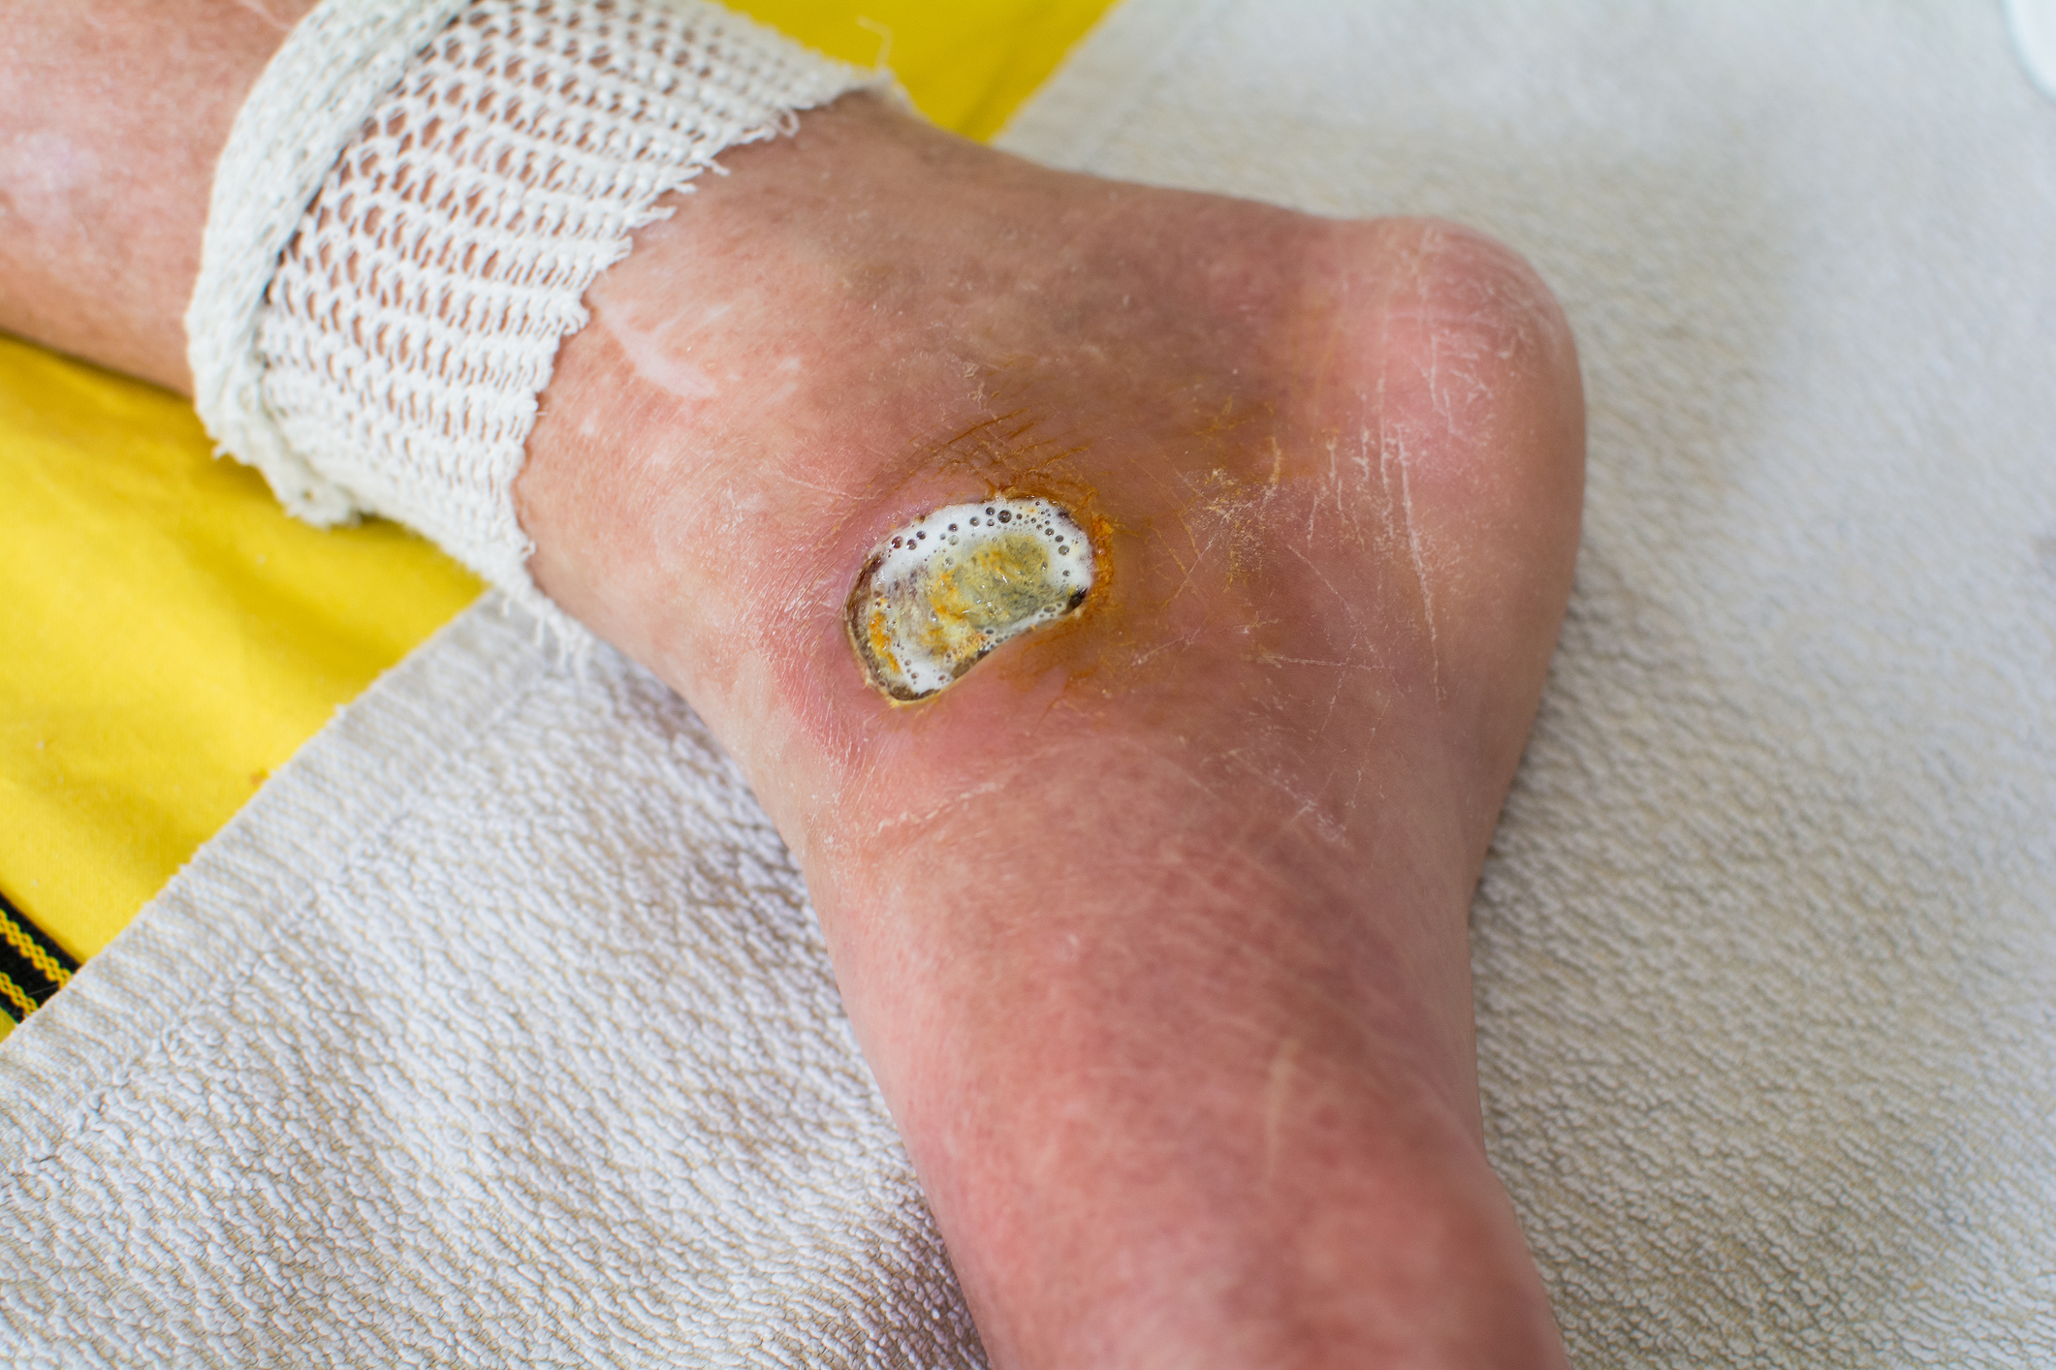

Slide 31
