Slide 1
CVS HISTORY
DR WAQAR ALI
ASST PROFESSOR OF MEDICINE

Slide 2
COMMON CVS DISEASES
Coronary artery disease (angina, Myocardial infarction)
Congestive heart failure
Arrhythmias (atrial fibrillation)
Pericarditis
Endocarditis
Peripheral vascular disease

Slide 3
SIGNS & SYMPTOMS
Cardio vascular diseases can present with the following:
Chest Pain (coronary artery disease, pericarditis
sometimes arrhythmias)
2) Dizziness/ Syncope (heart failure, aortic valve diseases)
3) Dyspnea( angina/MI, heart failure)
4) Palpitations( angina, MI, arrhythmias, hypertension)
5) Fatigue (heart failure)
6) Nausea/sweating (anginal attack, MI)
7) Claudication: peripheral vascular disease
8) Fever

Slide 4
FOCUSED CVS HISTORY
1) Introduction: Introduce yourself first
2) Patient’s demographic data:
* Age: Coronary artery disease & peripheral
vascular disease more common in old people
* Nationality
* Occupation: Ask if sitting or physical
exertion at work. Any stress at work?
( Physical exertion precipitates angina. Stress
also can worsen angina)

Slide 5
data contd.
* Housing: Ground floor or above
( climbing stairs precipitates
angina)
3) Chief complaints
4) History of chief complaints : ask details of the
main problem
5) Past medical history: any cardiac problem, HTN,
DM, high cholesterol ( risk factors for angina and MI)

Slide 6
6) Family history: ischemic heart disease , HTN
often run in families
7) Personal/Social history: smoking, alcohol,
recreational drugs, stress( all are risk factors
for ischemic heart disease)
8) Medicines Some medicines can damage the
myocardium

Slide 7
CHIEF COMPLAINTS
CHEST PAIN: Occurs in coronary artery disease (angina, MI) and in pericarditis. Does not occur in heart failure & endocarditis.
Follow the pneumonic SOCRATES
A) Site: Central or in the left side of the chest
B) Onset : Started suddenly or gradually?
( angina & MI is sudden pain, pericarditis is
gradual)

Slide 8
C) Character:
* Sharp pain : angina, MI
* Pricking pain: pericarditis
* Weight on the chest: angina/ MI
D) Radiation:
* radiation to the neck, left shoulder, jaw, left
arm angina/ MI
* No radiation : pericarditis

Slide 9
E) Associated features:
* nausea/vomiting, palpitations, sweating,
dizziness angina/MI
F) Time: How long it lasts?
* angina: lasts few minutes, comes and goes.
* MI : severe, lasts more than 10 min or so
* Pericarditis: persistent. Not “coming and
going”.

Slide 10
G) Exacerbating/Relieving factors:
* Angina & MI exacerbated by exertion,
relieved by rest
* Pericarditis : Worse by supine position,
improves by bending forward
H) Severity : how bad is it on scale of 1 to 10?
* angina & MI: severe
* Pericarditis : not very severe

Slide 11

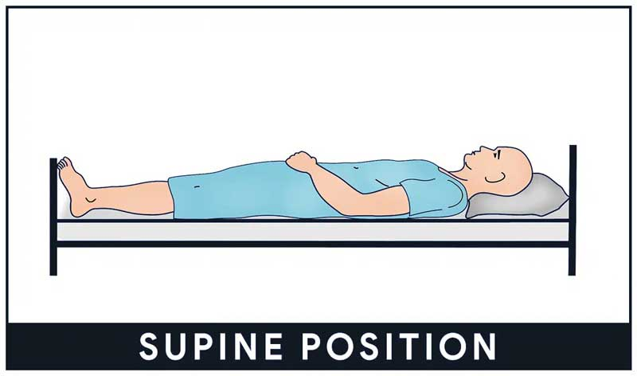
PERICARDITIS
PAIN GETS WORSE
PAIN GETS BETTER

Slide 12
2) Dizziness/syncope: Happens due to decreased blood flow to the brain.
* Heart failure * aortic valve problems
* Hypotension * Ischemic heart disease
3) Dyspnea: can occur in:
* angina/MI * heart failure (due to
pulmonary edema)

Slide 13
4) Palpitations: Due to rapid heart rate.
* Angina/ MI * arrhythmias
5) Fatigue : Occurs in heart failure
6) Orthopnea: Supine position produces
dyspnea. Occurs in heart failure
7) Claudication: Pain in the legs while walking.
Occurs in peripheral vascular disease
( narrowing of the arteries ischemia pain)

Slide 14
8) Fever : Occurs in endocarditis (infection of the
heart valves)

Slide 15
SUMMARY OF FEATURES
Angina/MI:
* Causes chest pain * Usually in adults
* Pain may radiate to the neck, jaw, left arm
* Risk factors are: fam. Hist, smoking, DM, HTN
high cholesterol
* Precipitated by exertion, relieved by rest
* Sharp, pressure like
* Pain comes and goes in angina
* Often associated with sweating, palpitations,
nausea, dizziness

Slide 16
2) Pericarditis:
* Pain not very severe * Persistent
* Worse while supine, better by leaning
* No radiation * Occurs gradually
* Pricking pain
3) Valve problems: Can lead to dizziness,
syncope, palpitations, dyspnea

Slide 17
4) Hypertension: Can be asymptomatic or produce headache, general body pain, dizziness
5) Heart failure:
* No chest pain * dyspnea * fatigue
* Orthopnea * Pedal edema
6) Arrhythmias: Produce palpitations, dizziness,
syncope, can be asymptomatic
7) Peripheral vascular disease: pain on walking

Slide 18
4) Arrhythmias: Produce palpitations, dizziness,
syncope. May be asymptomatic
5) Peripheral vascular disease: Pain on walking
6) Endocarditis: No chest pain. Fever present

Slide 19


