Slide 1
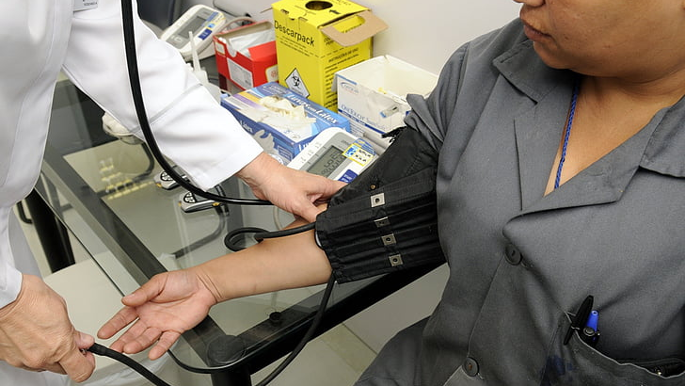

Cardiovascular examination
Dr Nada Abdelrahman

Slide 2

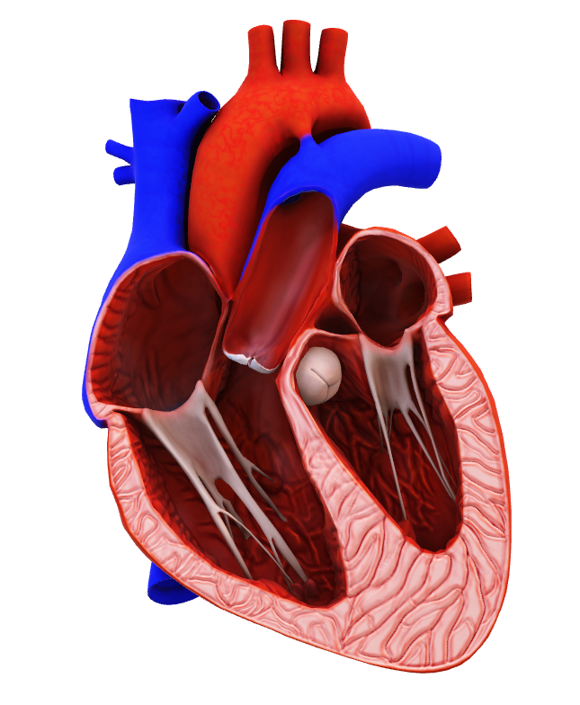
Learning objectives
By the end of this session, the student should be able to
Perform accurate cardiovascular examination
Illicit relevant cardiac signs and recognize their significance.

Slide 3
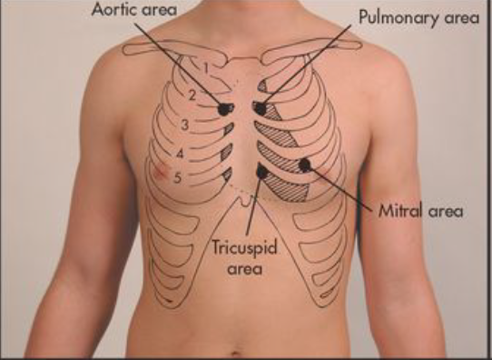
Cardiovascular examination
General
Hands
Pulse
Blood pressure
Face
Neck
Jugular venous pressure
Precordium
  1-Inspection
  2-Palpation
  3-Percussion
  4-Auscultation
-Back
-Abdomen
-Lower limbs

Slide 4
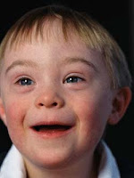
General examination
Position patient at 45 degrees
General appearance: body built: obese, Cachexia
Marfan’s syndrome
Down’s syndrome
This Photo by Unknown Author is licensed under CC BY

Slide 5

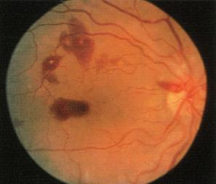
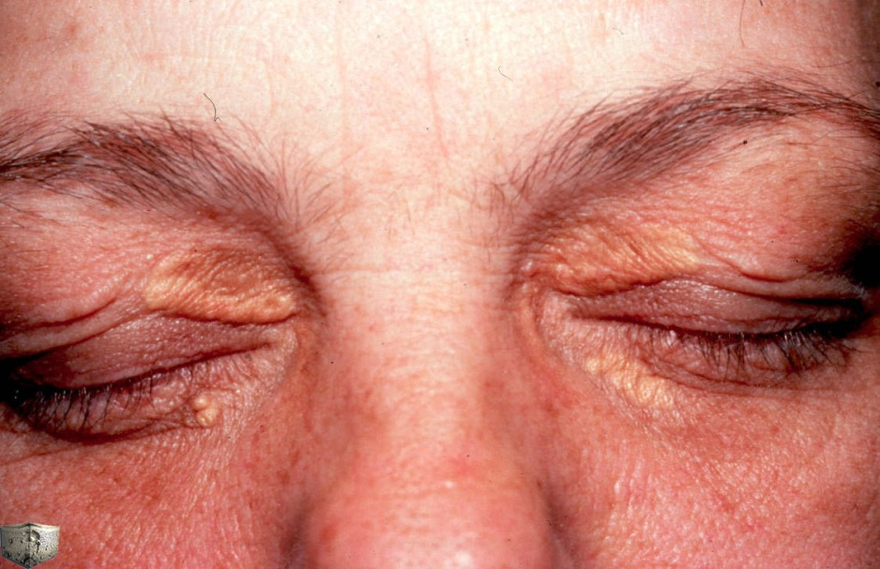
Examination of eyes
XANTHELASMATA
CORNEAL ARCUS
Roth spot
This Photo by Unknown Author is licensed under CC BY-SA-NC
Petechial haemorrhages on the conjunctiva

Slide 6
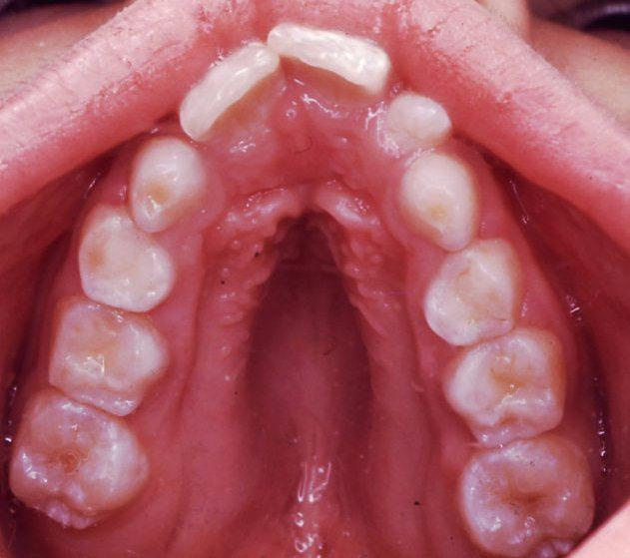
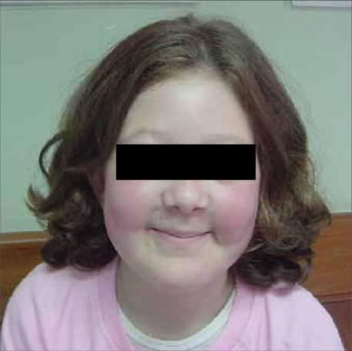
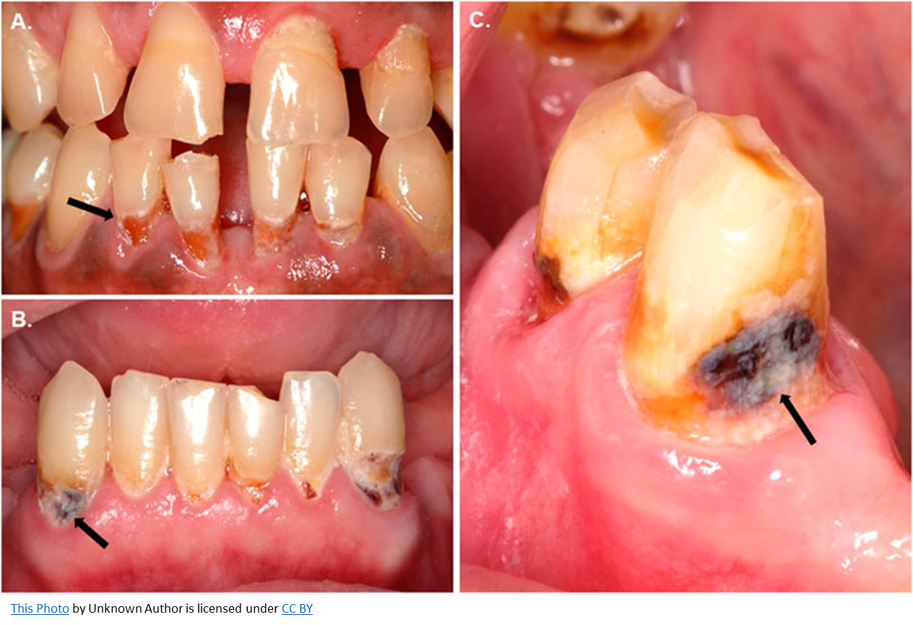
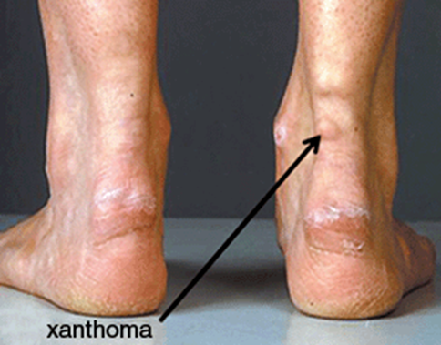
Peripheral signs in cardiac disases
High arched palate (Marfan’s syndrome)
Malar flush (mitral stenosis)
Xanthelasmata
Dental caries (infective endocarditis)

Slide 7
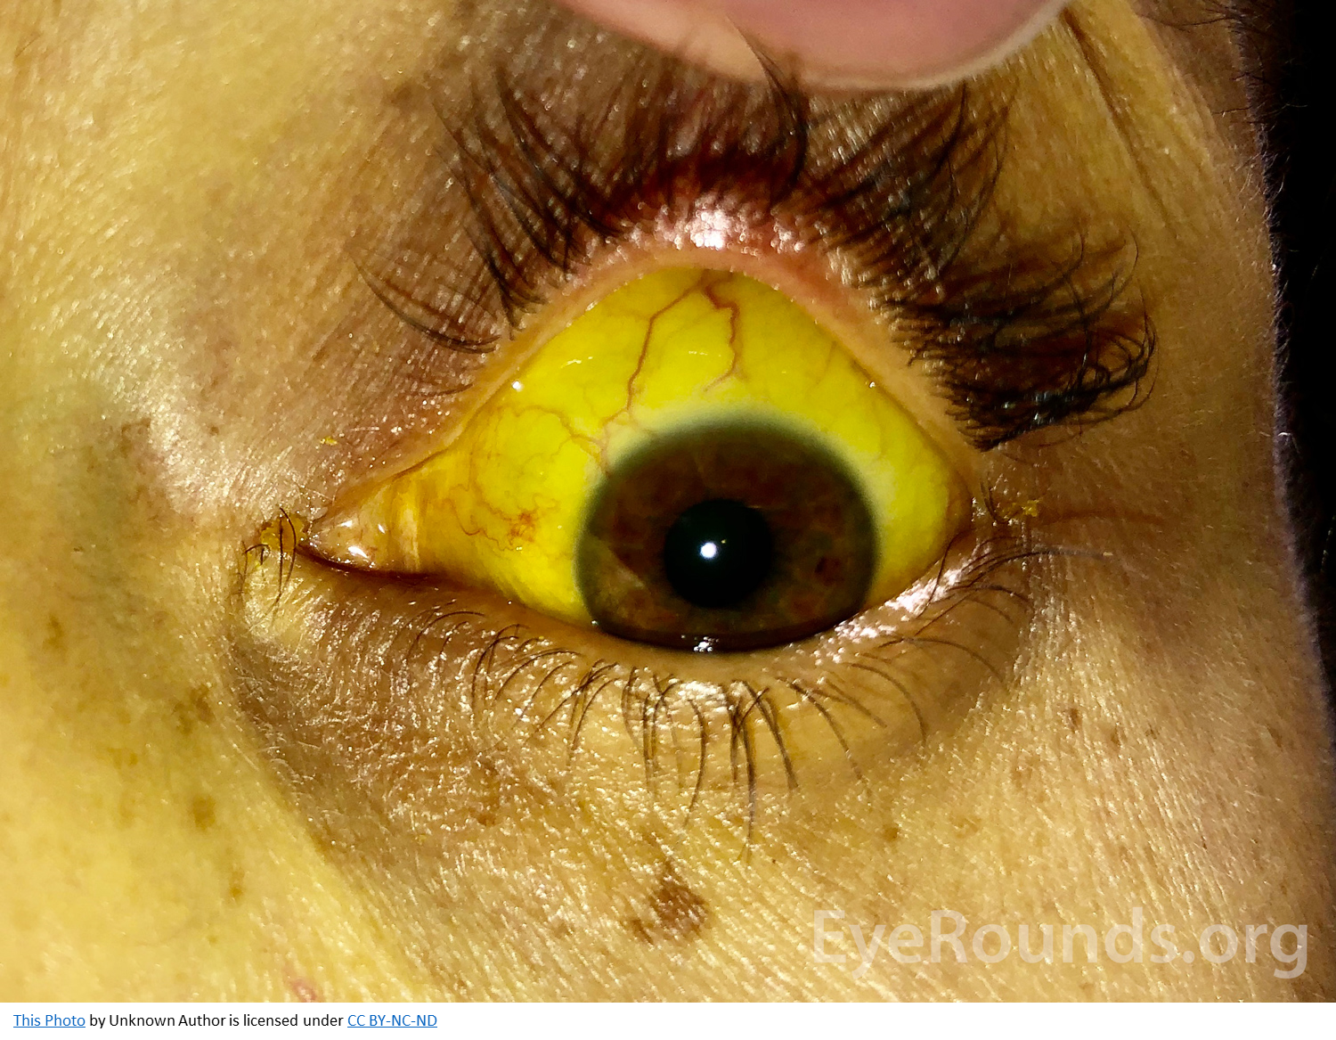
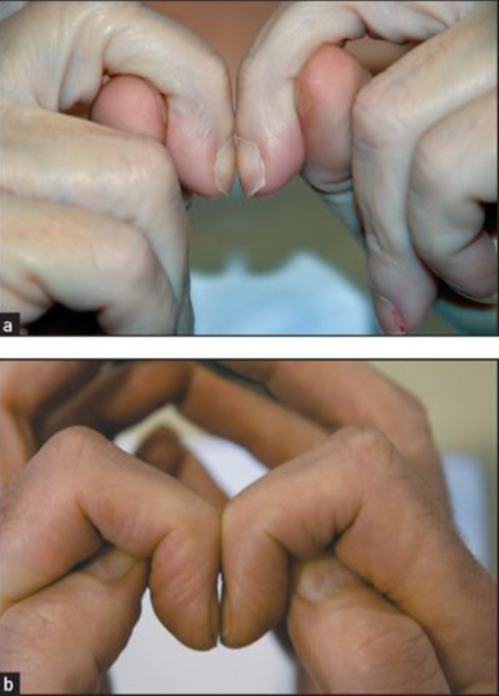
Peripheral signs
Osler’s nodes (tender)
Janeway lesions (non-tender)
Clubbing
Splinter hemorrhages (infective endocarditis)

Slide 8
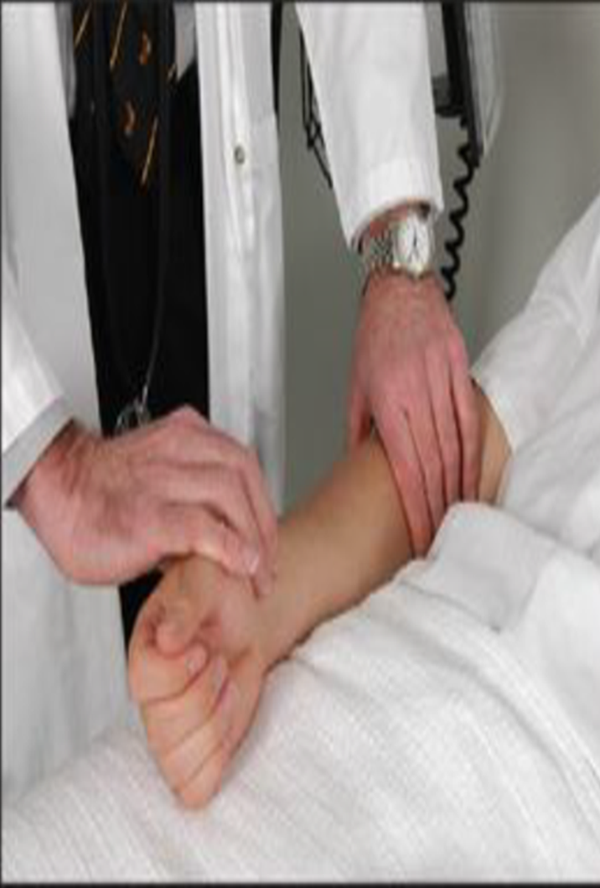
Pulse
Palpate the radial pulse
Rate: the number of pulses occurring per minute
Rhythm: the pattern or regularity of pulses
Volume: the perceived degree of pulsation
Normal volume
Small volume – low cardiac output
Large volume – thyrotoxicosis, anaemia
Character: an impression of the pulse waveform or shape.
Radio femoral delay (coarctation of the aorta)
Vessel Wall stiffness (arteriosclerosis
Rate - Feel the radial pulse with 2 or 3 fingers. Count the pulse rate for 15 seconds and multiply for 4 to get pulse rate per minute

Slide 9
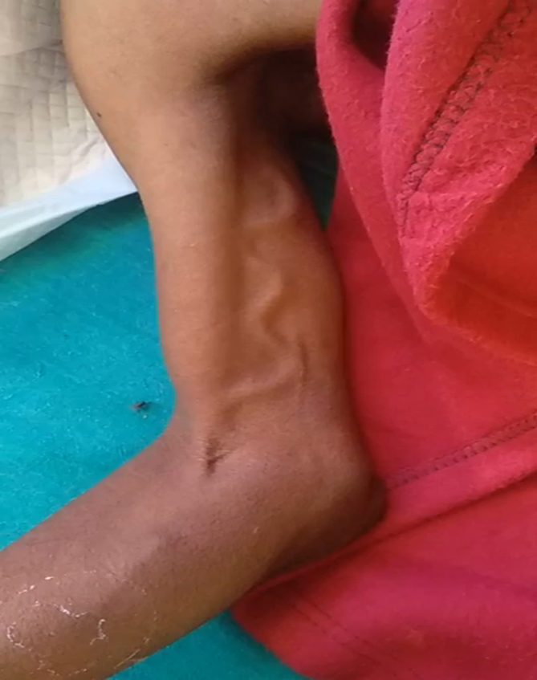
Locomotor Brachialis

Slide 10
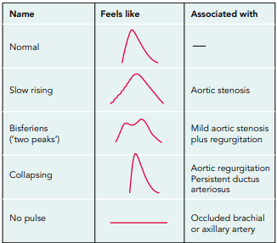
Pulse
Rhythm
– regular – normal
– regularly irregular – when extrasystoles
– irregularly irregular – atrial fibrillation,
multiple extrasystoles
Radial artery
Rate (60-100)
Bradycardia (<60)
Tachycardia (>100)
Character and volume assessed from carotid artery
Collapsing pulse (aortic regurgitation)
Pulsus alternans (left ventricular failure)
Pulse deficit (atrial fibrillation)
  Slow rising (AS)
  Bisferiens (AS + AR)
  Collapsing (AR)
  Alternans (LVF)
  Jerky (HOCM)

Slide 11
Heart rate
Fast rate (tachycardia, > 100 bpm)
Exercise
Pain
Excitement/anxiety
Fever
Hyperthyroidism
Medication:
Sympathomimetics,
e.g. salbutamol Vasodilators
Slow rate (bradycardia, < 60 bpm)
Sleep
Athletic training
Hypothyroidism
Medication:
Beta-blockers
Digoxin
Verapamil, diltiazem
Atrial fibrillation
Hypertension
• Heart failure
• Myocardial infarction
• Thyrotoxicosis
• Alcohol-related heart disease
• Mitral valve disease
• Infection, e.g. respiratory, urinary
• Post cardiothoracic surgery

Slide 12
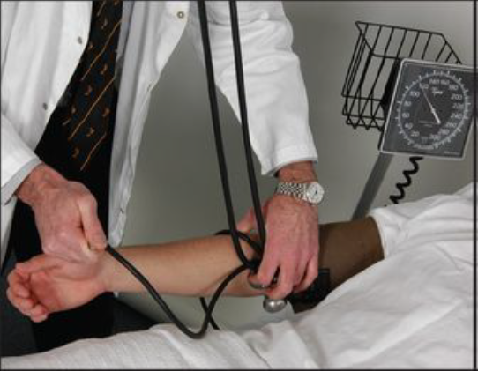
Blood Pressure
Sphygmomanometer
Systolic/diastolic pressure
Korotkoffp sounds
Normal <140/90 mmHg (lower in diabetes)
Use larger cuff width for large arms
Difference between arms of <10 mmHg
Pulses paradoxes: exaggerated reduction in BP with inspiration (>10 mmHg)
Postural hypotension

Slide 13
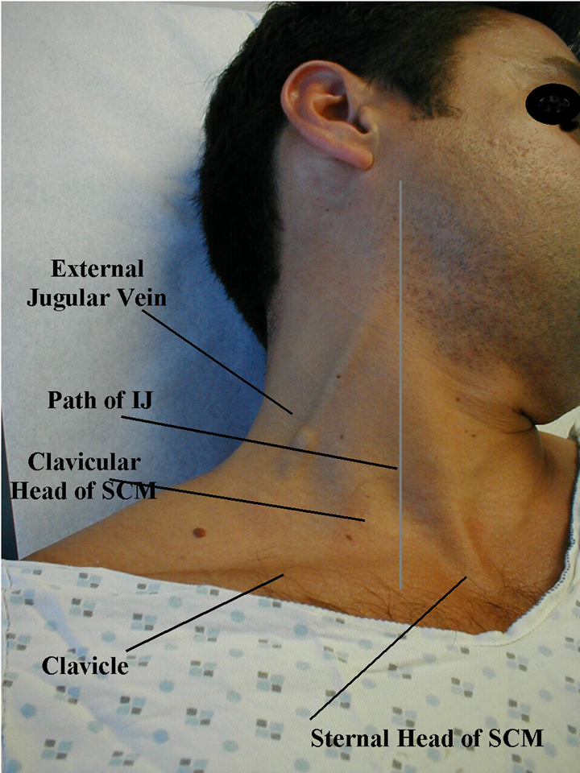
Jugular Venous Pressure
Patient at 45 degrees
Good lighting
Internal jugular vein
Reflects right atrial pressure
Zero point = sternal angle
Visible but not palpable
Complex wave form (a, c, v waves)
Decreases on inspiration

Slide 14
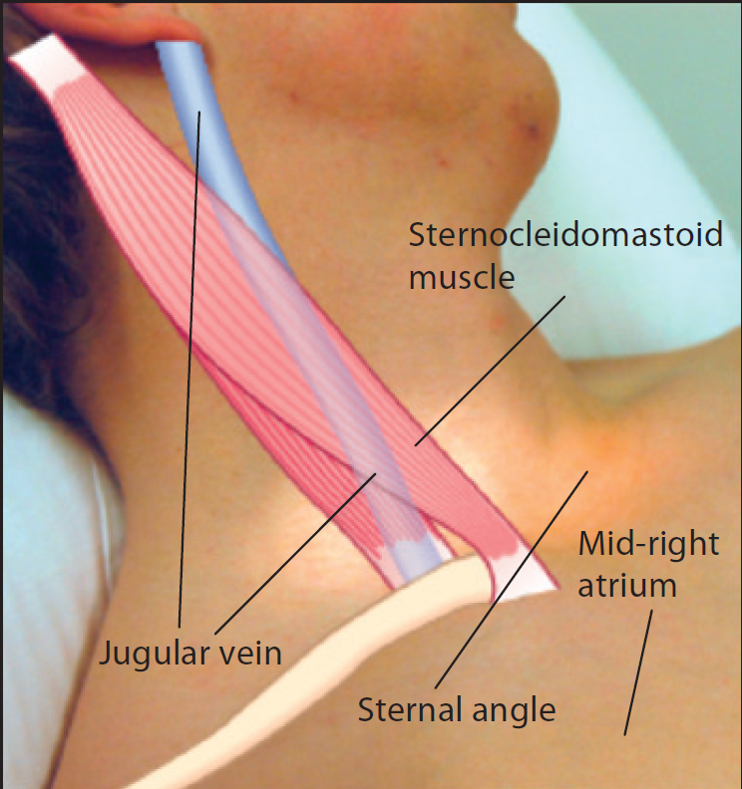
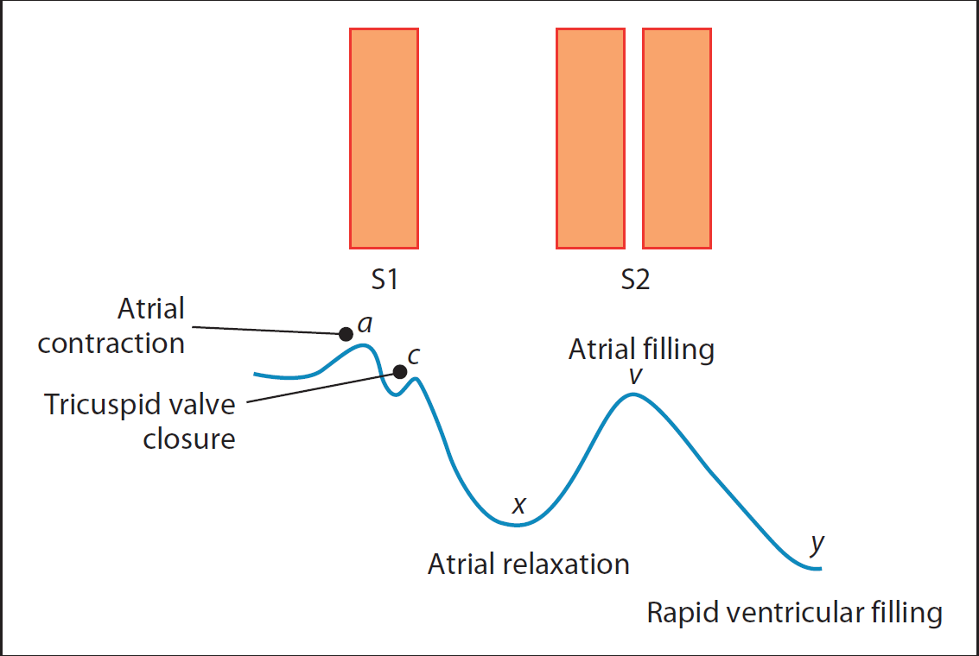

Slide 15
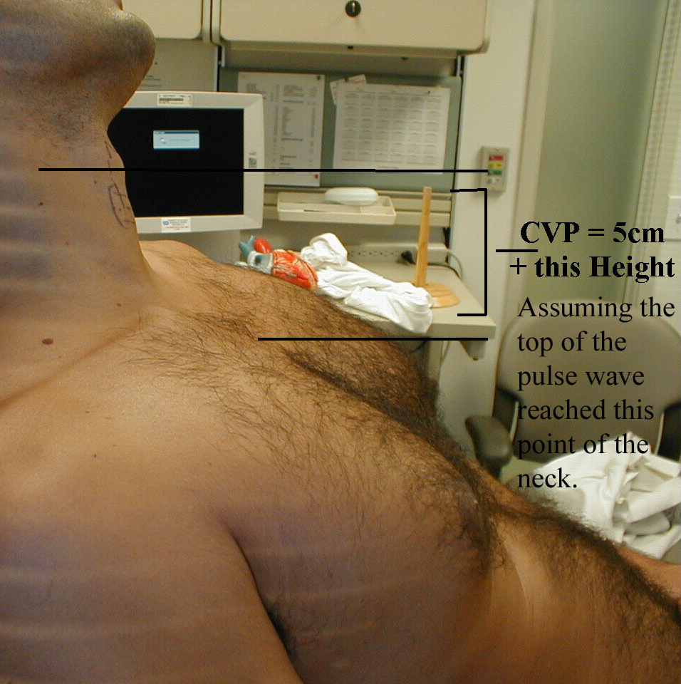
Jugular Venous Pressure
Fills from above
Hepatojugular reflux
Abnormal if >3 cm above zero point:
RV failure
RV infarct
Tricuspid stenosis
Tricuspid regurgitation
Pericardial effusion
SVC obstruction
Fluid overload

Slide 16
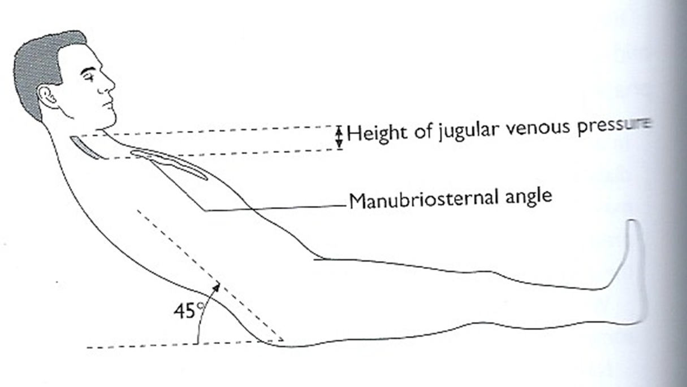
JVP
Observe the height of JVP when patient is in the bed at 45o
Access vertical height in centimeters above the sternal
angle (normal 2-4cm)
Observe the character of JVP
Look for a-wave (Atrial contraction)
- v-wave (Atrial filling when tricuspid wall is closed)
Large a-waves are caused by
- Tricuspid stenosis
- Pulmonary stenosis
- Pulmonary hypertension
Important - Absent a-wave in Atrial fibrillation
Large v-wave
- Tricuspid incompetence

Slide 17
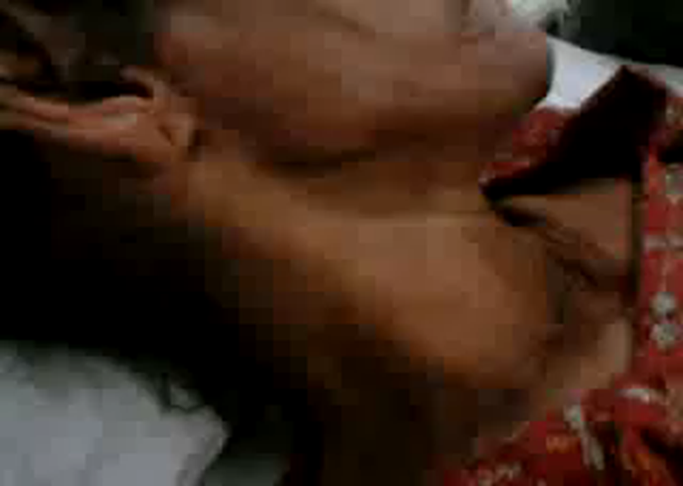


Slide 18
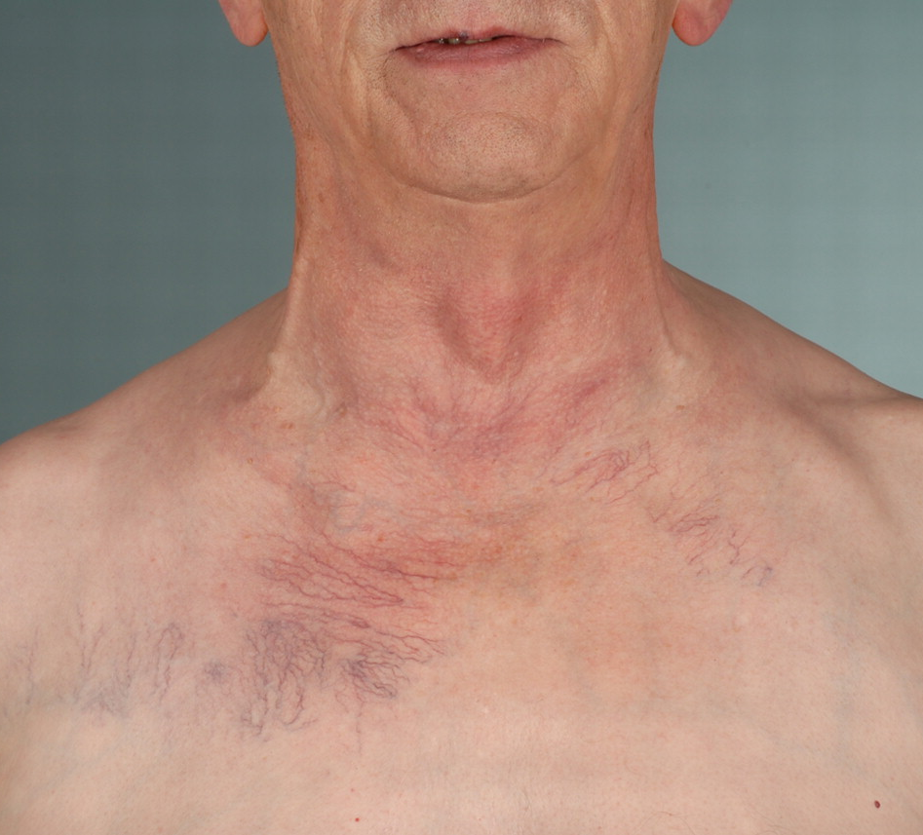
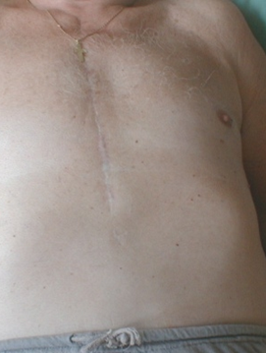
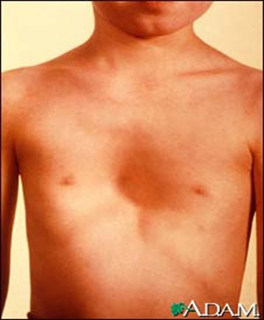
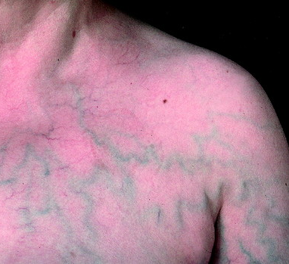
Inspection
Scars:
Median sternotomy
CABG
Valve replacement
Lateral thoracotomy
Infraclavicular (pacemaker)
Pectus excavatum
Apex beat

Slide 19
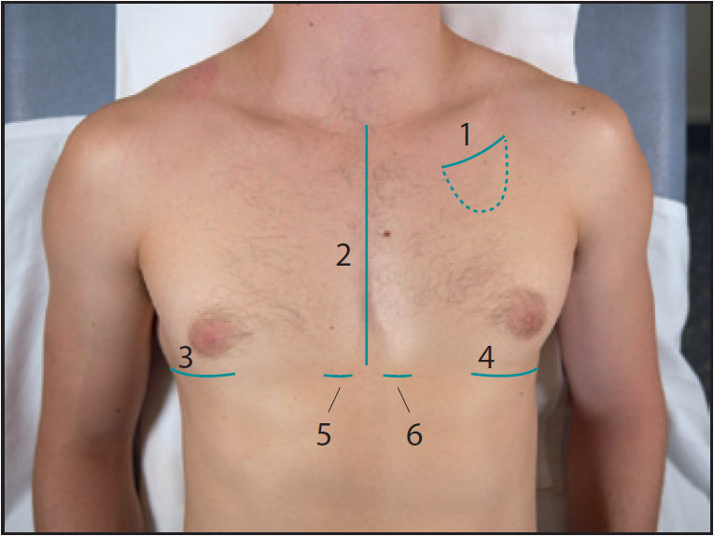
Scars
1 = pacemaker scar
2 = median sternotomy scar
3 + 4 = right and left
lateral thoractomy scars, 5 + 6 = surgical drain scars

Slide 20
Cardiovascular System
Palpate the apex beat
Measure the position – the space by counting down from the second intercostal space which lies below the sternal angle
Measure laterally in centimeters from the middle line
Describe the apex beat in relation to the mid clavicular line.
Important – normal position of apex beat is in the fifth left intercostal space just inside or on the mid clavicular line
Feel for the pulsation which is outer most and down most where the pulsation is felt distinctly
Palpation

Slide 21
Cardiovascular System
Apex beat
Assess the character
Normal
Tapping – in mitral stenosis
Heaving (when pressure overload) – aortic stenosis, hypertension
Thrusting (when volume overload) – mitral or aortic incompetence
Impalpable – obesity, COPD (Chronic Obstructive Pulmonary Disease), pericardial effusion

Slide 22
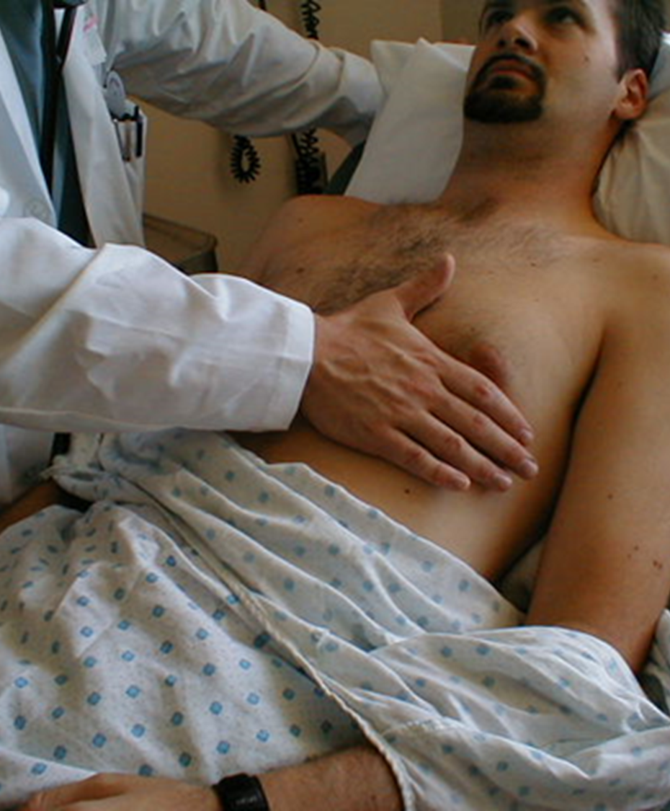
Precordium - Palpation
Apex beat
Assess the character
Normal
Tapping – in mitral stenosis
Heaving (when pressure overload) – aortic stenosis, hypertension
Thrusting (when volume overload) – mitral or aortic incompetence
Impalpable – obesity, COPD (Chronic Obstructive Pulmonary Disease), pericardial effusion

Slide 23

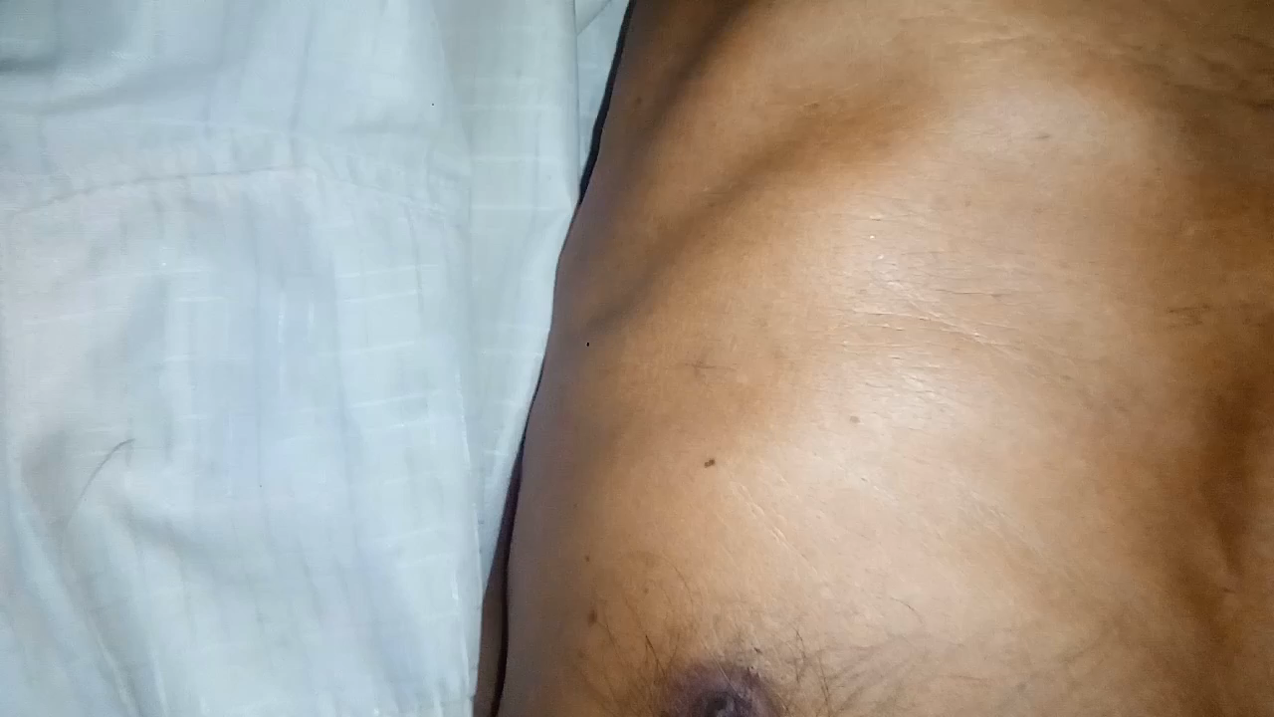
Displaced Apex

Slide 24
Palpation
Palpate firmly the left border of the sternum
- Use the flat of your hand – a left sternal heave suggest right ventricular hypertrophy
- Palpate right sternal border, base of the heart with flat of hand for thrills (palpable murmers)
Percussion – not routinely done

Slide 25
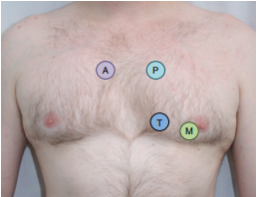
Auscultation

Slide 26
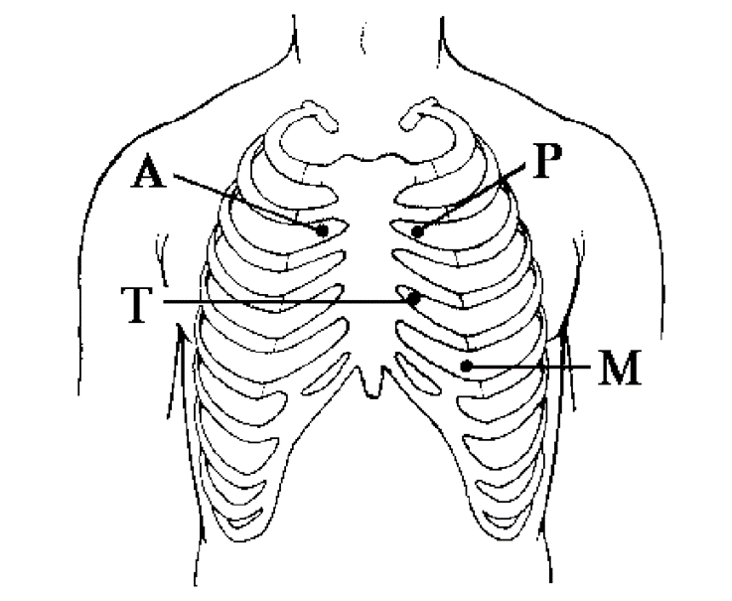
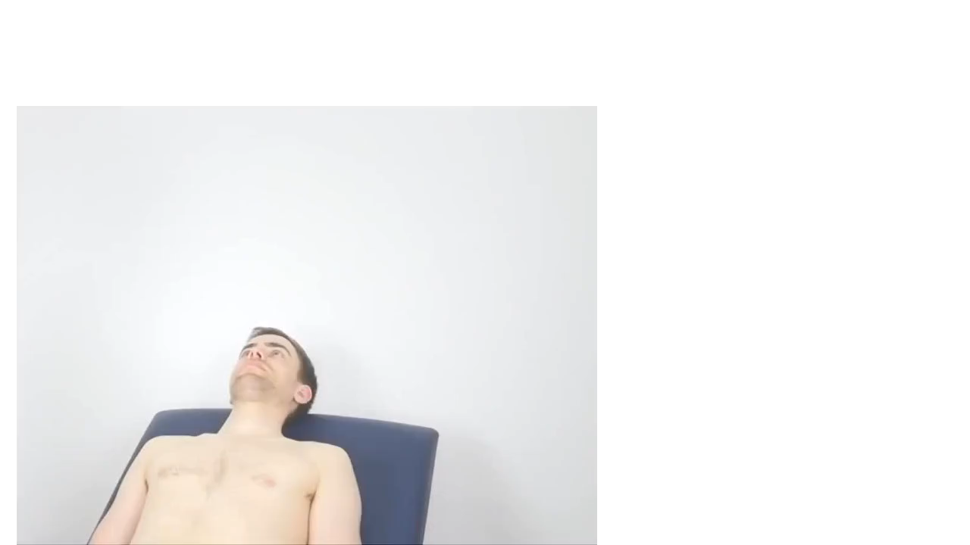
Bell (low pitched) Diaphragm (high pitched)
Mitral Tricuspid Pulmonary Aortic areas
S1 (first heart sound)
S2 – Splitting (A2, P2)

Slide 27
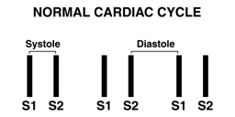
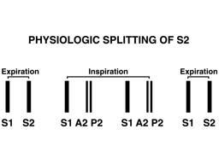
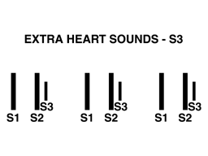
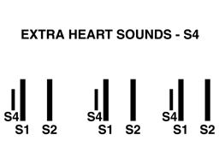

Slide 28
Abnormalities of Heart Sounds
Loud S1
Soft S1
Loud A2
Loud P2
Soft A2
Splitting of S1
Increased splitting of S2
Fixed splitting of S2
Reversed splitting of S2
S3 (third heart sound)
S4 (fourth heart sound)
Summation gallop
Opening snap
Systolic ejection click
Mid-systolic click
Tumor plop
Pericardial knock
Metallic click

Slide 29
Precordium – Auscultation
Murmurs
Timing of murmur
  Systolic
  Diastolic
  Continuous
Site of maximal intensity
Loudness
  Grades I-VI
  Thrill
Pitch
Radiation
Dynamic
  Respiration
  Valsalva
  Squatting

Slide 30
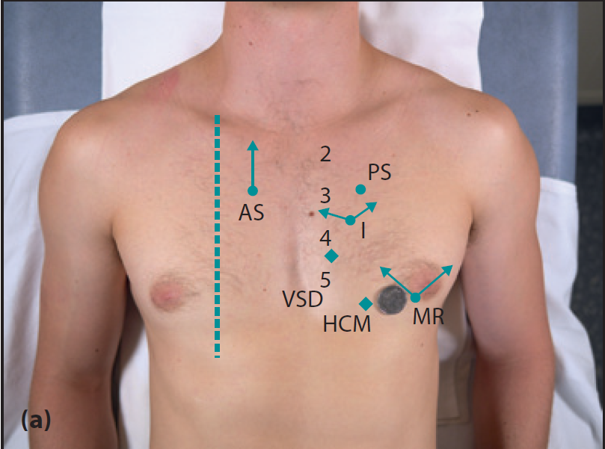
Systolic murmurs
AS = aortic stenosis
MR = mitral regurgitation
HCM = hypertrophic cardiomyopathy
PS = pulmonary stenosis
VSD = ventricular septal defect
I = innocent

Slide 31
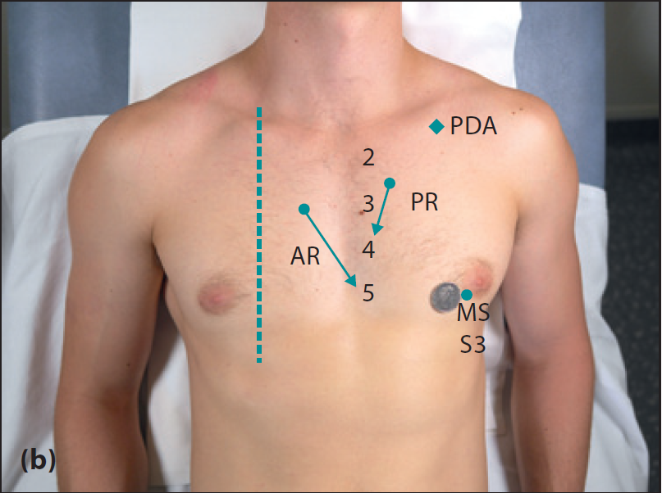
Diastolic murmurs and sounds
AR = aortic regurgitation
MS = mitral stenosis
S3 = third heart sound
PR = pulmonary regurgitation
PDA = patent ductus arteriosus (continuous murmur)

Slide 32
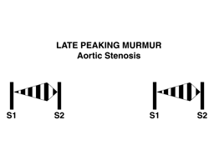
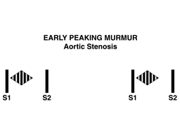
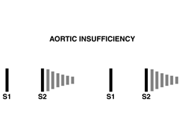
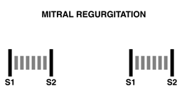

Slide 33
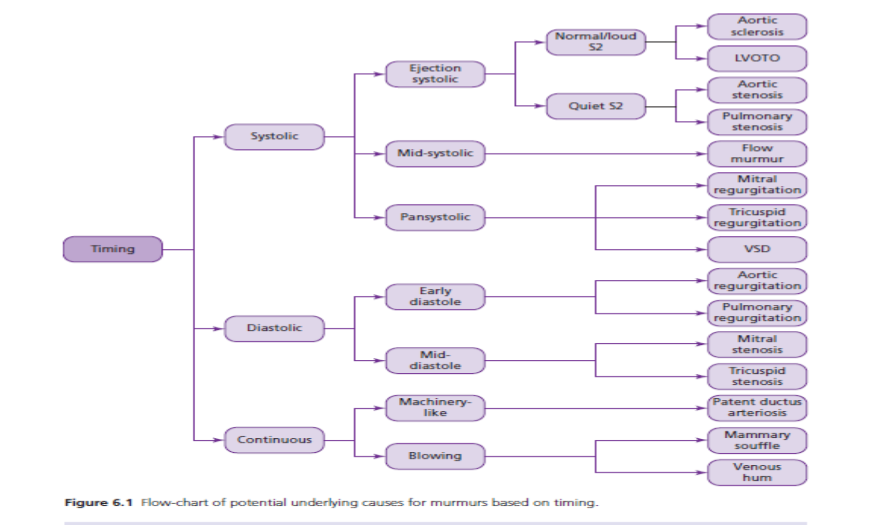

Slide 34
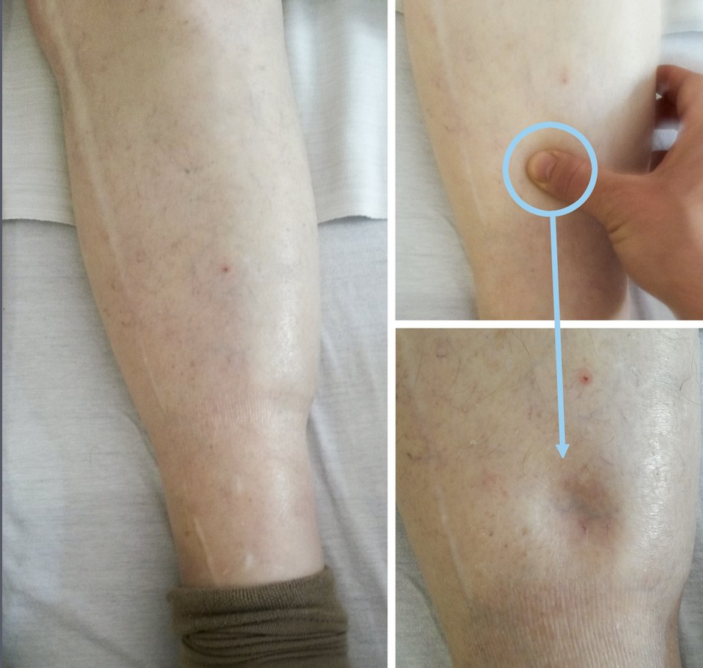
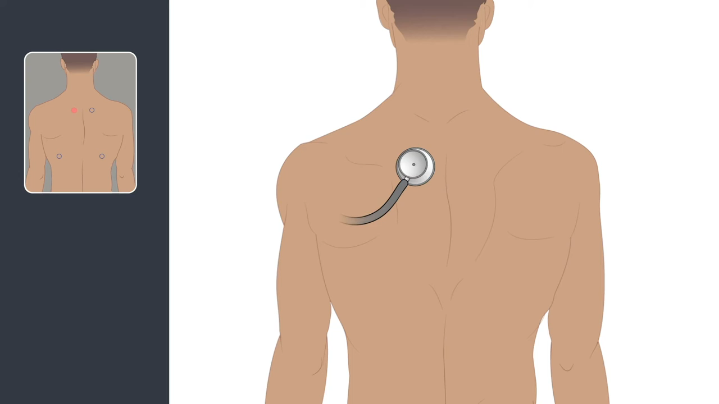
Percuss and auscultate lung bases
Left ventricular failure
Pleural effusion
Sacral pitting edema
Right heart failure
Examination – Back

Slide 35
Examination - Abdomen
Patient lying with one pillow (if tolerated)
Tender hepatomegaly
Pulsatile liver (tricuspid regurgitation)
Ascites
Splenomegaly
Abdominal aortic aneurysm

Slide 36
Examination – Lower Limbs
Peripheral edema
  Pitting/non-pitting
  Upper level
Achilles tendon xanthomata
Capillary return
Trophic skin changes
Palpate arteries
  Femoral
  Popliteal
  Posterior tibial
  Dorsalis pedis

Slide 37
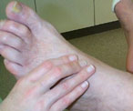
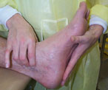
Peripheral Pulses
Dorsalis pedis pulse
Posterior tibial pulse

Slide 38
References
Nicholas J Talley: clinical examination. A systematic guide to physical diagnosis 8th edition: 57- 108 (Boxes and Tables)
HUTCHISON’S CLINICAL METHODS . Page 189-202 (Boxes & tables)
Macleod’s Clinical Examination : 15 edition Page 51-67

