Slide 1
Introduction to Diagnostic Imaging Modalities

Slide 2
Learning objectives
Define the Medical imaging.
Describe the principle of conventional radiography ,CT ,US ,Fluoroscopy ,MRI ,Nuclear medicine, Mammogram & angiography.
Explain the terms for different imaging modalities
Describe the 4 basic radiological density
Describe the various CT planes ,window planes and CT number.
Describe the advantages and disadvantages of MRI including its contraindication
Explain the MRI sequences (Mainly T1 & T2)

Slide 3
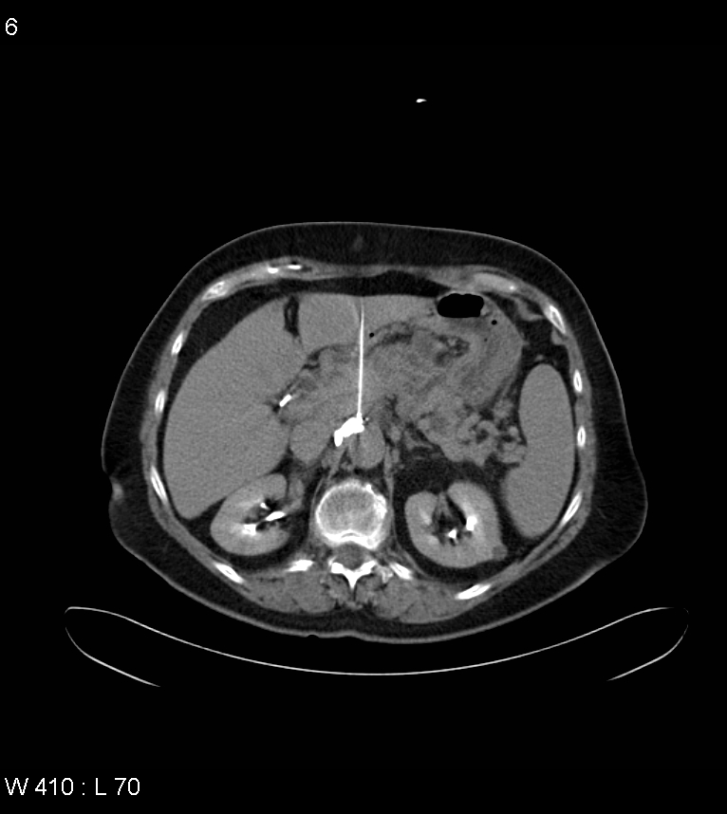
Definition of Medical imaging
Medical imaging refers to several different technologies that are used to view the human body in order to diagnose ,monitor, or treat medical conditions.

Slide 4
Diagnostic imaging Modalities
Conventional (Plain) x-rays or (Radiography)
Fluoroscopy(real time imaging, contrast often used)
Mammography
Ultrasound
CT Scan
MRI
Angiography
Nuclear Medicine,conventional,Spect/Pet and PET/CT fusion
Which of these modalities use ionizing radiation?

Slide 5
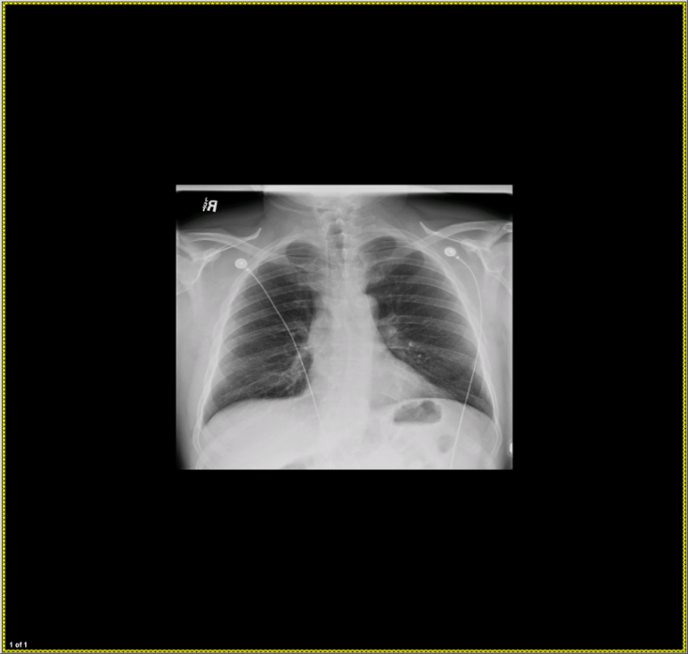
Technical background
X-Rays:
There are 3 main parts involved to create an x-ray image:
Generate a beam of x-rays from an x-ray tube.
Project x-rays toward an object with a detector behind.
  Some x-rays are absorbed by the object, dependent on its density and structural composition.
  Remaining x-rays pass through the object and are absorbed by the detector.
Generate image from detector (either digital or photographic film).
Q: Where on this image have x-rays passed through the body to the greatest degree?

Slide 6
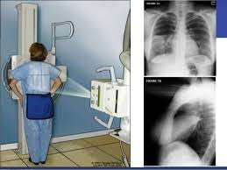
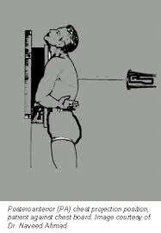
Conventional radiographs

Slide 7
Continue
_{X-ray image (Radiography)}
• The image is the result of interaction of X-ray beam and body tissue
• Conventional (projectional) radiography produces two-dimensional images of the object studied.
- X-rays that pass through a structure easily are least absorbed and therefore cause blackening on the radiograph (air-lung).
₋ Whereas structure that absorbs or reflects x-ray most appear white (bone-metallic).
• Soft tissues lie in between are gray. According to thickness of these, the shades of gray differ.

Slide 8
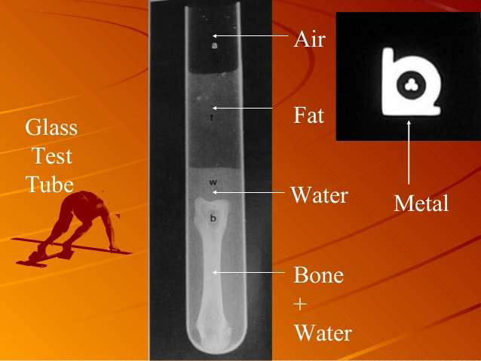

Slide 9
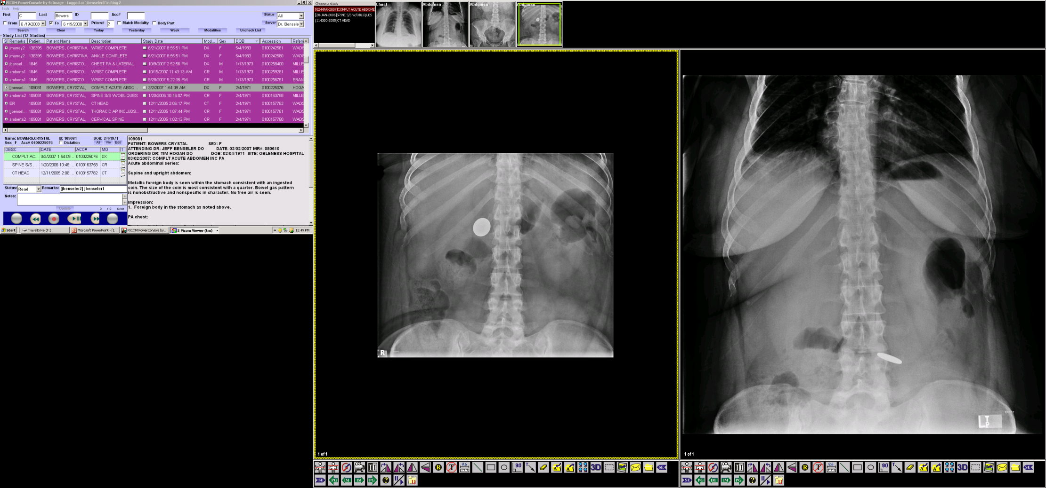
Image key:5 Basic Radiographic Densities
5
Radiographic image key or
Observable Densities:
1. Air
2. Fat
3. Fluid (Soft tissue)
4. Mineral (Calcium)
5. Metal
1
2
4
3

Slide 10
Ultrasound
Ultrasound is a radiological technique that involves sending soundwaves with very high frequencies (∼ 2–20 MHz for diagnostic imaging) through the body and receiving their echoes to visualize internal structures and organs.
There is organ limitation( It can not penetrate air or bone so we can not use with lung or brain.
Fluid is a good conductor of sound, therefore, ultrasound, is particularly good imaging modality for diagnosing cyst and other fluid filled structures like urinary bladder and biliary system and demonstrating the fetus in its amniotic sac.
www.upei.ca/~vetrad

Slide 11
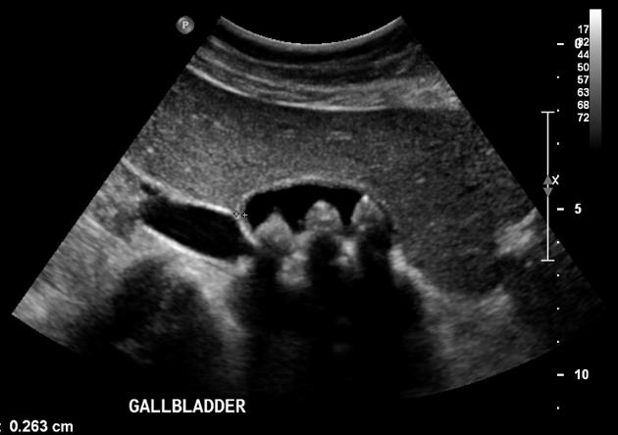
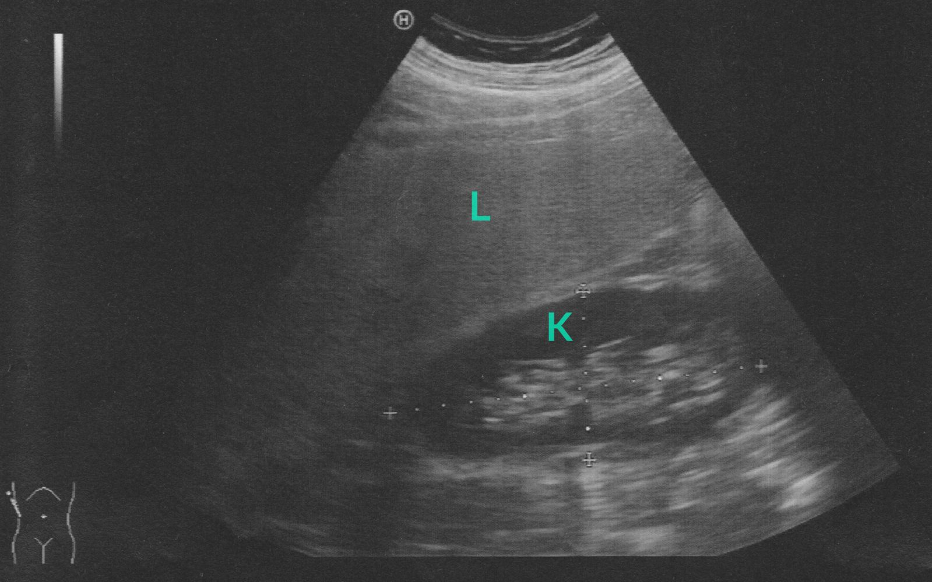
Echogenicity : Hypoechoic - hyper echoic- Isoechoic & anechoic
Hyperechoic – More echogenic (brighter) than normal.
Hypoechoic – Less echogenic (darker) than normal.
Isoechoic – The same echogenicity as another tissue.
Anechoic - Black than normal
Abdominal ultrasound: evidence of a fatty liver by comparing the echogenicity of tissue from the kidney (K) and liver (L)

Slide 12
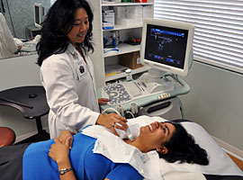
Ultrasound
Ultrasound can also be used endoscopically (e.g., transrectally, transvaginally, transesophageally, or transgastrically), to better evaluate internal organs and otherwise difficult to evaluate structures such as the prostate, ovaries, heart valves, and pancreas.

Slide 13
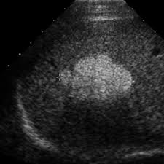
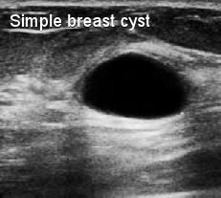
Ultrasound <<<<<
Acoustic shadow
If ultrasound waves are strongly absorbed and echoed at the surface, the waves will fail to penetrate the tissue. All structures behind the surface will appear black.
Acoustic enhancement
Because ultrasound waves are hardly weakened in fluids, structures that are located behind fluid-filled spaces will appear hyperechoic (brighter).
Ultrasound is often used to determine whether the structure is solid or cystic

Slide 14
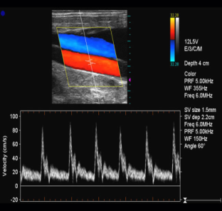
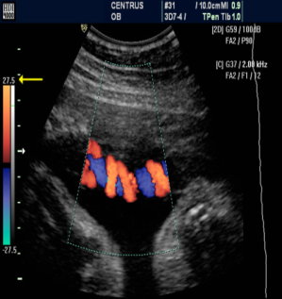
Doppler ultrasound
Doppler studies are used to detect venous thrombosis, arterial stenosis and occlusion.
Doppler or duplex mode used to visualize motion within structures, e.g., the velocity and direction of blood flow.
In obstetrics, Doppler ultrasound is used particularly to determine fetal blood flow through the umbilical artery.
With Doppler echocardiography it is possible to demonstrate regurgitation through incompetent valves.

Slide 15
Ultrasound
Due to the safety of ultrasound waves and the portability ultrasound machines, low cost, and high availability of ultrasound machines.
Ultrasound offers quick diagnosis for certain diseases (e.g., cholecystitis).
Ultrasound waves have no known harmful effects (compared to modalities using ionizing radiation
Noninvasive.
Enables real-time morphological and functional (moving image).
The main disadvantages of ultrasound are the training and skill required of the examiner, low resolution, and the common appearance of artifacts.

Slide 16
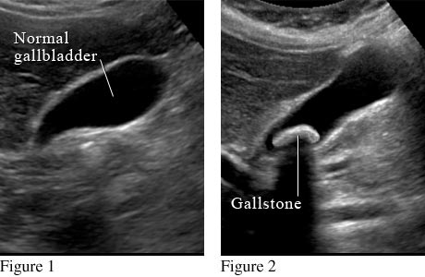
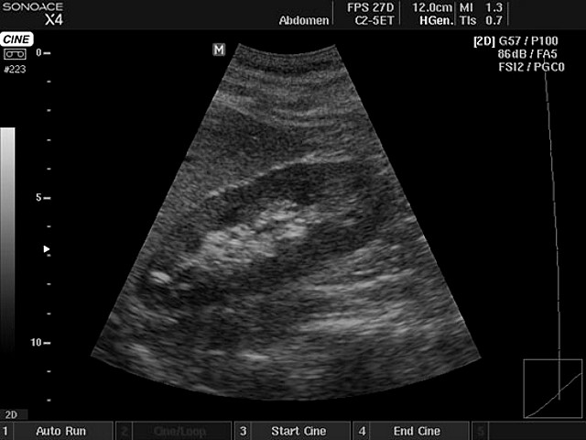

Slide 17
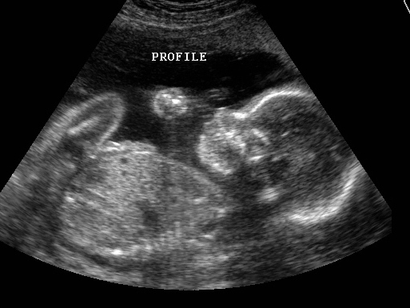
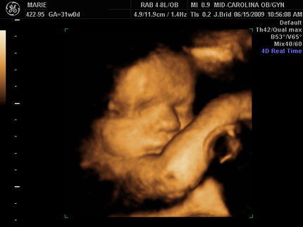
2D vs 3D

Slide 18
Computed Tomography
Computerized (or computed) tomography (CT scan) is an imaging technique that employs a rotating x-ray generator and multiple detectors to produce a large number of cross-sectional images on several planes.
Unlike traditional radiography, which produces projectional images of structures superimposed on each other, CT visualizes slices of the patient only a few millimeters thick, eliminating the problem of superimposition.
A CT scan is used to define normal and abnormal structures in the body and/or assist in procedures by helping to accurately guide the placement of instruments or treatment planning.
The advantages of CT scan besides allowing for image manipulation and 3D reconstruction include shorter study time and lower cost than MRI and higher resolution than projectional radiography, while disadvantages include lower resolution than MRI and exposure to ionizing radiation.

Slide 19
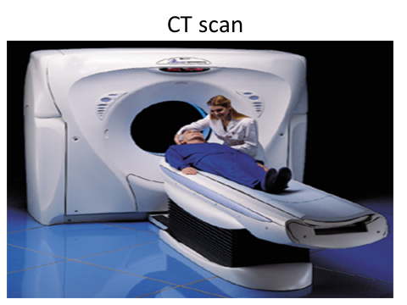
Interpretation:
Hypodensity: an area of tissue with lower density (appears darker) than normal or surrounding tissue
Hyperdensity: an area of tissue with higher density (appears brighter ) than normal or surrounding tissue
Isodensity: an area of tissue with the same density (appears with the same brightness) as surrounding tissue or reference structure

Slide 20
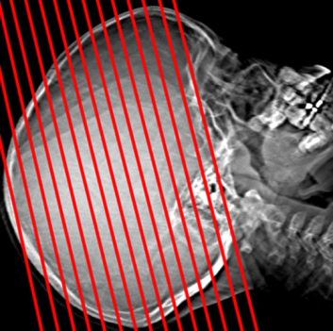
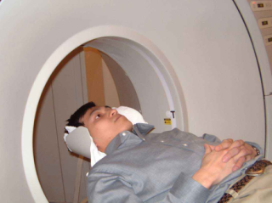
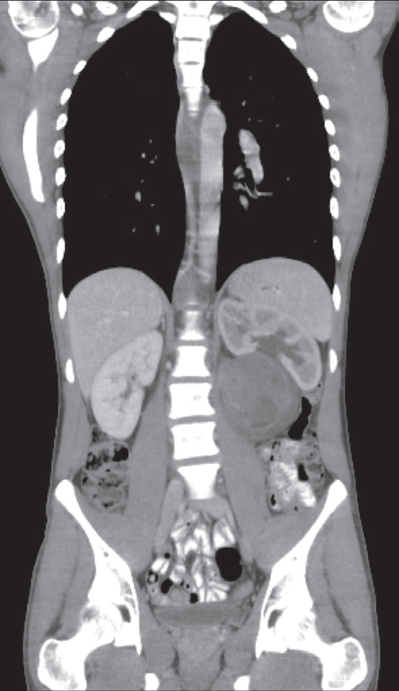
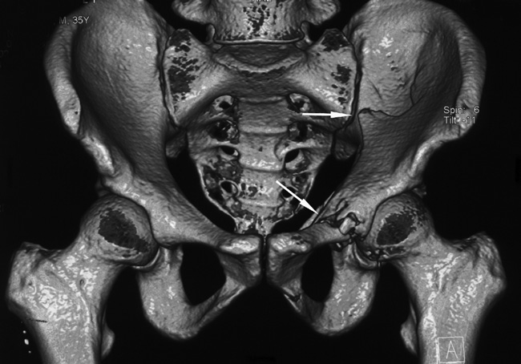
CT is usually performed in the axial plane, but it is possible to reconstruct excellent images in other planes, e.g. coronal , sagittal or oblique, and even three-dimensional (3D) images

Slide 21
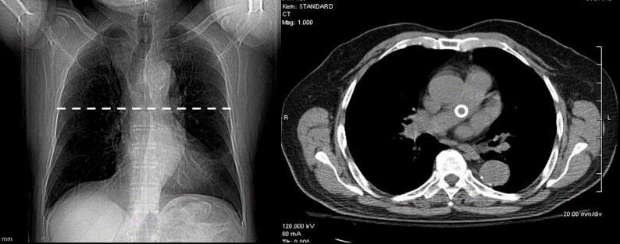
Hounsfield scale: An index used to quantify the radiodensity of materials imaged by CT.
A CT scan produces a greyscale image, with high-density material appearing bright (e.g., bone) and low-density material appearing dark (e.g., fat).
The shades of gray are described in terms of Hounsfield units (HU), also referred to as CT numbers, on a scale with water as the reference point (0 HU). Higher-density materials have values above 0 (e.g., bone: 1000–1500 HU), while lower-density materials have a value below 0 (e.g., air: -1000 HU).

Slide 22
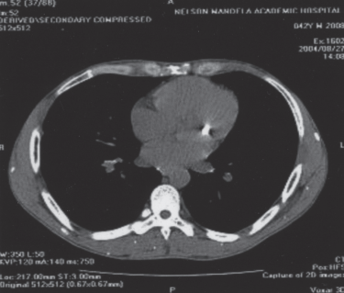
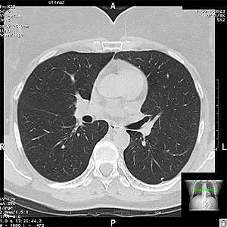
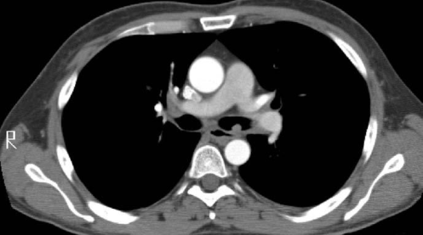
Computed Tomography

Slide 23
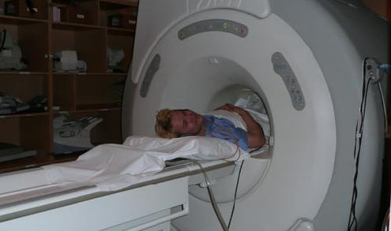
MRI

Slide 24
MRI (Magnetic Resonance Imaging)
Signal intensity(Hyper or hypo or isointense)
T1
T2
FLAIR. (Fluid attenuated inversion recovery)
T1 with contrast enhancement
Diffusion weighted
Perfusion weighted

Slide 25
MRI(Magnetic Resonance Imaging)
Magnetic resonance imaging (MRI) is a tomographic imaging modality that employs electromagnetic fields and radio waves rather than ionizing radiation to visualize structures and processes within the body.
Due to the high level of detail it can provide, MRI is especially useful for imaging soft and nervous tissue. While CT is preferable in the emergency setting and for the evaluation of bone structures!
Due to their time-consuming and cost-intensive nature, MRI studies may not be the preferred approach compared to radiographical studies, especially in emergency settings.
In addition, the strong electromagnetic field produced by MRI interacts with ferromagnetic materials, making it impossible for patients with certain nonremovable metal implants to undergo the procedure.

Slide 26
Signal intensity
MRI images display not only morphological features but also characteristic signal intensities for every type of normal and abnormal tissue.
Hyperintensity: Tissue has higher signal intensity and appears brighter than surrounding or normal tissue.
Hypointensity: Tissue has lower signal intensity and appears darker than surrounding or normal tissue.
Isointensity: Signal intensity and tissue brightness are the same as those of surrounding or normal tissue.

Slide 27
Findings based on MRI sequence
Sequences | Hyperintense | Hypointense
T1-weighted | Fat, adipose tissue (white brain matter) Contrast media | Water (CSF, edema ) Bone Ligaments, tendons Air (no signal)
T2-weighted | Water (CSF, edema ) Fat (less hyperintense than in T1) | Bones Ligaments, tendons Air (no sign
Water appears hypointense in T1 weighted images but hyperintense in T2 weighted images!
WW2: "Water looks white in T2”

Slide 28
MRI Contraindications
Absolute contraindication: patients with ferromagnetic medical implants
Ferromagnetic metals:
  Interfere with the static magnetic field of MRI.
  Causes injury due to MRI-related heating and movement of implants (e.g., certain cardiac pacemakers and cochlear implants)
  Examples: iron, nickel, and cobalt.
Nonferromagnetic metals:
  Do not interfere with the static magnetic field of MRI.
  Examples: titanium, gold, silver, and copper.
  Always ask patients about medical implants before performing an MRI!

Slide 29
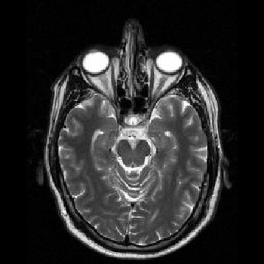
MRI continue
Axial
T2 Weighted
T1 Weighted

Slide 30
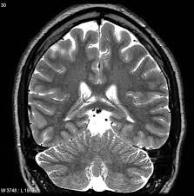
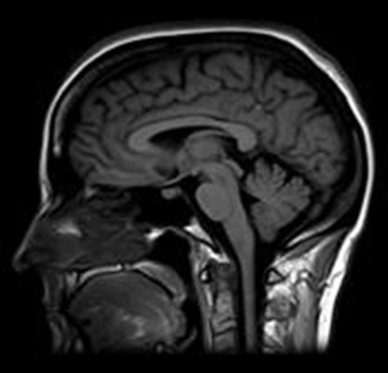
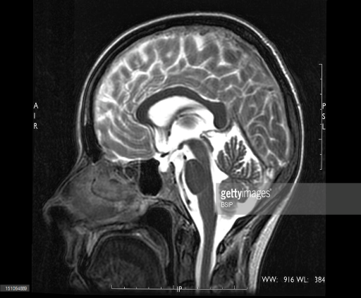

Slide 31
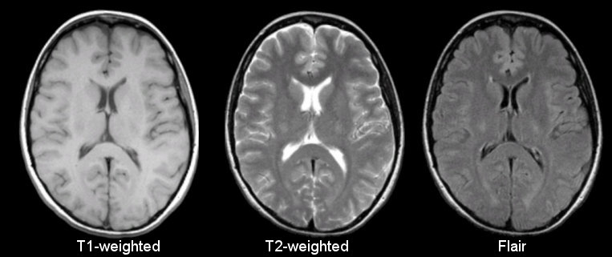

Slide 32
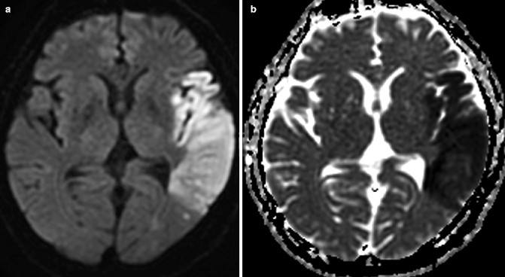
Diffusion weighted images

Slide 33
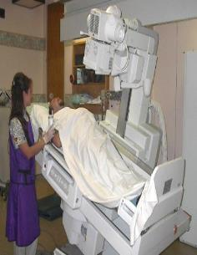
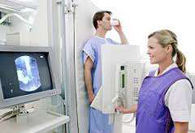
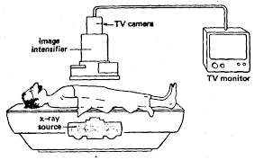
Fluoroscopy
An imaging technique that uses continuous x-rays to take a series of images that are particularly useful for the evaluation of moving structures (e.g., for swallow studies, catheter manipulation, angiograms).
Utilizes X-Rays
Real-time imaging
Utilizes image intensifier
May involves use of contrast agents

Slide 34
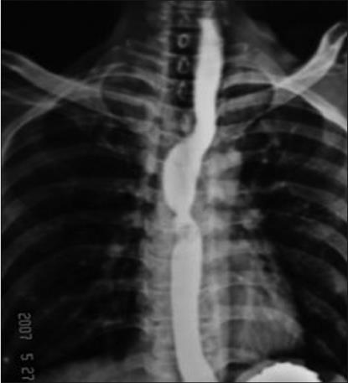
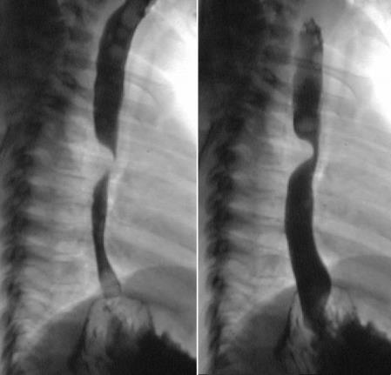
Barium swallow spot films

Slide 35
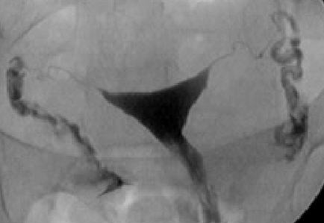

Slide 36
Angiography
1.Conventional angiography
2.CT angiography
3.MR angiography
Conventional or catheter angiography: Radiographic visualization of blood vessels after injection of radiopaque contrast media into the blood vessels.
Contrast is rapidly injected in to the blood vessel and a series of images are taken rapidly to follow the flow of contrast in the blood vessel. It is performed under fluoroscopy.
Angiography is indicated to diagnose vascular pathology.
Conventional angiography is diagnostic as well as therapeutic.

Slide 37
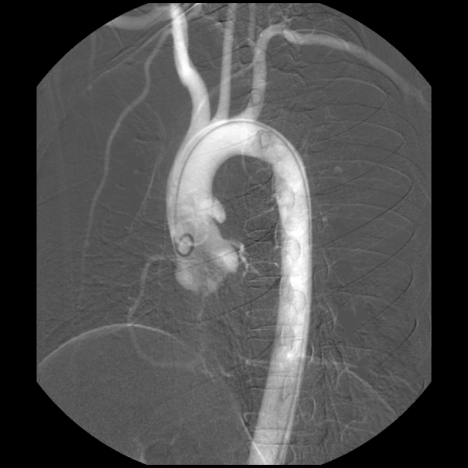
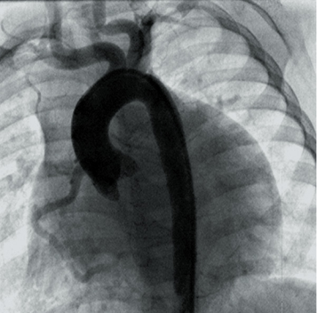
Thoracic aorta angiogram

Slide 38
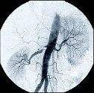
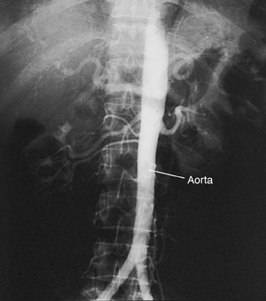
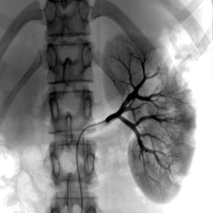
Abdominal aorta angiogram
Renal angiogram

Slide 39
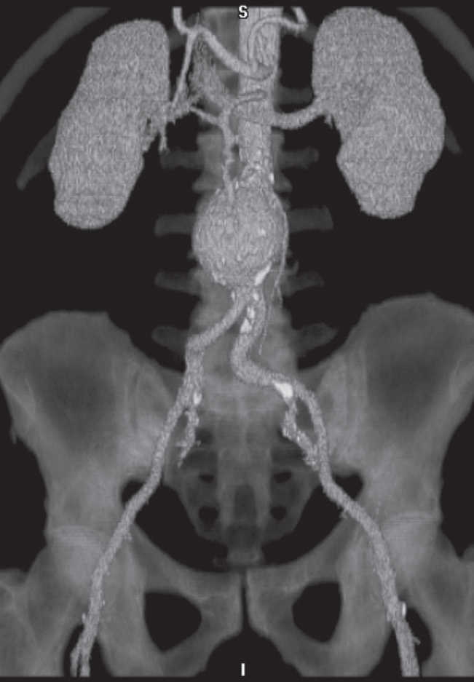
Computed tomography angiography
Rapid intravenous injections of contrast media result in significant opacification of blood vessels, which, with multiplanar or 3D reconstructions, can be exploited to produce angiograms.
CT angiogram. Reconstruction from many thin axial sections following an intravenous injection of contrast demonstrating an aortic aneurysm. Calcification is seen in the wall of the arteries

Slide 40
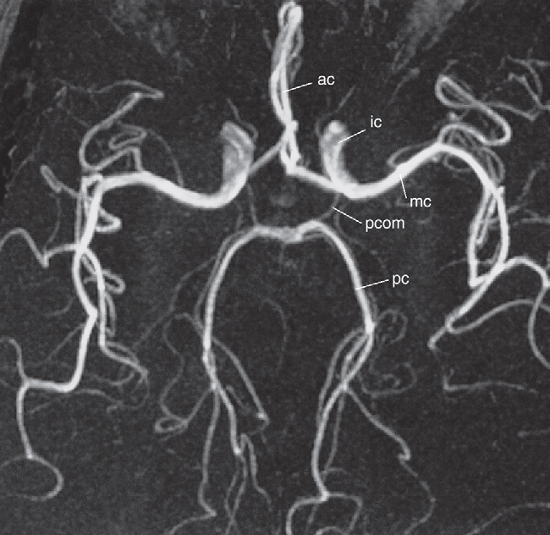
Magnetic resonance angiography is a very useful noninvasive technique, which can demonstrate both arteries and veins. Images of the vascular system can be obtained using special sequences that depend on the signal obtained from flowing blood or via an injection of a contrast agent (gadolinium DTPA (diethylene triamine pentacetic acid) into a peripheral vein
Magnetic resonance angiogram of the intracranial arteries.
No contrast medium was used to obtain this image.

Slide 41
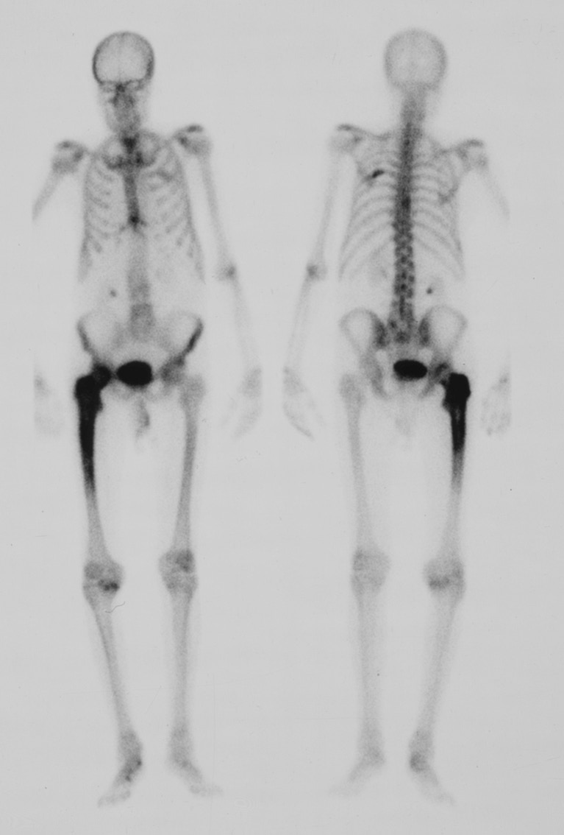
Nuclear Medicine (Scintigraphy)
The radioactive isotopes used in diagnostic imaging emit gamma-rays as they decay.
The radioisotopes used in medical diagnosis are artificially produced and most have short half lives, usually a few hours or days.
Technetium-99m (99mTc) is readily prepared, has a convenient half life of 6 hours and emits gamma-radiation of a suitable energy for easy detection.
Other radionuclides that are used include indium-111, gallium-67, iodine-123 and thallium-201.
Radionuclide bone scan. The patient has received an intravenous injection of a 99mTc-labelled bone-scanning agent
The increased uptake in the femur in this patient was due to Paget’s disease

Slide 42
PET Scanner: positron emission tomography
A PET scan uses a small amount of radioactive material (tracer). The tracer is given through a vein (IV). The tracer travels through your blood and collects in organs and tissues.
The most commonly used agent is F-18 fluorodeoxyglucose (FDG).
PET using FDG is the most sensitive technique for staging solid tumours, such as bronchial carcinoma , and in the follow-up of malignancies, particularly lymphoma.
PET is also used in the evaluation of ischaemic heart disease and in brain disorders such as dementia, epilepsy and Parkinson’s disease.
A PET scan measure the important body functions such as blood perfusion of tissues, oxygen use and glucose metabolism.

Slide 43
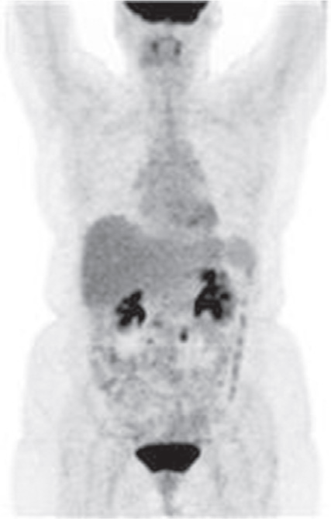
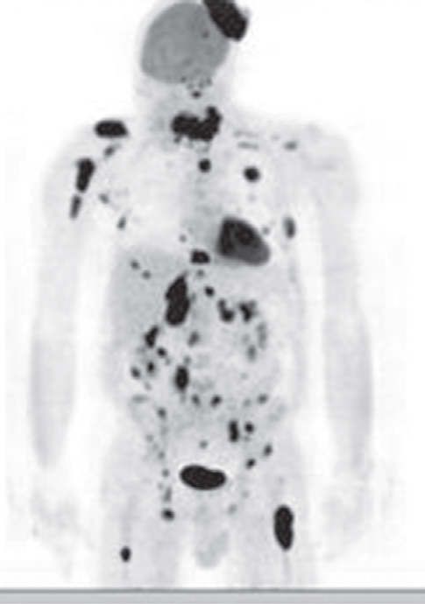
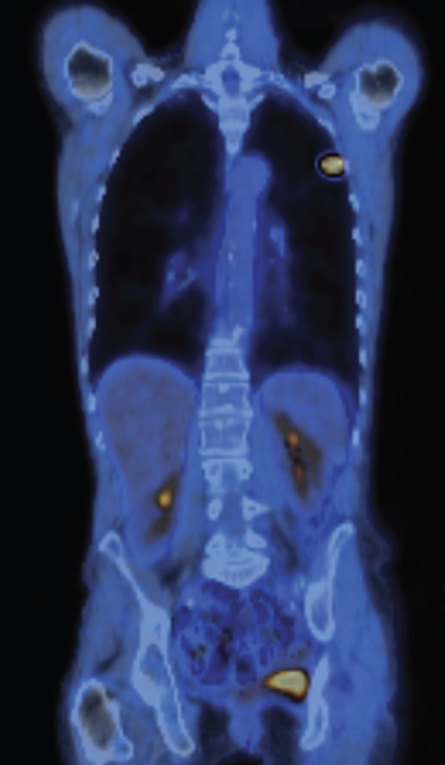

PET SCAN
FDG-PET scans, maximum intensity projections.
Normal isotope distribution. There is intense uptake in the brain and the neck uptake is in the tonsils. The FDG is excreted by the kidneys.
(b) Lymphoma, showing multiple visceral, nodal, bone and scalp deposits.
(a)
(b)
FDG-PET/CT of lung cancer.
(a) Coronal CT image and (b) maximum intensity projection, demonstrating a small left lung cancer. The remainder of the FDG uptake is physiological
(a)
(b)

Slide 44

Mammography
Mammography is the process of using low-energy X-rays (usually around 30 kVp) to image the human breast and is used as a diagnostic and a screening tool.
Mammography detects the majority of cancers and can detect lesions ∼ 2 years before they are clinically evident.

Slide 45
Mammogram technique and type:
1.screening:
Screening mammograms are routinely administered to detect breast cancer in women who have no apparent symptoms. It is recommended after the age of 40 years.
The goal of screening mammography is the early detection of breast cancer.
Single Medio lateral oblique view(MLO) is done only

Slide 46
2.Diagnostic Mammogram
Diagnostic mammograms are used after suspicious results on a screening mammogram or after some signs of breast cancer alert the physician to check the tissue.
For woman presenting with clinical evidence of breast disease, palpable mass or other symptoms such as breast pain and nipple discharge

Slide 47

Routine diagnostic mammography projections
  1.Craniocaudal (CC)
  2.Medio lateral oblique (MLO)

Slide 48


Slide 49

Additional views. Such as magnification views are done to detect microcalcifications

Slide 50
Mammography findings of benign and malignant breast lesions
 |  | Benign lesion | Malignant lesion
 | Appearance of the lesion | Well-defined, circumscribed mass | Focal mass or density
 | Margins | Surrounding radiolucent ring (halo sign) | Poorly defined, spiculated margins
 | Calcifications | Diffuse microcalcification or coarse calcification | Clustered microcalcifications
 | Further management | Regular check-ups Possibly surgical excision | Fine needle aspiration or core needle biopsy

Slide 51


Suspicious breast mass
Mammography (right breast; craniocaudal view)
A mass with suspicious features, including high density and indistinct margins, is visible in the posterior third of the breast.
Mammography in breast cancer
Mammography (right breast; mediolateral oblique view)
A high-density mass with an indistinct margin and containing microcalcifications projects in the upper breast.
The features of this lesion are highly suspicious for malignancy.

Slide 52


Fibro adenoma
well defined and ovoid or
spherical
Benign masses

Slide 53


Ultrasound image of a benign breast lesion. There is a very well-defined hypoechoic ovoid mass typical of a benign fibroadenoma.
In postmenopausal women and women ≥ 30 years of age with a suspicious breast mass, mammography is preferred over ultrasound. In premenopausal women < 30 years of age, ultrasound is preferred, because the higher density of breast tissue decreases the diagnostic power of mammography.

Slide 54



Breast ultrasound is usually done to differentiate between solid and cystic masses

Slide 55

MRI: Superior modality to:
Detect occult cancer
Cancer dense breast
Detection of cancer in breast with implants

Slide 56




RUQ pain in a middle age patient.
Identify these four imaging modalities used in this patient?

Slide 57
The End
Link of the QUIZ
https://forms.gle/7bU9UnSvRsqv3uum8

Slide 58


References
Diagnostic Imaging by Andrea G. Rockall, 7th edition

