Slide 1
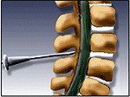
Lumbar Puncture Techniques
Prepared by:
Mohamad Ismail Khalil
Anaesthesia specialist
Almaarefa Colleges
College of Medicine

Slide 2
objectives
To know the indication and contraindication for lumber puncture.
To know the technique of insertion of the lumber puncture.
Too know the complication of lumber puncture.

Slide 3
Difinition
is a diagnostic and/or therapeutic procedure in which a spinal needle is passed into the subarachnoid space and cerebrospinal fluid (CSF) is removed, CSF opening pressure is measured, and/or medications are injected

Slide 4
Indications for Lumber puncture
Diagnostic indications:
  Infective pathology of unknown origin
  Inflammatory pathology.
  Subarachanoid hemorrhage (suspection of spontaneous subarachnoid hemorrhage)
  Malignancy and spread contrast dye into spinal canal
  Pressure recordings
Therapeutic indications:
  CSF drainage treatment of idiopathic intracranial hypertension
  Drug delivery chemotherapy
  infusion of anaesthesia

Slide 5
Contraindications for LP
Absolute Contraindications for LP
1- Patient refusal.
2- Lack of IV access.
3- infection in the tissues near the puncture site.
4- Raised (ICP) intracranial pressure.
5- uncorrected coagulopathy (Platelets < 50,000) or Disorders of coagulation or blood diathesis.
6- acute spinal cord trauma.
7-Suspected intracranial mass lesion or space occupying lesion.
8-Underlying spinal abscess.
9-Imaging evidence of midline shift.Posterior fossa tumour or other suspected 4th ventricular lesion

Slide 6
Relative contraindications
1-Bacteremia.
2-Preexisting neurological disease.
3-Aortic/mitral valve stenosis.
4-Previous spinal surgery.
5-Back problems.
6- psychiatric disease or emotional instability (Uncooperative).

Slide 7
Spinal Meninges
Dura Mater:
  Outer most layer, Fibrous.
Arachnoid Mater:
  Middle layer, Non-vascular
Sub Arachnoid Space:
  Lies between the arachnoid and pia
Pia Mater:
  Inner most layer, Highly vascular

Slide 8
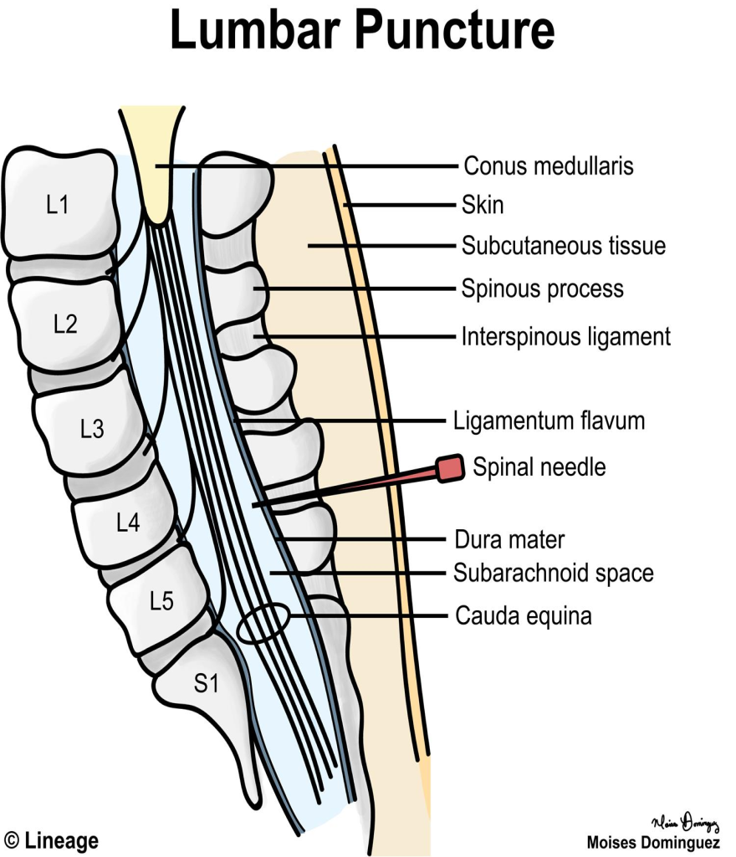
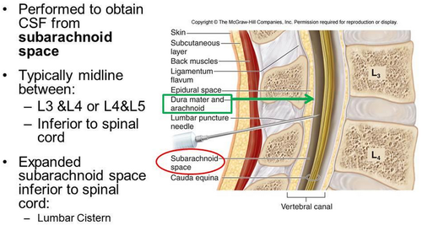

Slide 9
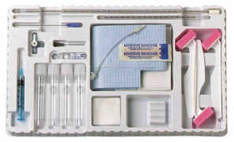
    preparation

Slide 10
LP trays come with:
1- Spinal needle
2- Three-way stopcock
3- Manometer
4- specimen tubes
5-Local anesthesia such as:
    Xylocaine /lidocaine 1%
    6- Betadine: (Povidone-iodine) solution & sponge wand.
    7- Drapes, gauze, and bandages.

Slide 11
Procedure
Explain the procedure in advance and discuss each step to reduce anxiety. and the possible common complication might happen.
Inquire about allergies to anesthetics.
Informed consent.

Slide 12
Steps of LP
Position of the patient:
There are two positions.
The preferred position is lying on their side (left lateral) with the patient's legs flexed at the knee and pulled in towards their chest, and upper thorax curved forward in an almost fetal position.
The second position is the upright or sitting position. Sit the patient on the edge of bed, with their legs resting on a stool or chair, ask them to roll their shoulders and upper back forwards and the chair is positioned to bring the thighs up towards the abdomen.
Notes:
To accurately measure opening pressure, the patient must be in the lateral recumbent position

Slide 13
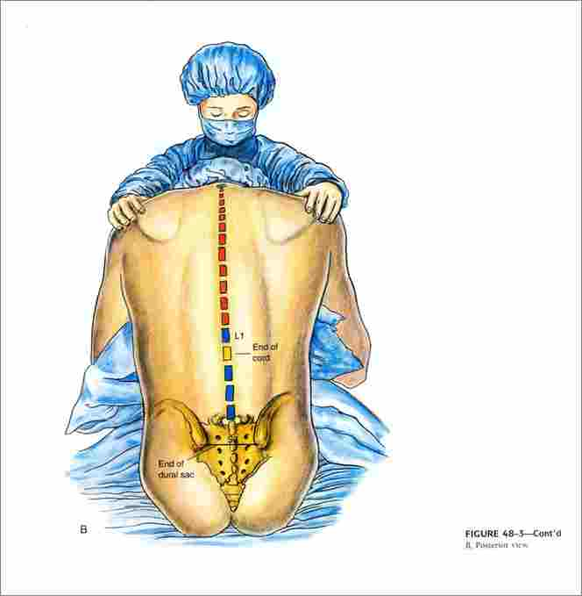
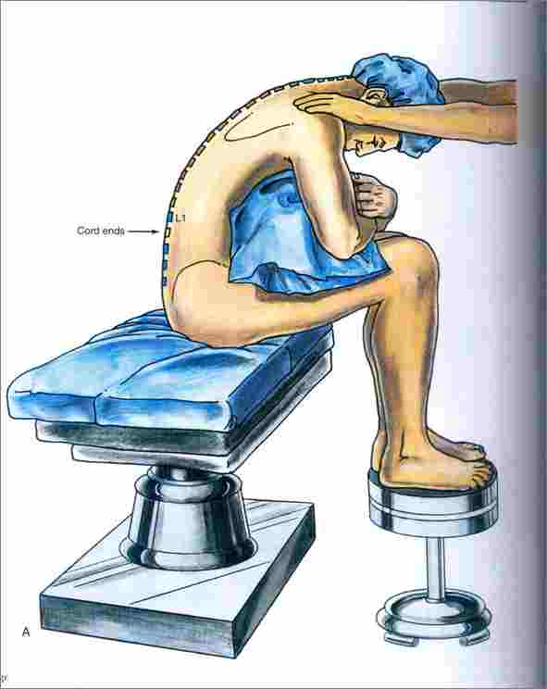

Slide 14
Site of injection
Locating the correct entry point is performed by identifying the surface anatomy of L4. This is done generally by palpating the iliac crests.
An imaginary line between the highest points of the iliac crests usually corresponds to L4 . The interspace of L3/L4 or L4/L5 are used as entry points.
Structures you pass through them When doing LP
  Skin Subcutaneous tissue Supraspinous ligament Interspinous ligament Ligamentum flavum Epidural space Dura mater and Arachnoid mater

Slide 15
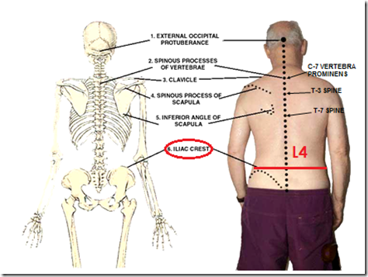

Slide 16
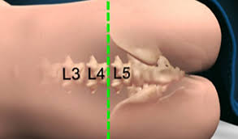
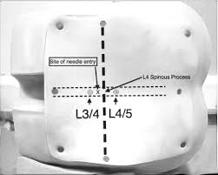

Slide 17
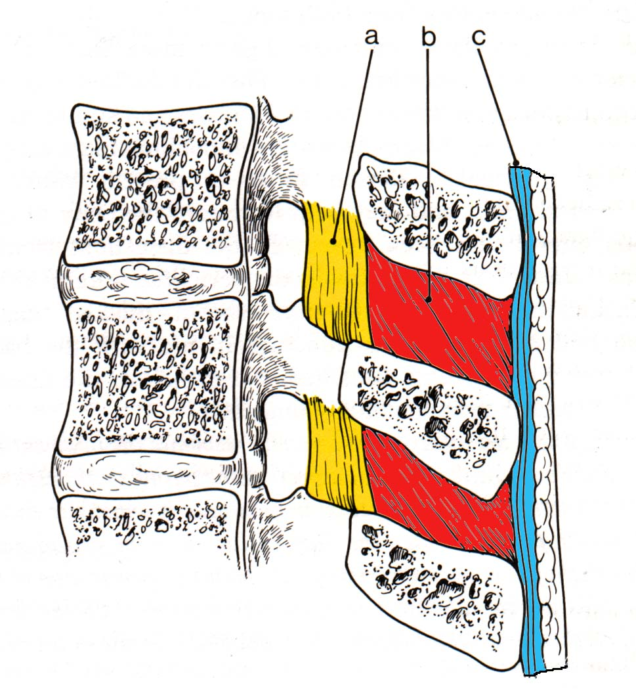
Ligament flavum is a strong, elastic, yellow membrane covering the interlaminar space between the vertebrae.
Interspinal ligaments join the inferior and superior borders of adjacent spinous processes.
Supraspinal ligament connects the spinous processes.

Slide 18
Lumbar Puncture Techniques
Wearing nonsterile gloves.
locate L4 by palpating the right and left posterior superior iliac crests and moving the fingers medially toward the spine.
Palpate the above interspace (L3-L4) and the below interspace (L4-L5) to find the widest space.
Mark the entry space with a thumbnail or marker.
Open the spinal tray.
change to sterile gloves and prepare the equipment.
Open the numbered plastic tubes and place them upright.
Assemble the stopcock on the manometer.
draw the lidocaine into the 10-mL syringe.

Slide 19
Use the skin swabs and antiseptic solution to clean the skin in a circular fashion, starting by the point of L3-L4 interspace and moving outward to include at least 1 interspace above and 1 below.
Place a sterile drape below the patient and a fenestrated drape on the back of the patient.
Use the 10-mL syringe and the 25-gauge needle to administer a local anesthetic.
aspirate to confirm that the needle is not in a blood vessel, and then inject a small amount as the needle is withdrawn a few centimeters.
Continue this process above, below, and to the sides very slightly (using the same puncture site).
This process anesthetizes the entire area if redirection of the spinal needle is necessary, the area will still be anesthetized

Slide 20
stabilize the spinal needle with the index fingers and advance it through the skin using the thumbs.
in the lateral recumbent position the bevel should face up, and in the sitting position, it should face to one side or the other.
Insert the needle at a slightly cephalad angle, directing it toward the umbilicus.
Advance the needle slowly. and smoothly occasionally when a characteristic “pop” is felt. And that means the needle penetrates the dura.
withdrawn the stylet after approximately 4-5 cm and observe the CSF.

Slide 21
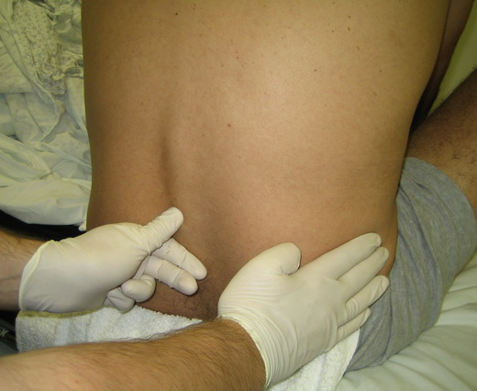

Slide 22
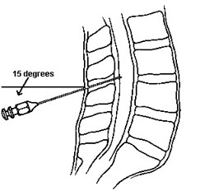

Slide 23
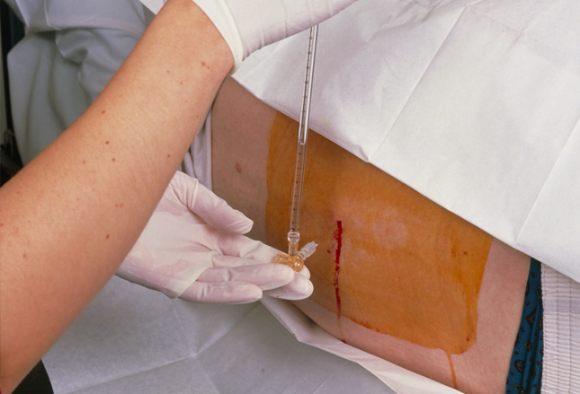
If no CSF , replace the stylet and advance or withdraw the needle a few millimeters, and recheck for CSF.
Continue this process until CSF is successfully returned.
For measurement of the opening pressure, after the CSF is returned from the needle, attach the manometer through the stopcock, and note the height of the fluid column.

Slide 24
Collect at least 1ml of CSF in each tube, starting with tube 1.
If possible the CSF in the manometer should be used for tube no 1.
If the CSF flow is too slow, ask the patient to cough or bear down to increase the flow.
Replace the stylet, and remove needle in one quick motion.
Cleanse the back of the Pt and cover puncture site and place
the pt. in supine position.
Collect 1ml of CSF in each tube for:
  Tube 1: culture & gram stain
  Tube 2: glucose, protein
  Tube 3: cell count & differential
  and extra CSF if desired for other lab test

Slide 25
Complications
1- Headache (most common)
2- Epidural or subarachnoid hematoma
3- Spinal cord trauma
4- Infection
5- Back pain (most common)
6- Hypotension, bradycardia.
Notes:
How to minimize the headache?
1-choice of needle standerd Quinck versus atraumatic .
2- decrease the number of attempts.
3-reinsersion of the stylet.
4- bed rest after the procedure.

Slide 26



