Slide 1
Urethral Catheterization

Slide 2
objectives
To know the definition and indication of urinary catheter insertion.
To know what is the types of urinary catheters.
To know the technique of insertion.
To know how to maintain insertion.
To know when to remove the urinary catheter.
To know what is the foly s care bundle

Slide 3
Definition of urinary catheterization
A urinary catheter is a tube that is inserted into the bladder through the urethra to allow the urine in the bladder to drain out

Slide 4
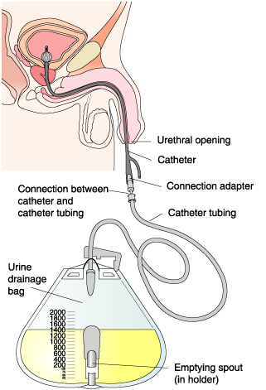
Indication of Urinary Catheter insertion
A urinary catheter is used in many different situations:
  A urinary catheter may be inserted to drain the bladder before or during a surgical procedure, during recovery from a serious illness or injury, or to collect urine for testing
  A urinary catheter may be used for a person who is incontinent of urine, if the person has wounds or pressure ulcers that would be made worse by contact with urine
  A urinary catheter is necessary when a person is unable to urinate because of an obstruction in the urethra

Slide 5
Types of catheters
  A condom catheter, consists of a soft plastic or rubber sheath, tubing, and a collection bag for the urine. The sheath is placed over the penis and the collection bag is attached to the leg. Collects urine when there is no need for catheter insertion.
  A straight catheter, is used when the catheter is to be inserted and removed immediately.
  An indwelling catheter, also known as Foley catheter, is left inside the bladder to provide continuous urine drainage.

Slide 6
  A suprapubic catheter is a type of indwelling catheter. The suprapubic catheter is inserted into the bladder through a surgical incision made in the abdominal wall, right above the pubic bone.
  A 3-way catheter for continuous bladder irrigation (CBI) is a type of indwelling catheter. It is inserted to irrigate the bladder to prevent obstruction (i.e bleeding)
  Coude catheter, it’s semirigid with curved tip, used in men with prostatic enlargement

Slide 7
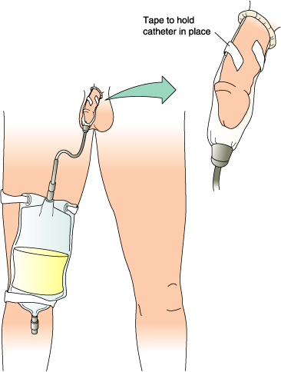
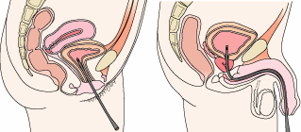
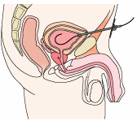
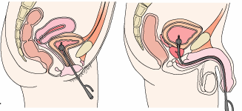
Catheters
Straight
Condom
Suprapubic
Indwelling

Slide 8
Technique of catheter insertion
Equipment: (check packages and expiry dates)
  Catheter tray (with drapes, fenestrated drape, cotton balls, forceps)
  Catheter (14-16 Fr (for women) 12 Fr for young girls
  (16-18 Fr (for men)
  Sterile drainage tubing with collection bag
  Correct size syringe (check catheter balloon)
  Sterile water
  Cleansing solution
  Lubricant
  Sterile gloves
  Specimen container
  Tape to anchor tubing
  Gloves
  Bath blanket

Slide 9
Assess
Review physician’s order and understand purpose of inserting catheter
Assess client (last urination, level of awareness, understanding)
Palpate bladder
Identify meatus and assess skin integrity
Identify potential difficulties (i.e enlarged prostate)

Slide 10
Implement
Wash hands thoroughly before and after insertion
Provide privacy
Raise bed, stand on left side of bed if right handed (right side if left handed)
Arrange equipment
Water proof pad under client
Position & drape client
Use smallest catheter possible to help prevent trauma

Slide 11
Female: dorsal recumbent (supine with knees flexed) or Frog-leg position (hips externally rotated slightly flexed, and knees bent) or lithotomy position.
Male: supine position
With disposable gloves, wash perineal areas
Wash hands
Open tubing with collection bag (attach to bed frame and
have tubing positioned to easily connect to catheter once inserted
organize sterile field – add catheter, lubricant, syringe and sterile water, test balloon, pour cleaning solution over cotton balls
Apply sterile gloves

Slide 12
Lubricate catheter (2.5 to 5 cm for women) and 12.5 to 17.5 cm for men)
*Note: there may be an order for lubricant containing local anaesthetic*
Apply sterile drapes keep gloves sterile
women: under buttocks and fenestrated over perineum
men: over thighs and fenestrated over penis

Slide 13
Place sterile tray and contents between legs
Cleanse meatus:
Women: with nondominant hand, expose meatus, maintain
Position of hand, cleanse with forceps, wipe from front to back,
new cotton ball each swipe, far labial fold, near, and directly
over meatus
Men: retract foreskin, hold penis below glans, maintain position
of hand, with forceps clean in a circular motion from meatus
down to base of glans, repeat three more times

Slide 14
Hold end of catheter loosely coiled in dominant hand, place end of catheter in tray
Insert catheter:
Women:
insert 5 to 7.5 cm until urine flows, then
advance another 2.5 to 5 cm
Men: hold penis perpendicular, catheter to the hilt (bifurcation)

Slide 15
Collect specimen if indicated
Allow bladder to empty unless policy restricts
Inflate balloon with amount indicated
If client complains of pain, aspirate solution and advance catheter further and inflate
Gently pull to feel resistance
Attach catheter to collection bag and attach to bed frame below bladder
Anchor catheter (thigh if appropriate and coil tubing on bed and attach to mattress)

Slide 16
Evaluate
Palpate bladder
Assess comfort
Characteristics and amount of urine

Slide 17
CATHETER MAINTENANCE
Assess need for Foley daily
Daily AM Care: Cleanse around catheter and meatus with soap and water daily and Limiting manipulation of the catheter reduces infection.
Secure the catheter with a leg band: Leg bands help keep the catheter in place and decrease pulling and twisting.
Avoid bladder irrigation unless obstruction has occurred.
Keep Drainage Bag BELOW the Bladder: This prevents reflux back into the bladder, which can increase infection

Slide 18
6.Keep Drainage bag OFF the Floor: To avoid contaminating the spout.
7.Use individual graduated container for EACH Patient/label with name
8.EMPTY the drainage bag before transport to avoid reflux
9.Maintain a Closed System:
  -Take urine samples through the port
  -Always scrub the hub first before taking a sample

Slide 19
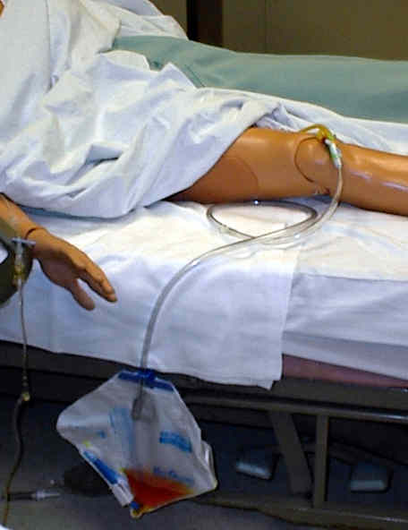
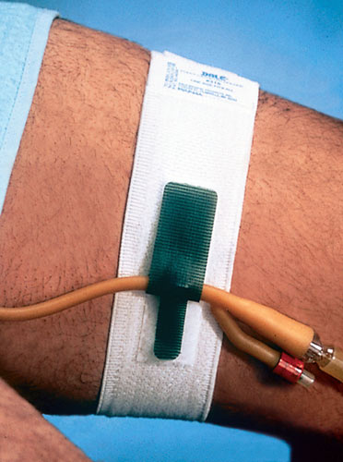

Slide 20
REVIEW AND REMOVE
“The duration of catheterization is the most important risk factor for development of infection.”
The necessity of a bladder catheter should be addressed by physicians daily as a part of rounds, and by nursing as part of their assessment.
Changing the catheter
Indwelling catheters as a rule should not be replaced routinely; they should not be changed if flow appears.
Changing an indwelling catheter at routine, fixed intervals is not recommended, and there is insufficient evidence to make a recommendation on long-term catheters ,However, catheters with mechanical problems (poor drainage, encrusted) need to be replaced.

Slide 21
Criteria for Removal
The patient is awake, alert and oriented and/or can verbally express that they had no trouble voiding before the catheter was placed.
Patient is able to resume their normal voiding position, or at least one that is presently comfortable.
If a Foley is present post invasive cardiac or radiological procedure, confer with physician to remove Foley unless there is a clear reason for not discontinuing the Foley.
Epidural catheter is removed.

Slide 22
Caring for a Person with an Indwelling Urinary Catheter
Indwelling urinary catheters are connected by a length of tubing to a urine drainage bag
The tubing is secured loosely to the person’s body near the insertion site using a catheter strap or adhesive tape
Securing the tubing to the person’s body prevents the catheter from being accidentally pulled out during repositioning

Slide 23
Providing Catheter Care
Providing good catheter care is important because the presence of the catheter in the urethra provides a pathway for bacteria to travel up from the perineum into the bladder
Having a catheter eliminates the “flushing” action of normal urination, which helps to remove bacteria from the urinary tract naturally.

Slide 24
Providing Catheter Care
Bacteria can be introduced into the body both when a catheter is inserted and after it is in place, urinary tract infections (UTIs) in catheterized people are one of the most common nosocomial infections.

Slide 25
Contraindications:
Known or suspected urethral injury in case of pelvic fracture (absolute)
Signs to suspect urethral injury (blood at meatus , gross hematuria ,perineal hematoma ,high riding prostate gland)
Urethral stricture, recent urethral or bladder surgery (relative)
Combative or uncooperative patient (relative)
Complications:
Urinary tract infection (UTI)
Trauma to urethra & bladder
Paraphimosis
Undesirable catheter retention

Slide 26
Thank you

