Slide 1
Endotracheal Intubation
Edited by Dr Shaher Abbarah

Slide 2
Definition:
Endotracheal tube is:
A flexible hollow tube designed to enter the trachea via the oropharynx or the nasopharynx, facilitate gas exchange, and protect the airway from aspiration
Definitive Airway is:
A tube placed in the trachea with cuff inflated below the vocal cord.

Slide 3
Advantages of Intubation
A cuffed endotracheal tube protects the airway from aspiration
Access is gained to the tracheobronchial tree for the suctioning of secretions
Ventilations via an endotracheal tube do not cause gastric distention
Maintains a patent’s airway and assists in avoiding further obstruction (like in burns)
Enables delivery of certain medications

Slide 4
Indications
For supporting ventilation in patient with :-
    Upper airway obstruction
    Respiratory failure
    Loss of conciousness
For supporting ventilation during general anesthesia.
Patients at risk of pulmonary aspiration
    Massive hemoptysis
    Uncontrollable vomiting
Difficult mask ventilation
Anticipated airway obstruction (inhalation Burns).
Cardiac arrest

Slide 5
Contraindications
Laryngeal disruption / fracture
DNAR (Do Not Attempt Resuscitation)

Slide 6
Condition that associated with difficult intubation
Congenital anomalies → Down’s syndrome
Infection in airway → Retropharyngeal abscess, Epiglottitis
Tumor in oral cavity or larynx
      Enlarge thyroid gland → trachea shift to lateral or compressed tracheal lumen
Maxillofacial ,cervical or laryngeal trauma
Temperomandibular joint dysfunction
Burn scar at face and neck
Morbid obesity

Slide 7
Air way assessment
1. Mallampati classification
This test is performed with the patient in the sitting position, head in a neutral position, the mouth wide open and the tongue protruding to its maximum
  Class I: Visualization of the soft palate, uvula, anterior and the posterior pillars.
  Class II: Visualization of the soft palate and uvula.
  Class III: Visualization of soft palate and base of uvula.
  Class IV: Only hard palate is visible. Soft palate is not visible at all.

Slide 8
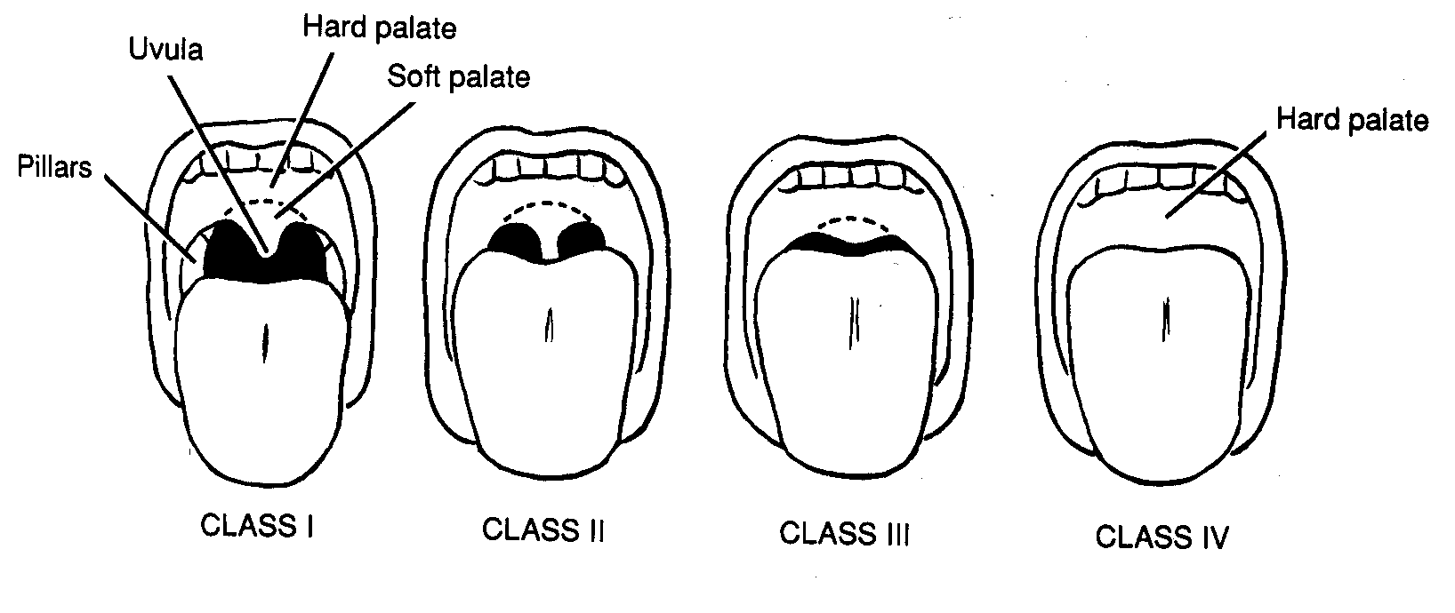
Class III, IV difficult to intubate
Soft palate
Uvula

Slide 9
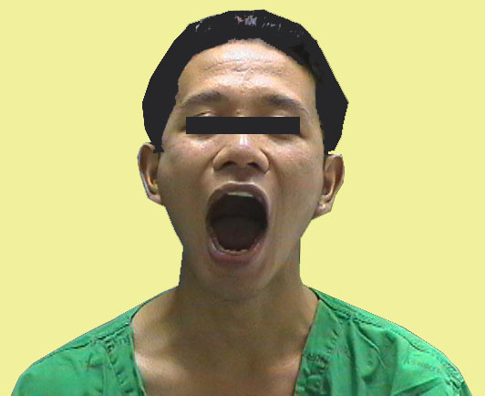
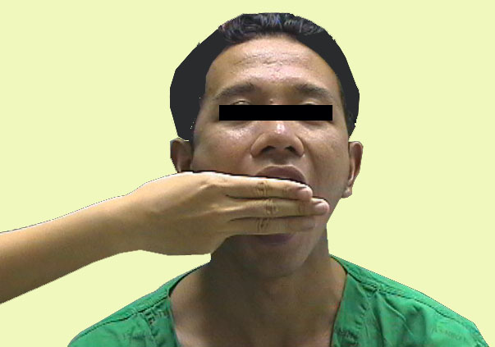
2. Interincisor gab:
Normal >4.5 cm (3 fingers)

Slide 10
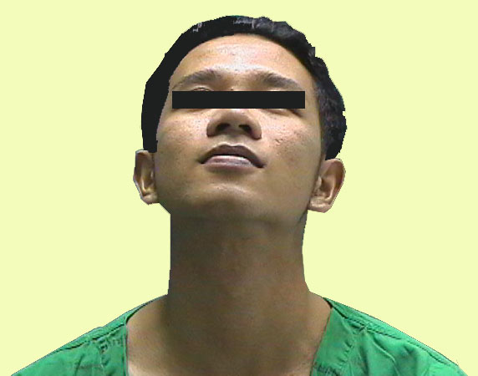
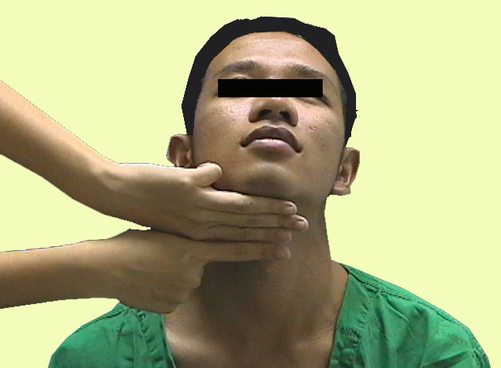
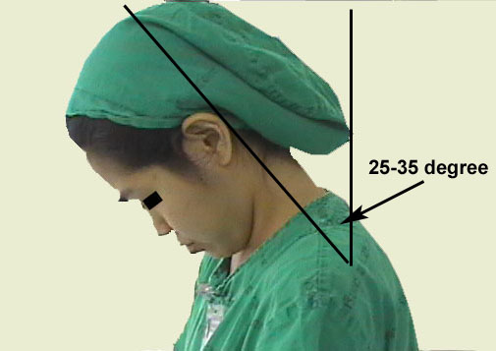
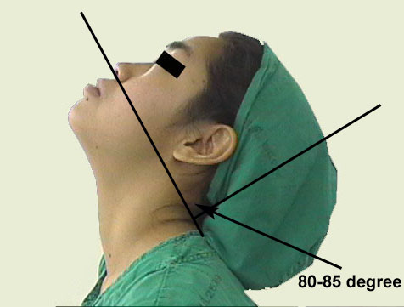
3) Thyromental distance (TMD) :
Lower border of mandible
Full head extension
Thyroid cartilage prominence
4) Flexion and extension of neck

Slide 11
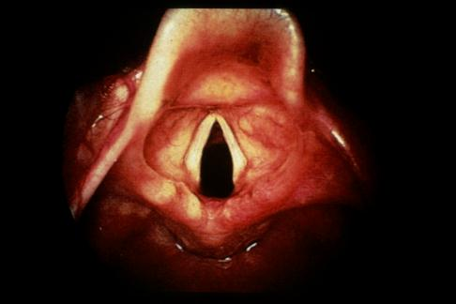
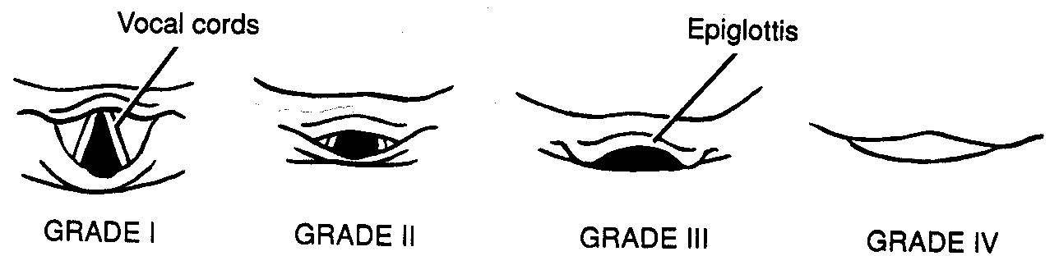
5. Laryngoscopic view
Grade 3,4 → risk for difficult intubation!

Slide 12
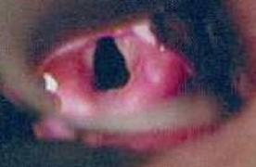
Laryngoscope view of the vocal cords

Slide 13
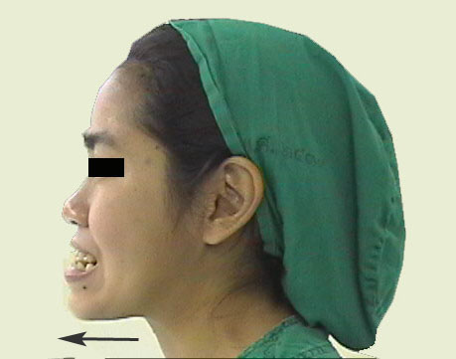
6) Movement of temperomandibular joint (TMJ)
Grinding

Slide 14
Preparing the procedure...
Essentials that must be present to ensure a safe intubation!..
They can be remembered by the mnemonic SALT
Suction. This is extremely important. Often patients will have secretions in the pharynx, making visualization of the vocal cords difficult.
Airway. the oral airway is a device that lifts the tongue off the posterior pharynx, often making it easier to mask ventilate a patient. Also a source of O2 with a delivery mechanism (ambu-bag and mask) must be available.
Laryngoscope. This is vital to placing an endotracheal tube.
Tube. Endotracheal tubes come in many sizes. In the average women adult, a size 7.0 or 8.0 endotracheal tube and 7.5 to 8.5 mm in men

Slide 15
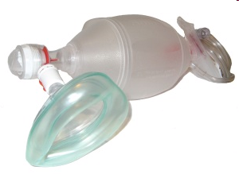
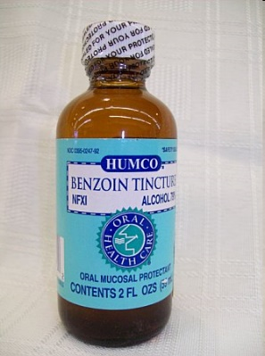
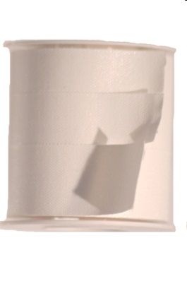
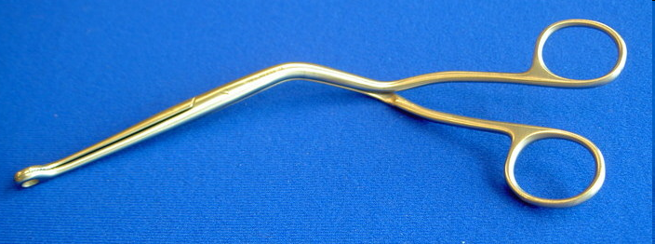
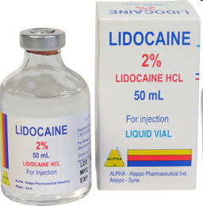
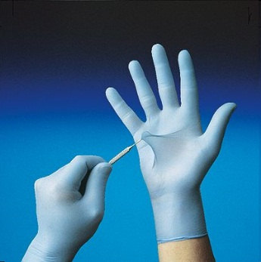
Instruments used...
Self-refilling bag-valve combination (eg, Ambu bag), tubing, and oxygen source.
Plaster or tube holder .
Introducer (stylets or Magill forceps).
Laryngoscope
Suction apparatus
Syringe, 10-mL, to inflate the cuff.
Mucosal anesthetics (eg, 2% lidocaine)
Water-soluble sterile lubricant.
Gloves.
Pulse oximeter
Stethoscope
Magill forceps

Slide 16
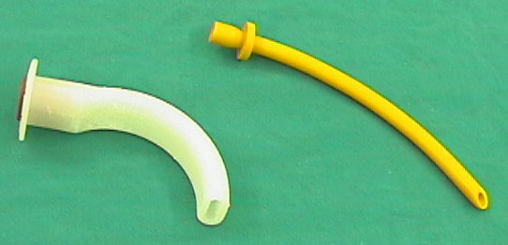
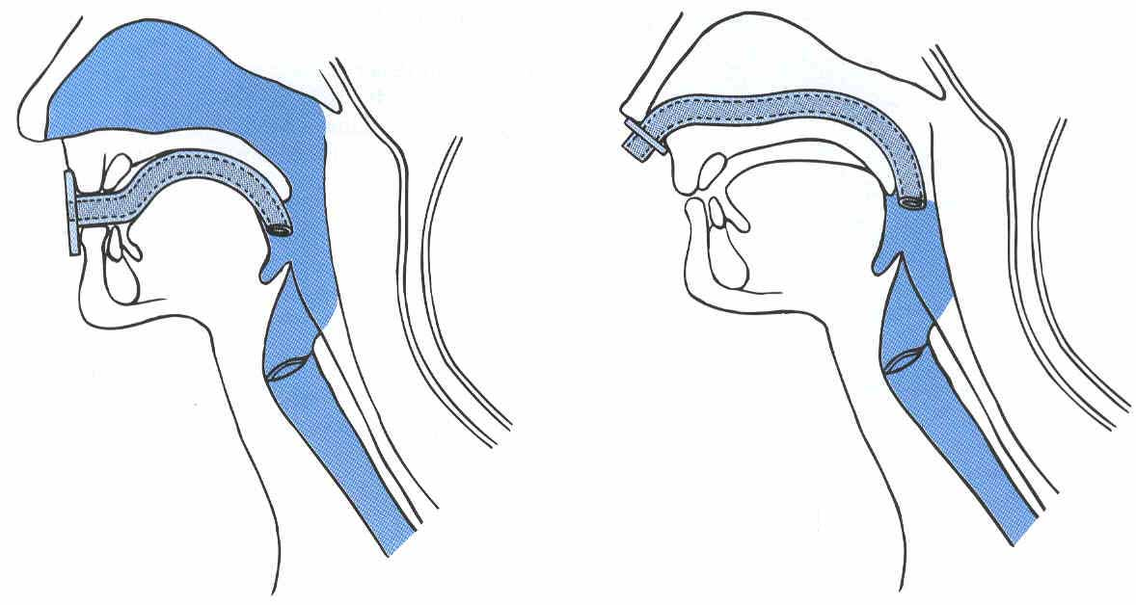
Oropharyngeal or nasopharyngeal airway
Oral airway Nasal airway

Slide 17
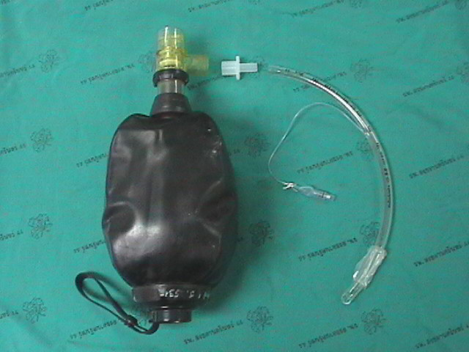

Slide 18
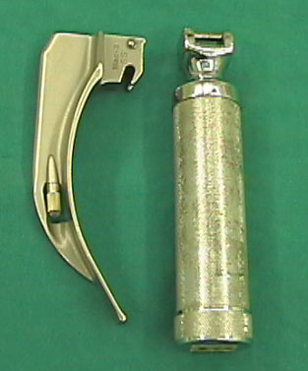
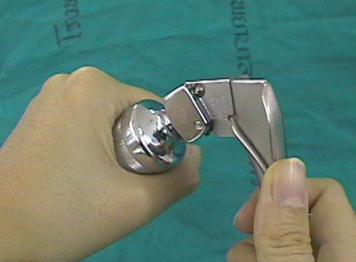
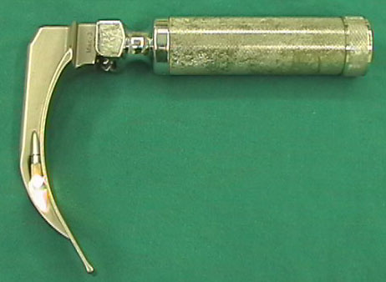
Laryngoscope : handle and blade

Slide 19
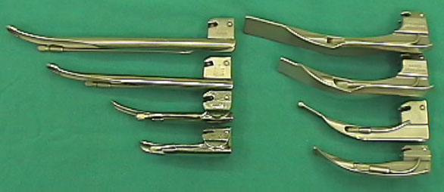
LARYNGOSCOPIC BLADE
Macintosh (curved) and Miller (straight) blade
Adult : Macintosh blade (No 3 and No 4),
Children : Miller blade (No 2 and No 3)
Miller blade
Macintosh blade

Slide 20
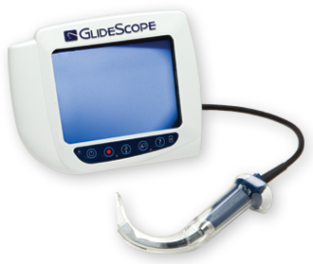
Video Laryngoscopy (Glidescope)

Slide 21
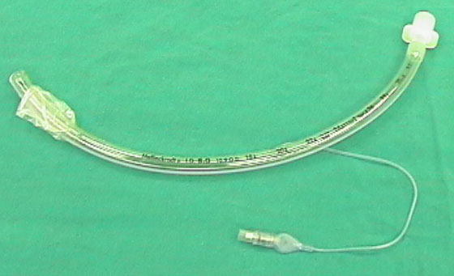
2) Endotracheal tube

Slide 22
Endotracheal tube
Size of endotracheal tube : internal diameter (ID)
Male: ID 8.0 mms . Female : ID 7.5 mms
New born - 3 months : ID 3.0 mms
3-9 months : ID 3.5 mms
9-18 months : ID 4.0 mms
2- 6 yrs : ID = (Age/3) + 3.5
> 6 yrs : ID = (Age/4) + 4.5
Notes:
Other formula to calculate tube size in children:
18 + age (year)/4

Slide 23
Depth of endotracheal tube : Midtrachea or below vocal cord ~ 3-4 cms ,
Adult: Male = 23 cms ,Female = 21 cms
Children: endotracheal tube = (Age/2) + 12 (cm)
The goal is to place the tip of the ETT 2 to 4 cm from the carina (to avoid endobronchial intubation) and the proximal edge of the cuff at least 3 cm below the vocal cords (to avoid vocal cord damage and inadvertent extubaion).

Slide 24
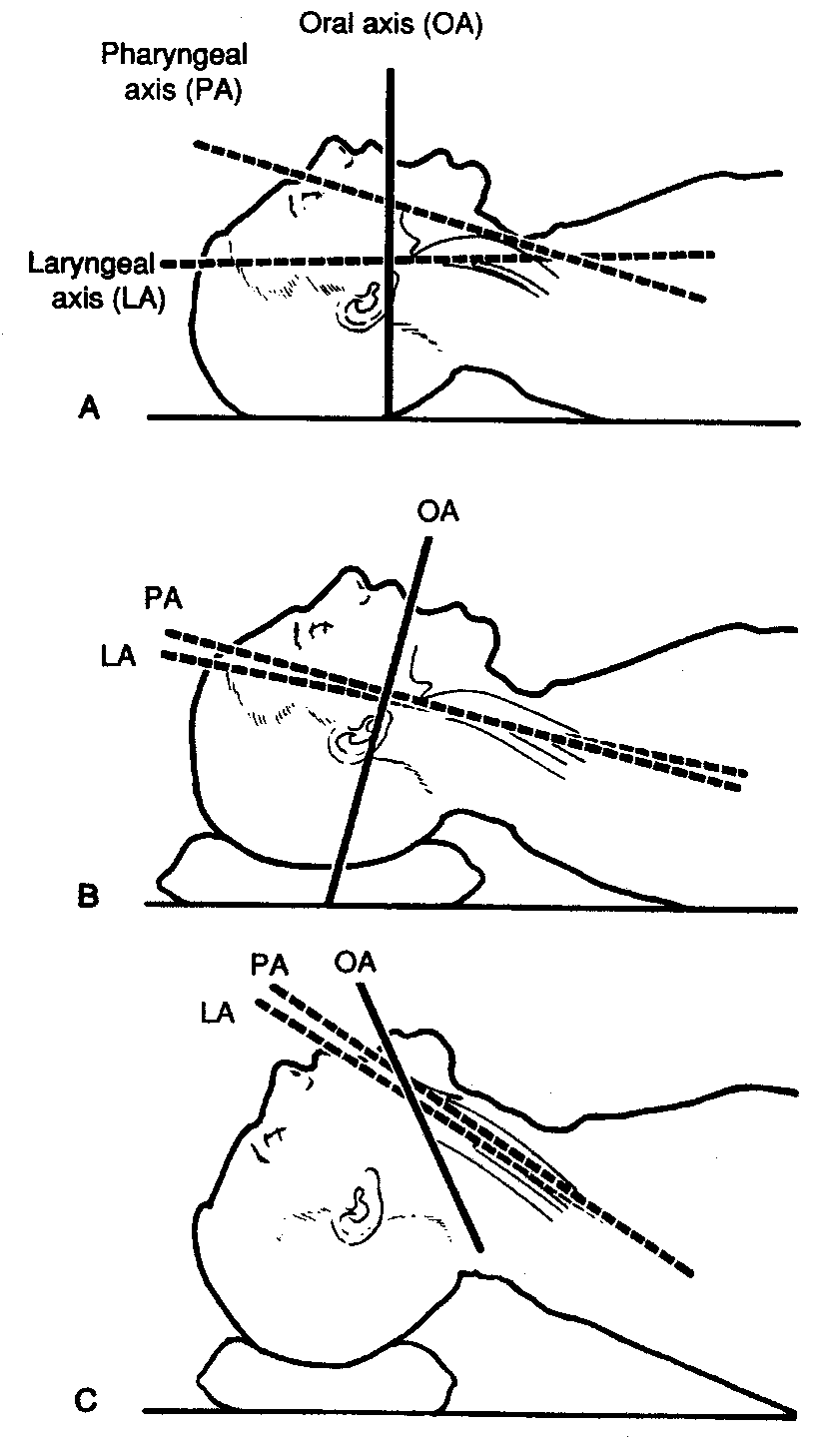
Tecnique:
Sniffing position
Flexion at lower cervical spine
Extension at atlanto-occipital joint

Slide 25
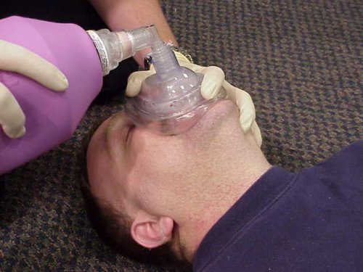
Tecnique
Make sure that all materials are assembled and close at hand
Make sure that the balloon inflates
Check the laryngoscope and blade for proper fit, and make sure that the light works
Anesthetize the mucosa of the oropharynx, and upper airway with lidocaine 2%, if time permits and the patient is awake.
Hyperventilate the patient with 100% oxygen for 1 minute prior to intubation attempt
Place the patient in the sniffing position.

Slide 26
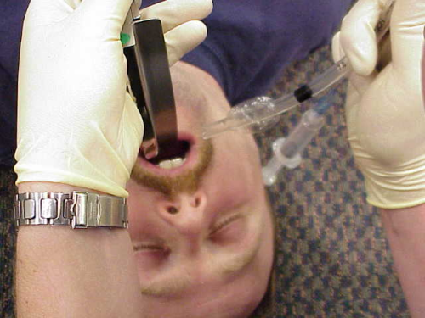
Open the patient's mouth with the right hand,.
Grasp the laryngoscope in the left hand
Spread the patient's lips, and insert the blade between the teeth, being careful not to break a tooth.
Pass the blade to the right of the tongue, and advance the blade into the hypopharynx, pushing the tongue to the left.
Lift the laryngoscope upward and forward, without changing the angle of the blade, to expose the vocal cords.

Slide 27
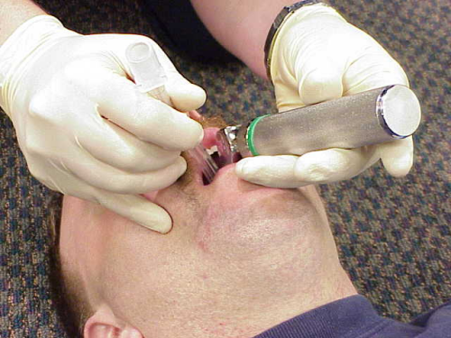
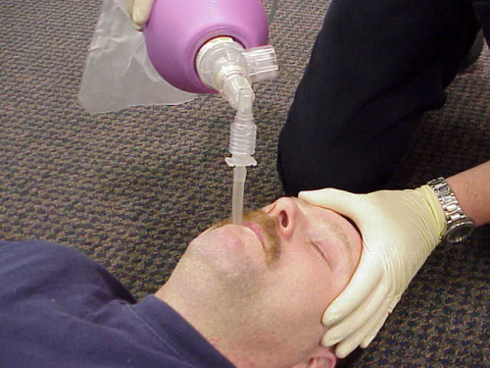
Take the endotracheal tube in the right hand and starts inserting it through the mouth opening.
The tube is inserted through the cords to the point that the cuff rests just below the cords (between 21-23 mark on the tube)
Holding the tube firmly in place, quickly remove the laryngoscope
Remove the stylet from the endotracheal tube (if used)
Finally, the cuff is inflated with 5-10 ml of air
Ventilate the patient
Observing the chest rise and fall with each ventilation

Slide 28
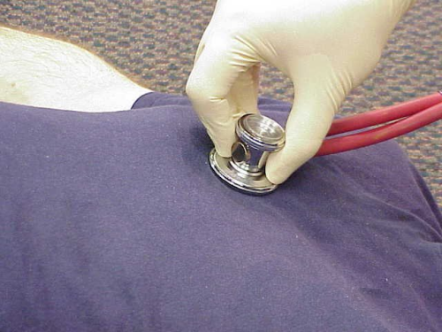
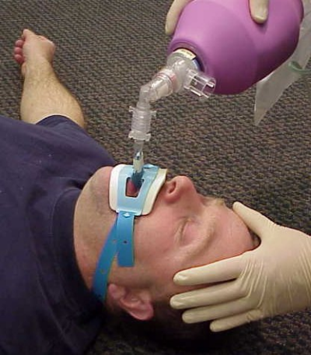
Listens for breathing sounds to ensure correct placement of the tube (in stomach and chest)
If no breath sounds and there is bubble sound in stomach (it is in stomach) remove the tube and ventilate the patient and start all over again
If the tube is advanced too far, it will get into the right bronchus and only the right lung is ventilated. If this occurs deflate the cuff with draw 2-3 cm and re-inflate the cuff and listen again
Attach the tube to the patient and to the ventilating apparatus

Slide 29
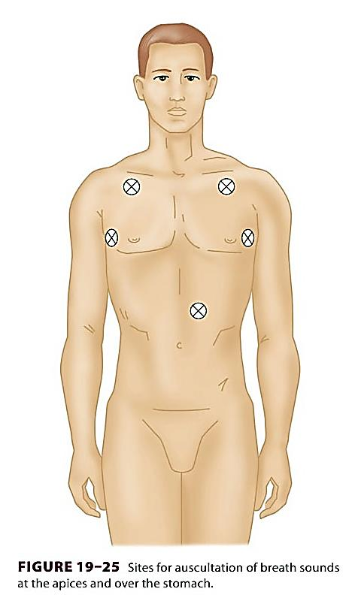
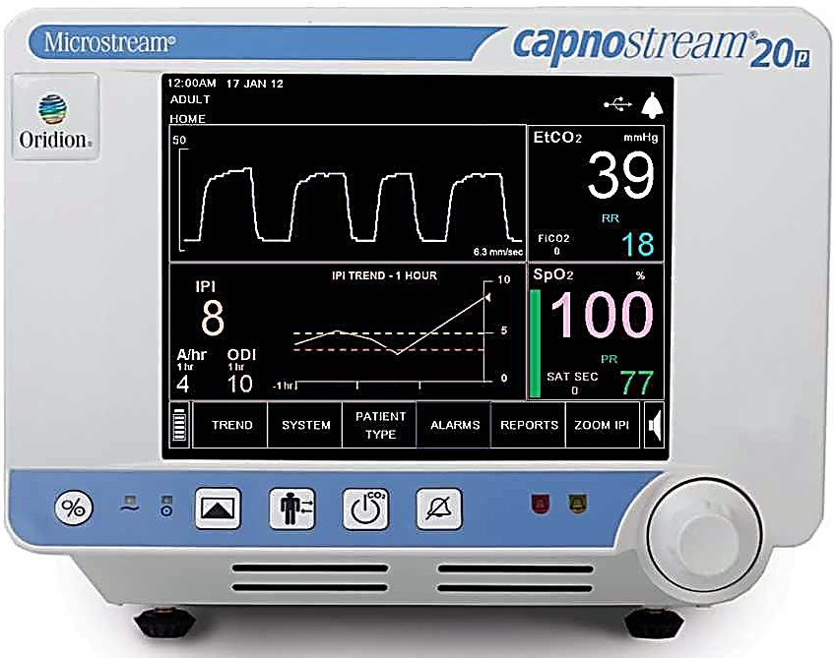

Confirmation of Tube Placement
End Tidal Carbon Dioxide Monitor

Slide 30
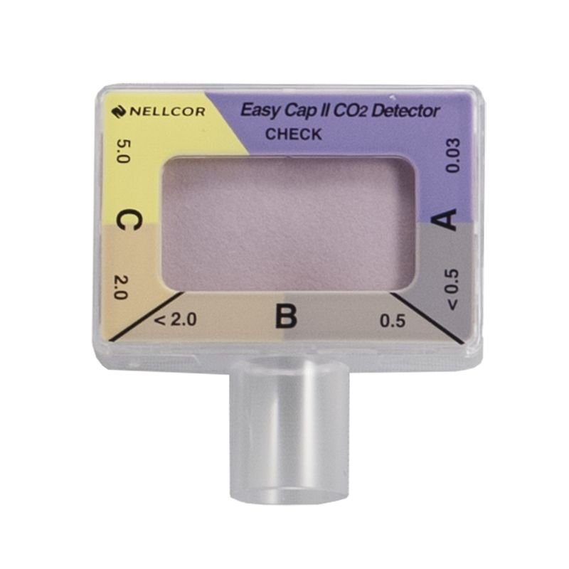
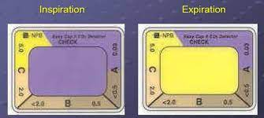
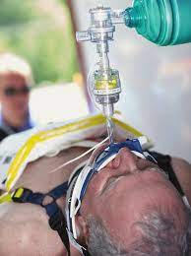
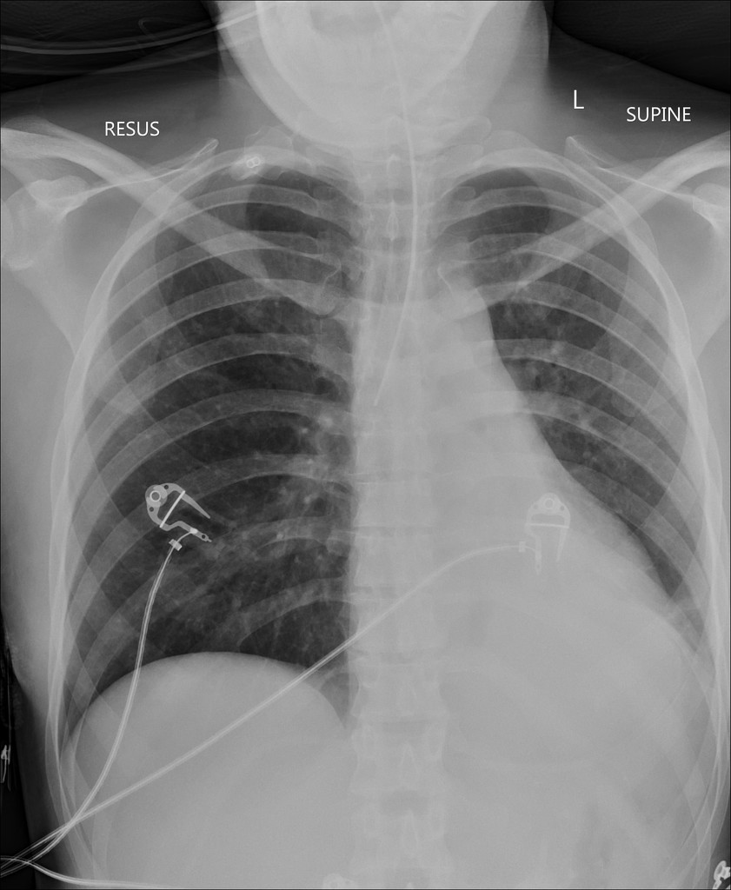
end tidal co2 detector
x-ray confirming endotracheal tube

Slide 31
Confirmation:
Direct visualization of endotracheal tube
Auscultation: breath sounds audible over both lung fields
Condensation: consistently visible in the tube during exhalation
CO2 detection: gold standard of successful endotracheal intubation
Imaging
CXR: The distal tip of the endotracheal or tracheal tube should be 2–6 cm above the carina
Trained practitioners only: Ultrasound may be used to confirm tube position.

Slide 32
Complication of endotracheal intubation
1) During intubation
2) During remained intubation
3) During extubation
4) After extubation

Slide 33
1) During intubation
Trauma to lip, tongue or teeth
Hypertension and tachycardia or arrhythmia
Pulmonary aspiration
Laryngospasm
Bronchospasm
Laryngeal edema
Increased intracranial pressure
Spinal cord trauma in cervical spine injury
Esophageal intubation

Slide 34
2) During remained intubation
Obstruction from secretion or overinflation of cuff
Accidental extubation or endobronchial intubation
Disconnection from breathing circuit
Lip or nasal ulcer in case with prolong period of intubation

Slide 35
3) During Extubation
Laryngospasm
Pulmonary aspiration
Edema of upper airway
Failed extubation

Slide 36
4) After Extubation
Sore throat
Hoarseness
Tracheal stenosis (Prolong intubation)
Laryngeal granuloma

Slide 37
Source:
AMBOSS
UpToDate
Essential Clinical Procedures 2nd edition

