Slide 1
Arterial Access
ABG

Slide 2
DEFINATION of (ABG)
An arterial blood gas (ABG) is a blood test that is performed by taking blood from an artery, rather than a vein.
It is performed in purpose of analyzing gas exchange process (so that an accurate measurement of oxygen and carbon dioxide levels can be obtained), as well acid-base balance. which then allowing administering patient medication properly.

Slide 3
An ABG is a test that measures the arterial oxygen tension (PaO₂), carbon dioxide tension (PaCO₂), and acidity (pH). In addition, arterial oxyhemoglobin saturation (SaO₂) can be determined.
Such information is vital when caring for patients with critical illness or respiratory disease. As a result, the ABG is one of the most common tests performed on patients in intensive care units (ICUs).
Pulse oximetry plus transcutaneous carbon dioxide measurement is an alternative method of obtaining similar information as well.

Slide 4
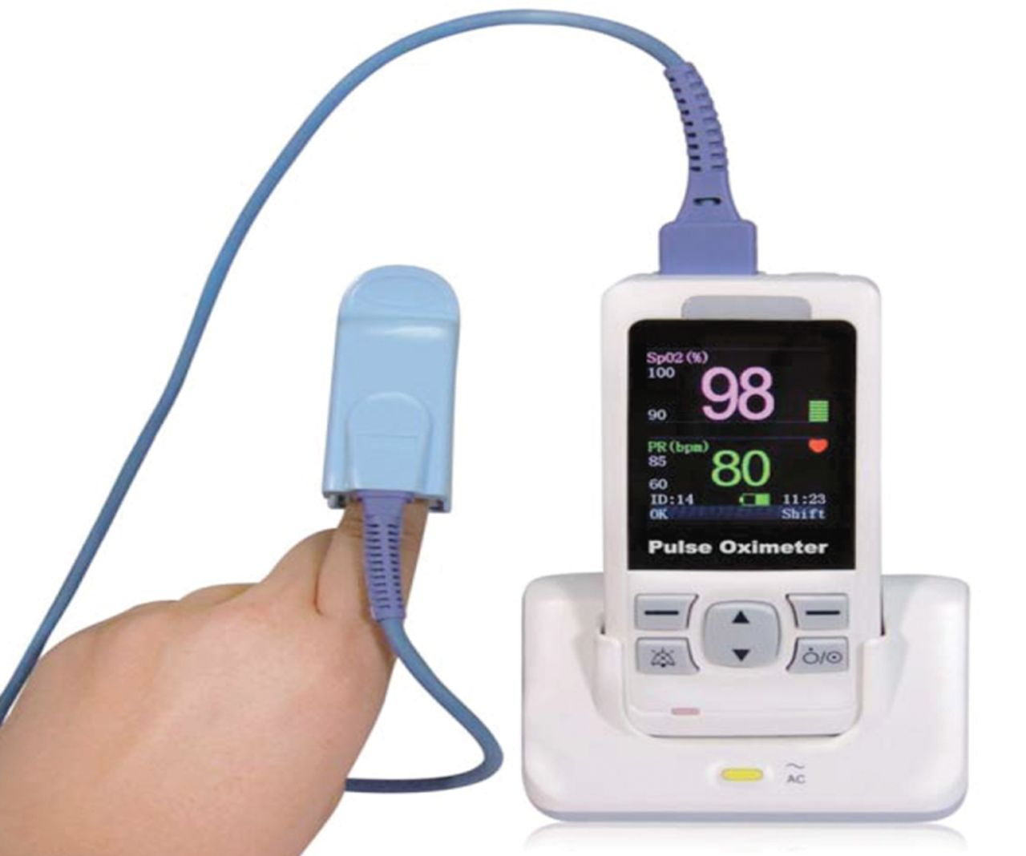
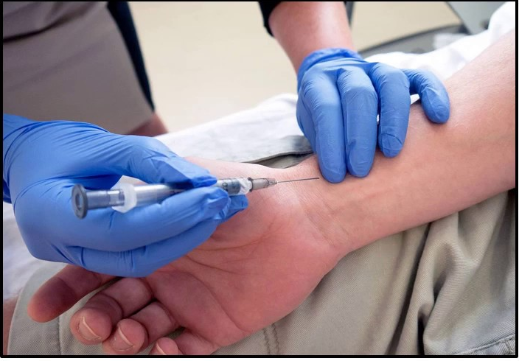
Pulse oximetry
ABG sample

Slide 5
Indications of arterial access:
Patients with respiratory disease ,ABG sampling will provide information about lung ventilation through interpretation of the PCO₂ and tissue oxygenation through interpretation of the PO₂.
Patients with certain metabolic diseases and selected drug overdoses are at risk for acid-base abnormalities. Acid base problems are diagnosed through interpretation of arterial pH, PCO₂ and HCO₃ levels.
Invasive Blood pressure monitoring

Slide 6
Contraindications:
Inadequate collateral circulation at the puncture sites.
Should not be performed through a lesion (Full thickness Burns)
Evidence of a peripheral vascular disease distant to the puncture site. (Beurger disease)
A coagulopathy or medium to high dose anti-coagulation therapy. (relative contraindication)

Slide 7
Complications:
Hematoma at the site of puncture is the most common complication .
Thrombus in the artery .
Infection at the site.
Pseudoaneurysm
AV fistula

Slide 8
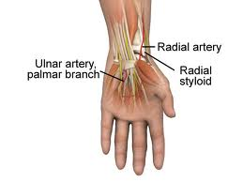
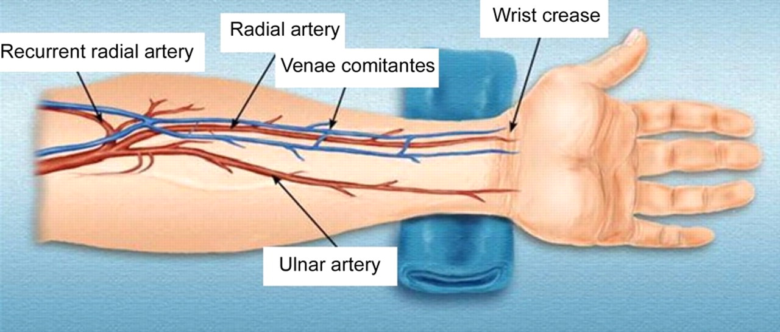
Arterial puncture sites
The wrist (RADIAL ARTERY )is the most common site used.

Slide 9
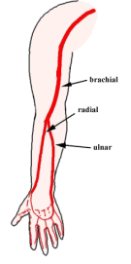
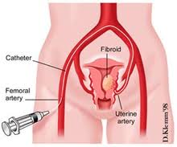
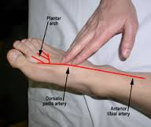
Alternative sites include:
Brachial artery at the antecubital fossa .
Femoral artery just below the inguinal ligament .
Dorsalis pedis artery in the foot .

Slide 10
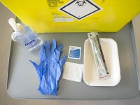
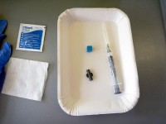
PROCEDURE OF ABG
Gather the necessary following equipment:
a blue (22-23 G) needle
2ml syringe with heparin
a cap for the syringe
a plastic bung
local anaesthetic (plus needle and syringe for giving)
alcohol gel
gauze
gloves
a sharps bin
Usually, the syringe, needle, cap and bung are all provided in one pack.
Equipment required for measuring arterial blood gases
ABG kit contents

Slide 11
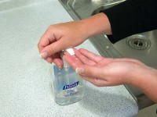
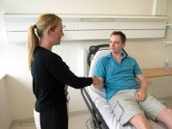
Wash your hands.
introduce yourself to the patient and clarify their identity. Explain what you would like to do and obtain consent. This is a slightly uncomfortable procedure so you should let the patient know this.

Slide 12
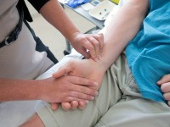
Locate the radial artery with your index and middle fingers.

Slide 13
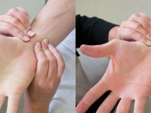
Perform Allen’s test where you compress both the radial and ulnar arteries at the same time.
The hand should become white, release the ulnar artery and the color should return to the hand.
This ensures that there will still be a blood supply to the hand if the ABG cause a blockage in the radial artery.

Slide 14
Put on your gloves and attach the needle to the heparinized syringe.
Also prepare your local anesthetic and give a small amount over the palpable radial artery.

Slide 15
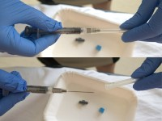
Take the cap off the needle.
Flush the heparin through the syringe and again locate the radial artery using your non-dominant hand.
Remove the cap from the needle
Notes:
Take a little amount of heparin in the syringe to lubricate the inner wall of the syringe, then flush out the heparin completely

Slide 16
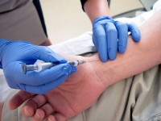
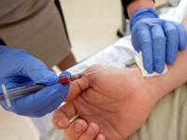
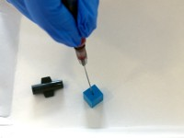
Insert the needle at 30-45 degrees to the skin at the point of maximum pulsation of the radial artery.
Advance the needle until arterial blood flushes into the syringe. The arterial pressure will cause the blood to fill the syringe.
Remove the needle/syringe placing the needle into the bung.
Press firmly over the puncture site with the gauze to halt the bleeding.
Remain pressed for 5 minutes.
Prepare to insert the needle
Remove the needle
Place the needle into the bung

Slide 17
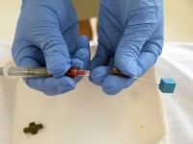
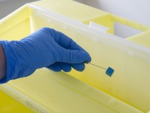
Remove the needle and discard safely in the sharps bin.
Remove the needle from the syringe
Safely discard the needle into the sharps bin

Slide 18
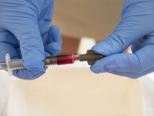
Cap the syringe.
Push out any air within it.
Send immediately for analysis ensuring that the sample is packed in ice.
Remove your gloves and dispose them in the clinical waste bin.
Wash your hands and thank the patient.
Cap the syringe

Slide 19
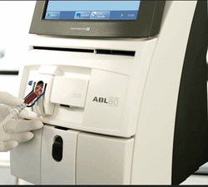
Blood Gas Analyzer

Slide 20
Venous or arterial blood?
Dark, non-pulsatile blood that requires manual suction to aspirate often indicates a venous sample(except in severe shock /cardiac arrest).
Another clue is when Sao2 on ABG analysis is significantly lower than Sao2 on pulse oximetry.

Slide 21
An extension to this station could be Blood gas interpretation

Slide 22
Reference
AMBOSS platform
Clinical procedure in Emergency Medicine 6th edition

Slide 23
Thank you

