Slide 1
Injection for Medications
Edited by dr Shaher Abbarah

Slide 2
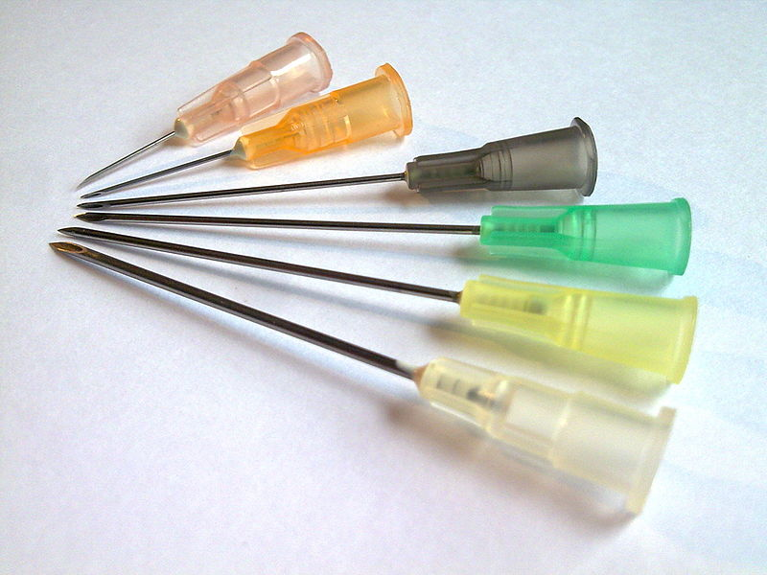
26G x 1/2" (0.45 x 12mm) (pink)
25G x 5/8" (0.5 x 16mm) (orange)
22G x 1 1/4" (0.7 x 30mm) (black)
21G x 1 1/2" (0.8 x 40mm) (green)
20G x 1 1/2" (0.9 x 40mm) (yellow)
19G x 1 1/2" (1.1 x 40mm) (white)

Slide 3
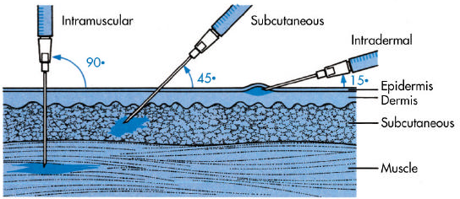
Types of Injections
  Intramuscular
  Subcutaneous
  Intradermal

Slide 4
Intramuscular Injection

Slide 5
Indications
When rapid response is required
Medication can not be taken orally (ex. Dysphagia, Profound vomiting, …)
No availability for oral preparation
Drug is ineffective after oral administration (patient has mal-absorption syndrome)

Slide 6
Contraindication
Active infection (cellulitis)
Known allergy/hypersensitivity of the medication
Muscular atrophy

Slide 7
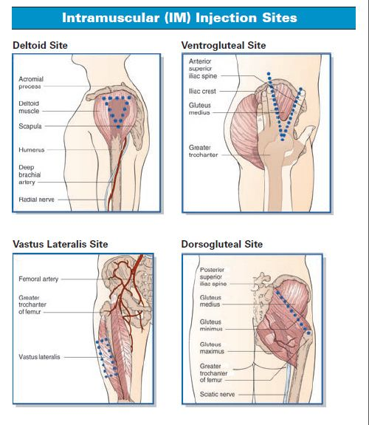

Slide 8
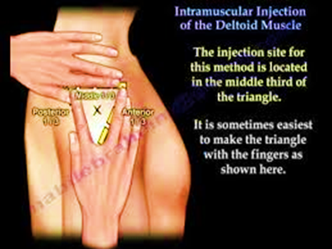
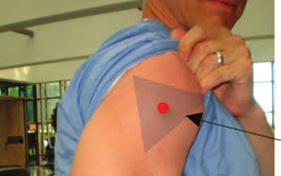
Common Sites for Injection
Mid Deltoid
  Common site, upper arm, 3 fingers width above and below (adults)

Slide 9
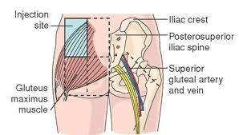
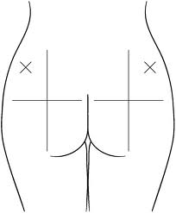
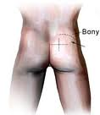
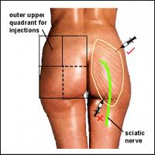
Common Sites for Injection
Dorsalgluteal
  Outer quadrant of the buttocks
  Look out for sciatic nerve
what-when-how.com
netplaces.com
drugs.com
squidoo.com

Slide 10
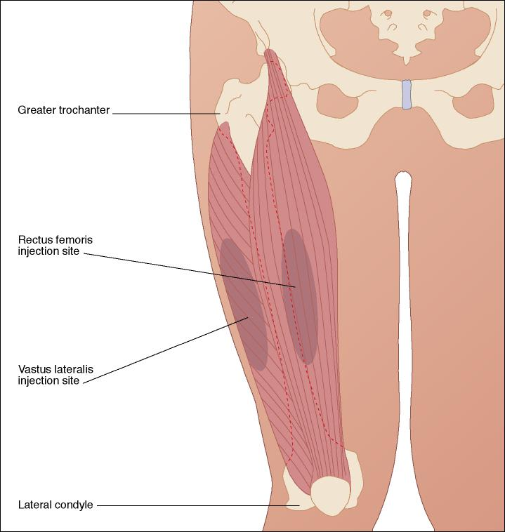
Common Sites for Injection
Rectus femoris
  Upper anterior aspect of the thigh
reach.mednetconsult.co.uk

Slide 11
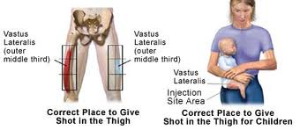
Common Sites for Injection
Vastis lateralis
  Lateral aspect of thigh, in the middle third
drugs.com
reach.mednetconsult.co.uk

Slide 12
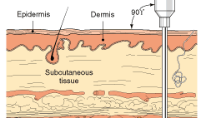
Amount of injection for IM
Buttocks, up to 5 mL may be given by IM injection although more than 3 ml can be painful
Deltoid up to 1 ml, 1 ½ inch, 19 or 21-gauge needle usually used

Slide 13
Equipment
Sterile syringe with appropriate size
Drug
Alcohol swab
Non sterile gloves
Band-Aid

Slide 14
Technique
Identify your patient, explain procedure and take permission
Check if you have the appropriate drug
Fill the syringe with the drug and empty air bubbles
Choose the site of injection
Wash your hands
Put on gloves
Open alcohol swab and in a circular motion, clean area in a 2 inch diameter at the site of the intended IM injection
Let fully dry

Slide 15
Technique
Pull skin around the clean site
Open the syringe cap and take needle in dominant hand between the thumb and the index finger
Inform the patient to relax and you will prick him/her which might be uncomfortable
Insert the needle at 90 degree angle
Stabilize the needle with the non dominate hand
Use dominate hand to pull back on the plunger and aspirate for blood

Slide 16
Technique
If there is blood aspirated back into the needle, remove and dispose in a sharps container. start from the beginning.
Push the medication at a slow and steady pace.
Pull the needle out and immediately discard in the sharp container (do not cover the syringe)
Apply gentle pressure on the site and cover with the Band-Aid
Write full documentation

Slide 17
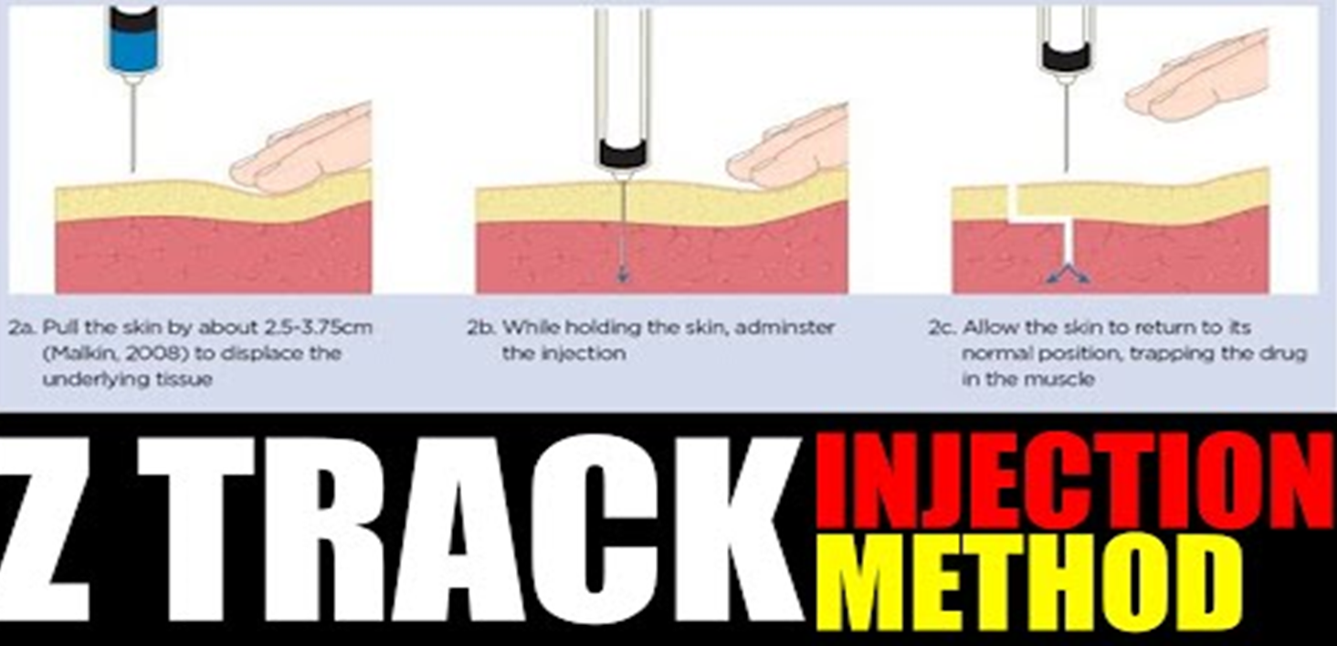

Slide 18
Complications
Pain
In gluteal administration, injury to the sciatic nerve
Tissue necrosis and abscess
Hemorrhage
Infection

Slide 19
Reference:
StatPearls

Slide 20
Subcutaneous Injection
Volume usually less than 0.5 mL
Administered through a ½ inch, 23- or 25-gauge needle
Indications are the same as IM
Best and most commonly used for regular injections of Insulin for Insulin-dependent diabetic patients

Slide 21
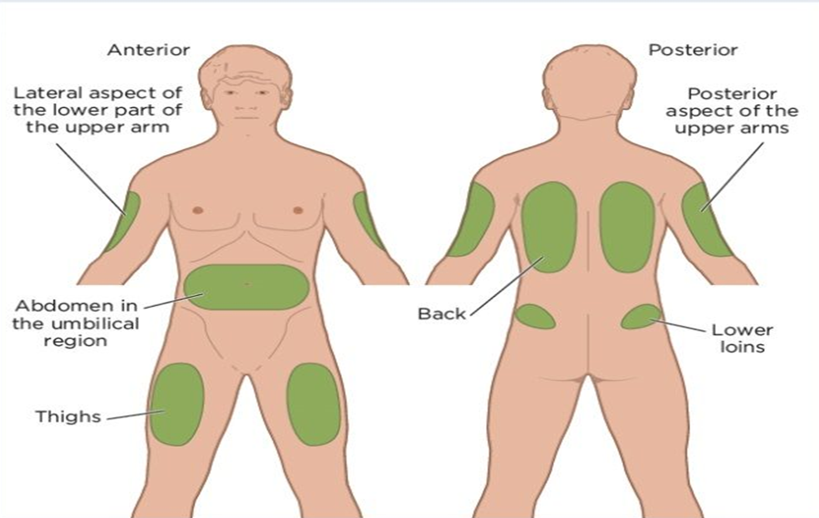
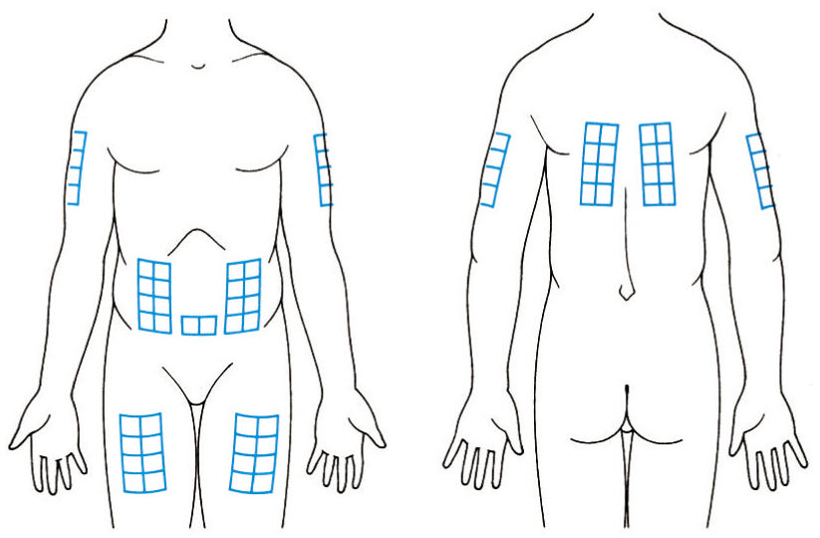
Sites for Subcutaneous Injections

Slide 22
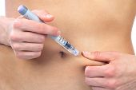
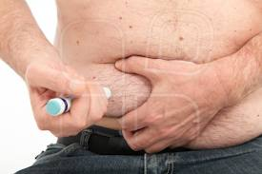
Technique (differences from IM)
Elevate subcutaneous tissue by “pinching” injection site
Remove the needle cap and insert needle at a 45- degree angle (or 90-degrees if thick fat and short needle)
Pull back slightly on plunger (aspirate)
Inject the drug slowly and steadily
bigstockphoto.com
mostphotos.com

Slide 23
Technique (differences from IM)
After the injection, withdraw the needle out at same angle it was inserted and
immediately discard in the sharp container (do not cover the syringe)
Document procedure
bigstockphoto.com
mostphotos.com

Slide 24
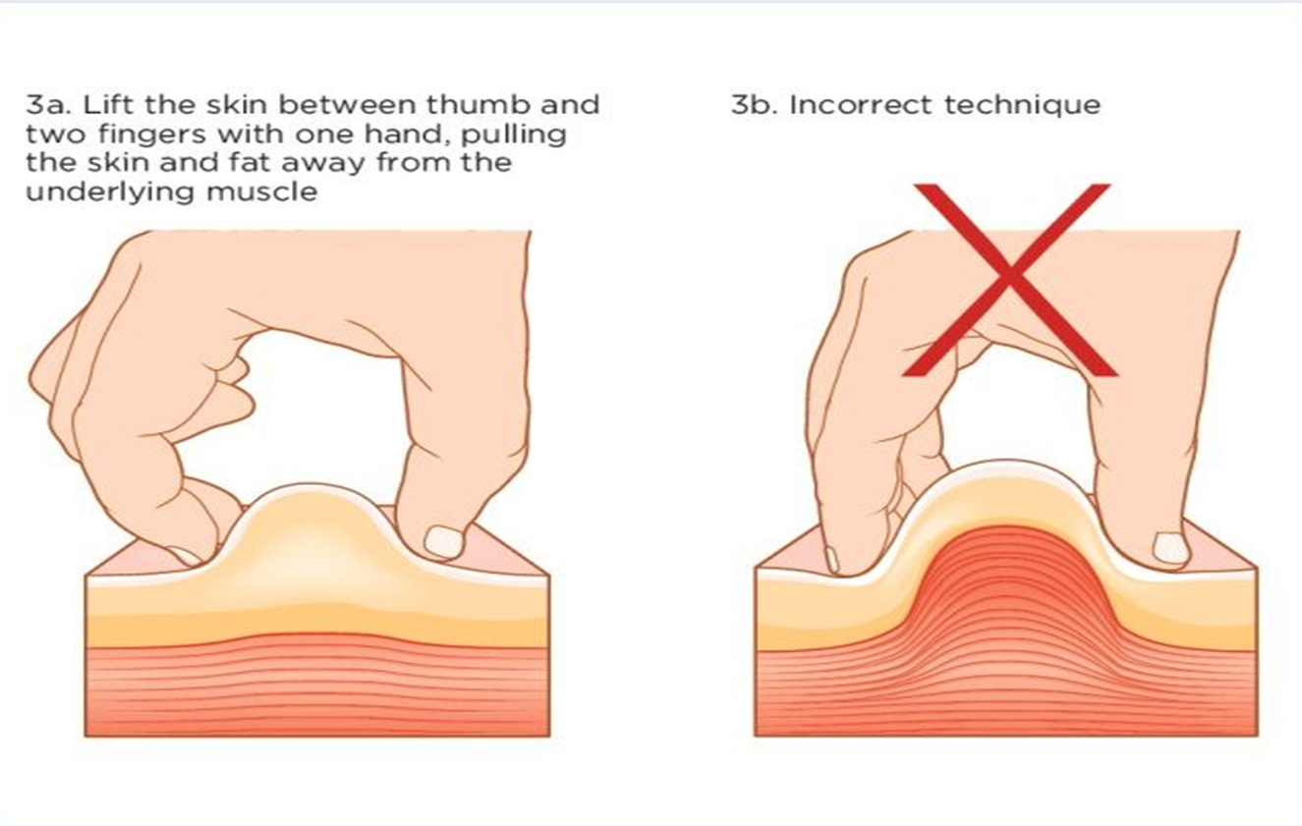

Slide 25
Complications of Subcut. Injection
Pain (mild)
Infection
Allergic reaction

Slide 26
Intradermal Injection
Small amounts are injected into the layers of skin
Often used to test for allergic reaction and antibody formation
Usual site: anterior forearm
Angle of insertion: almost parallel to skin (10º-15º)

Slide 27
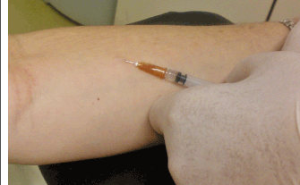
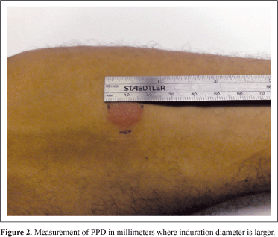
Intradermal Injection
Small amounts are injected into the layers of skin
Often used to test for allergic reaction and antibody formation
Usual site: anterior forearm
PPD test
www.scielo.br
www.scielo.br

Slide 28
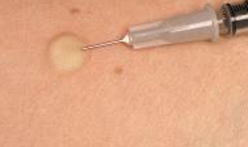
Intradermal Injection - Technique
The injection site is then rubbed vigorously with a swab, and disinfectant applied to cleanse the area and increase the blood supply.
With the bevel of the needle facing upwards, the needle is inserted into the skin, parallel with the forearm. The syringe should then be pushed in steadily and slowly, releasing the solution into the layers of the skin. This will cause the layers of the skin to rise slightly
emed.je

Slide 29
Summary
Intramuscular: many medications
Subcutaneous: mainly Insulin
Intradermal: test sensitivity and antibody formation

Slide 30
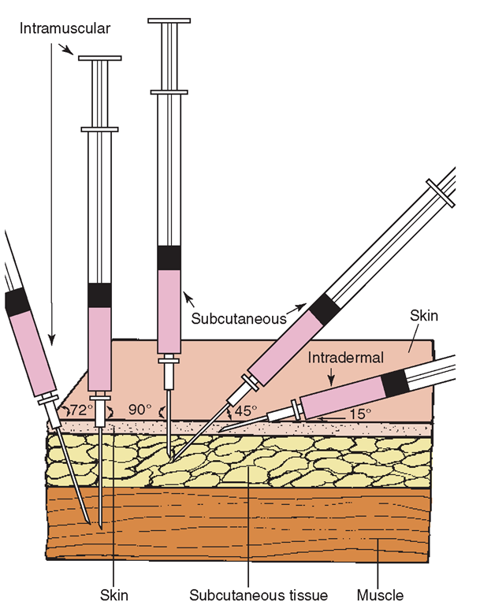
Summary – Comparison of Angles
Type | Angle of insertion
Intramuscular | 72º-90º
Subcutaneous | 45⁰ , or Up to 90º if fat layer is thick, and needle is short
Intradermal | 10º-15º

