Slide 1
Intravenous cannulation
Edited by Dr Shaher Abbarah

Slide 2
Intravenous cannulation is a technique in which a cannula is placed inside a vein to provide venous access.
Venous access allows sampling of blood as well as administration of fluids, medications, parenteral nutrition, chemotherapy, and blood products

Slide 3
Indication
Blood sampling
Intravenous fluid administration
Intravenous medications administration
Intravenous chemotherapy administration
Intravenous nutritional support
Intravenous blood or blood products administration
Intravenous administration of radiological contrast agents for imaging studies (CT, MRI, …)

Slide 4
Contraindications
When peripheral venous access is in an injured, infected, or burned extremity, it should be avoided if possible.
Veins of fractured limbs , AV fistula, side of Lymph node dissection (ex. Mastectomy)
Some irritant solutions can cause blistering and tissue necrosis if they leak into the tissue e.g. chemotherapeutic agents. These solutions are more safely infused into a central vein.

Slide 5
Complications
Pain (discomfort)
Failure to access the vein
Blood stops flowing into the flashback chamber
Arterial puncture (inadvertent)
Thrombophlebitis / Infection
Peripheral nerve palsy

Slide 6
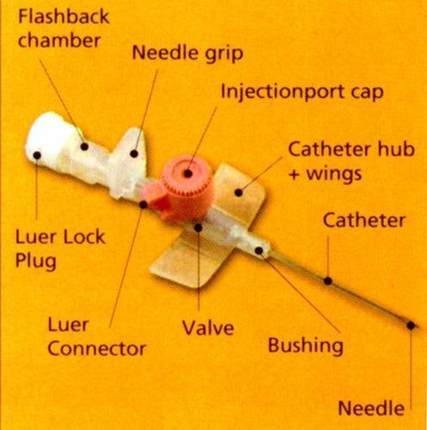
Cannula

Slide 7
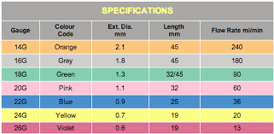
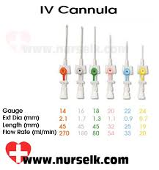
This device is available in various gauges (16-24 G), lengths (25-44 mm), compositions, and designs.

Slide 8
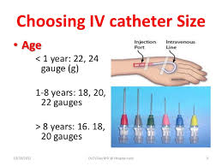

Slide 9
Tips
Routinely, use the smallest gauge of catheter if possible to prevent damage to the vessel intima.
In an emergency situation use a large gauge catheter to allow administration of large volumes of fluid.
The superficial veins of the upper extremities are preferred to those of the lower extremities for peripheral venous access as they interfere less with patient mobility and pose a lower risk for phlebitis.

Slide 10
It is recommended to choose a straight portion of a vein to minimize the chance of hitting valves.
Use the patient’s non-dominant arm (if possible)
For prolonged courses of therapy, it is recommended to start distally and move proximally as distal catheters are replaced.
N.B.
Remember best vein 3F&R (Firm,full,foroward &round vein)

Slide 11
Equipment
Non-sterile gloves
Tourniquet
Antiseptic solution
5-ml syringe
Sterile gauze
Cannula
Saline
Plaster

Slide 12
Before the procedure
1. Introduce yourself to the patient. Explain the procedure to the patient and gain informed consent to continue.
2. Make sure there is adequate light and that the room is warm enough to encourage vasodilation.
3. Make sure the patient is in a comfortable position and place a pillow or a rolled towel under the patient’s extended arm.
4. The patient’s skin should be washed with soap and water if visibly dirty.

Slide 13
5. If difficulty is encountered in finding an appropriate vein, one of the following techniques may be used:
      Inspection of the opposite extremity
      Opening and closing the fist
      Using gravity (holding the arm down)
      Gentle tapping or stroking of the site
      Applying heat (warm towel/pack)

Slide 14
Technique
Apply tourniquet and select the appropriate vein
Apply an antiseptic solution with friction for 30-60 seconds, allow to air dry for up. Once cleaned, do not touch or repalpate the skin.
Remove the cannula from its packaging and remove the needle cover ensuring not to touch the needle.
Stretch the skin distally and tell the patient to expect a sharp scratch.

Slide 15
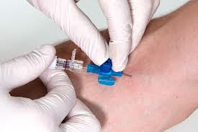
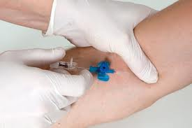
Insert the needle, bevel upwards at about 10 - 30 degrees
Advance the needle until a flashback of blood is seen in the hub at the back of the cannula
Once this is seen, progress the entire cannula a further 2mm, then fix the needle, advancing the rest of the cannula into the vein.

Slide 16
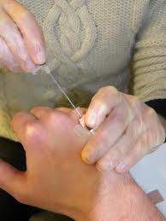
Release the tourniquet, apply pressure to the vein at the tip of the cannula and remove the needle fully.
Remove the cap from the needle and put this on the end of the cannula.
Carefully dispose of the needle into the sharps box.

Slide 17
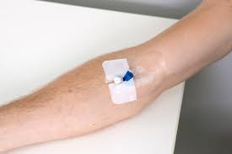
Check function by flushing with saline. If there is any resistance, if it causes any pain, or you notice any localized tissue swelling; immediately stop flushing, remove the cannula and start again.
Apply the plaster to the cannula to fix it in place.
Finally, ensure that the patient is comfortable and thank them.

Slide 18
Intravenous fluid

Slide 19
Indications
Maintain or replace body store .
Restore acid abase balance
Restore the volume of blood component
Administer of medication
Provide Nutrition/electrolytes correction

Slide 20
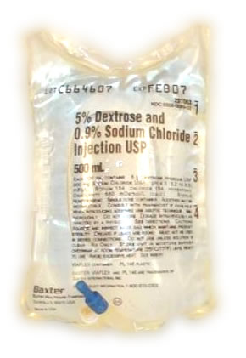
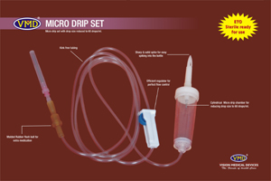
Equipment
Tray
Kidney dish containing sterile syringes
Spirit swabs
Drip stand
Drip + set

Slide 21
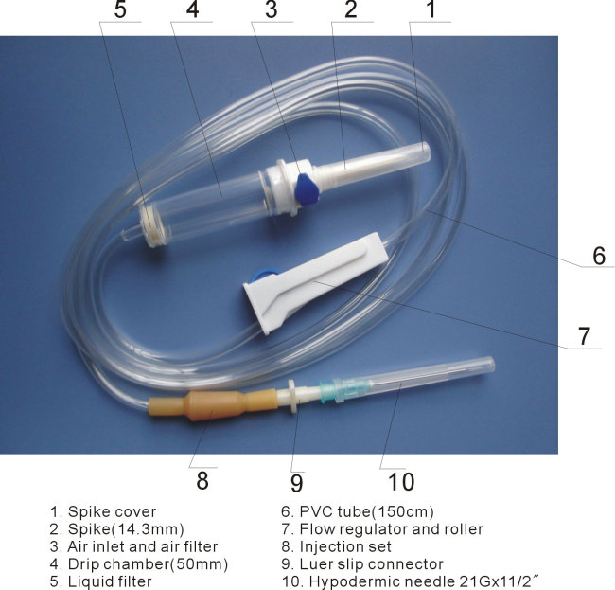
DRIP SET

Slide 22
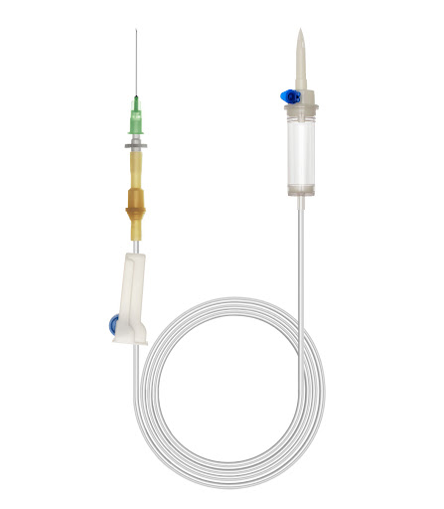

Slide 23
Technique
Introduce yourself to the patient.
Check the patient’s mane and the type of fluid to be given
Explain the procedure to the patient and gain informed consent .
Prepare your equipment
Assemble the tubing solution according to the manufacturer’s instruction

Slide 24
Let out the air from the tubing by letting some of the fluids run down the tubing
Close the drip set to prevent fluid from following out
Hang the bag in the drip stand
Open the cannula and connect it to the drip
Adjust the drips according to the appropriate dose (drop per minute)
Check regularly to see that the fluid is dropping at the same rate and that fluid is going in to the vein properly and that the puncture site is not swollen.

Slide 25
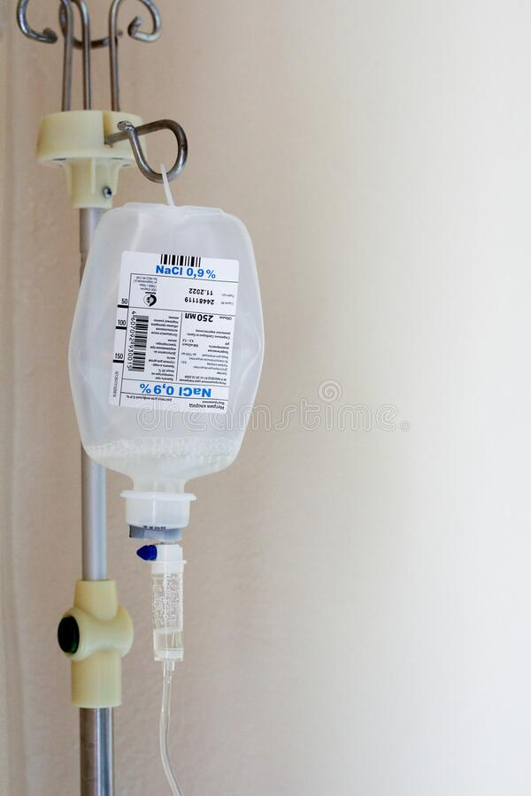
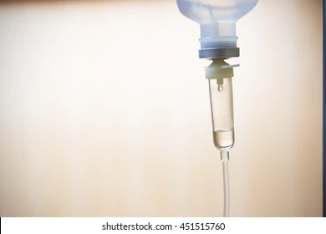

Slide 27
Reference
AMBOSS
Clinical Procedures in Emergency Medicine 6th edition

