Slide 1
Ischaemic heart diseases
By
Dr. Mohamed Abd Almoneim Attia

Slide 2
Ischemic heart disease (IHD) :
Ischemic heart disease is a condition in which there is imbalance between O₂ supply (coronary blood flow) and O₂ demand (heart work).
It includes:
Angina pectoris:Pain or discomfort in the chest caused by insufficient blood flow to the heart muscle.
(Acute coronary syndrome):……………….

Slide 3
Stable Angina (Angina pectoris)
Angina is a symptom, which must be recognized by its clinical manifestations.
Etiology:
• The most common is atherosclerotic narrowing of one or more epicardial coronary arteries.
The epicardial coronary arteries serve as conductance vessels, while the intra-myocardial arteries normally exhibit striking changes in tone and are therefore referred to as resistance vessels. Abnormal constriction of these vessels can cause ischemia, this condition is referred to as microvascular angina. This constriction can also occur in vasculitis and coronary embolization.
• Despite normal pericardial coronary arteries, myocardial ischemia can develop due to increase in myocardial oxygen demand because of myocardial hypertrophy, e.g hypertension, aortic stenosis, hypertrophic cardiomyopathy and aortic regurge.
• A reduction in oxygen carrying capacity of blood as in severe anemia.

Slide 4
So, the etiology :
1-Atherosclerosis of coronary artery is the most common cause.
2-Thrombi, spasm, and coronary emboli cause limitation of coronary blood flow.
3-Hypertension where the myocardial O₂ demands is increased due to ventricular hypertrophy.
4-Reduction in the O2 carrying capacity of the blood as in severe anemia.

Slide 5
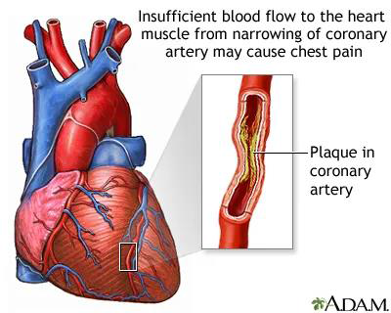

Slide 6
Pathophysiology:
Myocardial ischemia is caused by an imbalance between myocardial oxygen supply and oxygen demand.
Severe coronary narrowing and myocardial ischemia are frequently accompanied by the development of collateral vessels, especially when narrowing develops gradually.
Effects of ischemia:
It causes transient disturbances of the mechanical, biochemical and electrical function of the myocardium.
1-Mechanical: transient left ventricular failure, mitral regurge if papillary muscles are involved.
2-Biochemical: with severe oxygen deprivation, glucose is broken down to lactate and fatty acids can not be oxidized.
3-Electrical: ventricular tachyarrhythmias.
Risk factors for coronary atherosclerosis:
Age: men > 45y, women> 55y.
Family history of premature coronary heart disease (CHO).
Cigarette smoking.
Hypertension.
Diabetes mellitus.
Dyslipidemia.
Obesity.

Slide 7
Myocardial metabolism:
60% of the myocardial energy comes from aerobic oxidation of fatty acids (gives more energy but utilizes more O₂).
35% of the myocardial energy comes from aerobic oxidation of carbohydrates (gives less energy but utilizes less O₂).
5% of energy comes from oxidation of amino acids, ketone bodies, etc.

Slide 8
Atherosclerosis
Atherosclerosis contributes to more mortality and more serious morbidity than any other disorder in the western world.

Slide 9
Risk Factors
  Unchangeable risk factors
    Age
    Male gender
      Men are at grater risk than are premenopausal women, because of the protective effects of natural estrogens.
    FH of premature CAD
      Several genetically determined alterations in lipoprotein and cholesterol metabolism have been identified.

Slide 10
Risk Factors
Changeable risk factors – life style risk factors:
  Hyperlipidemia
    The presence of HPL is the strongest risk factor for atherosclerosis in persons < 45 years of age.
    Both primary and secondary HPL increase the risk.
  Cigarette smoking
  Hypertension
    High BP produces mechanical stress on the vessel endothelium.
    It is a major risk factor for atherosclerosis in all age groups and may be as important or more important than HPL > 45 years.
  Diabetes mellitus
    DM elevates blood lipid levels and otherwise increases the risk of atherosclerosis.
  Insufficient physical activity
  Stressful lifestyle
  Obesity

Slide 11
Pathogenesis of coronary heart disease (CHD)

Slide 12
Evaluation and Diagnosis
In patients presenting with chest pain
  Detailed history
  focused physical examination
  directed risk-factor assessment
Estimate the probability of significant CAD (i.e., low, intermediate, high)

Slide 13
Symptoms:
Pain: usually builds up rapidly within 30 seconds and disappears in decrescendo within 5 to 15 minutes. Fleeting or long-lasting discomfort is rarely angina
Character: variably described but typically presents as tightness, squeezing or constriction. Some patients describe an ache, a feeling of dull discomfort, indigestion, or burning pain. (the clenching of the fist over the sternum while describing the pain is classic)="grip-like," "pressure-like," "suffocating" and "heavy”; or a "discomfort" but not "pain." Angina is almost NEVER sharp or stabbing, and NOT change with position or respiration.
Site: retrosternal. It can be precordial
Radiation: left shoulder, left arm, back, neck, jaw, teeth, back and rarely epigastrium. If above the mandible, below the epigastrium, or localized to a small area over chest wall is rarely anginal.
Precipitating factors: exertion, emotion, and sexual activity.
Relieving factor: rest, and sublingual nitroglycerin usually within 30 secs to several mins.
Nocturnal angina: occurring during sleep.
Postprandial angina: develops after meals (because of an increased oxygen demand in splanchnic vascular bed)
Angina equivalents: No chest pain, instead dyspnea, dizziness, fatigue or faintness, more in diabetics. When these symptoms occur in response to exercise or stress, patients must be evaluated for possible myocardial ischemia.
Signs:
Examination is often normal, there may be signs of risk factors .

Slide 14
Clinical Classification of Chest Pain
Typical angina (definite)
  Substernal chest discomfort with characteristic quality and duration that is ...
  Provoked by exertion or emotional stress and
  Relieved by rest or NTG
Atypical angina (probable)
meets 2 of the of characteristics
Noncardiac chest pain
meets ≤ 1 of the typical angina characteristics

Slide 15
DD of Chest Pain
Non-Ischemic CV
  DAA
  pericarditis
Pulmonary
  pulm embolus
  pneumothorax
  pneumonia
  pleuritis
Chest Wall
  costochondritis
  fibrositis
  rib fracture
  sternoclavicular arthritis
  herpes zoster
Gastrointestinal
Esophageal
  esophagitis
  spasm
  reflux
Biliary
  colic
  cholecystitis
  choledocholithiasis
  cholangitis
Peptic ulcer
Pancreatitis
Psychiatric
Anxiety disorders
  hyperventilation
  panic disorder
  primary anxiety
Affective disorders
  depression
Somatiform disorders
Thought disorders
  fixed occlusions

Slide 16
Conditions Provoking or Exacerbating Ischemia
Increased Oxygen Demand
Cardiac
  HTN
  AS / HCM
  SVT / VT
Non-Cardiac
  Hyperthermia
  Hyperthyroidism
  Sympathomimetic toxicity (cocaine use)
  Anxiety
Decreased Oxygen Supply
  Anemia
  Hypoxemia
  COPD, PH,
  Sickle-cell disease
  Hyperviscosity
  polycythemia, leukemia,
  thrombocytosis, hypergammaglobulinemia

Slide 17
Investigations:
1-ECG:
Inbetween the attacks: the ECG may be completely free (so we can’t depend on ECG only for diagnosis). It is normal in 50% of cases, but does not exclude the diagnosis.
During ischemia: there is ST segment depression and T-wave inversion and may be ventricular tachyarrhythmias.
In myocardial infarction: there is deep Q-wave.
*Continuous 24-hour ECG recording (Holter monitoring).
Provocative testing:
Angina with normal resting ECG, the provocative testing can confirm the presence of ischemia,
1- Stress ECG: Treadmill":
Recording the 12-lead ECG before, during and after exercise. the physician should be present throughout the test. The test is discontinued upon evidence of:
Chest discomfort, severe dyspnea, dizziness, fatigue, fall in systolic B.P. > I 0 mmHg., ST segment depression of greater than 0.2 mV, or ventricular tachyarrhythmias
NB: The normal response to exercise includes a progressive increase in heart rate and blood pressure.

Slide 18
2- Stress echocardiography:
After I. V. dobutamine (pharmacological challenge) or exercise shows areas of regional wall motion abnormality (akinesia) in the left ventricle due to persistent ischemia or MI.
3- Multislice CT coronary angiography is emerging as the most reliable noninvasive method for coronary artery disease assessment, detection of coronary plaques and significant obstructive coronary lesions.

Slide 19
4- Positron emission tomography (PET) (with exercise or pharmacologic stress).
Indications: for assessing perfusion.
Intravenous pharmacologic challenge
Indications: patients who cannot exercise because of peripheral vascular or
musculoskeletal disease
Aim: To create a coronary "steal" by temporarily increasing flow in non-diseased segments of the coronary vasculature at the expense of diseased segments. For example, dipyridamole or adenosine to identify myocardial ischemia and increased risk of coronary events in exertional dyspnea ·The development of a transient perfusion defect with radioactive thallium or 99 mTc to detect myocardial ischemia.

Slide 20
5- Coronary angiography:
This invasive diagnostic method shows narrowing of coronary artery lumen. It can assess the severity of obstruction.
Indications:
1. Confirm or exclude the diagnosis of ischemia.
2. Patients who are severely symptomatic despite medical treatment.
3. Severe ischemia as demonstrated in non invasive testing.
4. High risk patients, including left ventricular dysfunction.

Slide 21
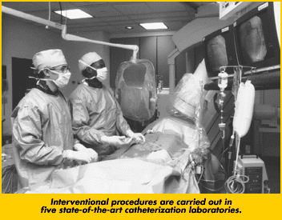
PTCA

Slide 22
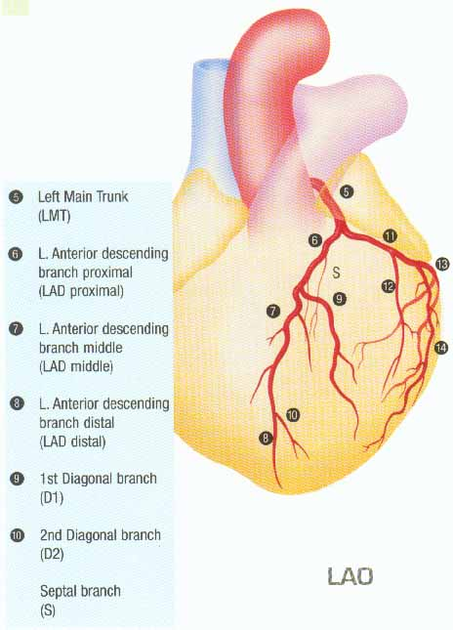
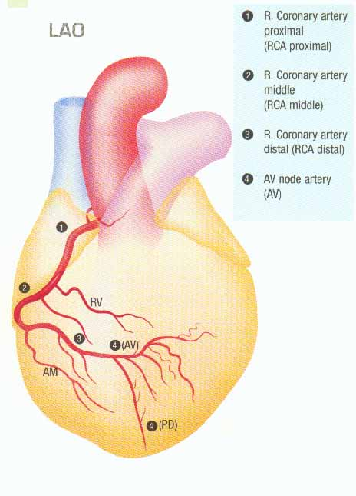
Coronary Angiography

Slide 23
Treatment:
The goals of treatment of stable angina involve:
Therapies to prevent/minimize ischemia and to improve survival.
These goals can be achieved with a variety of modalities including:
Medical therapy, non-pharmacologic and lifestyle measures
And revascularization with either percutaneous coronary intervention (PCI) or coronary artery bypass graft surgery (CABG).
1. Control of risk factors and associated disorders: Stop smoking. Treatment of hypertension, diabetes, anemia, disease. Lowering LDL cholesterol < I 00 mg%. Weight reduction.
Gradual institution of a regular aerobic exercise program is beneficial in the management of risk factors such as lipids, blood pressure, obesity, and diabetes mellitus.

Slide 24
Drug therapy (antianginal drugs):
1-During the acute attack:
Short-acting nitrates and nitrites.
Sedatives and tranquilizers to calm the patient.
2-In-between the attacks (prophylaxis):
Long-acting nitrates.
Beta-blockers.
CCBs.
Cytoprotective drugs: trimetazidine
Antiplatelet drugs: aspirin, dipyridamol, etc.
3-Surgical treatment (myocardial revascularization).

Slide 25
Organic nitrates and nitrites:
Inorganic nitrates are ineffective
Classification:
1-Short-acting nitrates:
Amyl nitrite (inhalation)
Nitroglycerine (SL)
Isosorbide dinitrate (SL)
i.v. nitroglycerin
2-Long-acting nitrates:
Isosorbide dinitrate or mononitrate (Oral)
3-Transdermal patches

Slide 26
Pharmacokinetics:
Absorption: nitrates are rapidly absorbed from buccal membrane, GIT, and bronchioles.
Metabolism: in the liver:
If given oral → extensive first-pass hepatic metabolism (oral bioavailability <10%).
If given sublingual → no first-pass metabolism → high bioavailability.
Excretion: via the kidney.

Slide 27
Sustained Released Tablet
Administer dose 1 hour before or 2 hours after meal with a full glass of water for faster absorption.

Slide 28
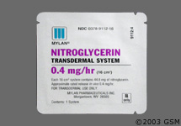
Nitroglycerine Patch

Slide 29
Nitroglycerin Patch
Place the patch on a hairless area of chest or upper arm each day.
Move patch to a different place on your body each day to prevent skin irritation.
Remove the patch for 8 to 12 hours each night and put on a fresh patch each day.
  Patches – takes 40 minutes to an hour to start working

Slide 30
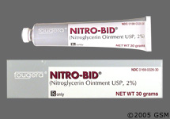
Nitroglycerine Ointment

Slide 31
Mechanism of action:
acts by causing systemic venodilation by causing liberation of the free radical nitric oxide (NO) which is identical to the endothelial derived relaxing factor (EDRF) → ↑ cGMP → ↓ Ca²⁺ influx into the vascular sm ms → VD (more on the veins).

Slide 32
Pharmacological effects:
CVS:
Blood vessels:
*VD of the venous (and to lesser extent to the arterial) side leading to ↓ preload . So, Reducing myocardial wall tension and oxygen requirements.
*Dilating the epicardial coronary vessels leading to increased coronary blood flow.
* Increasing blood flow in collateral vessels
  *VD of the arteries in the face and neck leading to flushing.
  *VD of meningeal arteries leading to throbbing headache.
Heart: Reflex tachycardia (in high dose) 2ry to ↓ BP.
BP: High doses cause ↓ in both systolic and diastolic BP.

Slide 33
Smooth ms: relaxation of bronchial, GIT, uterine, and biliary sm ms.
Respiration: reflex tachypnea (↑ resp rate) due to hypotension.
Blood: Methemoglobinemia in high doses due to oxidation of Hb into met-Hb.

Slide 34
Therapeutic uses:
1-Angina pectoris:
Nitrates are used for treatment of all types of angina both for relieving the acute attack and for prophylaxis.
These effects will lead to:
1-Reduction of myocardial O₂ demand through:
Venodilatation → ↓ venous return (preload) .
Arteriolodilatation → ↓ peripheral resistance (afterload).
2-Enhancement of myocardial perfusion through:
Coronary VD.
Redistribution of blood from large epicordial vessels to ischemic subendo-cardial vessels.

Slide 35
2-Myocardial infarction: to ↓ the area of myocardial damage.
3-Acute heart failure: to ↓ preload and afterload.
4-Treatment of cyanide poisoning:
cyanide has high affinity for metHb more than normal Hb.
5-Biliary colic.
6-Management of constriction ring during labor.

Slide 36
Side effects:
1-Hypotension and reflex tachycardia: may aggravate angina.
2-Throbbing headache: with nitroglycerin, due to VD of meningeal arteries.
3-Flushing of the face.
4-Tolerance to its effect: with long acting prepration due to:
  Depletion of sulfhydryl (-SH) containing enzymes necessary for liberation of NO from nitrates → ↓ formation of NO → ↓ VD effect.
  Reflex sympathetic activation (due to hypotension), this will cause VC.
►Prevention of tolerance: make a daily nitrate-free interval (8-10–12 h) to give chance for the SH- containing enzymes to regenerate.
During this period, give another anti-anginal drug (e.g. beta-blocker or CCBs).
5-Methemoglobinemia in high doses (rare).
  Never to be combined with other drugs causing
  vasodilation (Viagra®) or hypotension
NTG & Viagra
  irreversible hypotension

Slide 37
Precautions during nitrate therapy:
Tablet should be held under tongue until dissolved. Avoid eating, drinking, or smoking until tablet is dissolved.
  Advise patient to sit down.
  Relief should occur in 1 to 3 minutes
Use the smallest effective dose to avoid hypotension and reflex tachycardia.
The patient should consult his doctor if anginal pain does not improve after taking 3 SL tablets of NG during 15 min (may be MI). May be repeated every 5 minutes for 3 doses.
Nitroglycerine tablets should not be put in direct sunlight or with cotton .
The expiry date (60 days) should be checked (active tablets have burning taste).
Sudden withdrawal may cause acute MI.

Slide 38
Beta-blockers
Reducing anginal episodes and improving exercise tolerance.
The only antianginal drugs proven to prevent reinfarction and to improve survival in patients who have sustained an MI.
Doses are usually tolerated to reduce the resting heart rate to 55-60 beat per minute.
Mechanism in angina:
1-Reduction of myocardial O₂ demand through ↓ both heart work and systemic BP.
Bradycardia leads to ↑ diastolic filling time and improvement of myocardial perfusion
Redistribution of blood from normal to ischemic areas.
2-Cytoprotective effect through improving glucose utilization by shifting tissue metabolism toward a greater use of carbohydrate and a lesser use of free fatty acids

Slide 39
Combination of BBs and nitrates ↑ their efficiency and ↓ their side effects:

Slide 40
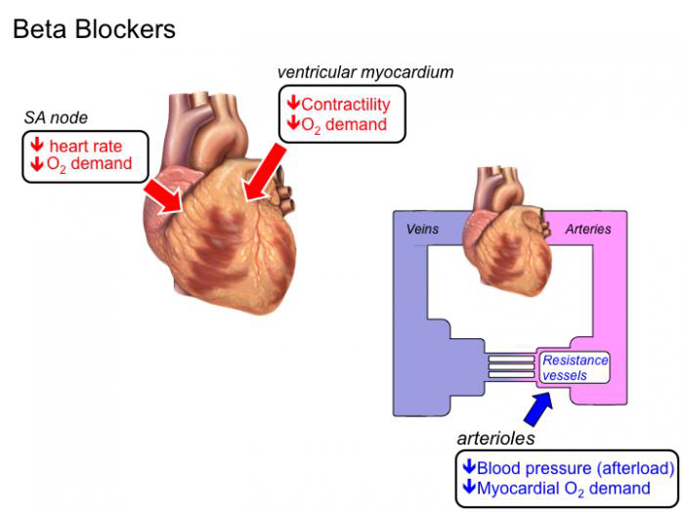

Slide 41
N.B.
Beta-blockers e.g (propranolol) are contraindicated in Prinzmetal’s (variant) angina because they block the β2-mediated coronary dilatation leaving the α1 receptors unopposed → ↑ coronary spasm.

Slide 42
Calcium channel blockers (CCBs):
  1-They ↓ myocardial contractility and myocardial O₂ demand.
  2-They ↓ coronary vascular resistance and increase coronary blood flow.
  3-They dilate epicardial coronary vessels.
  4-↓ myocardial cell necrosis.
N.B.
Although nifedipine is coronary dilator, it has some disadvantages in angina: It may cause hypotension and reflex tachycardia.
Diltiazem , Verapamil should be used when B Blockers are contraindicated (asthma peripheral vascular disease) or cause side effects (impotence, depression).

Slide 43
Antiplatelet drugs:
They can reduce risk of infarction.
- Aspirin.
Clopidogrel.
Others
Statin:
Indications: reduces risk of death, recurrent MI, unstable angina and stroke.

Slide 44
Cytoprotective drugs: Trimetazidine
1-It produces a metabolic switch via inhibition of fatty acid oxidation toward activation of glucose oxidation during ischaemia
2-↓ intracellular lactic acid accumulation and intracellular ion disturbance.
3-↓ intracellular Ca²⁺ and Na⁺ accumulation and preserve contractile function.
4-↓ membrane damage through antioxidant effect.

Slide 45
b) Surgery:
Coronary revascularization: result in an immediate relief of the obstruction to blood flow.
PTCA versus CABG depend on:
~ Number of diseased vessels
~ Location
~Age
~ Comorbidities
~ Diabetes
~ Character of the obstructing lesion
~ Preference of the patient

Slide 46
1. Percutaneous transluminal coronary balloon angiography (PTCA) stenting.
2. Coronary artery bypass grafting (CABG) using internal mammary arteries or saphenous vein graft to bypass area of stenos.

Slide 47
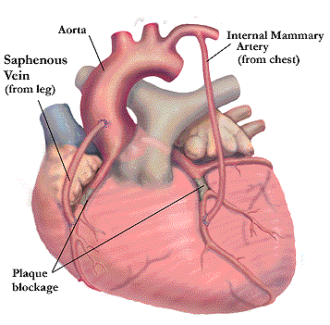
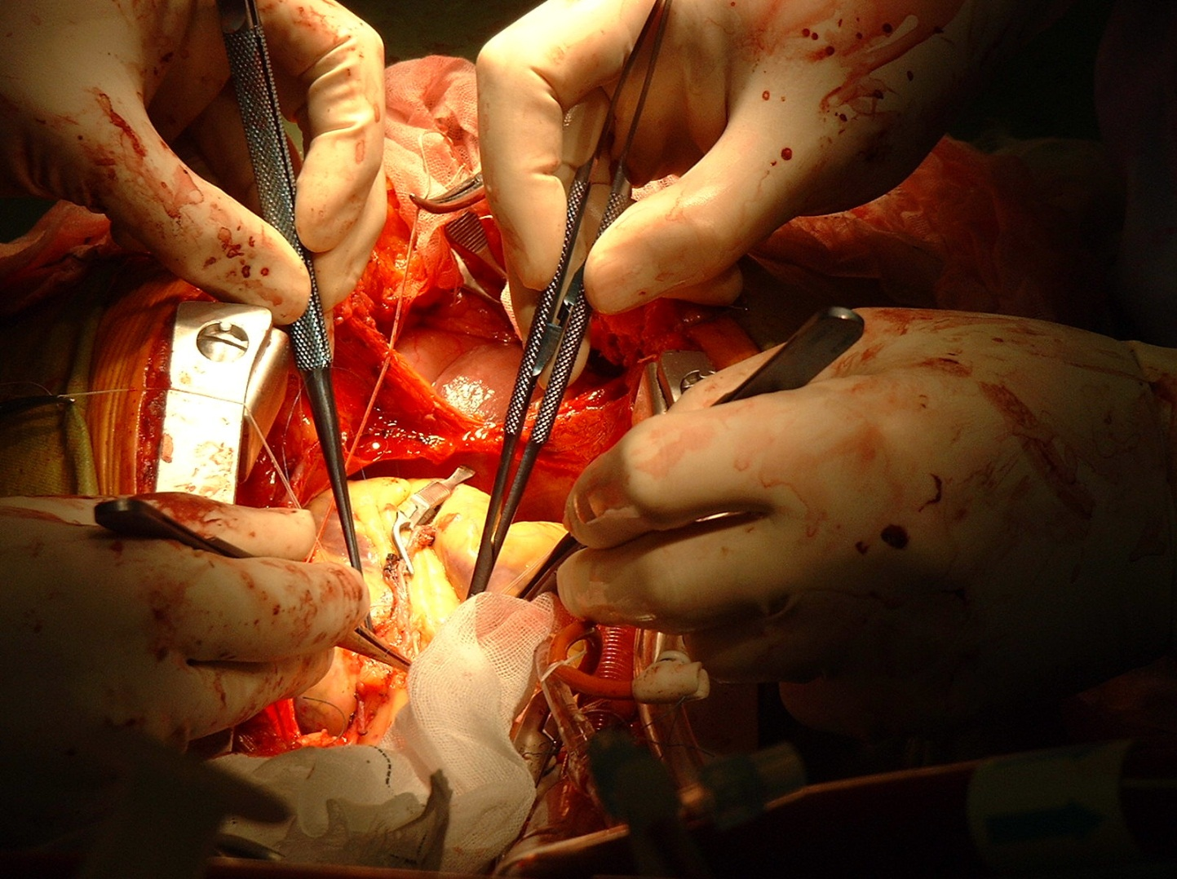
CABG

Slide 48
Management of angina with other concomitant diseases:
Hypertension and angina:
1-Control of blood pressure by using medication useful for angina e.g. β blockers or CCB .
2-Low sodium and low fat diet.
3-Mild exercise
4-Avoid stress.
5-Control of hyperlipidemia.

Slide 49
Acute Coronary Syndrome

Slide 50
Definition & Classification
The degree of occlusion and ischemia determines the diagnosis
  Stable angina
  Unstable angina (UAP)
  Non-ST elevation MI (NSTEMI)
  ST elevation MI (STEMI)
90% of AMI result of completely occluded vessel
  Myocardial infarction is the death of part of the heart muscle due to its sudden loss of blood supply usually caused by thrombus formation on coronary atheroma

Slide 51
Classifications of MI
According to the site and artery affected:
  Anterior ( left anterior descending)
  Lateral ( circumflex CA)
  Inferior ( Right CA)
According to the duration:
  Recent
  Late pattern
  Old
According to the extent of wall affection:
  Transmural
  Subendocardial
According to the complications:
  Non-complicated
  complicated

Slide 52
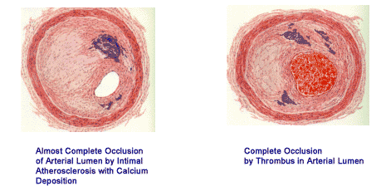
ACS: histology

Slide 53
Unstable angina
Unstable angina may present by one of the following:
~ Angina at rest
~ Crescendo angina (increased frequency and severity)
~ Angina of recent onset (within 4-6 weeks)
It may be due to:
• Non-occlusive coronary thrombus on top of atheroma.
• Coronary artery spasm (Prinzmetal's angina).
Unstable angina (UA) is considered to be present in patients with:
ischemic symptoms suggestive of an ACS without elevation in biomarkers with or without ECG changes indicative of ischemia.
Diagnosis:
ECG: shows changes in 30-50%.
Cardiac enzymes: are not elevated distinguished from acute MI.
Coronary angiography.

Slide 54
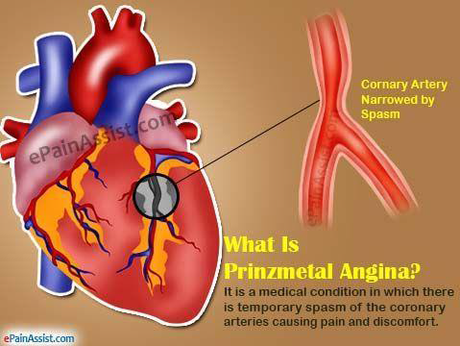

Slide 55
Treatment:
-To reduce progression to MI and relief of ischemic pain.
-Choice of a management strategy, i.e, an early invasive strategy (with angiography and intent for revascularization with PCI or CABG versus a conservative strategy with medical therapy.
-Initiation of antithrombotic therapy (including antiplatelet and anticoagulant therapies) to prevent further thrombosis of or embolism from an ulcerated plaque.

Slide 56
1. Intensified medical therapy in ICU including:
I.V. infusion nitroglycerin and can be increased to a level at which chest pain is abolished, Then transdermal or oral long acting nitrates.
B-Blockers.
Statin.
Antiplatelets, aspirin , clopidogrel or ticlopidine.
Low molecular weight heparin e.g. Enoxaparin .
NB: the majority of patients improve with such treatment.
If do not diminish within 24 to 48 h of treatment coronary angiography should be performed. Percutaneous transluminal coronary angioplasty (PTCA) can be performed with surgical standby.
2. Early coronary revascularization therapy: coronary angioplasty (PTCA) or CABG.

Slide 57
So, Types of Angina are :
1-Stable angina: (Effort, atherosclerotic, typical angina, classic): The pain is commonly induced by exercise, emotion……etc. It is due to atherosclerosis. Pain is induced by effort and disappears with rest.
2-Variant angina: (Prinzmetal's angina, α-receptor–mediated vasoconst-riction): the coronary artery undergoes severe spasm due to overactivity of α₁ receptors. May or may not be associated with atherosclerosis. The patient develops pain at rest.
3-Unstable angina: (accelerated angina =preinfarction syndrome ): Any type of angina that developed recent changes in the character, duration, or frequency of pain. The patient must be hospitalized.

Slide 58
ACS: Therapy
TIME
=
MYOCARDIUM

Slide 59
Reperfusion strategies
The definitive therapy for STEMI
  Reduces infarct size
  Preserves left ventricular function
  Reduces mortality
Fibrinolysis (thrombolysis)
PTCA (percutaneous transluminal coronary angiography)
CABG (coronary artery bypass grafting)

Slide 60
Physical findings:
a) Pallor is common, diaphoresis, fever during first week of MI.
b) Manifestation of sympathetic hyperactivity (tachycardia and/or hypertension) especially with anterior infarction.
c) Evidence of parasympathetic hyperactivity (bradycardia and/or hypotension) with inferior infarction.
d) However, hypotension occurs with right ventricular myocardial infarction or severe left ventricular dysfunction.
e) The pulse may be irregular because of ventricular ectopy, an accelerated idioventricular rhythm, ventricular tachycardia, atrial fibrillation or flutter, or other supraventricular arrhythmias; bradyarrhythmias may be present.
f) The precordium is usually quiet, however there may be signs of ventricular dysfunction (S4) and (S3).
g) Mitral regurgitation secondary to papillary muscle dysfunction.
h) A pericardial rub is heard in many patients with transmural MI.

Slide 61
COMPLICATIONS
Early :
  Arrhythmias all types most common is sinus tachycardia, VPCs
  Conduction defects
  LVF and pulmonary edema
  Cardiogenic shock
  Myocardial rupture
  Pericarditis and hemopericardium
  Acute MR
  Acquired VSD
  Mural thrombi and systemic embolization

Slide 62
COMPLICATIONS
Late :
  Dressler syndrome
  Post MI angina
  Frozen shoulder
  Ischemic cardiomyopathy

Slide 63
Investigations:
ECG: It may show:
1-ST segment elevation or depression.
2-T wave inversion
3-Pathological Q wave.
NB: When coronary artery occlusion is not totally occluded, ST segment is not elevated and Q wave will not develop (non-Q wave M.I.).
Cardiac enzymes: are elevated.
a. C K "creatine kinase" rises within 4-8 hr. for 48 hr. MB isoenzyme of CK is more specific as it is found mainly in cardiac muscle.
b. Troponin T & I : protein of sarcomere, not normally present in blood. Rises 2-4 hr. after infarction, remain raised for 5 to 14 days. Their long persistence has allowed them to replace lactic dehydrogenase for diagnosis of MI.
Echocardiography:
I- Assesses global and regional cardiac function.
2- Evaluates suspected complications of acute Ml.
Non specific laboratory tests: Polymorphonuclear leucocytosis ( 12,000 to 15,000 /µL),
C-reactive protein and ESR increase with acute MI.

Slide 64
Diagnosis:
At least 2 of the following 3 criteria:
Classic chest pain
ECG changes
Positive biomarkers
Treatment:
Prehospital management: Before transfer to CCU.
1. Pain relief: Morphine 2-4 mg l.V. to be repeated every 5 min. sublingual nitroglycerin.
2. Aspirin: Chewed 160-325 tablets reduce mortality, and acts rapidly as anti platelet.
3. Clopidogreil 300 mg.
4. l.V. B-Blockers: reduces also mortality. Metoprolol 5 mg/5 min. for 3 doses followed by I 00 mg orally/day.
5. Low molecular weight heparin e.g enoxparin I mg/kg s.c.
6. Oxygen: used in doses sufficient to avoid hypoxemia.

Slide 65
Relief of pain: Morphine sulfate (5 mg i.v.): can be repeated after 5 min.
*To produce analgesia.
*To ↓ stress of the patient → ↓ sympathetic discharge and heart work.
*Morphine causes venodilatation → ↓ venous return and ↓ cardiac work.
Morphine is usually given s.c. except in AMI (5 mg i.v.).
Morphine is contraindicated in cases of MI involving the inferior wall of the heart (inferior MI) because in this case, the patient has bradycardia and morphine causes vagal stimulation → aggravation of bradycardia.
So,What another opioid analgesic could be used in inferior MI?
Meperidine because it has atropine-like action → counteract bradycardia.

Slide 66
I. CCU management is aimed at the following:
I . Restoration of the balance between the oxygen supply and demand to prevent further ischemia by recanalization.
2. Pain relief
3. Prevention and treatment of complications.
It include the followings:
- Recanalization therapy
- Unfractionated heparin
- Nitroglycerin and other organic nitrates:
- B-blockers
- Angiotensin-converting enzyme inhibitors
- Antiarrhythmics
- Lipid-lowering therapy

Slide 67
Recanalization therapy:
1-Primary percutaneous coronary angioplasty (PTCA): Carried within few hours of Ml. Has emerged as an alternative to thrombolytic therapy and is usually the preferred recanalization strategy with better outcome.
2-Thrombolytic therapy only in patient with STEMI:
Indications
Given with in the first 12 hr. of chest pain, can cause reperfusion, limitation of infraction size and left ventricular dysfunction and reducing mortality.
Streptokinase, urokinase, acylated plasminogen streptokinas activator complex "APSAC", Pro- urokinase, alteplase, tenecteplae
Contraindications: …………………………..
The choice between PTCA vs thrombolytic therapy depends on the location and resources

Slide 68
Unfractionated heparin:
It should be used for 2-5 days or once revascularization was performed.
e.g enoxparin .
Antiplatelet drugs:
ACS patients should be treated with dual antiplatelet agents: aspirin 300 mg loading dose then 75 mg daily and (clopidogrel or prasugrel or ticagrelor).

Slide 69
Nitrates: Nitroglycerin and other organic nitrates:
The resulting vasodilation of veins and peripheral and coronary arteries may reduce excessive cardiac preload and afterload.
Route: Intravenous nitroglycerin is preferred
Indications: The first 24 to 48 hours of acute MI and heart failure , large anterior MI, persistent ischemia , or hypertension.
B blockers: B adrenoceptor blockers reduce heart rate, blood pressure and myocardial contractility and they stabilize heart electrically. These actions are limiting myocardial oxygen consumption, relieving ischemia, reducing infarct size, and preventing serious arrhythmias.
Early B-blockade is recommended for acute MI patients without severe L V failure or other contraindications.

Slide 70
Angiotensin-converting enzyme inhibitors:
Should be used within 24 hr. They reduce ventricular remodeling after infraction leading to reduction in risk of heart failure.
Antiarrhythmics:
Indications are reserved for treatment of symptomatic or life threatening ventricular arrhythmias, together with other appropriate measures e.g cardioversion, treatment of ischemia and metabolic disturbance.
Lipid-lowering therapy:
Lipid lowering, particularly with HMG-CoA-reductase inhibitors (statins) has been progressively validated for secondary prevention of MI.

Slide 71
Post-infraction management:
Long term therapy with antiplatelets (aspirin, clopidgril) reduces risk of recurrent infraction and stroke.
2. ACE inhibitors or ARBs reduce risk of heart failure and can prevent the adverse myocardial remodeling after MI.
3. B-Blockers for at least 2 years after infraction reduce risk of sudden death.
4. Modification of risk factors:
Statins to reduce LDLc < 1 OOmg
Regular exercise & weight reduction.
Stop smoking.
Control D.M. and hypertension.
5. Treadmill ECG and coronary angiography to detect areas of silent, reversible ischemia to be corrected by PTCA.

Slide 72
Treatment
Treatment of complications : e.g
Cardiogenic shock → give dobutamine i.v.i
Arrhythmia → give lidocaine i.v.

Slide 73


