Slide 1
CHEMOTHERAPY
DR.MOHAMED ABD ALMONEIM ATTIA
Associate professor of clinical pharmacology and therapeutics
Head of clinical pharmacology department, faculty of medicine, AlMaarefa university

Slide 2
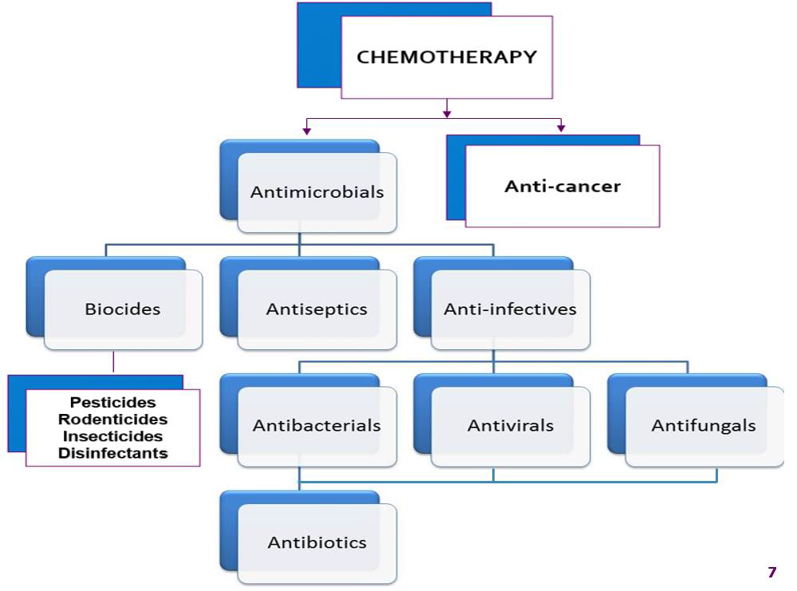

Slide 3
Antiseptics & Disinfectants
Antiseptics - applied to living tissues
Disinfectants - applied to inanimate objects
Sterilization - complete destruction of all organisms
Sanitization - contamination reduced to a level compatible with public health standards

Slide 4
Antiseptic & Disinfectant agents
Alcohols
Aldehydes
Iodine solutions
Chlorine compounds
Phenols
Miscellaneous

Slide 5
Alcohols - asantiseptics
Ethanol
  virucide & bacteriocide (dissolves cell wall)
  Most effective @ 70%
    more concentrated is less effective
    90% kill with 2 minute exposure

Slide 6
Aldehydes
Gluteraldehyde
  lethal to all microorganisms
  Disinfectant use only
    too toxic to use as antiseptic
    requires 10 hours exposure for complete kill
Formaldehyde
  only as disinfectant
  slower acting than gluteraldehyde
    requires 2-4 days

Slide 7
Iodine solutions
Iodine solution & iodine tincture
  Antiseptic - in use for more than 150 years
Povidone-iodine [Betadine]
  less effective
  povidone is a slow-release reservoir
  Used postoperative

Slide 8
Miscellaneous antriseptics
Chlorhexadine
  Antibacterial but not virucidal

Slide 9
Antimicrobials
The pharmacotherapy of infectious diseases is unique. In the pharmacotherapy of most diseases, we give drugs that have some desired pharmacologic action at some receptor or protein in the patient. To treat infections, we give antibiotics to exert a desired pharmacologic effect on the organism that is causing infection in the patient. With few exceptions, direct effects on the patients from antibiotics are not desired and are adverse effects.

Slide 10
Antimicrobial Drugs
Drugs used to treat microbial infections
Before antimicrobials, large number of people died from common illnesses
Now many illnesses easily treated with antimicrobials
However, many antimicrobial drugs are becoming less useful
Different types of antimicrobial drugs:
  Antibacterial drugs
  Antifungal drugs
  Antiprotozoan drugs
  Antihelminthic drugs

Slide 11
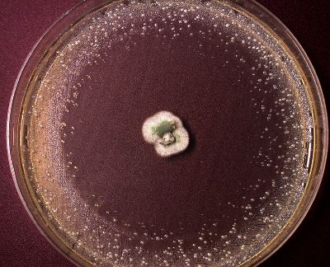
Antibiotic
A chemical substance produced by various species of organisms that is capable of killing or inhibiting the growth of other microbes or cells
i.e refers only to a subset of antibacterial drugs that are natural products.
The discovery of the first antibiotic was an accident.
  Alexander Fleming accidentally contaminated a plate with a fungus.
  He observed a clearly defined region of no bacterial growth where the fungi had contaminated the plate.
  The area around the fungus was eventually referred to as a zone of inhibition.

Slide 12
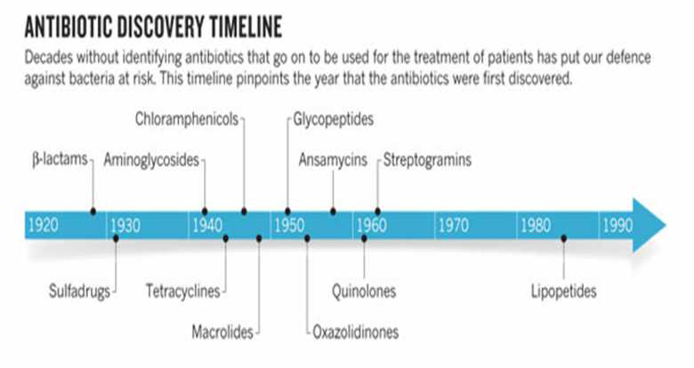

Slide 13
Classifications of antimicrobials
According to their antimicrobial spectrum:
Antimicrobial agents are also classified according to pharmacological effects as either:
1- bacteriostatic or
2- bactericidal agents.
C. According to the source and chemistry:
1-Synthetic Chemotherapeutic Agents:
2-Antibiotics:
D. Antimicrobial agents are also classified according to their Mechanism of action:

Slide 14
1- Spectrum of Activity
refers to the range of microorganisms that a antimicrobial agent can kill or inhibit, so it may be:
1-broad spectrum
    affect a wide range
    can disrupt the normal flora of the body (superinfection)
    used particularly in the cases of rapid onset life-threatening infections, when there is no time to culture the causative agent
    2- Narrow spectrum
    limited range
    requires the identification of the pathogen

Slide 15
Different antibiotics target different kinds of bacteria
  i.e., different spectrum of activity
Examples:
  Penicillin G (= original pen.) mainly streptococci (narrow spectrum)
  Vancomycin only Gram-positive bacteria (intermediate spectrum)
  Carbapenems many different bacteria (very broad spectrum)

Slide 16
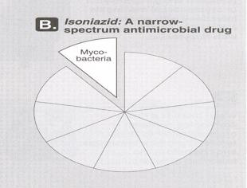


Slide 17
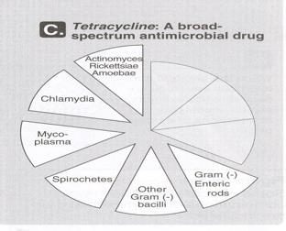

Slide 18
2- Selective toxicity:
  the antimicrobial agent blocks or inhibits a metabolic pathway in a micro-organism which is either absent or is different in the mammalian cells of the human host.
  =The drug must be more toxic to a pathogen than a pathogen’s host.
Differences between cells of microorganisms and humans in anatomy, biochemistry, and affinity of antibiotics for their targets are what allow for the safe and effective use of antibiotics.

Slide 19
Bacteriostatic-inhibit growth of bacteria, hosts immune responses necessary to eradicate bacteria. If antibiotics are removed, the organisms can begin growing again.
Bacteriostatic antibiotics are usually successful in treating infections because they allow the patient’s immune system to “catch up” and kill off the organisms. (Remember, many bacteria can double every 20–30 minutes!)
Other antibiotics are considered bactericidal; their action kills the organisms without any help from the immune system.
• Disadvantage of bactericidal: rapid bacterial lysis e.g. in meningitis with overwhelming inflammatory response with increased mortality. i.e Bactericidal may lead to release of toxins and microbial contents leading to subsequent illness and inflammatory responses.
For most infections, outcomes using appropriate bacteriostatic versus bactericidal drugs are similar; however, for certain infections, bactericidal drugs are preferred. Such infections include endocarditis, meningitis, and infections in neutropenic patients. The immune system may not be as effective in fighting these infections because of the anatomic location or the immunosuppression of the patient.
So,. Bactericidal drugs are preferred in:
Impaired host defense
Infections with poor blood flow (endocarditis, endovascular infections , osteomyelitis ………
Low WBC (<500)
Cancer patients
CSF penetration (meningitis)

Slide 20
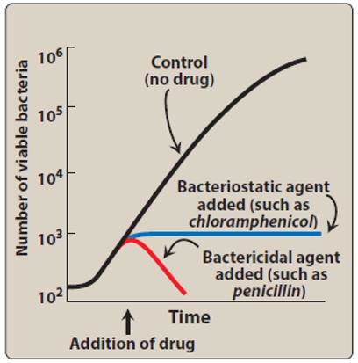

Slide 21
3- According to mechanism of action
Each micro-organism has special structure which can be a target for the antimicrobials
Example for bacteria :

Slide 22
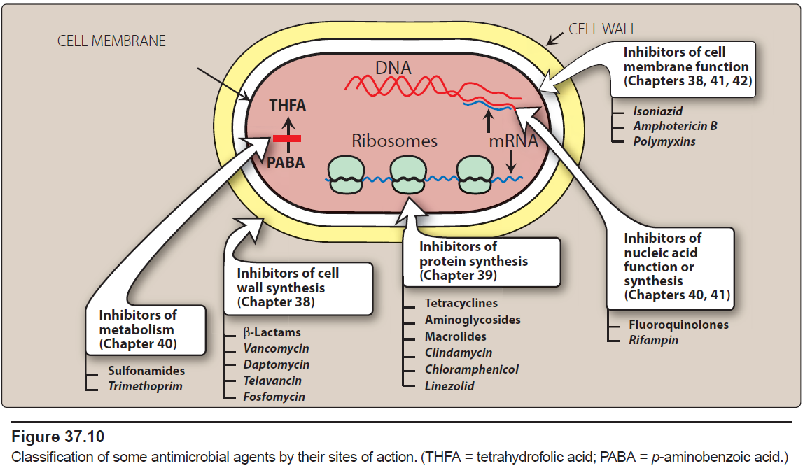

Slide 23
Cell coverings of bacteria
Inner: Cell / plasma membrane
Outer: Cell wall, Peptidoglycan layer consists of glycan chains
Glycan chains: linear strands of two alternating amino sugars
N-acetylglucosamine (Nag)
N-acetylmuramic acid (Nam)
Cross linking of these strands by peptide chains

Slide 24
One of the most fundamental differences among types of bacteria is how they react to a Gram stain. Gram stain (crystal violet) is a substance that selectively stains the cell walls of gram-positive bacteria but is easily washed away from gram-negative bacteria. Why? In gram positive bacteria, the outermost membrane is a thick layer of peptidoglycan, a cellular substance that gives bacterial cells rigidity. In contrast, gram-negative bacteria have an outer membrane of lipopolysaccharide that blocks the stain from adhering to the peptidoglycan within the cell i.e Gram-negatives also contain peptidoglycan, but in smaller amounts, and it is not the outermost layer of the cell.
Both gram-positive and gram-negative organisms contain an inner cell membrane that separates the cell wall from the cytoplasm of the organism.

Slide 25
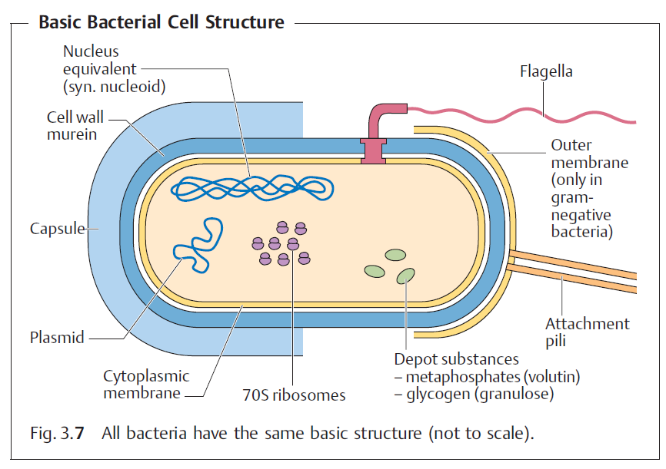

Slide 26
AGAIN
Gram positive bacteria have a thick cell wall
  Peptidoglycan directly accessible from environment
Gram negative bacteria have a different wall
  Thin layer of peptidoglycan
  Surrounded by an outer membrane composed of lipopolysaccharide, phospholipids, and proteins
  outer membrane is a barrier to diffusion of molecules including many antibiotics
    Only some antibiotics are that hydrophobic
    Porins allow passage of only some antibiotics

Slide 27
Indications for antibiotics include:
Treating bacterial infections in accordance with culture and sensitivity testing.
Prophylaxis: as in
  surgery e.g. gastro-intestinal surgery, joint replacement.
  meningitis contacts
  surgical/ dental procedures in patients with artificial heart valves or heart valve lesions.

Slide 28
The use of antimicrobial chemotherapy falls into one of three general categories:
1- Prophylaxis refers to antibiotics given to prevent an infection that has not yet developed. Use of prophylactic therapy should be limited to patients at high risk of developing an infection, such as those on immunosuppressive therapy, those with cancer, or patients who are having surgery. These patients have weakened natural defenses that render them susceptible to infection. However, the world is not sterile, and breakthrough infections do occur among patients receiving prophylaxis.
So, it Prevent an initial infection or its recurrence after infection
Examples
Trimethoprim/sulfamethoxazole (TMP/SMX) to prevent Pneumocystis cranii (jirovecii pneumonia )in a patient on cyclosporine and prednisone after a liver transplant or HIV patients
Cefazolin given before surgery to prevent a staphylococcal skin infection of the surgical site

Slide 29
Empiric Therapy:
Empiric therapy is given to patients who have a proven or suspected infection, but the responsible organism(s) has or have not yet been identified i.e before specific culture information has been reported or obtained .
It is the type of therapy most often initiated in both outpatient and inpatient settings. After the clinician assesses the likelihood of an infection based on physical exam, laboratory findings, and other signs and symptoms, he or she should generally collect samples for culture and Gram staining.
The process of culturing the sample begins around the time that the clinician performs the Gram stain. After a day or so, testing will reveal the identification of the organism, and eventually the organism can be tested for its susceptibility to various antibiotics. However, this process takes several days, so empiric therapy is generally initiated before the clinician knows the exact identification and susceptibilities of the causative organism. Empiric therapy is our best guess of which antimicrobial agent or agents will be most active against the likely cause of infection. Sometimes we are right, and sometimes we are wrong. The significance of making a correct guess differs depending on the severity of the infection; a wrong choice for an uncomplicated urinary tract infection (UTI) results in an annoyed patient, whereas the wrong choice for meningitis is fatal. Keep in mind that empiric therapy should not be directed against every known organism in nature—just those that cause the infection in question. Her we use use more “broad spectrum” anti-microbials.
Examples
Levofloxacin initiated for a patient with presumed community-acquired pneumonia
Ceftriaxone given for the treatment of suspected pyelonephritis

Slide 30
Definitive Therapy:
After culture and sensitivity results are known, the definitive therapy phase of treatment can begin. Unlike empiric therapy, with definitive therapy we know on what organisms to base our treatment and which drugs should work against them. At this phase, we choose antimicrobial agents that are safe, effective, narrow in spectrum, and cost-effective. This helps us avoid unneeded toxicity, treatment failures, and the possible emergence of antimicrobial resistance; it also helps manage costs. In general, moving from empiric to definitive therapy involves decreasing the spectrum of coverage, because we do not need to target organisms that are not causing infection in our patient. In fact, giving overly broad-spectrum antibiotics can lead to the development of superinfections: infections caused by organisms resistant to the anti-biotics in use that occur during therapy.
So,
  Organism(s) identified and specific therapy chosen
  More “narrow” spectrum

Slide 31
Examples of Definitive Therapy
Transitioning from piperacillin/tazobactam to ampicillin in a patient with a wound infection caused by Enterococcus faecalis, which is susceptible to both drugs
Discontinuing ceftriaxone and initiating ciprofloxacin for a patient with a UTI caused by Klebsiella pneumoniae that is resistant to ceftriaxone but susceptible to ciprofloxacin

Slide 32
Selecting a Therapeutic Regimen
Confirm presence of infection: by :
  (a). History
  (b) signs and symptoms
    Fever
    Pain, tenderness and inflammation
    Symptoms related to organ
    WBC count and ESR
  (c) Identify predisposing factors
Selection of drug: Before selecting Empiric therapy get material for c/s or for microscopy
Consider the spectrum of activity; narrow versus broad spectrum
Special conditions like sepsis or meningitis
Notes:
A.

Slide 33
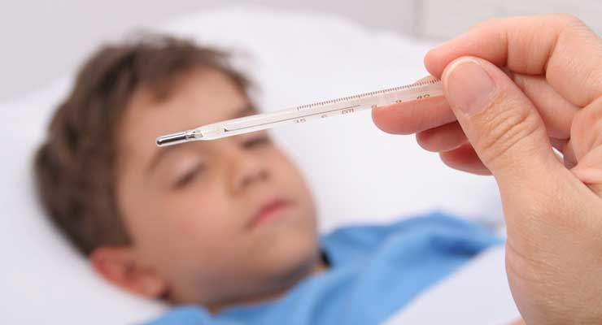
  Confirm the presence of an infection
  CAREFUL history and physical exam including relevant laboratory data and signs and symptoms
  Fever:
  Is considered a hallmark of most infectious diseases.
  defined as elevated temperature >37.2◦C.
  May be present in absence of infection e.g. in autoimmune disorders and several malignancies.

Slide 34
  White blood cell count:
  Normal WBC is 4000-10,000 cells/mm3.
  Bacterial infections are associated with elevated granulocyte counts (neutrophils, basophils, and eosinophils).
  Viral, TB and fungal infections are associated with elevated lymphocytic count.
  Parasitic infections and allergic reactions are associated with increased eosinophilic count.
  Any swelling or erythema at a particular site
  Purulent drainage from a visible site
  Patient complaints

Slide 35
  Selection of antimicrobial agents
  Identification of the infecting organism:
  Infected body materials (e.g., blood, sputum, urine, wound drainage, etc.) must be sampled and cultured before initiating treatment.
  Empirical therapy before identification of the organism is necessary in the following conditions:
  In all acutely ill patients with infections of unknown origin.
  Infection in a neutropenic patient, or a patient with meningitis.

Slide 36

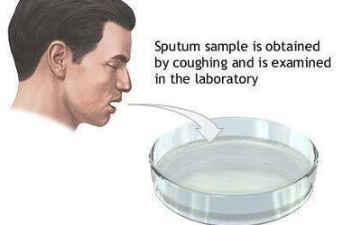
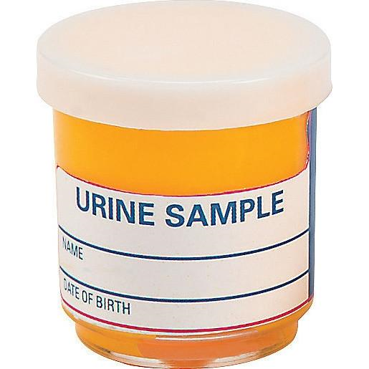
Blood sample | Sputum sample | Urine sample

Slide 37
Definitive identification and susceptibility testing may take anywhere from hours to months, depending on the organism and the methods used. Microscopic examination and staining may allow for rapid preliminary identification. For bacteria, the most important of these techniques is the Gram stain. Being able to interpret preliminary results of microbiology testing will allow you to provide the most appropriate therapy for your patients as early as possible.

Slide 38
Many bacteria that can cause human disease are also normal commensal flora, including Escherichia coli, Streptococcus pneumoniae, and Staphylococcus aureus. Thus, growth of one of these organisms from a culture is not necessarily synonymous with infection.
Suspicion of infection is increased greatly if the organism grows from a normally sterile site, such as the bloodstream or cerebrospinal fluid (CSF).
Indicators of infection in nonsterile sites (such as sputum and wound cultures) are a high number of organisms, the presence of inflammatory cells, and symptoms referable to the culture site (e.g., cough or dyspnea in a patient with a sputum culture growing S pneumoniae, redness and pain in a patient with a skin culture growing S aureus).

Slide 39
Culture Results
Minimum inhibitory concentration (MIC)
  The MIC is the lowest concentration of antimicrobial that prevents visible growth (inhibits bacterial growth) in body tissues and fluids that. (measured visually)
  Organism and antimicrobial specific
Report organism(s) and susceptibilities to antimicrobials
  Susceptible (S)
  Intermediate (I)
  Resistant (R)
  N.B : Drug must inhibit microorganism at lower concentrations than those that produce toxic effects in humans
MBC = minimum bactericidal concentration lowest concentration of antibiotic that kills bacteria.

Slide 40
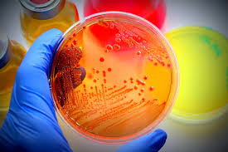
Culture for micro-organism

Slide 41
  Patient factors:
  In neonates
  The use of chloramphenicol can lead to shock and cardiovascular collapse(gray baby syndrome).
  The use of sulfonamides may lead to kernicterus (brain damage)
  In growing children:
  the use of fluoiroquinolones can lead to arthropathy
  - the use of tetracyclines can bind to growing bones and teeth resulting in abnormal teeth and bone formation.

Slide 42
  In old age(>65years)
  The incidence of renal toxicity with aminoglycosides is greater than in younger patients.
  In immunocompromised patients
  The use of bactericidal agents is necessary , as the host’s immune system is not capable of final elimination of the bacteria.
  Pregnancy:
  Many antibiotics cross the placenta and cause adverse effects to the fetus e.g. aminoglycosides and tetracyclines.

Slide 43
  Tissue penetration:
  The capillary lining in some tissues e.g. brain form natural barriers to drug delivery due to presence of tight junctions of the capillary wall.
  Lipid soluble antibiotics e.g. chloramphenicol and metronidazole can cross these barriers in normal conditions.
  Poor perfusion of some area
  e.g. diabetic foot, reduces the amount of antibiotic reaching this area, making treatment is difficult.

Slide 44
  Determinants of the rational dosing:
  May be :
  Concentration or dose dependent killing:
Antibacterial effect directly depends on their concentrations in the locus of inflammation
  Giving these antibiotics by a single large dose per day achieves high peak levels and cause rapid killing of bacteria. (high doses every 1-2 times/24h)
Examples :Aminoglycosides, Fluoroquinolones
Metronidazol, Amphotericin B

Slide 45
Time-dependent killing:
depends on the time of the drug concentration to remain above the MIC. So, preparations with long duration kill more bacteria.
e.g.β-lactam antibiotics, macrolides, clindamycin, and linezolid
Post-antibiotic effect (PAE):
The Post-Antibiotic Effect (PAE) shows the capacity of an antimicrobial drug to inhibit the growth of bacteria after removal of the drug from the culture.(after levels of antibiotic fall below the MIC.)
The PAE provides additional time for the immune system to remove bacteria that might have survived antibiotic treatment before they can eventually regrow after removal of the drug.
(e.g. aminoglycosides and fluoroquinolones) usually require one dose per day.

Slide 46
 Adverse effects of antimicrobial agents:
The adverse effects associated with the use of antimicrobial agents include:
1-Hypersensitivity or allergic reactions: In form of fever, skin rash, arthralgia, cholestatic jaundice or hemolysis. More serious reactions are agranulocytosis, bone marrow aplasia or anaphylactic reaction.
2-Resistance
3-Superinfection= (Opportunistic infection): Reactions related to alterations in normal body flora

Slide 47
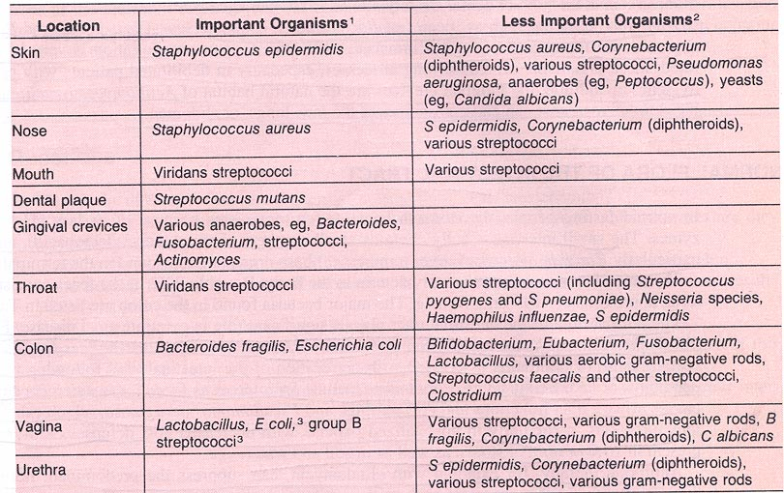
Normal Bacterial Flora

Slide 48
Superinfection
Colonization with commensal organisms can be beneficial, given that they compete with and crowd out more pathogenic organisms. They may even have a role in the prevention of other human diseases and in proper immune system development.
Administration of antimicrobials usually alter bacterial flora but with no ill effect in most cases however, broad-spectrum antibiotics if used for long time may alter or kill bacterial flora. So, the bacteria and fungi that are normally inhibited by bacterial flora will multiply leading to superinfection (its early manifestation may by diarrhea).
  Causative micro-organisms : may be staphylococci, Pseudomonas, proteus, Candida albicans or Clostridia difficile.
  sites : Superinfection may be vaginal, oral, pharyngeal or even systemic infection e.g. staphylococcal enterocolitis, candidiasis or Pseudomembranous colitis(=antibiotic-associated diarrhea).

Slide 49
For example:
1-Administration of antibiotics can lead to the overgrowth of the gastrointestinal (GI) pathogen Clostridioides difficile, which is clinically resistant to most antibiotics. C difficile can cause diarrhea and life-threatening bowel inflammation.
2- Similarly, administration of broad-spectrum antibacterial drugs can select for the overgrowth of fungi, most commonly yeasts of the genus Candida. Disseminated Candida infections carry a high risk of death.
To reduce the risk of the impact of antibiotics on the commensal flora, and thus the likelihood of superinfection, antibiotics should be administered only to patients with proven or probable infections, using the most narrow-spectrum agents appropriate to the infection for the shortest effective duration.

Slide 50
Treatment:
Stop the causative agent and give drug, which kill the organisms responsible for super infection e.g.
(staphylococcal enterocolitis, which is treated by metronidazole or vancomycin orally), antifungal nystatin for candidiasis. If it is in the form of pseudmembranous colitis, it is treated with (antianaerobic e.g. metronidazole or vancomycin, in addition you must give symptomatic treatment in form of adsorbants and antidiarrheal).

Slide 51
4-Vitamin B complex deficiency may follow the use of antimicrobials e.g broad-spectrum antibiotics. It is due to inhibition of bacterial flora that forms these vitamins.
5-Direct toxic reactions (organ toxicity), resulting from high doses or drug interactions, on hemopoietic system, liver, kidney, GIT, nervous system or CVS.

Slide 52
◆ Resistance to antimicrobial drugs
Biochemical mechanisms:
1-Production of inactivating enzymes:
e.g. β-lactamases (by staph. and some gram-negative bacilli) inactivate β-lactam antibiotics.
2-Reduced bacterial permeability to antibiotics:
e.g tetracyclines accumulate by active transport mechanism in susceptible organisms. Resistant strains lack this mechanism.
3-Modification of the receptor site:
e.g. Loss or alteration of the receptor protein on 30S ribosome causes resistance to aminoglycosides and 50S ribosome causes resistance to erythromycin.
4-Development of an alternate metabolic pathway that bypasses the reaction inhibited by the drugs:
e.g. sulfonamide-resistant bacteria can utilize pre-formed folic acid.

Slide 53
Genetic basis of acquired resistance:
Chromosomal resistance:
Extrachromosomal resistance:
This results from transfer of genetic material from one bacterium to another.The genetic material may be in the form of plasmids . The genetic material and plasmids can be transferred by transformation, transduction, conjugation, or translocation.
 Prevention of antimacrobial resistance:
1-Choice of proper effective drug.
2-Give the proper dose for sufficient time to maintain sufficiently high levels of the drug in tissues
3-Drug combination e.g. in TB
4-Avoid unnecessary exposure of microorganism to a particularly valuable drug by restricting its use (e.g. rifampicin mainly for TB)

Slide 54
◆ Combinations of antimicrobials
Clinical values (indications or aims) of antimicrobials combination:
1-To obtain better effect (synergism) or to increase the spectrum e.g.
Sulfamethoxazole plus trimethoprim to form co-trimoxazole.
clavulanic acid plus amoxicillin as clavulanic acid inhibits β-lactamase. Another example is sulbactam with ampicillin
Penicillin plus aminoglycoside.
2-To reduce the toxicity or incidence of adverse effects.
3-To prevent or delay the emergence of resistant strains especially in chronic infections as tuberculosis in which two or three agents are used.
4-In mixed infections as peritonitis (following colon perforation), a drug active against anaerobes and gram-positive bacteria (e.g. clindamycin) is combined with one active against gram-negative bacteria coliforms e.g aminoglycosides.
5-For emergency treatment of serious infections before laboratory studies are completed e.g. in suspected septicemia. Anti-staphylococcus (nafcillin) may be combined with a drug active against aerobic gram-negative bacilli (aminoglycosides).

Slide 55
Results of antimicrobial combinations:
Combining antimicrobial agents may result in the following:
1-Bactericidal + bactericidal results in synergism:
2-Bacteriostatic + bacteriostatic results in addition (summation):
3-Bactericidal + bacteriostatic (antagonism):
Synergism occurs when the effect of two drugs together is greater than the effect of either alone.
Antagonism occurs when the effect of two drugs together is less than the effect of either alone.

Slide 56
 Disadvantages of antimicrobial combination:
1-Antagonism:
This may occur if a bacteriostatic (tetracycline, chloramph-enicol) and a bactericidal (penicillin, cephalorporins, aminoglycosides) drugs are used together.
2-Increase incidence of Adverse effects and cost.
3-Efforts toward accurate diagnosis may be neglected.

Slide 57
◆ General principles of therapy with antimicrobials
1-Antimicrobials should only be given when necessary and after antimicrobials susceptibility test whenever possible.
2-The pharmacokinetics of the drug should be taken into consideration e.g. the state of hepatic and renal functions of the patient.
3-In serious infection it is better to start with a parentral loading of a bactericidal agent to avoid emergence of resistant strains by giving adequate dosage for sufficient duration.
4-Antimicrobials should be continued for 3 days after apparent cure is achieved to avoid relapse.
5-Bactericidal drugs should be used when there is leucopenia or the phagocytic cells can not get to the site of infection e.g. endocarditis.

Slide 58
Why Do Antimicrobials Fail?
1-Host Factors
Immune System (poor host defense)
Underlying Diseases
Barrier Status
Retained Foreign Bodies
undrained pus (presence of dead tissue).
2-Site of Infection
CNS
Intravascular
Pulmonary
Surgical Intervention
3-Antibiotic Properties
Improper route of administration, Metabolism & Elimination , poor penetration into the site of infection.(pharmacokinetics)
Pharmacodynamics (Inappropriate choice, in adequate duration or dose)
Adverse Event Profile
4-Pathogen
Species
Virulence Factors
Resistance Mechanisms
superinfection

Slide 59
Desired properties of antibiotics (ideal antibiotic)
Selective toxicity.
Bacteriocidal rather than bacteriostatic.
Narrow spectrum – does not kill normal flora
Pharmacokinetics properties : Good absorption ,Water soluble and stable. Soluble in body- Good tissue distribution – BBB.
Long plasma half-life. Remains in body long enough to be effective - resists excretion and breakdown.
Cost not excessive.
Various routes of administration – IV, IM, oral
Few adverse reactions – toxicity, allergy.
Do not develop antibacterial resistance.
10- High therapeutic index – ratio of toxic level to therapeutic level

Slide 60
Other factors for selection of therapy
HOST FACTORS
Allergy
Age
Pregnancy
  Organ dysfunction :consideration e.g. the state of hepatic and renal functions of the patient.
Concomitant use of drugs
Comorbid disease states

Slide 61
  Antimicrobials should only be given when necessary and after antimicrobials susceptibility test whenever possible.
  The pharmacokinetics of the drug should be taken into In serious infection it is better to start with a parenteral loading of a bactericidal agent to avoid emergence of resistant strains by giving adequate dosage for sufficient duration and adapting proper combination regimens.
  Antimicrobials should be continued for 3 days after apparent cure is achieved to avoid relapse.

