Slide 1
Meningitis
Dr.Mohammed Abdelmoneim Attia

Slide 2
The brain and spinal cord are covered by connective tissue layers collectively called the meninges which form the blood-brain barrier.
1-The pia mater. closest to the CNS
2-The arachnoid mater
3-The dura mater . farthest from the CNS.

Slide 3
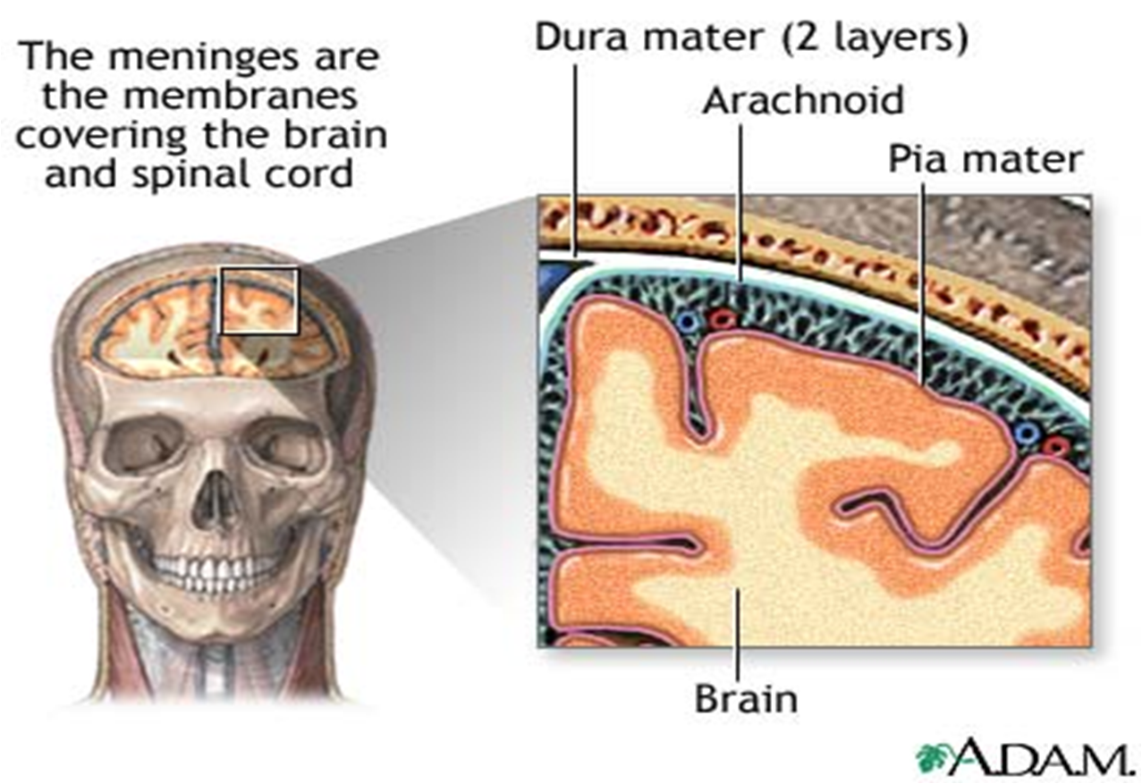

Slide 4
Meningitis is an inflammation of the meninges.
Encephalitis, an inflammation of the brain tissue
Miningoencephalitis is inflammation. of the meanings and brain tissue.

Slide 5
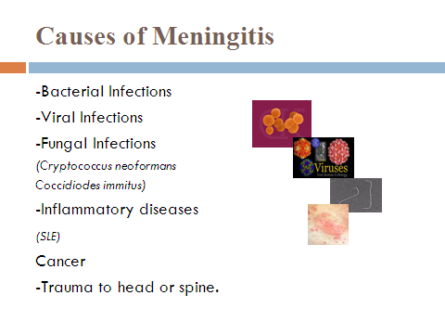

Slide 6
Bacterial Meningitis
Streptococcus pneumoniae (pneumococcus). This is the most common cause of bacterial meningitis in infants, young children and adults.
Neisseria meningitidis (meningococcus).
Haemophilus meningitis: Since 1985 Incidence has declined by 95% due to the introduction of Haemophilus influenza b vaccine.
Listeria monocytogenes (listeria). These bacteria can be found in soft cheeses, hot dogs and luncheon meats
Other bacterial meningitis caused by E-Coli, Klebsiella species and Enterobacter species are less common overall

Slide 7
Aseptic Meningitis
Definition: A syndrome characterized by acute onset of meningeal symptoms, fever, with bacteriologically sterile cultures.
Laboratory criteria for diagnosis:
No evidence of bacterial or fungal meningitis.
Comment
Aseptic meningitis is a syndrome of multiple etiologies, but most cases are caused by a viral agent
Enteroviruses (Coxsackie's and echovirus): most common.
-Adenovirus
-Arbovirus
-Measles virus
-Herpes Simplex Virus
-Varicella
Modes of transmission:
-Primarily person to person and arthopod vectors for Arboviruses
Treatment: No specific treatment available. Most patients recover completely on their own

Slide 8
Bacterial Meningitis - Pathogenesis
Infection of upper respiratory tract
Invasion of blood stream (bacteraemia)
Direct truma
inflammation of meninges

Slide 9
MEMNINGOCOCCAL MENINGITIS
(Cerebrospinal fever)
It is an acute infectious bacterial disease characterized by purulent meningitis.
Causative agent: Meningococci (Neisseria meningitidis) including serogroups:
Resistance
Delicate organisms rapidly killed on exposure to heat or cold.
Reservoir: Human, in the form of cases (very minor role in transmission) & carriers (The most important source of infection in endemic areas) . Exit:Nasopharyngeal discharges.
Period of infectivity: as long as meningococci present in nasopharyngeal discharges.
Proper antimicrobials rapidly eliminate the organisms within 24 hours.

Slide 10
Mode of transmission:
1. Direct droplet infection (the main mode): contact with carriers or may be cases.
2. Indirect transmission: by air-borne infection (droplet nuclei & dust) or contaminated articles play minor role (delicate organism)
Portal of entry: nose & mouth.
Incubation period: 2 to 7 days (1-3 days during epidemics).

Slide 11
Susceptibility & resistance
Age: Occurs usually in children & young adults. In epidemics, it affect any age
Sex: More in males than females.
Immunity:
- There is no maternally acquired immunity.
- Vaccination gives high immunity for the strain in the vaccine for 3 years.

Slide 12
Clinical features:
- It may be mild or moderate or sometimes severe.
- Typical features include: fever, severe headache, nausea & vomiting & neck stiffness. There may be a petechial or purpuric rash on trunk & limbs.
In fulminating cases: sudden prostration & shock with rash & has a high fatality rate
- Chronic meningococcal septicemia: febrile episodes, skin rash & fleeting joint pains.
Complications:
- fatality exceeds 50% in untreated cases. By early diagnosis & supportive therapy, it is reduced to 5-10%.

Slide 13
Complications:
(1) Nervous:
*Hydrocephalus, hemiplegia, encephalitis or mental deficiency or cranial nerve palsy usually 3, 4,6,7th nerve.
(2) Eyes:
*Conjunctivitis, iridocyclitis, keratitis or rarely blindness.
(3) Ear:
*Deafness (affection of the 8th nerve or otitis media).
(4) Cardiac:
*Pericarditis. *Endocarditis.
(5) Genito-urinay:
*Nephritis. *Pyelitis.
*Epididymitis. *Orchitis.
(6) Joint:
*Arthritis especially in the knee and shoulder joints.

Slide 14
Clinical signs
Signs of infection (fever, malaise , rigor….)
Signs of meningeal irritation:
1.headache
2.neck stiffness
3.photophobia
4.irritability

Slide 15
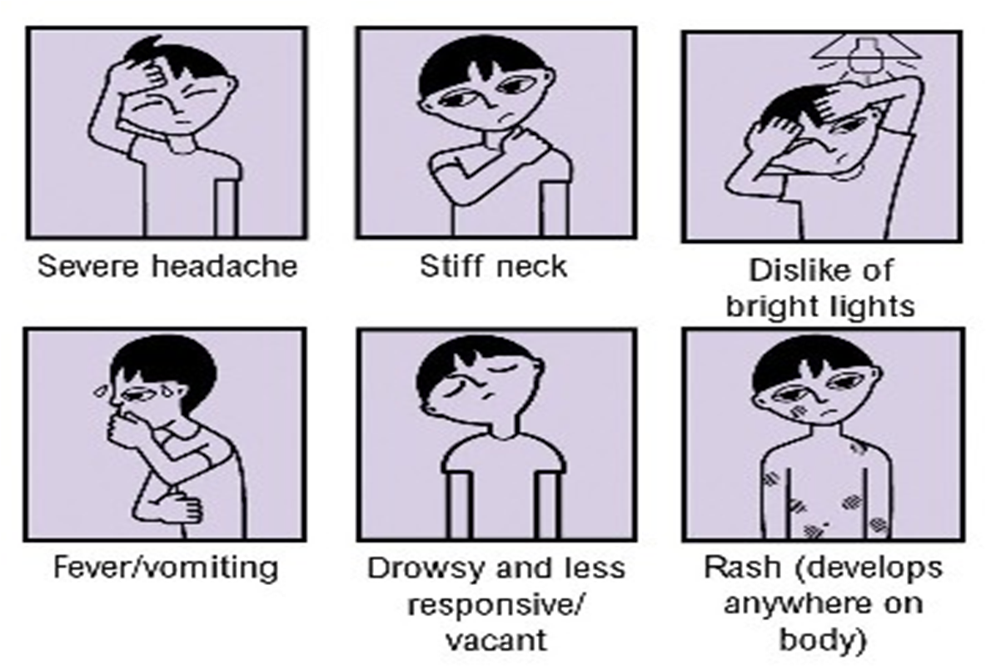

Slide 16
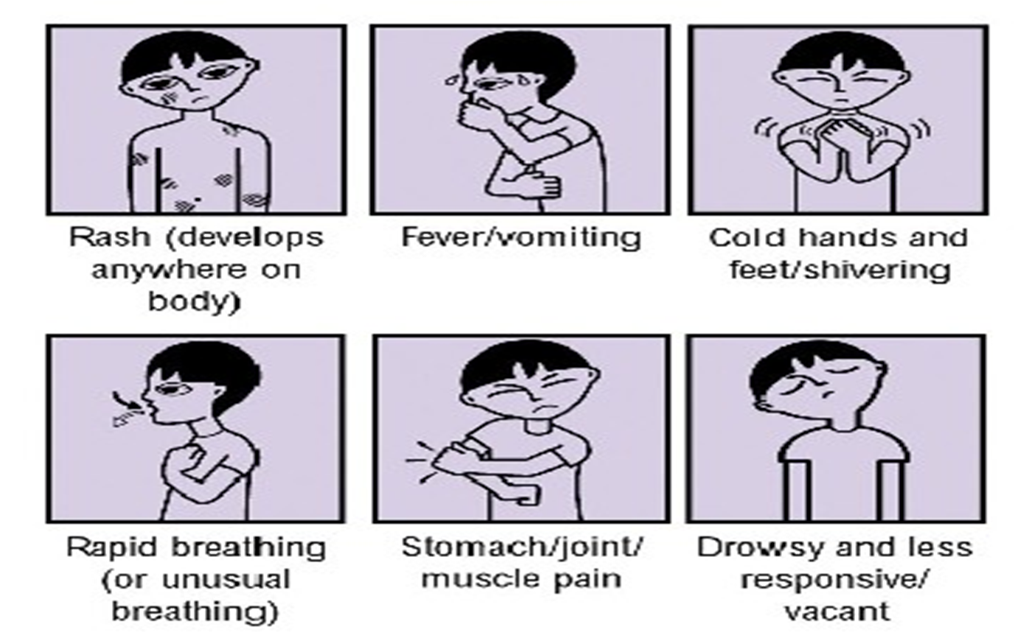

Slide 17
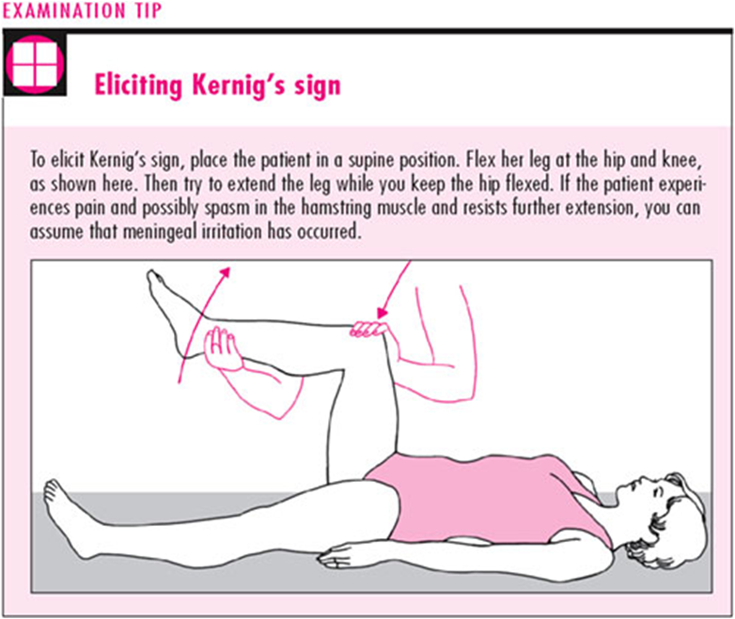

Slide 18
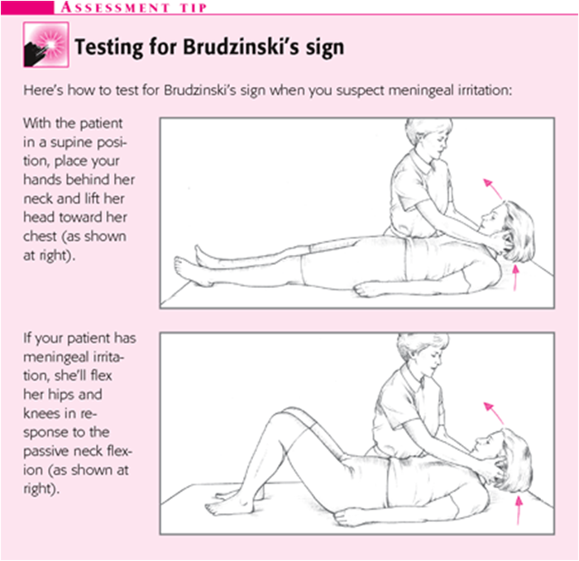

Slide 19
Skin rashes
One sign of meningococcal septicemia is a rash that does not fade under pressure
-This rash is caused by blood leaking under the skin. It starts anywhere on the body. It can spread quickly to look like fresh bruises.
-This rash is more difficult to see on darker skin. Look on the paler areas of the skin and under the eyelids

Slide 20
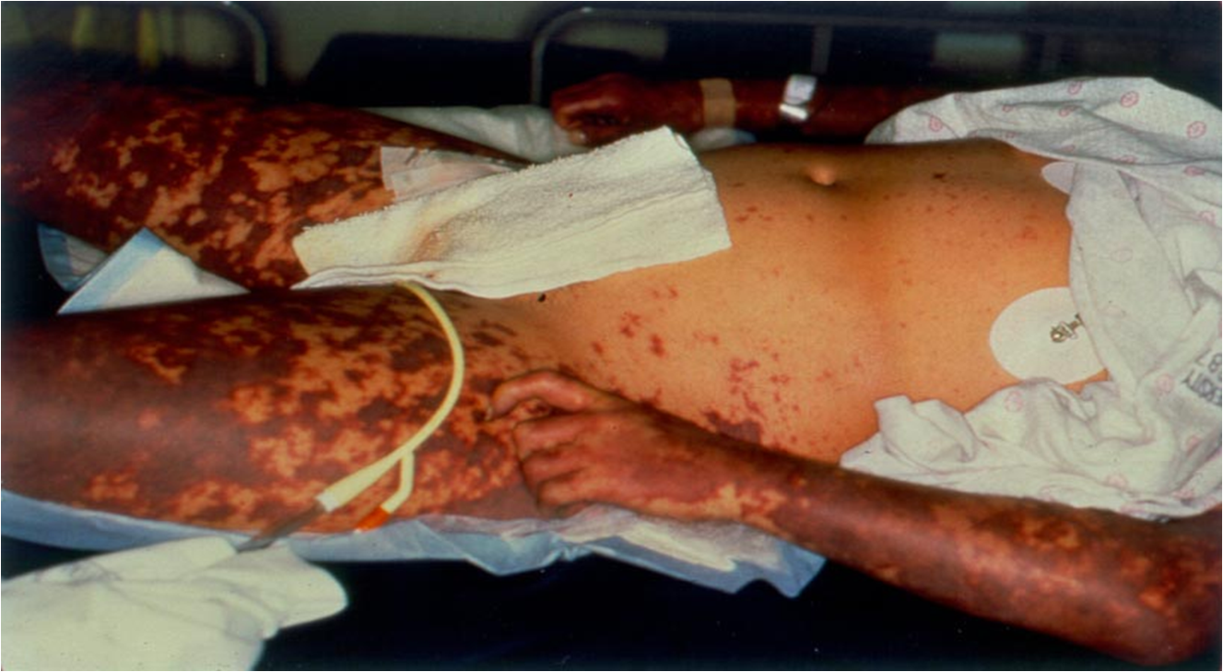

Slide 21
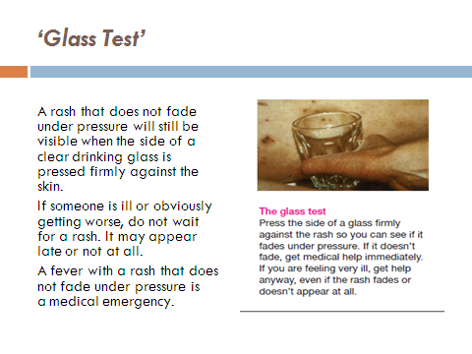

Slide 22
How is meningitis diagnosed?
Lumbar puncture The definitive diagnosis of meningitis requires an analysis of cerebrospinal fluid (CSF), it contains organisms that cause the illness.
blood culture and stains (Gram's stain)
Imaging. X-rays and computerized tomography (CT) scans of the head, chest or sinuses may reveal swelling or inflammation

Slide 23
Blood studies that may be useful include the following:
Complete blood count (CBC) with differential
Serum electrolytes
Serum glucose (which is compared with the CSF glucose)
Blood urea nitrogen (BUN) or creatinine and liver profile

Slide 24
Differential diagnosis:
1- Other causes of bacterial meningitis.
2- Aseptic meningitis.
3- Meningism: meningeal irritation without inflammation due to acute infection in another site in the body e.g. pneumonia, otitis media.

Slide 25
The difference between Meningitis and Septicaemia
Meningitis - bacteria enter the blood stream and travel to the meninges and cause inflammation.
Septicaemia - when bacteria are present in the blood stream they can multiply rapidly and release toxins that poison the blood. (The rash associated with meningitis is due to septicaemia.)
Meningitis and septicaemia often occur together

Slide 26
Prevention:
[1] General Prevention: (General Preventive measures for droplet infections)
[2] Specific prevention:
(1) Active immunization:
Quadrivalent vaccine containing group A, C, Y & W 135:
In Egypt, it is given to school children at the age of 6 & 9 years

Slide 27
2- Chemoprophylaxis
Cotrimoxazole : 1gm/12 hours, for 2 days, children half the dose.
Rifampicine: 600mg/12 hours, for 2 days, children half the dose.
Ceftriaxone: 250mg IM given in a single dose.
Ciprofloxacine: 500 mg orally once for adult.
Treatment:…………………………………..

Slide 28
Other types of meningitis are treated with specific therapy as appropriate for the causative pathogen:
Fungal meningitis - Cryptococcal (amphotericin B, flucytosine, fluconazole, itraconazole),
Tuberculous meningitis (isoniazid, rifampin, pyrazinamide, ethambutol, streptomycin)
Parasitic meningitis – Amebic (amphotericin B, miconazole, rifampin)
or helminthic (largely supportive)

