Slide 1
Quinolones

Slide 2
Quinolones and FLUOROQUINOLONES (FQs)
Nalidixic acid is the first quinolone to be introduced and also the predecessor to all fluoroquinolones, Numerous structural modifications during the 1980's with the discovery that addition of fluorine at position-6 of the quinolone nucleus will increase antimicrobial activity and improve pharmacokinetics.

Slide 3
MOA: cidal
All topoisomerases can relax DNA but only gyrase can also carry out DNA supercoiling (‘supercoiling’ process is necessary to compact the bacterial chromosome which is 1000 times longer than the bacterial cell).
Topoisomerases are also involved in DNA replication, transcription and recombination.
• The main quinolone target is the DNA gyrase which is responsible for cutting one of the chromosomal DNA strands at the beginning of the supercoiling process. The nick is only introduced temporarily and later the two ends are joined back together (i.e., repaired).
• The quinolone molecule forms a stable complex with DNA gyrase thereby inhibiting its activity and preventing the repair of DNA cuts

Slide 4
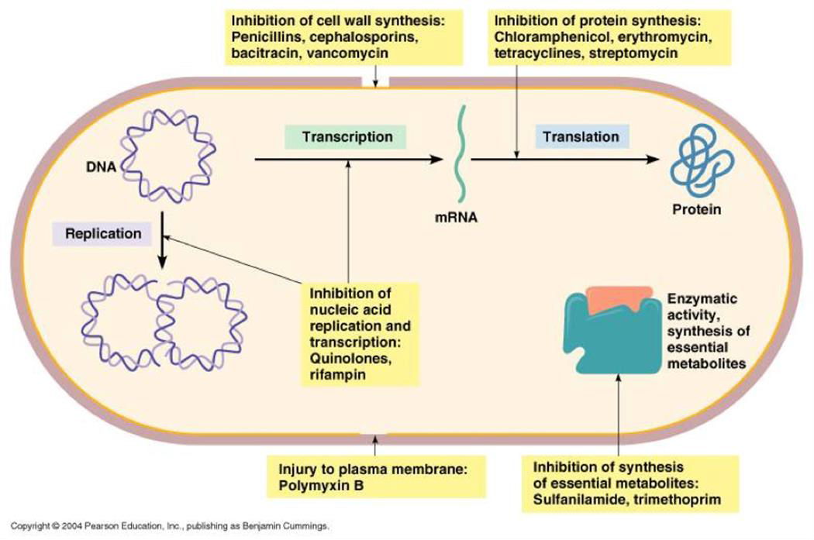
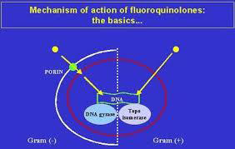
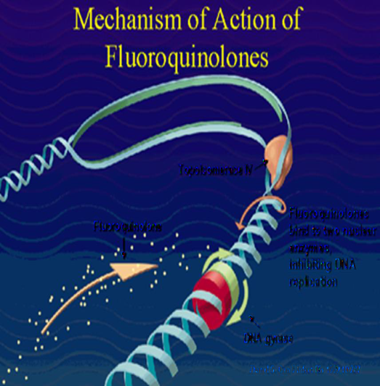

Slide 5
Spetrum : fluoroquinolones are effective against: gram gram-positive organisms and negative organisms, atypical organisms (Legionella, Chlamydia), and some mycobacteria (Mycobacterium tuberculosis). Fluoroquinolones are typically
not used for the treatment of Staphylococcus aureus or enterococcal infections.
Fluoroquinolones may be classified into “generations” based on their antimicrobial targets:
1- Nalidixic acid is considered to be first generation, with a narrow spectrum of susceptible organisms.
2-Ciprofloxacin and norfloxacin are second generation because of their activity against aerobic gram-negative and atypical bacteria. In addition, these fluoroquinolones exhibit significant intracellular penetration, allowing therapy for infections in which a bacterium spends part or all of its life cycle inside a host cell (for example, chlamydia, mycoplasma, and mycobacteria)
3-Levofloxacin is classified as third generation because of its increased activity against gram-positive bacteria.
4- Lastly, the fourth generation includes only moxifloxacin because of its activity against anaerobic and gram-positive organisms. Moxifloxacin also has activity against many anaerobes.
Levofloxacin and moxifloxacin are sometimes referred to as “respiratory fluoroquinolones,” because they have excellent activity against S. pneumoniae, which is a common cause of community-acquired pneumonia (CAP).

Slide 6
Pharmacokinetics
Absorption: Ingestion of fluoroquinolones can form complex with (chelate) sucralfate, aluminum- or magnesium- containing antacids, or dietary supplements containing iron or zinc as in (multivitamins)so it can reduce the absorption of them. Milk , Calcium and other divalent cations also interfere with the absorption of these agents .
So, separate these agents by at least 2 hours or have your patient take a week off of the supplements, if possible.
2- Distribution: Binding to plasma proteins ranges from 10% to 40%. The fluoroquinolones distribute well into all tissues and body fluids. Levels are high in bone, urine (except moxifloxacin), lungs, kidney, and prostatic tissue. Penetration into cerebrospinal fluid is relatively low (except for ofloxacin). Fluoroquinolones also accumulate in macrophages and polymorphonuclear leukocytes, thus having activity against intracellular organisms.
3-Elimination: Most fluoroquinolones are excreted renally therefore, dosage adjustments are needed in renal dysfunction. Moxifloxacin is excreted primarily by the liver, and no dose adjustment is required for renal impairment.

Slide 7
Uses:
1- Norfloxacin: is infrequently prescribed due to: poor oral bioavailability and a short half-life. It is effective in treating non-systemic infections, such as: urinary tract infections (UTIs), prostatitis, and infectious diarrhea
2-Levofloxacin:
is l-isomer of ofloxacin and has largely replaced it clinically. Levofloxacin has broad spectrum activity and is used in wide range of infections including: Prostatitis, skin infections, Community acquired pneumonia (CAP), Nosocomial pneumonia. Levofloxacin has excellent activity against S. pneumoniae respiratory infections. Levofloxacin has 100% bioavailability and is dosed once daily.
3-Ciprofloxacin: is effective in the treatment of many systemic infections caused by gram-negative bacilli . Ciprofloxacin has the best activity against P. aeruginosa Ciprofloxacin is effective for (Traveler’s diarrhea caused by E. coli , typhoid fever caused by Salmonella typhi . And Tuberculosis as a second-line agent).

Slide 8
4- Moxifloxacin: not only has enhanced activity against gram positive organisms (for example, S. pneumoniae) but also n has excellent activity against many anaerobes. It has poor activity against P. aeruginosa. Moxifloxacin does not concentrate in urine and is not indicated for the treatment of UTIs.
5- Bone and joint infections caused by gram-negative organisms
6- Ophthalmic infections
Fluoroquinolones are commonly considered alternatives for patients with a documented severe β-lactam allergy.

Slide 9
Adverse reactions:Several fluoroquinolones have been removed from the market as a result of serious side effects ( trovafloxacin and gatifloxacin).
1-Nausea, vomiting, diarrhea, headache, dizziness or light- headedness. Patients with central nervous system (CNS) disorders, such as epilepsy, should be treated cautiously with these drugs (seizure inducing potential). Peripheral neuropathy and glucose dysregulation (hypoglycemia and hyperglycemia) have also been noted
2-Phototoxicity : patients taking these agents should be advised to use sunscreen and avoid excess exposure to sunlight. if phototoxicity occurs, discontinuation of the drug is advisable.
3- Articular cartilage erosion (arthropathy) has been observed in immature animals exposed to fluoroquinolones. therefore, these agents should be avoided in pregnancy and lactation and in children under 18 years of age.
4- Arthralgia and increased risk of tendinitis or tendon rupture is more common in the elderly, patients with renal dysfunction, and
those taking corticosteroids. Tendonitis usually precedes rupture, so complaints of tendon
pain should be taken seriously. Less commonly, exacerbations of myasthenia gravis may
occur. Vigorous exercise should be avoided during fluoroquinolone therapy, particularly in patients receiving corticosteroids. They can also exacerbate muscle weakness in patients
with myasthenia gravis also occur with systemic fluoroquinolone use.
5- Interstitial nephritis and crystalluria and pseudomembranous colitis

Slide 10
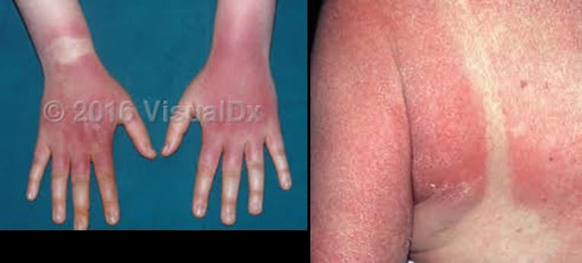

Slide 11
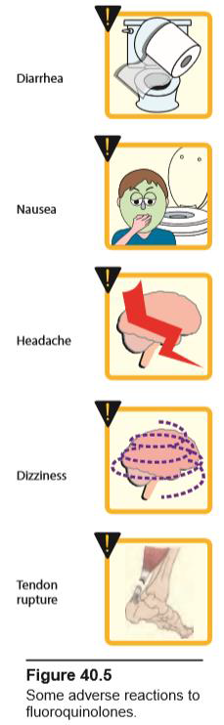
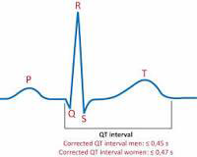
6- Moxifloxacin and other fluoroquinolones may prolong the QTc interval thus, they should not be used in patients who are predisposed to arrhythmias or those who are taking other medications that cause QT prolongation.
7- Quinolones may raise the serum levels of warfarin, caffeine, cyclosporine and theophylline by inhibiting their metabolism (--cytoochrome oxidase enzymes in liver i.e HMEI) Trovafloxacin removed from market very quickly after release cardiac
arrhythmias, liver destruction, phototoxicity.
Gatifloxacin (Tequin®) removed from market(diabetes.)

Slide 12
FOLATE ANTAGONISTS :
folates are essential for the synthesis of purines and pyrimidines (precursors of RNA and DNA). Therefore, in the absence of folate, cells cannot grow or divide. To synthesize the critical folate derivative (tetrahydrofolic acid) humans must first obtain pre-formed folate in the form of folic acid from the diet. In contrast, many bacteria are impermeable to folic acid and other folates and, therefore, must rely on their ability to synthesize folate de novo.

Slide 13
FOLATE ANTAGONISTS :
(sulphonamides, trimethoprim, pyrimethamine and dapson)
1- Sulphonamides :
Mechanism of action
In many microorganisms, dihydrofolic acid is synthesized from p-aminobenzoic acid (PABA), pteridine, and glutamate . All the sulfonamides currently in clinical use are synthetic analogs of PABA. Because of their structural similarity to PABA, the sulfonamides compete with this substrate for the bacterial enzyme, dihydropteroate synthetase. They thus inhibit the synthesis of bacterial dihydrofolic acid and, thereby, the formation of its essential cofactor forms.
Antibacterial spectrum
They are bacteriostatic chemotherapeutic agents, effective against gram-positive organisms, some gram-negative organisms and chlamydia.
They also are effective against Toxoplasma gondii &chloroquine-resistant Plasmodium falciparum.

Slide 14
◆ Pharmacokinetics
Absorption and distribution:
1-After oral administration, most sulfa drugs are well absorbed (the best is sulphadiazine) but an exception is sulfasalazine. It is not absorbed when administered orally or as a suppository and, therefore, Sulfasalazine is reserved for treatment of chronic inflammatory bowel disease (IBD) (for example, ulcerative colitis).
2- In burn units, creams of silver sulfadiazine or sulfamylon have been effective in reducing burn-associated sepsis because they prevent colonization of bacteria.
Distribution:
Sulfa drugs are bound to serum albumin in the circulation, Sulfa drugs distribute throughout the bodily fluids and penetrate well into cerebrospinal fluid even in the absence of inflammation. They can also pass the placental barrier and enter fetal tissues.
.
Metabolism: The sulfa drugs are acetylated and conjugated primarily in the liver. The acetylated product is devoid of antimicrobial activity but retains the toxic potential to precipitate (insoluble ) in renal tubules at neutral or acidic pH. This causes crystalluria (stone formation) and, therefore potential damage to the kidney. Both parent compounds and metabolites are excreted in the urine (so, it is useful for the urinary tract infection).
Excretion: Sulfa drugs are eliminated by glomerular filtration and secretion and require dose adjustments for renal dysfunction. Sulfonamides may be eliminated in breast milk.

Slide 15
Preparations of Sulfonamides
Well absorbed from GIT:
Short acting e.g. Sulfadiazine.
Long acting e.g S. Doxine.
Poorly absorbed from GIT: S. Suxidine and S. Thalidine
For local use only :
S. Thiazole for wounds in absence of pus.
Mafenide for wounds and burns in presence of pus.
S. Acetamide: used as eye drops.
Silver sulphadiazeine for infected burns, bed sores, etc.
Others: S. Salazine for chronic ulcerative colitis.
Therapeutic uses
Systemic uses: shrinking uses due to……………………? Resistance is generally irreversible
But its combinations is used ……………see below
Local uses:
Prevention of infections in burned patients e.g silver sulfadiazine.
Sulfacetamide is used topically for treatment of ocular infections.

Slide 16
Adverse effects
Mild e.g. nausea, vomiting, headache, cyanosis and arthritis.
Serious:
1-Crystalluria:
it is a precipitation of acetylated form or sulfonamide itself in renal tubules leading to renal colic, haematuria, oliguria and even anuria
Prevention:
Give excess fluids (at least 2 liters urine/day)
Give alkalinizing agent e.g. citrate, bicarbonate to prevent precipitation (i.e. increase solubility of sulfonamide and its acetylated form).
2-Allergic reactions
2. Hypersensitivity: Hypersensitivity reactions, such as rashes, angioedema or Stevens-Johnson syndrome, may occur.
Stevens-Johnson syndrome is a rare, serious disorder of your skin and mucous membranes. It's usually a reaction to a medication or an infection. Often, it begins with flu-like symptoms, followed by a painful red or purplish rash that spreads and blisters. Then the top layer of the affected skin dies, sheds and then heals.

Slide 17
4. Hematopoietic disturbances: Hemolytic anemia is encountered in patients with glucose-6-phosphate dehydrogenase (G6PD) deficiency. Granulocytopenia and thrombocytopenia can also occur.
4. Kernicterus: This disorder may occur when given in last 2 weeks of pregnancy or in newborns and infants, because sulfa drugs displace bilirubin from binding sites on serum albumin. The bilirubin is then free to pass into the CNS, because the blood– brain barrier is not fully developed.. It occurs with long acting sulfonamides if used for long time because sulfonamides compete with bilirubin for albumin leading to high free bilirubin concentration in blood.
5. Drug potentiation: Transient potentiation of the anticoagulant effect of warfarin results from the displacement from binding sites on serum albumin. Serum methotrexate levels may also rise through its displacement.
6- Superinfection (with poorly absorbed sulfa).

Slide 18
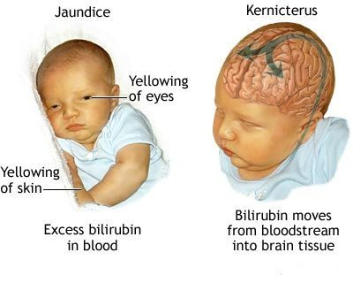
kernicterus

Slide 19
TRIMETHOPRIM
Potent inhibitor of bacterial dihydro folate reductase
◆ Pharmacokinetics
Absorption and distribution:
Trimethoprim is well absorbed from the gastrointestinal tract.
Because the drug is a weak base, so higher concentration will be trapped in acidic prostatic and vaginal fluids. It is also penetrate the cerebrospinal fluid.
◆ Mechanism of action
Trimethoprim competitively inhibits dihydrofolate reductase, the enzyme that catalyzes the reduction of dihydrofolic acid (folic acid) to tetrahydrofolic acid (folinic acid) leading to decreased tetrahydrofolic acid coenzyme required for purine and pyrimidine synthesis. The bacterial reductase has a much stronger affinity for trimethoprim than does the mammalian enzyme, which accounts for the selective toxicity of the drug.
The antibacterial spectrum of trimethoprim is similar to that of sulfamethoxazole. However, trimethoprim is 20- to 50-fold more potent than the sulfonamides. Trimethoprim may be used alone (although fluoroquinolones are preferred) in the treatment of UTIs , Prostatitis

Slide 20
◆ Antibacterial spectrum
Similar to sulfonamide and more potent.
It can be used alone in treatment of acute urinary tract infection, bacterial prostatitis (fluoroquinolones are preferred) and vaginitis.
◆ Adverse effects
1-Hypersensitivity to trimethoprim.
2-It produces the effects of folic acid deficiency which include megalobastic anaemia, leucopenia, and granulocytopenia especially in pregnant patients and those having very poor diets. These blood disorders may be reversed by the simultaneous administration of folinic acid, which does not enter bacteria
3-Possible teratogenic risk in pregnancy.
 Trimethoprim is contraindicated in pregnancy because it is a folate antagonist.

Slide 21
SULFONAMIDES COMBINATIONS:
1- CO-TRIMOXAZOLE:
It is a combination of trimethoprim and S. methoxazole:
Either drug alone is bacteriostatic, but in combination co-trimoxazole is bactericidal (because it inhibits two successive steps of the enzymatic pathway for the synthesis of folinic acid), less bacterial resistance develops and bacteria which were not sensitive to sulfonamides become sensitive e.g. Salmonella, Proteus.
The combination drug trimethoprim/sulfamethoxazole (TMP/SMX) is the most widely used folate antagonist, active against both bacterial and parasitic/fungal infections.
The combination was selected because of: the synergistic activity and the similarity in the half-lives of the two drugs.
Effect of it is synergestic - greater than sum
  Example : 1+1 = 4
Drugs: TMP:SMZ = 1 : 5
It is effective against salmonella, shigella, staphylococci, proteus, E.coli, haemophilus, Neisseria (Pseudomonas is usually insensitive).

Slide 22
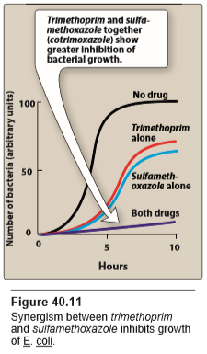

Slide 23
◆ Mechanism of action
Sulphamethoxazole acts on the first step in the folic acid synthesis pathway(see before).
Trimethoprim acts on the second step in the folic acid synthetic pathway(see before). This step occurs in man, but the sensitivity of the enzyme that is inhibited is much greater in bacteria than in man, therefore, the drug is relatively safe.
These drugs inhibit steps in the folate biosynthesis pathway, depleting the pool of nucleosides and ultimately leading to inhibition of DNA synthesis in susceptible organisms.
Cotrimoxazole has a broader spectrum of antibacterial action than the sulfa drugs alone . It is effective in treating= uses
1- Used in treatment of uncomplicated lower UTIs
and prophylaxis against recurrent UTIs and respiratory tract infections,
2-Pneumocystis jirovecii pneumonia tretment and prophylaxis
3- toxoplasmosis,
4-salmonella infections (typhoid fever) resistant to ampicillin or chloramphenicol.
5-community-acquired skin and soft tissue infections caused by methicillin-resistant S aureus infections (MRSA).
6- TMP/SMX is also an alternative therapy for bacterial prostatitis,
Adverse effects
Like sulfonamides and trimethoprim (see before)

Slide 24
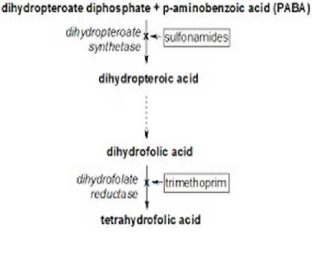

Slide 25
TMP/SMX can cause both true and pseudo-renal failure. Crystalluria and acute interstitial nephritis (AIN) caused by the SMX component can lead to acute renal failure; however, the blockade of creatinine secretion by TMP can cause an increase in serum creatinine without a true decline in glomerular filtration rate. TMP can also cause hyperkalemia in a fashion similar to the potassium-sparing diuretics (e.g., triamterene).

Slide 26
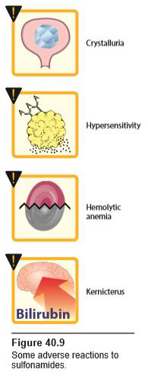
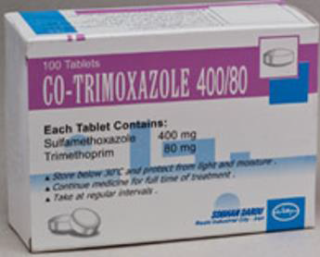

Slide 27
OTHER SULPHONAMIDES COMBINATIONS:
2- sulfadiazine in combination with pyrimethamine (dihydrofolate reductase inhibitor) is the preferred treatment for toxoplasmosis.
3- Sulfadoxine in combination with pyrimethamine is used as an antimalarial drug.

Slide 28
Pyrimethamine and sulfadiazine are used in the treatment of toxoplasmosis.
Dapsone is a sulfone antibiotic that may be tolerated by some patients with TMP/SMX allergies and is often used as an alternative agent for Pneumocystis prophylaxis in these patients. Also in leprosy

