Slide 1
Cell Wall Inhibitors I
b-lactam Inhibitors

Slide 2


b -lactam Inhibitors
They share a β-lactam ring in their molecular structure. They decrease bacterial cell wall synthesis.
Penicillin
Cephalosporins
Monobactams
Carbapenem

Slide 3
Penicillins
Antibacterial Spectrum:
  Gram-positive cocci: e.g. streptococci, pneumococci and staphylococci.
  Gram-positive bacilli: anthrax bacillus, C. diphtheria and clostridia.
  Gram-negative cocci: gonococci and meningococci.
  Gram-negative bacilli: shigella, salmonella, etc.
  Spirochetes: treponema pallidum.
  Actinomyces

Slide 4
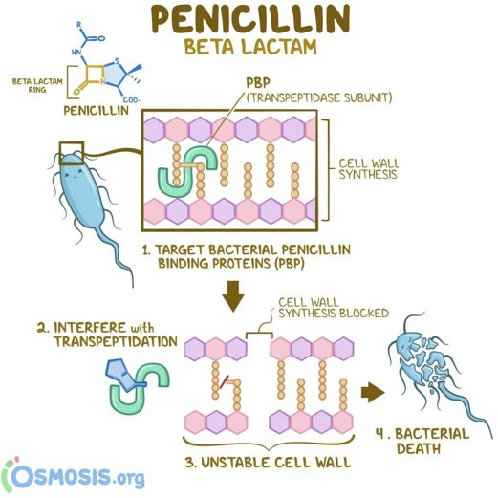
Mechanism of Action (Inhibit cell wall by 2 main mechanisms):
  Bind with penicillin binding sites, then blocks the activity of Transpeptidase enzyme which takes part in cell wall strength.
  Autolytic enzyme activation
Pharmacokinetics
Distribution: Do not cross BBB (only in the case of Inflammation). Can cross placenta but pregnancy safe.
Excretion:
  All secreted by kidney (Tubular system) which is Inhibited by Propenecid.
  Naficillen secreted by Biliary route

Slide 5
Penicillins Classification
Benzyl Penicillin (Penicillen G) | Penicillenase resistant (Anti- staph). | Amino penicillins (Broad Spectrum) | Anti-Pseudomonal | Amidinopenicillens
Short Acting (IM,IV) Long Acting (IM) Procaine (12-24 hrs) Benzthine (Days to weeks) so its used in prophylaxis of RF Oral: Penicillin V | Methicillin Cloxacillin Dicloxacillin Flucloxacillin Nafcillin | Ampicillin Pro Ampicillin pivampicillin talampicillin Pacampicillin Amoxycillin | Carbencillin Ticarcillin Azlocillin Mezlocillin Piperacill | Mecillinam Pivmecillinam

Slide 6
[CC]

Slide 7
Benzyl Penicillin (Penicillen G)
Spectrum
  Gram +ve: Streptococcus spp, Pneumococci, Staphylcoccus spp
  Gram –ve: Gonorrhea and Treponema
Cons: Taken by Injections Only, short half life, Beta Lactamase susceptible, Narrow spectrum
Drugs: Procaine, Benzathine, Penicillin V
The only antibiotic that can be used for prophylaxis (Benzathine)

Slide 8
Penicillenase resistant (Anti-staph).
Spectrum
  Staphylcoccus spp only
Cons: Narrow spectrum, Only one Indication
Drugs: Methicillin Cloxacillin, Dicloxacillin, Flucloxacillin, Nafcillin.
Extended Spectrum (Amino Penicillens)
  How? The amino group tricks the bacterial cell wall and lets the drug in
  Spectrum
    Like Pen-G with the addition of G-ve: Salmonella, Shigella, Proteus, H.Influenza
  Cons: Beta Lactamase susceptible, Cause superinfection

Slide 9
Extended Spectrum (Amino Penicillens)
How do we solve the problems?
Beta Lactamase | Superinfection
Add calvulinic acid which even extend the spectrum even more. Hepatotoxic Drug name: Augmentin | Usage of prodrugs piva,tala,paca Higher levels in blood and tissues
Comparison between Ampicillin and Amoxicillin
 | Ampicillin | Amoxicllin
Absorption | ✓ | ✓✓
Distribution | ✓ | ✓✓
Diarrhea | +++ | +
Spectrum | Shigella, H.Infeluenza | Salmonella, Strept.Facialis

Slide 10
Anti-Pseudomonal
Spectrum
  Very broad spectrum even containing pseudomonas and anerobes. (eg.
Bacteroids fragilis causing intrabdominal sepsis)
  Should only be used against pseudomonas
Cons: Beta Lactamase susceptible (can be combined with clavulanic acid)
Pros: Have an amazing synergetic effect when combined with aminoglycosides
Drugs: Carbencillin, Ticarcillin, Azlocillin, Mezlocillin, and Piperacillin
Amidinopenicillens
Drugs: Mecillinam, Pivmecillinam.

Slide 11
Therapuetic Uses
Bacteria | Disease
Streptococcus spp | Wound sepsis, puerperal fever acute throat infections, subacute bacterial endocarditis,.. etc.
Staphylococcus spp | Infections of skin, mucous membrane and bone.
Pneumococcus spp | Pneumonia and empyema.
Spirochetes | Syphilis and gonorrhoea.
Gram –ve | Meningococcal infections (Meningitis)
Pseudomonas | Pneumonia, Exterenal otitis, endopthalmitis.. etc
Actinomyces and others | Actinomycosis, Anthrax and H. influenza infections. Diphtheria, tetanus and gas gangrene Penicillin may be used together with the specific antitoxins. Peptic ulcer

Slide 12
Therapuetic Uses
Prophylaxis (Benzathine only)
  To prevent recurrency of Acute Rheumatic Fever
  To prevent gonorrheal opthlamia in neonates
  To prevent subacute bacterial infective endocarditis occurring due to
    Operative procedures (eg. Dental extraction, Tonsillectomy)
    Congenital or acquired vascular diseases
    Immunocompromised

Slide 13
Side Effects
Hypersensitivity (10% of the patients)
  Common with long courses.
  Due to metabolites not penicillin itself
Early / Anaphylactic (Type I) | Delayed / Serum sickness (Type III)
Severe fall in BP Bronchoconstriction Angioedema (Larynx) Can cause death Minutes (IV) to Less than an hour (Oral) | Fever, Malasie, Arthalgia, Skin rash, Angioedema 2-12 Days
Prevention
  History and Hypersensitivity test
Treatment: ECAA : Epinephrine / Corticosteroids / Anti-Histamine (Chlorpheniramine)/ and Aminophylline

Slide 14
Side Effects
Neurotoxicity
  Intrathecal injections: Seizures, Coma and Death.
Glossitis, Stomatitis, and Superinfection
  By Candida Albicanis more with Ampicillin
Cation Toxicity (Renal Insufficiency patients)
Procaine Penicillens
  Accidental IV administration causes mental changes, convulsions, and Pulmomary infarcts

Slide 15
Interactions
Penicillin shouldn’t be with bacteristatic drugs (eg. Tetracycline,
Chloramphenicol, Erythromycin).
  Inhibiting protein synthesis interferes with penicillin
Gentamicin and Anti-psuedomonals have SYNERGITIC effect.
  Penicillin makes the penetration easier for Aminoglycosides
  But they cancel each other’s work when prepared in the same needle, even preferably not in the same site

Slide 16
 | (Penicillen G) | Penicillenase resistant (Anti-staph). | Amino penicillins (Broad Spectrum) | Anti-Pseudomonal
Spectrum | Gram +ve: Streptococci Pneumococci Staphylcocci Gram –ve: Gonorrhea Treponema | Staphylcocci Only | Pen G like G-ve: Salmonella Shigella Proteus H.Influenza | Amino Penicillin + pseudomonas and anerobes.
Beta Lactamase susceptibility | Yes | No | Yes | Yes
 |  |  | Can Be combined with Clavulanic Acid to make it resistant (Hepatotoxic)

Slide 17
Cephalosporins
MOA: Same as Penicillin, So it have more effect on Gram +Ve
  Bactericidal
Pharmacokinetics
  Absorption: Oral better be separated from food
  BBB: Only new drugs (3rd and more)
  Excretion: Mainly renal (1st/2nd) Renal and Biliary (3rd/4th)

Slide 18
First Generation
Second Generation
Third Generation
Fourth Generation
Drugs
Oral : Cephradine Paracentral: Cephradine, Cefadroxil
Oral: Cefuroxime, Cefaclor Parenteral: Cefuroxime
Parenteral Only: Cefotaxime, Ceftazidine, Cefoperazone, Ceftriaxone
Parenteral Only:
Cefepime
Spectrum
Gram +ve cocci mainly
Few Gram –ve bacilli
Same as first + few anerobes
Enhanced Gram –ve bacilli (Proteus, H.Influenza, Enterobactar)
Low Gram +ve
Excellent Gram –ve
+ Pseudomonas
and Anaerobes.
Very wide coverage both Grams
Haemophilus, Pseudomonas, and anaerobes.
b-lactamase Susceptibility
Yes
No
CSF Penetration
No
No (except Cefuroxime)
Yes (except Cefoperazone)
Yes
Cross Allergy with Penicillin
High
Moderate
Low
Elimination
Renal
Renal and Biliary

Slide 19
Therapeutic Uses (Most Urgent)
  M: Bacterial Meningitis: (3rd Generation) Cefotaxime and Ceftriaxone
  O: Osteomylitis
  S: Skin Infections
  T: Typhoid (Biliary Infection) (3rd Generation) Cefoprazone or Ceftriaxone
  U: UTI (E.Coli) (3rd/4th)
  R: RTI
  G: Gonorrhea (Penicillin Resistant) IM Ceftriaxone
  E: ENT Infections
  N: Intestinal Infections
  T: Topical
• + Pseudomanl Infections.

Slide 20
Side Effects (All Nephrotoxins Dislike Prothrombin)
  ALL : 1st and 2nd do not use after failed or allergic penicillin treatment
  Nephrotoxins: Nephrotoxic 1st and 2nd. Increased with diuretics or with nephrotoxic agents (Aminoglycosides).
  Dislike: Disulfram like action
  Prothrombin: Some of the new drugs causes prothrombin/Platelet dysfunction (3rd)
  Superinfection (Most antibiotic causing polyps)
    Treated with Metronidazole or Vancomycin

Slide 21
Monobactam (Aztreonam)
Spectrum
  Excellent Gram –ve but poor against Gram +ve and Anerobes
Pros: Resistant to most Beta Lactamases, Less likely to cause hypersensitivity
Carbapenems (Imipenem/Meropenem)
Antibiotic of LAST RESORT
Spectrum: Broad +ve and –ve except pseudomonas
Pros: Resistant to most Beta Lactamases, Very Broad spectrum
Imipenem if given alone is inactivated by renal dihydropeptidase so it’s combined with cilastatin which inhibits renal dihydropeptidase.
Adverse effects: Allergy, Neurotoxic, Blood disorders

Slide 22
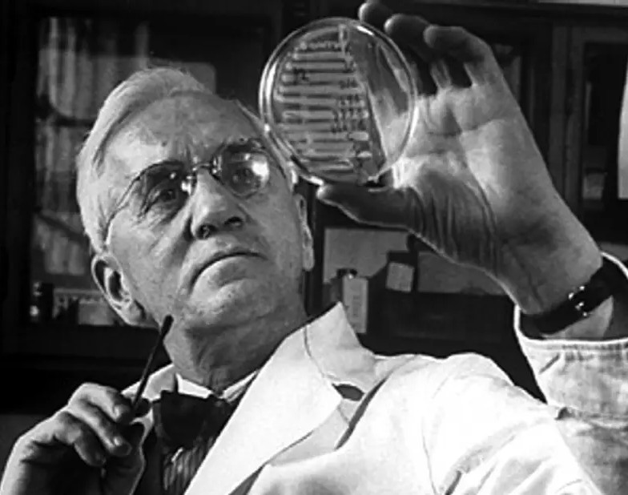
Founder of Penicillin
_______________________ Dr. Alexandar Fleming 1881-1955

Slide 23
Bacterial cell wall inhibitors
Dr. Mohammed A. Attia

Slide 24
Non β−Lactams
  1- Polypeptides or (cyclic peptide) :Bacitracin and cycloserine
2- Glycopeptide :vancomycin
3-Lipoglycopeptide : Dalbavancin, Oritavancin
Telavancin, and Teicoplanin
4- Lipopeptides: Daptomycin
  5- Fosfomycin

Slide 25
Bacitracin
Mechanism of action
Bacitracin prevents cell wall synthesis.
Antimicrobial spectrum
Bacitracin inhibits gram-positive cocci and a few gram-negative organisms.
Therapeutic uses: limited uses due to its side effects when used systemically (nephrotoxicity)
it is mainly used topically alone or in combination with other antibiotics (Notably polymyxin-B and neomycin) or hydrocortisone (as anti-inflammatory) in the form of creams, ointments and aerosol preparations.

Slide 26
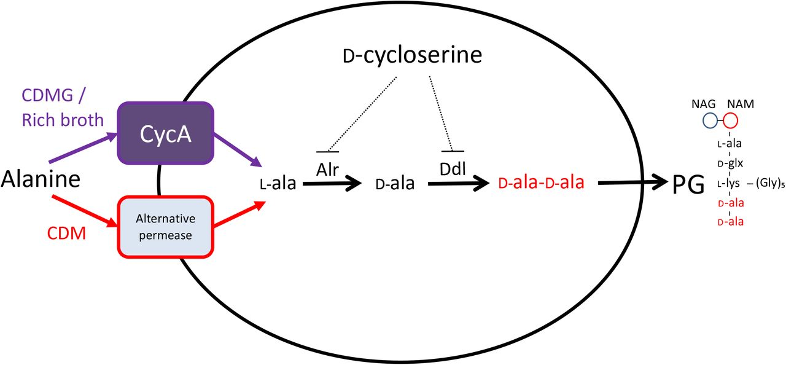
CYCLOSERINE
Structural analog of D-alanine
Exclusively use in strains of Mycobecteria resistant to first line anti tuberculous drugs
Serious dose related nervous toxicity i.e psychosis, tremors, convulsions

Slide 27
1-Vancomycin
Mechanism of action
Glycopeptides bind to terminal D-ala-D-ala chains on peptidoglycan in the cell wall, preventing further elongation of peptidoglycan chains.
Antimicrobial spectrum
It has a narrow-spectrum activity (only against gram-positive bacteria).
Therapeutic uses
It is mainly used in:
1-Vancomycin is also the drug of choice in patients in whom pseudomembranous colitis (antibiotic associated colitis) has developed
2-Methicillin-resistant Staphylococcus aureus infections
3-Other infections due to susceptible organisms e.g. streptococci, bacillus anthracis, corynebacterium diphtheria, clostridium tetani and difficile.

Slide 28
Adverse effects
1-The major adverse effect associated with vancomycin therapy is ototoxicity.
2-"Red neck syndrome": More commonly, the intravenous infusion of vancomycin can result in the occurrence of chills, fever, hypotension and a maculopapular skin rash often involving the head and upper thorax due to histamine release. Now it is called vancomycin Infusion-related reactions . This reaction can be prevented by slowing the infusion rate and is not a true allergy. Antihistamines can also ameliorate the
reaction.
3- Nephrotoxicity:

Slide 29
2- Telavancin is a lipoglycopeptide that was modified from vancomycin’s structure but with unique properties that may be advantageous compared with vancomycin, such as improved activity against MRSA that is less susceptible to vancomycin, but it is used primarily for patients who do not respond to vancomycin. (vancomycin R organisms)
Telavancin is more rapidly bactericidal than vancomycin because it has dual mechanism of action:
1- The first as vancomycin.
2- The second mechanism where the drug interferes with the cell membrane also, disrupting membrane function.
Telavancin side effects :
1-Because the core structure of telavancin is essentially vancomycin, it may cause vancomycin infusion reaction as well.
2-Taste disturbances and foamy urine occur with telavancin.

Slide 30
LONG-ACTING GLYCOPEPTIDES:
dalbavancin, oritavancin:
Are unique agents. Pharmacologically, they start with the base structure of a glycopeptide and add structural characteristics that slow their elimination. Both can be dosed intravenously just once for the equivalent of 2 weeks of therapy since each has a half-life of over a week.
Both drugs have strictly gram-positive activity that includes MRSA and streptococci. Used in Skin and skin structure infections in patients whose infections are either known or highly suspected to be caused by gram-positive organisms.
nausea, vomiting, diarrhea, and rash were the most common adverse effects with both drugs.

Slide 31
• Daptomycin (lipopeptides)
Mehanism of action and spectrum :
Daptomycin binds to the cell membrane of gram-positive bacteria, weakening it and allowing essential ions to leak out of the organism. This leads to a rapid depolarization of the membrane potential and cessation of needed cell processes, leading to cell death. Instead of blowing the bacteria apart as beta lactams do, daptomycin leaves the dead bacteria intact.
Lipid portion of the drug inserts into the cell membrane of gram-positive organisms, leading to the leakage of intracellular cations that maintain membrane polarization. The result is rapid depolarization and cell death.
Daptomycin is active against many resistant gram-positive organisms, including VRE and MRSA. It has been proven effective in staphylococcal endocarditis (specifically right-sided endocarditis), an indication that few antibiotics have. Though it penetrates lung tissue very well, daptomycin cannot be used to treat pneumonia. Human pulmonary surfactant binds to daptomycin, rendering it inactive.
Uses:
is effective for treating complicated skin and soft tissue infections. It is administered intravenously once daily and is excreted unchanged in urine; dose adjustments are required when given to individuals with severe renal insufficiency.
Adverse effects :
Daptomycin has effects on skeletal muscle that can manifest (rarely) as muscle pain or weakness, or possibly rhabdomyolysis. To monitor for this effect, creatine kinase (CK) concentrations should be checked weekly while a patient is on therapy. This toxicity can be decreased by administering the drug no more than once daily and by adjusting the interval in renal dysfunction. Eosinophilic pneumonia has been reported in patients on daptomycin therapy

Slide 32
The polymyxins
polymyxin B and colistin (polymyxin E) are used in the treatment bacterial diseases.
MOA:
Polymyxins bind to the outer membrane of gram-negative bacteria (P. aeruginosa and coliform organisms in particular)., leading to disruption of membrane stability and leakage of cellular contents.
Therapeutic uses
1-In combination with neomycin, polymyxin B is used as a bladder irrigant to reduce the risk of catheter- associated infections.
2-Polymyxin B also is applied topically in combination with other antibiotics for infections of skin, eye or ear.

Slide 33
Adverse effects
1- Nephrotoxicity.
2-Neurotoxicity. recognized by perioral paresthesia, numbness, weakness, ataxia and blurred vision.
3-These drugs precipitate respiratory arrest (due to Neuromuscular blocking effect) especially both in patients given muscle relaxants during anesthesia and in persons suffering from myasthenia gravis.

Slide 34
CLOSTRIDIOIDES DIFFICILE –
SPECIFIC AGENTS
fidaxomicin, bezlotoxumab:
They only treat Clostridioides difficile infections. Fidaxomicin is a nonabsorbed macrocyclic antibiotic with a narrow spectrum that is ideal for treating infections caused by C difficile because it is sparing to the normal flora of the GI tract, allowing it to be restored during therapy.
Developed specificially to clostriduim deficille – neutrulizes the toxins – Umab = Antibody for drugs – Best used together

Slide 35
Mehanism of action:
1-Fidaxomicin is a ribosomal protein synthesis inhibitor that is bactericidal. It is classified as a macrolide , but unlike other macrolides, it is not absorbed in the GI tract and is able to kill susceptible organisms.
2-Bezlotoxumab is a monoclonal antibody that binds to toxin B produced by C difficile inactive, decreasing the risk of recurrent infections.
Side effects:
Nausea, diarrhea, abdominal pain, and cramping.
Since bezlotoxumab only binds toxins and does not kill C difficile directly; patients need to receive anti-bacterials that are treating C difficile as well (e.g., vancomycin or fidaxomicin).
Bezlotoxumab can be given at any time during the treatment course, with a similar reduction in recurrence.

Slide 36
Fosfomycin:
Is a synthetic, broad-spectrum, bactericidal antibiotic with activity against large number of Gram-negative and Gram-positive organisms including E. coli, Klebsiella spp., Proteus spp., Pseudomonas
spp., and VRE.
Fosfomycin is available in an oral formulation only in the U.S. and its pharmacokinetics allow for one-time dosing.
((Acts on gram negative and positive)) – used only when all other drugs failed to treat – so used broad spectrum.

