Slide 1
The Respiratory tract infections
DR: Mohammed AbdelMoneim Attia

Slide 2
The Respiratory System
A major portal of entry for infectious organisms
It is divided into two tracts “upper and lower” based on structures and functions in each part.
The two parts have different types of infections.

Slide 3
The Respiratory System & infections
From(nose, sinuses ,larynx and trachea)
Infections are fairly common
LRT
Bronchi & Lung
Infections are more dangerous
Examples : Pharyngitis
Sinusitis
Otitis Media
Examples : Bronchitis & Pneumonia
URT

Slide 4
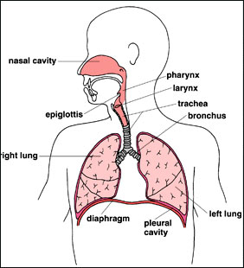

Slide 5
Upper respiratory tract infection (URI)
Are illnesses caused by an acute infection which involves the upper respiratory tract: nose, sinuses, pharynx or larynx .
The prototype is the common cold in addition to pharyngitis, sinusitis, etc………..
Influenza is a systemic illness that involves the upper respiratory tract and should be differentiated from other URI.

Slide 6
Upper Resp. Tract Infections (URIs, Colds, rhinosinusitis)
The most common infections in childhood with 6-8 colds / year (2-4 in adults).
The most common medical reasons for school absenteeism.
The common cold:
Definition: a viral illness in which the symptoms of rhinorrhea and nasal obstruction are prominent.
Rhinitis,
rhinosinusitis,
(rhinoconjunctivitis)
EPIDEMIOL0GY
Colds occur year-round, but the incidence is greatest from the early fall until the late spring.

Slide 7
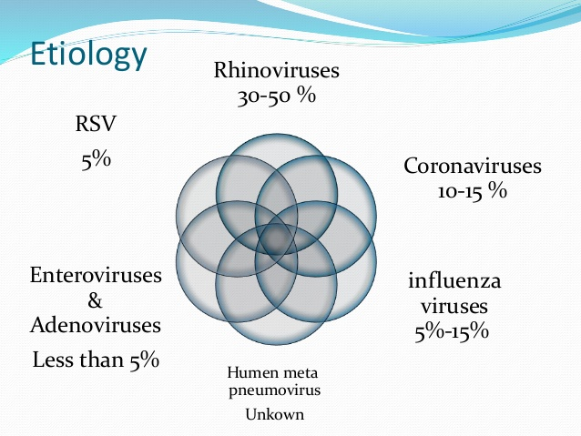

Slide 8
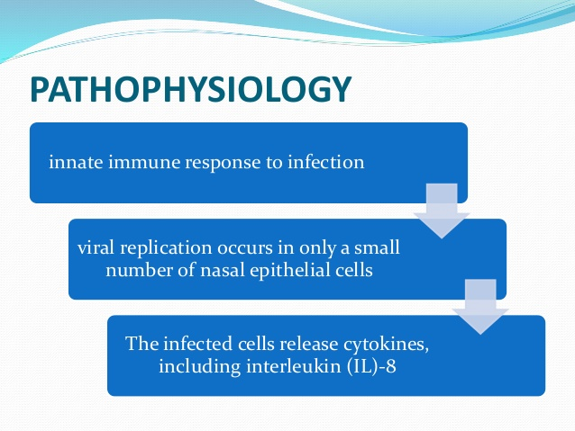

Slide 9
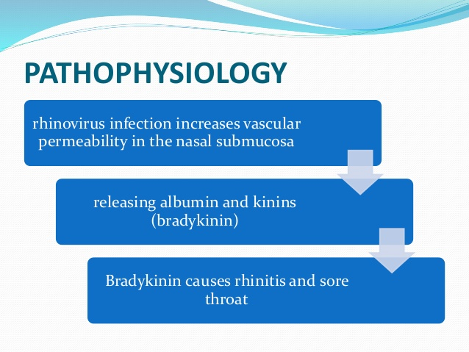

Slide 10
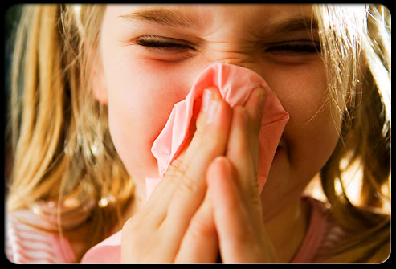

Slide 12
Clinical manifestation
The onset of 1-3 days after viral infection.
sore or "scratchy" throat, followed closely by nasal obstruction and nasal discharge
Systemic manifestations:
Fever, chills, restlessness, bone aches, headache and anorexia
The usual cold persists for about 1 week,
although 10% last for 2wk.

Slide 13
Treatment
Symptomatic treatment:
1- antiviral ttt ??
2- nasal decongestants .
Effective topical adrenergic agents such as xylometazoline, oxymetazoline, or phenylephrine. (Reduced-strength formulations of these medications are available for use in younger children, although they are not approved for use in children <2 yr old)
3-Anti pyretics e.g -----------paracetamol
4-Cough sedatives
5- supportive : hydration, hot drinks…..etc
Children should never take ASA* (acetylsalicylic acid) for a viral infection of the respiratory tract.

Slide 14
  Differential diagnosis :
Infections:
Sinusitis
pharyngitis
Allergy:
allergic rhinitis
Others……………….
Complications:
URT: otitis media, sinusitis and periorbital cellulitis ….
LRT: laryngeobronchitis, bronchiolitis and asthma attacks

Slide 16
Etiology of Acute Pharyngitis
-Rhinoviruses (> 100 serotypes). -Influenza -Parainfluenza -RSV -Coronavirus -Adenoviruses -Enteroviruses -Epstein-Barr -Herpes simplex | Viral causes:
-Group A beta hemolytic Streptococci (GAS) --Mycoplasma pneumoniae -N. gonorrhea -Corynebacterium diphtheriae -Bacteria as Streptococcus pneumoniae, Haemophilus (?) | Bacterial causes:

Slide 17
Etiology of Acute Pharyngitis
A variety of bacteria & viruses can cause infection in the pharynx. But the etiology is mostly viral.
5-30% are bacterial usually caused by a classic bacterial infection causing sore throat is: Streptococcus pyogenes (GABHS), which can cause abscesses on the tonsils.
GABHS infection is usually self-limited and therapy is usually indicated to prevent late sequelae as AGN or ARF.
Non infectious causes include allergy or physical irritation
Infection occurs through contact with infected secretions and can be interrupted through hand hygiene.
GAS infection is uncommon before 2-3 y and peaks in early school years and occurs most often in winter and spring.

Slide 18
Clinical picture:
1-streptococcal pharyngitis
Sore throat,
Red pharynx, enlarged tonsils and classically covered with a yellow, blood-tinged exudate.
petechiae on the soft palate and posterior pharynx.
enlarged , tender anterior cervical lymph nodes.
The incubation period is 2-5 days.
2-Viral pharyngitis
Gradual onset , rhinorrhea, cough, and diarrhea.
A viral etiology is suggested by the presence of conjunctivitis, hoarseness, and cough.

Slide 19
Clinical Diagnosis of Pharyngotonsillitis
Sore Throat
-Acute onset
-Temp >38
-Tender ant Cx LN
-Tonsilar erythema or exudate
-Age 3-15 years
Consider Bacterial
-Rhinorrhea
-Cough
-Diarrhea
-Conjunctivitis
-Older age
Consider Viral

Slide 20
Hallmarks of STREP sore throat
Group A streptococcal infections affect all ages but peak incidence at 5-15 years of age
Tender lymph nodes
Close contact with infected person
Scarlet fever rash
Tonsillar exudates in older children
Abdominal pain
GOLD STANDARD: POSITIVE THROAT CULTURE

Slide 21
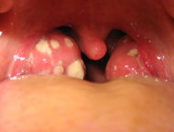
Streptococcal tonsilitis

Slide 22
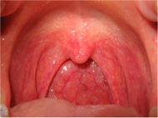
Viral pharyngitis

Slide 23
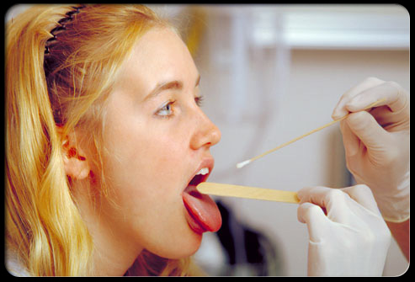

Slide 26
Complications
Viral infections may predispose to bacterial middle ear infections.
Streptococcal pharyngitis ----
local suppurative complications, as parapharyngeal abscess, sinusitis, otitis media and adenitis
nonsuppurative illnesses, as acute rheumatic fever and acute post infectious glomerulonephritis.
Differential diagnosis:
1-Pneumococcal or H influenza
2- membranous exudate: diphtheria, EBV
3- Agranulocytosis: ulcerative lesion

Slide 27
Treatment
The primary benefit of treatment is the prevention of acute rheumatic fever,
Penicillin V is given bid or tid for 10 days: 250 mg/dose
Oral amoxicillin A once-daily 750 mg dose of amoxicillin given orally for 10 days
A single intramuscular dose of benzathine penicillin (600,000 U)
for children <27 kg [50 lb]; 1.2 million U for larger children and adults)
Erythromycin: 40 m{kglday divided bid, tid, or qid orally for 10 days; for patients allergic to B-lactam antibiotics
Eradicating streptococcal carriage is clindamycin, 20 mglkglday divided in 3 doses orally for 10 days.

Slide 28
Symptomatic treatment
Oral analgesic antipyretics such as acetaminophen or ibuprofen to relieve fever and sore throat.
Gargling with warm salt water is often comforting
Local anesthetic sprays may provide local relief especially in ulcerative stomatitis.

Slide 29
Surgical Care in Pharyngitis
Indications for tonsillectomy:
-4-5 confirmed group A streptococcal infections in a single year.
-Chronic sore throat with adenopathy that is not responsible to treatment over 6 months.
- Hypertrophied tonsils with obstruction of breathing or deglutition

Slide 30
Home message
Up to 90% of URTI are of viral etiology.
Throat congestion, exudate and tender anterior cervical adenopathy in children > 2 years are suggestive of streptococcal etiology
Penicillin for 10 days is the drug of first choice in streptococcal sore throat infection.
ARF and PSGN are important late sequelae of maltreated GAS throat infection.

Slide 33
ACUTE SINUSITIS
Inflammation of the mucosa lining the sinuses and nasal passages.
Normally, the paranasal sinuses are sterile. Infection occurs after damage to the mucous membrane accompanied a viral URTI or dental disease.
Sinusitis is a complication of the common cold
Self-limited sinus inflammation is a part of the pathophysiology of the common cold
The diagnosis of bacterial sinusitis should be considered if:
1- Rhinorrhea or daytime cough persists without improvement for at least 10-14 days
2- if signs of more severe sinus involvement such as fever, facial pain, or facial swelling develop.

Slide 34
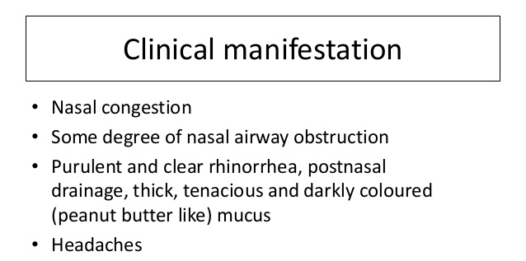
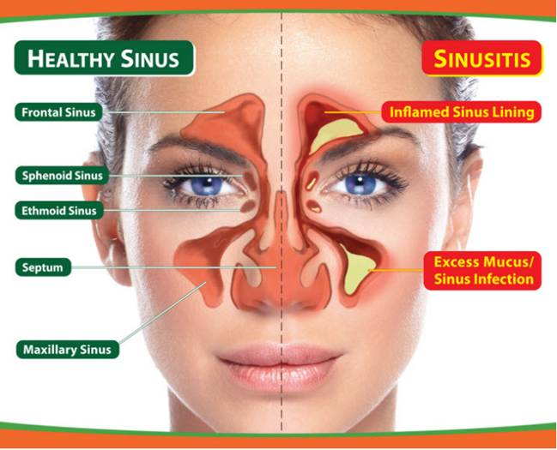

Slide 35
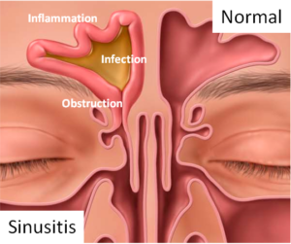
The most common 3 causative agents are
  Streptococcus pneumonia (G+ve)
  Haemophilus influenzae (G-ve)
  Moraxella catarrhalis (G-ve)
  Others: Staph aureus and anaerobes

Slide 36
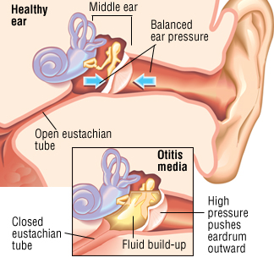
Otitis Media
Definition:
Inflammation of the middle ear
Incidence:
seen most frequently in children younger than 3 years.

Slide 37
Pathophysiology
RISK FACTORS:
    Following common cold
    Adenoidal hypertrophy
    Cleft palate
    Down syndrome
    Eustachian tube dysfunction
  Bacterial pathogens
    Pathogens: Most cases are due to
    1- bacteria “Streptococcus pneumoniae , Moraxella catarrhalis and H. influenza are the two most common”,
    2- although viruses such as influenza virus and rhinoviruses have been implicated..

Slide 38
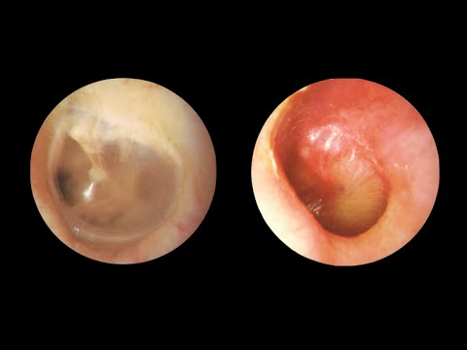
Otitis Media
Clinical features:
Classically, otitis media presents with (Otalgia)= ear pain, which may be severe. If the drum perforates, the pain is relieved, and a purulent discharge may follow= Otorrhea. Also may be , Fever .
Others as Recent onset of anorexia ,Irritability ,Vomiting , Diarrhea
  There may be a degree of hearing impairment .
  The diagnosis is made clinically by otoscope
otoscopic findings of the tympanic membrane :Opacity, Bulging
Erythema ,Middle ear effusion (MEE)
Normal appearance
Otitis media

Slide 39
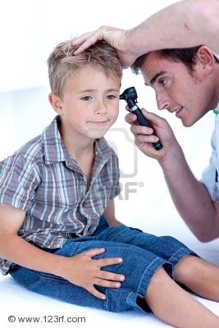
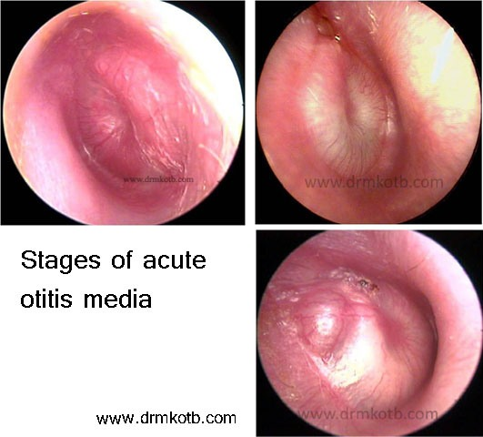

Slide 40
Otitis Media
Treatment:
  Spontaneously settled in most children.
  Antibiotics were most useful in patients under 2 years with bilateral acute otitis media and patients with perforation and discharge.
  If antibiotic treatment is to be given, it should be effective against the 3 main bacterial pathogens: S. pneumoniae, H. influenza and S. pyogenes.
  So, the broader-spectrum amoxicillin and ampicillin, amoxicillin/clavulanate or ceftriaxone are preferred.

Slide 41
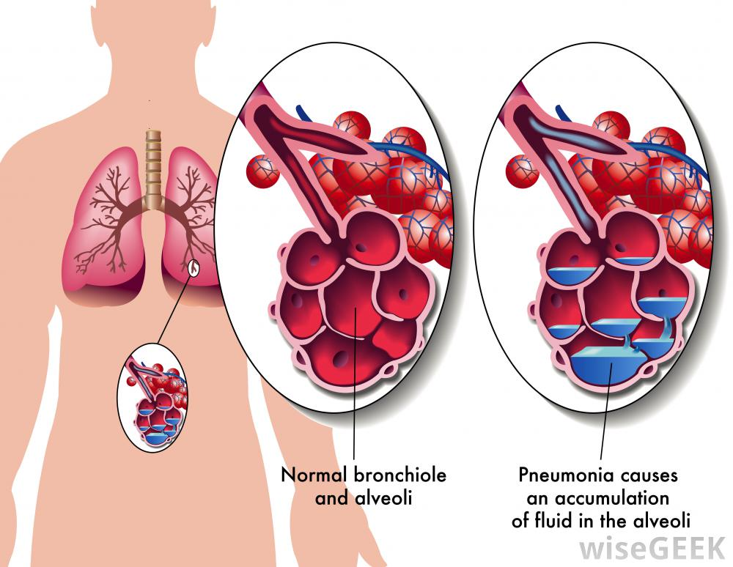
What is Pneumonia?
Definition:
  It is acute inflammation of the lung parenchyma.
  The cause may be infectious or non infectious.
Pneumonia affects 450 million/yr, 7% of population and
result in 4 million deaths.

Slide 42
Community Acquired Pneumonia (CAP)
  In a patient not hospitalized or less than 48 hours from hospital admission
  An acute infection of the lung parenchyma that is associated with at least some symptoms of acute infection, accompanied by the presence of an acute infiltrate on a chest radiograph, or auscultatory findings consistent with pneumonia,
  HAP(nosocomial pneumonia) is a pneumonia that occurs ≥ 48 hrs. after hospital admission.
  VAP is a pneumonia that occurs ≥ 48 -72hrs after tracheal intubation

Slide 43
Pathogenesis
Primary inhalation: when organisms bypass normal respiratory defense mechanisms or when the Pt inhales aerobic GN organisms that colonize the upper respiratory tract or respiratory support equipment
Aspiration pneumonia : occurs when the Pt aspirates colonized upper respiratory tract secretions . Stomach: reservoir of gram-negative bacilli that can ascend, colonizing the respiratory tract.
Hematogenous: originate from a distant source and reach the lungs via the blood stream.
Inhalation
Aspiration
Hematogenous

Slide 44
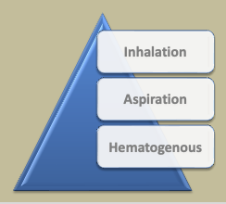
Anatomical
Etiological
Clinical

Slide 45
Infectious causes of CAP (Etiological)
Pneumonia is due to infections caused primarily by Bacteria or Viruses and less commonly by Fungi and Parasites.
Mixed infections with both viruses and bacteria may occur in up to 45% of infections in children and 15% of infections in adults.

Slide 46
  Infectious causes of CAP (bacterial)
  TYPICAL
  Streptococcus pneumonia 35%
  Staph aureus pneumonia
  Haemophilus influenzae
  Moraxella catarrhalis
  Klebsiella pneumoniae
Other
Anaerobic organisms
TB pneumonia
  ATYPICAL
  Mycoplasma pneumoniae
  Chlamydophila pneumoniae
  Legionella pneumophila
  Coxiella burnetii

Slide 47
N.B: atypical pneumonia
It does not respond to the usual antibiotics
Causes a milder form of pneumonia (hence the term “walking pneumonia”)
Typical pneumonia can come on more quickly + with more severe early symptoms
Epidemiology:
It is thought that the 3 main atypical pathogens might be implicated in up to 40% of community acquired pneumonia(CAP)
The precise incidence is not known. Not identified in clinical practice due to lack of readily available, reliable standardized tests to confirm diagnosis.

Slide 48
Management of atypical pneumonia :
Macrolides, such as Erythromycin, Clarithromycin + Azithromycin have been shown to be effective in the Rx of all 3 organisms
Severe Legionella infections may require rifampicin + a macrolide
Tetracycline, Doxycycline + Fluoroquinolones are also effective
Recommened duration of therapy usually 2-3 weeks

Slide 49
Infectious causes of CAP (Non-bacterial)
Parasitic
Toxoplasma
  Viral
  Influenza
  Parainfluenza pneumonia
  Measles
  Adenoviruses
  Corona viruses
  Fungal
  Aspergillus
  Histoplasmosis
  Candidiasis
A causative agent may not be isolated in approximately half of cases despite careful testing

Slide 50
Clinical Presentation of pneumonia
Acute cough (>90%)
Fevers/chills (80%)
Sputum production (66%)
Dyspnea (66%)
Pleuritic chest pain (50%)
Tachypnea (RR > 24)
Bronchial breath sounds
Percussion dullness
Diminished breath soundnds

Slide 51
Community Acquired Pneumonia
Laboratory Tests:
    CBC with differential
    BUN/Cr
    glucose
    liver enzymes
    electrolytes
    Gram stain/culture of sputum
    pre-treatment blood cultures
    oxygen saturation

Slide 52
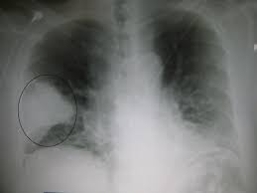
Community Acquired Pneumonia
Diagnostic Evaluation
CXR
  usually needed to establish diagnosis
  prognostic indicator
  rule out other disorders
  may help in etiological diagnosis
CT scan of Chest
  Radiologic findings may not be present in the early stages of the disease, especially in the presence of dehydration, or may be difficult to be interpreted in the obese or those with a history of lung disease. A CT scan can give additional information in indeterminate cases

