Slide 1
ANTITUBERCULOUS DRUGS by
Dr.Mohammed Abd-Almoneim

Slide 2
Mycobacterium tuberculosis
Mycobacterium avium complex
Mycobacterium leprae
A particular problem with both these organisms is that they can survive inside macrophages after phagocytosis, after phagocytosis, the organisms are contained in phagolysosomes where the pH is low.
The main mycobacterial infections in humans are tuberculosis and leprosy.

Slide 3
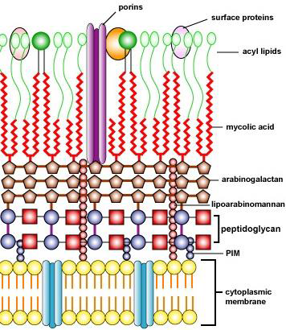

Slide 4
Tuberculosis and other mycobacterial diseases are difficult to treat for several reasons. Mycobacteria replicate more slowly than “typical” bacteria such as Escherichia coli or Staphylococcus aureus. This may seem to make the disease easier to control, but it makes pharmacotherapy more difficult because rapidly dividing cells are most metabolically active and therefore more susceptible to antibiotic chemotherapy.
They may exhibit long period of metabolic inactivity.
Mycobacteria can also exist in a dormant state, making them resistant to nearly all antibiotics. In the host, they live inside human cells (Most of tubercle bacilli are intracellular with slow growth) , therefore antimicrobials that have poor intracellular penetration are less effective.
Mycobacteria also have cell walls that are structurally different from typical gram-positive and gram-negative bacteria. The outermost layer of mycobacteria consists of phospholipids and mycolic acids that make a waxy layer that resists penetration from antibiotics. Arabinogalactan and peptidoglycan are polysaccharide components of the cell wall, but the peptidoglycan is not accessible to beta-lactam antibiotics, and they are poorly active.

Slide 5
General principles:
Resistant strains occur naturally to any drug given alone So:
(1)combination therapy, at least two effective drugs and sometimes up to four agents are used to prevent emergence of resistant strains.
(2)Treatment must be continued long enough (6 - 18 month's) to eradicate the bacilli from the body.
(3)Poor compliance in taking the therapy is the commonest cause of failure. So, it is better to give drugs in a single dose before breakfast, better in a combined formulation.

Slide 6
Drugs used for treatment of tuberculosis are classified into first line and second line on the basis of their efficacy, activity and risk of adverse reaction.

Slide 7
Anti-tuberculosis drugs
On the basis of efficacy & risk of adverse effects, they categorized into 1st & 2nd line .
1st line include : 2nd line:
Isoniazid (INH) capreomycin
Rifampin ethionamide
Pyrazinamide cycloserine
Ethambutol amikacin & kanamycin (aminoglycosides)
Streptomycin paraaminosalicylic acid (PAS)
^{Clarithromycin}
^{Linezolid}
^{Azithromycin}
^{Amikacin}
Rifapentin fluroquinolones (ciprofloxacin, )
Rifabutin Moxifloxacin
^{Levofloxacin}

Slide 8
REGIMEN OF THERAPY OF TB
The treatment has two phases of combination therapy:
An initial intensive course for at least two months to reduce the number of bacilli as rapid as possible and avoid emergence of resistant strains. At least three drugs are used (INH + rifampin + pyrazinamide ), a fourth drug may be added if resistance is possible. The fourth drug may be ethambutol or streptomycin.
Continuation phase during which the number of bacilli is further reduced. Isoniazid and rifampin are used at least for 4 months. Ethambutol may be added if resistance is suspected.

Slide 9
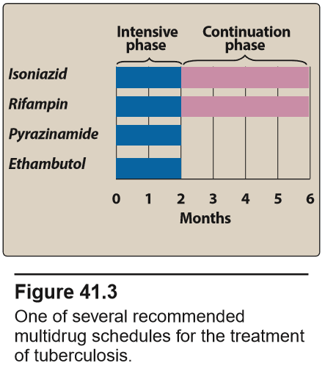

Slide 10
Anti-tuberculosis drugs
The previous regimen is used in uncomplicated pulmonary TB.
Generally treatment depends on the type of the organism , site of lesion & severity of the disease.
The course varies from 6-18 months.
Long course is needed in cases of TB meningitis , bone , joint , kidney & some forms of lymph-adenopathy.

Slide 11
ISONIAZID (Isonicotinic acid hydrazid; INH)
Pharmacokinetics:
Isoniazid is well absorbed from GIT. It diffuses readily into all tissues, body fluids, (CSF, Pleural fluids etc… )
Isoniazid is metabolized in the liver by acetylation which depends on genetic factors that determine whether a person is a slow or rapid acetylator of the drug , with slow acetylators patients enjoying a better therapeutic response. Rapid acetylators are more likely to develop hepatotoxicity, while the slow acetylators are liable to neuropathy.
The half-life in slow inactivators is 3 hours and in rapid inactivators, 1 hour. Isoniazid is excreted in the urine partly as unchanged drug and partly in the acetylated or otherwise inactivated form.

Slide 12
N.B. INH causes pyridoxine deficiency which lead to neurotoxicity.
Antimycobacterial activity:
Isoniazid is a selective antituberculous drug and has no activity against other bacteria. Isoniazid is bactericidal for TB organisms and is able to act on intracellular and extracellular bacilli.

Slide 13
Mechanism of action:
1-Isoniazid inhibits the synthesis of mycolic acid, which is important constituent of cell wall.
2-Isoniazid inhibits the desaturase enzyme, which is essential for cell wall synthesis of bacilli. Other bacteria do not contain mycolic acid and so is not sensitive to INH.
3-Isoniazid may interfere with NAD and form false NAD. This will disrupt carbohydrate and fat metabolism of the bacilli.

Slide 14
Therapeutic uses:
Isoniazid is the keystone of antituberculous drugs since it is the most active, relatively lack of toxicity and low cost. Also, it achieves a high level in all body cells and fluids.
Isoniazid is used alone as chemoprophylaxis in the following cases:
1- Very close contact to recent diagnosed cases.
2- Persons converting from negative to positive tuberculin skin test.

Slide 15
Adverse effects:
1-Neurotoxicity in the form of:
peripheral neuropathy (numbness, tingling of lower limbs)
Optic neuritis.
C.N.S toxicity as memory impairment, dizziness, convulsion. Neurotoxcity is more common in slow acetylators and it is due to pyridoxine deficiency. It can be prevented by vitamin B6.
2-Hepatocellular toxicity: This risk increases with age, presence of liver disease and in rapid acetylators. So, follow up the patients by liver function tests especially in the people of high risk.
3-Hypersensitivity reactions: Skin rashes, fever .
4-GIT upset, anaemia and systemic lupus.
5-Haemolytic anaemia in individuals with G6-PD deficiency.

Slide 16
RIFAMYCINS: rifampin (rifampicin), rifabutin, rifapentine, rifaximin (not used for mycobacterial disease)
The rifamycins are potent inducers of the cytochrome P450 system, and patients receiving them should always be screened for drug interactions. In addition to their activity against mycobacteria, rifamycins are active against many “typical” bacteria as well and are sometimes added to other therapies, particularly to treat difficult methicillin-resistant Staphylococcus aureus (MRSA) infections.
Mechanism of Action
Rifamycins are protein synthesis inhibitors that work by inhibiting RNA polymerase, preventing transcription by blocking the production of messenger RNA. This separates them from other protein synthesis inhibitors, which inhibit translation.

Slide 17
RIFAPENTINE :A long-acting analog of rifampin used in
the treatment of tuberculosis. Studies of its effectiveness are limited.
Until more data become available, rifampin is preferred. Rifapentine is given once weekly.
RIFAXIMIN :Rifaximin is a nonabsorbed rifamycin used only in the treatment or prevention of GI conditions. It is not used for mycobacterial diseases.
RIFABUTIN : Similar to rifampin, but is used to prevent and treat tuberculosis and disseminated Mycobacterium avium infections in patients with AIDS. It has fewer drug interactions than rifampin.

Slide 18
RIFAMPIN (rifampicin)
Pharmacokinetics:
It is well absorbed after oral administration.
Rifampin is widely distributed in tissue and body fluids. It can reach TB cavities, sputum and penetrate macrophage killing TB bacilli.
Rifampin is excreted mainly through liver and small amount is excreted in urine, saliva and tears. It give red orange color to urine, saliva and tears.
Rifampin can result in induction (increase synthesis or activity ) of liver microsomal enzymes.

Slide 19
Antibacterial spectrum:
Rifampin is active against mycobacteria tuberculosis and mycobacteria lepra.
Rifampin has a broad activity against gram-positive especially resistant Staphylococci and gram-negative bacteria.
Rifampin is effective on chlamydia and poxviruses.

Slide 20
Mechanism of action:
*It is bactericidal. Rifampin bind strongly to DNA-dependent RNA polymarse enzyme inhibiting RNA synthesis (human enzyme is not affected).
*&In poxviruses, rifampin interferes with envelope formation.
It enters phagocytic cells and can therefore kill intracellular micro-organisms including the tubercle bacillus.

Slide 21
Therapeutic uses:
Rifampin is one of first line anti-TB drugs. in combination with one or more of other anti-TB drugs.
Rifampin is used for treatment of pharyngeal carrier of Niesseria meningitides.
Rifampin is used as prophylaxis against Haemophilis influenza meningitides.
It is used in combination with other antimicrobials in treatment of resistant Staphylococcus aureus.
Rifampin is effective in leprosy.
It can be used for treatment of gram-negative infections.
In combination with ceftriaxone or vancomycin intreatment of meningitis caused by highly penicillin- resistant strains of pneumococci.

Slide 22
Adverse effects:
1-Hepatotoxicity in the form of: abnormal liver enzyme, jaundice or hepatitis. This side effect occurs if there is chronic liver disease, alcoholism or old age.
2-Rifampin is an enzyme inducer, thus, it increases the metabolism of anticoagulants, contraceptives and other drugs leading to a decrease in its therapeutic effect.
3-Intermittent therapy causes flue like syndrome or influenza-like syndrome as fever, chills, malaise, vomiting, diarrhea.
4-CNS: headache and dizziness fatigue.
5-GIT disturbance.
6-Hypersensitivity reactions.
7-Red urine and tears.

Slide 23
ETHAMBUTOL
Mechanism of Action
Ethambutol inhibits the enzyme arabinosyl transferase III, which blocks production of arabinogalactan. Because arabinogalactan is a component of the cell wall of mycobacteria but not “typical” bacteria, the microbial activity of ethambutol is limited to mycobacteria.
Disruption of arabinoglycan alters the cell barrier , enhancing the activity of lipophilic drugs such as rifampin & ofloxacin.

Slide 24
Therapeutic uses:
Ethambutol has no effect on organisms other than mycobacteria.
1-In combination with INH and rifampin.
2-It may be used with INH or alone during pregnancy, as it is least toxic.
Adverse effects:
1-Visual disturbance e.g. optic neuropathies, often manifesting as decreased visual acuity or the inability to differentiate red from green. The occurrence of this adverse effect is dependent on both the dose and duration of therapy
It is not recommended for routine use in children too young to permit assessment of visual acuity & red-green color discrimination.
2-Hyperuricaemia and gout due to decreased renal excretion of uric acid.
3-Mild GIT upset, malaise fever, rash, headache and peripheral neuritis.

Slide 25
PYRAZINAMIDE
It is a relative to nicotinamide.
It is is a prodrug (converted to pyrazinioic acid , the active form of the drug).
In its active form it is thought to prevent the production of mycolic acids by inhibiting the enzyme fatty acid synthetase I
Pyrazinamide is inactive at neutral pH but tuberculostatic at acid pH. It is effective against the intracellular organisms in macrophages.
Bactericidal
It is well absorbed and diffuse to all body fluids including CSF. It is metabolized in the liver and
is excreted by the kidney.
Therapeutic uses: used in combination with INH and rifampin in the initial intensive course or when resistance is suspected.
Adverse effects:
1-Hepatotoxicity:Tell your patients to report any signs of hepatitis (dark urine, abdominal pain, loss of appetite) when they are on pyrazinamide.
2-Hyperureacemia
3-Artheralgia and GIT upset.

Slide 26
STREPTOMYCIN
Streptomycin is one of aminoglycosides. It is bactericidal .
It is given by I.M injection.
It is not 1st choice drug.
It used in combination with INH, rifampin & pyrazinamide for treatment of life – theatening TB & very ill patient eg. Milliary TB & renal TB (because50-90 % is excreted unchanged through the kidney)
Adverse effects: as aminoglycosides ……………………..see before

Slide 27
Ethionamide
It is a congener of INH.
Blocks synthesis of mycolic acid.
Adverse effects:
severe GIT irritation ( main side effect)
Hepatitis
Neurotoxicity.
Endocrinal disorders (impotence& gynecomastia).

Slide 28
capreomycin
Capreomycin is a peptide antibiotic given by intramuscular injection. There is some cross-reaction with the aminoglycoside kanamycin.
It is an important injectable agent for treatment of drug- resistant tuberculosis.
It is nephrotoxic & ototoxic (tinnitus, deafness & vestibular disturbances ).
Local pain at the site of injection or sterile abscess may occur.
The drug should not be given at the same time as streptomycin or other drugs that may damage the eighth nerve.

Slide 29
Para-amino-salicylic acid (PAS)
Anti-folate.
Active only against TB bacilli.
AS as compared with streptomycin and INH is less effective and more toxic.
Toxicity:
Hepatotoxicity
GIT upset
Hypothyroidism.

Slide 30
CYCLOSERINE
Cycloserine is a broad-spectrum antibiotic that inhibits the growth of many bacteria, including coliforms and mycobacteria.
Inhibits cell wall synthesis.
A wide variety of CNS side effects disturbances may occur, ranging from headache and irritability to depression, convulsions and psychotic states. Its use is limited to tuberculosis that is resistant to other drugs.

Slide 31
TB and pregnancy: The best therapeutic regimen is INH and ethambutol. Rifampin is used only if TB is disseminated or very extensive. Streptomycin should not be used.

Slide 32
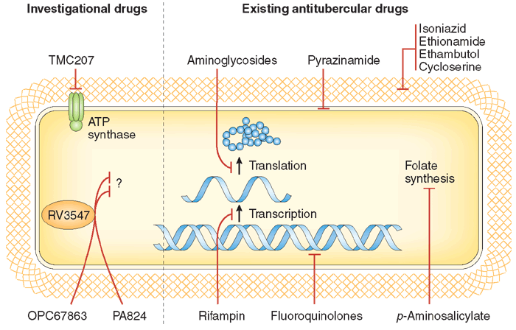

Slide 33

Leprosy (Hansen's disease)
Leprosy is one of the most ancient diseases known to mankind.
Multidrug treatment regimens initiated by the World Health Organization in 1982 are now the mainstay of treatment.
Leprosy is a chronic, systemic infection characterized by progressive cutaneous lesions.
It's caused by Mycobacterium leprae.
Attacks cutaneous tissue and peripheral nerves, producing skin lesions, anesthesia, infections, and deformities.

Slide 34
Types of Lprosy
Tuberculoid leprosy .
Lepromatous leprosy .
Borderline leprosy:
  characteristics of both lepromatous and tuberculoid leprosies.

Slide 35
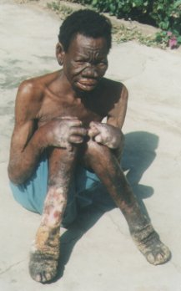
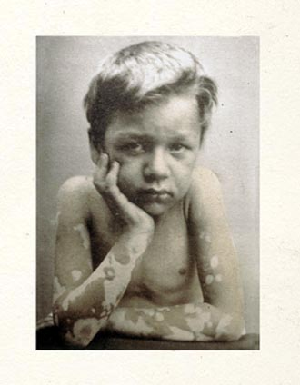

Slide 36
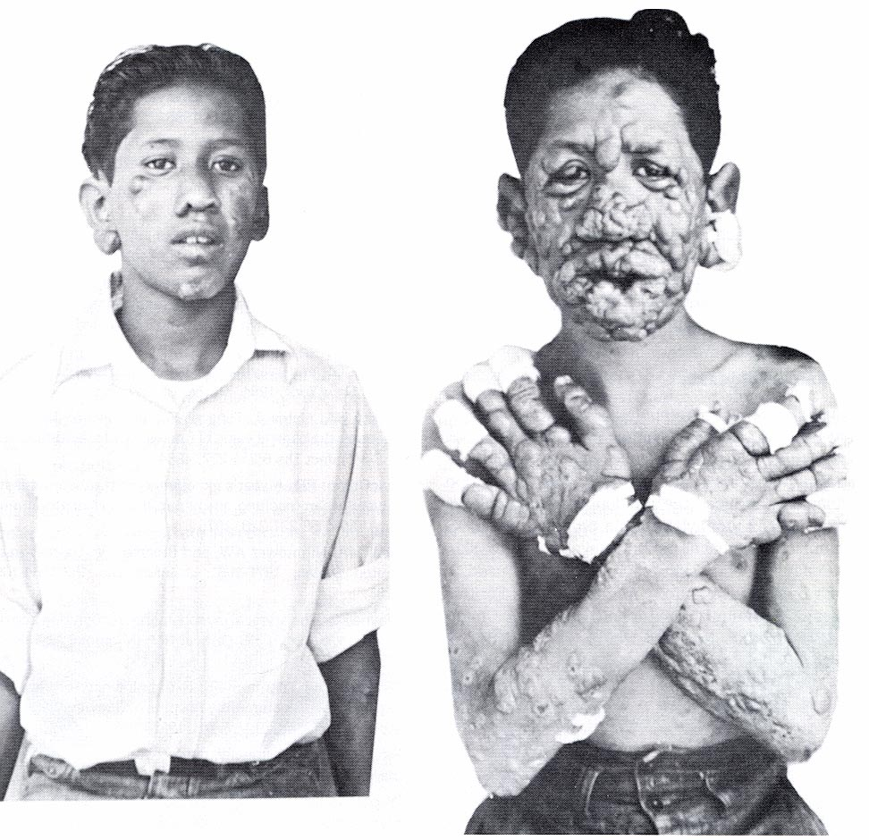

Slide 37

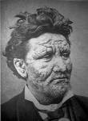



Slide 38
Antileprotics
For tuberculoid leprosy : Dapsone & rifampicin , drugs are continued for 6 months
For lepromatous leprosy : Dapsone , Rifampicin & clofazimine ,
is treated for at least 2 years.

Slide 39
Antileprotics
1- DAPSONE :
It is chemically related to the sulphonamides.
Acts by inhibition of folate synthesis
Resistance to dapsone is increasing , so drug combination is recommended
it is given orally. Well absorbed.
widely distrubted through the body water & all tissues.
plasma half life is 24-48 hours , but it remains in certain tissues to longer periods.
there is enterohepatic recycling ,but some is acetylated & excreted in urine ,the dose may have to be adjusted in renal failure.
it is bacteriostatic .

Slide 40
Uses of dapsone
1.Leprosy.
2.it is used to ttt.of dermatites herpetiforms (chronic blistering skin condition).
3.Dapsone may also be used to ttt Pneumocystis carinii pneumonia in AIDS.
Side effects:
hemolysis of RBCs (usually not severe) , methemoglobinemia , anorexia ,nausea & vomiting.
Gastrointestinal intolerance ,fever,pruritus & rashes.
Lepra reaction ( exacerbation of lepromatous lesions ; erythema nodosum leprosum , and potentially fatal may be suppressed by corticosteroids or by thalidomide).

Slide 41
Rifampin
IT is the most active anti lepromatous drug available .
To avoid resistance ,it is given in combination
Clofazimine:
it is a dye of complex structure
No cross resistance .
Mechanism of action :
bind to mycobacterial DNA and inhibit mycobacterial replication and growth.
Clofazimine is given orally and tend to accumulates in the body, being sequestered in the mononuclear phagocyte system. The plasma half-life may be as long as 8 weeks. The antileprotic effect is delayed and is usually not evident for 6-7 weeks.
It also has anti-inflammatory activity and is useful in patients in whom dapsone causes inflammatory side effects.
the anti-leprotic effect is delayed (after 6-7 weeks)
the plasma half –life may be as long as 8 weeks.
Unwanted effects of clofazimine
1- Unwanted effects may be related to the fact that clofazimine is a dye. The skin and urine can develop a reddish colour and the lesions a blue-black discoloration.
2-Dose-related nausea, giddiness, headache and gastrointestinal disturbances can also occur

Slide 42
Thank you

