Slide 1
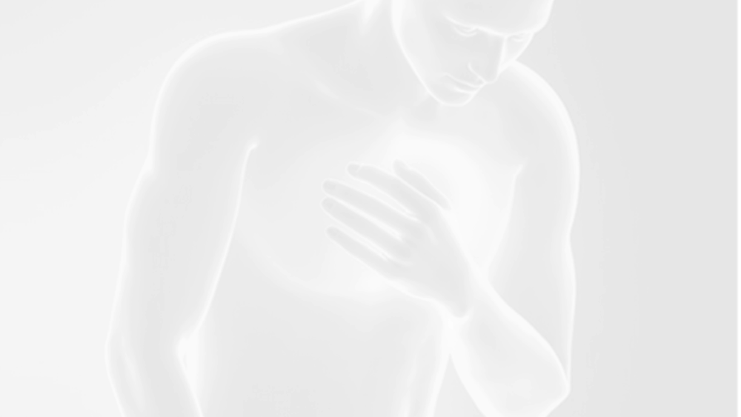
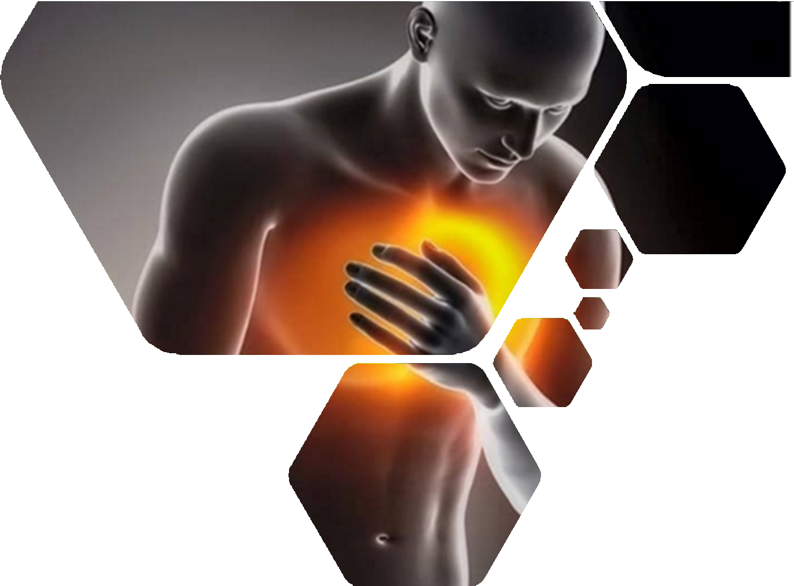

Approach to chest Pain
Presented by Dr. Nada Abdelrahman

Slide 2
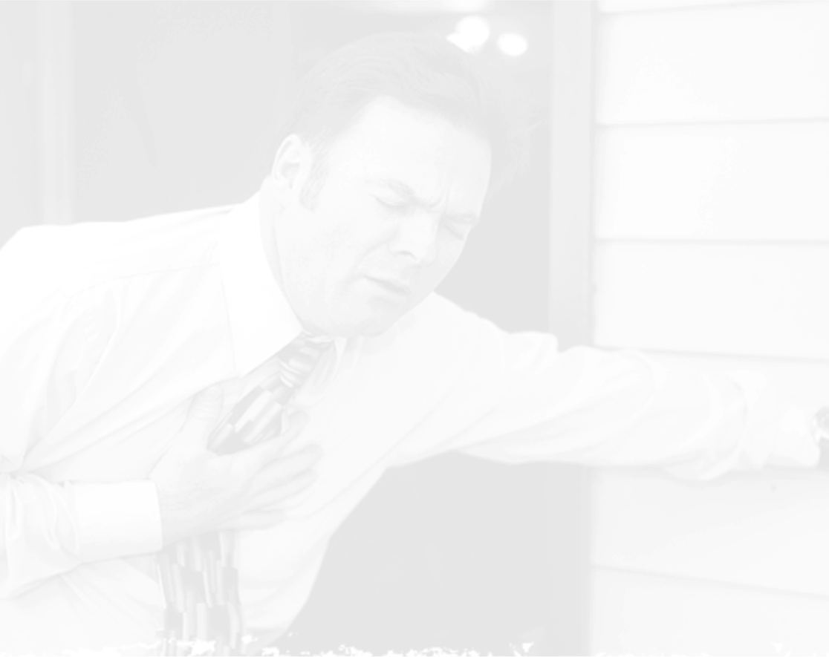
Learning Outcomes
By the end of this lecture the student should be able to
01
Formulate a differential Diagnosis of
Chest Pain.
Review approach to chest
02
pain
03
Focus on life threatening causes of CP
Manage life threatening causes of chest pain
04

Slide 3
Introduction
5 Million (9%) ED visits
Second most common cause of ED presentation among adults in the US
Chest pain is the chief compliant for 1-2% of OPC and 70% of ED visits.
Cardiac etiology found in < 1/3
2% of patients with acute MI are unrecognized and discharged from the ED.
Accurate Diagnosis Remains A Challenge

Slide 4

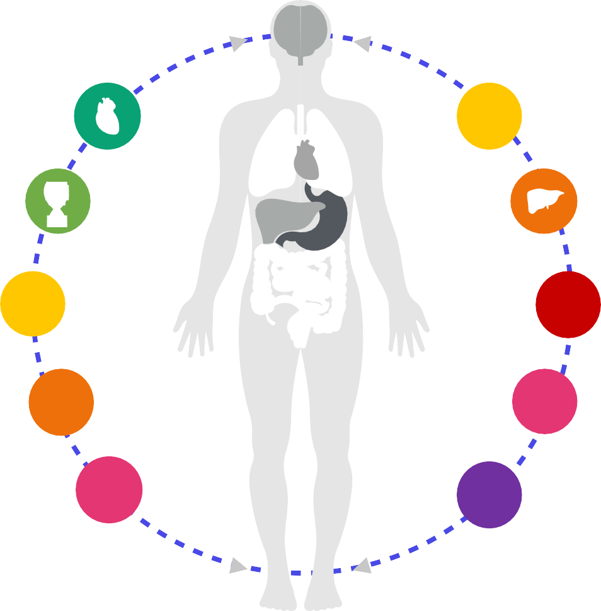
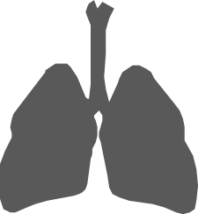




Common Causes of chest pain
Cardiac
Pulmonary Embolism.
Pulmonary causes:Pneumonia, Spontaneous pneumothorax
Gallbladder disease, Pancreatitis, Transverse colitis
Thoracic outlet syndrome, Prolapsed Disc
Peptic ulcer, Esophageal reflux, spasm
Psychological, Panic episodes
Costochondritis ,Cervical disk disease , Trauma or strain,
Herpes Zoster
3/26/24

Slide 5
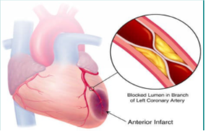
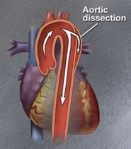
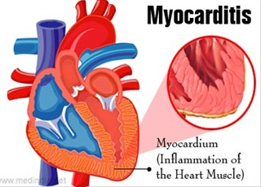
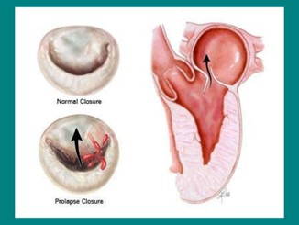
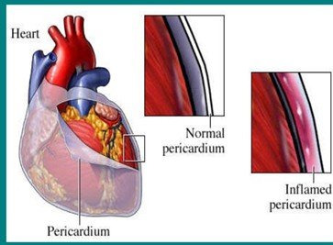
Cardiac causes of Chest pain
redTemplate.com
Acute Coronary Syndrome (NSTEMI/STEMI)
Aortic dissection/Aortic Aneurysm
Myocarditis
Valvular: Aortic stenosis, HOCM, MVP
Pericarditis
1
2
3
4
5

Slide 6






HISTORY IS THE KEY TO THE DIAGNOSIS OF ETIOLOGY OF CHEST PAIN

Slide 7


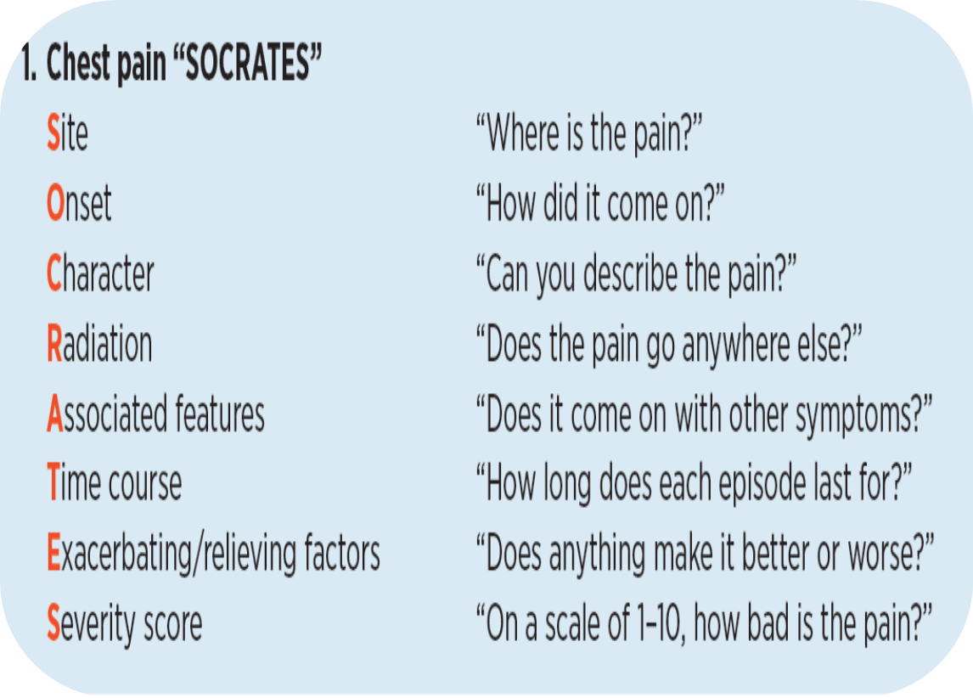

CLINICAL APPROACH TO CHEST PAIN HISTORY

Slide 8
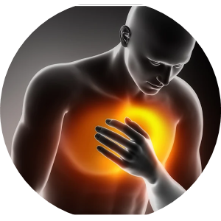


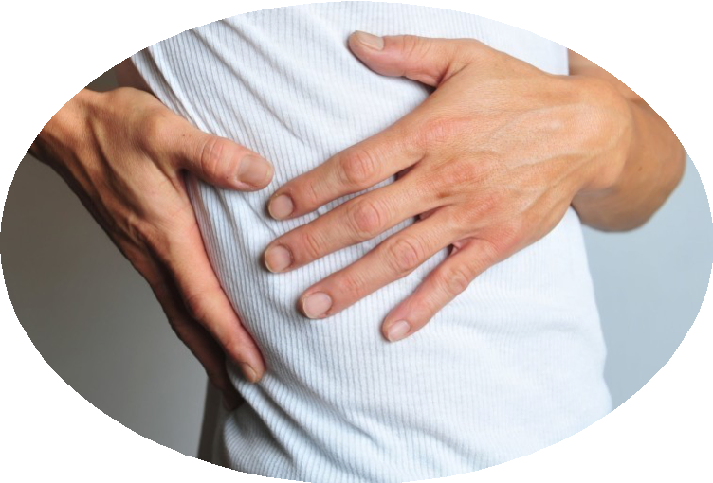
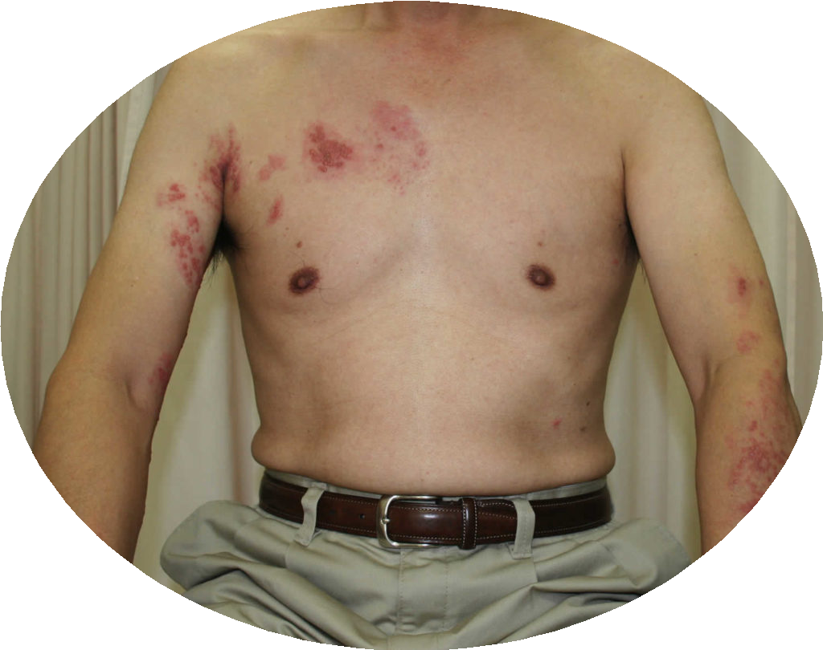
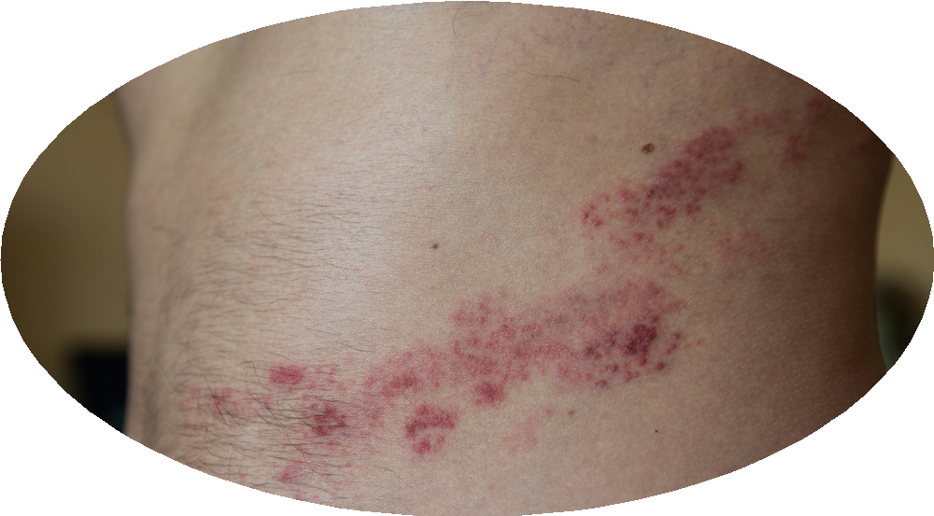
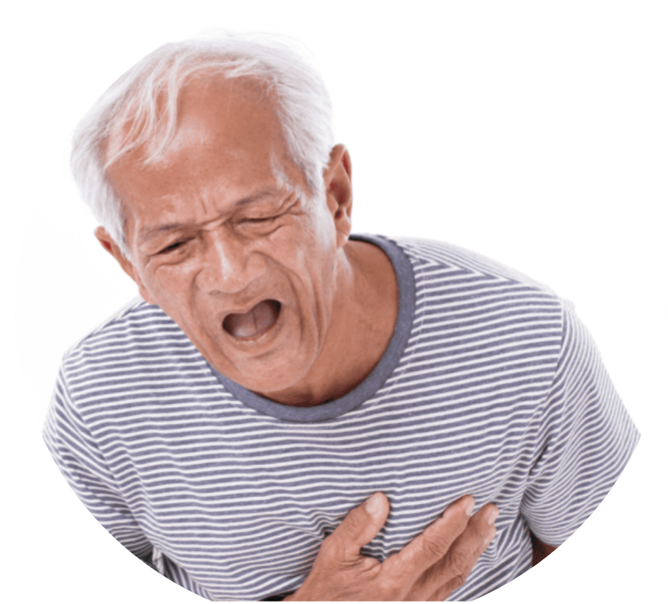

Site
Over Ribs
Poor localize
Retrosternal
Over Skin
Mid-line

Slide 9
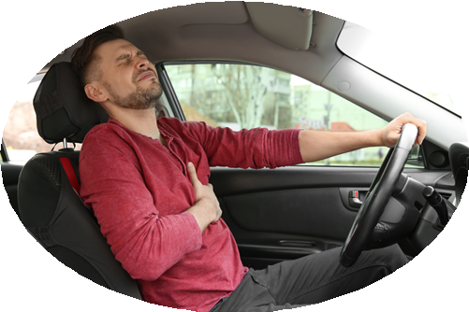

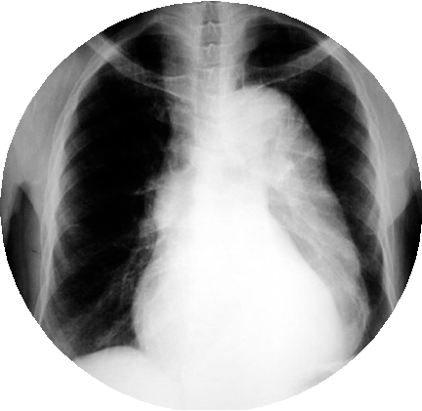


Onset: Sudden
AD
PE
Pneumothorax
ACS

Slide 10

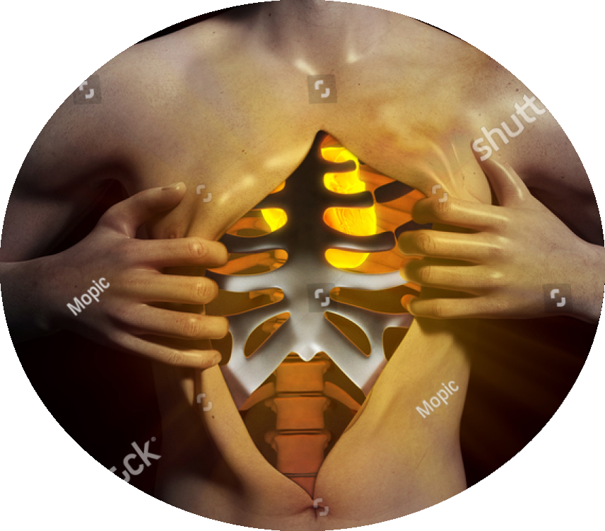

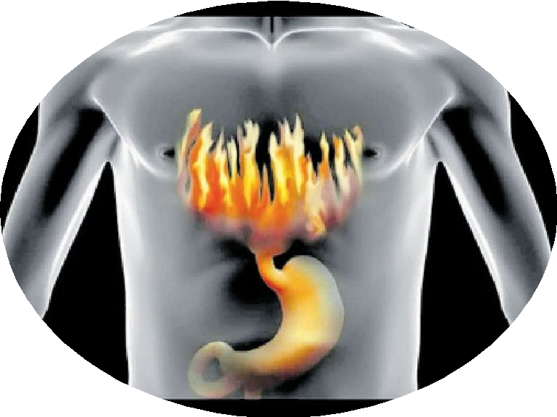
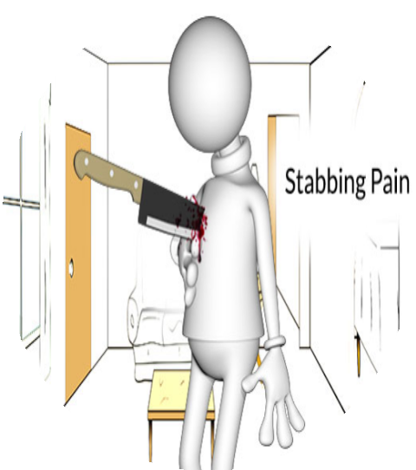

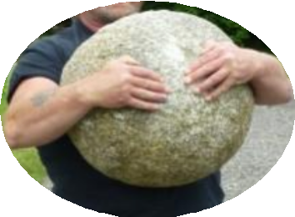
Character
AD
GERD
Pneumothorax
ACS

Slide 11
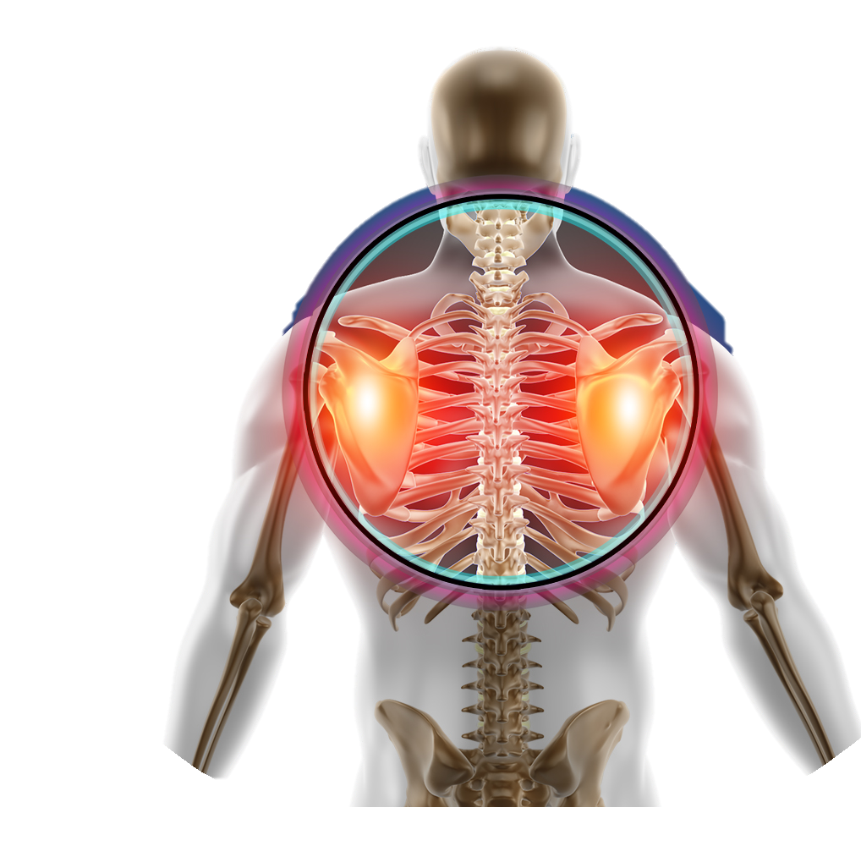
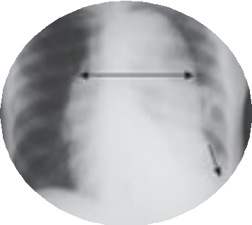
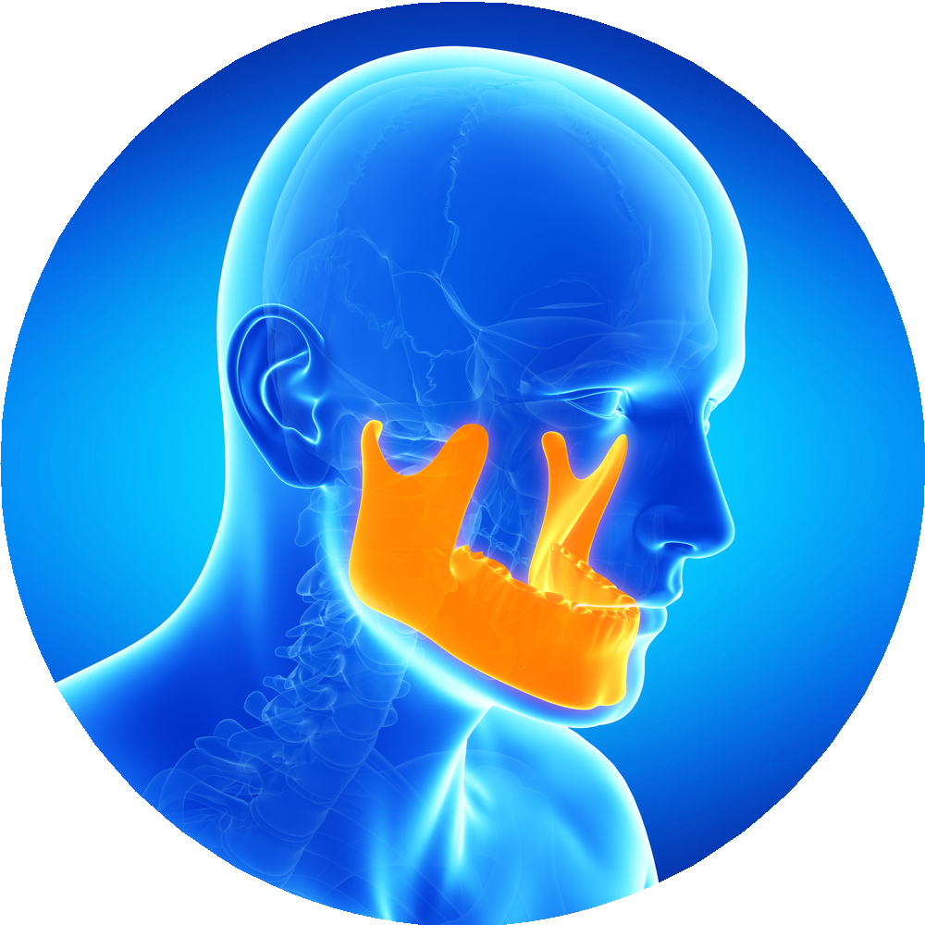
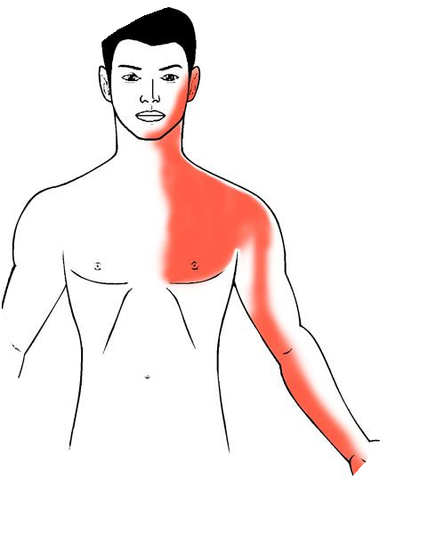
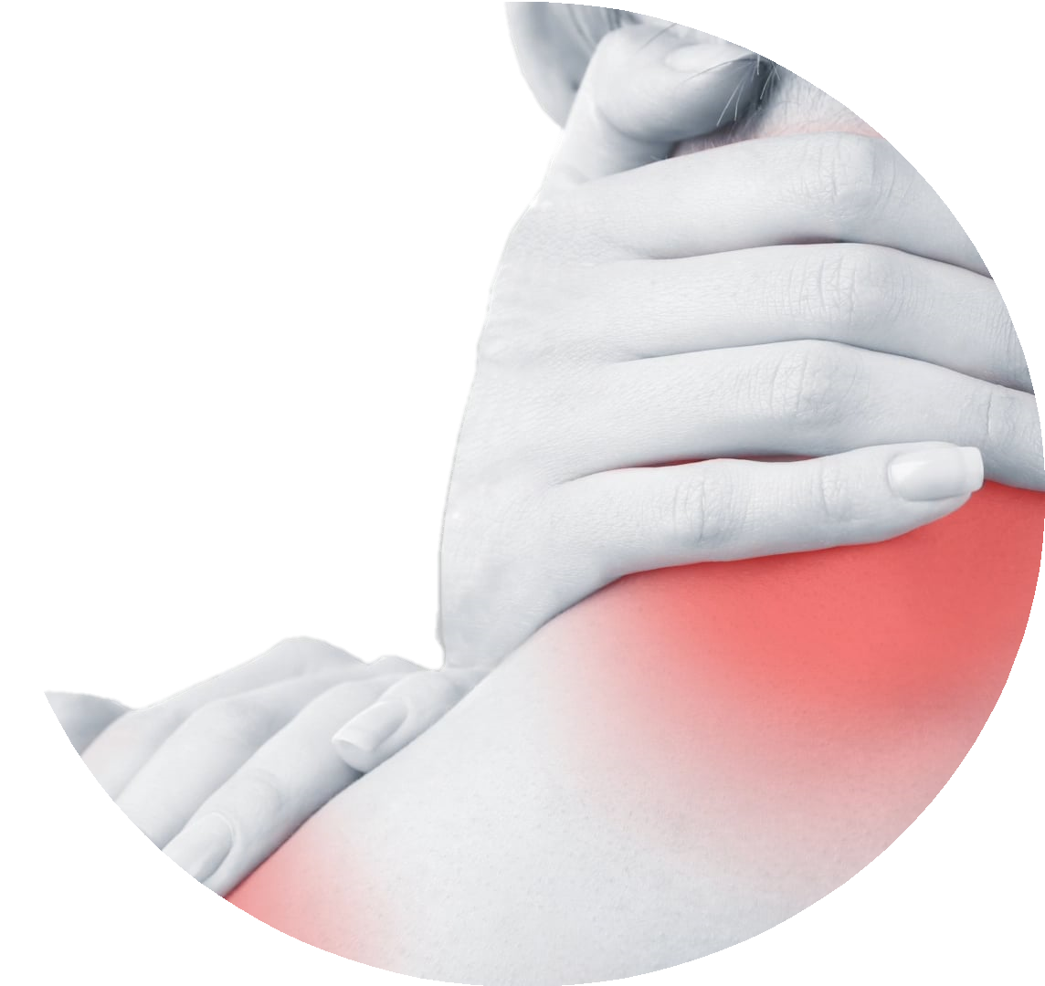
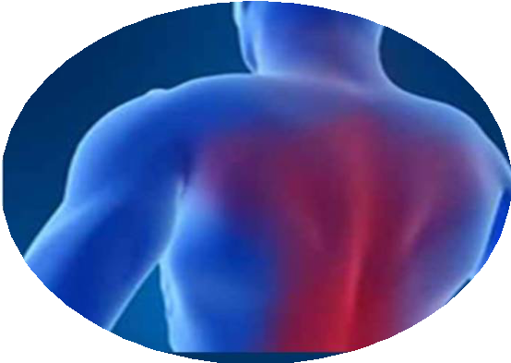
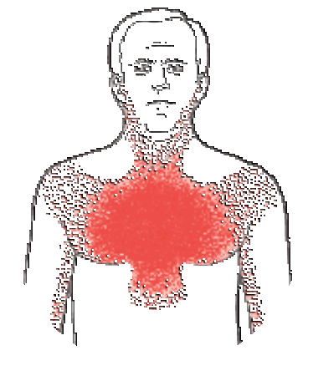
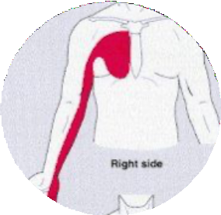
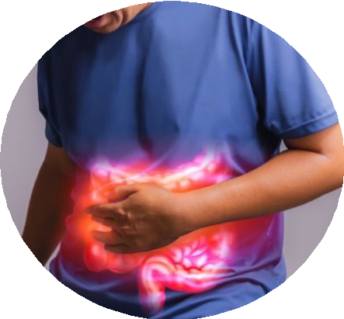
Radiation
AD
ACS

Slide 12
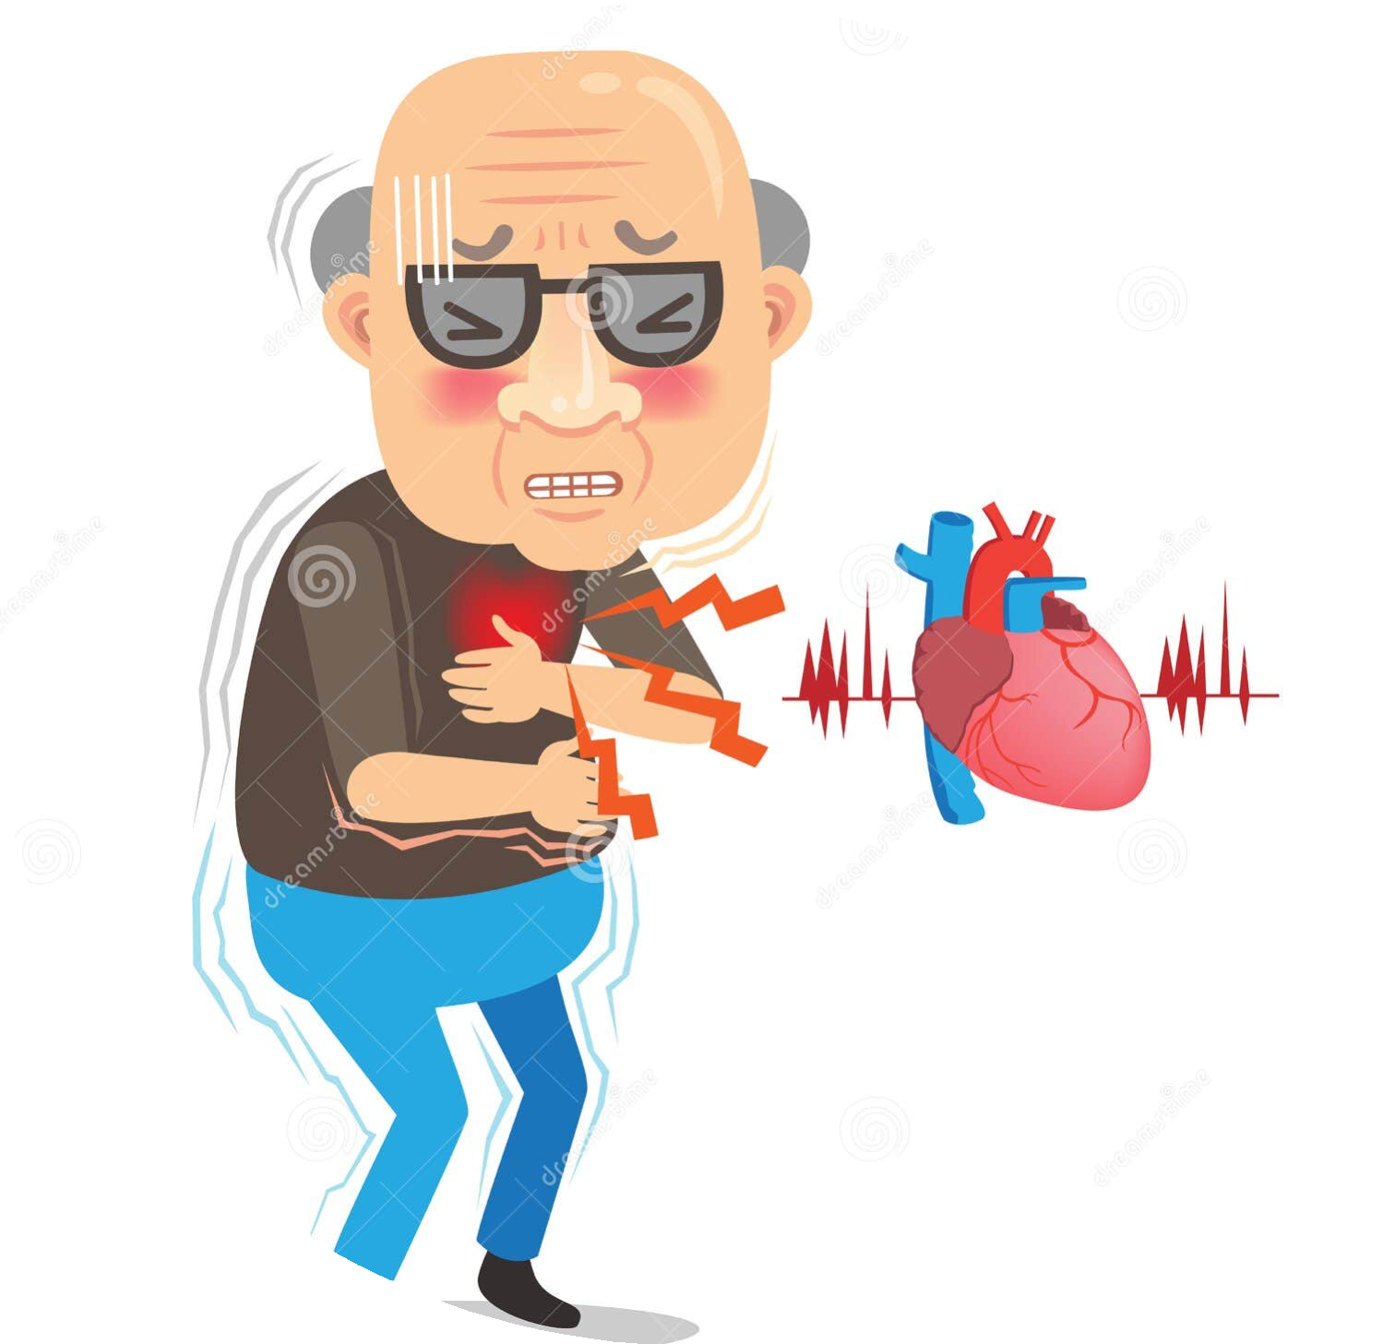
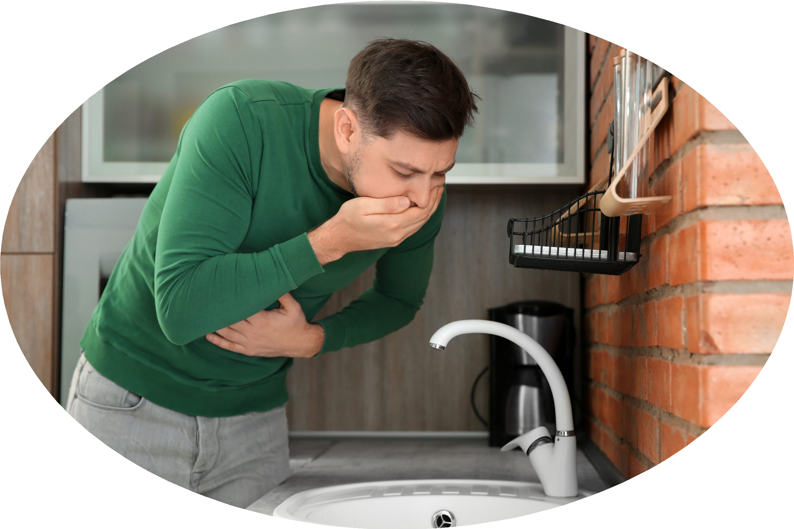



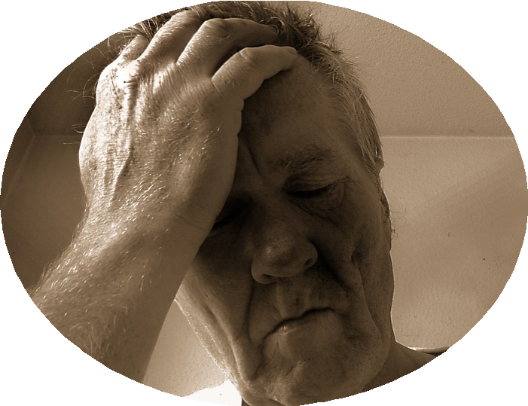
Associated features
ACS

Slide 13
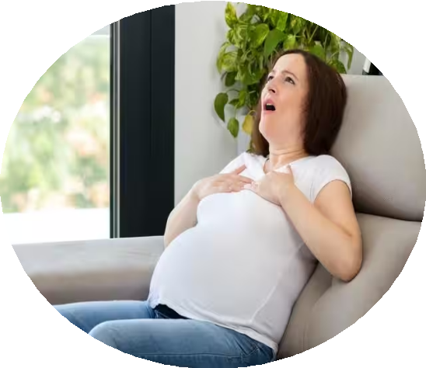
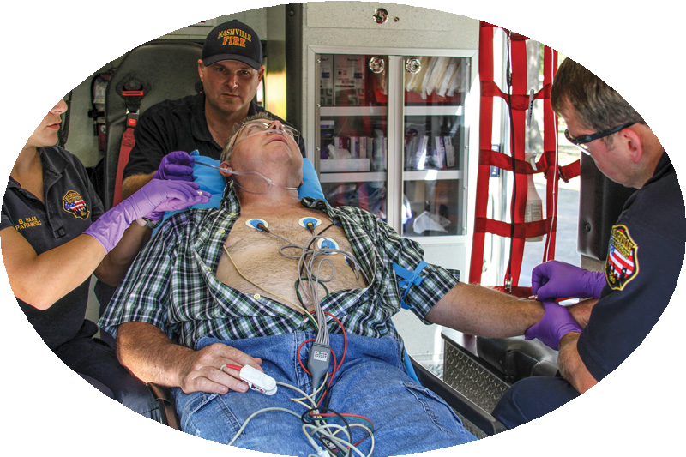
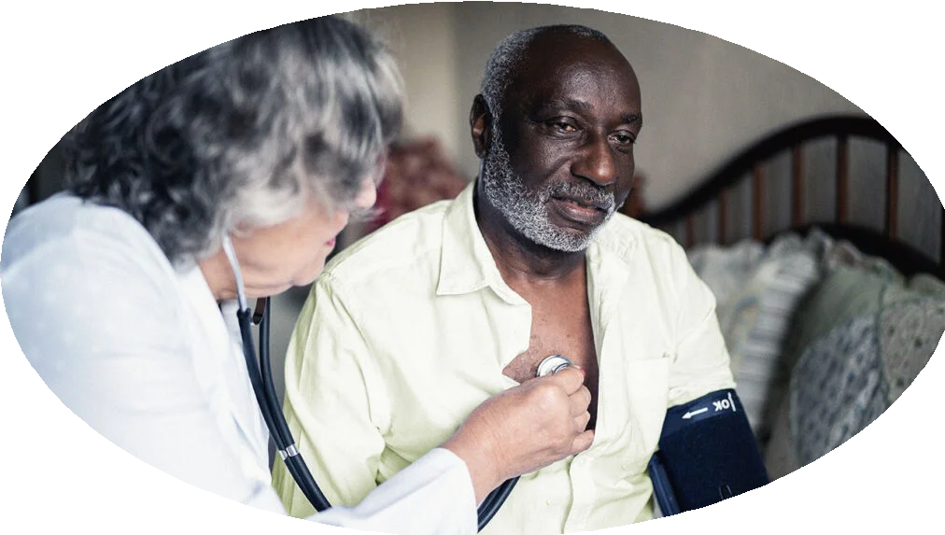
Time course
Few hours
PE
>30 min
ACS
< 15 min ( 2- 10) min Stable Angina
Days

Slide 14
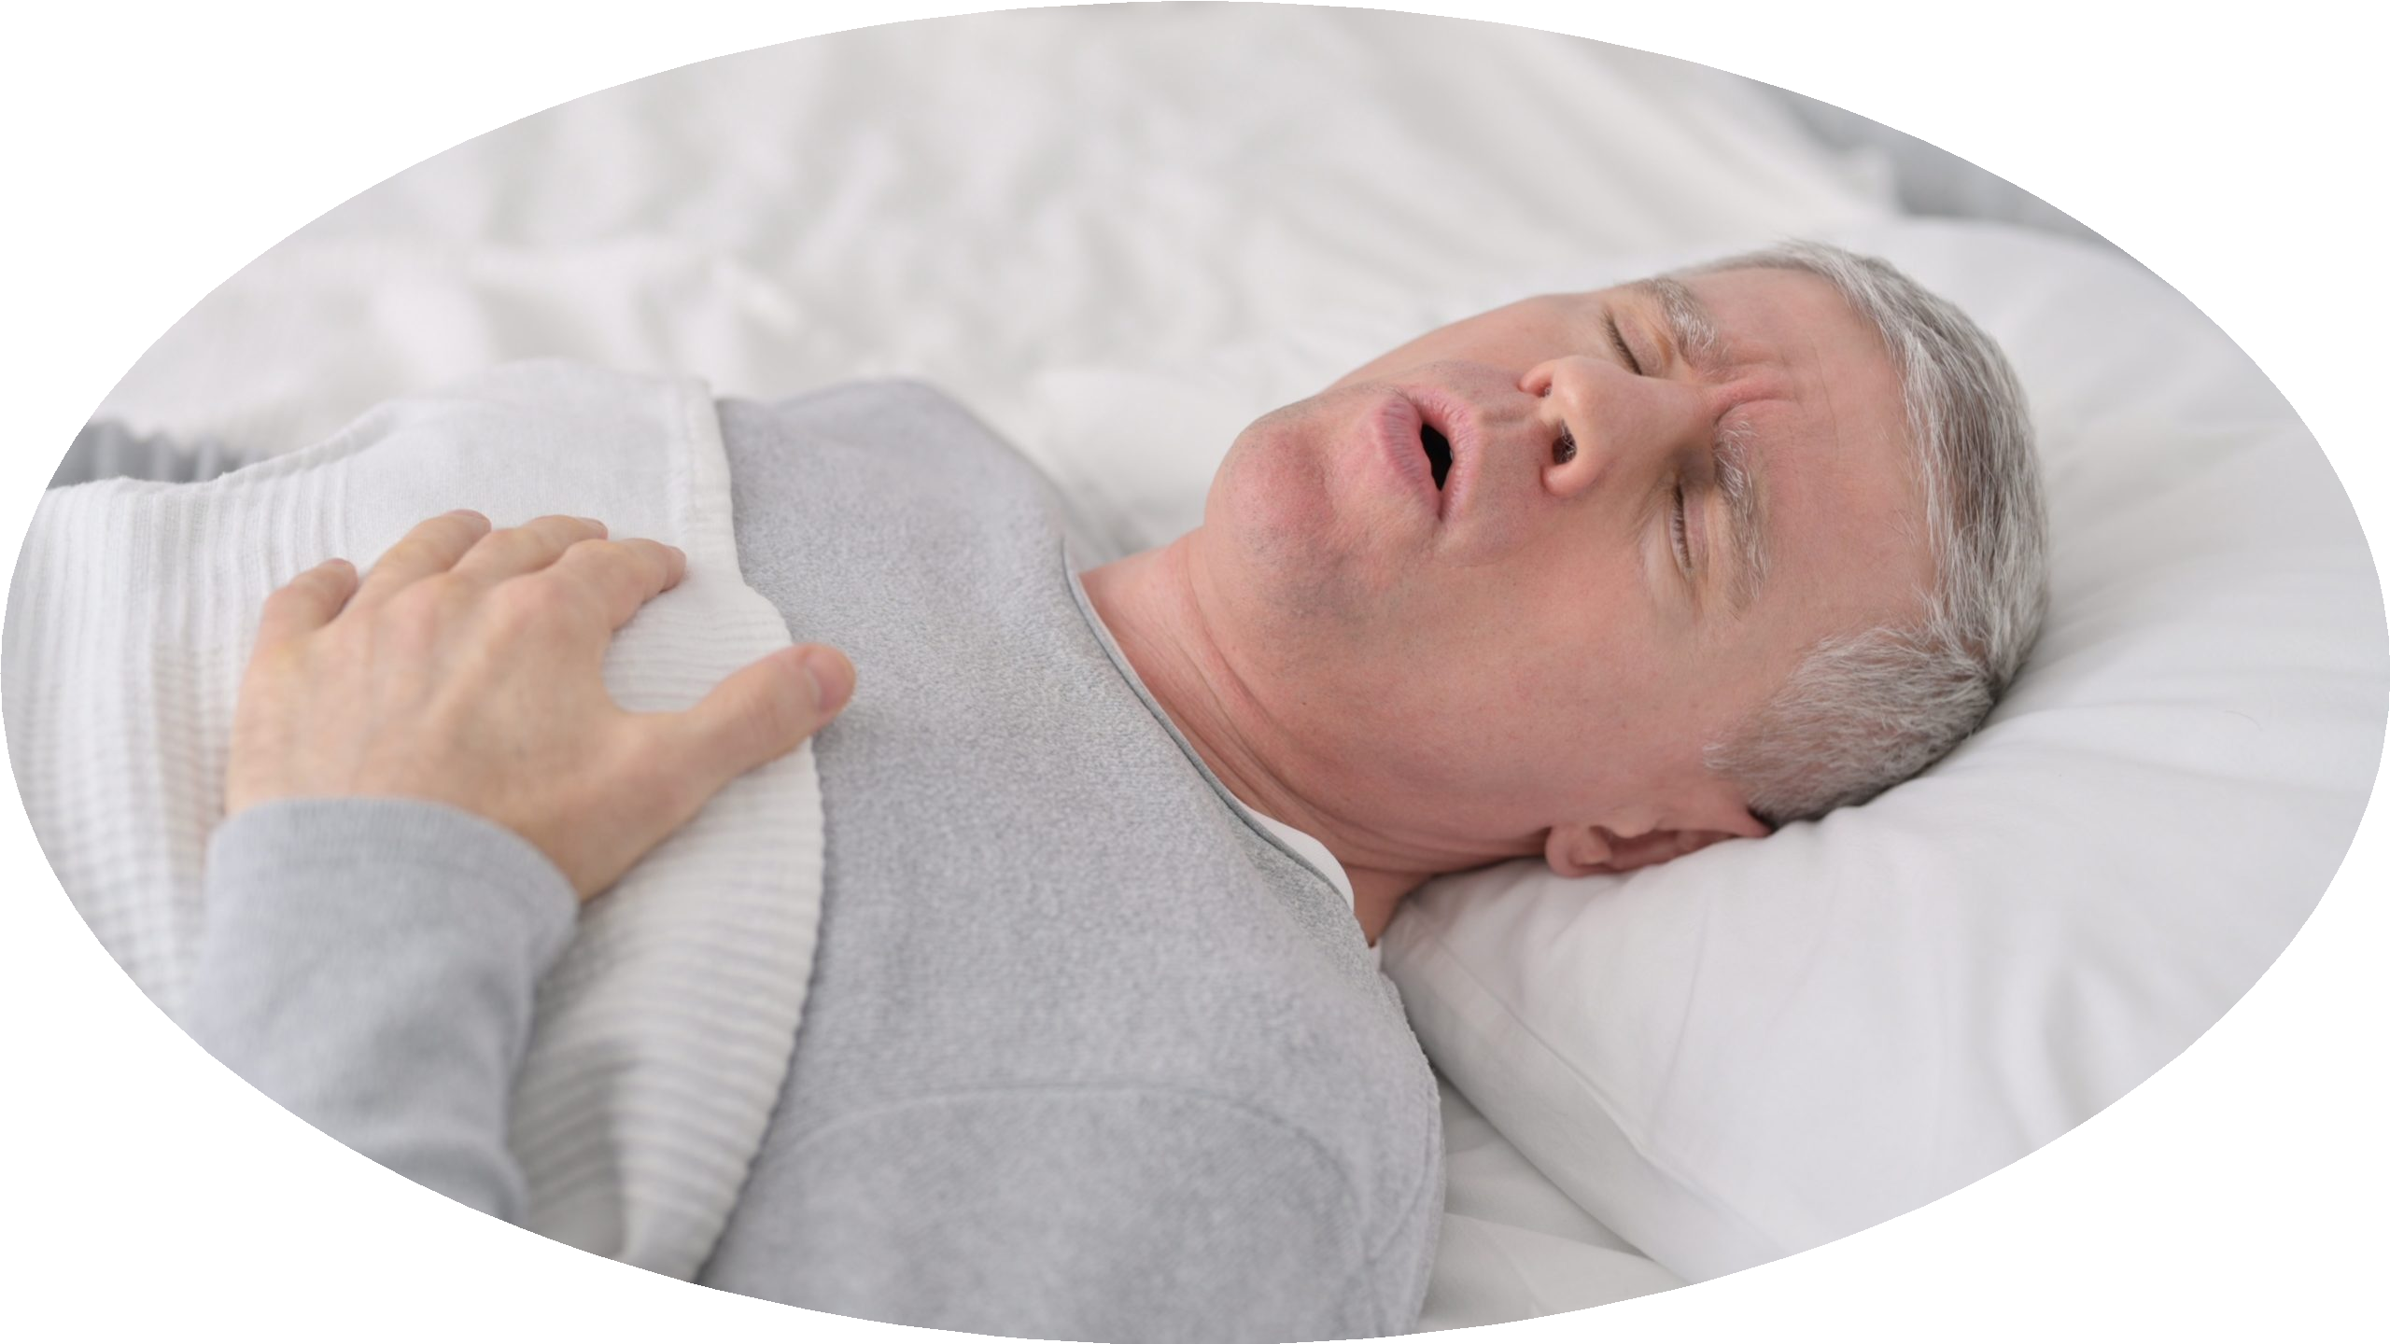




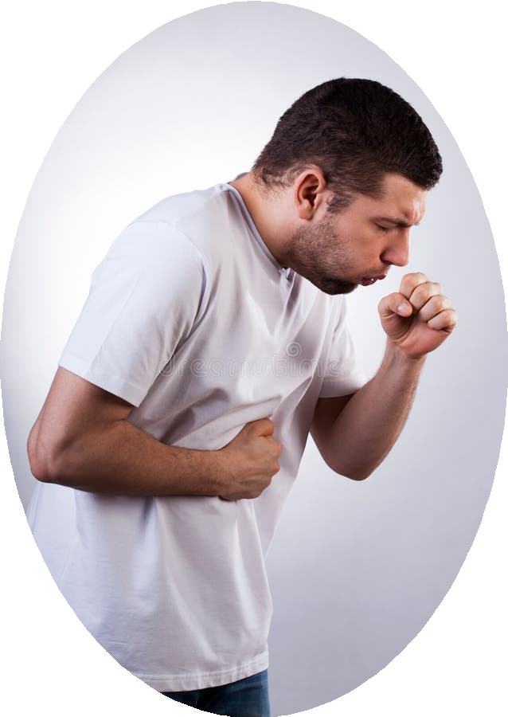
Exacerbating factors
Pericarditis
ACS
GERD
Pleuritis

Slide 15
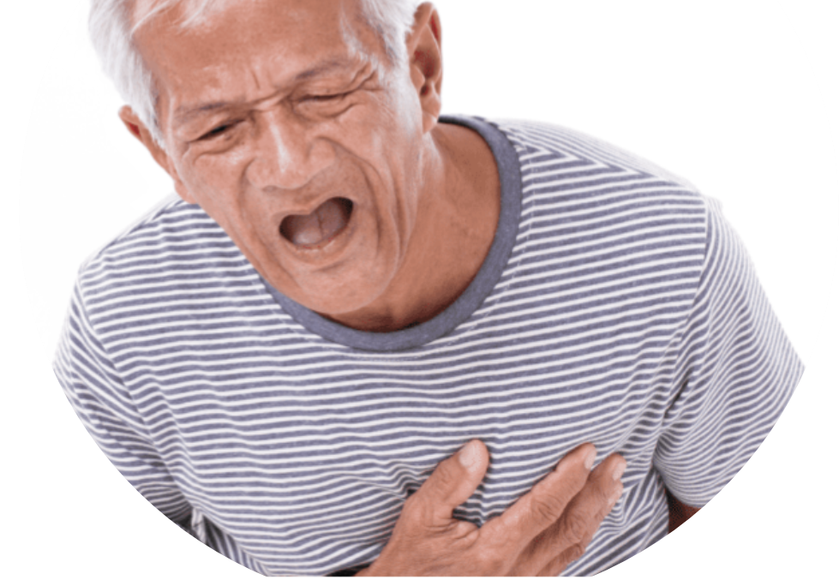
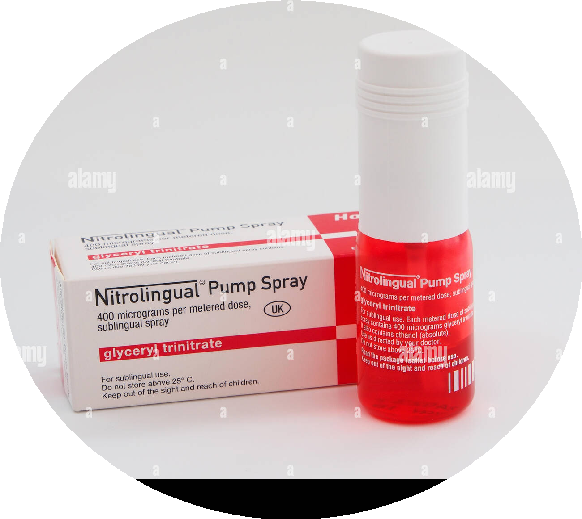

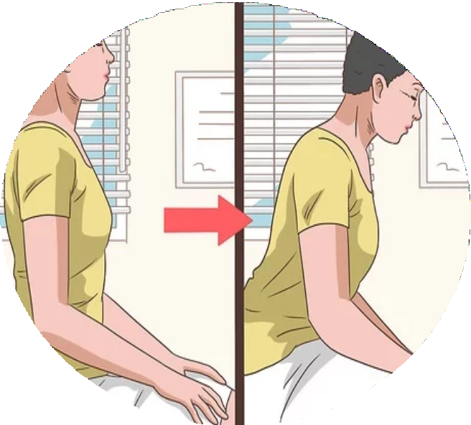
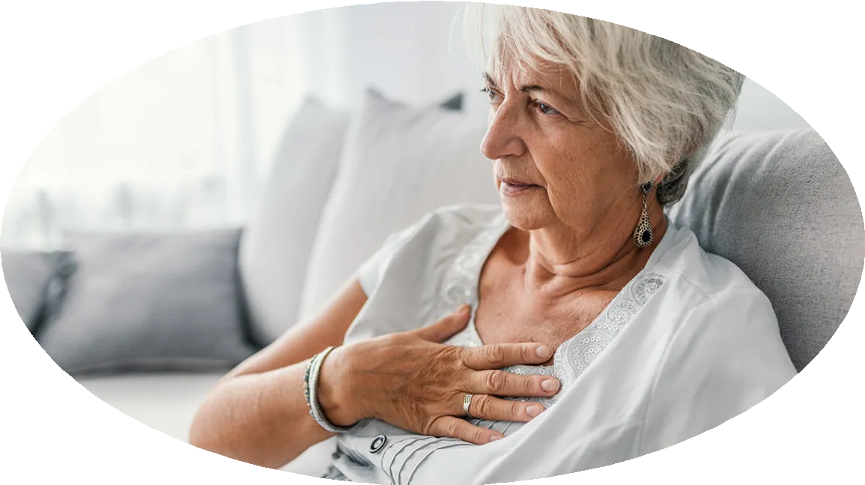
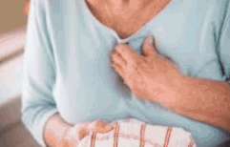
Relieving factors
ACS
Pericarditis

Slide 16
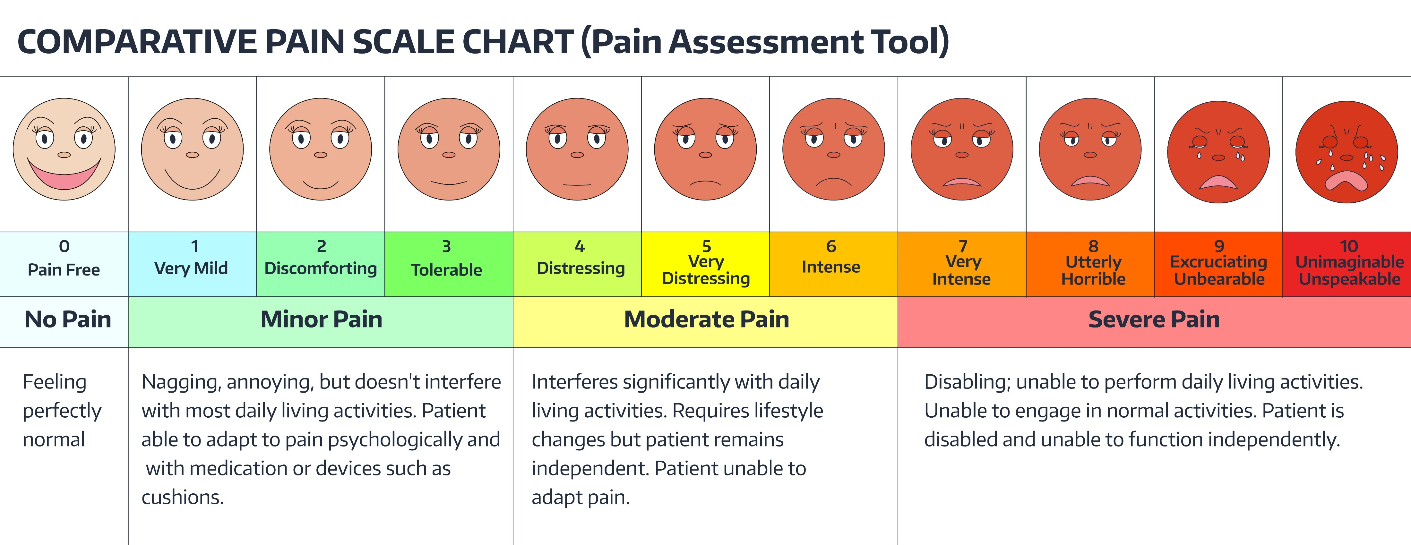
Severity Score

Slide 17

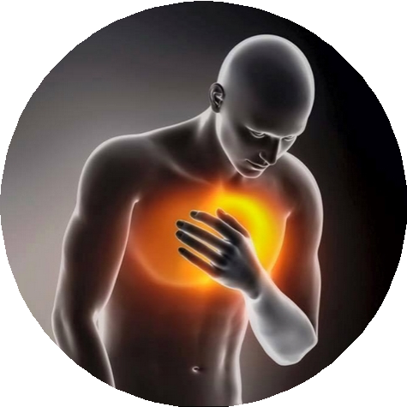

LIFE THREATENING CAUSES
Oesophageal Rupture
Acute coronary syndrome
Dissecting Aortic Aneurysm.
Cardiac tamponade
Pulmonary embolism
Tension Pneumothorax

Slide 18

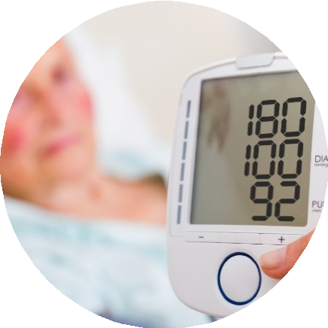
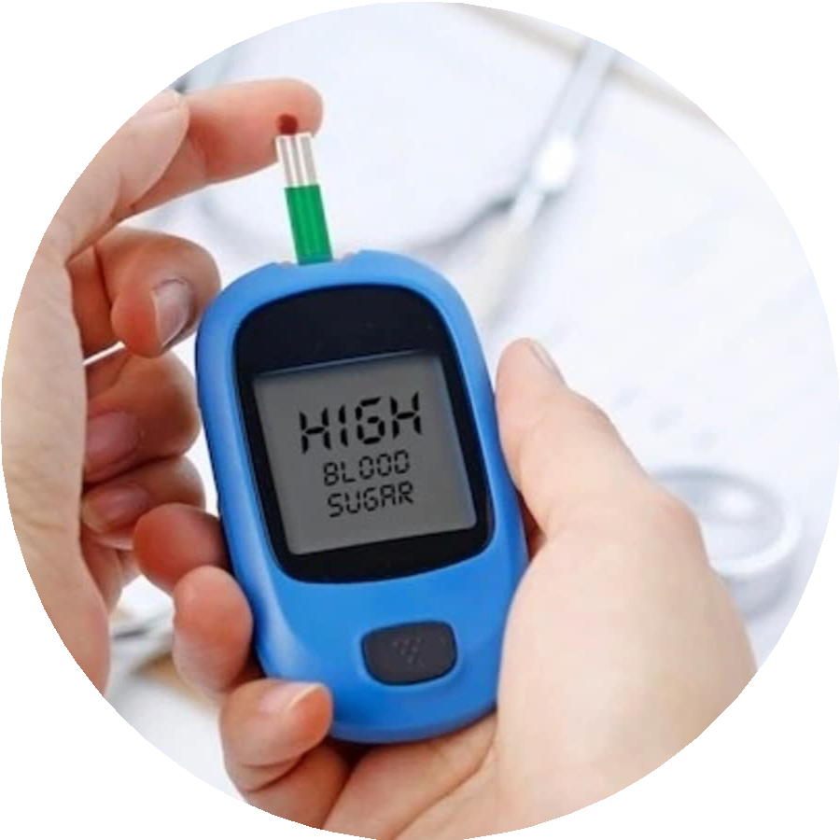



Risk Factors

Slide 19

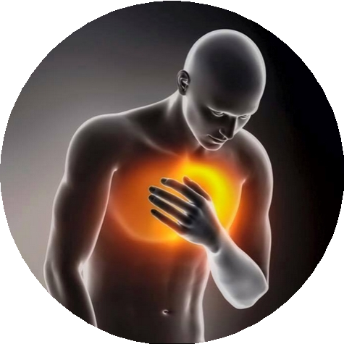
NOT IMMEDIATELY LIFE- THREATENING CAUSES
01
Mitral valve prolapse
02
Pneumonia.
02
GERD
03
Costochondritis.
04
Esophagitis..
05
Herpes zoster.
06
Gallbladder diseases.
.

Slide 20
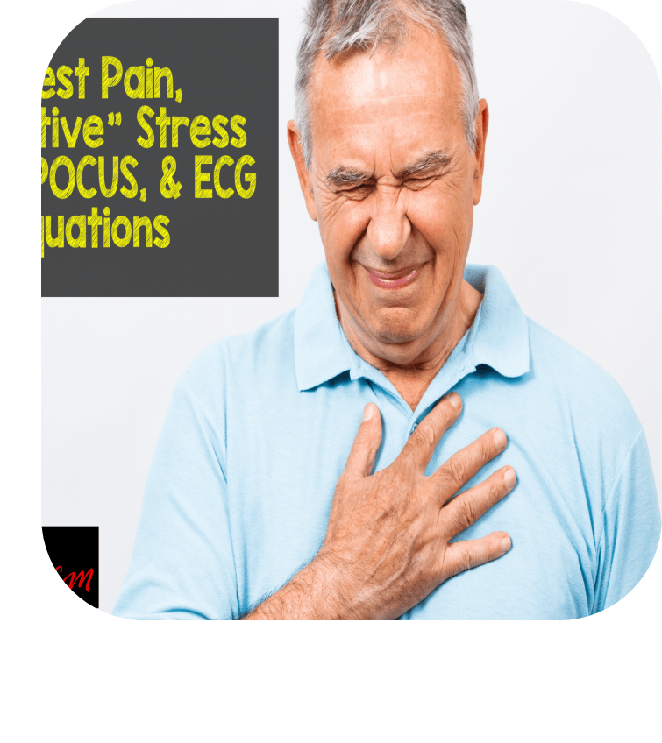


CASE SCENERIO 1
A 40-year-old man smoker, hypertensive presented to ER with h/o of retrosternal crushing chest pain, breathlessness, sweating since 2 hrs.
What is your initial assessment ?

Slide 21






What will
you do next?

Slide 22



What is your
diagnosis?
Acute Anteroseptal myocardial infarction

Slide 23

If the ECG
looks like this ?

Slide 24
What is your
diagnosis?
Acute Inferior MI

Slide 25

CASE SCENERIO 2
30 yo M with a history of ankle fx 2 weeks ago, c/o sudden onset of chest pain.
What is your initial assessment ?

Slide 26




What will
you do next?

Slide 27
What is your
diagnosis?
Acute Pulmonary Embolism

Slide 28




WESTERMARK’S SIGN
HAMPTON’S HUMP
PALLA’S SIGN
ALMOST ALWAYS NORMAL CHEST X-RAY

Slide 29

Pulmonary Angiography (GOLD STANDARD)
Arrow indicates abrupt termination of a pulmonary artery.
Www.brighamrad.Harvard.edu/cases/bw h/images.

Slide 30
CASE SCENERIO 3
A 65-year-old man comes to the ER with h/o sudden onset of chest pain . He was just about to go out for a meet with his friends.
He is a K/C/O hypertension, DM for the past 10 years on medications.
He is a smoker
What is your initial assessment ?

Slide 31






SCENARIO 3
What will you do next?

Slide 32
What is your
diagnosis?
Dissecting aortic Aneurysm

Slide 33

CASE SCENERIO 4
A 25-year-old tall man comes to the ER with h/o sudden onset of chest pain .
What is your initial assessment ?

Slide 34
What is your
diagnosis?
Tension Pneumothorax

Slide 35
What is your diagnosis?
If a patient present with this ECGs

Slide 36


If the ECG looks
like this ?
This is a case of large pericardial effusion (tachycardia, a low voltage recording, and the electrical alternans .

Slide 37




What is
your diagnosis?
Mediastinal air (pneumomediastinum) Oesophageal rupture

Slide 38

Left sided _{W}ma_{h}ss_{a}iv_{t}e _{is} pleural eff_{y}us_{o}io_{u}n_{r}with mediastina_{d}l _{i}s_{a}hi_{g}ft_{nosis?}

Slide 39




Left upper lobe pneumonia
What is
your diagnosis?

Slide 40


What is
Herpes zoster
your diagnosis?

Slide 41



SCENARIO 4

Slide 42


Approach to chest pain
3/26/24
Designed by PoweredTemplate.com 42

Slide 43


Quiz Time
udf9934

Slide 44












Thank You

