Slide 1
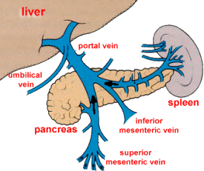
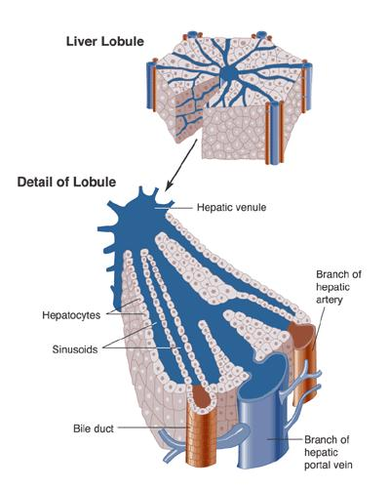
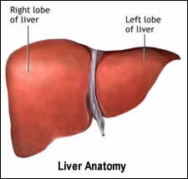
Liver Function Tests
(LFTs)
https://next.amboss.com/us/article/Ln0wFg?q=liver+function+tests#Zec7198aab35043cf581b97bde4bf916f

Slide 2
Major Metabolic Functions of the Liver
Synthetic functions
  Proteins: plasma proteins albumin, globulins, coagulation factors as prothrombin…etc
  Lipids: cholesterol, triglycerides, fatty acids, phospholipids & lipoproteins (VLDL)
  Carbohydrates: glycogen synthesis & gluconeogenesis maintain fasting blood glucose
Detoxification & excretion functions
- Detoxication of ammonia to urea (urea cycle)
- Billirubin conjugation & excretion into bile
  - Excretion of cholesterol into bile
  - Drug detoxication & excretion into bile (why blood from gut pas through liver before heart)
3. Storage Function
  - Storage of fat soluble vitamins (vitamins A, D, E & K)
  Storage of vitamin B₁₂
4. Digestive Function: Production of bile salts
- Help digestion and absorption of lipids and (vitamins A, D, E & K)
Patients with severe hepatic dysfunction are expected to have low plasma urea, low plasma cholesterol ,low glucose, low albumin and high ammonia level

Slide 3
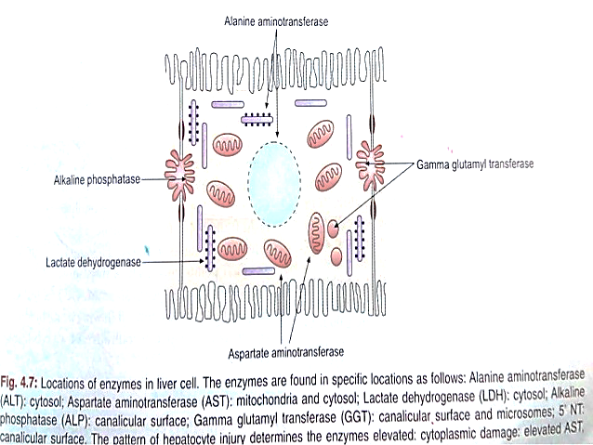
Routine Liver Function Tests (LFTs)
1- plasma proteins mainly Albumin
2- Blood Liver Enzymes: parenchymatous and cholestatic
Alanine amino transferase (ALT)
Aspartate amino transferase (AST)
Gamma glutamyl transferase (GGT)
Alkaline phosphatase (ALP)
5’-nucleotidase (5'-NT)
3- Blood Coagulation Factors (prothrombin)
Prothrombin Time (PT) and INR
4- Blood Billirubin: see jaundice lecture
(total 1 mg%, direct 0.8%& indirect 0.2%)
LFTs can be affected by extrahepatic factors such as nutrition, hemolysis, antibiotic use, systemic illness

Slide 4
1- Serum Albumin
(Synthetic Function of Liver)
Albumin is present in higher concentrations (55%) than other plasma proteins
( 3.5- 5 g/dL in normal adults). It is responsible of maintenance of O.P of plasma
Albumin 100% is synthesized in the liver & has a half-life of 20 days (not affected in acute liver diseases).
Hypoalbuminemia leads to ascites and pitting edema but edema may be due to
              malnutrition,
              heart,
              liver or
              Kidney diseases

Slide 5
Causes of hypoalbuminemia
1- Artefactual : Diluted sample
2- Physiological : Pregnancy - Recumbence
3- Decreased protein intake: Reduced essential amino acids in diet
Malnutrition, Malabsorption.
4- Increased catabolism : Surgery, Trauma, infections
5- Defective synthesis in liver: Chronic liver diseases with cirrhosis
6- Increased loss : From the kidney: Nephrotic syndrome (with albuminuria)
From GIT: Protein loosing enteropathies
From Burns: less than 2 gm/dl means mortality > 80%

Slide 6
2- Blood Liver Enzymes
Blood Transaminases (ALT=SGPT & AST=SGOT)
= liver damage indicators
Alanine amino transferase (ALT): ALT is more liver specific than AST because ALT rarely increases in lesions other than the liver parenchyma. 2 types cAST 20% and mAST 80%
They are sensitive and increased even before the clinical symptoms and signs (1 week before jaundice)
Extent of increase of AST and ALT reflects the degree of hepatocellular damage
ALT (48h) mainly cytoplasmic elevations persist longer than do AST (18h) ? For about 5 weeks
Persistent increase of enzymes for more than 6 months = chronic liver disease
Aspartate transaminase (AST): Blood AST are increased with many diseases of various organs:
1- Liver diseases
2- Myocardial infarction (MI): However, ALT may be also increased if liver congestion occurs
secondary to congestive heart failure
3 - Progressive skeletal muscular dystrophy, Crush injury
4- Hemolytic diseases (RBCs)

Slide 7
Causes of elevated levels of blood ALT & AST: De Ritis ratio (AST/ALT ratio)
1- Viral , toxic or alcoholic hepatitis (Acute liver diseases)
Marked increase in ALT & AST (Up to 20 - 50 - may reach up to 100 folds).
In viral hepatitis, ALT is much elevated than AST
2- Cirrhosis (chronic liver diseases) with low prothrombin and albumin
(Moderate increase (up to 4 – 5 folds)
In chronic cases, AST is much elevated than ALT.
3- Obstructive jaundice (Obstructive liver diseases): with very high ALP and GGT
ALT & AST are increased up to 3 folds (moderate increase)
4- After alcoholic or drug intake: (transient slight to moderate increase).

Slide 8
Gamma glutamyl transferase (GGT)
GGT present in blood originates primarily from hepatobiliary system. Membrane-bound enzyme involved in glutathione metabolism and amino acid transport. The most sensitive parameter for diseases of the liver and/or biliary tract. Usually the first liver enzyme to rise after bile duct obstruction. Used to confirm hepatic origin of elevated ALP levels Not elevated in bone disease (in contrast to ALP)
Causes of increased blood GGT:
1- Biliary obstruction: GGT is markedly increased with obstructive jaundice (5 – 30 folds)
Increase earlier (more sensitive) than ALP- Persists longer than ALP
2- Viral, toxic & alcoholic hepatitis : Increase is only 2 – 5 folds (less sensitive than ALT & AST)
3- Primary and secondary liver tumors: GGT is elevated earlier than other enzymes in liver neoplasm. Secondaries of other organ tumors in the liver can be early detected by elevated GGT. (arouse suspicious that the diseases is metastatic to liver)
4- Induction of GGT synthesis by these cells occurs without cell damage (isolated GGT ↑)
by alcohol or drugs as anticonvulsants , phenobarbitone & phenytoin

Slide 9
Alkaline Phosphatase (ALP)
Alkaline phosphatases (ALP) are group of enzymes that hydrolyze organic phosphates at high pH (9 – 10.5)
Main Sources of ALP:
1- Cells of hepatobiliary tract (hepatocytes adjacent to the biliary canalculi) Activity in the liver is localized on those parts of the cell membrane of the parenchymal cell adjoining the biliary canalculi
2- Osteoblasts of bone : The function of ALP is important for bone calcification.
3- placenta
Clinical significance of increased serum ALP activities:
1-Physiological increase of ALP:
  During periods of active bone growth in infancy and at puberty.
- In children under 3 years, total ALP activity is increased up to 2.5 times the upper limit
- Increased twice, during the third trimester of pregnancy (placental ALP).

Slide 10
2- Pathological increase of ALP:
A- Bone causes (due to increased osteoblastic activity):
  - Paget`s Disease of bone Marked increase , may be 10 – 25 folds
  - Primary osteogenic tumors
  - Secondary malignant deposits in bone e.g. cancer prostate causing deposits in bones (osteoblastic tumor)
  - Rickets & osteomalacia (vitamin D deficiency)
  - Primary & secondary hyperparathyroidism (increased PTH)
  - Healing of bone fractures
B-Hepatobiliray tract: liver diseases with involvement of biliary tract
1- Obstructive jaundice (intrahepatic or extrahepatic)
- Extrahepatic cholestiasis : (Marked increase, up to 10 – 12 folds)
- Intrahepatic cholestiasis: (Moderate increase , ~ 3 -5 folds)
  2- hepatitis: Viral, toxic & alcoholic
Mild to moderate increase, less than 3 folds (ALP may be may be normal)

Slide 11
Clinical Hint: Compare to what degree the ALT and ALP are raised. A greater than 10-fold increase in ALT and a less than 3-fold increase in ALP suggests a predominantly hepatocellular injury.
A less than 10-fold increase in ALT and a more than 3-fold increase in ALP suggests cholestasis.
If ALP is elevated due to a bone disease: In this case, GGT is normal
i.e. GGT is used to differentiate increased ALP is due to bone or hepatobiliary disease
5'-nucleotidase (5'-NT)
Membrane-bound enzyme that hydrolyzes a nucleotide into a nucleoside and phosphate
Used to confirm hepatobiliary origin of elevated ALP levels.
5'-NT is more specific to the liver and/or biliary tract than ALP
What if the patient is jaundiced but ALT and ALP levels are normal?
An isolated rise in bilirubin is suggestive of a pre-hepatic cause of jaundice.
Causes of an isolated Jaundice (rise in bilirubin with normal liver functions )include:
Haemolysis: check a blood film, full blood count, reticulocyte count, haptoglobin and LDH levels to confirm.

Slide 12
3- Coagulation factors (Prothrombin Time) 11–12 seconds
Time it takes to produce fibrin polymers after adding thromboplastin and calcium
Increased in: Vitamin K deficiency and Impaired coagulation factor production (e.g., cirrhosis)
The liver makes many of the proteins (prothrombin & other clotting factors) needed to make blood clot. In certain liver disorders the liver cannot make enough of these proteins and so blood does not clot so well. Therefore, blood clotting tests may be used as a marker of the severity of certain liver disorders
In acute and chronic liver disease, the synthesis of prothrombin is diminished, Also in obstructive jaundice (due to vitamin K deficiency)→ prolonged prothrombin Time (PT)
This may be one of the earliest abnormalities seen in hepatocellular damage, since prothrombin has a short half-life (~ 6 hours). So it must be done for every patient prone to surgery or operation.

Slide 13
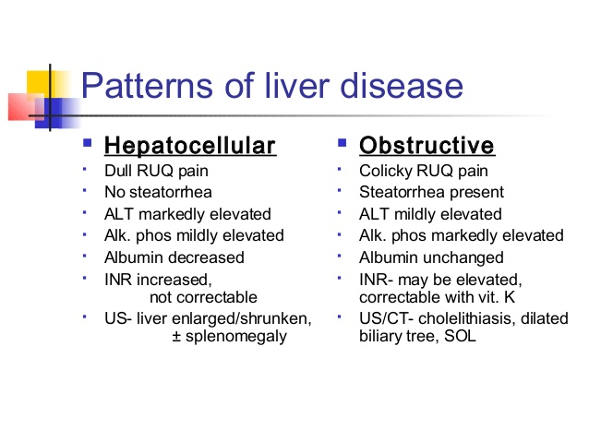

Slide 15
Bilirubin Metabolism
Jaundice
https://next.amboss.com/us/article/WS0PA2?q=bilirubin+metabolism#Z924dbf25def7ca057f504e6c7a4fd13a

Slide 16


Hemoglobin metabolism
The lifespan of RBCs is about 120 days. After this time, macrophages in the reticuloendothelial system of the bone and the spleen phagocytose RBCs. They are then broken down and their parts recycled.
heme (red) → biliverdin (green pigment) → bilirubin (yellow pigment)
Heme is converted to biliverdin by heme oxygenase.
  Requires NADPH + H⁺
  Carbon monoxide (CO) is released.
  Iron is released, oxidized, and taken up by transferrin to be recycled.
Biliverdin is converted to bilirubin by biliverdin reductase (requires NADPH + H⁺)
Heme breakdown is responsible for the color changes in hematomas.

Slide 17
Unconjugated bilirubin (insoluble in water) is released into the blood by macrophages → binds to albumin and reaches the liver
Unconjugated bilirubin is converted into bilirubin via enzyme UDP-glucuronosyltransferase in the liver.
  Bilirubin is conjugated with glucuronic acid → bilirubin diglucuronide = conjugated bilirubin (water soluble)
  Most conjugated bilirubin is excreted into the GI tract via bile, while some is released into the blood.
Conjugated bilirubin excreted in bile is broken down by GI bacteria into urobilinogen
  Most urobilinogen is converted to stercobilin → excreted in feces (brown color).
  Part of urobilinogen oxidates to urobilin → excreted in the urine (yellow color)

Slide 18
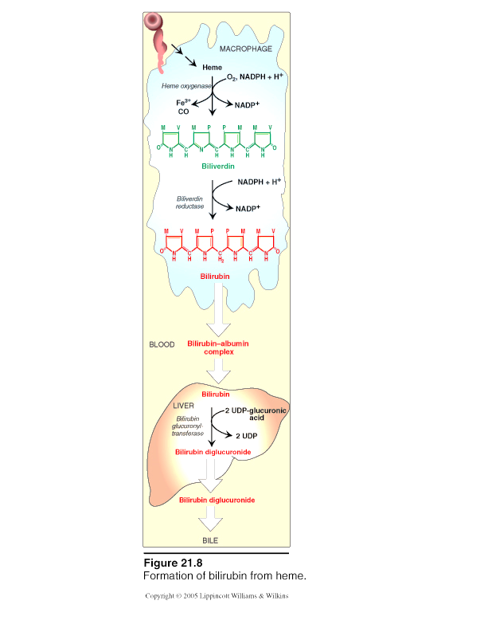
1-Formation of Bilirubin from Heme in RES
Heme is degraded in RE system (esp. liver & spleen)
85% from RBCs
15% from turnover of immature RBCs & cytochromes
Heme
Heme Oxygenase
biliverdin (green)
bilirubin (red-orange)
bile pigments
In Blood with albumin
UNCONJUGATED BILIRUBIN
(or INDIRECT BILITUBIN)

Slide 19
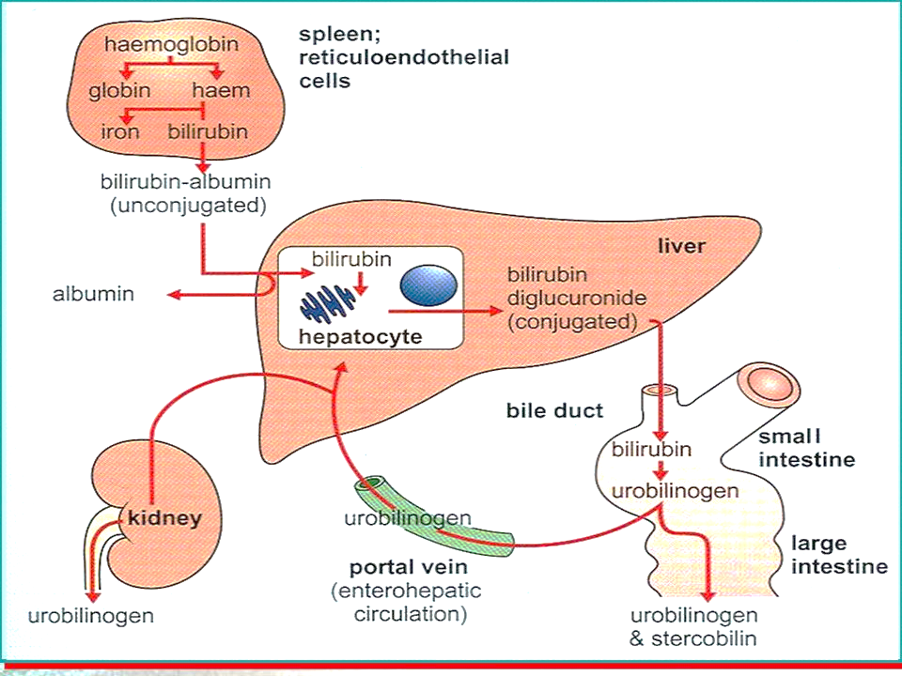
2- Bilirubin Metabolism in the Liver
Uptake of Bilirubin by hepatocytes: Bili dissociates from albumin & enters hepatocytes
Conjugation of Bilirubin: bilirubin is conjugated with two molecules of glucuronic acid by the enzyme glucuronyl transferase to form Conjugated bilirubin
Excretion of bilirubin into bile: Conjugated bilirubin (bilirubin diglucuronide) is transported into bile canalculi & then into bile. Process is energy dependent & is impaired in liver diseases

Slide 20
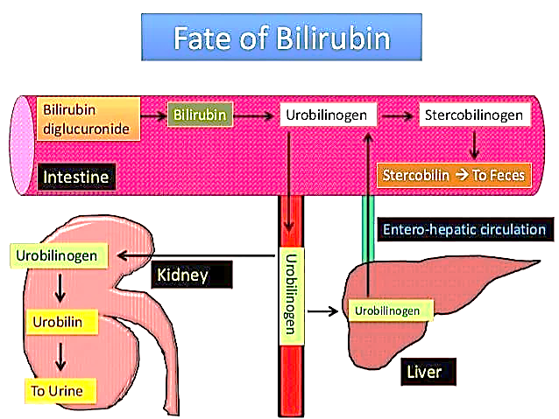
Bilirubin Metabolism in the Intestine

Slide 21
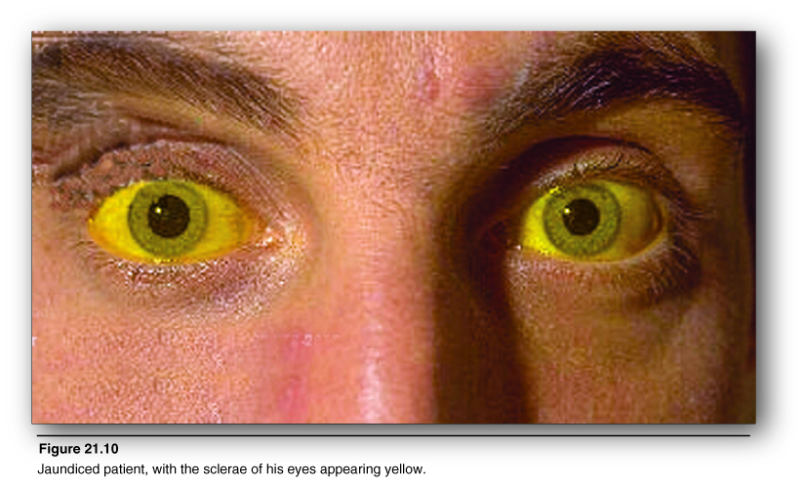
Jaundice
Yellow color of skin, mucous membranes & sclera caused by deposition of bilirubin secondary to increased bilirubin levels in blood (hyperbilirubinemia)
JAUNDICE IS NOT A DISEASE
HOWEVER,
IT IS A SIGN OF
AN UNDERLYING DISEASE
Pseudojaundice ^{[14]}
  Carotenoderma: Deposition of carotene in the skin cause yellow-orange skin.
    Due to excessive consumption of beta carotene (e.g., carrots, sweet potatoes, kale, oranges)
  Addison disease: hyperpigmentation of skin by increased melanin synthesis

Slide 22
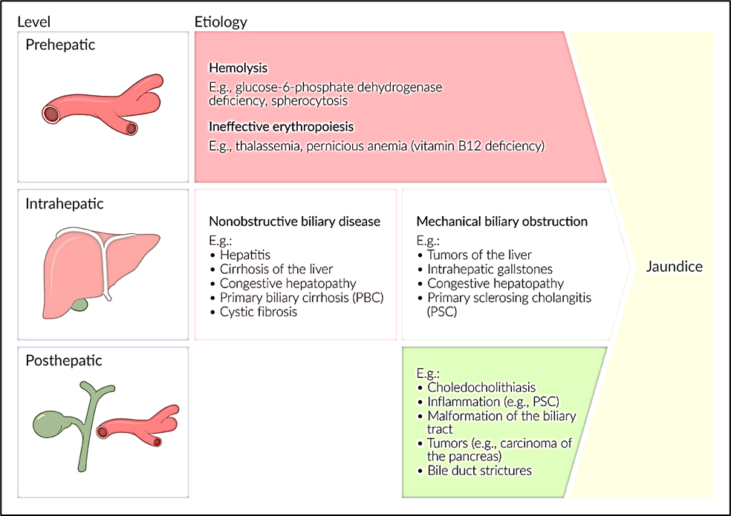
Types of Jaundice = hyperbilirubinemia
Adult jaundice divided into prehepatic, intrahepatic, and posthepatic etiologies. The most common causes of adult hyperbilirubinemia can be remembered with the mnemonic “HOT Liver”: Hemolysis, Obstruction, Tumor, and Liver disease.
1- Hemolytic Jaundice (Pre hepatic) (Unconjugated)
2- Obstructive Jaundice (Post hepatic) (Conjugated)
3- Hepatocellular Jaundice (Hepatic) (mixed)

Slide 23
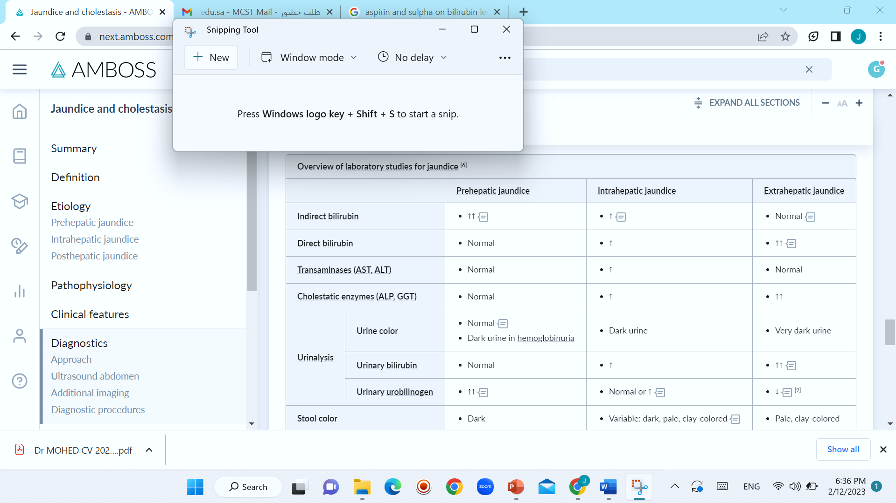
LABORATORY INVESTIGATIONS IN TYPES OF JAUNDICE

Slide 24
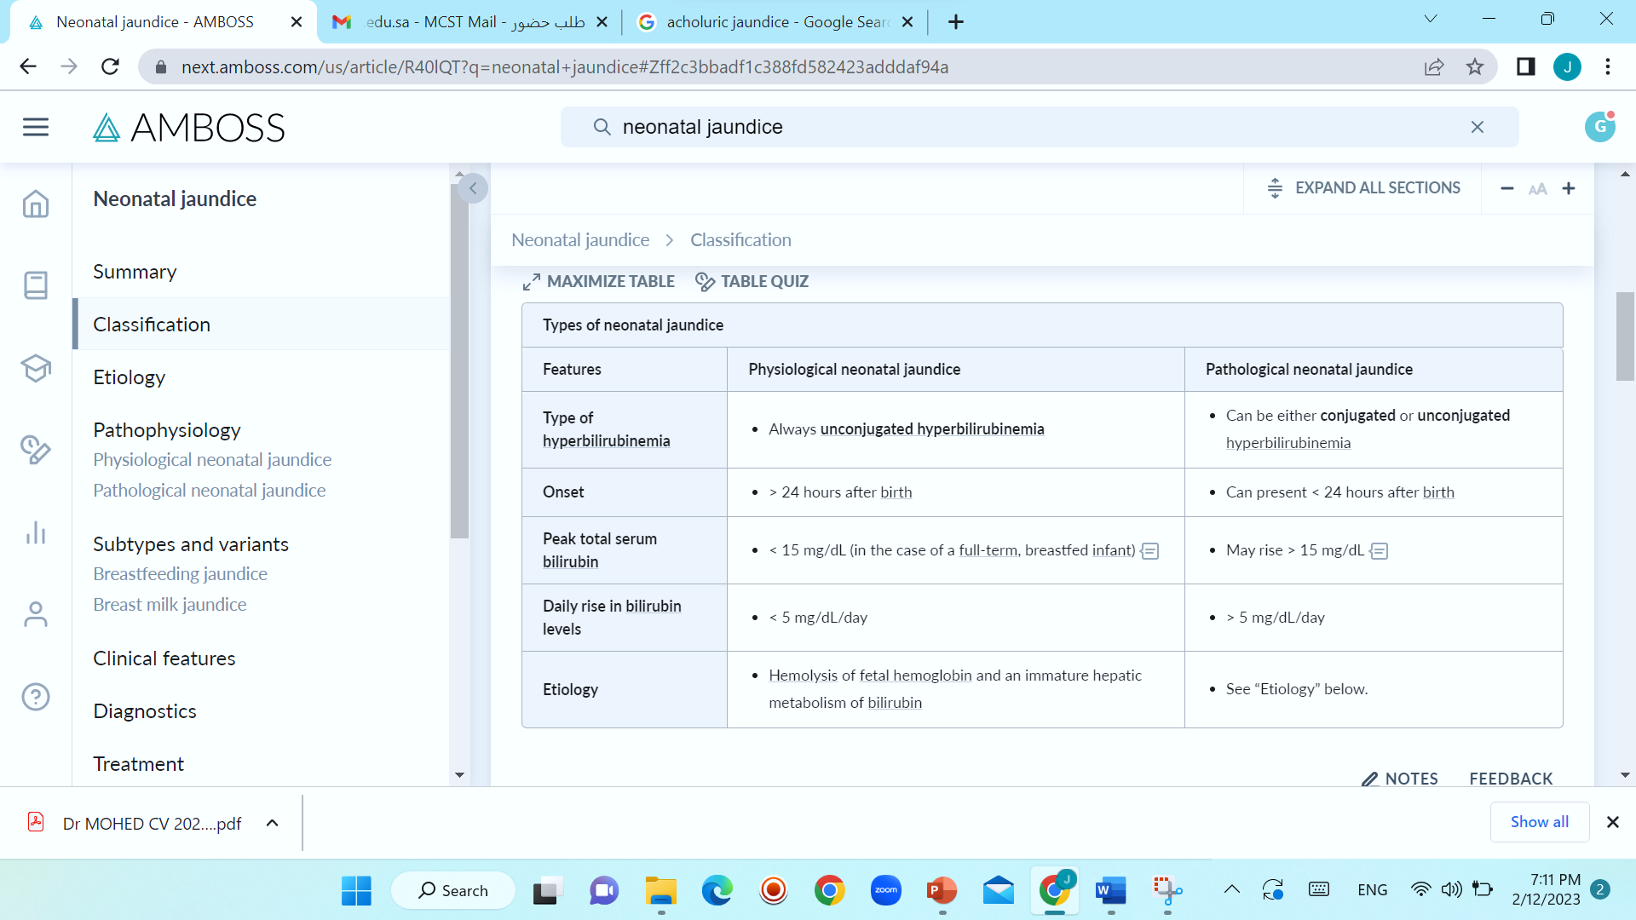

Slide 25
