Slide 1

Diabetes Mellitus
Pathology and complications
Dr. Gehan Abdelmenam

Slide 2
Intended Learning Objectives
Recall definition,types,diagnostic criteria of Diabetes Mellitus.
List differences between type I&II of Diabetes Mellitus.
Describe metabolic,vascular,pancreatic changes associating diabetes.
List acute and chronic Complications of diabetes mellitus .

Slide 3
Diagnostic criteria for diabetes mellitus
diagnosis | fasting blood sugar | Glucose tolerance test (after 2 hours) | HbA1c
Normal | ﹤100mg/dL | ﹤140mg/dl | ﹤5.7％
Prediabetic | 100-126 mg/dL | 140-199/dL | 5.7-6.4％
Diabetic | ﹥ 126mg/dL | ﹥200mg/dL | ﹥6.4 %

Slide 4
 | Type I diabetes | Type II diabetes
1.clinical | Onset:childhood. Normal weight or weight loss | Above 40 years. -obesity
2. Etiology | Hereditary as it linked to MHC class I&II Autoimmune inflammation with destruction of the B.cells by circulating autoantibodies due to failure of tolerance to self antigens | Not linked to MHC antigens. No islet autoantibodies There is prepheral resistance to insulin enhanced by cytokines released from adipose tissue that mask insulin receptors.
3. B. Cell mass. | Insulitis with lymphocytic infiltration causing early b cell depletion and atrophy of them leading to Progressive decrease in insulin level . | normal in early stage as no insulitis,later on shows amyloid deposition with mild B cell depletion.

Slide 5
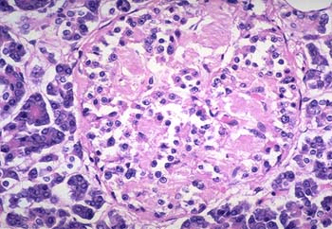
Pancreatic islets in type II DM - H &E stain(Islet shows extensive deposition of amyloid)
Amyloid

Slide 6
* Complications of diabetes mellitus:
I.Acute complications:
  diabetic ketoacidosis
  Hypoglycemic coma
II. Chronic complications:(appear after 15 to 20 years after onset of hyperglycemia)
a. Microvascular
Retinopathy
- Nephropathy
- Neuropathy
b. Macrovascular: they will undergo atherosclerosis leading to ischemia of tisssues.

Slide 7
Acute Complications of diabetes mellitus

Slide 8
Diabetic ketoacidosis (DKA)
- May be the 1st presentation of type 1 DM.
Predisposing factors:
1- absolute insulin deficiency sever hyperglycemia.
2- relative insulin deficiency as in trauma,infection,surgery.
Clinical presentation of DKA:
1- Polyurea polydepsia, dehydration and electrolyte imbalance leading to hypotonia and coma .
2- Anorexia and abdominal pain.
3- Nausea and vomiting.
4-Tachycardia(due to high adrenergic stress release).
Diagnosis of DKA:
1-Hyperglycemia(plasma glucose level is 500 to 700 mg/dl).
2- Ketonemia and Ketonuria as their production level exceed rate of
tissue utilization.
3-Acidosis (PH< 7.3 )(due to excess ketone bodies as hydroxy butyric acid and acetoacetic acid)

Slide 9
Clinical presentation of DKA:

Slide 10
Complications of DKA:
Cerebral edema caused by hyponatremia(most common cause of death in children )
Vascular thrombosis Myocardial infarction.
Infection(due to hyperglycemia in addition to defective function of both neutrophils and macrophages with failure of migration outside thickned blood vessel wall inside inflammed tissue)
Treatment of DKA:
Fluid replacement.
Insulin therapy for hyperglycemia.
Electrolyte correction.
Acidosis correction.
Treatment of precipitating cause

Slide 11
Hypoglycemic coma
Hypoglycemia is the most frequent acute complication in type 1 diabetes.
Predisposing factors:
I- Increase glucose utilization:(excess exercise,high insulin dose,alcohol intake).
II- Decrease glucose supply:(missed or delayed meal).
Clinical manifestations of hypoglycemia:
1- At first adrenergic manifestation (if glucose level less than 70mg/dl :
Hunger,Tremor,Palpitation,Anxiety,Pallor, Sweating.
2- Then Neurologic manifestations(if glucose level less than 45mg/dl) :
Impaired thinking,Change of mood, Irritability ,headache,Convulsion,Coma.
Treatment of hypoglycemia:
In mild cases :oral rapidly absorbed carbohydrate.
In sever cases :(comatose patient) I.V hypertonic glucose 25% or 50% concentration & glucagon injection.

Slide 13
Chronic Complications of diabetes mellitus

Slide 14
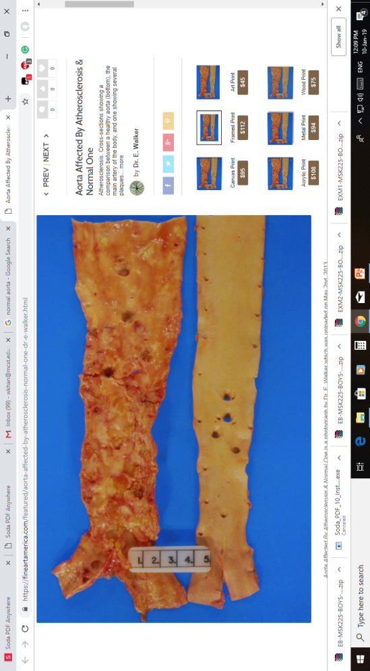
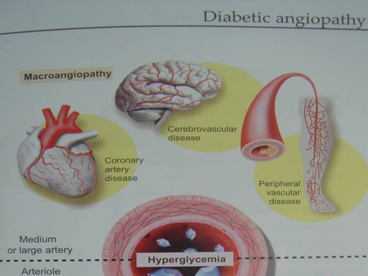
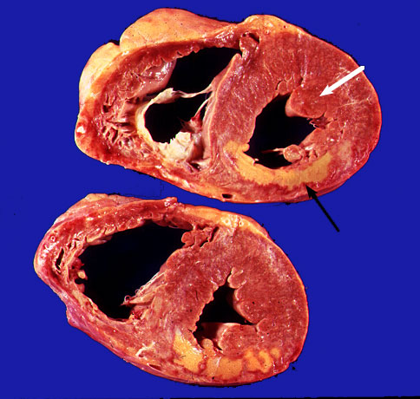
Pathologic effect of diabetes on blood vessels( Vascular changes)
I. Diabetic macroangiopathy:
A- large and medium sized arteries :
aorta,coronary and cerebral arteries have accelerated atherosclerosis .
- Cerbrovascular : hemorrhage,infarction,memory loss.
-Cardiovascular: angina,heart failure.
- Peripheral vascular disease: ulcer ,gangrene in limbs,foot.
B- small sized arterioles :
thickening of their walls due to deposition of hyaline material e.g afferent and
efferent arterioloscelrosis of kidney(hypertension).
ATHEROSCLEROSIS OF AORTA
infarction

Slide 15
II. Diabetic microangiopathy:
- It affects capillaries of retina, renal glomeruli, and peripheral nerves.
-Reason :long standing hyperglycaemia.
-Pathogenesis :Microvasculature (capillaries) shows both :
1-structural abnormalities due to :
a- Hyperglycemia inability to metabolize glucose within pericytes
osmotic damage with increase permeability.
b- Glycosylation (i.e. binding of glucose to wall of blood vessels).
2- functional abnormalities :
a- Increased capillary permeability Retinal exudates,Increased
urinary loss of albumin .
b- Disturbed platelet function with tendency to aggregate and thrombosis.

Slide 16
Diabetic retinopathy
- it is 3 stages
I. Stage of Diabetes without retinopathy:
II. Stage of non proliferative retinopathy( Background retinopathy):
- Clinical presentation:
1- Asymptomatic 2- Blurred vision,floaters,blindness
- pathological lesions:
1-Microaneurysm - earliest sign.
2- Hemorrhage.
Dot’s (microaneurysm) and blot’s (hemorrhages)
3- Macular edema.
4- Vascular occlusion leads to large ischaemic areas producing
infarcted areas (cotton-wool spots).

Slide 17
III. Stage of Proliferative retinopathy : due to damage of retinal capillaries leading to ischemia which stimulate release of VEGF and formation of new capillaries
Other Eye Complications:
- Cataracts,glaucoma at earlier age than non diabetic persons.
-Vitreous Bleeding.

Slide 18
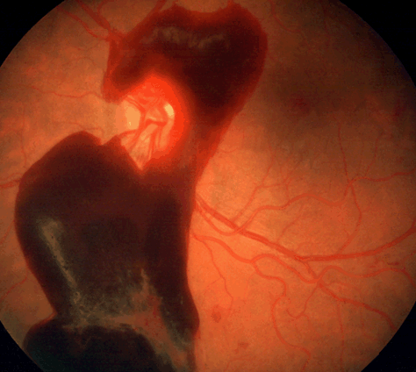
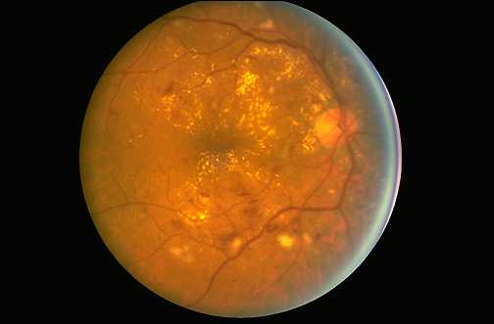
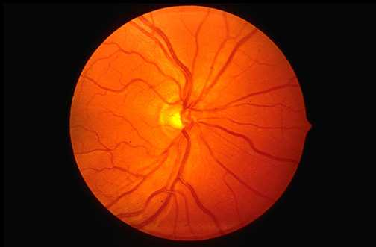
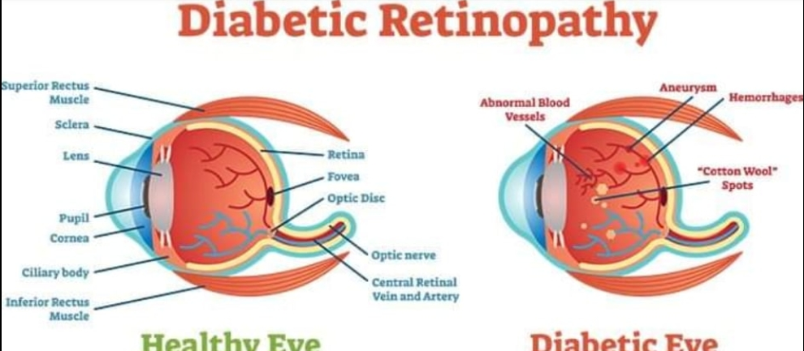
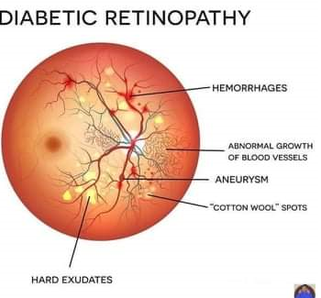
Vitreous Bleeding
Normal retina
Normal
Cotton wool spots

Slide 19
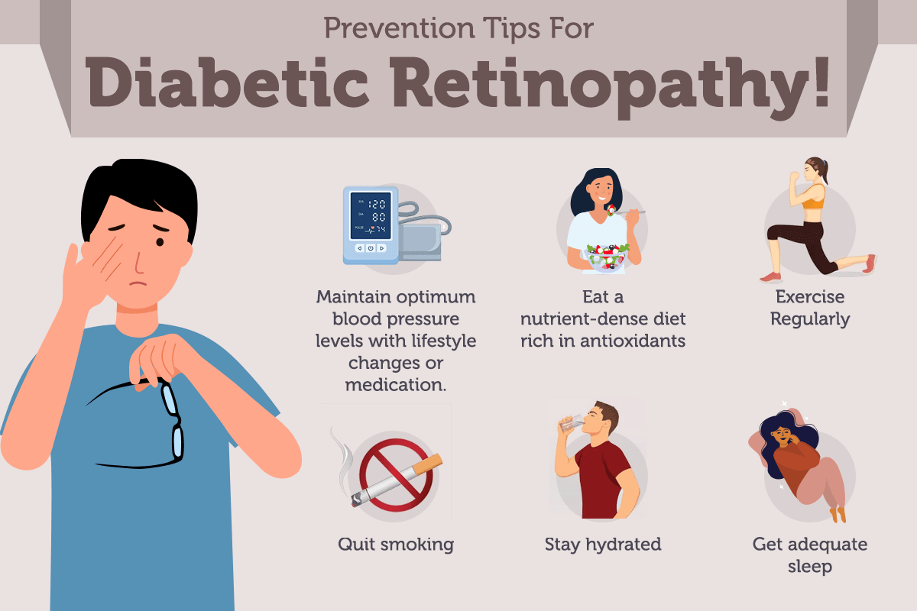

Slide 20
Management of Diabetic retinopathy
I. Asymptomatic patients :
-blood glucose regulation
-yearly eye examination
II- Symptomatic patients
1-Metabolic control:
A- glycemic control HBA1C ﹤7％
B- Blood pressure ﹤130／80mmHg
2- Antiangiogenic factor:using monoclonal antibodies that bind to
vascular endothelial growth factor(VEGF).
3 - Retinal laser photocoagulation with local anathesia:specialy in patients with proliferative
retinopathy stage.
4- surgery: e.g vitrectomy specialy if there is hemorrhage interfere with vision

Slide 21
Diabetic Nephropathy (DN)
About 20 – 30% of patients with diabetes develop diabetic nephropathy.
Pathophysiology: it is 3 stages
1- Hyperglycemia increase GFR hypertension.
(hypertension is also aggravated by activation of renin angiotensin system which cause efferent arteriole vasoconstriction)
2- excess production of reactive oxygen species,inflammatory cytokines lead to damage of endothelium and increase permeability (albuminuria >300 mg/day).
3-Nephron ischemia (due to damage of mesangial vasculature&vasoconstriction from renin angiotensin system) infarction& fibrosis of nephron decrease GFR .
Diagnostic criteria : a- microalbuminuria(first clinical sign)
b-rising blood pressure.
c-decrease glomerular filtration rate

Slide 22
Microscopic features of diabetic nephropathy
Glomerular lesions
Nodular glomerulosclerosis: ‘’Kimmelstiel-Wilson lesion’’- nodules in periphery of glomeruli
Diffuse glomerulosclerosis.
2. Renal vascular lesions
-Hyaline arteriolosclerosis in afferent &efferent arterioles
-Atherosclerosis in renal artery
3. Pyelonephritis

Slide 23
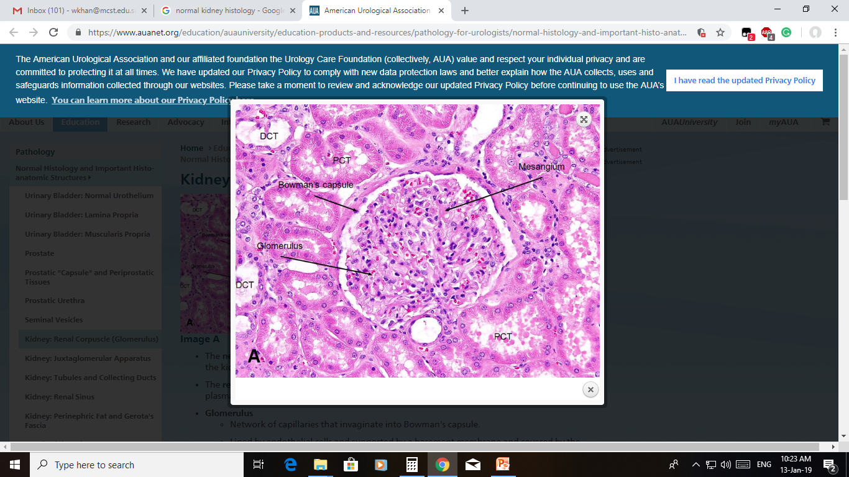
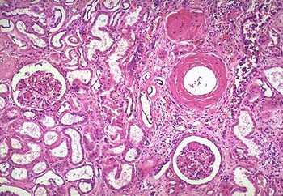
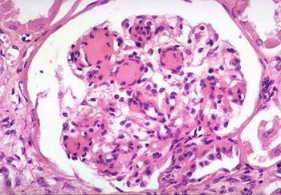
Diabetic nephropathy
1
2
3
1
                Normal kidney 1.nodular glomerulosclerosis.
                2. diffuse glomerulosclerosis.
                3.Hyaline arteriolosclerosis

Slide 24
Diabetic Nephropathy managment
1- Hyperglycemic control
2- Antihypertensive drugs
3- in end stage with decrease in GFR :
- Renal dialysis.
- Renal transplant.

Slide 25
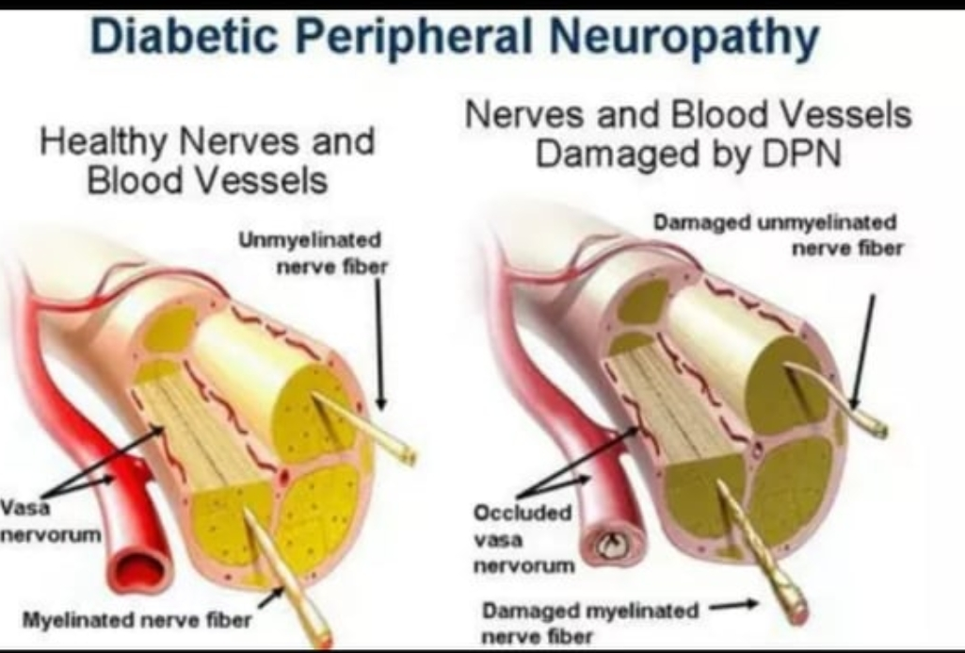
Diabetic Neuropathy
1. Sensorimotor neuropathy.
2. Autonomic neuropathy.
Pathogenesis:
There is axonal neuropathy with marked loss of mylinated fibers with thickning of endoneuronal vessel wall leading to vascular insufficiency and ischemia of the affected prepheral nerve.

Slide 26
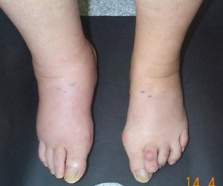
Sensorimotor Neuropathy
- It is prepheral symmetrical polyneuropathy .
-Motor nerve affection can lead to Ptosis,foot drop.
- Sensory nerves affection more common than motor nerves .
- sensory nerve affection of feet and hand called ’’Glove and Stocking’’ with the
following manifestations:
1- numbness and paresthesia(altered sensation),burning,tingling
2- loss of pain sensation unnoticed injury.
- Complications :
1-ulceration (painless) with diffcult healing due to diffuse vascular injury.
2-charcot neuroarthropathy :damage of weight bearing joints as
knee and ankle joints also damage of tarsal and metatarsal joints in foot.
3- Callosities:hardening and thickning of skin specially in pressure areas with prolonged friction.
-
charcot joint
Foot drop

Slide 27
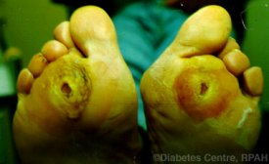
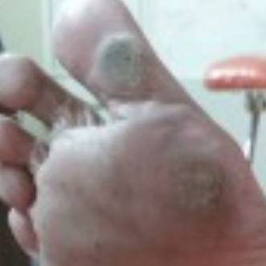
Diabetic foot
charcot joint
Foot drop
callosities
foot ulcer
Diabetic foot pathogenesis:
1-decrease sensitivity unnoticed injury infection.
2-autonomic dysfunction of sweat glands skin fissure,cracks,callus.
3-motor nerve dysfunction high arched foot and susceptibility to injury.

Slide 28
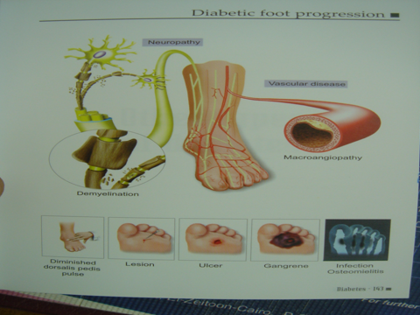
Diabetic foot progression

Slide 29
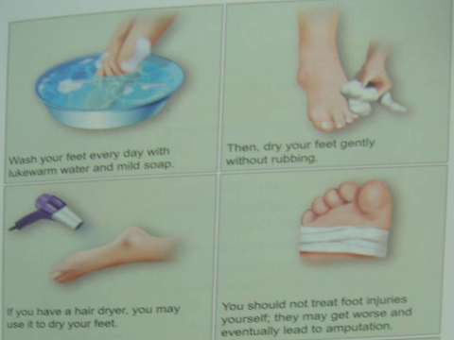
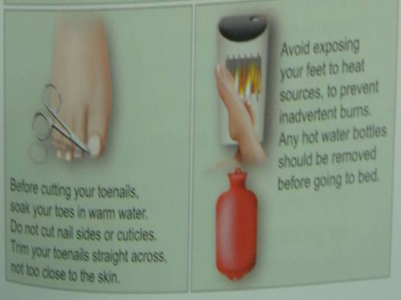
Diabetic foot care

Slide 30
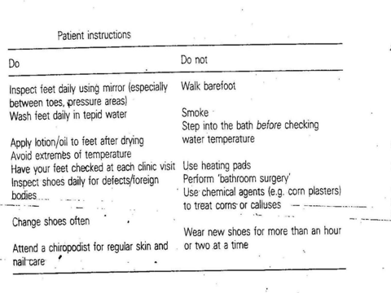
Diabetic foot care

Slide 31
Autonomic Neuropathy
- affect heart,stomach,intestine,bladder,sex organs,blood vessels.
1- Postural hypotension i.e feeling of dizziness with rapid stand up.
2- silent heart attacks.
3- sudden hypoglycemic coma due to absence of hypoglycemic
manifestations(tremor,palpitations,hungery).
4- Diabetic diarrhea.
5- Erectile dysfunction.

Slide 32
prevention of diabetic Neuropathy
- control blood pressure and prevent hypertension.
- control blood glucose level.
- Healthy diet rich in omega 3 as salmon,tuna,unsalted nuts but less intake of saturated fats and processed food.

Slide 33
REFERENCES
Robbins and Cotran Pathologic Basis of Disease, 9th edition, 2014 ( Kumar, Abbas, Aster)
Robbins Basic Pathology 10th edition, 2017
( Kumar, Abbas, Aster).
https://next.amboss.com/us/article/3s0Suh?q=DIabetic%20complications#Y2c2bb57ac9693bb0cb5019b3cadd9879

