Slide 1
HTN & RENAL ARTERY STENOSIS
DR WAQAR
MBBS, MRCP, Int. Medicine( London)
MRCP, Endocrinology & DM(London)
ASST. PROFESSOR

Slide 2
OBJECTIVES
Know the latest classification of BP
Etiology of HTN
Approach towards diagnosis
Know causes of secondary HTN
Investigations to do initially
Treatment
Definition & management of hypertensive crisis
Complications of HTN

Slide 3
LATEST DEFINITIONS
According to A.C.C. ( American college of cardiology) & AHA ( American heart association)
Normal BP : 120/80 or less
If systolic BP is between 120 & 130, its now called “elevated BP”.
Stage 1 HTN: Sys. 130 -140 , diastolic 80 to 90
Stage 2 HTN: Sys. 140 or more, diast. 90 or more

Slide 4
REMEMBER !
The diagnosis of HTN is made if BP is high on 2 different days, and the person should not be under stress or acutely sick.

Slide 5
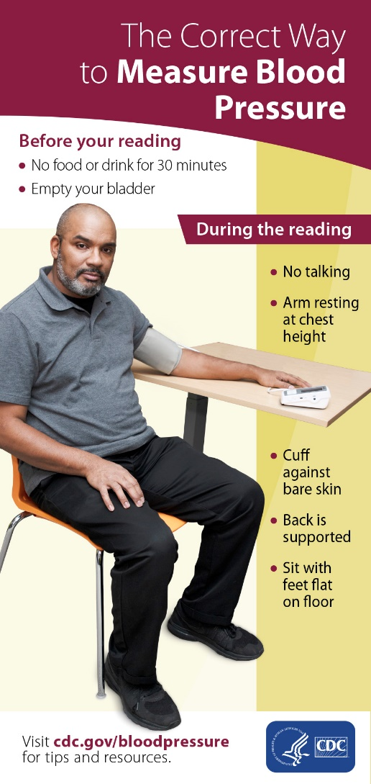
CORRECT WAY OF BP CHECKING

Slide 6
Beware of “ White Coat Hypertension”( high BP in doctor’s office).
Sometimes, you may need 24 hrs continuous BP monitoring at home ( ambulatory BP monitoring) to diagnose HTN.

Slide 7

24 hrs BP monitoring

Slide 8
EPIDEMIOLOGY
* In K.S.A, more than 25% of the adult population has HTN ( saudi medical journal, 2007)
* In the U.S., 29% of the adults have HTN
* Incidence is rising throughout the world
( ? Due to lifestyle)

Slide 9
WHY IS HTN HARMFUL ?

Slide 10
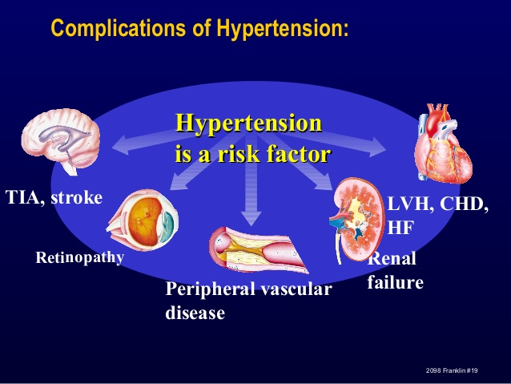

Slide 11
STAGES OF HTN
Elevated B.P. : Systolic between 120-130
Stage 1 HTN : Systolic between 130-140
and/or diastolic b/w 80 & 90
Stage 2 : Systolic 140 or more and/or diastolic 90 or more
* Hypertensive Crisis : Systolic usually more than 180 and diastolic more than 120
Urgency Emergency

Slide 12
Hypertensive Urgency:
* Very high BP. DBP usually >120, but NO acute
end organ damage (encephalopathy, angina,
papilloedema etc)
Hypertensive Emergency :
* Very high BP ( SBP > 210, and DBP> 130) +
end organ damage begins ( eg encephalo-
-pathy, angina/MI/blurred vision etc)

Slide 13
TYPES OF HTN
PRIMARY SECONDARY
( no known cause) ( secondary to an
Also called essential underlying disease)
HTN
( most cases are prim.)

Slide 14
Primary HTN
Also called Essential HTN. Etiology not known
Most cases are primary HTN( >90%)
Not due to any underlying disease, but the following may contribute to it :
genetics, obesity, high salt intake, alcohol,
smoking.

Slide 15
Secondary HTN
Secondary to some other disease
Accounts for less than 10% of HTN cases
Renal etiologies: Commonest etiology of secondary HTN is renal disease :
* Chronic renal failure ( due to any cause)
* Renal artery stenosis
* DM nephropathy
* Polycystic kidney disease

Slide 16
Contd.
2) Endocrine Causes :
* Excess cortisol (Cushing’s disease)
* Excess aldosterone ( Conn’s syndrome)
* Excess noradrenaline ( Pheochromocytoma)
( all above are adrenal diseases)
3) Drugs & Meds. :
* NSAIDs, * Steroids, * Estrogens, * Flu & cold
meds ( will worsen HTN), * Cocaine

Slide 17
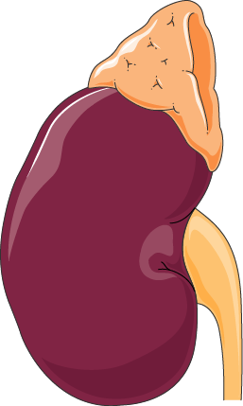
Imagine kidney and adrenal

Slide 18
  WHEN TO SUSPECT SEC. HTN?
  1) Young age ( less than 30 yrs)
  2) HTN not responding to max. therapy
  3) Clinical features of the secondary causes
  ( acromegaly, Cushing’s etc)

Slide 19
S/S of HTN
Very non-specific
Asymptomatic
Headache, dizziness, body pain
Sec. HTN: features of the underlying disease
Severe rise in BP can present as angina/MI, CHF, stroke/TIA, altered mental status (encephalopathy) hypertensive crisis

Slide 20
Physical Exam
Do a detailed examination at the first visit.
Check the pulses, cardiac examination
Examine for any S/S of stroke
Examine the eyes for retinopathy
Examine the heart for murmurs, CHF
Auscultate the abdomen for renal artery bruit ( occurs in renal artery stenosis)
Look for features of Cushing’s, acromegaly etc. if you suspect these.

Slide 21
HYPERTENSIVE RETINOPATHY
Divided into 4 grades , based on severity
Grade 1: Retinal vessels become less clear
Grade 2: A-V nipping
Grade 3: Edema, hemorrhages, Copper wiring
Grade 4: Optic disc edema, silver wiring
DON’T MEMORIZE THIS !

Slide 22
Routine investigations
CBC, urea, creatinine, electrolytes, lipid profile, ECG, blood sugar, urinalysis
If secondary HTN is suspected order further tests accordingly
ECG may show left ventricular hypertrophy
High creatinine suspect renal pathology

Slide 23
TREATMENT
Aim of BP :
* < 120/80

Slide 24
Rx contd.
1) First, a trial of diet & exercise for about 2 months ( depending on the BP)
* low salt diet * wt. reduction * exercise
* eat more fruits & vegetables * stop smoking
2) Add medicine if the above fails.
3) Start with 1 medicine and gradually go to the
max. dose
4) Give at least 2-3 wks for a medicine to work
fully. Then add another medicine if needed.

Slide 25
DRUGS FOR HTN
Diuretics
ACE inhibitors
ARBs (angiotensin receptor blockers)
Beta blockers
Ca. channel blockers
Others

Slide 26
DRUG CLASS | EXAMPLES | COMMON SIDE EFFECTS | AVOID IN
DIURETICS | THIAZIDES | WEAKNESS, HYPOKALEMIA, HYPERGLYCEMIA, HIGH CHOLESTEROL, HIGH URIC ACID | DM, GOUT, HIGH CHOLESTEROL
ACE INHIBITORS | CAPTOPRIL, ENALAPRIL, LISINOPRIL, RAMIPRIL | DRY COUGH, RASH, ANGIOEDEMA,HYPERKALEMIA, HIGH CREATININE | PREGNANCY, RENAL ARTERY STENOSIS
ARBs (angiotensin receptor blockers) | VALSARTAN, CANDESARTAN etc | ALLERGIC REACTIONS ( DON’T CAUSE COUGH) | SAME
BETA BLOCKERS | PROPRANOLOL, BISOPROLOL, ATENOLOL, METOPROLOL | BRADYCARDIA, BRONCHOSPASM, WEAKNESS, IMPOTENCE, VASOSPASM | ASTHMA/COPD, PVD, DM, HEART BLOCK, ACUTE CHF
CALCIUM CHANNEL BLOCKERS | AMLODIPINE, VERAPAMIL, DILTIAZEM | CONSTIPATION , BRADYCARDIA & HEART BLOCK (VERAPAMIL), PEDAL EDEMA, HEADACHE, | CHF, HEART BLOCK & BRADYCARDIA
OTHERS | METHYLDOPA, ALPHA BLOCKERS, HYDRALAZINE, CLONIDINE | VARIOUS

Slide 27
GUIDELINES TO START Rx.
Suggested by National Institute of Clinical
Excellence , U.K. ( NICE guidelines)
Age < 55 or white race : ACE or ARB
Age > 55, black race : Calcium channel
blocker or diuretic
These are just “guidelines”, & they are different in different countries

Slide 28
SPECIAL SITUATIONS
HTN w/ DM : First choice ACE or ARB
HTN w/ IHD : First choice is beta blocker , ACEI
HTN w/ pregnancy: Methyldopa(aldomet), hydralazine, labetolol ( all safe)
ACEI AND ARBs ABSOLUTELY “NO ” IN PREG.& Bilateral renal artery stenosis
4) Patient w/ high sympathetic activity (tachycardia, anxious looking, hyperthyroid beta blocker is better

Slide 29
SOME IMPORTANT POINTS
Avoid beta blockers in asthma/COPD, heart
severe bradycardia/heart blocks
2) Avoid beta blockers in DM ( they mask the S/S
of hypoglycemia). Not an absolute
contraindication.
3) Never stop beta blockers suddenly. Always
taper.

Slide 30
HYPERTENSIVE CRISIS
Very high BP, systolic usually > 180 & diast. > 120
BP should be lowered gradually over few hours, to about 110-100 Diastolic.
Oral medicines can be given ( but not TAHT-AL LISAAN !
HTN emergency needs ICU admission & i.v. meds.
* nitroglycerin * nitroprusside
* i.v. hydralazine * Nicardipine * labetolol

Slide 31
HYPERTENSIVE CRISIS (contd.)
Dont “reduce” the BP quickly. Reduce by 10% in the first hour, then slowly. Normalisation can occur over few days.
Don’t give sublingual medicines. It will cause sudden drop in BP can cause ischemia to the brain
If not treated timely, hypertensive crisis can cause permanent end organ damage.

Slide 32

DID YOU ENJOY?

