Slide 1
Basic introduction
By
Dr. MOHAMED ABD ALMONEIM ATTIA

Slide 2
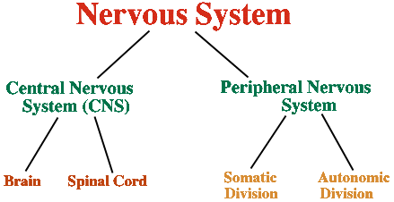

Slide 3
Peripheral Nervous System
Somatic NS
Controls voluntary actions (e.g. writing your name)
Consists of nerves connected to sensory receptors and skeletal muscles
Autonomic NS
controls the
Involuntary functions
of blood vessels,
Glands and internal organs (e.g.: the bladder, stomach, heart)

Slide 4
Autonomic nervous system
Definition:- The autonomic nervous system (ANS) is the system that controls involuntary activity of the body.
A)Sympathetic nervous systems (SNS).
B)Parasympathetic nervous systems (PNS)

Slide 5
  Parasympathetic Nervous System
  This system is concerned with the conservation of the body processes.
  Its main neurotransmitter is acetylcholine.
  Its receptors are muscarinic and nicotinic
  Sympathetic Nervous System
  This nervous system is designed to cope with emergency situations.
  This is commonly known as the “fright or flight” response.
  Its neurotransmitters are epinephrine and norepinephrine.
  Its receptors are the α and β receptors.

Slide 6
2 divisions of Autonomic Nervous System
Preganglionic neuron autonomic ganglion postganglionic neuron target from CNS outside CNS

Slide 7
2 divisions of ANS
Sympathetic
  “Fight or flight”
  “E” division
    Exercise, excitement, emergency, and embarrassment
Parasympathetic
  “Rest and digest”
  “D” division
    Digestion, defecation, and diuresis

Slide 8

Fig. 45.34(TE Art)
Hypothalamus activates
sympathetic division of
nervous system
Heart rate, blood pressure,
& respiration increase
Blood flow to
skeletal muscles
increases
Adrenal medulla
secretes
epinephrine and
norepinephrine
Stomach
contractions
are inhibited

Slide 9
Autonomic tone
Definition: continuous flow of impulses along one division of autonomic nervous system more than the other.
Organs under parasympathetic tone:
Heart, GIT, UT, Eye , etc……………………………
Organs under sympathetic tone e.g. blood vessels.
Organs under both sympathetic and parasympathetic tone: Iris.

Slide 10
2 Divisions of ANS
I- Sympathetic NS
(Thoracolumbar)
II- Parasympathetic NS (Craniosacral)

Slide 11
➢Every autonomic nerve is composed of two neurones: preganglionic neurone and postganglionic neurone. Both neurones are separated by ganglion.
The suprarenal medulla is a modified sympathetic ganglion.

Slide 12
Chemical transmission
The traveling of signal in the nervous system between different neurons is mediated by the effect of a chemical substance released at the nerve terminal called chemical transmitter.
In the sympathetic nervous system the chemical transmitter is adrenaline, noradrenaline or sometimes acetylcholine.
When the chemical transmitter is adrenaline the nerve fiber is called adrenergic,
when the chemical transmitter is acetylcholine, the nerve fiber is called cholinergic.

Slide 13
Adrenaline and noradrenaline:
Most of the synthesis occurs in the adrenergic nerve ending and stored in granular vesicles called chromaffin granules close to the site of release into synaptic cleft .
Biosynthesis could also occur in suprarenal medulla and other tissues.
The enzyme (N-methyl transferase) which catalyses the conversion of noradrenaline to adrenaline occurs almost exclusively in suprarenal medulla and is therefore missing in the peripheral nerve terminals. Hence noradrenaline is the final step in the synthetic process in most adrenergic nerves.
Catecholamines are sympathomimetics that contain the catechol nucleus (e.g. noradrenaline and adrenaline).
Catecholamines are stored in synaptic granules in two forms in equilibrium:
Bound noradrenaline with ATP and protein is the (inactive part).
Free noradrenaline is released by nerve stimulation.
Another portion of it is stored in the cytoplasm in free form (cytoplasmic free noradrenaline).

Slide 14
➢Release of the chemical transmitters
On the arrival of an action potential to the nerve terminal, vesicles containing acetylcholine or granules containing norepinephrine accumulate at the nerve ending facing the membrane.
Once they got closer to the membrane they open releasing their contents of the chemical transmitter through an exocytotic process.
Calcium ion is essential for this step (through Ca++ channels).
The vesicle membranes are retained to return back to the nerve cytoplasm to be used for storage again.
The released chemical transmitter will stimulate the specific autonomic receptors.
The interaction of chemical transmitter with the receptors will produce the post receptor events that will elicit the change in the function of the organ that contains that receptor.

Slide 15
➢Fate of the chemical transmitters
►Fate of noradrenaline:
1. Re-uptake:
(80% of the released amount): It is the major mechanism by which the released NE is removed from the vicinity of the sympathetic ends.
Three uptake processes participate in removing NE:
Neuronal uptake (uptake 1): active transport of NE into the neuronal cytoplasm
Granular uptake (uptake III): active transport of NE from the cytoplasm of the nerve ends into the storage granules.
Non-neuronal uptake (uptake II): uptake to the tissue
N.B.
2. Metabolism by specific enzymes:
NE and other catecholamines are metabolized into biologically inactive products by oxidation (monoamine oxidase; MAO enzyme) and methylation (cathecol-Omethyl transferase; COMT enzyme)

Slide 16
N.B.
Vanillyl Mandelic Acid (VMA) is the main catecholamine metabolite in the urine. Normal Values is 4-8 mg/day. High Levels suggest the presence of a tumour in the suprarenal medulla (pheochromocytoma) that secretes excess catecholamines leading to hypertension. 2% of NE is excreted unmetabolized in the urine.

Slide 17
➢Synthesis and storage of the chemical transmitters
Acetylcholine:
acetylcholine (A.Ch.) is formed in the cholinergic nerve ending by acetylation of choline by the enzyme choline acetylase in presence of Co-A.
C0-A
Acetat Acetyl COA
Choline acetylase
Acetyl Co-A + Choline Acetylcholine + Co-A
The synthesized A.Ch. is stored in granular vesicles within the axon close to the site of release into the synaptic cleft .

Slide 18
Autonomic receptors
The released chemical transmitter will produce its physiological or pharmacological action via stimulating the corresponding receptor on the effector cell.
Receptors that respond to acetylcholine are called cholinoceptors and those that respond to epinephrine and NE are called adrenoceptors
A. Adrenoceptors:
Can be subdivided into alpha and beta adrenoceptor types.
Alpha adrenoceptors

Slide 19
Alpha adrenoceptors :
Alpha 1 adrenoceptors
Site: postsynaptic in the effector tissues
Alpha 2 adrenoceptors
Site: Presynaptic and Postsynaptic.
Stimulation of alpha adrenoceptors will produce:
Alpha 1 stimulation:
Generalized vasoconstriction of all blood vessels (arteries and veins) causing hypertension.
Contraction of pupillary dilator muscle causing mydriasis.
Contraction of gut sphincters
Contraction of trigone and sphincter of urinary bladder.
Contraction of the uterus.??????????????
Ejaculation.
Contraction of the pilomotor muscle causing hair erection.
Adrenergic sweating e.g. in palms of hands.
Increase neuromuscular junction (NMJ) impulse transmission. .

Slide 20
Alpha 2 stimulation:
Presynaptic alpha 2:
Decrease NE and AC.CH release (feedback or autoregulation).
Postsynaptic alpha 2:
CNS (decrease central sympathetic outflow)
Decreased renin
So, it decrease central & peripheral sympathetic discharge
Any drug having alpha 2 stimulant action will produce all the above mentioned effects.
Beta adrenoceptors:
Site:
Postsynaptic (in the effector organ): β1 adrenoceptors ,β2 adrenoceptors and β3 adrenergic receptors
Presynaptic: β2 on adrenergic nerve terminals to facilitate the release of norepinephrine.
Stimulation of beta adrenoceptors will produce:
Beta 1 adrenoceptor stimulation:
Heart: increase all cardiac properties (contraction, Heart rate………….
Kidney: Increase renin release.
Fat cells: lipolysis

Slide 21
Beta 2 adrenoceptor stimulation:
Relaxation of smooth muscle fiber of large blood vessels leading to VD of coronary, skeletal, pulmonary, and renal arterioles leading to hypotension
Relaxation of bronchial muscle.
Relaxation of uterus,
Relaxation of Wall of U.B.
Relaxation of Wall of GIT leading to decrease gut motility.
Decrease mast cell degranulation.
Hepatic glycogenolysis. Leading to increase blood glucose
Increase aqueous humor formation.
Decrease plasma K.
Skeletal muscle tremors.
T4 to T3 conversion
Presynaptic β2 facilitates NE release.
Beta 3 adrenoceptors stimulation:
Increase lipolysis in fat cells.
All adrenergic receptors are present in the wall of GIT causing relaxation.

Slide 22
Definition of systemic hypertension:
Persistent or recurrent elevation of systemic blood pressure greater than or equal to 140/190 mmHg.
even after period of rest
Blood pressure is a characteristic of each individual like weight and height, with marked inter-individual variation.
Diagnosis of hypertension should be made only after finding an elevated blood pressure on three readings on different occasions. However, patients with very high blood pressure reading should be started on therapy immediately.
*Ambulatory 24 hours –blood pressure (monitoring) reading in may be helpful in evaluating in patients with (white coat hypertension)

Slide 23
Hypertension is a condition that affect almost 1 billion people worldwide and is a leading cause of morbidity and mortality.
More than 20% of Americans are hypertensive, and one-third of these Americans are not even aware they are hypertensive. Therefore, this disease is sometimes called the "silent killer“ or The Silent Enemy!
Up to 26.3% of adults in Egypt have hypertension.
Measurement is the only way to know if you have hypertension -- you will not feel it until it is too late!

Slide 24
Categorization Of Hypertensive Patient
Classification of BP level
The following WHO/ISH classification of the levels of BP is recommended:
Category | Systolic BP | Diastolic BP | Diabetics?
Optimal | < 120 | < 80
Normal | < 130 | <85
High normal | 130-139 | 85-89
Grade I (mild HTN) | 140-159 | 90-99
Grade II (mod HTN) | 160-179 | 100-109
Grade III (severe HTN) | ≥ 180 | ≥ 110
Isolated systolic HTN | ≥ 160 | < 90

Slide 25
1-Isolated systolic HTN
2-Systolic & Diastolic HTN
Etiology
I- Essential (primary):
In more than 95%of cases, an underlying cause cannot be found.
II- Secondary hypertension:
In about 5% of cases an underlying cause can be found:
Renal:
It accounts for 80% of the cases of secondary hypertension.
Types of Hypertension

Slide 26
A- Primary (Essential):
1- Genetic background with multifactorial inheritance. Family history of cardiovascular disease . hypertension is more common in some families and in some ethnic groups like Africans, Americans.
2- Environmental factors: include obesity, alcohol, lack of exercise (Sedentary life style)and , cigarette smokers (Adds 20/10 mmHg) .
excess salt intake.
3- Stress.
4- Sex: more in males(2:1) and postmenopausal women .
5- Others :High cholesterol diet, Co-existing disorders such as diabetes and hyperlipidaemia

Slide 27
Clinical Evaluation Of Hypertensive Patient
Causes of Hypertension
B- 2ndry HTN:
1- Renal causes:…………………….
2- Endocrinal causes:…………………………..
3- Neurogenic causes:…………………………….
4- C.V causes:…………………………………………

Slide 28
Clinical Evaluation Of Hypertensive Patient
Causes of Hypertension
5- miscellaneous causes:
* Drug- induced→
Oral contraceptives, corticosteroids,, cyclosporine, clonidine withdrawal , carbenoxolone, cocaine , sympathomimetic agents, NSAIDs, liquorice,, erythropoietin

Slide 29
B) According to persistence:
*Labile hypertension: occasionally elevated.
*Persistent hypertension: continuously elevated.
C) Benign or malignant hypertension:
*Benign means affection of medium and large sized arteries.
*Malignant: it affects arterioles and small arteries with endarteritis obliterans and necrosis which lead to organ damage.

Slide 30
Complications of untreated hypertension(Target organ damage)
1-Blood vessels:
Wide spread atheroma formation leading to coronary and or cerebrovascular disease, particularly if other risk factors (e.g. smoking, dyslipidemia, diabetes) are present.
2-Central nervous system:
Stroke (due to hemorrhage or thrombosis and transient ischemic attacks (TIAs) are more common in hypertensive patients.
Subarachnoid hemorrhage
Hypertensive encephalopathy: a condition of high blood pressure and neurologic symptoms, usually reversible if hypertension is controlled.
Symptoms include disturbances of speech and vision, disorientation, fits and loss of consciousness.
3-Retina:
Papilledema is common.
Changes are associated with hypertension include retinal ischemia or infarction and also central retinal vein thrombosis.
4-Heart:
Higher incidence of coronary artery disease
Left ventricular hypertrophy (forcible apex and S4, ECG and echocardiographic evidence)
Left ventricular failure in severe hypertension even in the absence of coronary artery disease.
5-Kidneys:Long standing hypertension may lead to proteinuria and renal failure due to damage of renal vasculature.

Slide 31
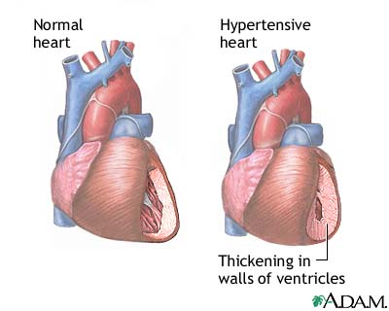

Slide 32
Clinical Evaluation Of Hypertensive Patient
Clinical pictures of Hypertension
A- Uncomplicated:
* No symptoms
→headache (occipital)
→ Dizziness
→ Vertigo
→ Tinnitus
→ Palpitation.
symptoms

Slide 33
Clinical Evaluation Of Hypertensive Patient
Clinical pictures of Hypertension
B- Complicated HTN:
1- CV complications:
* LVH & Failure
* CAD
* Aortic dissection
* Hemorrhage e.g epistaxis.
2- Cerebral:
* TIA
* Hypertensive encephalopathy
* Cerebral thrombosis & Hge
* Subarachnoid Hge.

Slide 34
Clinical Evaluation Of Hypertensive Patient
Clinical pictures of Hypertension
3- Renal:
* Proteinuria & microscopic hematuria
* Nephro-sclerosis with RF in 10-20% esp. in malignant HTN.
4- Retinal complications: Hypertensive retinopathy
* G 1→ Narrowing of retinal arteries & mild sclerosis.
* G 2→ Marked sclerosis of retinal art. with compression of the veins at points of crossing (A-V nicking).
* G 3→ Oedema, Hge & cotton-wool spots & markedly spastic arteries.
* G 4→ Papilloedema ( malignant HTN).

Slide 35
Signs:
1 - High blood pressure:
• BP should be measured in the sitting or the supine position with the arm supported after 5 minutes resting.
• Standing BP should be measured in the elderly and those suffering from positional hypotension (diabetics and patients on antihypertensive medications) to exclude orthostatic hypotension.
2- Signs of secondary hypertension:……………..
Radio-femoral delay (coarctation of the aorta)
Enlarged kidneys (polycystic kidney disease)
Abdominal bruits (renal artery stenosis)
Moon face and trunkal obesity ( cushing syndrome)

Slide 36
3- Signs of other cardiovascular risk factors:
Abdominal obesity (metabolic syndrome)
Tendon xanthomas (hyperlipidemia)
4- Signs of end organ damage and complications:
- Retinopathy:
Stage I arteriolar narrowing
Stage II arteriolar irregularity
Stage III hemorrhages and exudates
Stage IV papilledema associated with severe life threatening disease. (Malignant hypertension)
Cardiac: Left ventricular enlargement or failure.
Peripheral vascular disease: weak or absent peripheral pulsation
Carotid vascular disease (carotid bruit).
CNS: Cerebrovascular disease (stroke).

Slide 37
Investigations
1- All hypertensives:
Urine: for blood, protein and glucose
Blood urea and serum creatinine. If elevated, more specific renal investigations are as creatinine clearance.
Electrolytes (hypokalemia may occur in primary hyperaldosteronism or more commonly due to diuretic therapy)
Blood glucose, lipid profile (total and high density lipoprotein cholesterol).
ECG: Left ventricular hypertrophy (LVH) & Coronary artery disease (CAD).

Slide 38
2- Investigations In selected cases:
Imaging:
Chest x ray: (cardiomegaly, heart failure, co-arctation).
Ambulatory BP monitoring: (borderline or white coat hypertension).
Echocardiography: left ventricular hypertrophy (L VH).
Abdominal ultrasound (possible renal disease).
Renal angiography, MR & CT angiography, renal arterial duplex (renal artery stenosis).
Laboratory:
Urinary catecholamines e.g VMA, free metanephrins (pheochromocytoma).
Urinary cortisol and Dexamethasone suppression test (Cushing's syndrome).
Plasma renin and aldosterone (primary aldosteronism).
Sensitive thyroid-stimulating hormone level.

Slide 39
The pathogenesis of primary type is unknown but multiple theories and the most important is multifactorial theory: #Z
*Anxiety: increases catecholamine release.
*If vasoconstriction is prolonged: renal ischemia occurs which stimulates rennin angiotensin system which leads to Na and H2O retention which leads to hypervolaemia with Na retention in SMF which sensitizes blood vessel wall to sympathetic stimulation and to circulating vasopressors (catecholamines and angiotensin) so, increases calcium in blood vessel which leads to vasoconstriction.
*Resetting of baroreceptors to a higher level.
Others:
* Hyperinsulinemia as part of metabolic syndrome: hyperinsulinemia ,
glucose intolerance, reduced levels of HDL cholesterol, hypertriglyceridemia and central obesity (all of which are related to insulin resistance).
* Alterations in vascular endothelium resulting in reduction of vasodilators
or increase in vasoconstrictors

Slide 42
Therapy of systemic hypertension
By
Dr.Mohamed Abd Almoneim

Slide 43
Treatment of hypertension
Studies have demonstrated clear benefits of treatment of hypertension even
grade 1.
Treatment goal <140/90 for most patients.
Treatment includes:
A-Non-pharmacologic therapy (Life style interventions):
Avoid stress.
Smoking cessation: smoking accounts for 30% of all cardiovascular deaths.
Weight reduction: BMI should be < 25 Kgm/m2
Diet: low salt :< 6gm/day , adequate potassium: increase fruit and vegetable
consumption, adequate calcium, low saturated fat diet.
Exercise: moderate exercise 30-40 minutes most days of the week is
beneficial in lowering BP in hypertensive patients.
Limited alcohol consumption.

Slide 44
Antihypertensives
Aim: to reduce the risk of complications.
The Ideal Antihypertensive:
  Maintain adequate BP
  Maintain perfusion
  Reduce workload of heart
  No undesirable effects
  Allow for long term administration

Slide 45
  Drug therapy (antihypertensive drugs):
►First choice groups (commonly used drugs): ABCD
Angiotensin-converting enzyme inhibitors (ACEIs) and ARBs.
Beta-blockers.
Calcium channel blockers.
Diuretics specially (thiazides).
►Second choice groups:
α₁-adrenergic blockers: e.g. prazosin and doxasosin.
Combined α and β-blockers: e.g. labetalol.
Adrenergic neuron blockers: e.g. α-methyldopa and reserpine.
Direct vasodilators: e.g. hydralazine and diazoxide.
Central α₂ stimulants: e.g. clonidine and guanfacine.
Dopamine (D1) receptor agonists: e.g. fenoldopam.

Slide 46
Diuretics in hypertension

Slide 47
Beta blockers (LoL)
* Pharmacokinetics classification:
a)Lipophilic :Propranolol (good absorption –high first pass metabolism in liver –less bioavailability-pass BBB-liver elimination -short duration)
b)Hydrophilic : Atenolol (less absorption-less first pass metabolism-high bioavailability-not pass BBB-renal elimination -long duration 24 hours)
c)Balanced: Bisoprolol
d)Short acting: Esmolol act for 8 min (hydrolyzed by plasma esterase)

Slide 48
Mechanism of Action classification:
A-Beta blocking action: block beta receptors
B) B blocker with intrinsic sympathomimetic activity (ISA):
e.g Pindolol-acebutalol ( has less cardio-depression and bronchospasm) Used in patient with low resting heart rate
C) B blocker with membrane stabilizing activity
( Na channel blockers):e.g. propranolol (preferred in arrhythmia) may be called Anti-arrthymic effect or Local anaesthetic or quinidine-like action.
D) Vasodilator B blockers: (due to blocking of α receptor ):
e.g. carvidelol, labetalol, bucindolol, celiprolol, dilevalol
E)CNS depressant action. (for those passing CNS)
Not all beta-blockers have the above-mentioned actions but they differ in their mechanism of action.

Slide 49
Receptor selectivity classification
1- NON SELECTIVE BETA-BLOCKERS (1st GENERATION)=block β1, β2, β3
Liable to cause side effects. Propranolol , Nadolol
2- BETA-1 SELECTIVE BLOCKERS "CARDIOSELECTIVE" (2nd GENERATION)= block β1 only Atenolol ,Metoprolol ,Bisoprolol
Beta-1 selective blockers "cardioselective"
3- BETA-BLOCKERS WITH V.D. ACTION (3rd GENERATION)e.g carvidelol, labetalol, bucindolol, celiprolol, dilevalol

Slide 50
Pharmacological Effects
Cardiovascular system
*Decreases heart rate and myocardial contractility.(B1)
*Slow A-V conduction (B1).
* Quindine like action suppresses ectopic foci in the heart (antiarrhythmic effect).
*Decrease blood flow to most tissues by the unopposed alpha effect in response to reduced COP. (B2)
Lowers blood pressure by:********
1-Negative inotropic and chronotropic effects lead to decreased COP (B1)
2-Decrease renin release(B1)
3-Blocks presynaptic β2 receptors lead to decreased NE release.
4-Decrease central sympathetic outflow.
5-May act through vascular prostaglandins.
6-Some βblockers have vasodilator properties.
7- resetting of baroreceptors downwards

Slide 51
Respiratory system
Bronchospasm and increased airway resistance in susceptible patients
Eye
Decreases aqueous humor formation and reduce intra-ocular pressure.
Metabolic effects:
1-In normal individual : no effect on blood glucose. But:
Augment hypoglycemic effects of insulin by blocking glycogenolsis and gluconeogenesis.
Mask the hypoglycemic symptoms except sweating.
2-Increase triglycerides and decrease H.D.L.
CNS
Antianxiety effect
Insomnia, lethargy, night mares, vivid dreams and depression
Others
Salt and water retention secondary to the decrease in COP.

Slide 52
Therapeutic Uses:
A- Cardiovascular
1-Treatment of hypertension with a diuretic. Indications: It is of choice in younger patients < 55 y and not black.
2-Ischaemic heart diseases :(angina and infarction)
3-Cardiac arrhythmias:
*Supraventricular arrhythmias especially those produced by exercise, thyrotoxicosis and pheochromocytoma.
*Digitalis induced arrhythmias.
*Arrhythmias induced during surgery (I.V. esmolol).
4-Hypertrophic obstructive cardiomyopathy: by their negative inotropic action.????????
5-Stable systolic heart failure (to avoid reflex sympathetic tachycardia and decrease long term exposure of heart to adrenaline . regulate B1 receptor to improve cardiac output) bisoprolol ,metoprolol or carvedilol in small dose)
6-Acute dissecting aortic aneurysm (labetalol)

Slide 53
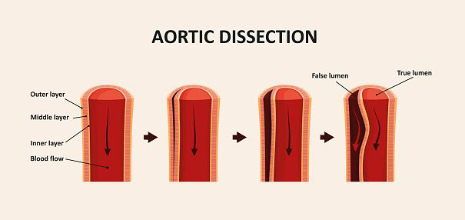
Acute dissecting aortic aneurysm
(labetalol)

Slide 54
B-GIT
Cases of gastrointestinal bleeding by decreasing COP and enhancing splanchenic vasoconstriction.
C-Endocrine
Hyperthyroidism.
Pheochromocytoma. (Must be combined with alpha-blockers).
D- Eye
Open angle glaucoma. (Timolol)
E- CNS
Prophylaxis of migraine
Anxiety and essential tremors.

Slide 55
Combined alpha and beta-blockers: labetalol
It is selective(α1 blocker and non-selective beta-blocker).
It has rapid onset of action.
It is used to control severe hypertension associated with pheochromocytoma and hypertension in pregnant patient.

Slide 56
Adverse Effects
1- Heart failure, bradycardia, hypotension.
2- Bronchospasm in susceptible patients.
3- Potentiation of the hypoglycaemic effect of insulin and oral hypoglycemic drugs and masking of the hypoglycaemic symptoms.
4- Peripheral ischaemia, intermittent claudication and cold extremities.
5- Reduced blood flow to the liver and kidney reducing metabolism of drugs.
6- Hyperkalaemia..
7- Nightmares, vivid dreams and depression.
8- Nausea, vomiting, diarrhea or constipation.
9- Increased plasma triglycerides and decrease HDL.
10 -Allergic reactions (rash fever)
11- Sudden withdrawal leads to aggravation of the disease under treatment due to up regulation of beta-receptors.
12- Decrease sexual function.

Slide 57
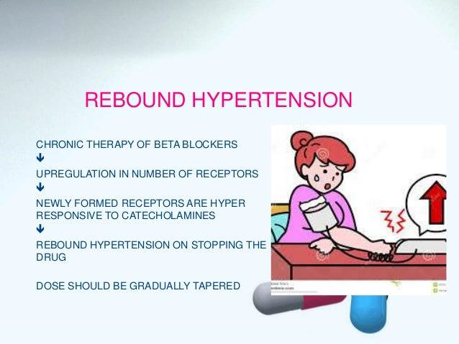

Slide 58
Contraindications
Congestive heart failure.
Heart block.
Variant angina. (why?????????)
Hypotension.
Peripheral vascular diseases.
Bronchial asthma.
Alone in pheochromocytoma (Severe hypertension).
Never stopped suddenly (Especially in case of angina)
Diabetes mellitus.

Slide 59
Drug interactions:
1-Pharmacodynamic interactions:
1-With calcium channel blockers (verapamil) cause bradycardia, heart block And heart failure
2-Aspirin (NSAID) decrease antihypertensive effect as it decrease PGs and Causing salt water retention
3-Non selective beta blockers ,Mask hypoglycemic symptoms and
Prolong hypoglycemia induced with insulin and oral hypoglycemic drugs
4-With epinephrine cause severe hypertension due to unopposed alpha vasoconstriction
2-Pharmacokinetic interactions:
1-Enzyme inducers increase metabolism of lipophilic beta blockers
2-Enzyme inhibitors decrease metabolism of lipophilic beta blockers
3-propranolol decrease hepatic blood flow and decrease metabolism Of flow dependent drugs (lignocaine)

Slide 60
Alpha blockers :PRAZOSIN
Mechanism of Action (Selective α1 blocker).
Pharmacological Effects
V.D. of arteries and veins lowering the blood pressure.
Therapeutic Uses
1-Treatment of mild to moderate hypertension.
2-Treatment of acute congestive heart failure (decreases pre- and after-load).
3-Impaired bladder emptying due to prostate obstruction (decreased the tone of trigone) leads to decreased resistance to flow of urine. (tamsulosin)
4-Peripheral vascular disease (Raynaud’s disease )
Adverse Effects
First dose effect:
1-The initial dose especially if large can produce postural hypotension and syncope.
It occurs most commonly in salt and water depleted patients (start with a small dose and at bedtime).
2-Dizziness, headache, drowsiness, and palpitation (disappears with continued treatment).
3-False positive tests for antinuclear factor.
4-Salt and water retention.
5- Flushing , ,Nasal congestion, Failure of ejaculation in males .
TERAZOSIN , alfuzosin and TRIMAZOCIN Similar to prazosin but it does not produce first-dose syncope.

Slide 61
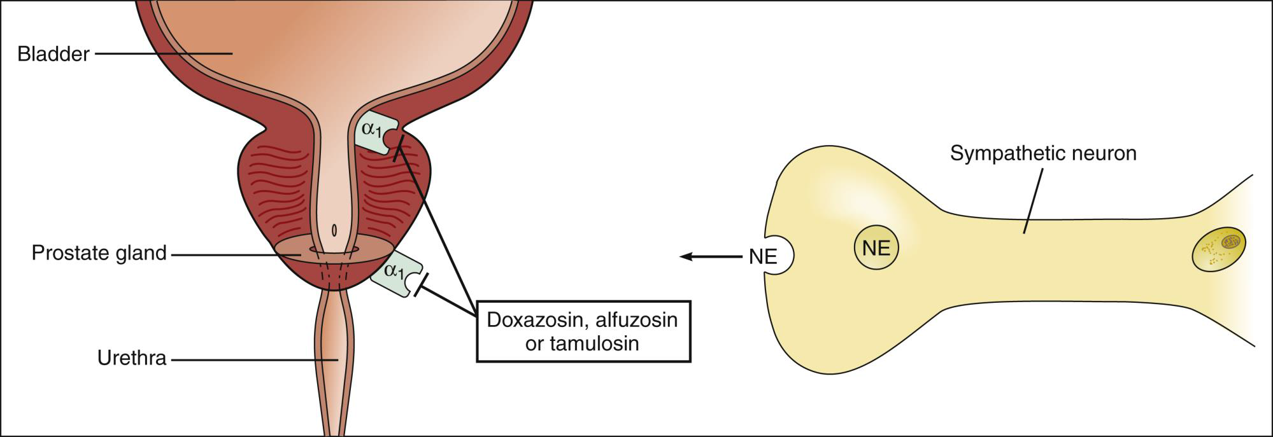

Slide 62
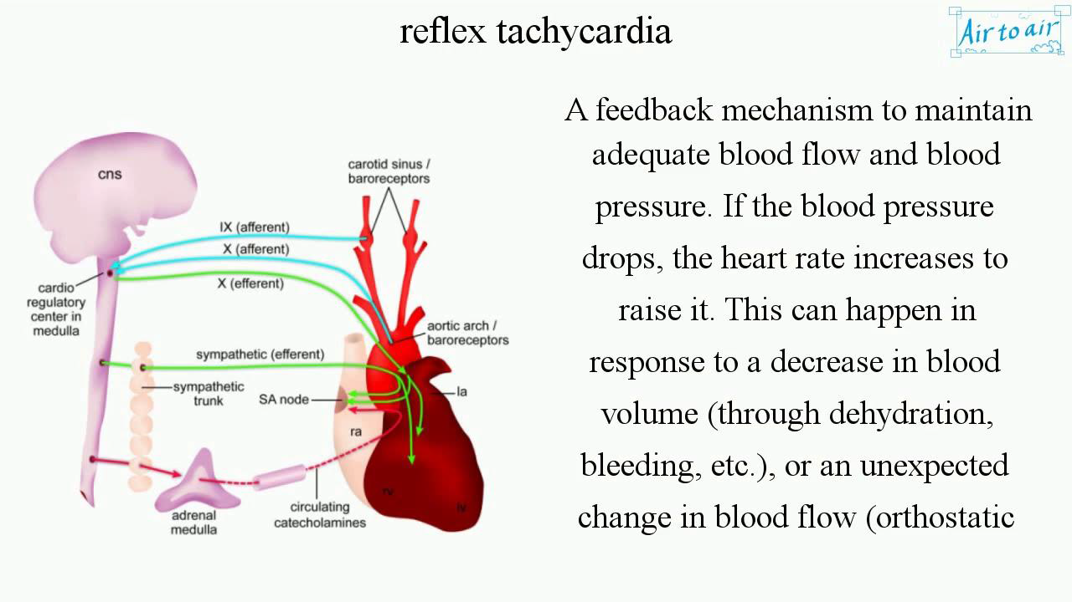

Slide 63
Centrally acting antihypertensive drugs
1-Adrenergic neuron blockers: reserpine .
Reserpine :
*Adrenergic neurone blocking action by preventing the granular uptake of catecholamines where it stays outside the granules (in the cytoplasm) to be inactivated by MAO enzyme.
*Parasympathomimetic action.
The hypotension effect is due to:
Adrenergic neurone blocking action.
Central action (inhibition of VMC and tranquilization)
Depletion of suprarenal medulla.

Slide 64
Adverse Effects:
1-Bradycardia, flushing and nasal stuffiness.
2-Hyperacidity, peptic ulceration, salivation and diarrhea.
3-Loss of libido and impotence in males.
4-Salt and water retention.
5-Psychic depression, suicidal attempts, parkinsonian-like rigidity and nightmares, cancer breast.
Uses : Less common nowadays due its side effects.
Not alone but as part of combination therapy for treatment of hypertension.

Slide 65
2-Alpha methyl dopa:
Pharmacological actions
*Competes with dopa for dopa decarboxylase enzyme leading to formation of alpha methyl norepinephrine (false chemical transmitter) Which:
1-activates inhibitory α2 receptor in the medullary region leading to inhibition of the sympathetic outflow.
2-Inhibits plasma renin activity.

Slide 66
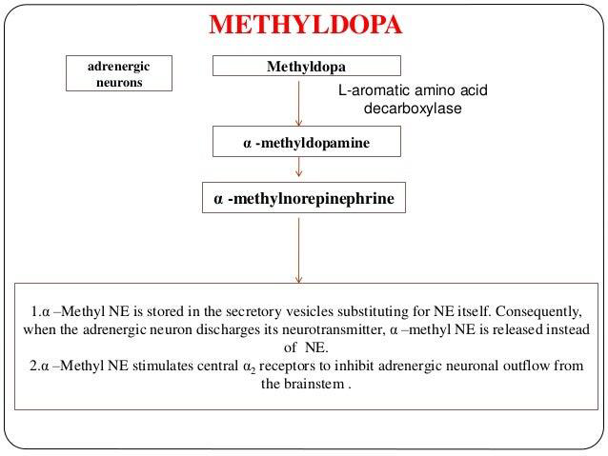

Slide 67
Pharmacological effects
Antihypertensive.
3-Beta-Blockers: propranolol .

Slide 68
4-Central α₂ stimulants: Clonidine, dexmedetomidine and guanfacine.
Mechanism: in therapeutic dose
It stimulates presynaptic α₂ receptors on the nerve endings → inhibition of NA release.
Inhibition of central sympathetic outflow (stimulates presynaptic α2 receptors in NTS).
So, it inhibits central &peripheral NE release
It inhibits dopamine hydroxylase enzyme → inhibition of NA synthesis.
It inhibits renin release and plasma renin activity.
Therapeutic uses:
1-Moderate to severe hypertension.
2-Prophylaxis of migraine.
3-In opiate withdrawal to decrease symptoms of sympathetic over activity.
4-As a sedative to reduce anxiety in preanesthetic medication.
5- Diarrhea of autonomic neuropathy

Slide 69
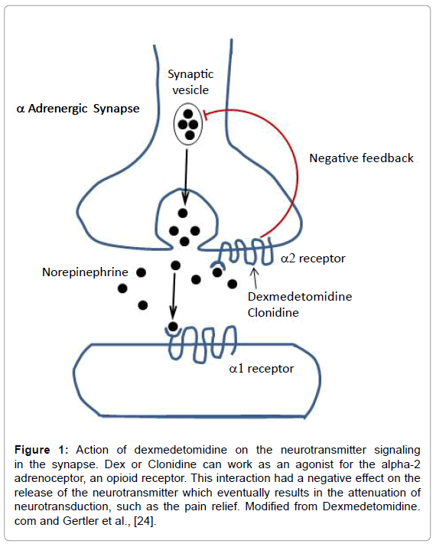

Slide 70
Side effects:
Sedation and dry mouth (xerostomia).
Severe hypertension can occur with overdoses due to stimulation of α₁ receptors as a result of loss of selectivity.
Sudden withdrawal can lead to hypertensive crisis (treated by combined α & β blockers), so it must be stopped gradually.
Salt and water retention.

Slide 71
Dopamine (D1) receptors agonists: Fenoldopam
Mechanism:
It stimulates D₁ receptors in peripheral arteries leading to VD and diuresis.
Uses: it is given by continuous i.v. infusion
Treatment of hypertensive emergencies.
Treatment of post-operative hypertension.
Side effects:
Hypotension and reflex tachycardia
Increase IOP so it should be avoided in patients with glaucoma.

Slide 72
Calcium channel blockers (CCBs)
These are drugs that block voltage-gated Ca²⁺ channels.
Classification of CCBs according to therapeutic effect:
CCB with mainly cardiac effects: verapamil, diltiazem (???????).
CCB with mainly vascular effects: nifedipine, amlodipine, isradipine, felodipine, nimodipine

Slide 73


Pharmacokinetics:
Oral absorption is nearly complete.
Plasma protein binding is 70-98% .......
Metabolism: verapamil and diltiazem are metabolized into active metabolites.
In older patients and in patients with liver cirrhosis the dose should be decreased.
Pharmacological effects:

Slide 74
Verapamil | Diltiazem | Nifedipine
+++ ↓↓↓ ↓↓ | ++ ↓↓ ↓ | - - ↑ (reflex) | Heart: –ve inotropic effect A-V conduction HR
+ ↓ | ++ ↓ | +++ ↓↓↓ | Blood vessels: Coronary and arterial dilatation BP

Slide 75
Other effects:
1-Smooth muscles: they relax bronchial, GIT, and uterine smooth ms.
3-Insulin release: verapamil ↓ insulin release (in high dose).

Slide 76
Therapeutic uses:
A. Cardio-selective CCBs (verapamil and diltiazem):
1-Ischemic heart disease: see IHD
2-Cardiac arrhythmias: supraventricular tachycardia (SVT):
Because they ↓ SAN activity and slow A-V conduction.
N.B.
Nifedipine is contraindicated because it cause hypotension and reflex tachycardia.

Slide 77
3-Hypertrophic obstructive cardiomyopathy (IHSS):
  In hypertrophic obstructive cardiomyopathy, the wall of the left ventricle and interventricular septum is much thickened leading to narrowing of the aortic outlet and obstruction of blood flow. This obstruction is increased by increasing contractility while decreasing contractility leads to decrease resistance to blood flow through the aortic outlet.
N.B.
Nifedipine is contraindicated because it produces reflex tachycardia → worsening of the outflow obstruction.

Slide 78
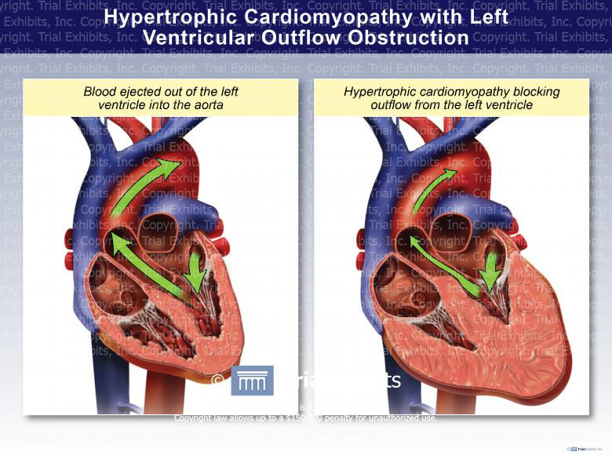

Slide 79
4-Arterial hypertension:
  They cause VD due to ↓ Ca²⁺ influx in the vascular smooth muscles.
  They ↓ myocardial contractility and COP.
B. Vasculo-selective CCBs (Nifedipine and amlodipine):
1-Arterial hypertension.
2-Senile cerebral ischemia (nimodipine).
3-Peripheral vascular disease: to improve peripheral microcirculation.

Slide 80
Adverse effects:
1-Verapamil and diltiazem:
*Bradycardia and heart block.
*Worsening of CHF (due to their –ve inotropic effect).
*↓ insulin release and worsening of DM.
*Constipation and reversible hepatotoxicity.
*Ankle edema (less common than with nifedipine).

Slide 81
2-Nifedipine:
*Hypotension and reflex tachycardia. Can be prevented by…………………………..
*Gingival hyperplasia.
*Ankle edema (due to VD).
How to treat ankle edema if occurred from CCBs?
Minimize sodium intake.
Avoid prolonged standing.
Mild diuretics.
Stop CCBs if the above measures failed.

Slide 82
Contraindications and precautions:
1-Verapamil:
Heart failure.
Bradycardia, heart block, or sick sinus syndrome (SSS).
With β-blockers: because both β-blockers and verapamil have –ve inotropic and chronotropic effects, this will cause severe cardiac depression (nifedipine is the drug of choice if β-blockers are used with CCBs because it doesn't cause bradycardia).
With digitalis: because digitalis also ↓ A-V conduction and HR.

Slide 83
2-Nifedipine:
Severe heart failure.
Hypotension.
Hypertrophic obstructive cardiomyopathy (IHSS)
Unstable angina (for fear of reflex tachycardia).

Slide 84
(cc)??

Slide 85
RENNIN ANGIOTENSIN ALDESTERON SYSTEM
RENIN: It is a proteolytic enzyme secreted by the kidney into the blood stream.Stimuli that increase renin secretion: Sodium depletion, diuretics, hypotension, hemorrhage, upright posture, dehydration, constriction of renal artery, heart failure and Cirrhosis

Slide 86
Actions of Angiotensins
Angiotensin I (precursor of angiotensin II): It has no pharmacological action.
Angiotensin II: It acts on two receptors; AT₁ and AT_{2 receptors}
(1) Its action on AT₁ receptor produces the following:
CVS:
Arteriolar constriction leading to increased systolic and diastolic blood pressure (40 times as active as norepinephrine).
Angiotensin II produces positive inotropic and chronotropic effects which are primarily due to central and peripheral sympathetic stimulation.
Endocrine:
Increase secretion and synthesis of aldosterone which causes Na and water retention.
Facilitate catecholamine synthesis and release.
Increase pituitary vasopressin and ACTH.

Slide 87
Renal:
Suppress renin release
V.C of renal efferent arterioles, increases proximal tubular Na⁺ reabsorption
C.N.S
Increase H2O intake and vasopressin secretion.
Stimulate central sympathetic discharge.
(2)Its action on AT₂ receptor produces the following:
Antiproliferation.
Apoptosis (normal cell death).
Vasodilatation and increase local bradykinin.

Slide 88
Inhibitors of the renin-Ang system:
Inhibitors of renin release: β-blockers, α-methyldopa, clonidine.
Inhibitors of plasma renin activity: aliskrine.
Inhibitors of Ang-2 formation: angiotensin-converting enzyme inhibitors (ACEIs)(pril)
Blockers of AT receptors: saralasin, losartan, valsartan

Slide 89
Angiotensin-converting enzyme inhibitors (ACEIs):
Classification:
A-SH-Containing:
Captopril
Zofinopril
The sulfhydryl group (-SH) present in captopril may be responsible for the immunological side effects e.g. angioedema, taste changes, skin rash, leukopenia
B-Non SH-Containing:
Enalapril
Fosinopril
Lisinopril
Benazepril

Slide 90
Mechanism of action: They inhibit Ang-converting enzyme (ACE) leading to:
Inhibition of Ang-2 formation in the heart, blood vessels, and tissues.
Prevent degradation of bradykinin which is a potent VD.
So, ACEIs have direct VD action to both arteries and veins.

Slide 91
Pharmacological effects:
CVS:
1-They ↓ BP mainly by decreasing peripheral resistance.
3-They ↓ the left ventricular mass and wall thickening after myocardial infarction because they prevent myocyte cell proliferation and collagen synthesis (i.e. prevent cardiac remodeling).
4-They maintain cerebral and coronary blood flow.

Slide 92
Kidney:
They ↓ proteinuria in mild renal impairment and diabetic patients.
They ↑ RBF.

Slide 93
Therapeutic uses:
1-Hypertension:
2-Congestive heart failure (CHF):
3-Post-infarction ventricular remodeling:
To ↓ mass and wall thickness of the left ventricle through:
4-Diabetic nephropathy and microalbuminuria:

Slide 94
Side effects: CAPTOPRIL
C Cough and bronchospasm: inhibition of ACE leads to accumulation of bradykinin, which cause bronchial irritation and constriction.
Prevention: by administration of NSAIDs (e.g. aspirin) to ↓ bradykinin synthesis
A Angioedema (edema of the face and throat): due to accumulation of bradykinin or due to autoimmune reaction. It may be fatal.
P :Proteinuria in patients with bilateral renal artery stenosis.
T Taste changes: temporary loss of taste (ageusia and dysgeusia).
O Orthostatic (First dose) hypotension: especially in sodium depleted patients.
Prevention: the first dose must be small and at bedtime then increase gradually.
P Pregnancy: teratogenesis (fetal pulmonary hypoplasia and growth retardation)
R skin Rash
I Increased K⁺ (hyperkalemia).
L Leukopenia (neutropenia)

Slide 95
Contraindications:
1-Hypotension.
2-Severe renal failure (serum creatinine > 3 mg/dl).
3-Bilateral renal artery stenosis or stenosis in a solitary kidney.
aggravation of renal failure in both kidneys. As angiotensm II play a role in maintaining renal perfusion.
4-Pregnancy and lactation: they may cause fetal pulmonary hypoplasia and growth retardation.
5-Hyperkalemia.
6-Neutropenia or thrombocytopenia.
7-Severe anemia: as they may cause bone marrow depression.
8-Immune problems: e.g. autoimmune diseases and with immunosuppressive drugs.

Slide 96
Precautions:
1-Initial dose should be small and at bedtime to avoid 1st dose hypotension.
2-Frequent monitoring of kidney functions (serum creatinine) one week after treatment and then every 3 months.
3-Frequent monitoring of serum K⁺.
4-Avoid use with K⁺ sparing diuretics to avoid severe hyperkalemia.
5-Mention other contraindications…….

Slide 97
Angiotensin II receptor blockers (ARBs)
(Losartan, valsartan, candesartan, eprosartan, telmisartan)
They selectively block AT₁ receptors.
They have no effect on bradykinin metabolism.
They have the potential for more complete inhibition of Ang-2 action compared with ACE inhibitors because there are non-ACE enzymes (cathepsin and chymase) that can convert Ang-1 into Ang-2.
The adverse effects and contraindications are similar to those described for ACE inhibitors but cough and angioedema are less common than with ACE inhibitors.

Slide 98
Vasodilators
Classification
1-Arterio-dilators: e.g. nifedipine, hydralazine, minoxidil, diazoxide.They directly dilate arteries.
2-Venodilators: e.g. nitrates.They dilate veins.
3-Mixed dilators: sodium nitroprusside, prazosin, ACEIs, trimetaphan.

Slide 99
General considerations:
They usually cause reflex sympathetic stimulation (e.g. reflex tachycardia and ↑ plasma renin) so they can be combined with beta-blockers.
They usually cause salt and water retention so they should be combined with diuretics.
They preserve renal and cerebral blood flow.

Slide 100
Hydralazine
Therapeutic uses:
  Severe systemic hypertension.
  Hypertension in pregnancy (2nd choice after α-methyldopa).
Side effects:
Hypotension and reflex tachycardia.
Salt and water retention.
Headache, Anginal pain, Nausea, Dizziness (HAND).
Systemic lupus erythematosis (SLE)-like syndrome in slow acetylators.

Slide 101
Minoxidil
Therapeutic uses:
Topical minoxidil is used to stimulate hair growth in male baldness.
Side effects:
Hypotension and reflex tachycardia.
Salt and water retention.
Headache, Anginal pain, Nausea, Dizziness (HAND).
Hypertrichosis= hirsutism (undesirable hair growth in the face and body).

Slide 102
Diazoxide
Mechanism: direct arteriolodilator by opening K⁺ channels → hyperpolarization → relaxation of the vascular sm ms.
Therapeutic uses:
Hypertensive emergencies e.g. hypertensive encephalopathy. (rapid i.v. injection to avoid rapid and extensive binding with plasma proteins).
Hypoglycemia due to hyperinsulinism to decrease insulin secretion from the pancreatic β-cells through opening of its K⁺ channels.

Slide 103
Side effects:
Hypotension and reflex tachycardia.
Salt and water retention.
Headache, Anginal pain, Nausea, Dizziness (HAND).
Hyperglycemia due to inhibition of insulin release.
Hyperuricemia.

Slide 104
Sodium nitroprusside
Mechanism: It liberates nitric oxide (NO) → ↑ cGMP → ↓ Ca²⁺ entry in the vascular sm ms → dilatation of both arteries and veins.
Therapeutic uses:
Hypertensive encephalopathy: It must be given by i.v. infusion .
Congestive heart failure: to ↓ both preload (venodilatation) and afterload (arteriolodilatation).

Slide 105
Side effects:
Hypotension and reflex tachycardia.
Headache, Anginal pain, Nausea, Dizziness (HAND).
Prolonged therapy can lead to cyanide toxicity.
►Precautions:
Avoid exposure to light because the drug is sensitive to light.
Stop infusion gradually to avoid rebound hypertension.
Too much infusion may lead to cyanide toxicity.

Slide 106
Hypertensive emergency
Severe hypertension (often defined as systolic blood pressure > 180 mmHg and or diastolic blood pressure > 120 mmHg) can produce a variety of acute, life-threatening complications, which are considered hypertensive emergencies.
Those include:
l. Hypertensive encephalopathy, stroke.
2. Acute left ventricular failure, myocardial infarction /unstable angina, aortic dissection
3. Progressive renal damage & malignant hypertension.
Hypertensive encephalopathy: is characterized by the insidious onset of headache, nausea, and vomiting, followed by non-localizing neurologic symptoms such as restlessness, confusion, and, if the hypertension is not treated, seizures and coma.

Slide 107
Malignant hypertension is a syndrome associated with an abrupt increase in blood pressure in a patient with underlying hypertension or sudden onset of hypertension in a previously normotensive individual. The absolute level of blood pressure is not as important as its rate of rise.
Pathologicaly: …………………………………………………….
Clinical picture: CCRR…………………………………………….
Approach to the patient:
In the ICU, therapy must often begin before a comprehensive patient evaluation is completed.
A brief history and physical examination should be initiated to assess the degree of target organ damage (TOD) and to rule out obvious secondary causes of hypertension.
History:
History of hypertension or other significant medical disease. Medication use and compliance.
Symptoms attributable to target organ damage TOD
a) Neurological: (headache, nausea and vomiting; visual changes; seizures; focal deficits; mental status changes).
b) Cardiac (chest pain, shortness of breath).
c) Renal (hematuria, decreased urine output).

Slide 108
Physical examination:
1-Blood pressure readings in both arms.
2-Signs of neurological ischemia, such as altered mental status or focal neurological deficits.
3-Direct ophthalmoscopic examination.
4-Auscultation of the lungs and heart.
5-Evaluation of the abdomen and peripheral pulses for bruits or masses.
Laboratory evaluation of:
Electrolytes, blood urea nitrogen and creatinine, complete blood count with assessment of cardiac function and chest radiography.

Slide 109
Treatment: Initial goals of BP reductions: In hypertensive emergencies
- The initial aim of treatment in malignant hypertension and hypertensive
encephalopathy is to lower the diastolic pressure about I0% in the first hour and additional l5% within 3 to 12 hours, but not less than 160/110.
- More aggressive antihypertensive therapy is both unnecessary and may reduce the BP below the auto -regulatory range, possibly leading to
ischemic events (such as stroke or coronary disease).
- The only 2 exceptions for rapidly lowering of the blood pressure are aortic
dissection and post-operative bleeding from the suture lines.
- Once the BP is controlled, the patient should be switched to oral therapy,
with the diastolic pressure being gradually reduced to 85 to 90 mmHg over
two to three months
Hypertensive encephalopathy
- The initial goal of therapy is to reduce the mean arterial blood pressure by
no more than 25% within minutes to 2 hours or to a blood pressure in the
range of 160-100/11O mmHg.
- This may be accomplished with IV nitroprusside, a short acting vasodilator
with a rapid onset of action that allows minute to minute control of blood
pressure. Parenteral labetalol & nicardipine are also effective in hypertensive encephalopathy.

Slide 110
Hypertesive urgency (severe asymptomatic hypertension):
a) No proven benefit from rapid reduction of the blood pressure in patients
with severe asymptomatic hypertension.
b) In fact cerebral or myocardial ischemia or infarction can be induced with aggressive antihypertensive therapy if the blood pressure falls below the
range at which tissue perfusion can be maintained by autoregulation.
N.B:- This has been most often described with sublingual nifedipine or
captopril; the degree of blood pressure reduction cannot be controlled or
predicted, and severe ischemic complications have ensued.
c) The goal of management is to reduce the blood pressure to <160/100
mmHg over several hours to days.

Slide 111
Oral versus parenteral therapy:
In the intensive care unit, parenteral therapy with closed hemodynamic monitoring is preferred.
Indications of parenteral antihypertensives are:
1- Intracranial hemorrhage.
2- Aortic dissection.
3- Rapidly progressive renal failure.
4- Eclampsia.
5- Hypertensive encephalopathy.
6- In heart failure or myocardial infarction complicating hypertension.
7- Uncomplicated accelerated hypertension and malignant hypertension.

Slide 112
Resistant hypertension:
Resistant hypertension is defined as uncontrolled blood pressure despite the use of
three or more antihypertensive drugs, including a diuretic, in optimal doses.
These patients may be experiencing of the following factors as the cause of resistant
hypertension:
1-Inadeguate treatment. Patients may not be on an effective drug, or concomitant volume expansion may occur as a side effect of the drug.
Extracellular volume expansion. May occur because of renal insufficiency, sodium retention due to treatment with vasodilators ,high-salt diet, or insufficient dosing of diuretic.
3-Poor compliance with medical therapy or dietary modifications. This should be addressed with patient education, simplification of the drug regimen, and use of drugs with the fewest adverse effects.
4-Secondary hypertension: Whenever confronted with resistanthypertension, Chronic kidney disease ,drug-induced hypertension, obstructive sleep apnea and primary aldosteronism represent the most common secondary causes of resistant hypertension.
5- Several drugs can induce or exacerbate pre-existing hypertension, with non-steroidal anti-inflammatory drugs being the most common due to their wide use. secondary causes of hypertension should be excluded.

Slide 113
Choice of antihypertensive drugs in special situations:
Preferred drug | Clinical situation
α Methyl dopa,hydralazine,labetalol and nifedipine | Hypertension in pregnancy
ACEI ,α Methyl dopa | Hypertension and diabetes
CCB | Hypertension and bronchial asthma
,CCB clonidine,α Methyl dopa, Loop diuretics (frusemide) | Hypertension and renal failure
Diuretics and ACEI | Hypertension and heart failure

Slide 114
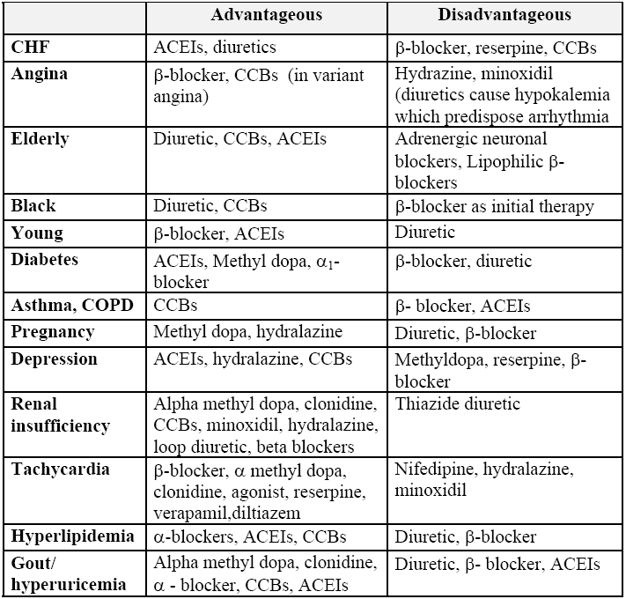

Slide 117
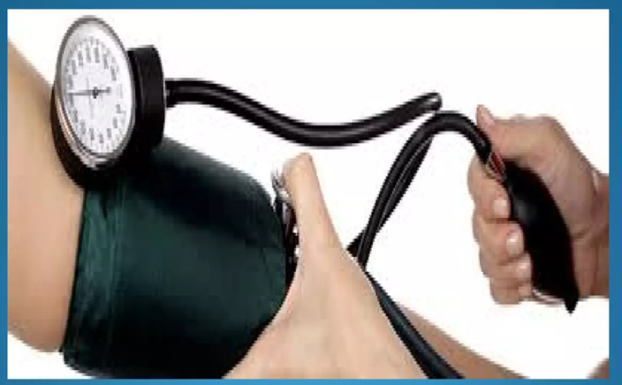
Pathology of
Hypertension
Dr. Eman Enan
Ass.Professor
of
Pathology

Slide 118
Introduction
Silent Killer
Responsible for the majority of office visits
Number one reason for drug prescription
25% of population, 35% unaware
Complications bring to diagnosis but late
Chronic vascular and end-organ damage
Without appropriate treatment, some 50% of hypertensive patients die of ischemic heart disease (IHD) or congestive heart failure, and another third succumb to stroke.

Slide 119
Definitions
Sustained increase of Arterial blood pressure
Hypertension in adults:
2020 International Society of Hypertension (ISH) and 2014 JNC 8:
  persistent SBP ≥ 140 mm Hg and/or DBP ≥ 90 mm Hg
Primary hypertension: hypertension with no identifiable cause
Secondary hypertension: hypertension caused by an identifiable underlying condition
Acute severe Hypertension (Malignant HPTN): An increase in systolic blood pressure above 180 mmHg or diastolic blood pressure above 120 mmHg.
Notes:
Like height and weight, blood pressure is a continuously distributed variable; moreover, detrimental consequences increase continuously as the pressure rises, with no rigidly defined threshold dependably predicting total safety. Nevertheless, sustained diastolic pressures greater than 90 mm Hg or sustained systolic pressures in excess of 140 mm Hg are reliably associated with an increased risk for atherosclerosis and are therefore used as cutoffs in diagnosing hypertension in clinical practice. By these criteria, over 25% of individuals in the general population are hypertensive. As noted however, these values are
somewhat arbitrary, and in patients with other cardiovascular risk factors (e.g., diabetes), lower thresholds may be applicable.

Slide 120
Classification of hypertension in adults
 | 2017 ACC/AHA guideline ^{[1]} | 2014 JNC 8 guideline ^{[2][7]} | 2020 ISH guideline ^{[3]}
Normal blood pressure | SBP < 120 mm Hg AND DBP < 80 mm Hg |  | SBP < 130 mm Hg AND DBP < 85 mm Hg
Elevated blood pressure | SBP 120–129 mm Hg AND DBP < 80 mm Hg | SBP 120–139 mm Hg OR DBP 80–89 mm Hg | SBP 130–139 mm Hg OR DBP 85–89 mm Hg
Stage 1 hypertension | SBP 130–139 mm Hg OR DBP 80–89 mm Hg | SBP 140–159 mm Hg OR DBP 90–99 mm Hg
Stage 2 hypertension | SBP ≥ 140 mm Hg OR DBP ≥ 90 mm Hg | SBP ≥ 160 mm Hg OR DBP ≥ 100 mm Hg
Notes:
Source: AMBOSS

Slide 121
Epidemiology
Prevalence
Hypertension affects between approximately one-third and one-half of adults in the US.
  Primary hypertension: accounts for 90%-95% of cases of hypertension in adults .
  Secondary hypertension: accounts for ∼ 5-10% of cases of hypertension in adults ^{[1]}
  Prevalence increases with age: Approximately 65–75% of adults develop hypertension by 65–74 years of age.
  ∼ 60–87% of overweight and ∼ 73–95% of obese patients are affected.
Sex
  ♂ > ♀ below 65 years of age
  After menopause, prevalence increases in women.
Notes:
However, the prevalence of hypertension among school-aged children and adolescents is increasing (particularly in those who are obese)
At ≥ 75 years of age, prevalence is higher in women than men.

Slide 122
Etiology
Primary (essential) hypertension:
Multifactorial etiology including epigenetic, genetic, and environmental factors
Directly related to total peripheral resistance and cardiac output
Risk factors for primary hypertension
  Non-modifiable risk factors
    Positive family history
    Race and ethnicity
    Advanced age
  Modifiable risk factors
    Overweight and obesity (greatest modifiable risk factor)
    Uncontrolled diabetes
    Smoking
    Excessive alcohol intake
    Diet high in sodium and low in potassium
    Physical inactivity
    Psychological stress

Slide 123
Secondary hypertension:
Important causes include:
Renal: GN, renal artery stenosis, Renin tumors
Endocrine: pheochromocytoma, hyperthyroidism, hyperaldosteronism, hypercortisolism, OCP
Vascular: Coarctation of aorta, PAN, Aortic insufficiency.
Neurogenic: Psychogenic, raised intracranial pressure, polyneuritis, Obstructive sleep apnea,
certain drugs (e.g., sympathomimetics).
Pregnancy-induced hypertension

Slide 124
Clinical features
Hypertension is usually asymptomatic until:
  Complications of end-organ damage arise
  Or an acute increase in blood pressure occurs (“Hypertensive crisis”)
Nonspecific symptoms of primary hypertension
  Headaches, esp. early morning or waking headache
  Dizziness, tinnitus, blurred vision
  Flushed appearance
  Epistaxis
  Chest discomfort, palpitations
  Strong, bounding pulse on palpation
  Nervousness
  Fatigue, sleep disturbances
  Secondary hypertension usually manifests with symptoms of the underlying disease.
Notes:
Since hypertension is often asymptomatic, regular screening is necessary to prevent end-organ damage.

Slide 125
Complications
Arterial hypertension is the most common risk factor for cardiovascular disease
It leads to chronic changes in the vascular endothelium, particularly of the small vessels, and can therefore affect any organ system.
Acute severe hypertension causes “Hypertensive crisis”

Slide 126
Hypertensive crisis
“Acute severe hypertension”
“Malignant hypertension”
An increase in systolic blood pressure above 180 mmHg or diastolic blood pressure above 120 mmHg.
Rapidly progressive end organ damage
May complicate any type of HPTN
Artery necrosis with thrombosis
Rapidly developing renal failure
Hypertensive encephalopathy
Left ventricular failure
Notes:
Hypertensive crises refer to acute increases in blood pressure (generally defined as ≥ 180/120 mm Hg) that cause or increase the risk of end-organ damage, i.e., damage to the brain (e.g., encephalopathy, stroke), eyes (e.g., retinopathy), cardiovascular system (e.g., ACS, pulmonary edema, aortic dissection), and/or kidneys (e.g., acute kidney injury). They can be due to primary hypertension or precipitated by underlying conditions (e.g., pheochromocytoma, pre-eclampsia, drug toxicity).

Slide 127
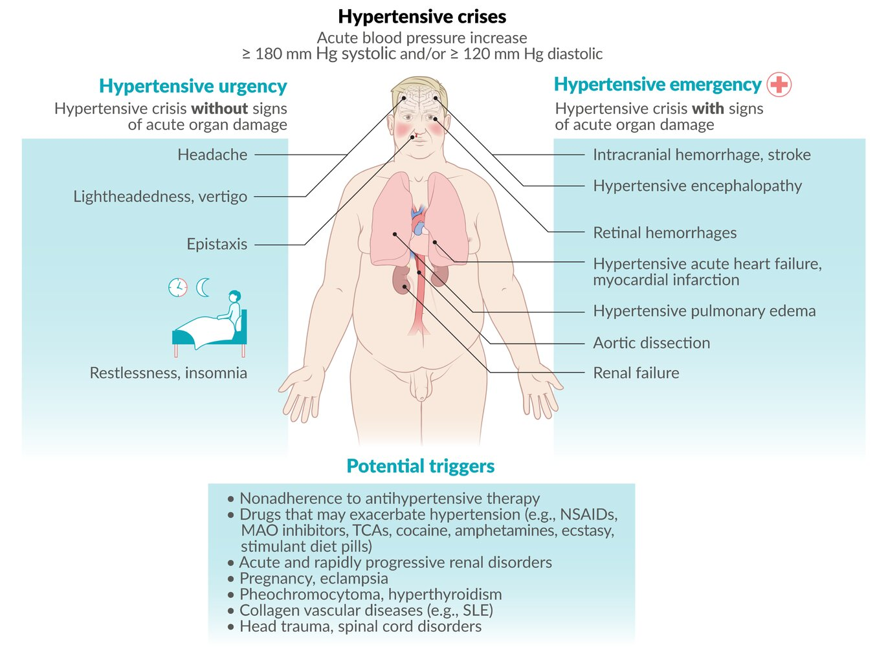
Notes:
Prognosis
If left untreated, hypertensive emergencies are associated with a 1-year mortality rate of > 80% and a median survival of 10–11 months.

Slide 128
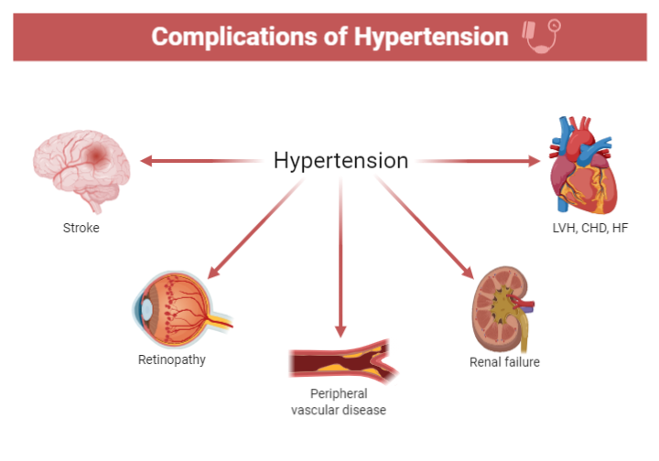

Slide 129
Pathology of hypertensive Complications
Vascular:
Macro-angiopathy: Atherosclrosis
Micro-angiopathy: Arteriolosclerosis (hyaline or hyperplastic)
Heart: LVH, Hypertensive cardiomyopathy-→IHD, MI
Kidney: Hypertensive nephrosclerosis
Eyes: Hypertensive retinopathy
Brain: Hemorrhage, infarction

Slide 130
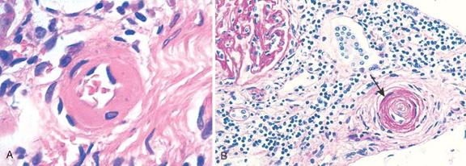
Hypertensive vascular disease
“HYALINE” = BENIGN HTN. “HYPERPLASTIC” = MALIGNANT HTN. 1) ONION SKIN 2) “FIBRINOID” NECR.

Slide 131
Cardiovascular system (hypertensive vascular disease)
Left ventricular hypertrophy, hypertrophic cardiomyopathy, dilated cardiomyopathy
Congestive heart failure
Coronary artery disease and myocardial infarction
Atrial fibrillation
Aortic aneurysm
Aortic dissection
Carotid artery stenosis
Peripheral artery disease
Atherosclerosis

Slide 132
Systemic (left sided) hypertensive heart disease
Hypertensive heart disease (HHD) is a consequence of the increased demands placed on the heart by hypertension, causing pressure overload and ventricular hypertrophy
The criteria for the diagnosis of systemic hypertensive
heart disease are
left ventricular hypertrophy in the absence of other cardiovascular pathology (e.g., valvular stenosis), and
a history or pathologic evidence of hypertension.
Notes:
The Framingham Heart Study established unequivocally that even mild hypertension (above140/90 mm Hg), if sufficiently prolonged, induces left
ventricular hypertrophy. Roughly 25% of the U.S. population suffers from at least this degree of hypertension.

Slide 133
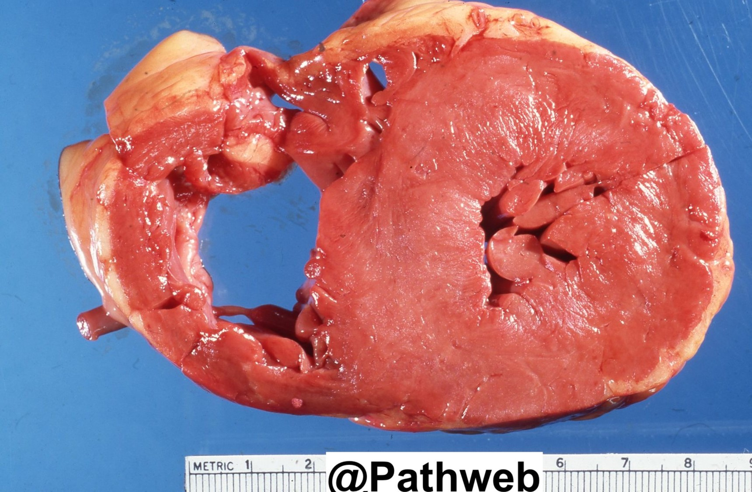
Left ventricular Hypertrophy

Slide 134
Kidney: Hypertensive nephrosclerosis
A renal vascular injury secondary to long-standing arterial hypertension
Pathophysiology:
  chronic hypertension → hypertrophy of medial and intimal layers → narrowing of afferent arterioles → ↓ glomerular blood flow → glomerular and tubular ischemia → arteriolonephrosclerosis and fibrosis (focal segmental glomerulosclerosis) → end-stage renal disease

Slide 135
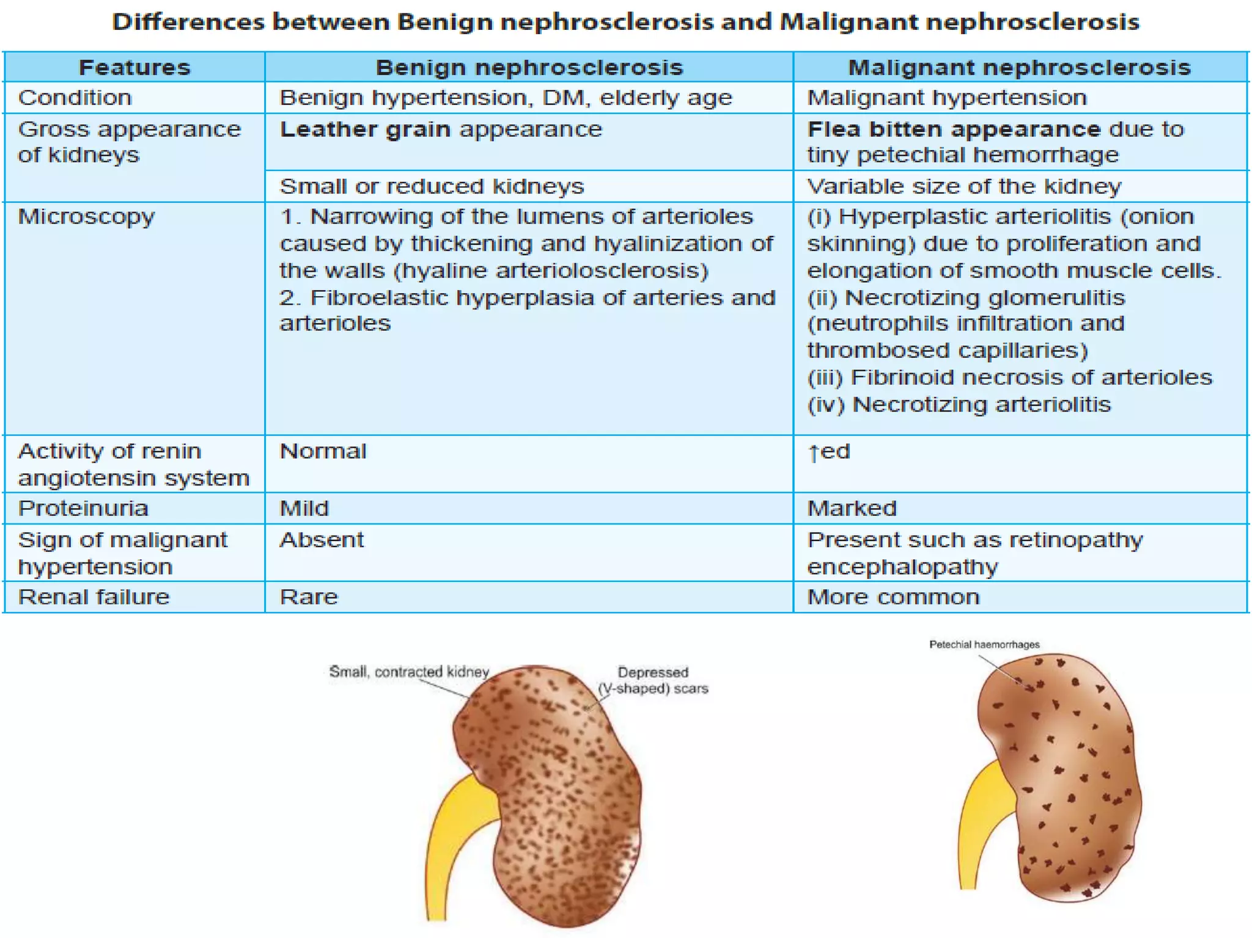

Slide 136
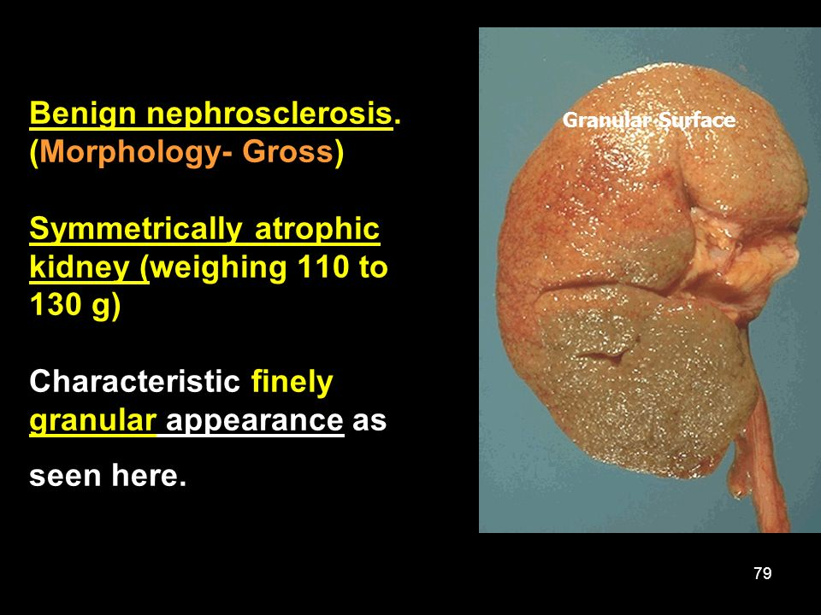

Slide 137
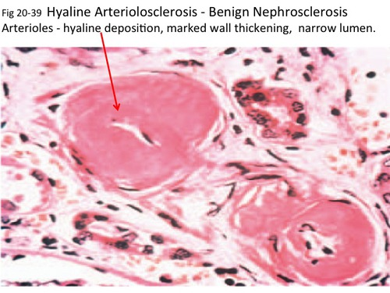
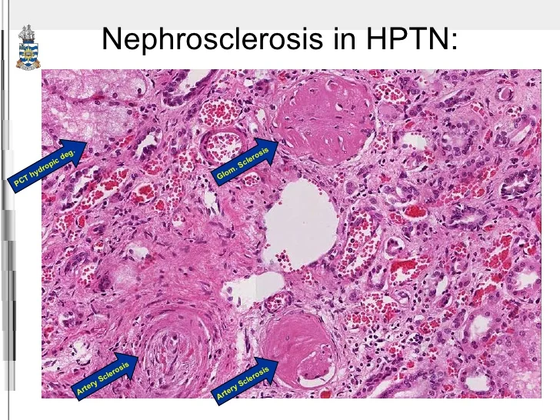
Benign Nephrosclerosis

Slide 138
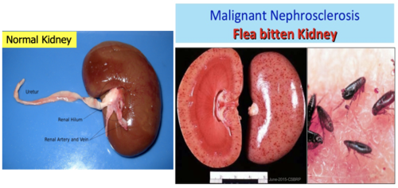

Slide 139
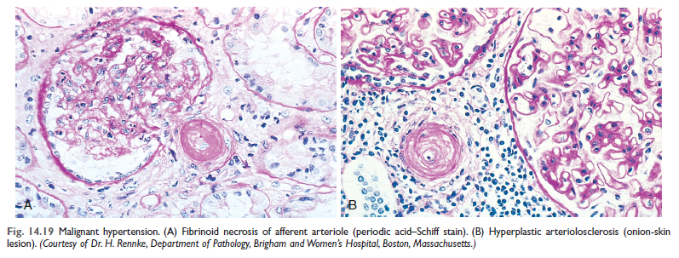
Malignant nephrosclerosis

Slide 140
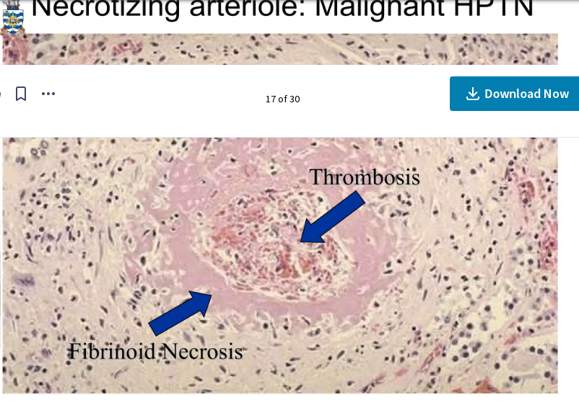
Necrotizing arteriole: Malignant HPTN

Slide 141
Hypertensive cerebrovascular disease
Massive intacerebral hemorrhage
Lacunar infarct
Slit hemorrhage
Hypertensive encephalopathy

Slide 142
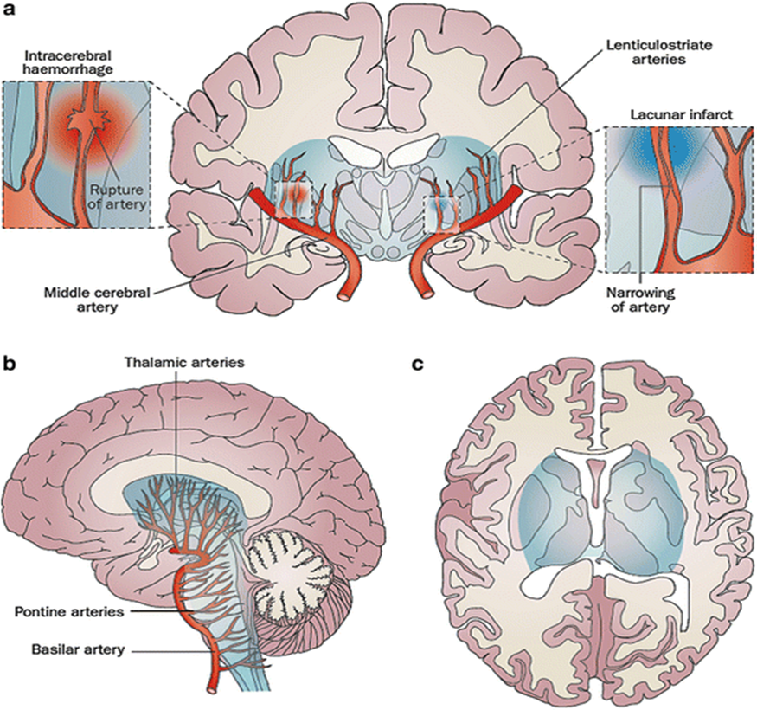
HPTN &STROKE
Long-standing poorly-controlled hypertension leads to a variety of pathological changes in the vessels:
1. Microaneurysms of perforating arteries (Charcot-Bouchard aneurysms)
small (0.3-0.9 mm) diameter
occur on small (0.1-0.3 mm) diameter arteries
distribution matches the incidence of hypertensive hemorrhages
  80% lenticulostriate
  10% pons
  10% cerebellum
found in patients with hypertension
may thrombose, leak (see cerebral microhemorrhages) or rupture
2 .Accelerated atherosclerosis: affects larger vessels
3. Hyaline arteriolosclerosis
4. hyperplastic arteriolosclerosis: seen in very elevated and protracted cases

Slide 143
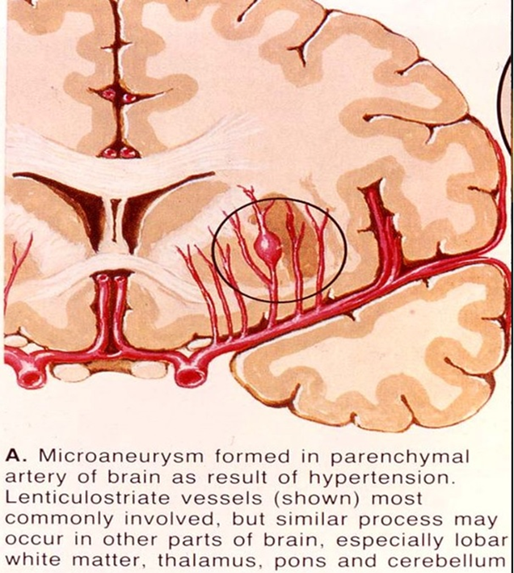
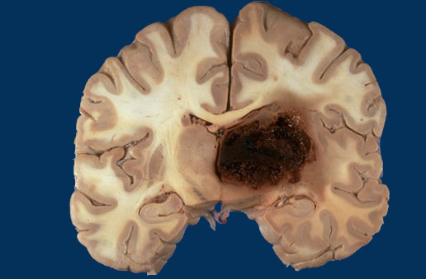
Intracerebral hemorrhage

Slide 144
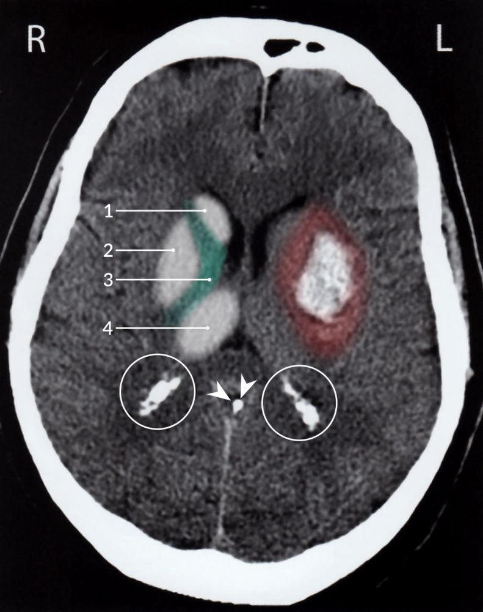
Basal ganglia hemorrhage
Notes:
Basal ganglia hemorrhage
CT head (without contrast; axial plane) of a patient with a history of chronic hypertension
Hyperdense hemorrhage in the left basal ganglia is surrounded by hypodense perifocal edema (red overlay).
The location is typical for hemorrhage from the lenticulostriate arteries as a result of long-standing hypertension.
1: head of caudate nucleus; 2: putamen; 3 and green overlay: internal capsule; 4: thalamus
Arrowheads: calcified pineal gland; white circles: calcified choroid plexus
Source: © IMPP

Slide 145
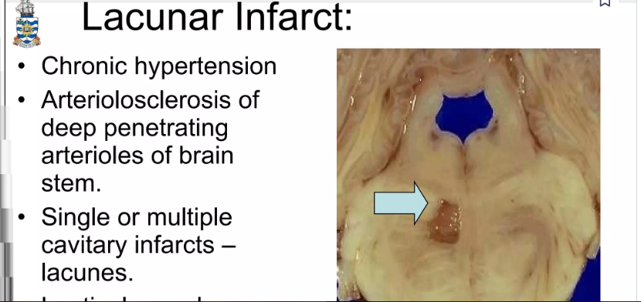
Lacunar infarct

Slide 146
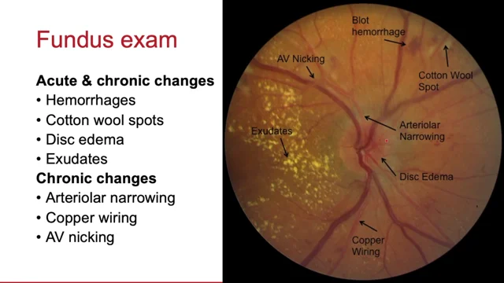
Hypertensive retinopathy

Slide 147
Hypertensive retinopathy
Classification system according to Keith-Wagener-Barker ^{[51]}
Grade | Findings | Symptoms
Grade I | Vessel diameter variation: arteriolar constriction and tortuosity | Usually asymptomatic
Grade II | Gunn sign and marked constriction of vessels and sclerosis of arterioles
Grade III | Cotton wool exudates, hard exudates, retinal hemorrhage, retinal edema, macular star formation | Decreased and/or blurred vision, headaches
Grade IV | Papilledema, optic atrophy
Notes:
*Gunn sign (Arteriovenous nicking)
A tapering of a retinal venule at the point where a retinal arteriole crosses the retinal venule; creates an hourglass shape. Associated with advanced hypertensive retinopathy.
*Hard exudate
Accumulation of exudate from capillary leakage within the outer plexiform layer (Henle layer) and the inner nuclear layers of the retina.
Local treatment of retinopathy is not possible, therefore, systemic reduction of blood pressure is critical

Slide 148
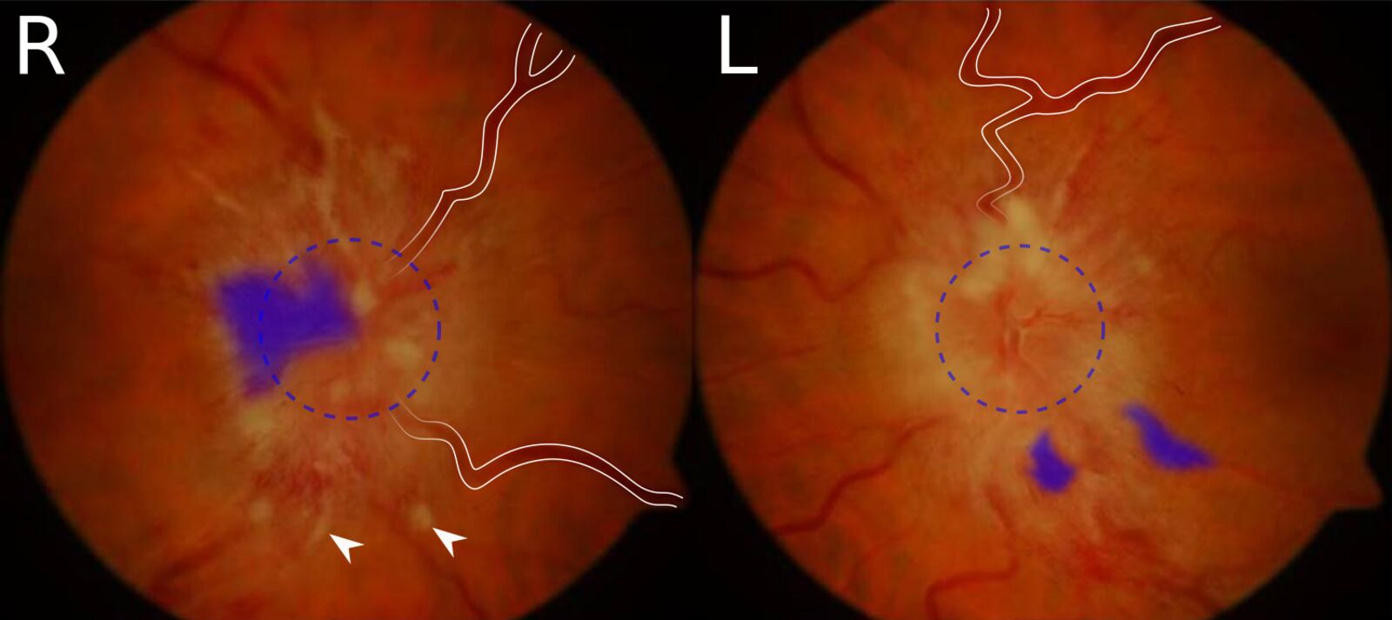
Bilateral papilledema- hypertensive emergency
Notes:
Bilateral papilledema
Fundus photography of right (R) and left (L) optic disc of the same patient:
The optic discs show severely blurred margins (dashed circle indicates supposed margin). The retinal veins are dilated and tortuous (examples marked by white lines). There are multiple peripapillary hemorrhages, which appear as flame-shaped hemorrhages (examples marked by blue overlay). Cotton wool spots are also present and appear as bright spots (examples marked by arrowheads).
These features are characteristic of papilledema. If present bilaterally, possible causes include cranial hypertension or hypertensive emergency.
Source: “Figure 1. in: A 43-year-old woman on triptorelin presenting with pseudotumor cerebri: a case report” by Uday Kumar Bhatt, Imran Haq, Venkata S. Avadhanam und Kim Bibby, Journal of Medical Case Reports, licensed under CC BY 2.0. The supplementary image with overlays of relevant areas was adapted from the image mentioned above (© AMBOSS).

Slide 149
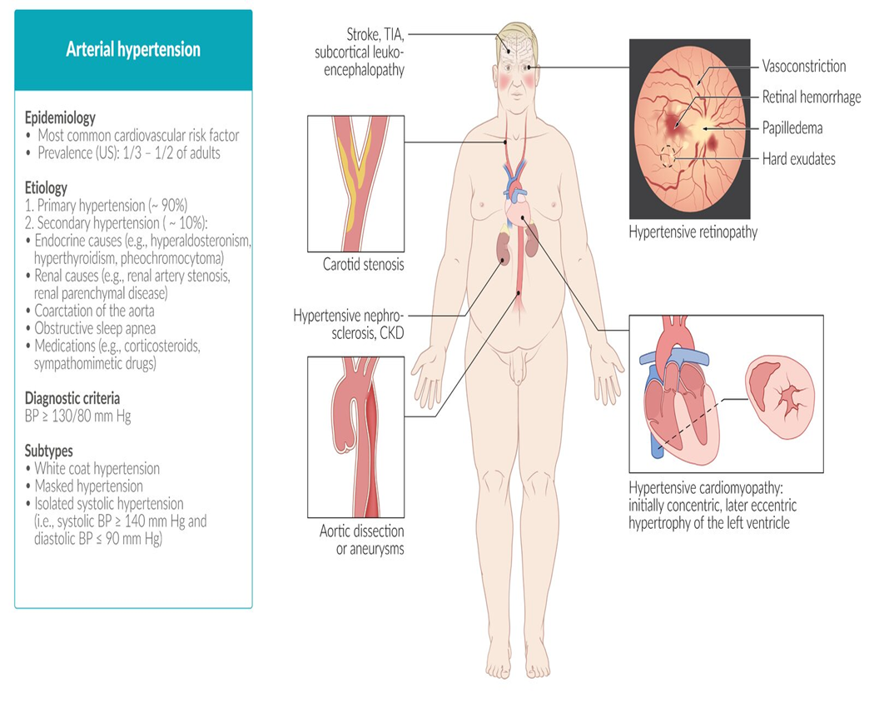

Slide 150
References
Robbins Basic Pathology 10th edition, 2017
( Kumar, Abbas, Aster)
AMBOSS:
https://next.amboss.com/us/article/Xh09cf?q=hypertension

