Slide 1
DRUG THERAPY OF ACID - PEPTIC DISEASE
By
Dr.Mohamed Abdelmoneim Attia

Slide 2
Acid peptic disease includes peptic ulcer “gastric and duodenal", gastroesophageal reflux and pathological hypersecretory states such as Zollinger - Ellison syndrome.

Slide 3
Gastro- Esophageal Reflux Disease (GERD)
Definition: GERD: occurs when the amount gastric juice that refluxes into the esophagus exceeds the normal limit, causing symptoms with or without associated esophageal mucosal injury.
Prevalence:
• Affect all ages and both sexes.
• Very common, 10% of population have daily symptoms and 33% of population have intermittent symptoms
Pathophysiology:
The following factors protect against occurrence of GERD. impairment of one or more of these factors may lead to GERD:
I. Competent gastroesophageal junction. e.g Impairment can occur in the form of decrease lower esophageal sphincter (LES) tone.
II. Effective esophageal clearing through esophageal peristalsis.
III. Neutralization of refluxed fluid by saliva.

Slide 4
Presentation of GERD:
I. Typical Symptoms: Heart burn and/or regurgitation and halitosis.
II. Extra- esophageal manifestations:
-Non cardiac chest pain which may be typical to angina however never diagnosed except after exclusion of coronary heart disease.
-Asthma.
-Chronic cough
-Pneumonia and pneumonitis
-Laryngitis
-Hoarseness of voice
Ill. Manifestations of complications:
1. Erosive esophagitis causing hematemesis.
2. Peptic stricture causing dysphagia.
3. Barrett's esophagitis (columnar metaplasia): a condition in which specialized intestinal type columnar mucosa replaces the normal squamous mucosa in response to chronic gastro esophageal reflux disease with increased risk of adenocarcinoma. Endoscopy with biopsy is recommended for Barrett's esophagus but not chronic gastroesophageal reflux disease.

Slide 5
Diagnosis of GERD:
1-Presence of typical symptoms.
2-Endoscopy: showing inflammation and/or complications in lower esophagus.
3-24-hour Ambulatory pH monitoring: detecting abnormal acid reflux.
Treatment:
1. Active Disease: by acid suppression:
• H-2 receptor blockcers for mild disease. Options include ranitidine, cimetidine, famotidine and nizatidine .
• Proton pump inhibitors for moderate or severe disease e.g. omeprazole, lansoprazole and esmoprazole.
2. Long term therapy: to avoid recurrence:
*Life style modification: reduce weight, stop smoking, small frequent diet, raise bed head and avoid late meals.
*Infrequent symptoms: intermittent acid suppression therapy.
*Frequent symptoms: long term therapy or surgery (fundoplication).

Slide 6
GASTRITIS
Definition: It is inflammation of the gastric mucosa. It might be acute or chronic.
Causes:
a. H.pylori gastritis (commonest cause)
b. Erosive and hemorrhagic gastritis (NSAIDs)
c. Autoimmune gastritis
d. Viral infection (CMV & herpes simplex)
e. Crohn' s disease
Erosive and hemorrhagic gastritis:
• This form of gastritis is usually due to drugs as aspirin and NSAIDs.
• Aspirin inhibits the synthesis of the protective prostaglandin E2 and F2a leading to
increased acid secretion and decreased formation of the protective mucosal layer and
hence gastritis and acute mucosal erosions. The condition may be chronic due to
chronic or recurrent use of these drugs e.g. in patients with osteoarthritis.
• Alcohol may also lead to damage of the mucosal protective layer and gastric erosions.
• Stress gastritis may occur in stressful situations where there is major physical trauma
as in acute myocardial infarction and cerebrovascular strokes.

Slide 7
Clinical picture:
1-Epigastric pain
2-Dyspepsia
3-Gastrointestinal bleeding
Investigations:
Upper endoscopy confirms the diagnosis and is mandatory in any patient having hematemesis.
Treatment: (see also treatment of peptic ulcer)
- H2 receptor blockers
- Proton pump inhibitors
- Sucralfate
Prophylaxis with gastroprotective treatment in critically - ill patients ( e.g. ICU patients ) should be initiated if aspirin and NSAID had to be given .

Slide 8
Autoimmune gastritis:
- This is pangastritis that occur due to the presence of antibodies to gastric parietal cells.
- It is associated with megaloblastic anemia (Pernicious anemia), diabetes mellitus and
thyroid disease.
Helicobacter Pylori Gastritis
H. pylori is a spiral gram-negative rod that resides beneath the gastric mucous layer adjacent to gastric epithelial cells. Although not invasive, it causes gastric mucosal inflammation with polymorphonuclear neutrophils and lymphocytes.
Mode of transmission:
Transmission is from person to person, and an important mode of spread may be gastro-oral (ie, through exposure to vomitus or saliva).
Epidemiology:
H.pylori infection is commoner in developing countries and is associated with low socioeconomic standards worldwide. The majority of infections are probably acquired in childhood.

Slide 9
Clinical sequelae:
l. Although chronic H pylori infection with gastritis is present in 30-50% of the population, the majority are asymptomatic and suffer no sequel.
2. Peptic ulcer disease (especially duodenal ulcer); however, only J 5% of people with chronic infection develop a peptic ulcer.
3. Chronic H pylori gastritis
4. Increased risk of gastric adenocarcinoma and low-grade B cell gastric lymphoma (mucosa-associated lymphoid tissue lymphoma; MALToma).

Slide 10
Diagnosis:
A. Noninvasive testing for H. pylori:
1-Serologic ELISA tests have sensitivity and specificity of over 90%. Positive serologic tests do not necessarily imply ongoing active infection. After H. pylori eradication with antibiotics, antibody levels decline to undetectable levels in 50% of patients by 12-18 months.
2-A fecal antigen immunoassay has excellent sensitivity and specificity (90%). A positive test is indicative of active infection
3-The 13C-urea and 14C-urea breath tests also have excellent sensitivity and specificity (90%), and a positive test is indicative of active infection. However, their
greater cost makes them less attractive than other noninvasive tests in most clinical settings.

Slide 11
B. Endoscopic testing for H. pylori:
Endoscopically obtained gastric biopsy specimens can be obtained for detection of H pylori by testing for urease production.
Histologic assessment of biopsies from the gastric antrum and body is more definitive.
Eradication therapy:
o All patients with duodenal and gastric ulcers should have H. pylori eradication therapy.
o There are several protocols for eradication but the most widely accepted is done by one week triple therapy including:
o Omeprazole (20 mg bid)+ Clarithromycin (500 mg bid) + Metronidazole (500 mg bid or amoxicillin (1 gm bid)
NB: However recurrence is common.

Slide 12
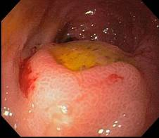
Diagnosis of H. pylori

Slide 13
Therapy of peptic ulcer
Definition: ulcer which occur in presence of acid and pepsin (penetrate muscularis mucosa).
It is defined as a chronic inflammatory condition characterized by ulceration in regions of the upper gastrointestinal tract where parietal cells secrete pepsin and hydrochloric acid. The most common sites are the duodenum and stomach.
Types:
1-Acute : ( superficial gastric erosions): due to
*ulcerogenic drugs e.g NSAID and aspirin
*Stress ulcer e.g MI, hypotension due to hemorrhage….etc.
2-chronic ulcer

Slide 14
Definitions
Ulcer:
A lesion on an epithelial surface (skin or mucous membrane) caused by superficial loss of tissue.
Erosion:
A lesion on an epithelial surface (skin or mucous membrane) caused by superficial loss of tissue, limited to the mucosa.

Slide 15
Definitions
Peptic Ulcer
An ulcer of the alimentary tract mucosa, usually in the stomach or duodenum, & rarely in the lower esophagus, where the mucosa is exposed to the acid gastric secretion
It has to be deep enough to penetrate the muscularis mucosa

Slide 16
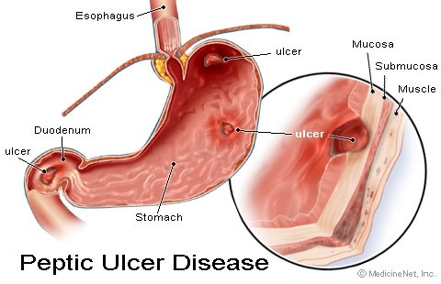
Peptic Ulcer Disease

Slide 17
Sites of peptic ulcer :
DU-GU-……….
Path physiology of peptic ulcer :
Normally there is balance between :
1) Defensive mechanism in the stomach due to
*mucosa secrete mucous and bicarbonate
*mucosa rapidly replaces damaged epithelial cells
*mucosa synthesizes PGE1 and PGE2 which (stimulate synthesis and secretion of mucous and bicarbonate and increases gastric blood flow)
So, mucous and bicarbonate form protective gel like over the mucosa which with the epithelial cells tight junction form mucosal barrier which prevent (back diffusion of acid (H) , also Na and K diffusion to gastric mucosa)

Slide 18
2)Aggressive factors in the stomach:
*secretion of HCL and pepsin(proteolytic enzyme)
*infection of the stomach specially in the duodenum with helicopacter pylori (G-ve bacilli)
So, etiology of peptic ulcer is due to :
Etiology:
Major causes of peptic ulcer:
• H. pylori infection (previously discussed)
• Aspirin and other Non steroidal anti-inflammatory drugs (NSAIDs). Most of drug induced ulcers are dose related. They decrease mucosal resistance (main factor in GU
• Acid hypersecretory states such as Zollinger-Ellison syndrome. (gastrin hormone production)
• Up to one-fourth of ulcers are idiopathic.

Slide 19
• excess vagal stimulation (stress and anxiety)
• decreased gastrin and histamine destruction as in liver cell failure and hepatic cirrhosis
• allergic conditions (histamine)
The two most common causes of PUD are:
  Helicobacter pylori infection ( 70-80%)
  Non-steroidal anti-inflammatory drugs (NSAIDS)
The majority of PUD patients are H. pylori infected
N.B.:
Cyclooxygenase-2 (COX-2) inhibitors: Celecoxib, rofecoxib, and valdecoxibe are NSAIDs that selectively inhibit cyclooxygenase-2 (COX-2)-the principal enzyme involved in prostaglandin production at sites of inflammation-while sparing cyclooxygenase-1 (COX-1), the principal enzyme involved in the synthesis of prostaglandins important in gastric cytoprotection.

Slide 20
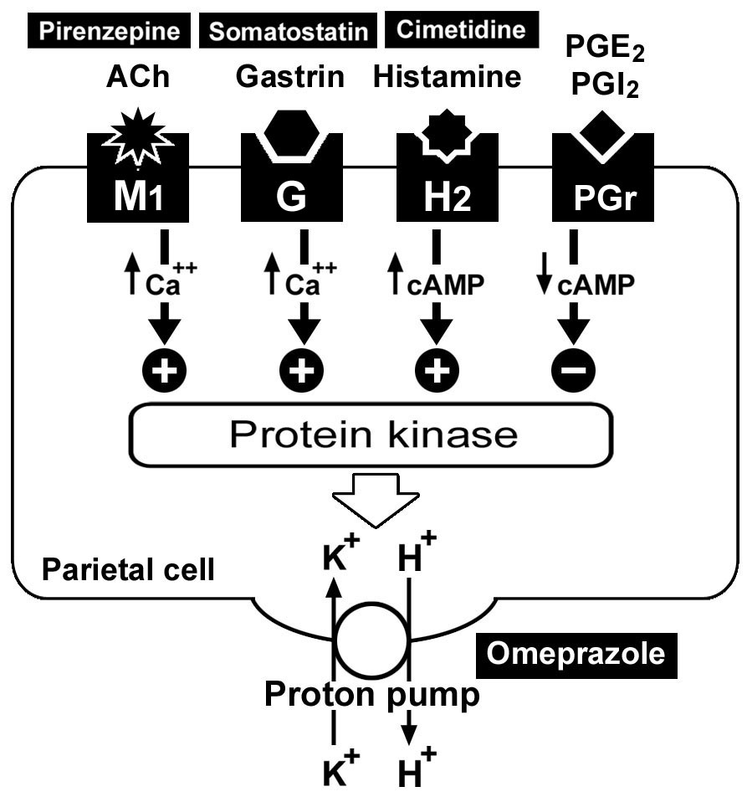
Regulation of HCl secretion

Slide 21
Pathology:
Ulcers extend through the muscularis mucosae and are usually over 5 mm in diameter. Ulcers
occur five times more common in the duodenum than the stomach. Over 95% of the duodenal
ulcers are in the bulb or pyloric channel.
Incidence:
Peptic ulcer disease (PUD) is a common disorder that affects millions of individuals worldwide
Although ulcers can occur in any age group, duodenal ulcers most commonly occur between the ages of 30 and 55, whereas gastric ulcers are more common between the ages of 55 and 70.

Slide 22
Complications of peptic ulcer:
• Hemorrhage:
- Is the most common complication, it is an emergency situation and is lethal in I 0% of
patients, the mortality increases with age.
It presents with anemia with occult blood in stools, hematemesis, vomiting of coffee
ground material, melena or with shock.
Treatment:
The patient needs to be admitted to the ICU, resuscitated by fluids and blood.
Endoscopy upper GI to know the cause of the bleeding, should b e done Intravenous proton pump inhibitors.
• Perforation :
- It usually presents with sudden onset of severe abdominal pain; ileus and board like
rigidity of the abdominal wall.
- The first presentation may be shock and septicemia.
Polymorph nuclear leukocytosis and raised serum amylase may be found.
- Plain X-ray abdomen in the erect position may show air under the diaphragm.
- Management:
Nasogastric tube to empty the stomach and prevent further peritoneal soiling. IV fluids
and broad spectrum antibiotic, followed by surgical closure and omental patch.
• Penetration:
Into the pancreas or the biliary system presents with increasing severity of the pain
with radiation to the back and symptoms and signs of pancreatitis and cholangitis.

Slide 23
• Gastric outlet obstruction:
- It presents with epigastric fullness, vomiting of foul odor of previously ingested food with alkalosis , loss of weight is seen in longstanding cases.
- The obstruction may be due to edema and inflammatory reaction around the ulcer.
- Barium meal and endoscopy are diagnostic.
- Management:
Naso-gastric suction for one week combined with IV fluid replacement and proton pump inhibitors. The most common cause is fibrosis and scarring and this needs
endoscopic balloon dilatation or surgery.
• Malignant change in gastric ulcer

Slide 24
Clinical picture of peptic ulcer:
(A) Typical presentations:
Symptoms: Patients can be asymptomatic or have anorexia, nausea, vomiting, heartburn or epigastric pain.
Ulcer pain or ulcer dyspepsia:
*etiology : due to contact of acid with exposed nerve ending in the base of the ulcer
*character: deep seated burning sensation(may be dull-colicky-stabbing), differ in DU and GU as follow :
1-Time :
* DU pain occur 0 .5- 2 hours after meal (hunger pain) to buffer hyperacidity. Also occur at night (nocturnal pain which awake patient at midnight)
*GU pain occur 0.5-1 hour after meal.

Slide 25
2-Site :
*DU: epigastric pain to the right of middle line
*GU: epigatric pain to the left of middle line
3- What increases?
DU: hunger, irritant foods, smoking, stress, tea, coffee, drugs….. *
* GU: food (why?) + …….
4-What decreases?
DU: alkalies and eating
Gu:alkalies and vomiting
5-Signs:
Localized tenderness at the site of pain (left or right)
6- Appetite:
Du: weight gain
GU: weight loss

Slide 26
(B) Atypical presentation:
*Painless ulcer: may be (bleeding, perforation, DM….etc
*Complicated ulcer:
1-GIT bleeding: may be
--Occult blood in the stool
-severe hemorrhage with haematemesis and melena
2-Perforation
3- Malignancy

Slide 27
• Physical examination
It is often normal in uncomplicated peptic ulcer disease. Localized epigastric tenderness to deep palpation may be present. Pointing tenderness in the epigastrium in D.U.
Signs of complication:
Pallor due to anemia due to chronic blood loss.
Haematemsis and melena.
Gastric carcinoma in gastric ulcer.

Slide 28
Investigations:
1- Laboratory findings:
Microcytic hypochromic anemia may occur with blood loss from a bleeding ulcer .
Leukocytosis suggests ulcer penetration or perforation.
An elevated serum amylase in a patient with severe epigastric pain suggests ulcer penetration into the pancreas.
A fasting serum gastrin level to screen for Zollinger-Ellison syndrome is needed in some patients with recurrent intractable ulcers .
2-Endoscopy:
Upper endoscopy is the procedure of choice for the diagnosis.
Duodenal ulcers are virtually never malignant and do not require biopsy. However, biopsies of gastric ulcers are performed to rule out malignancy.
•Imaging: Barium upper gastrointestinal series has limited accuracy .
•Testing for H pylori: (Discussed previously)

Slide 29
The differences between DU and GU can be slight, making differentiation difficult based on symptoms alone so, the accurate diagnosis depends on radiological (barium meal) or endoscopic visualization of the ulcer.

Slide 30
Treatment Goals
Rapid relief of symptoms
Healing of ulcer
Preventing ulcer recurrences
Reducing ulcer-related complications
Reduce the morbidity (including the need for endoscopic therapy or surgery)
Reduce the mortality

Slide 31
General measures :
1-rest "
*mental (in some cases we can use minor tranquilizers as diazepam to relieve pain and improve healing)
*physical (rest in bed in case of acute hemorrhage)
2-diet
*give small frequent light meals for DU patient (why?)
in order to buffer high acidity.
*avoid heavy meal , irritant, spices

Slide 32
3-habits:
Avoid smoking, alcohol, carbonated water , xanthine beverages as coffee, tea, cola)
4-drug avoidance:
(parasympathomimetics , reserpine, xanthenes, all anti-inflammatory drugs (steroids and NSAID) caffeine. morphine, and nicotine (nicotine increases HCl secretion). .KCL, digestants,

Slide 33
Drugs Used For Treatment of Peptic Ulcer
Medications that decrease acid secretion:
  proton pump (H+/K+ ATPase inhibitors)
  H2 receptor antagonists
  anticholinergic drugs.
Drugs enhancing mucosal defense mechanisms:
  Antacids (drug raising intragastric pH).
  Sucralfate
  Colloidal bismuth compounds.
  Prostaglandins analogues.
Antimicrobials that are effective in eradication of H. pylori:
  Amoxicillin, tetracycline (doxycycline), bismuth subsalicylate, metronidazole& clarithromycin.

Slide 34
MEDICATIONS THAT DECREASE ACID SECRETION
PROTON PUMP (H+/K+ ATPASE) INHIBITORS (PPIs) e.g.
(Omeprazole, lansoprazole, pantoprazole, rabeprazole and esomeprazole).
Mechanism of Action
They are prodrugs absorbed from the intestine, then diffuse across gastric parietal cell, they convert into active metabolites in gastric mucosa and bind to parietal cell H+/K+ ATPase ( binds irreversibly to H+/K+ ATPase enzyme) leading to dose-dependent inhibition of both basal and stimulated gastric acid secretion and can reduce acid secretion almost to zero for 1 –2 days.
Full restoration of acid secretion after discontinuing the PPI takes about 3-5 days (time of re-synthesis of H+/K+ ATPase).

Slide 35
Uses
1-Gastric and duodenal ulcer.
2-Stress ulcer. (drug of choice)
3-Gastro- esophageal reflux disease (GERD).
4-With ulcerogenic drugs e.g. antirheumatics as a prophylaxis against injury of gastric mucosa.
5-Pathological hypersecretory syndrome “Zollinger Ellison Syndrome".
6-With antimicrobial regimens to eradicate H. pylori.
7-Eradication of H. pylori.

Slide 36
Adverse effects
1-Low incidence of diarrhea, abdominal colic, headache, dizziness, skin rash, leucopenia, transient increase of liver enzymes (Short term use <12 weeks)
2-A dose- dependent decrease in vit B12 absorption has been observed after more than 12 weeks because acid is important for its absorption in a complex with intrinsic factor.

Slide 37
3-The PPIs profoundly inhibit gastric secretion and may alter the bioavialability of orally administered drugs, such as ketoconazole, digoxin, iron.
4-Omeprazole selectively inhibits hepatic P450 isoenzymes and decreases the elimination of phenytoin, diazepam, warfarin, and cyclosporine.
5-In rats’ in high doses induce gastric carcinoid tumor.

Slide 38
H2-RECEPTOR ANTAGONISTS e.g.
Cimetidine, Ranitidine, Famotidine and nizatidine
Pharmacological Actions
1-Competitive block of H₂ receptors
2-Endocrine action and Enzyme inhibition ( for cimetidine only).

Slide 39
Pharmacological Effects
A Effects due to H₂-blockade:
Block of H2 receptors of parietal cells of gastric mucosa, reduces gastric HCl secretion induced by different stimuli.
Block H2 receptors on mast cells, thus may exaggerate histamine release during hypersensitivity reactions.

Slide 40
B Endocrine effects:(occur following use of very high doses of cimetidine)
*Block of androgenic receptors:
 decreases libido, sperm count and produces impotence
*Hyperprolactinaemia:
 produces galactorrhea in female and gynaecomastia in male.

Slide 41
C Enzyme inhibition: ( These effects occur following use of cimetidine)
*Inhibits cytochrome oxidase P-450 hepatic microsomal enzyme system, this will lead to inhibition of the metabolism of some drugs metabolized by this enzyme system e.g. β-blockers, Ca²⁺ channel blockers, sulphonylureas, warfarine, ... etc.
*Decreases glucouronation of acetaminophen. Thus may increase its effect.

Slide 42
Therapeutic Uses
1-Duodenal and gastric ulcers.
2-Zollinger-Ellison syndrome (gastrin-secreting tumour which increases HCl secretion) usually larger doses are required according to the severity of the condition.
3-Reflux oesophagitis.
4-Gastritis.
5-With ulcerogenic drugs e.g. antirheumatics as a prophylaxis against injury of gastric mucosa
6-Prophylaxis against gastric ulceration and bleeding in stress (e.g. after burns , trauma or major surgery) and bleeding oesophageal varices.
7- Eradication of H. pylori infections.

Slide 43
Side Effects
1-Nausea, vomiting and diarrhea, but constipation is less common.
2-Antiandrogenic side effects observed with very high doses (cimetidine).
3-Hyperprolactinaemia leading to gynecomastia (male) & galactorrhea (female) (cimetidine).
4-Metabolic enzyme inhibition with subsequent drug interactions (cimetidine).

Slide 44
5-Myalgia, arthralgia and fatigue.
6-CNS:
headache, slurred speech, delirium, confusion and occasionally coma (particulary cimetidine).
Occur primarily in elderly patients and after I.V. administration.
7-Granulocytopenia and aplastic anaemia.
8-Liver: reversible hepatitis, cholestasis.

Slide 45
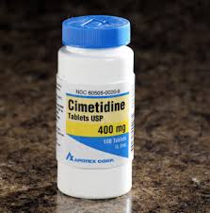


Slide 46
Precautions
It crosses the placenta and passes with milk, so, better avoided during pregnancy and lactation.
Rebound ulcers due to sudden withdrawal of the drug are possible.
RANITIDINE
It is more potent than cimetidine.
The oral dose in peptic ulcer is 300 mg for 4-8 weeks, then, 150 mg daily for 6 months or more as maintenance dose.
)Ranitidine doesn’t significantly affect the cytochrome oxidase P-450, thus the subsequent drug interactions are not reported. The risk of untoward antiandrogenic effects and hyperprolactinaemia from ranitidine use appears to be minimal(.
Adverse CNS effects of cimetidine have been less reported.

Slide 47
FAMOTIDINE
It is the most potent.
It has a longer half-life than cimetidine or ranitidine.
Pharmacodynamics and adverse effects are similar to those of ranitidine, without any antiandrogenic or enzyme inhibitory effects.
NIZATIDINE
Similar to ranitidine in pharmacological action and potency.
In contrast to cimetidine, ranitidine and famotidine, which are metabolized by the liver, it is eliminated principally by the kidney.

Slide 48
ANTICHOLINERGIC DRUGS
(Pirenzepine and telenzepine)
Mechanism of Action
Selective blocker of peripheral M1 muscarinic receptors of gastric parietal cells, so it suppresses basal gastric acid secretion with less effect on secretion stimulated by food in the stomach.
Uses
Useful in patients refractory to treatment with H2-receptor antagonists alone or those with nocturnal pain.
(Because of their relatively poor efficacy and undesirable side effects they rarely are used).
Side Effects
Untoward effects of cholinergic blockade (dry mouth, mydriasis, glaucoma, constipation, tachycardia and urine retention).

Slide 49
DRUGS ENHANCING MUCOSAL DEFENSE MECHANISMS
1- ANTACIDS
They are weak bases that neutralize gastric acidity increasing pH of the stomach to 5 or above leading to decrease total acid delivery to the duodenum and inhibit pepsin activity, so decreasing pain associated with ulcer and may promote healing
Classification
Antacids are classified into systemic (absorbable) e.g. NaHCO3 and Calcium carbonate and non-systemic (Non-absorbable), e.g. salts of aluminum and magnesium.

Slide 50
Sodium bicarbonate (NaHCO3)
It is an absorbable antacid, with rapid onset of action increasing gastric pH into 5-7 with short duration of action.
It may induce (systemic alkalosis, sodium retention, release of Co2 leading to rebound hyperacidity and perforation).
It is contraindicated in hypertension, heart failure and renal failure………..(why?)
Calcium carbonate
Partially absorbable antacid, with relative rapid onset of action.
Ca++ may act directly to stimulate secretion and to release gastrin leading to rebound hyperacidity.
Contraindicated in patients with renal disease.

Slide 51
Magnesium salts
Magnesium hydroxide:(Milk of magnesia)
Non-absorbable antacid has rapid onset of neutralization increasing pH up to 8-9.
Magnesium oxide and magnesium trisilicate:
neutralize acid slowly and have slow onset of action, and long duration. Magnesium trisilicate also coats base of ulcer by Sico₂ (Physical action).
*They increase gut motility and produce diarrhea.

Slide 52
Aluminum hydroxide
It is a non-systemic antacid neutralizing HCI, binds bile, pepsin and so, It has direct cytoprotective action
It binds phosphate, so it is used as antacid and to decrease hyperphosphatemia in chronic renal failure.
*It induces constipation
Antacid combinations e.g. gaviscon

Slide 53
Gaviscon (Alginic acid + Mg trisilicate + Al-hydroxide gel + NaHCO3)
Alginic acid in presence of saliva and NaHCO3 forms a highly viscous foamy solution of Na-alginate into which liberated CO2 is trapped and the material swells and floats on the gastric content as a raft, which prevents gastric reflux.

Slide 54
Uses of Antacids
Symptomatic treatment of gastric, duodenal ulcer and oesophagitis

Slide 55
Adverse Effects of Antacids
1-Change in bowel habits
e.g., AL & Ca based antacids cause constipation, while Mg-based causes diarrhea. Either combining or alternating compounds with these effects can treat this problem.
2-Cation absorption (Na, Ca, Mg, Al)
*Increase Ca++ leads to systemic hypercalcaemia with formation of calculi and milk alkali syndrome especially in renal impairment.
*Increased Mg++ causes muscle weakness and fatigue
*Increased Na+ absorption leading to systemic alkalosis.
3-AL binds phosphate and prevents its absorption leading to hypophosphatemia with muscle weakness and resorption of bone.
4-Rebound hypersecretion of HCl with Ca++ and NaHCO3 containing antacids.

Slide 56
Drug Interactions
Ca, AL and Mg, decrease absorption of tetracycline, Al (OH)3 decrease absorption of digoxin, isoniazid (INH), warfarin, anticholinergic drugs and iron.
The increase in gastric pH decrease the absorption of acidic drugs.
Systemic antacids increase excretion of drugs e.g quinidine.

Slide 57
SUCRALFATE
Mechanism of Action
1-In the presence of acid it acts to protect the gastric and duodenal mucosa from acid pepsin attack through formation of complex with proteins at the ulcer site (ulcer crater) to form a protective layer against acid, pepsin, bile.
2-It decreases back diffusion of H⁺ and binds to pepsin, bile salts
3-It increases secretion of endogenous prostaglandins.

Slide 58
Pharmacokinetics
Slightly absorbed from G.I.T, excreted in stools and urine.
Uses
In duodenal and gastric ulcer to promote healing and decrease recurrence.
Adverse Effects
It has few side effects as it is not absorbed systemically and acts locally:
1-Constipation
2-decreased bioavailability of tetracycline, digoxin and phenytoin can occur. This is due to decreased rate of absorption of these drugs if they are administered concurrently with sucralfate.

Slide 59
BISMUTH SUBSALICYLATE
Mechanism of Action
1-In the presence of acid, they act locally by selective binding with exudates, mucus and protein in the base of the ulcer crater, coating and protecting it from acid and pepsin. (as ?)
2-It inhibits pepsin activity and increase mucus and PG synthesis.
3-It has some antimicrobial activity against gastric Helicobacter pylori.
Uses
Promoting healing of duodenal ulcer and gastric ulcer.
Adverse Effects
Minimal effects e.g. stool and teeth discoloration (black).
Chronic use causes encephalophathy especially in renal failure due to accumulation of bismuth.

Slide 60
Sucralfate and colloidal bismuth compound are not given simultaneously with antacids or H2-receptor antagonists (at least 30 minutes must be elapsed in-between).

Slide 61
CARBENOXOLONE (It is liquorice derivative )
Mechanism of Action
It increases production, secretion and viscosity of mucus, so increases mucosal resistance. In addition, it affects the metabolism of PG E, F and decreases pepsin activity.
Uses
Treatment of gastric ulcer
Treatment of oesophagitis
Treatment of duodenal ulcer.
Adverse Effects
Na+-retention and hypokalemia (aldosterone-like effect):
 This leads to edema, hypertension and heart failure especially in elderly and in cardiac, renal and hepatic patients.

Slide 62
PROSTAGLANDINS ANALOGUES
Synthetic PGE1 analogue (Misoprostol)
Mechanism of Action
1-Inhibition of gastric acid secretion by the parietal cells due to inhibition of histamine stimulated cAMP production.
2-Cytoprotective effect on gastric and duodenal mucosa with increased mucus and bicarbonate secretion
3-Maintains gastric mucosal blood flow and stimulates mucosal cellular regeneration.

Slide 63
Uses
Treatment of peptic ulcer
Prevention and treatment of mucosal damage induced by NSAID.
Adverse Effects
1-Diarrhea due to promoting secretion of fluid and electrolyte into the lumen of bowel and decreasing intestinal segmentary contractions that retard flow of luminal contents.
2-Uterine contractions and abortion So, It is contraindicated during pregnancy

Slide 64
ANTIMICROBIALS USED TO ERADICATE ULCER
Suppression of acid secretion will heal the ulcers, but………
long-term cure requires eradication of H. pylori, if that is the cause of ulcer.
Amoxicillin, tetracycline (doxycycline), bismuth subscitrate, metronidazole & clarithromycin.
1-Currently, either triple therapy consisting of a PPI with metronidazole or amoxicillin or clarithromycin, or
2-quadruple therapy of bismuth subscitrate and metronidazole plus tetracycline plus an H2 antagonist or a PPI, are administered for a two-week course.

Slide 65

Thank you

