Slide 1
Therapy of bronchial asthma
By
Dr. Mohamed Abd AlMoneim Attia

Slide 2
Definition
Asthma is a chronic inflammatory airway disease in which many cells play a role in particular mast cells, eosinophils, and T lymphocytes with the following characteristics :
  Periodicity of symptoms.
  Airflow obstruction.
  Diurnal variability of symptoms.
  Airway hyperresponsiveness.

Slide 3
Burden (epidemiology) of Asthma
Asthma is one of the most common chronic diseases worldwide with an estimated 300 million affected individuals
Prevalence increasing in many countries, especially in children
A major cause of school/work absence
Wide variation in disease incidence and prevalence allover the world.
The prevalence of the disease is increasing worldwide over the last few decades.

Slide 4
(N.B)Lung innervations:
Air ways are rich supplied with afferent and efferent vagal nerves responsible for bronchoconstriction (parasympathetic tone) ,so M₃ blockers can dilate the constricted air ways.
In contrast, noradrenergic sympathetic innervations of air way is sparse, whoever β₂ adrenergic receptors are present in airways.
Airway cell surface have receptor for adenosine which causing contraction of airway smooth muscle and histamine release from airway most cell.

Slide 5
Etiology
Due to a combination of genetic and environmental factors.

Slide 6
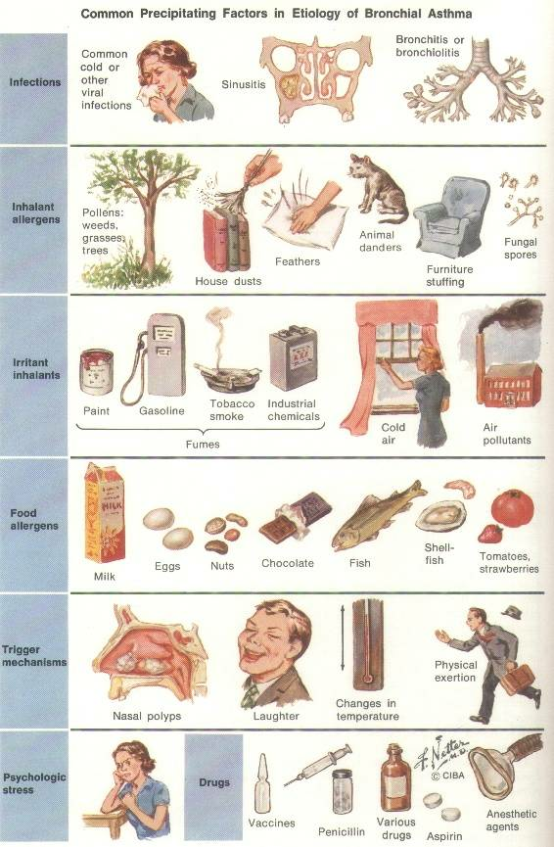
2-Environmental Factors
Indoor allergens
Outdoor allergens
Occupational sensitizers
Tobacco smoke
Air Pollution
Respiratory Infections
Parasitic infections
Socioeconomic factors
Family size
Diet and drugs
Obesity
Indoor allergens
Outdoor allergens
Occupational sensitizers
Tobacco smoke
Air Pollution
Respiratory Infections
Parasitic infections
Socioeconomic factors
Family size
Diet and drugs
Obesity

Slide 7

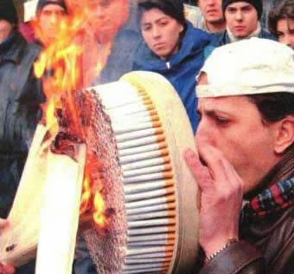

Slide 8
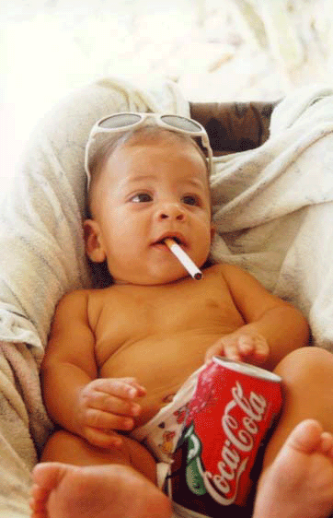

Slide 9
Factors that Exacerbate Asthma
Allergens
Respiratory infections
Exercise
Weather changes
Food, additives Sulfur dioxide and drugs
Psychological ? (40%)

Slide 10
Definition: paroxysmal reversible generalized obstructive airway disease.
Causes:
1-Extrinsic= atopic=secondary to hypersensitivity to one or more antigens e.g. pollen grain.
2-Intrinsic=cryptogenic=secondary to non antigenic etiology e.g. neuronal imbalance.
Pathology: bronchospasm, mucosal oedema and viscid sputum.

Slide 11
Pathophysiology
Best described as chronic eosinophilic bronchitis/bronchiolitis.
Airway obstruction due to:
1- Smooth muscle contraction.
2- Mucosal edema.
3- Lumen secretion.

Slide 12
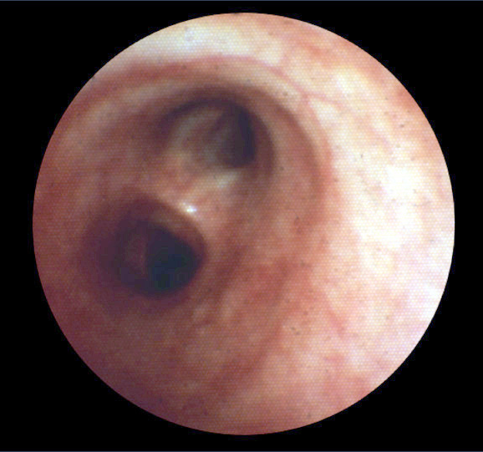
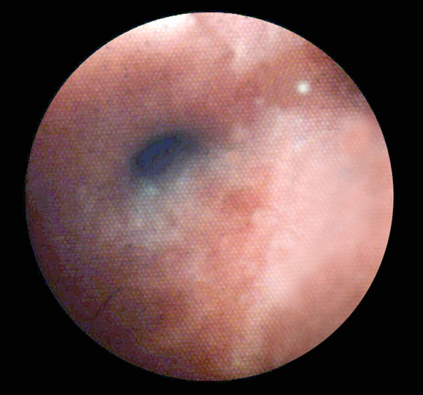
Bronchoconstriction
Before
10 minutes after allergen challenge

Slide 13
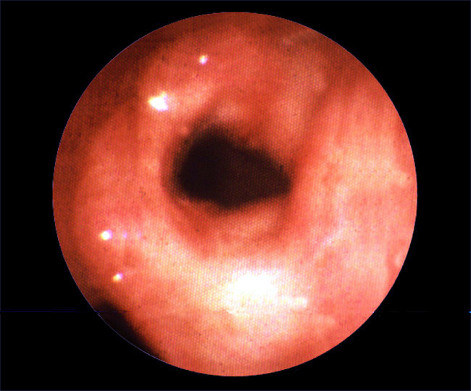
Airway mucosal oedema

Slide 14
Pathogensis of atopic asthma:
Early or immediate phase (bronchospasm): due to mediators release from mast cells as histamines and leucotriens.
Late phase (inflammation): due to release of secondary mediators e.g. cytokines and interleukins.

Slide 15
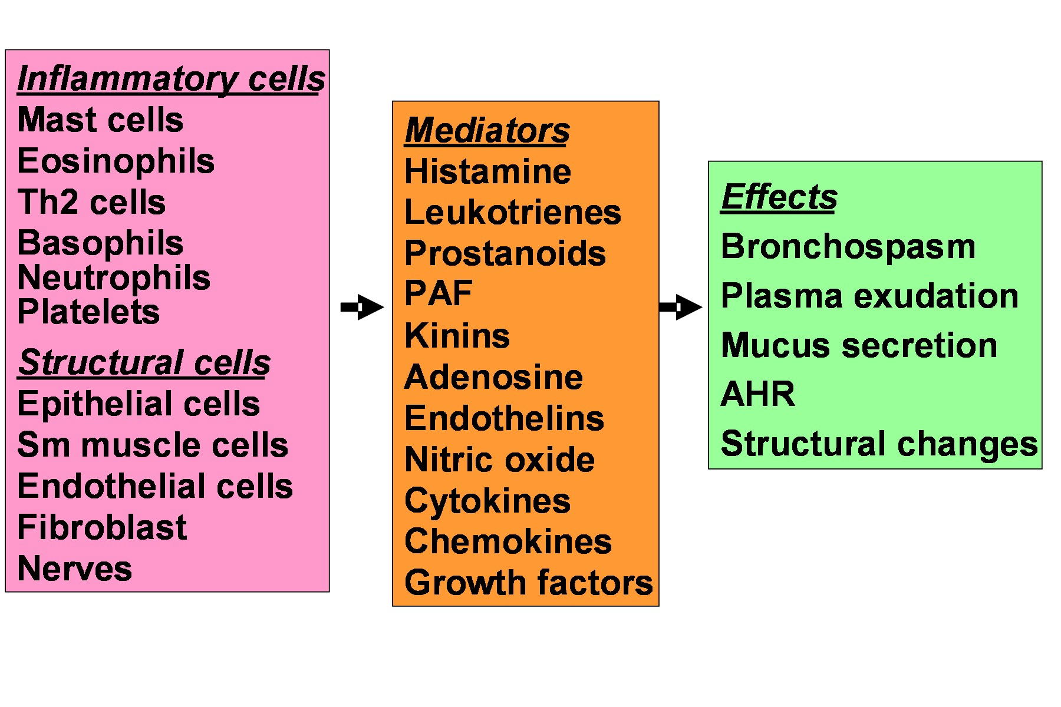
Cells and Mediators

Slide 16
Symptoms
Cough
Dyspnea
Wheeze
“…he found himself getting out of breath and feeling wheezy…”

Slide 17

Nocturnal
Symptoms
Cough
Dyspnea
Wheezes

Slide 18
Signs “In-between the attacks”
Patient may be entirely normal on examination .

Slide 19
Signs “during acute asthma”
General examination: Tachypnea, tachycardia, use of accessory muscle of respiration.
“His pulse was 100/minute, respiratory rate 22/min….”
Local (Chest) examination:
  1- Inspection: Hyper expanded chest
  2- Palpation: Limited chest expansion
  3- Percussion: Low diaphragm
  4- Auscultation: Expiratory wheeze, may be silent chest (life threatening asthma)

Slide 20
Is it Asthma?
Recurrent episodes of wheezing
Troublesome cough at night
Cough or wheeze after exercise or chest tightness after exposure to airborne allergens or pollutants

Slide 21
Asthma Diagnosis
History and patterns of symptoms
Measurements of lung function
- Spirometry
- Peak expiratory flow
Measurement of airway responsiveness
Measurements of allergic status to identify risk factors
Extra measures may be required to diagnose asthma in children 5 years and younger and the elderly

Slide 22
A- Clinical manifestations
  Attacks of expiratory dyspnea
  Shortness of breath
  Cough
  Chest tightness
  Wheezing (high-pitched whistling sounds when breathing out)

Slide 23
C-Lab. Investigations
  1-Blood:
  Eosinophilia,
  Moderate leukocytosis
  Increased serum level of Ig E.
  2-Sputum:
  Inflammatory cells,
  Curschmann's spirals (viscous mucus which copies small bronchi)
  Charcot-Leyden crystals (crystallized enzymes of eosinophils and mast cells).

Slide 24
D- Chest X-ray reveals:
Hyperlucency of lung fields
Low standing and limited mobility of diaphragm
Expanded intercostal spaces
Horizontal rib position.

Slide 25
Classification of bronchial asthma:
A. According to aetiology:
Extrinsic asthma (allergic): It is due to allergy to antigenic substances in the inspired air e.g. pollens, animal feather, drugs, or home dust mite.
Intrinsic asthma (non-allergic): bronchospasm can be evoked by internal causes. It is common above 40 years and have bad prognosis.
B. According to clinical severity:
Mild asthma: patient has bronchoconstrictive episodes <2 times/week and is asymptomatic between attacks.
Moderate asthma: patient has bronchoconstrictive episodes >2 times/week and symptoms requiring inhaled beta agonists daily.
Severe asthma: patient has continuous symptoms, Hospitalization may be required.
C. According to clinical presentation:
Acute asthma.
Chronic asthma.
Acute severe asthma (status asthmaticus): is a condition in which bronchodilators are ineffective in relieving the attack after 24 hrs.

Slide 26
Treatment
Non drug treatment :( EDUCATION)
avoid exposure to antigen .
avoid humidity.
Avoid drugs which precipitate asthma as (parasymathomimetics-ββ-PGF2α- -histamie releasers as morphine ,curare, Drugs that cause allergic reactions e.g. penicillins, cephalosporins..etc Salicylate and other NSAIDs [they can induce asthma through increased synthesis of leukotrienes].
Psychotherapy.(40%)

Slide 27
( 2) drug treatment:
Bronchodilators:
Anti-inflammatory as (corticosteroids –mast cell stabilizers-leukotrien antagonists).
Others:
Expectorants and mucolytics
Antibiotics
O2 and Helium
tranquilizers

Slide 28
I. BRONCHODILATATION
There are three groups of bronchodilator drugs;
(1) B-adrenergic agonists.
(2) Muscarinic receptor anatgonists.
(3) Methyl xanthines: theophylline derivatives.

Slide 29
β-ADRENERGIC AGONISTS: are classified into:
1- NON-SELECTIVE β-STIMULANTS i.e stimulate β receptors and other receptors: (Epinephrine –Ephedrine )
2- BETA STIMULANTS SELECTIVE FOR RESPIRATORY TRACT : ( Salbutamol -Terbutaline and Bambuterol (similar to turbutaline but it is a prodrug)

Slide 30
Mechanism of action role of β receptors in the bronchi:
Binding of adrenergic β-agonist with β receptors ctivate adenyl cyclase which
converts adenosine triphosphate to cAMP which will lead to:
Relaxation of airway muscles.
Inhibition of release of the mediators from mast cells

Slide 31
Non selective β agonists:
EPINEPHRINE (ADRENALINE)
It directly stimulate alpha and beta adrenoceptors.
Pharmacological Effects:
2- Respiratory system
Tracheobronchial tree: bronchodilatation (β2) and decongestion( v.c of blood vessels)(α₁).
2- Anti-allergic effect:
It is the physiological antidote to histamine i.e. it antagonizes the effects of histamine by acting on adrenergic receptors and not on histamine receptors.

Slide 32
Therapeutic Uses
  1-Acute attack of bronchial asthma (S.C, I.M, inhalation)
  2-Treatment of allergic reaction e.g. urticaria, angioedema, anaphylactic shock.
1 ml from 1/1000 solution S.C. every 15-30 min.

Slide 33
Side Effects( due to non selectivity)
Tachycardia, palpitation, anxiety, headache, tremors, hypertension.
Contraindications
Heart diseases.
Hypertension.
Pulmonary embolism. Etc……….

Slide 34
SELECTIVE β₂ AGONISTS
The selective β₂ agonists have replaced non-selective β -agonists because they have the following advantages:
They induce selective effect on airway with least systemic effect, so they can be given to hypertensive patients.
These agents are used to treat acute episodes of bronchial asthma and prophylactically to prevent airway obstruction.
The short acting selective β2 (salbutamol, terbutaline, fenoterol) can given by inhalation , orally, SC and by I.V infusion.
The long acting (salmeterol & formoterol) have long duration of action (12 hrs) and administrated by inhalation only.

Slide 35
Adverse effects:
Tremors of skeletal muscle, nervousness and weakness.
Tachycardia secondary to hypotension produced by skeletal vasodilatation.
Hypokalemia
Tolerance may occur with prolonged use but temporary cessation of drug restores its original effectiveness.
All selective β₂-agonists lose its selectivity when it is given in large frequent doses especially in aerosols.

Slide 36
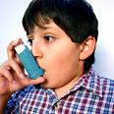
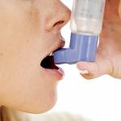


Slide 37
Muscarinic receptor antagonists(Block of M₃ receptors):
May be (A) non selective as atropine. Atropine blocks the muscarinic receptors in airways leading to bronchodilatation through unopposed β₂ actions but has a lot of side effectse.g.:
Dryness of the mouth.
Skin flushing: children are more susceptible to develop coetaneous V.D which makes the child flushed.
Retention of urine especially in patients with enlarged prostate.
Acute attack of glaucoma in patients who have or susceptible to glaucoma.
Constipation.
Blurred vision is common adverse effects in all age groups.
makes the sputum viscid and difficult to expel in asthmatic patients.

Slide 38
B) selective as (Ipratropium- Tiotropium)
Ipratropium is a quaternary antimuscarinic agent used by inhalation to reduce bronchoconstriction in asthma and chronic obstructive pulmonary disease (COPD). Although not as efficacious as beta gonists, ipratropium is less likely to cause cardiac arrhythmias. It has very few antimuscarinic effects outside the lungs because it is( quaternary) i.e poorly absorbed and rapidly metabolized. Ipratropium is less effective than β₂ adrenoceptor agonists so it is not administered alone.
In contrast to ipratropium, tiotropium has a longer bronchodilator action and can be given once daily (longer duration). Tiotropium reduces the incidence of COPD exacerbations.

Slide 39
XANTHINES
Classification:
Natural: there are three pharmacologically important xanthines:
Caffeine; present in tea, coffee, cacao and cola drink.
Theophylline.
Theobromine.
Synthetic: aminophylline

Slide 40
Mechanism of action:
They block cell surface receptor for adenosine (Adenosine causes contraction of airway smooth muscle, enhances histamine release from cells present in the lung).
They inhibit the enzyme phosphodiestrase (PDE) leading to an increase in the intracellular cAMP level which lead to relaxation of airway muscles and inhibition of release of the bronchoconstrictor substances from the mast cells.
They stimulate the release of catecholamines from adrenal medulla and inhibit COMT enzyme leading to bronchodilatation.
Theophylline improves diaphragmatic contraction and reduces respiratory muscle fatigue.

Slide 41
Pharmacological effects:
Respiratory effects: thophphylline and aminophylline are potent direct bronchodilators and has some anti-inflammatory action in the air way
CNS effects:
Caffeine and theophylline produce psychomotor stimulant effects.
Reduced fatigue, improved mental performance, increased alertness and power of concentration without euphoria. large doses may produce restlessness, insomnia, headache and convulsions.

Slide 42
CVS effects:
All xanthines, possess an inotropic action. Large and toxic dose may cause extrasystoles. The heart rate is usually increased .
Xanthines cause constriction of the cerebral vessels (mainly caffeine).
And causes peripheral dilatation of the blood vessels. Peripheral dilatation of blood vessels dominates the cerebral vasoconstrictor effect resulting in hypotension.

Slide 43
Smooth muscles: xanthines, particularly theophylline and aminophylline, are direct smooth muscle relaxants, the most prominent effect is on the bronchi.
Skeletal muscles: xanthines, particularly caffeine, cause direct stimulation of the skeletal muscles, this together with the central stimulant action delays fatigue and improves muscle work.
Diuretic action: xanthines cause weak diuresis, this is partly due to increased renal blood flow and partly due to inhibition of sodium reabsorption.
Miscellaneous:
Stimulation of gastric secretion (mainly caffeine).

Slide 44
Therapeutic Uses:
(A) Respiratory uses:
Management of asthma:
Symptomatic relief of acute attack: aminophylline (250 mg) is given by slow I.V infusion (at least over 15 minutes) followed by maintenance I.V infusion of 0.7 mg/Kg/h. also used in all types of asthma.
Treatment of bronchospasm due to chronic bronchitis or emphysema.

Slide 45
(B) CNS uses:
Headache (caffeine + aspirin)
Migraine (Caffeine + ergot
(C) Cardiac uses:
Refractory cases of congestive heart failure (positive inotropic)
(D) Gastrointestinal uses: acute biliary colic

Slide 46
Adverse effects:
GIT: nausea, vomiting, anorexia, reactivation of peptic ulcer.
CVS: palpitations, tachycardia, precordial pain, and arrhythmias. Rapid I.V.injection can cause hypotension, syncope and cardiac arrest.
CNS: irritability, insomnia, nervousness & convulsions.
Respiratory: tachypnea and respiratory arrest at large dose.

Slide 47
II. REDUCTION OF BRONCHIAL INFLAMMATION AND HYPERREACTIVITY
The bronchial hyperactivity and inflammation is controlled or reduced by regular treatment with adrenocortical steroides.

Slide 48
ADRENOCORTICAL STEROIDES
Glucocorticoids have become the cornerstone of therapy of both asthma and allergic rhinitis.

Slide 49
The exact mechanism is not known and may include:
They suppress the immune mechanism and reduce antibody synthesis.
Potentiate the effect endogenous catecholamines by preventing their non neuronal uptake and increase number of β receptors.
Inhibition of the influx of inflammatory cells into the lung and inhibition of the release of mediators from macrophages and eosinophils.
Also, corticosteroids prevent the formation of bronchoconstircting PGs, LTs and platelets activating factor by inhibiting phospholipase A₂ enzyme.

Slide 50
Indications
all types of asthma: may be used systemically as hydrocortisone, prednisolone, dexamethazone
or by inhalation as beclomethazone, fluticasone and triamcinolone (By this method, the drugs exert local action with minimal systemic absorption and reduced adverse effects).

Slide 51
Adverse effects:
These occur if high doses of systemic corticosteroids are used for long duration. They include:
Adrenal suppression, Cushing syndrome, weight gain, salt and water retention, immunosuppression with flare of infection, depression, psycosis, growth retardation in children, peptic ulcer and cataract.
Oropharyngeal candidiasis can occur after inhaled corticosteroid. To be avoided; use mouth wash and gargle after each inhalation. If Candida infection occurs.

Slide 52
LEUKOTRIENE INHIBITORS
Leukotrienes substances serve as mediators in the inflammatory events that contribute to bronchospasm in patients with asthma.
Zafirlukast and montelukast, are leukotriene receptor antagonists.
Zileuton, a leukotriene synthesis inhibitor.

Slide 53
III. PROPHYLACTIC TREATMENT
MAST CELL STABILIZERS:
DISODIUM CROMOGLYCATE
They inhibits or prevents bronchospasm induced by various stimuli including antigens, exercise, cold or dry air. Also, its chronic use may reduce the overall level of bronchial hyperreactivity.

Slide 54
Mechanism of action: stabilizes mast cells so preventing release of mediators induced by antigens & nonspecific stimuli.
This occurs by inhibiting Ca⁺⁺ influx across mast cell membrane. It also suppresses inflammatory cell influx and chemotactic activity as well as antigen induced reactivity.

Slide 55
Therapeutic Uses:
It is used as a prophylactic treatment in case of mild to moderate asthma by inhalation in between the attacks.
Allergic rhinitis or hay fever.
Adverse Effects:
The adverse effects are minor & localized at the site of deposition, in the form of throat irritation, cough, mouth dryness, chest tightness and wheezing.
may lead to bronchospasm. These symptoms can be prevented by inhaling β₂ agonist before cromolyen inhalation.
KETOTIFEN
In addition it has antihistaminic effect due to blockade of hi receptors. It is given orally.
Side effects: sedation, dry mouth & dizziness.

Slide 56
V. OTHER DRUGS USED IN TREATMENT OF BRONCHIAL ASTHMA
Expectorants and Mucolytics: are useful in chronic bronchial asthma to render mucus less viscid and help its expectoration.
Mixture of Oxygen & Helium: Helium is an inert gas. It has low density, this allows O₂ diffusion through an obstructed airways reducing the work of breathing. Inhalation of Mixture of helium (80%) and O₂ (20%) is indicated in severe cases of acute bronchial asthma and status asthmaticus.

Slide 57
Anti-IgE Monoclonal Antibodies as . Omalizumab

Slide 58
N.B:
Antihistamines are not used in bronchial asthma because bronchospasm is not only due to histamine but also due to other mediators. Moreover, antihistamines through their atropine like action decrease bronchial secretion to become more viscid and difficult to be expectorated and blug small bronchiols.

Slide 59
Treatment of acute severe asthma (status asthmatics)
Definition: acute severe asthma (status asthmatics) is a condition in which bronchodilators are ineffective in relieving the attack after 24 hours.
Management:
Hospitalization.
Perform chest X-ray, ECG and blood samples for electrolytes.
Epinephrine SC, if there is no contraindications
Aminophylline: 500mg slowly IV (monitoring of serum levels).
Hydrocortisone: 200mg IV / 6hs.
Salbutamol nebulizer (to allow continuous administration of salbutamol and to allow simultaneous oxygen therapy).
Humidified O₂ or O₂ helium mixture and bronchial lavage.
Sedative as diazepam (5-10mg orally).
Correction of acidosis and dehydration (Na HCO3 & 5% glucose respectively).
Antimicrobials.
Mucolytics and expectorants e.g. bromohexine & guaifenesin respectively.

Slide 60
Thank you

