Slide 1
Liver cirrhosis
By
Dr. Mohamed Abd Almoneim attia

Slide 2
Functions of the liver:
1- Bile metabolism.
2- Protein metabolism:
*formation of albumin (3.5-5.5 g/dl).
*formation of clotting factors (2, 7, 9, 10).
*incorporation of ammonia with CO2 to form urea.
3-fat metabolism.
4- carbohydrate metabolism: gluconeogenesis, glycogen
storage and glucose release.
5-detoxification of (hormones, drugs, and toxic substances).

Slide 3
Clinical Terms
Hepatitis: inflammation of liver; presence of inflammatory cells in organ tissue
Acute Viral Hepatitis: symptoms last less than 6 months
Acute Hepatic Failure: Massive hepatic necrosis with impaired consciousness within 8 wks of onset of illness.
Chronic Hepatitis: Inflammation of liver for at least 6 months
Cirrhosis: Replacement of liver tissue→ fibrosis, scar tissue

Slide 4
Liver cell failure:
1- acute :
Develop within less than 8 weeks in patients without preexisting liver disease and is fatal
2- chronic:
Complicate all forms of liver diseases e.g cirrhosis.

Slide 5
Investigations
Liver function
  Serum transaminase : ALT(alanine transferase) ↑
    AST(aspartase transferase) ↑
  Albumin
  Bilirubin
  Prothrombin time
  Detection of the markers of hepatitis virus
Ultra-sound examination
FibroScan-Non-invasive test of liver fibrosis
Liver biopsy

Slide 6
Liver cirrhosis:
Definition:
1- Pathological: diffuse liver diseases characterized by (degeneration, regenerating nodules, fibrosis and loss
of architecture)
2- Clinical: liver with sharp edge and firm in consistency (shrunken).
Types :
Clinical picture:
1-latent well compensated with no liver functions impairment.
2-active and decompensated : may be :
*loss of functions of liver cells = liver cell failure.
*vascular decompensation:= portal hypertension.

Slide 7
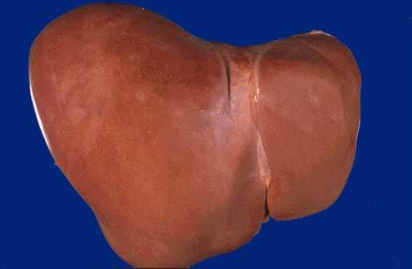
Normal Liver

Slide 8
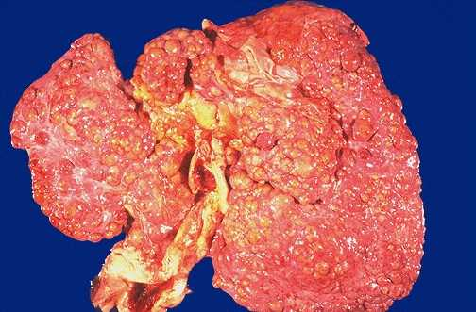
Cirrhosis

Slide 9
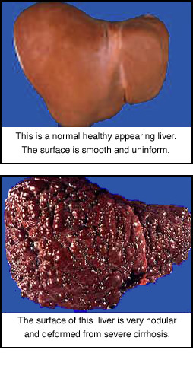
Cirrhosis

Slide 10
Cirrhosis Facts:
Progressive, leads to liver failure
Insidious, prolonged course
9th leading cause of death in U.S.
Twice as common in men
Highest incidence between ages
40 and 60.

Slide 11
Causes of Cirrhosis
Chronic viral hepatitis(HCV, HBV±HDV)
Metabolic: hemochromatosis, Wilson dis, alfa-1-antitrypsin, NASH
Prolonged cholestasis (PBC, PSC)
Autoimmune hepatitis
Hepatic venous outflow obstruction (VOD, BCS, Constrictive pericarditis)
Drugs and toxins
Alcohol

Slide 12
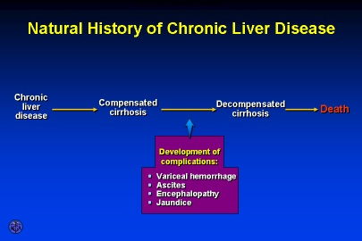

Slide 13
Portal hypertension:
Definition: elevation of hydrostatic pressure within portal vein or its tributaries (normally =5 mmHg so, if portal hypertension = 7 mmHg or 30 CM water)
Anatomy:
Union of superior mesenteric vein and splenic vein behind head of pancreas.
Causes:
*hepatic (cirrhosis)

Slide 14
Clinical picture:
1- congestion:
*gastric: leading to dyspepsia
* intestinal : leading to constipation and diarrhea
*spleen: enlarged spleen (left hypochondreal pain)
hepatosplenomegally
2-rupture esophageal varices:
*dilated elongated tortuous veins in the upper stomach , lower esophageus manifested by haematemesis and melena.

Slide 15
* Esophageal varices may be:
- silent
-repeated insidious hemorrhage leading to iron deficiency anaemia.
-sudden rupture either :
(From within due to sudden increase in portal venous pressure by cough, exercise, or straining) OR erosion from esophegitis due to ( NSAID-hard food or peptic ulcer).
Here patient manifested by bright red blood not stopped spontaneously because of negative intrathoracic pressure which keep veins patent
It can be diagnosed by endoscopy and barium swallow.

Slide 16
Varices

Slide 17
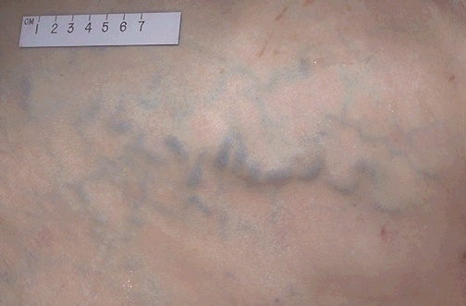
Prominent abdominal veins.

Slide 18
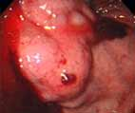
Esophageal Varices

Slide 20
Complications:
Esophageal & Gastric Varices:
  Esophageal: Complex of twisting veins at lower end of esophagus and upper portion of stomach
Most life threatening complication!!
The varices can rupture in 1/3 cases and can lead to death in 50% cases.
Clinical Feature :
*Melena (black color stools)
*Hematemesis
*Hypovolemic shock

Slide 21
Esophageal Varices
Medical Management
Prevent
initial
hemorrhage
Manage
acute
hemorrhage
Prevent
recurrent
hemorrhage

Slide 22
Treatment
A- Stop drugs.
B- treatment of upper GIT bleeding:
Definition: bleeding occur from upper portion of GIT usually (esophagus, stomach, duodenum ) due to:
( rupture esophageal varices, peptic ulcer (gastroduodenal ), systemic cause as NSAID).
Clinical picture:
*Overt bleeding in the form of hematemesis and melena.

Slide 23
Treatment:
A)- Stop acute bleeding:
*Urgent hospitalization, complete bed rest with head lower down with warmth.
*Monitor the vitals signs and Pass I/V line.
* Fresh blood transfusion to supply deficient clotting factors and avoid stored blood which contain ammonia
(may be packed RBCs to maximize O2 delivery)
(don’t give plasma expander which produce dilution of blood coagulation constituents so, increasing bleeding tendency).
*FFP( Fresh Frozen Plasma) can be given in case of thrombocytopenia.
*After restoring blood volume , take blood sample for (clotting and bleeding time and for level of creatinine for acute renal failure).
*Vitamin K (IM) to correct hypoprothrombinemia) , recombinant activated factor 8 to augment initiation of coagulation.

Slide 24
*Suction of blood from the stomach then gastric lavage with cold saline.
*Sedative (if needed give oxazepam not diazepam), never morphine.
*Ranitidine I.V. or PPI : aim is decrease stomach PH to reduce gastric irritation and so, decrease frequency of stress induced mucosal lesions ( surgery , trauma, burn , hemorrhage…_)
*Emergency endoscopy: its aim to detect blood origin , exclude bleeding peptic ulcer from other causes.
* Drug treatment:
Only used to control acute bleeding from rupture esophageal varices due to portal hypertension e.g :

Slide 25
1- Vasopressin: (via V1 receptors):
Mechanism of action:
*V.C of splanchnic blood vessels so, decreasing blood inflow and decrease intravariceal blood flow.
*contraction of esophageal musculature so, collapsing of varices.
*contraction of intestine so, get rid of blood in the bowel.
*V.C of other blood vessels (systemic so, increasing blood pressure , coronary so, producing angina pain, etc….)
* Spasmogenic to other SMF, as uterus leading to its contraction (abortion in pregnant female).
Side effects:
-Abdominal colic, facial pallor, and bowel evacuation (active drug).
-PPT myocardial ischemia.
- abortion in pregnant female.
-antidiuretic action.

Slide 26
2-Glypressin (given bolus):
Vasopressin is released from it over several hours in amounts beneficial to decrease portal venous pressure without systemic side effects.
3-Terlipressin:
Same as vasopressin with slow release with long t1/2 but higher tissue penetration than vasopressin.
4- Somatostatin:
Has short t1/2 so its analogues (octereotide,,….) are used .
It decreases hepatic blood flow, portal pressure in patient with cirrhosis with no alteration of systemic blood pressure.
It causes of v.c of collateral vessels feeding varices.

Slide 27
*Non drug therapy for ROV:
*Sclerotherapy by injecting varices with sclerosant
*Banding - can be performed by putting rings at basis of varices Endoscopic Band Ligation (EBL) .
*Ballon tamponade.
Prophylaxis :
Once the initial episode of bleeding is controlled, the risk of rebleeding is 50-80% without further therapy.
(1) Long term injection sclerotherapy
usually 4-6 treatment one required to prevent rebleeding, but every year endoscopy should be done to see the condition of varices.
*Endoscopy for every cirrhotic patient at diagnosis and periodically
(2)-BB (propranolol, timolol…):
It decrease portal pressure by
*B1 blockade in the heart will decrease COP with decrease hepatic flow.
*Block V.D effect of splanchnic blood vessels B2 leading to unopposed alpha1 action leading to splanchnic V.C.

Slide 28
3- H2 blockers (ranitidine to prevent gastroduodenal erosion)or PPIs.
4-Diuretics (spironolcatne with low Na in diet to decrease blood volume).
5-New treatment to decrease portal pressure by manipulating intrahepatic circulation:
Nitrates………
*Carvedilol………...
*Losartan…………….
*Ritanserin……………..
*Verapamil……………..
*Metoclopramide……………...
*Pentoxiphylline………………………………etc

Slide 29
Shunting Procedures:
Used more after 2nd major bleeding episode
TIPS
  shunt is placed between systemic and portal venous systems
    redirect’s portal blood flow
    reduces portal venous pressure
    decompresses varices

Slide 30
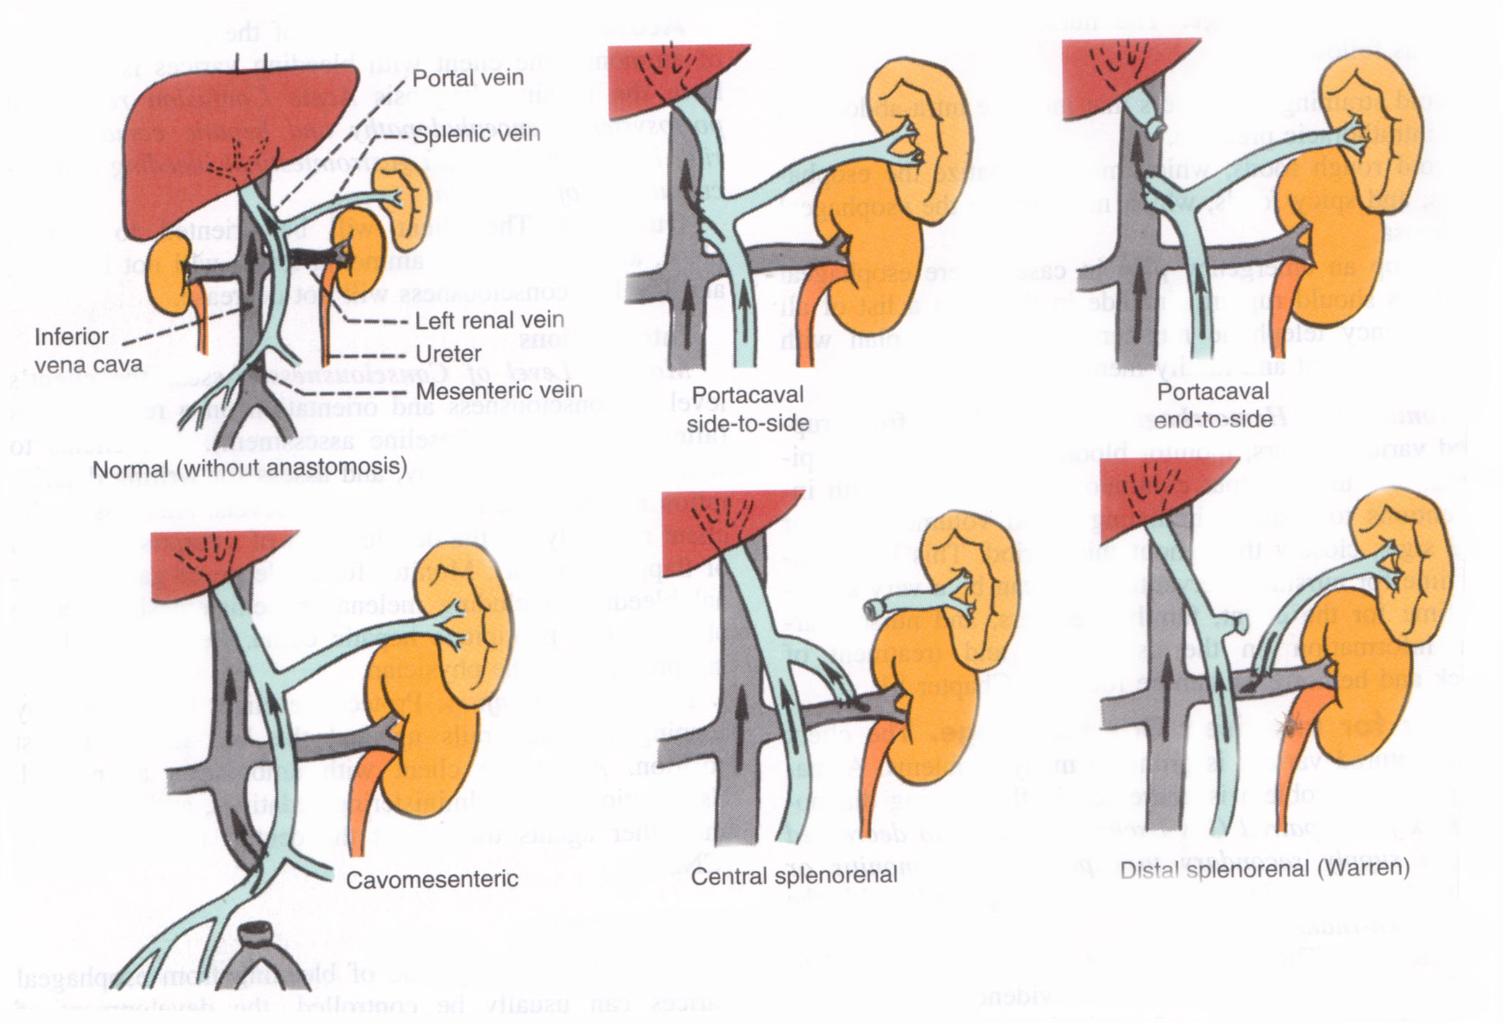
ShuntsTransjugular intrahepatic portosystemic shunt
T.I.P.S.

Slide 31
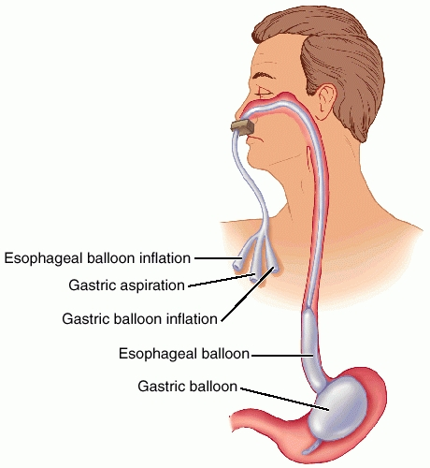
Sengstaken-Blakemore Tube
Three Lumens:
Esophageal balloon inflation
Gastric balloon inflation
Gastric aspiration

Slide 32
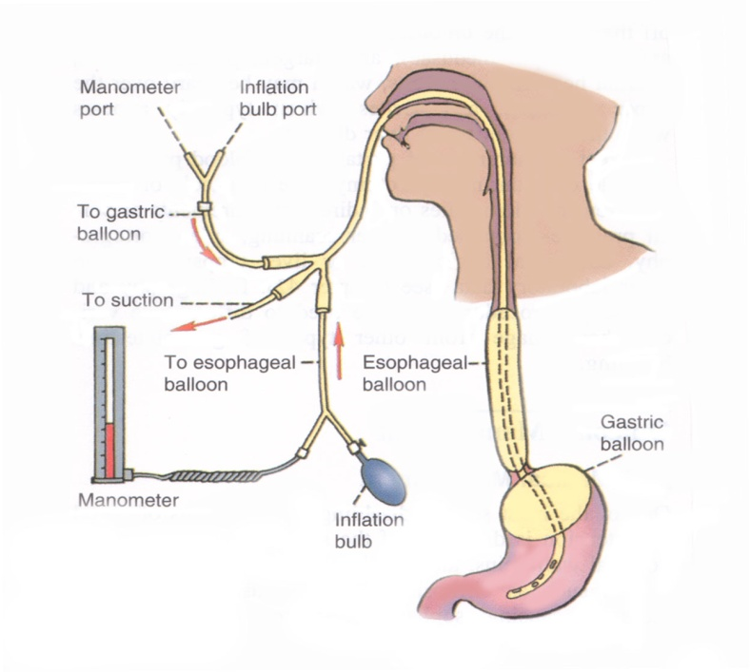

Slide 33
Ascites:
Definition: Fluid accumulation within peritoneal cavity
Causes: most important cause is liver cirrhosis
Mechanism of cirrhotic ascites :
A- Classic Starling theory:
Hypoalbuminaemia decrease plasma osmotic pressure (ascetic threshold= 3) and due to portal hypertension (act as localizing factor which localizes fluid in the peritoneal cavity rather than peripheral tissues)

Slide 34
B-generalized fluid retention:
*hyperaldosteronism due to decreased renal blood flow which stimulate RAS also, due to decreased degradation of aldosterone by the liver.
*Others:
- Complications:

Slide 35
1- Spontaneous bacterial peritonitis with:
Clinical manifestations:
  clinical onset of Fever, chill
  generlaized Abdominal pain
  Abdominal tenderness
  Altered mental status
Can be treated by amioglycosides and ampicillin or third.
generation cephalosporin or quinolones.
2-Complication due to treatment e.g hepatorenal syndrome if vigorous dieresis.
Treatment :
1- Bed rest to decrease metabolites handled by the liver and to increased renal perfusion.
2-diet : Na and water restriction.
3-diuretics:
*best is I.V albumin.
*Spironolactone (maximum rate of ascetic fluid mobilization is 1-2 L / day and if very rapid (dehydration, hepatorenal syndrome and electrolyte imbalance and hepatic encephalopathy)

Slide 36
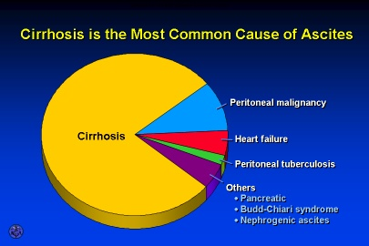

Slide 37
Ascites
Assessment of ascites
  Grading
    Grade 1 — mild; Detectable only by US
    Grade 2 — moderate; Moderate symmetrical distension of the abdomen
    Grade 3 — large or gross asites with marked abdominal distension
Imaging studies for confirmation of ascites
  Ultrasound is probably the most cost-effective modality

Slide 38
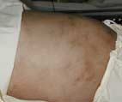
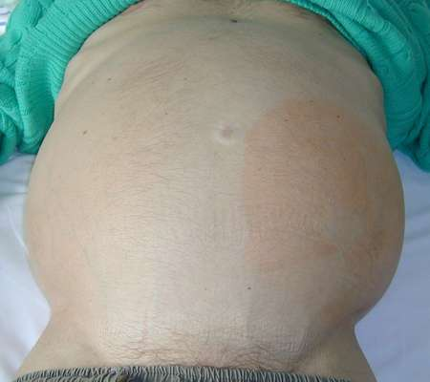
Ascites

Slide 39
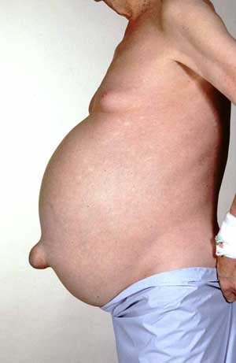

Slide 40
Medical Management of Ascites:
Diuretic therapy:
Paracentesis
  have patient void before procedure then needle puncture of abdominal cavity to remove ascitic fluid- temporary

Slide 41
Paracentesis:
Which is removal of ascitis fluid (4- 6L) from the abdominal cavity with a needle or catheter.
Indicated in tense ascites.
Fluid is rich in albumin → for every 1 L removed give 6-8g albumin.

Slide 42
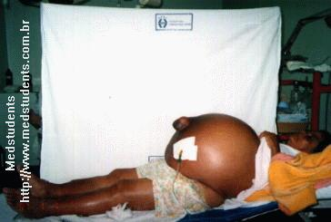
Paracentesis

Slide 43
Diuretics:
Diuresis should be gradual because hypokalemia or intravascular volume depletion caused by aggressive therapy→ compromised renal function, and hepatic encephalopathy.

Slide 44
Complications:
1-Hepatorenal syndrome:
Definition: Functional oliguric renal failure which occur as a serious complication in patient with cirrhotic ascites.
Causes:
Any factor which decrease blood volume as :
1-G.IT bleeding due to rupture esophageal varices.
2- aggressive diuretics, paracentesis.
3- severe diarrhea.
4-others (urinary tract infection and nephrotoxic drugs as NSAId)
May be reversed by liver transplantation

Slide 45
Hepatic encephalopathy:
Definition: complex neuropsychatric syndrome complicating acute or chronic liver disease .
Pathogenesis: many factors with lack of detoxification of toxic substaces absorbed from intestine due to :
A- severe hepatocellular damage
B- vascular shunt (in portal hypertension).

Slide 46
P.P.F:
1- Ammonia theory:
Increase blood ammonia level (unionized) which when reach the brain combine with alpha ketoglutaric acid to be converted to glutamine which decrease oxygen consumption in Krebs cycle to produce diffuse cerebral inhibition.
Source of ammonia:
*GIT: (dietary protein- GI hemorrhage ) by bacterial deamination of amino acids in the intestine .
*hepatic (decrease urea synthesis).
*renal (in hepatorenal syndrome )
2-Synergism theory :
Include ammonia and long chain fatty acids (elevated in cirrhosis)
These long chain fatty acids displace neuroactive chemicals e.g tryptophan from serum albumin.

Slide 47
3-False neurotransmitters theory :
With increase aromatic amino acids level e.g phenyl alanine which compete with tyrosine so, there is less conversion to NE and dopamine but increase level of octopamine (weak chemical transmitter) leading to manifestations of extrapyramidal syndrome which is improved with L, dopa and branched chain amino acids.
Also, increased level of tryptophan which is strong inhibitory chemical transmitter.
4-GBAB theory:
GABA level is increased in the brain which produce diffuse cerebral inhibition (act as endogenous benzodiazepines)
5-Inflammation and infection theory:
Infection act to synergizes ammonia effect in the brain.

Slide 48
P.P.F:
A: azotemia
B: bleeding.
C: constipation (increased ammonia formation due to increased gut transit time).
D: diet(protein) and drugs (diuretics,, CNS inhibitors as benzodiazepines, alcohol;, narcotics…etc)
E: electrolyte imbalance ( hypo or hyperkalaemia)
F: febrile illness (tissue catabolism = infection).

Slide 49
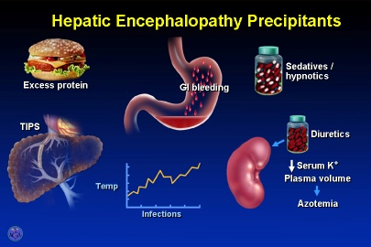

Slide 50
Clinical picture:
1- Hepatic precoma:
*Psychiatric ( lack of concentration, disturbed mood, altered personality…)
*Neurological :( tremor, rigidity)
*imperfect performance.
*Disturbed conscious state (insomnia and hypersomnia).
*Flapping tremors.
*Dysarthria.
2- Hepatic coma.

Slide 51
Treatment of ammonia theory= hyperammoniaemia
1-Decrease ammoniogenic substances:
*prevention of GIT bleeding.
*dietary protein restriction to decrease ammonia formation.
* give vegetable proteins (high in branched chain and low in aromatic amino-acids )so, this help to restore balance between both.
*use lactulose cleansing enema and orally.
2- Inhibit production and absorption of ammonia:
*Antibiotics:
-neomycin but its side effects limits its use so, use
-rifamixin , metronidazole or vancomycin.
*pre and probitics.
*lactulose.
*lactitol.

Slide 52
Neomycin:
Is a non absorbable aminoglycoside which destroy some of intestinal bacteria which generate ammonia so, decrease ammonia blood level.
Its side effects : ototoxicity, and nephrotoxicity.
Used in acute exacerbation of hepatic encephalopathy as it has rapid onset of action.
Can be used in the form of retention enema or orally.

Slide 53
Rifaximin
Poor bioavailability - confined to the gut
Mechanism thought be through intestinal flora alteration
Similar efficacy to (lactulose)
Due to cost, reserved for patients who cannot tolerate or do not respond to lactulose
Neomycin is a less costly alternative, but association with ototoxicity and nephrotoxicity limit use

Slide 54
*Lactulose:
- is non absorbable disaccharide (galactose- fructose) non absorbed in the small intestine.
-metabolized by colonic intestinal bacteria into low molecular weight acids (acetic acid, lactic acid and formic acid) which:
1-decreases PH of colonic environment to inhibit ammonia producing bacteria and favor ammonia transport from blood to colonic lumen where it is converted to ammonium ion which is poorly absorbed but excreted in the stool due to its osmotic laxative effect.
2- osmotic laxative by acceleration colonic transit time and increase excretion of ammonia ion.

Slide 55
-uses:
Less used in acute attack due to slow onset of action (1-2 days) but used in :
*prevention of portosystemic encephalopathy.
*patient with advanced hepatic cirrhosis to improve patient tolerance.
*laxative.
- may be used orally or in the form of retention enema (In patient with impending coma or in patient with coma stage of hepatic encephalopathy)
- side effects :
At therapeutic doses : abdominal distension, flatulence, nausea, vomiting, diarrhea all these side effects can be controlled with decreasing doses so, this drug can be used for a long time with less side effects.

Slide 56
*lactitol
As lactulose but quick onset with less diarrhea and less flatulence and more palatable

Slide 57
*For GABA theory: give flumazenil I.V which give response within minute but 2/3 of patients deteriorates after 3-4 hours.
*For false neurotransimitter theory:
-infusion of BCAA
-oral BCAA supplement.

Slide 58
Four Stages of Hepatic Encephalopathy
Stage Symptom
I Mild confusion, agitation, irritability, sleep disturbance, decreased attention
II Lethargy, disorientation, inappropriate behavior, drowsiness
III Somnolence but arousable, incomprehensible speech, confusion, aggression when awake
IV Coma

Slide 59
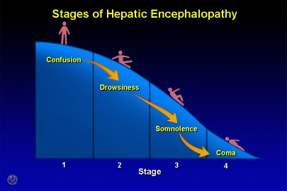

Slide 60
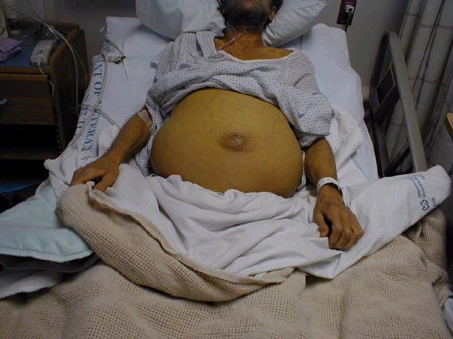

Slide 61
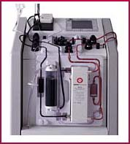
Liver Dialysis
Bridge to transplant
Dialyze 6 hours at a time

Slide 62
Thank you

