Slide 1
Insulin
Functions and Dysfunctions
Dr Sami Billal
Head of clinical sciences department PhD, MD

Slide 2
Objectives
By the end of this lecture, you will be able to :
1. Describe the structure of insulin
2. Enumerate the stimulators and inhibitors of insulin
secretion.
3. Explain the insulin secretion by beta cells of the pancreas.
4. Describe the mechanisms of insulin action on the target
cells.
List the insulin actions.
Define insulin resistance and hyperinsulinemia.
Define metabolic syndrome

Slide 3
Insulin Hormone Structure
Insulin is a 51 amino acids protein hormone composed of two chains, A and B
Linked together by two disulfide bonds.
The A chain consists of 21 amino acids.
The B chain consists of 30 residues.
In the stored form, the two chains connected by C- peptide

Slide 4
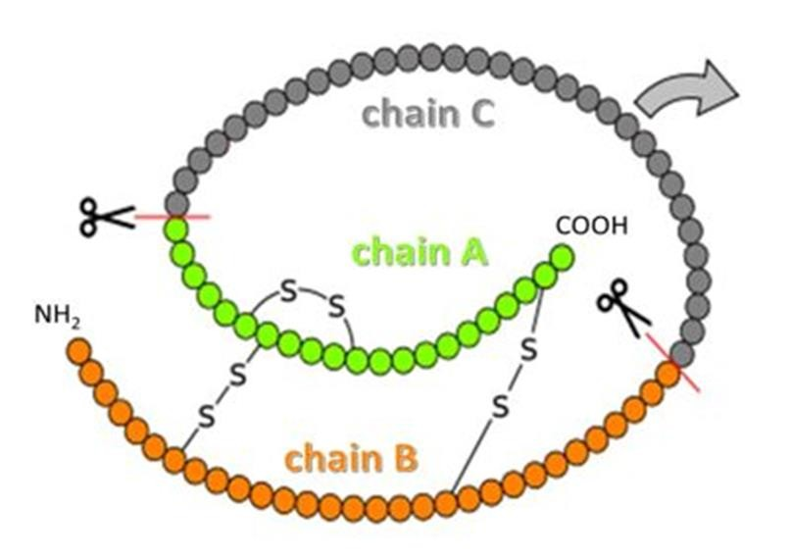
Stored insulin
What is the importance of C-peptide level measurement?

Slide 5
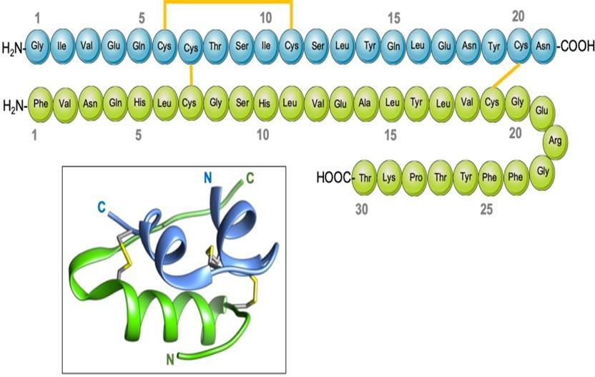
Insulin hormone
What is the importance of insulin level measurement?

Slide 6
Half-lives
The insulin and C-peptide are secreted in equimolar concentration.
Insulin has a short plasma half-life of 4-6 minutes.
This is because insulin needs to respond rapidly to changes in blood glucose.
The half-life of C-peptide is around 30 to 35 minutes.
The C-peptide used to measure the endogenous insulin secretion

Slide 7
Insulin Secretion
The pancreatic β-cell secretes insulin in response to the plasma level of glucose and nutrients (amino acids, free fatty acids)
Glucose is the primary factor controlling β-cell function and survival.
Additional signals like metabolic factors, neurotransmitters, and hormones modulate insulin secretion.
Glucose entering β-cell via glucose transporters
Glucose rapidly phosphorylated to glucose-6-phosphate by glucokinase
G-6-P oxidated in mitochondria ATP from Kerb’scycle.

Slide 8
Insulin Secretion
The rise of ATP ratio in β-cell leads to subsequent closure of the KATP channel
K ions retention causes depolarization and opening of L-type voltage-dependent Ca2+ channels.
High intracellular Ca2+ induces exocytosis of secretory
granules containing insulin/proinsulin from pancreatic β-cell.
It is mainly cleared by insulinase activity within the liver, kidneys, and other tissues.

Slide 9
Glucose induces insulin secretion (GSIS)
Is a biphasic peak-manner :
1. 1st phase is a rapid, early peak due to exocytosis of stored (readily releasable) insulin granules.
2nd phase is a slower and gradually rising peak activated by cytosolic Ca2+, ATP, and cAMP production.
It is due to the subsequent supply of new insulin granules for release.

Slide 10
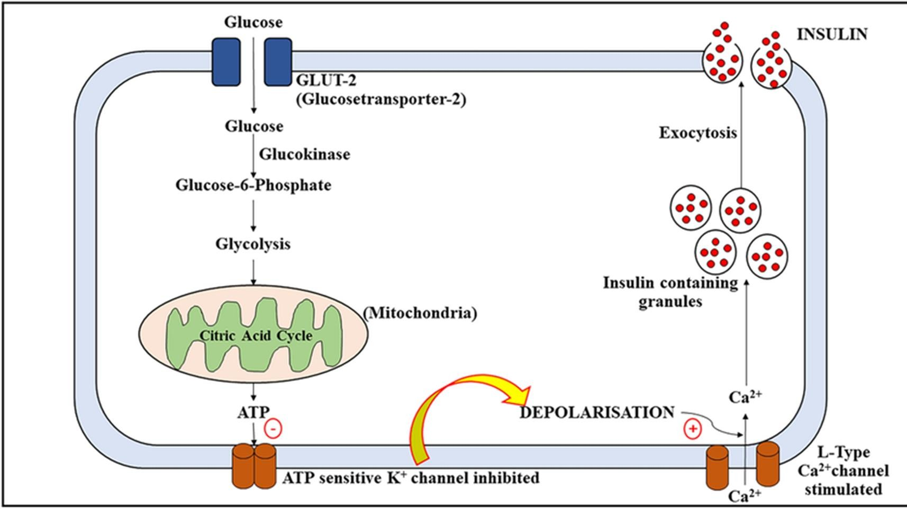
Insulin secretion

Slide 11
Insulin receptor (IL) stimulation
Insulin binds to the target cell's plasma membrane-bound receptor and coordinates the integrative anabolic action of nutrient availability.
IR, a tyrosine kinase, consists of α and β chains and is activated
by insulin-like growth factors I and II and insulin.
There are two IR isoforms, A and B, but the B isoform is the primary isoform and is more specific for insulin.
The B isoform is expressed in the liver, muscle, and adipose tissue and is thus thought to mediate most of insulin's metabolic effects.

Slide 12
Insulin receptor (IL) stimulation
The binding of insulin to the α chain of IR causes structural changes in the β chain by inducing auto‐phosphorylation in tyrosine residues.
These changes are essential for downstream events such as the recruitment of the adaptor proteins IR substrates.
The downstream of IR activation can be functionally divided into mitogenic and metabolic signals.

Slide 13
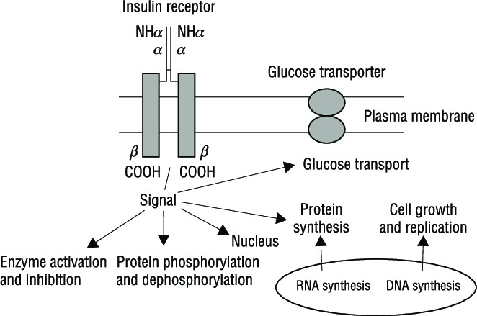
Insulin receptors

Slide 14
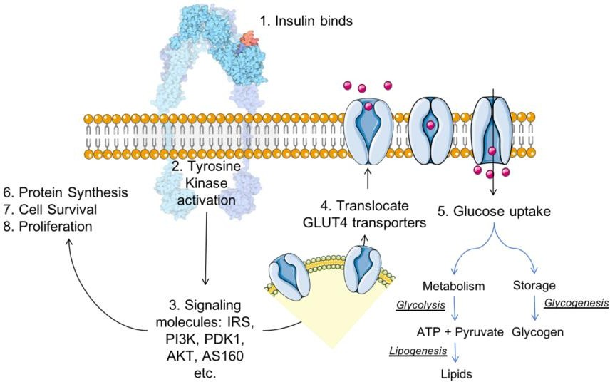
Insulin hormone – receptor reaction

Slide 15
Discussion 1
Why is insulin necessary physiologically?
Why is insulin imbalance substantial clinically?

Slide 16
Insulin Actions
Insulin is anabolic anticatabolic hormone
The role of insulin in glucose homeostasis is represented by the direct effect of insulin on skeletal muscle, liver, and white adipocytes.
Insulin induces synthesizing glycogen from glucose and converting excess glucose into fatty acids and precursor triglycerides (TAGs).

Slide 17
1. Role of Insulin in the Regulation of Liver Function
The liver is the primary organ of insulin action. A- Insulin upregulates glucose-utilizing activity:
Accelerated hepatic glucose utilization
Glycolysis
Glycogenesis
B- Insulin downregulates glucose production by
Suppressing net glucose production
Gluconeogenesis
Glycogenolysis.

Slide 18
2. Role of Insulin in the Regulation of Muscle Function
Approximately 70% of the whole-body glucose uptake is used by skeletal muscle.
Patients with type 2 diabetes are associated with poor muscle strength and function.
In skeletal muscle, a representative insulin-acting tissue, insulin promotes glucose utilization and storage by increasing glucose transport and net glycogen synthesis.

Slide 19
3. Role of Insulin in the Regulation of Fat
In white adipocyte tissue, insulin inhibits lipolysis and increases glucose transport and adipogenesis.

Slide 20
4- Role of Insulin in the Regulation of
Endothelium and Vasculature
1.
Increases nitric oxide (NO) bioavailability
Decreases oxidative stress mediated by elevated reactive oxygen species (ROS) production,
Prevents the expression of pro-inflammatory and pro-thrombotic factors.
Thus, insulin dysfunction predisposes to increased susceptibility to atherosclerosis, coronary heart disease, and hypertension.

Slide 21
5. Insulin effects on the Brain
Increases glucose uptake in the spinal cord tissues and some brain regions, such as the choroid plexus, the pineal gland, and the pituitary.
Controls neuronal plasticity, memory processing, and cognition

Slide 22
6. Insulin effects on the Bone
Promotes bone development
Increases bone mineralization
Increases osteoblast proliferation, collagen synthesis, and alkaline phosphatase production rate.
Inhibits the activities of osteoclasts

Slide 23
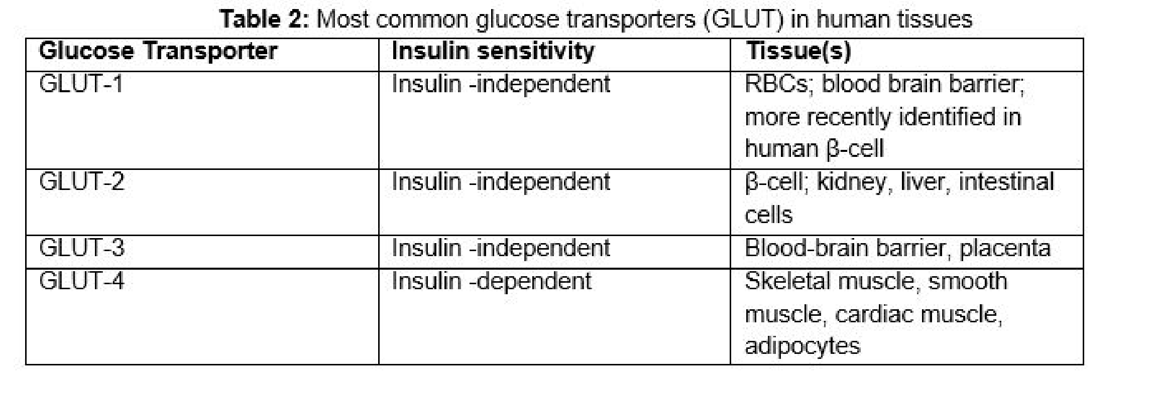

Slide 24
Hormones that increase IR responsiveness and related diseases
Growth hormone→ Acromegaly
Cortisol → Cushing Syndrome
PRL→ Hypogonadism
Gonadal steroids→ PCOS

Slide 25
Clinical disturbance due to insulin impairment
Diabetes mellitus
Insulin resistance
Hyperinsulinemia
Metabolic syndrome

Slide 26
Definition and Diagnosis of Insulin resistance
Insulin resistance may be defined as a subnormal glucose response to endogenous and/or exogenous insulin.
The diagnosis of insulin resistance in most patients is based upon clinical findings (eg, metabolic syndrome traits):
Abdominal obesity
Hyperglycaemia
Dyslipidaemia
Hypertension
Hyperinsulinemia

Slide 27
Insulin resistance syndromes
There are two types of insulin resistance – insulin resistance syndrome type A and type B.
Type A syndrome:
Insulin can’t bind well because insulin receptors are either absent
or malfunctioning due to genetic mutation.
Type B syndrome:
It is very rare that antibodies are produced against the insulin receptors.
When antibodies are directed against the receptors, they block
them, and insulin can’t bind as well.

Slide 28
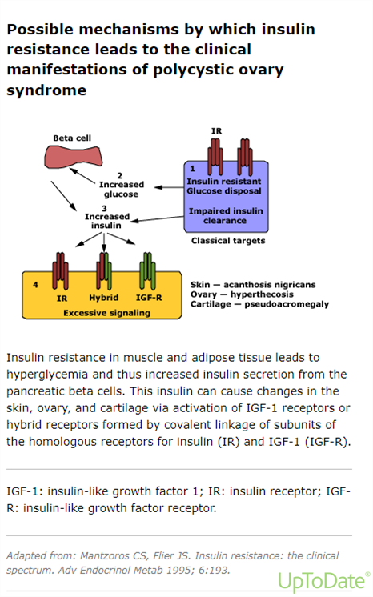
Copyrights apply

Slide 29
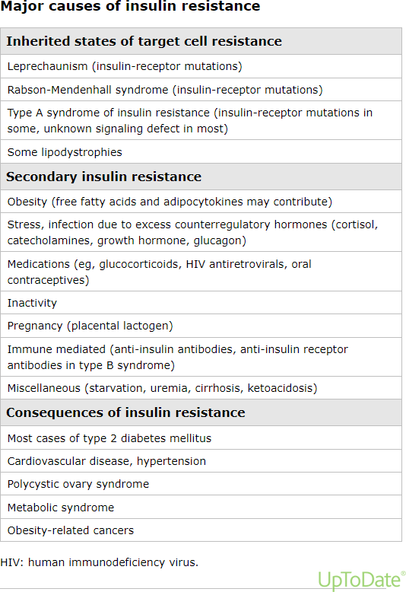
Copyrights apply

Slide 30
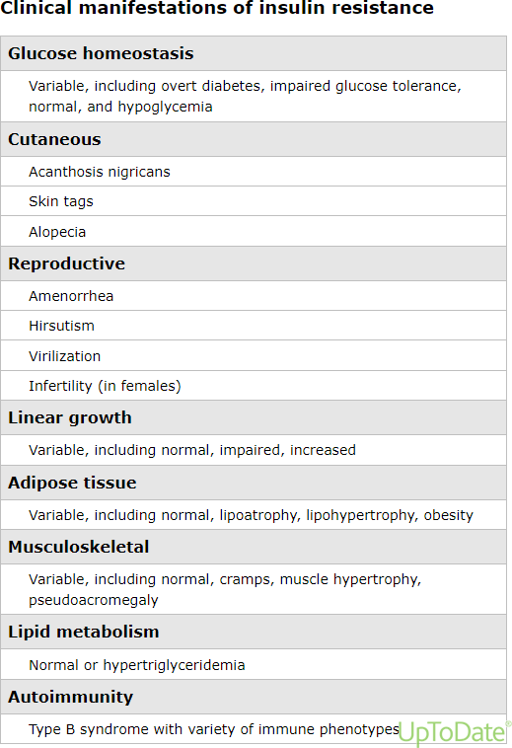
Copyrights apply

Slide 31
Metabolic syndrome
Metabolic syndrome is defined as the co-occurrence of metabolic risk factors for type 2 diabetes and cardiovascular disease (CVD), specifically abdominal obesity, hyperglycemia, dyslipidemia, and hypertension.

Slide 32
The therapeutic goals in metabolic syndrome are: Discussion 2
Treat underlying causes by reducing weight and increasing physical activity
Treat cardiovascular risk factors if they persist despite lifestyle modification

