Slide 1
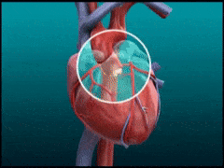
Coronary Artery disease
Dr Nada Abdelrahman

Slide 2

Learning objectives
By the end of this lecture, the students should be able to
Describe in brief the pathogenesis and aetiological factors of CAD.
Assess a patient presented with chest pain
Diagnose coronary artery disease from history, examination and investigations.
Risk- stratify patients with CAD.
Outline the management of acute & coronary artery disease.

Slide 3

Clinical scenario
A 58-year-old diabetic and hypertensive man presented with an intermittent painful retrosternal dullness for 4 weeks. The pain is recurrent and occurs on exertion or outside walking during cold weather. He experiences shortness of breath and palpitations during these episodes. The symptoms resolve spontaneously when he stops or sits down for a while. Over the past few days, the episodes have increased in frequency.
Physical examination: pulse is 88/min, respirations are 20/min, and BP: 144/90 mm Hg. A cardiac examination shows no abnormalities. Normal CXR. An ECG shows a normal sinus rhythm without any signs of ischemia. Normal cardiac markers. Which is your most likely diagnosis?

Slide 4

Coronary Artery Disease
CAD is the largest cause of death in UK (1 in 3 men and 1 in 4 women die ), and worldwide.
This Photo by Unknown Author is licensed under CC BY-SA

Slide 5
Background (Coronary circulation)
SDL : Revise the coronary circulation

Slide 6
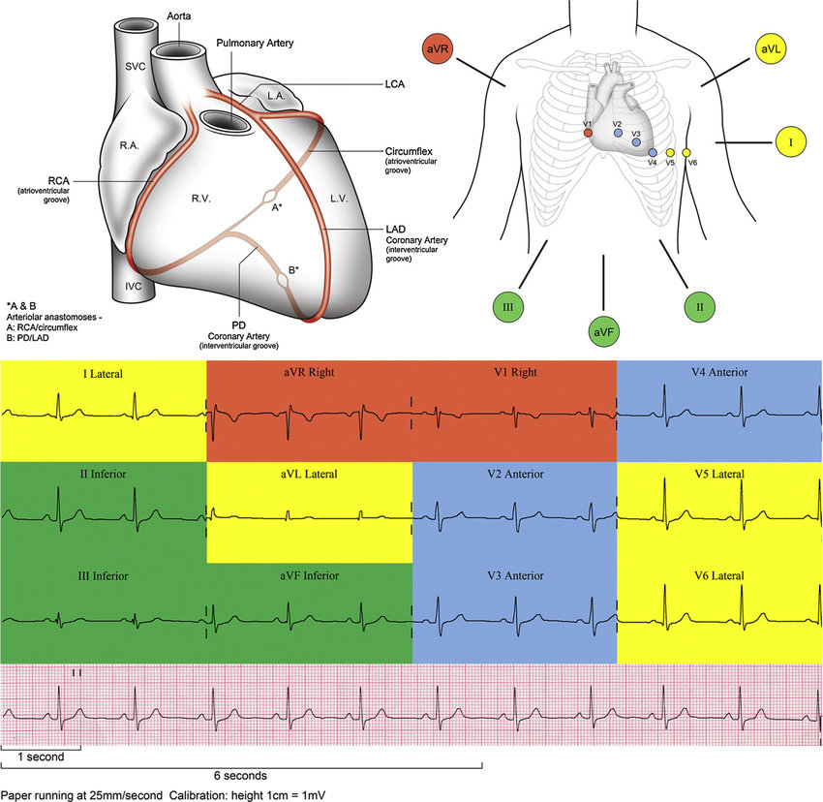
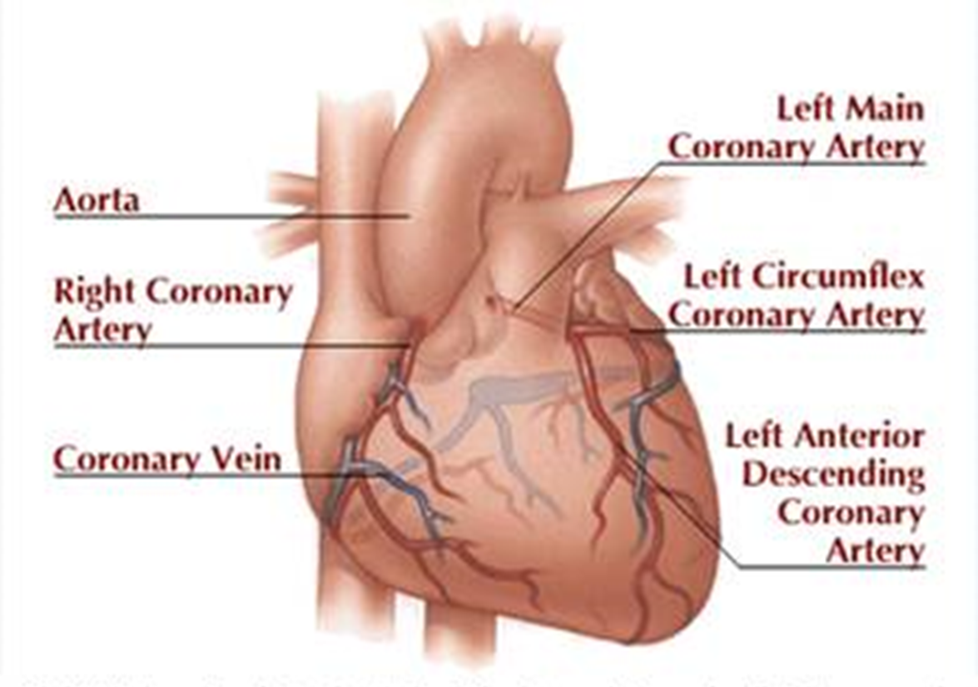

Slide 7
Pathophysiology
SDL: Revise the Pathology of IHD and atherosclerosis

Slide 8

Pathophysiology and mechanisms

Slide 9
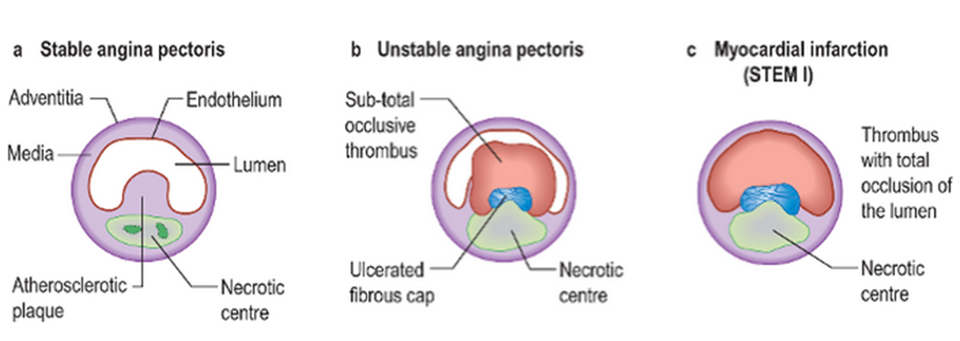
Mechanisms: CAD can be caused
Atheroma
Thrombosis
Embolus
Spasm (reversible)
Coronary ostial stenosis

Slide 10
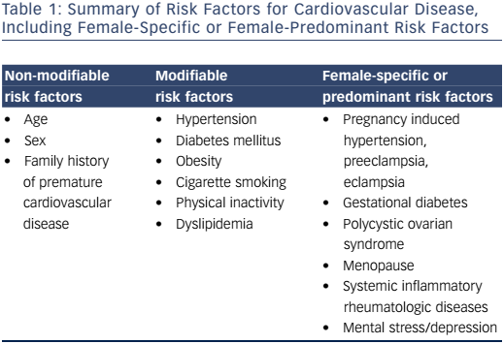
Risk factors for CAD
Notes:
It is recommended that adult should do a minimum of 30mins of moderate activity e.g. Brisk walking, cycling on 5 days of the week

Slide 11
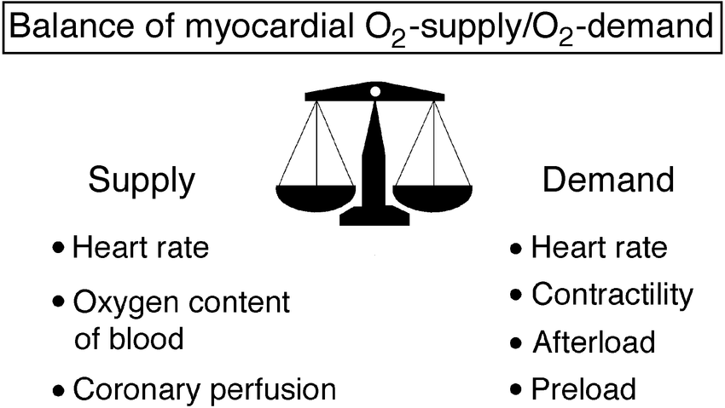
Clinical symptoms
Angina: chest pain caused by myocardial ischemia.
  classically: left side
  Radiate: left arm or neck
  Absent (atypical): elderly, diabetic or female
dyspnoea
nausea and vomiting
sweating
palpitations
Notes:
Decrease Supply
- Anaemia
- Carboxyhaemoglubinaemia
- Hypotension
Increased demand
increase cardiac output e.g. Thyrotoxicosis
myocardial hypertrophy e.g. Hypertension,
Aortic Stenosis

Slide 12
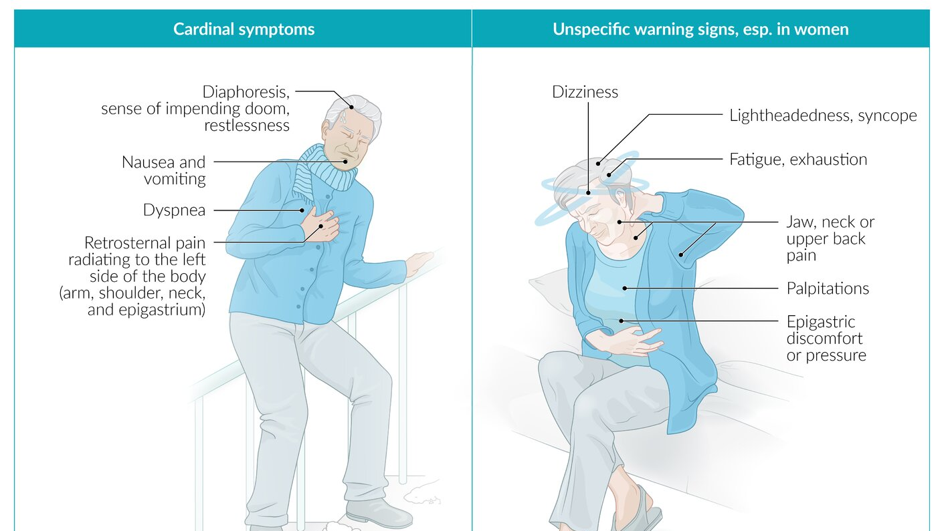

Slide 13
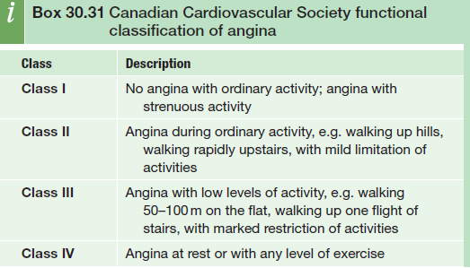
Classification of Angina
Classical angina or typical angina characterized by chest pain:
• ‘Heavy’, ‘tight’ or ‘gripping’ central or retrosternal radiate to jaw and/or arms.
• occurs with exercise or emotional stress.
• Pain eases rapidly with rest or with GTN.
Atypical angina: 2 out of 3
Non-angina chest pain: 1 out of 3 of

Slide 14
Definition
Coronary artery disease (CAD): IHD due to narrowing or blockage of coronary arteries.
Stable angina: retrosternal, on exertion, mental stress, and/or exposure to cold and subsides within 20 minutes of rest or after administration of nitroglycerin
Unstable Angina: recent onset (<24 hr), deterioration of stable angina or at rest.
Stable CAD: asymptomatic, stable angina; post-MI medically ttt
Refractory angina: pain not controlled by medication
Variant (Prinzmetal’s) angina (♀): due to spasm, ttt with CCB, associated with ↑ST(episode)
Microvascular angina : Hx of exertional angina + positive exercise test & normal angiography.
Notes:
Intracoronary acetylcholine may cause coronary spasm. Whilst they have a good prognosis, they are often
highly symptomatic and can be difficult to treat. In women with

Slide 15
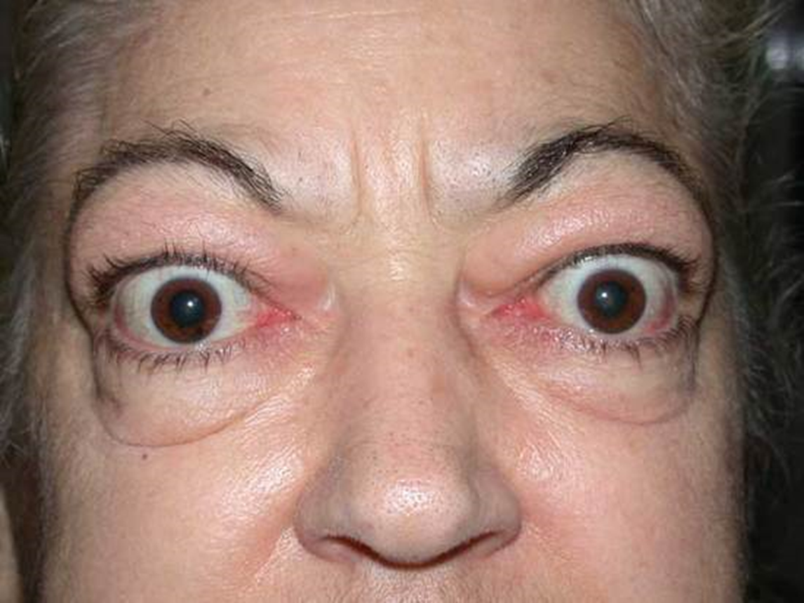

Physical examination
No abnormal finding in angina
Look for
Anaemia
Thyrotoxicosis
Hyperlipidaemia (Xanthelasma,
Tendon Xanthoma)
Check for hypertension
Examine CVS, exclude AS

Slide 16

Investigations (Stable Angina)
ECG
12 lead ECG: normal between attacks
During attack: transient ST-depression, T-wave inversion.
Cardiac enzymes(Troponin T & I): Normal
Exercise (Stress) ECG – ST- depression of 2 mm is taken as positive test
CT – coronary angiography (accurate - noninvasive)
Non-invasive functional test
Cardiac catheterization
Notes:
Need to confirm or exclude CAD
Medical therapy fails to relieve anginal symptoms
History and noninvasive testing suggest high-risk coronary anatomy

Slide 17
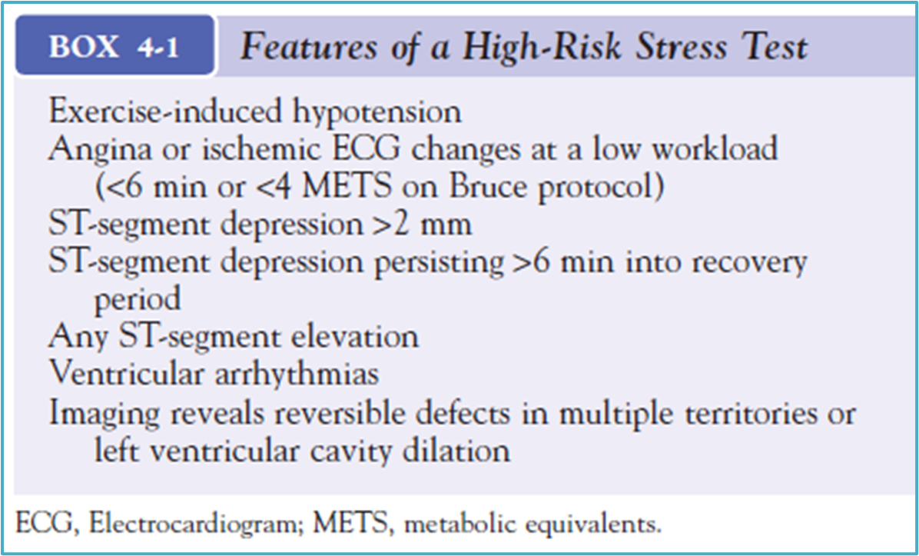
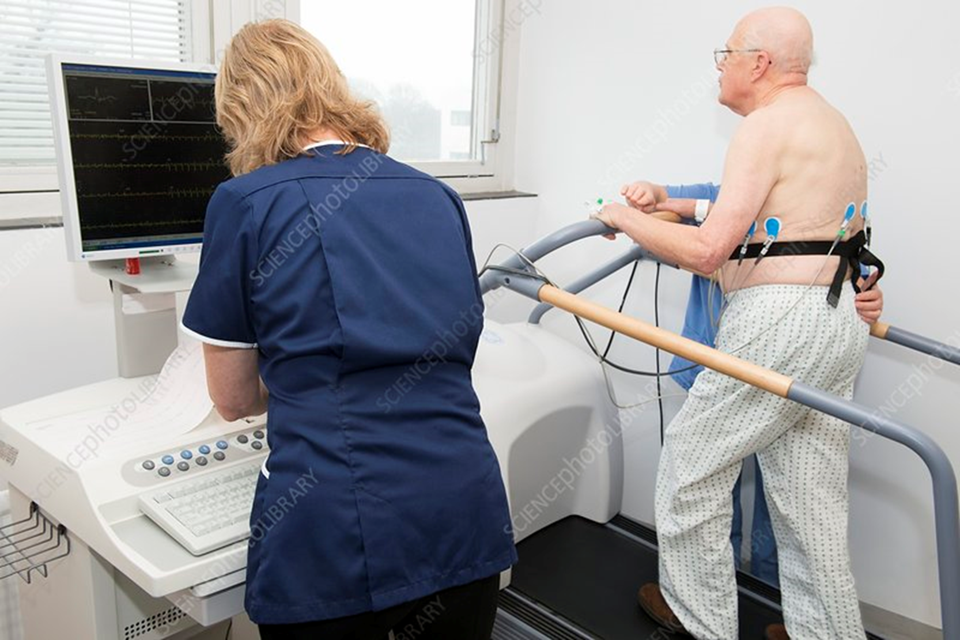
Stress ECG
Evaluation of patients with known or suspected coronary heart disease (CHD).
Diagnosis & risk assessment and prognosis.
Types
Exercise electrocardiogram (ECG)
Exercise with imaging
Pharmacologic stress testing with imaging: physical ability to perform exercise.

Slide 18
Investigations
64-slice
CTCA.
non-invasive
functional tests
Alternative diagnosis/ tests
Chest pain with ST changes or Q waves
SPECT, stress echocardiography, stress MRI).
Notes:
•

Slide 19

Management of Chronic CAD: stable angina
Non- pharmacological
Address modifiable risk factors (lipid lowering, cigarette cessation)
Strict diabetic control
Optimum blood pressure control
Correct illnesses that can precipitate or exacerbate angina (anaemia, infection, thyroid disease)
Encouraged Regular exercise
This Photo by Unknown Author is licensed under CC BY-ND

Slide 20
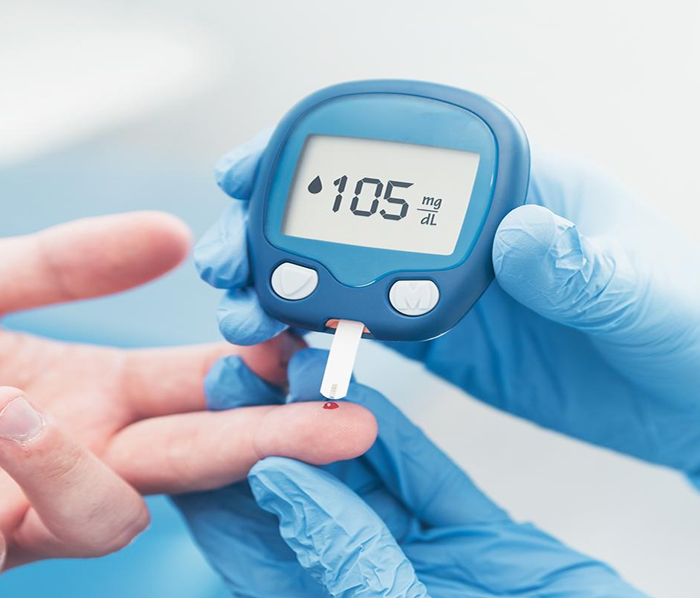

Non-pharmacological therapy
Important Point
Blood Pressure : < 140/90 mmHg (Diabetes: BP 130/80 mmHg)
Serum cholesterol < 4.0 mmol/L
HDL > than 1 mmol/L
LDL < than 2 mmol/L
This Photo by Unknown Author is licensed under CC BY

Slide 21

Pharmacological therapy
Vasodilator – GTN (Glyceryl Trinitrate 0.3-1mg sublingual). Isosorbide mononitrate – 10-60mg orally bd
Action
Venodilation: ↓ cardiac preload, decreasing wall stress and O2 demand
Relieving angina and improving exercise tolerance
does not affect mortality.
Contraindicated: sildenafil, RT ventricular Infarction, severe hypotension
Notes:
Nitrates are contraindicated in case of hypotension, myocardial infarction of the right ventricle, and recent use of PDE-5 inhibitors like Sildenafil, because in these situations nitrates can cause really severe hypotension.

Slide 22
Pharmacological therapy
Beta Blocker : 1st line
Atenolol (Tenormin) 25-100mg daily
Bisoprolol (Concor) 2.5-10mg/day
Action
↓ heart rate
↓ BP
↓ myocardial O₂ demand (!! heart failure)
β-blockers reduce both morbidity and mortality. (Post-MI & HF)
C/I: Prinzmetal angina, bradycardia, cardiogenic shock, and cocaine-related ACS.

Slide 23
Calcium channel blockers
Second-line therapy
Improve myocardial oxygen supply by ↓ coronary vascular resistance, myocardial demand is ↓ by a ↓ in myocardial contractility.
Verapamil and Diltiazem Inhibit cardiac conductive tissue.
Contraindicated: Bradycardia, H block, LVF
Do not use short-acting dihydropyridines, which increase mortality rates in patients with ACS
Long-acting agents are safe and effective in chronic stable angina

Slide 24

(Do not combine β- blockers with non-dihydropyridine calcium antagonists).
If these fail to control symptoms or are not tolerated, trial other agents.
Ranolazine: SDL

Slide 25

Primary and Secondary Prevention
Read SDL: QRISK®3 risk assessment tool
Primary Prevention
- prevention of atherosclerotic disease process. (Atorvastatin 20 mg)
Aspirin: Not recommend in primary prevention !!!
Secondary Prevention
- treatment of atherosclerosis (its complication) . Atorvastatin 80 mg
This Photo by Unknown Author is licensed under CC BY-SA
Notes:
The 2014 NICE guidelines: Cardiovascular disease: risk assessment and reduction, including lipid modification have lowered the UK threshold for offering a statin for primary prevention to a 10% or greater 10year risk of developing cardiovascular disease, according to the QRISK2 score. The previous recommendation advised offering a statin to patients with a 20% 10-year risk. A high-intensity low cost statin should be 1st line in this context, such as atorvastatin 20mg.
Prescribing aspirin for primary prevention is controversial, whether the benefits in primary prevention outweigh the bleeding risks is unclear, therefore most guidelines do not recommend aspirin in primary prevention. Unlike in secondary prevention where the benefits usually outweigh the risks.
The NICE guidelines advise NOT prescribing omega-3-fatty acid supplements for primary or secondary prevention of cardiovascular disease, as they have not shown to be efficacious in reducing cardiovascular risk in meta-analyses. However, guidance continues to encourage consuming regular portions of oily fish, the 2014 nice guidance specifically advises: 2 portions of fish per week, including a portion of oily fish.

Slide 26
Secondary Prevention of IHD
Medications that decrease morbidity and mortality
Aspirin 75mg daily – All patient unless contraindications. S/E GI bleeding
ACE inhibitors – used if hypertension, heart failure.
Statins (Lipitor ): elderly ≥ 75 y. & left ventricular (LV) dysfunction (ejection fraction [EF] <40%)
This Photo by Unknown Author is licensed under CC BY-SA
Notes:
Atorvastatin 20 mg is recommended for the primary prevention of
cardiovascular disease in people with a 10-year
risk of cardiovascular
disease of 10% or higher. In patients with established cardiovascular
disease, NICE recommends atorvastatin 80 mg, unless there
are potential drug interactions, a high risk of adverse effects or a
different patient preference.

Slide 27
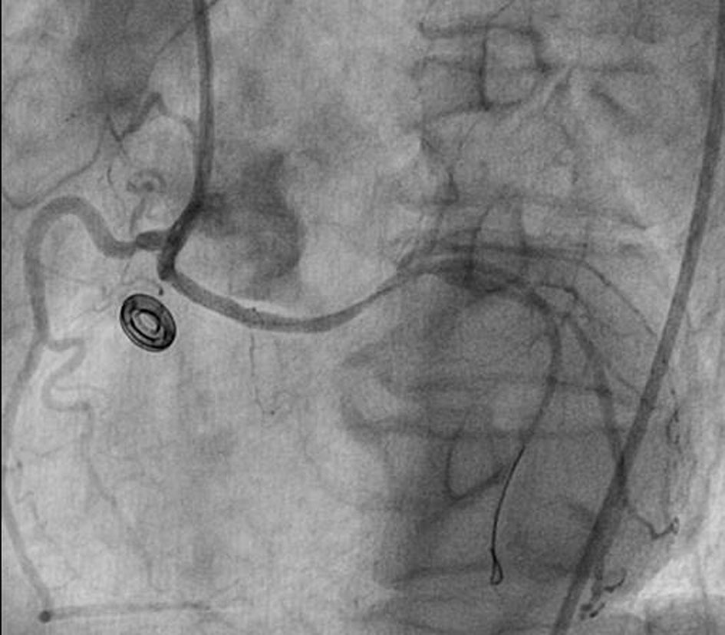
Revascularization of chronic CAD
Major indication for revascularization in chronic CAD :
Relief of angina symptoms in patients on optimal medical management.
Two methods of revascularization:
Percutaneous coronary intervention (PCI)
Coronary artery bypass grafting (CABG)
This Photo by Unknown Author is licensed under CC BY-NC

Slide 28
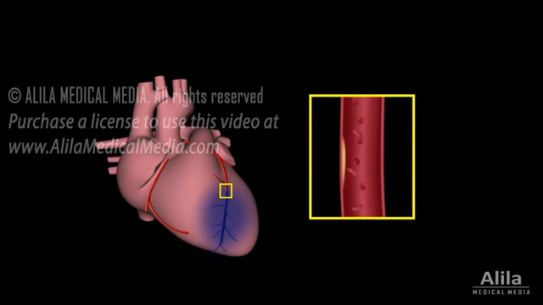
Revascularization of chronic CAD

Slide 29
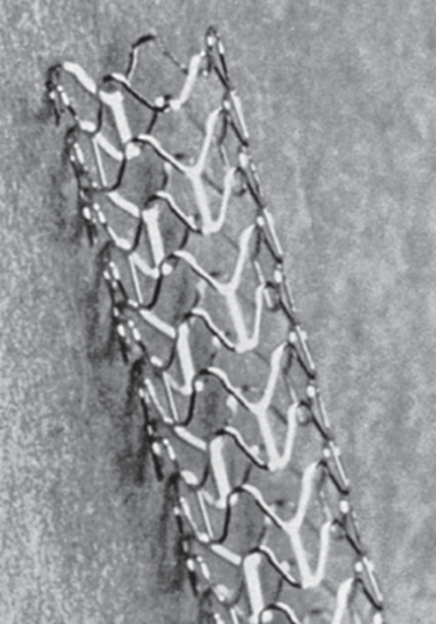
PCI – Percutaneous Coronary Intervention
It is process to dilate coronary artery stenosis, using inflatable balloon and metallic stent introduced via femoral, radial, or brachial artery.

Slide 30
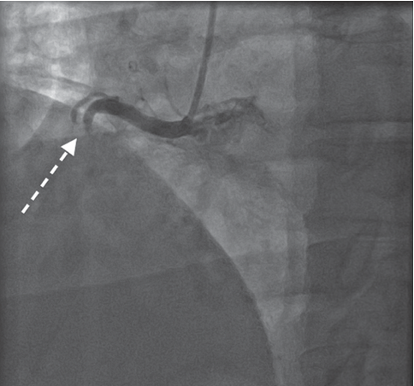
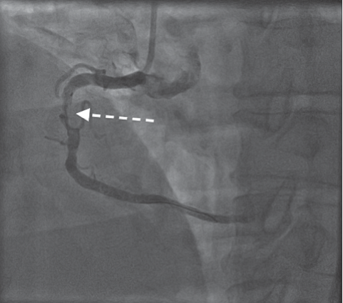
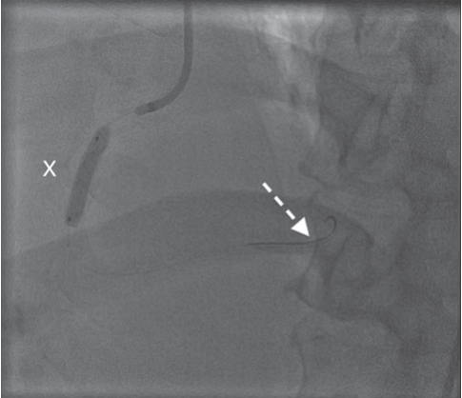
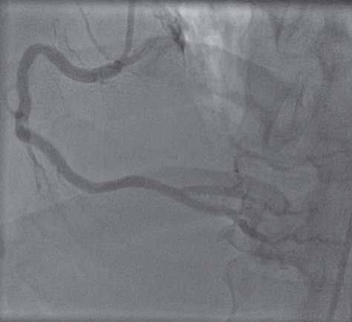
Percutaneous Transluminal Coronary Angioplasty PTCA
Complication
Bleeding, hematoma, pseudoaneurysm
Serious Complication
– Acute MI 2%
– Stroke 0.4%
– Death 1%
When metallic Drug-eluting stent: advised to take Aspirin, Plavix for 1 year
A. Right coronary artery (RCA) occluded
B. Soft wire passed
C. Balloon is inflated to dilate stenosis
D. RCA reopened

Slide 31
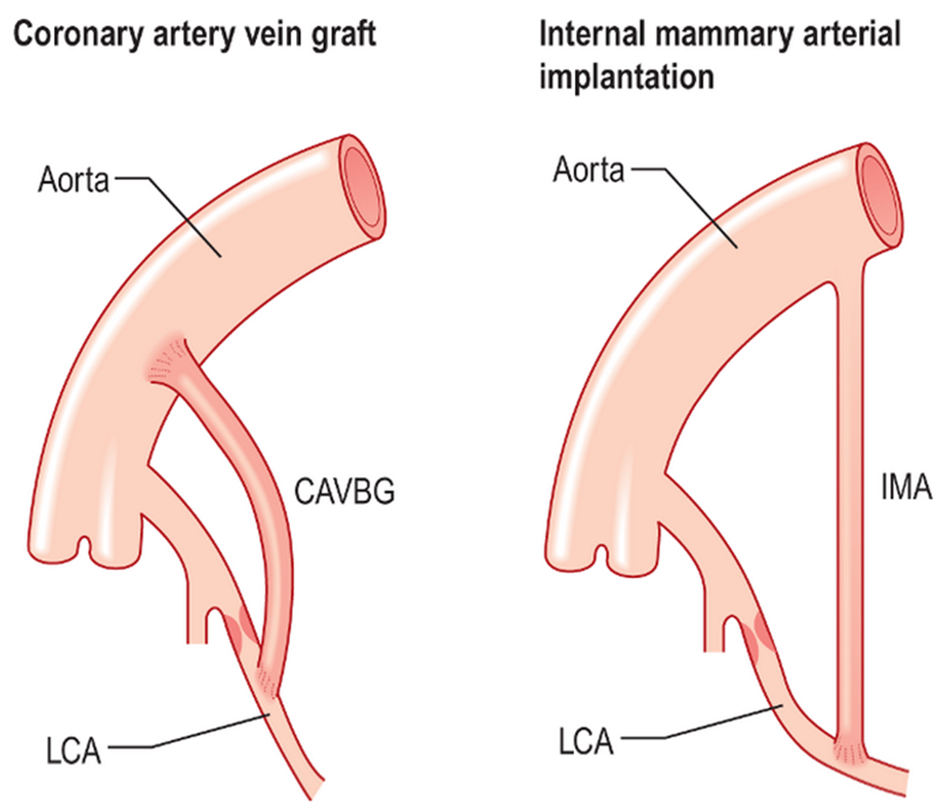
Coronary Artery Bypass Grafting (CABG)
Autologus veins or arteries are anastomosed
Saphanous vein or internal memory artery are used
Operative mortality < 1%
Relief of Coronary Obstruction By Surgical Techniques

Slide 32
CABG versus medical therapy
CABG is recommended for patients with triple-vessel CAD and impaired left ventricular function (LVEF 35–49%).
Left stem disease with a stenosis of ≥50% is a class I indication for revascularization.

Slide 33
PCI versus CABG
Comparative trials between CABG and PCI all demonstrate a higher need for repeat revascularization with PCI than with CABG.
European Society of Cardiology (ESC) has recommended PCI only in cases of single- or double-vessel disease that does not involve the proximal left anterior descending artery.

Slide 34
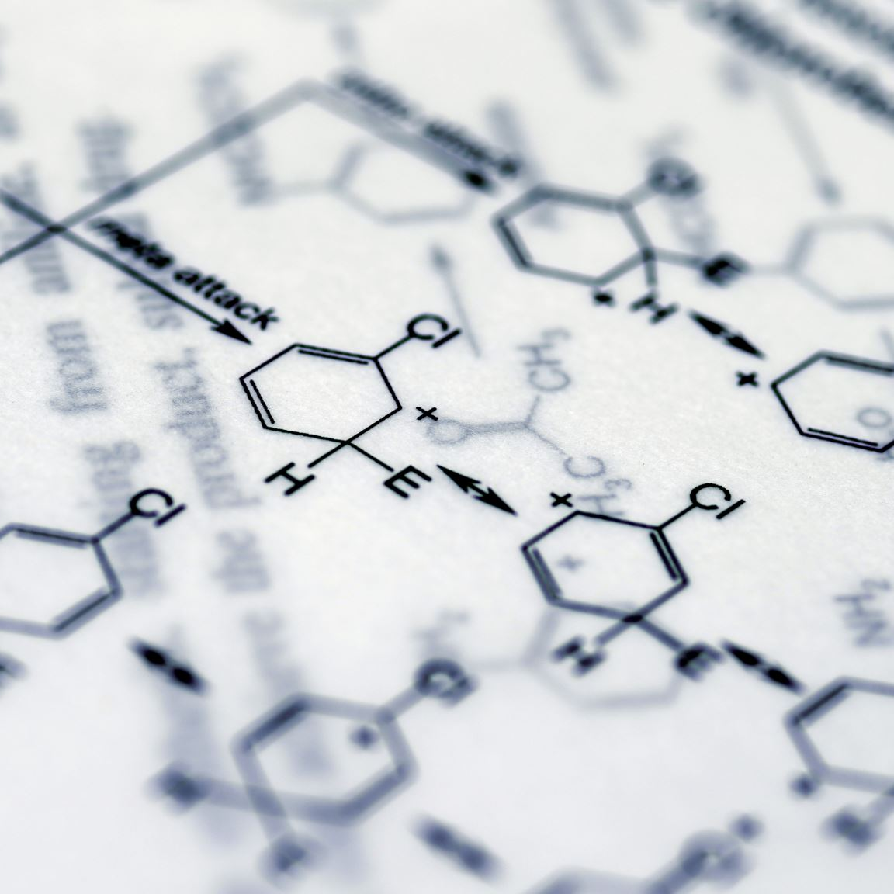
Antiplatelet agents commonly used during PCI
Aspirin: An irreversible cyclooxygenase inhibitor.
Thienopyridines: Clopidogrel: ↓ (ADP)-mediated platelet activation.
Glycoprotein IIb/IIIa inhibitors: Abciximab and eptifibatide; reduce CVS complications of PCI in the acute setting.

Slide 35
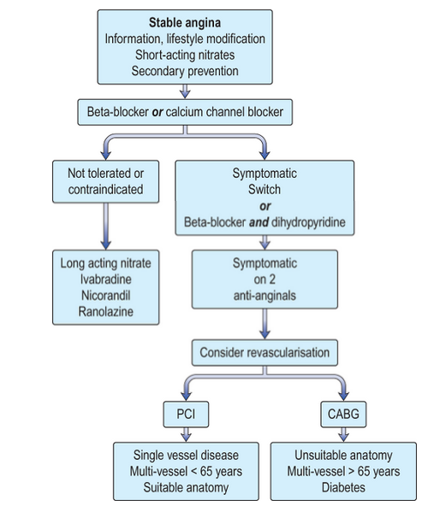
Algorithm for Management of Patient’s with Stable Angina
SDL revise Kumar 1083
Notes:
FIRST MEDICAL THEN ADD BB THEN PCI

