Slide 1


Slide 2
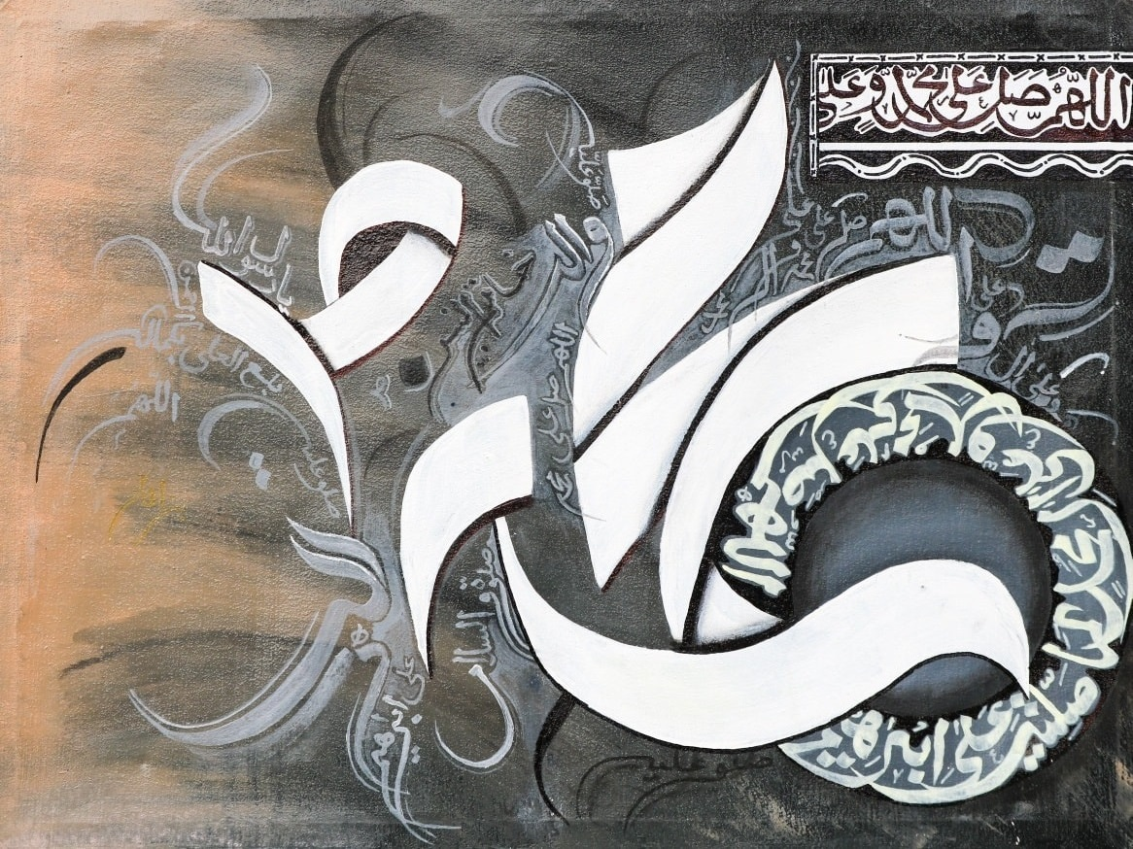

Slide 3

ACUTE RENAL FAILURE
BY
DR WAQAR
MBBS, MRCP, Internal Med. (London)
MRCP, Endo.& Diabetes( London)
ASST. PROFESSOR

Slide 4
NORMAL FUNCTIONS
OF THE KIDNEYS
Excretion of wastes ( Urea, creatinine )
Acid-base balance ( excretion of acids produced in the body)
Electrolyte balance ( Na, K, P etc)
Erythropoeitin production ( for RBC synthesis). It is a hormone.
Salt & water balance maintain BP
Activate Vit D, thus managing Ca & Phosph.

Slide 5
EFFECTS OF RENAL FAILURE
High urea & creat. ( uremia)
Acidosis
High K & Phosphorus
Decreased erythropoeitin anemia
Poor water excretion HTN,CHF
No Vit D activation Vit D deficiency,
which causes : bone disease (details in chronic
renal failure lecture)

Slide 6
TYPES OF RENAL FAILURE
ACUTE ( ARF) CHRONIC (CRF)
ARF : Duration of renal failure less than 3 months.
CRF : Persistent renal failure for more than 3 months. It is progressive
CRF finally leads to end stage renal disease(ESRD)

Slide 7
TYPES OF
ARF
( Based on the site of the problem)
Pre-renal : Decreased blood flow to the kidneys
Renal : Diseases “in” the kidney
Post-renal : Obstruction “beyond” the kidney

Slide 8
PRE-RENAL ARF
ETIOLOGY : Decreased blood supply to kidneys:
* Blood loss, severe dehydration
* Hypotension
* CHF ( decreased effective circulating vol.)
* Renal artery stenosis (bilateral)

Slide 9
WHEN TO SUSPECT PRE-RENAL
ARF
1) See the whole situation ( bl. Loss, dehydration)
2) Suspect pre-renal failure in patients with high creatinine who have the following:
* Low BP, fast pulse (indicates fluid loss)
* Orthostasis ( when a supine pt. sits
or stands, systolic BP falls more than 20, &
pulse rises more than 10. This is abnormal
& is called orthostasis. Indicates severe fluid
loss)

Slide 10
INVESTIGATIONS IN
PRE-RENAL ARF
1)BLOOD:
* High BUN
* High creatinine
* BUN: creatinine ratio high ( > 20)

Slide 11
Investigations (contd)
2) Urine:( just imagine that kidneys are absorbing
all the water & salt)
* Decreased amount (oliguria)
* Increased osmolality/specific gravity ( very
concentrated urine)
* Decreased amount of Na in urine. This is called
“fractional excretion” of Na (FeNa) & is
expressed as a %.
* In pre renal failure, FeNa is less than 1%

Slide 12
PRE-RENAL ARF
TREATMENT
I.V. fluids, blood ( according to the situation)
Treat the cause ( CHF etc)
With correct Rx, renal perfusion improves & so
urine output improves.
If it is not treated soon, renal hypoperfusion can
damage the tubules

Slide 13
“POST-RENAL” etiologies of
Renal failure
This occurs due to obstruction of the urine flow, anywhere beyond the kidney
Obstruction should be bilateral.
Etiology :
* BPH ( benign prostate hypertrophy)
* Urethral stricture
* Large stones in both ureters

Slide 14
TREATMENT
TREAT THE CAUSE

Slide 15
Etiologies of “Renal” type of Renal failure
Can be due to
Glomerular Tubular Interstitial
damage damage damage
Commonest cause is tubular damage
(Glomerular diseases to be discussed in other lectures)

Slide 16
Tubular damage causing ARF
ETIOLOGIES:
1) Prolonged ischemia ( decreased blood flow)
2) i.v.contrast agents
3) Drugs (medicines)
4) Uric acid
5) Pigments ( eg hemoglobin, myoglobin)

Slide 17
What happens after tubule damage?
In tubular damage, tubules cannot absorb water & sodium, so water & sodium lost in the urine, so:
b) Dilute urine, High urine Na (FeNa is high) and output is not reduced (may be even high)

Slide 18
Causes of Tubular damage
( acute tubular necrosis ATN)
Ischemia to the tubules:
*Due to prolonged hypovolemia or hypotension
* In most cases, recovery in few weeks, if managed properly in hosp.

Slide 19
Other causes of Tubular Damage
2) i.v. contrast : Can precipitate in the tubules
* More chances in DM, & dehydrated pt.
* i.v. fluids before X-ray procedure reduces the
risk.
3) Drugs : Aminoglycosides, NSAIDs, antibiotics
4) Pigment nephropathy: Certain pigments can filter thru the glomerulus in abnormal situations.
* Hb.: In hemolysis.
* Myoglobin : In rhabdomyolysis (myoglobin is a
pigment in skeletal muscle)

Slide 20
In rhabdomyolysis, urine is “tea colored” &
tests positive for blood, just like hematuria but
there are no RBCs

Slide 21
5) Tubule damage by uric acid:
* Occurs when blood uric acid is very high
uric acid filters through the glomerulus
can damage the tubules
* Happens in cancers when chemotherapy is started & there is too much breakdown of cancer cells, which releases uric acid.
* This is called TUMOR LYSIS SYNDROME. It can cause acute renal failure due to tubule damage by uric acid

Slide 22
GLOMERULAR CAUSES OF ARF
Various glomerulonephritis can cause ARF
Urine shows : “Deformed” RBCs, RBC casts,
& proteinuria
INTERSTITIAL DAMAGE CAUSING RENAL FAILURE
Also called “interstitial nephritis”
Commonest cause : Antibiotics ( PCN, Cephalosporins), Infections, NSAIDs
Urine : * WBC casts & eosinophils in urine

Slide 23
Investigations in Renal type of ARF
Blood:
* High BUN & Crea
2) Urine:
* Output may be normal or high
* Low osmolality/specific gravity (dilute urine)
* Na. lost in the urine, so fractional excretion
of Na is high (FeNa)

Slide 24
URINALYSIS HELPS A LOT IN ARF
Pre-renal ARF
Renal-ARF
Urine output low
Specific gravity high (urine is concentrated)
FENa low ( amount of Na. in urine low)
a. Output normal or high
( Tubules are damaged and can not absorb water like normal)
b. Specific gravity low (urine is dilute)
c. FENa high (amount of Na in urine high)

Slide 25
Other Urinalysis Features
Glomerulonephritis: RBC casts
Tubular damage: Granular/muddy casts
Interstitial nephritis: WBC casts
Hyperuricemia: Uric acid crystals

Slide 26
MANAGEMENT OF ARF
Treat the underlying cause
Fluid & electrolyte management
Strict intake/output charting
If oliguria, give Lasix

Slide 27
Treatment of Hyperkalemia
( of any etiology)
i.v. calcium gluconate ( immediate treatment, if K is very high or ECG changes present ).
Ventolin nebulization (pushes serum K into the cells)
i.v. insulin + i.v. glucose ( insulin pushes K from blood into the cells)
Diuretics like Lasix or thiazides
Dialysis (if above treatment is not helpful)
Stop K containing foods
Oral KAY-EXALATE ( it’s a K binding resin)

Slide 28
PROGNOSIS OF
ARF
Depends on the cause
In most patients, renal function recovers in 3-4 wks, if treated properly in hosp
In others, renal damage becomes irreversible
leads to CRF (chronic renal failure)

Slide 29
LAST SLIDE IS VERY IMPORTANT

Slide 30


