Slide 1
STROKE
Stroke, or cerebrovascular accident (CVA), is a clinical term that describes a sudden loss of neurologic function persisting for more than 24 hours that is caused by an interruption of the blood supply to the brain.
Stroke is the third leading cause of death worldwide, with considerable disability among survivors.
Someone in the USA has a stroke every 40 seconds.
Every 4 minutes, someone dies of stroke
Stroke is a leading cause of serious long-term disability.
Stroke reduces mobility in more than half of stroke survivors age 65 and over.

Slide 2
THREE STROKE TYPES
Focal Brain Dysfunction
Ischemic
Stroke
Clot occluding
artery
Intracerebral Hemorrhage
Bleeding
into brain
Subarachnoid Hemorrhage
Bleeding around brain
85%
10%
5%
Diffuse Brain Dysfunction

Slide 3
TYPES OF STROKE
80% ischemic
Thrombosis
Embolism
Hypoperfusion
20% hemorrhagic
Intracerebral
Subarachnoid

Slide 5
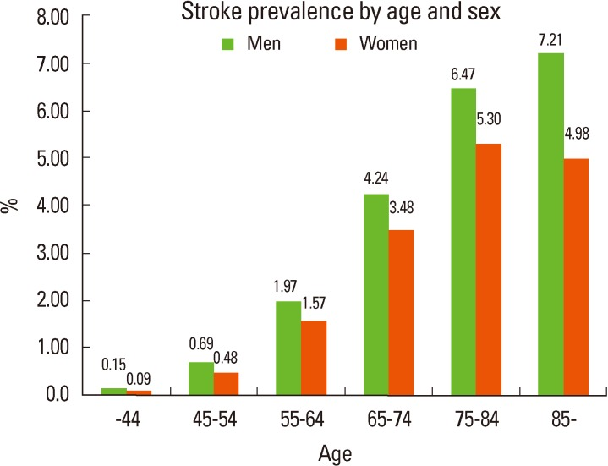
Stoke: Prevalence

Slide 6
Pathogenesis of Ischemic stroke
Penumbra
Infarction

Slide 7
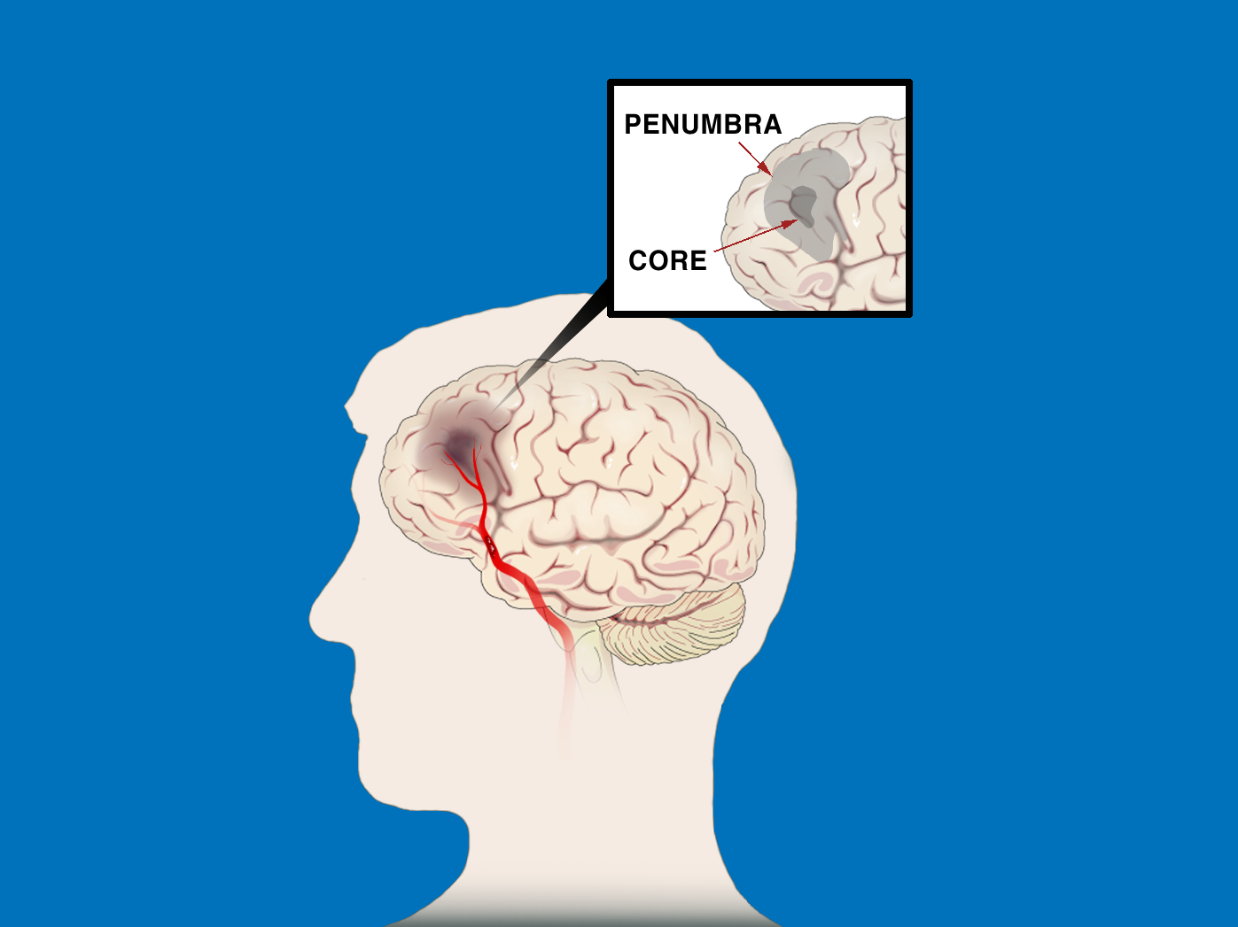
ISCHEMIC STROKE PATHOPHYSIOLOGY The First Few Hours
“”TIME IS BRAIN:
“SAVE THE PENUMBRA”
Penumbra is zone of reversible ischemia around core of irreversible infarction—salvageable in first few hours after ischemic stroke onset
Penumbra damaged by:
Hypoperfusion
Hyperglycemia
Fever
Seizure
Penumbra
Core
Clot in Artery

Slide 8
ISCHEMIC PENUMBRA
Immediately after an
ischemic stroke (top
left), a core of
irreversibly damaged
brain tissue (red) is
surrounded by an area
of viable but at-risk
tissue called the
penumbra (green).
Unless blood flow is
restored quickly, the
tissue within the
penumbra will be lost
(bottom right).

Slide 9
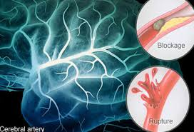
TIA IS BRAIN EMERGENCY
TIA is a “Mini brain attack”
“Time lost may be brain lost”

Slide 10
TIA: symptoms “Mini stroke”
A transient ischaemic is caused by a temporary disruption in the blood supply to part of the brain.
Warning sign for stroke
Brief localized ischemia
Common manifestations:
Contralateral numbness
Weakness of hand, forearm, corner of mouth
Aphasia
Visual disturbances- blurring
Amaurosis fugax
Deficits last less than 24 hours (usually less than 1 or 2 hours)
Crescendo TIA’s
Cerebral ischemia increasing in frequency, severity and duration
Capsular warning syndrome: repeated weakness face, arm, leg

Slide 12
STROKE PATHOGENESIS
PLATELET AGGREGATION & THROMBUS FORMATION
Platelets (magnified
here thousands
of times) home to
damaged areas of
blood vessels and
contribute to the
formation of
clots. Antiplatelet
drugs can help
reduce the risk of
ischemic stroke.

Slide 13
CAUSES (ETIOLOGIES) OF ISCHEMIC STROKE: SIX MAIN CATEGORIES
OLDER PATIENTS
(> 55)
YOUNGER PATIENTS
(< 55)
Hypercoagulable
states
Nonatherosclerotic
vasculopathies
Large-artery
atherosclerosis
Small-artery
disease
Cardio-embolism
Hypotension
Correct therapy depends on cause of stroke!
“Cause” & “risk factor” are not synonymous—must Rx both!

Slide 14
ETIOLOGIC EVALUATION: IDENTIFY STROKE, FIND SOURCE OF CLOT
NONINVASIVE
Day 1
INVASIVE
Day 2
ARTERIES
MRI & intracranial MRA
Carotid duplex (CD)
*Catheter
angiogram
HEART
ECG & monitor
Cardiac biomarkers
Transthoracic echo (TTE)
*TEE
BLOOD
*Hypercoagulable profile
*in select
patients

Slide 15
Signs and symptoms
Consider stroke in any patient presenting with acute neurologic deficit or any alteration in level of consciousness.
Abrupt onset of hemiparesis, monoparesis, or (rarely) quadriparesis
Hemisensory deficits
Monocular or binocular visual loss
Visual field deficits
Diplopia
Dysarthria
Facial droop
Ataxia
Vertigo (rarely in isolation)
Nystagmus
Aphasia
Sudden decrease in level of consciousness

Slide 16
Examination
The goals of the neurologic examination include:
Confirming the presence of stroke symptoms
Distinguishing stroke mimics
Neurologic baseline, to monitor progress
Establishing stroke severity: (National Institutes of Health Stroke Scale [NIHSS]) to assist in prognosis and therapeutic selection
Essential components of the neurologic examination:
Cranial nerves
Motor function
Sensory function
Cerebellar function
Gait
Deep tendon reflexes
Language (expressive and receptive capabilities)
Mental status and level of consciousness

Slide 17
Cardio-embolic Sources
High Risk
Medium Risk
Low / Unclear Risk
Atrial fibrillation
Recent anterior MI
Mechanical valve
Rheumatic mitral
stenosis
Thrombus / tumor
Endocarditis
LV hypokinesia / aneurysm
Bioprostetic valve
Congestive failure
Cardiomyopathy
Myxomatous MVP
Patent foramen ovale
Atrial septal aneurysm
Spontaneous echo contrast

Slide 18
Immediate Diagnostic Studies: Evaluation of a Patient With Suspected Acute Ischemic Stroke
All patients
Non-contrast brain CT or MRI
Blood glucose
Oxygen saturation
Serum electrolytes/renal function tests*
Complete blood count, including platelet count*
Markers of cardiac ischemia*
Prothrombin time/INR*
Activated partial thromboplastin time*
ECG*
Lumbar puncture (if SAH is suspected in CT –ve
scan
EEG (if SZ are suspected)

Slide 19
HYPERCOAGULABLE PROFILE PATIENTS < 55 YEARS OLD
CBC
PT/aPTT
Fibrinogen
Factor VIII
Factor VII
C-reactive protein
Antithrombin III
Protein C
Protein S (total & free)
Lipoprotein (a)
Activated protein C resistance (APCR) (& Leiden factor V mutation if APCR -)
Prothrombin G20210A mutation
Antiphospholipid antibodies
Methyltetrahydrofolatereductase (MTHFR) C677T & A1298C mutations
Sickle cell screen

Slide 20
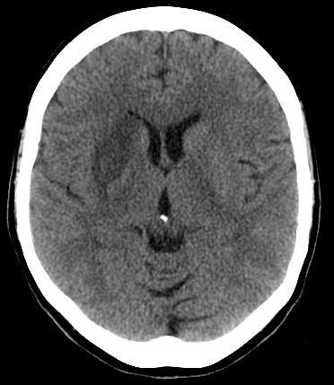
CT Examination
Axial non-contrast computed tomography (NCCT) scan demonstrates diffuse hypodensity in the right lentiform nucleus with mass effect upon the frontal horn of the right lateral ventricle in a 70-year-old woman with a history of left-sided weakness for several hours.

Slide 21
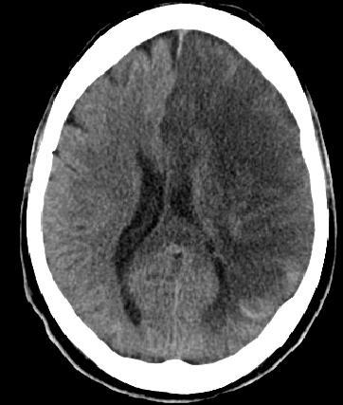
CT Examination
NCCT scan in a 52-year-old man with a history of worsening right-sided weakness and aphasia demonstrates diffuse hypodensity and sulcal effacement with mass effect involving the left anterior and middle cerebral artery territories consistent with acute infarction. There are scattered curvilinear areas of hyperdensity noted suggestive of developing petechial hemorrhage in this large area of infarction.

Slide 22
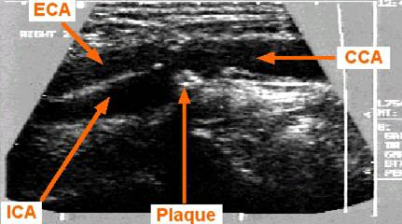
CAROTID DUPLEX
Evaluates carotid arteries in neck (operable area)
Excellent screen in the right hands
May not differentiate 99 vs. 100% stenosis
Need contrast angiography for clinically relevant stenosis measurement
Carotid duplex =
Doppler (velocities) +
B-mode ultrasound
(echo picture)
ECA
CCA
ICA
Plaque

Slide 23
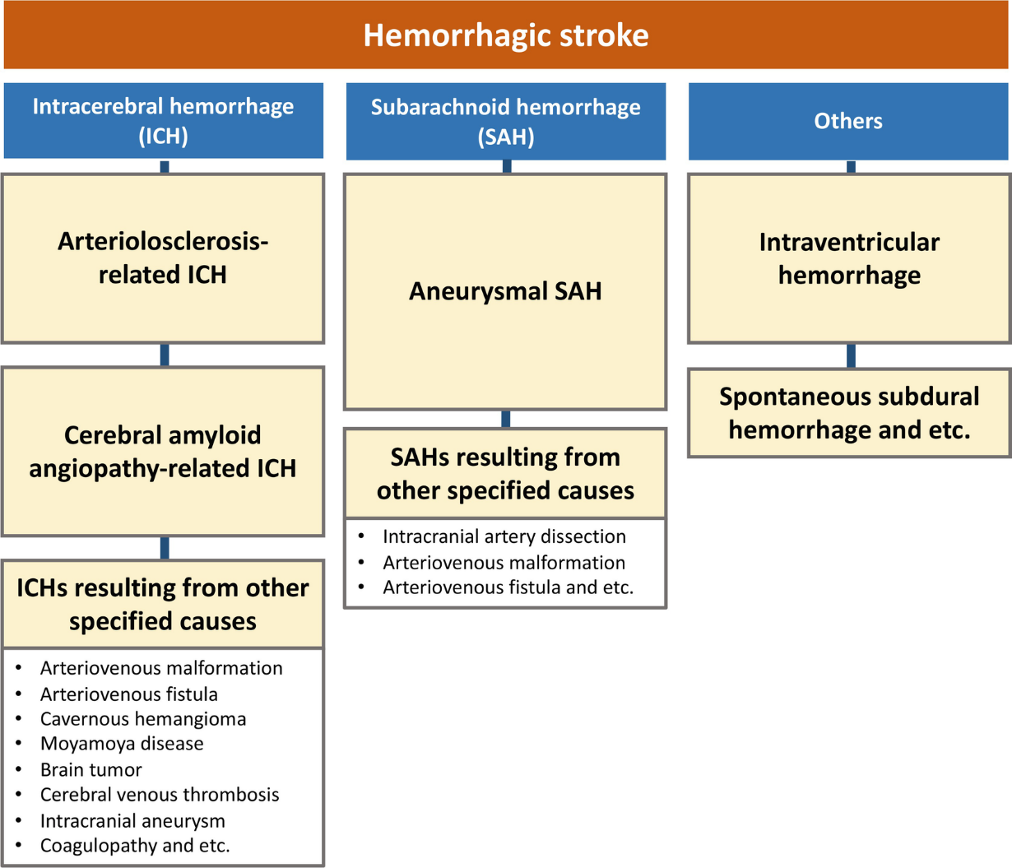
Hemorrhagic strokes

Slide 24
Hemorrhagic strokes
Subarachnoid hemorrhage
Intracerebral hemorrhage

Slide 25
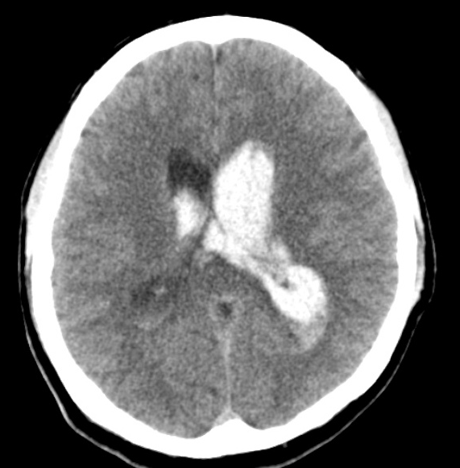
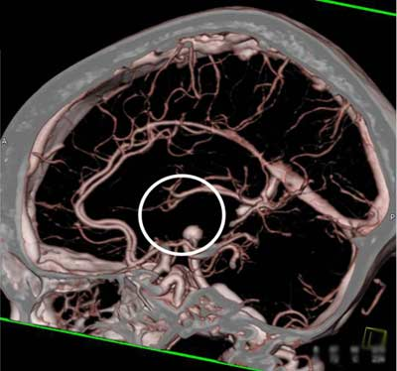
Hemorrhagic strokes
Primary IVH
CTA showing a brain aneurysm.

Slide 26
Lacunar strokes
15 – 20% of ischemic strokes
Small penetrating branches of circle of Willis, MCA, or vertebro-basilar artery
Atherothrombotic or lipohyalinotic occlusion
Infarct of deep brain structures
Basal ganglia, cerebral white matter, thalamus, pons, and cerebellum
From 3 mm to 2 cm
Clinical syndromes:
Pure motor hemiparesis (with dysarthria)
Pure sensory stroke (loss or paresthesia)
Dysarthria-clumsy hand (with contralateral face and tongue weakness)
Ataxia-hemiparesis (contralateral face and leg weakness)

Slide 27
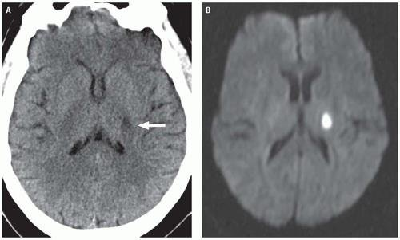
Lacunar strokes
A
B
Acute lacunar infarct. A: Axial unenhanced CT image demonstrates an ovoid area of hypo density centered in the posterior limb of the left internal capsule. B: A corresponding DWI image demonstrates high-signal intensity, reflecting restricted diffusion in an acute lacunar infarct

Slide 28
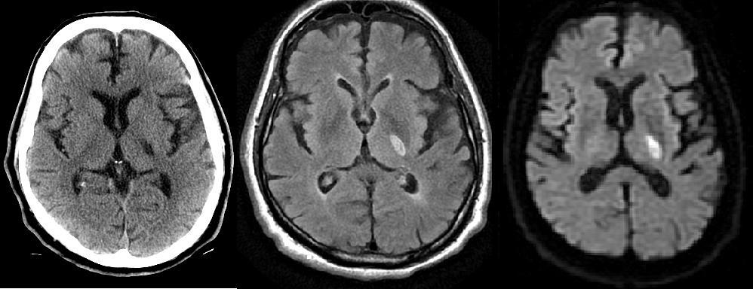
L
A
C
U
N
A
R
I
N
F
A
R
C
T
S
L
A
C
U
N
A
R
I
N
F
A
R
C
T
S
A
B
C
B
Axial NCCT scan: Demonstrates a focal area of hypodensity in the left posterior limb of the internal capsule in a 60-year-old man with acute onset of right-sided weakness.
High signal FLAIR sequence (middle image) and diffusion-weighted magnetic resonance imaging (MRI) scan (right image), with low signal on the apparent diffusion coefficient (ADC) maps indicating an acute lacunar infarction.
Lacunar infarcts are typically no more than 1.5 cm in size and can occur in the deep gray matter structures, corona radiata, brainstem, and cerebellum.

Slide 29
Deep border-zone, or watershed infarcts
MRI scan of a 62-year-old man with HTN and diabetes and a history of transient episodes of right-sided weakness and aphasia. The FLAIR image demonstrates patchy areas of high signal arranged in a linear fashion in the deep white matter, bilaterally. This configuration is typical deep border-zone, or watershed infarction, in this case the anterior and posterior middle cerebral artery (MCA)

Slide 30
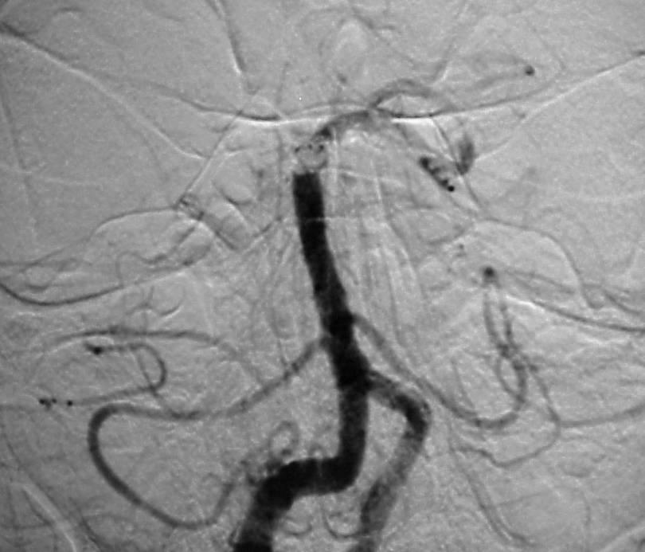
Cerebral angiogram showing basilar artery occlusion
Cerebral angiogram: performed approximately 4.5 hours after symptom onset in a 31-year-old man demonstrates an occlusion of the distal basilar artery.

Slide 31
MANAGEMENT: AIS
The goal for the management of stroke is to complete the following within 60 minutes or less of patient arrival:
Assess airway, breathing, and circulation (ABCs) and stabilize the patient as necessary
Complete the initial evaluation and assessment, including imaging and laboratory studies
Initiate reperfusion therapy, if appropriate
Critical treatment decisions focus on the following:
The need for airway management
Optimal blood pressure control
Identifying potential reperfusion therapies (e.g., intravenous fibrinolysis with rt-PA (alteplase) or intra-arterial approaches)

Slide 32
National Institutes of Health Stroke Scale (maximum= 42)
Response | Score | Response | Score
Level of consciousness Alert Drowsy Stupors Coma | 0 1 2 3 | Motor arm (Left and right) No drift Drift before 1o seconds Falls before 10 seconds No effort against gravity No movement | 0 1 2 3 4
Response to level of consciousness: Questions Answers both correctly Answers one correctly Answers neither correctly | 0 1 2 | Motor arm (Left and right) No drift Drift before 1o seconds Falls before 10 seconds No effort against gravity No movement | 0 1 2 3 4
Response to level of consciousness: Commands Obeys both correctly Obeys one correctly Obeys neither | 0 1 2 | Ataxia Absent One limb Two limb | 0 1 2
Pupillary response Both reactive One reactive Neither reactive | 0 1 2 | Sensory Normal Mild Severe | 0 1 2

Slide 33
National Institutes of Health Stroke Scale (maximum= 42)
Response | Score | Response | Score
Gaze Normal gaze palsy Partial gaze palsy Partial gaze palsy | (1) (2) (3) | Language Normal Mild Aphasia Severe Aphasia Mute or global Aphasia | (0) (1) (2) (3)
Visual Loss No Visual Loss Partial Hemianopia Complete Hemianopia Bilateral Hemianopia | (0) (1) (2) (3) | Facial Palsy Normal Minor Paralysis Partial Paralysis Complete Paralysis | (0) (1) (2) (3)
Dysarthria Normal Mild Severe | (0) (1) (2) | Extinction/Inattention Normal Mild Severe | (0) (1) (2)
Level of consciousness Questions: “How old are you?” What month is this?” Level of consciousness Commands: “Squeeze my hand” (using non-paretic hand), “Close your eyes.” < 4 = good prognosis – No tPA 4--20 = mild to moderate – ideal tPA > 20 severe deficit - No tPA

Slide 34
THE AIS-BP RELATIONSHIP
In AIS, high BP is a response not a cause – don’t lower it !
BP increase is due to arterial occlusion (i.e., an effort to perfuse penumbra)
Failure to re-canalize (w/or w/o thrombolytic therapy) results in high BP and poor neurological outcomes
Lowering BP starves penumbra, worsens outcomes
Only definite indications to ⬇ BP emergently in AIS:
AMI, CHF, Aortic dissection, ARF, or HTN encephalopathy
Candidate for thrombolysis and BP > 185/110

Slide 35
Thrombolytic Therapy: Eligibility and Exclusion Criteria
IV tPA Indications:
Within 3 hours of stroke symptom onset:
AIS diagnosis with severe or mild but disabling stroke symptoms
Symptom onset < 3 hours before starting treatment
Age > 18 years
Between 3- 4.5 hours after stroke symptom onset:
Age < 80 years
No history of both DM and prior stroke
NIHSS score < 25
Not taking oral anticoagulants
CT/MRI does not show involvement of > ⅓ of middle cerebral artery territory
If otherwise eligible and:
BP is safely lowered to < 185/110 mm Hg.
On antiplatelet drug therapy (aspirin or aspirin + clopidogrel) if benefit outweighs small risk of ICH
Contraindications for IV tPA:
Symptom onset is unknown, > 4.5 hours, or if patient awoke with stroke
Acute or previous ICH
Imaging showing extensive regions of irreversible injury (hypo-attenuation)
Prior ischemic stroke, severe head trauma, or intracranial/intra-spinal surgery within 3 months
Symptoms of SAH
GI malignancy or GI bleed within 21 days
Coagulopathy: (Platelets < 100, 000/mm³, INR > 1.7, aPTT > 40 s, PT > 15 s)
Treatment dose of low LMW heparin within 24 hours (does not apply to prophylactic doses to prevent VTE)
Persistent elevated BP (systolic > 185 mm Hg or diastolic > 110 mm Hg)

Slide 36
Thrombolytic Therapy
Rt-PA Dosing:
0.9 mg/kg is total dose
(Maximum total dose not exceed 90 mg)
10% given as bolus dose
Remaining 90% as an infusion over one hour.
Mix 50 ml of normal saline with 50 mg of rt-PA
Mixture should be used within 6 hours.
Follow up of Patients Receiving rt-PA:
Vital signs every 15 minutes/2 hrs: 30 minutes/ 6 hrs; hourly 24/ hrs until discharge.
NIHSS assessment at 24 hours at day 7, 30 and 90.
Ranking Scale and Barthel Index at 4 weeks and 3/12.
Repeat CT Scan at 22-36 hours after start therapy.
Physiotherapy and mobilization at 24 hours.
Bloods at 24 hours day 30 or PRN
CBC, LFT, U/E’s, Blood Sugar, PT, PTT & INR
Avoid (24 Hours) Invasive procedures, blood extraction, IM injections, NG tube, Folly’s cath.

Slide 37
THROMBOLYSIS COMPLICATIONS: SUSPECTD ICH
Prompted by :
New headache
Neurological deterioration
Acute hypertension
Nausea/Vomiting
Action:
Discontinue rt-PA infusion
Immediate CT Scan
Blood: PT; PTT, INR, Platelet, Fibrinogen
Give Fibrinogen 6-8 U & Cryoprecipitate with Factor VIII
Prepare to give Platelets 6-8 U
No ICH on CT Scan:
End algorithm
If ICH present on CT
Evaluate Lab results: Fibrinogen, PT aPTT, INR
Give fibrinogen or cryoprecipitate accordingly
Alert Neurosurgeon
Alert Hematologist
Consider second CT Scan to assess size change

Slide 38
MANAGEMENT: AIS (Prevention)
Primary stroke prevention: refers to the Rx of individuals with no previous history of stroke.
Measures may include use of the following:
Platelet antiaggregants
Statins
Exercise
Lifestyle interventions (e.g., smoking cessation, alcohol moderation)
Secondary prevention: refers to the Rx of individuals who have already had a stroke.
Measures may include use of the following:
Platelet antiaggregants
Antihypertensives
Statins
Lifestyle interventions

Slide 39
THANK
YOU

