Slide 1
JAUNDICE
By
Dr Waqar
MBBS, MRCP ( London)

Slide 2
DEFINITION
Yellow discoloration of sclera and mucous membranes due to bilirubin deposition is called jaundice.

Slide 3
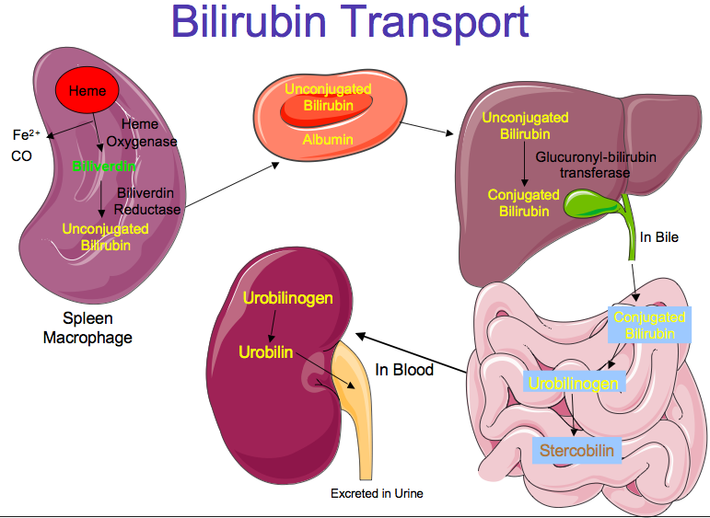
ETIOLOGIES OF JAUNDICE

Slide 4
Etiologies
1) Prehepatic
2) Hepatic
3) Post hepatic

Slide 5
PREHEPATIC CAUSES
All hemolytic anemias ( eg sickle cell disease, hereditary spherocytosis etc.
So, ask about history of any hemolytic anemia in the patient or in the family.
Ask drug history ( many drugs can cause hemolysis)

Slide 6
HEPATIC CAUSES
Hepatitis A
Hepatitis B & C ( cases in hospitals are usually chronic Hep B & C)
Cirrhosis ( any chronic liver disease can lead to cirrhosis eg chr. Hep B, C, fatty liver )
Primary biliary cholangitis
Drug induced hepatitis

Slide 7
So, ask about :
Hep A :
Recent travel history ( eating street food, drinking unclean water)
Recent restaurant visits
( hep A is spread by fecal –oral route)

Slide 8
2) Chronic Hep B & C :
* Ask about iv drug abuse, any blood transfusion, any needle stick injury from a hep B or C positive person, history of Hep B/ C in the spouse or mother, use of unsterile syringes, history of multiple sexual partners specially unknown people.

Slide 9
3) Cirrhosis :
* Same questions as for Hep B and C
* Ask about DM ( causes fatty liver)
4) Primary biliary cholangitis:
* Female with jaundice, itching & xanthelasma
( confirmation of PBC is by blood test)

Slide 10
5) Drugs:
* Take a drug history, even simple medicines

Slide 11
POST HEPATIC ETIOLOGIES
CB duct stone
Pancreatic head cancer
Gall bladder cancer
Ask about :
Symptoms of gallstones
Wt. loss ( cancer)
Stool color: Due to biliary obstruction, stools become pale
Ask “ are the stools easy to flush?

Slide 12
Labs to do in Jaundice
CBC : Can show :
* Anemia
Low platelets ( cirrhosis)
2) PT/INR : High in chronic liver disease
3) LFTs : Abnormal
* In hepatic causes, AST and ALT much higfher than alkaline phosphatase, in post hepatic causes, alk phos is much higher
4) Serum albumin: Low in chronic liver disease

Slide 13
Labs (contd)
5) Check Hep B & C serology. Any other serologies depending on the cause

Slide 14
IMAGING
Ultrasound
CT/ MRI ( rarely)
Biopsy ( not always)

Slide 15
Complications of Cirrhosis
Portal HTN
Esophageal varices
Ascites
Hepatocellular carcinoma

Slide 16
Treatment
Hep A: No specific treatment. Just good nutrition
Hep B : Interferon + some other drugs
Hep C : Oral meds. Now available
Avoid any medicines which damage the liver

Slide 17
Treatment of complications
Ascites: salt & water restriction, Diuretics ( eg Aldactone)
Esophageal varices : Sclerotherapy
In patients with cirrhosis, always rule out hepatocellular carcinoma by doing :
* Liver ultrasound every year
* Check blood levels of alpha fetoprotein every year ( very high in cancer)

Slide 18
THE END

