Slide 1
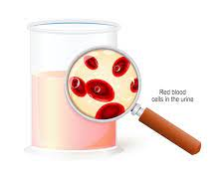
APPROACH TO HEMATURIA
Prepared by :
Dr.salma elgazzar
MRCPI-pediatrics
Master’s degree in pediatrics Alexandria University

Slide 2
LEARNING OBJECTIVE
1. Define hematuria.
2. Discuss the methods of detection of hematuria.
3. Recognize the general classification of hematuria.
4. Discuss the commonest causes of hematuria in pediatrics.
5. Discuss the key components from the history and physical examination in evaluating a child with hematuria.
6. Identify the distinguishing features between glomerular and non-glomerular causes of hematuria based on urine analysis.
7. Formulate an appropriate management plan to evaluate an infant with hematuria.
8. List the indication of renal biopsy in the evaluation of hematuria.

Slide 3
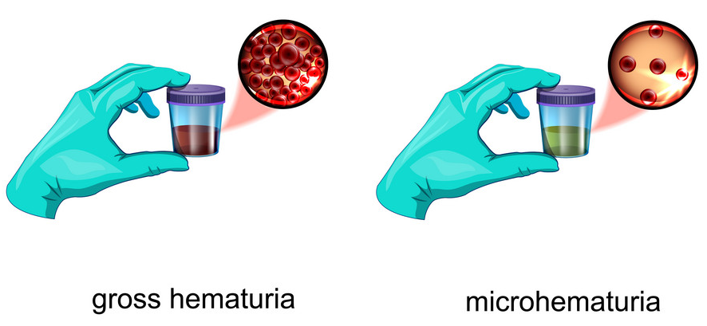
DEFINITION
Hematuria, defined as the persistent presence of more than five red blood cells (RBCs)/high-power field (hpf) on freshly voided and centrifuged urine.
Occurs in 4–6% of urine samples from school-age children.
Microscopic hematuria = urine grossly appears normal.
Gross hematuria = blood visible to the naked eye

Slide 4

IMPORTANT QUESTION
Is it true hematuria? Or any colored urine?

Slide 5
To answer the question?
History & clinical examination
+
Check urine for blood by dipstick & microscopic examination
Heme negative, negative RBCs by microscopy :
-Foods: beet roots, black berries.
-Drugs: Rifamipicin, Desferal, Nitrofurantoin.
-Urate crystals (red diaper).
Positive hemostick and negative RBCs by microscopic could be either :
Hemoglobinuria
Myoglobinuria
Positive RBCs in microscopic examination means real hematuria

Slide 6
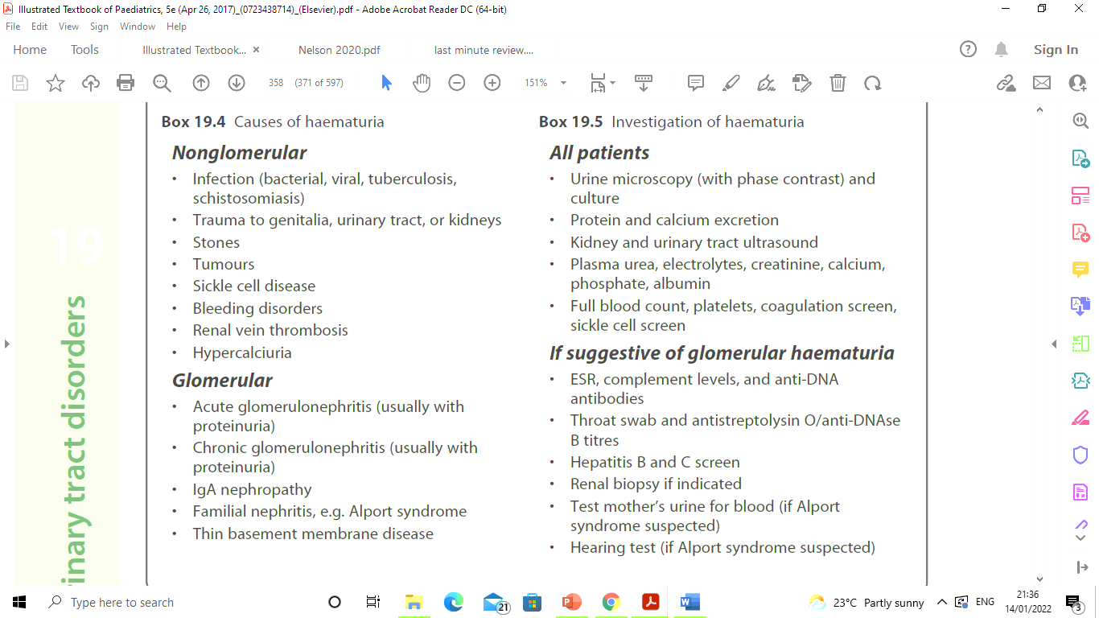
CAUSES OF HEMATUREA

Slide 7
GLOMERULAR
Brown or tea colored (coca-coloured) urine
Red blood cell casts, cellular casts ,tubular cells
Proteinuria > +2 by dipstick in the absence of gross hematuria
Dysmorphic RBCs by phase contrast microscopy
Erythrocyte volume < 50
NON-GLOMERULAR
Red dark urine
Blood clots
No proteinuria or < +2 in the absence of gross hematuria
Normal morphology of erythrocytes
Erythrocytes volume> 50

Slide 8
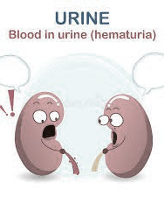

APPROACH TO HEMATUREA

Slide 9
Evaluation of the child with hematuria begins with a careful history, physical examination, and microscopic urinalysis.
HISTORY
Patients with hematuria can present with a number of symptoms : Tea- or cola-colored urine, facial or body edema,
hypertension, , oliguria , flank pain ,Frequency, dysuria, unexplained fevers, renal colic, headache,
mental status changes, visual changes (diplopia), epistaxis, or heart failure ,Rash and joint complaints
Open question about the chief Complaint
• Color : pink to red (extra glomerular), brown cola -coloured (glomerular), smell, stones, clots (extra glomerular)
• Phase of urination ,duration of the problem
• Time at night or with activity
• Frequent & amount in each episode of urination or not
• Previous similar problem.
• Recent history of:
  ✓Recent febrile illness
  ✓Recent pharyngitis
  ✓Recent streptococcal skin infection
  ✓ Recent trauma, menstruation,or strenuous exercise
  association symptoms (fever , dysuria, pain, edema , headache, Weight loss, fatigue, FTT, pallor, jaundice)

Slide 10

Systemic review:
Respiratory system (URTI): IgA GN , post.GABS
CVS: Exercise intolerance, fatigue (acute secondary to HTN),infective endocarditis
GIT: bloody diarrhea HUS ,abdominal mass.
CNS: headache, loss of consiousness, convulsion e.g hypertensive encephalopathy
Muscoskeletal: Arthritis e.g SLE.
Skin: (rash/ HSP ) (photosensitivity / SLE), (petechial / bleeding tendency)
(skin infection /post strept) (Jane way & Osler nodules /infective endocarditis)
Eyes & Ear: deafness, cataract & keratoconus e.g Alport syndrome
Hematology: bleeding tendency ,sickle cell anemia. hb urea: intravascular hemolysis e.g G6PD & PNH.

Slide 11
Past history
Medical history :kidney diseases, recurrent URTI, trauma & exercise
Drug hx & food intake.
Developmental history (deafness /alport syndrome.) Family History (H.urea, renal diseases ,tendency to form stones, deafness /alport syndrome.)

Slide 12
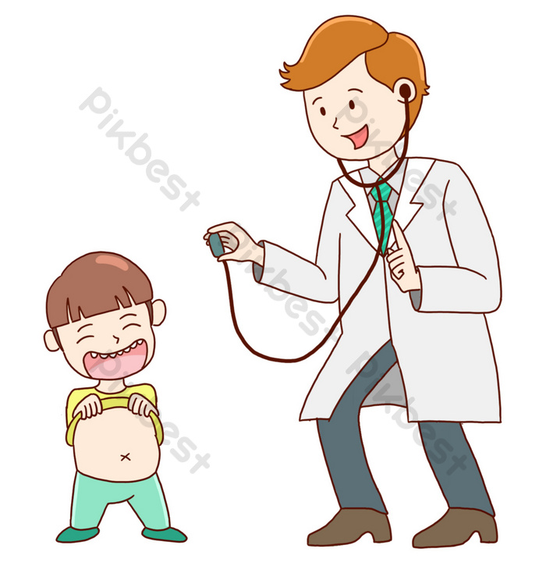
PHYSICAL EXAMINATION
Physical examination may also suggest possible causes of hematuria.
Temperature
Measuring blood pressure: presence of hypertension, edema, or signs of heart failure suggests acute glomerulonephritis.
Abdominal masses may be:
  Bladder distention in posterior urethral valves.
  Hydronephrosis in ureteropelvic junction obstruction.
  Polycystic kidney disease, or wilms tumor.
A flank mass :hydronephrosis, renal cystic diseases, renal vein thrombosis, or tumor
Several malformation syndromes are associated with renal disease.

Slide 13

Rash and joint complaints : HSP or SLE nephritis.
Eye examination:
visual changes (diplopia) may be associated severe hypertension.
Alport syndrome : anterior lenticonus, cataract , funduds
Perineum and urethral meatus:
Anatomic abnormalities of the external genitalia.
unexplained perineal bruising and hematuria: Child abuse must always be suspected .

Slide 14
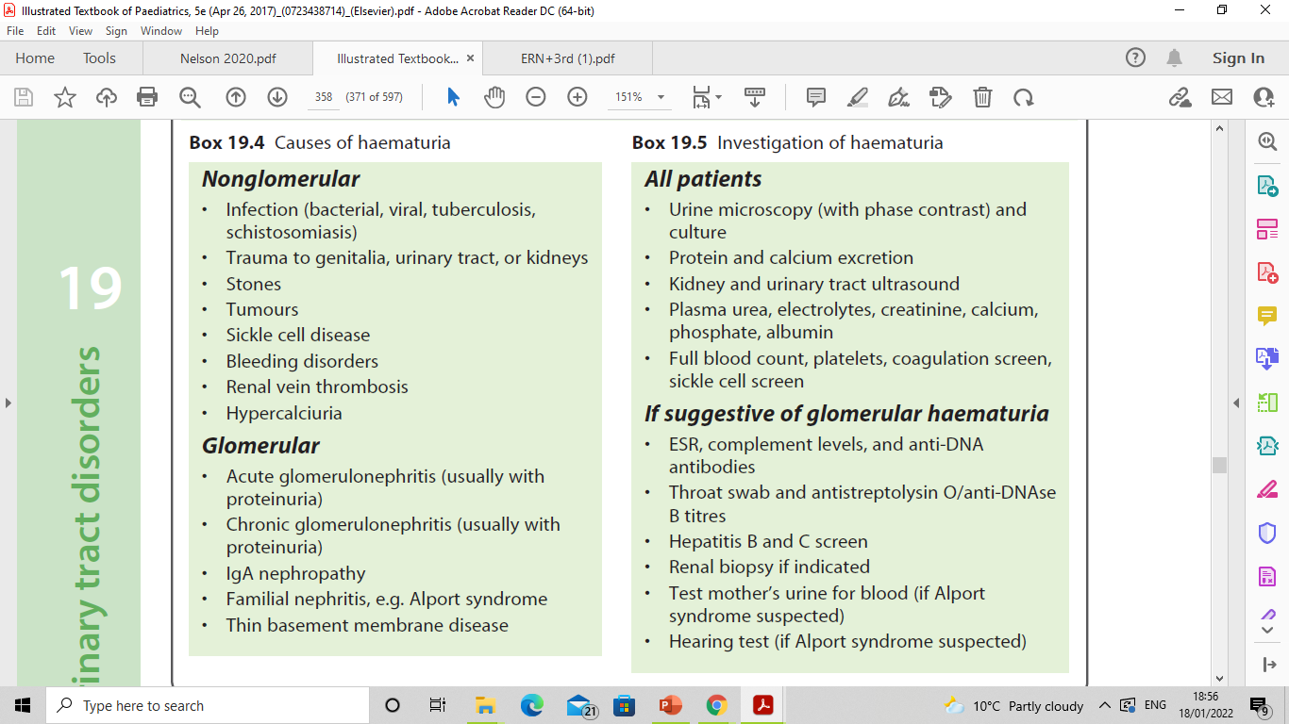
Investigations

Slide 15
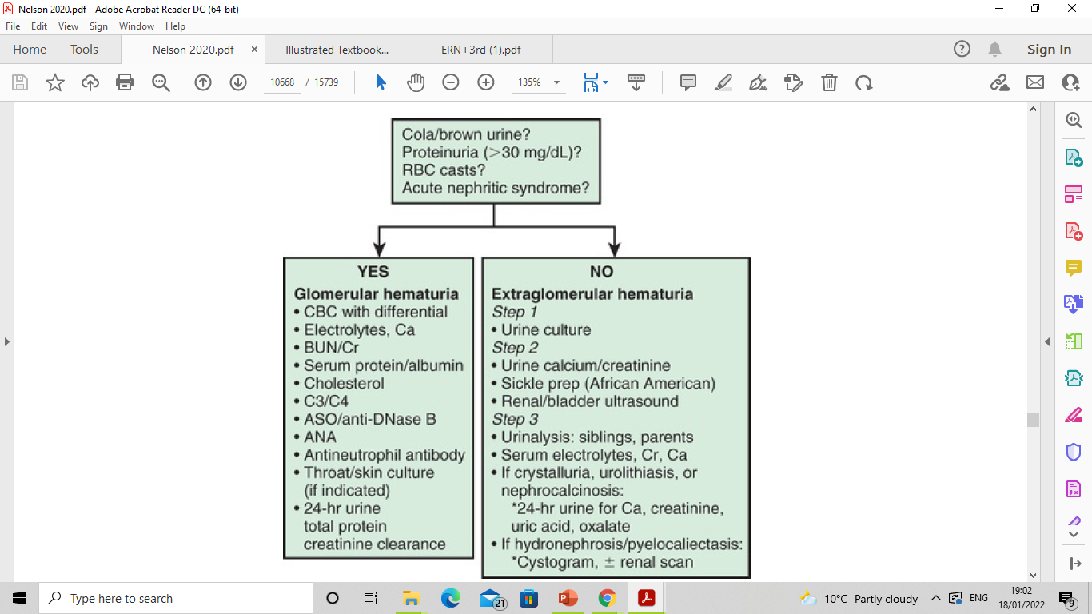

Slide 16
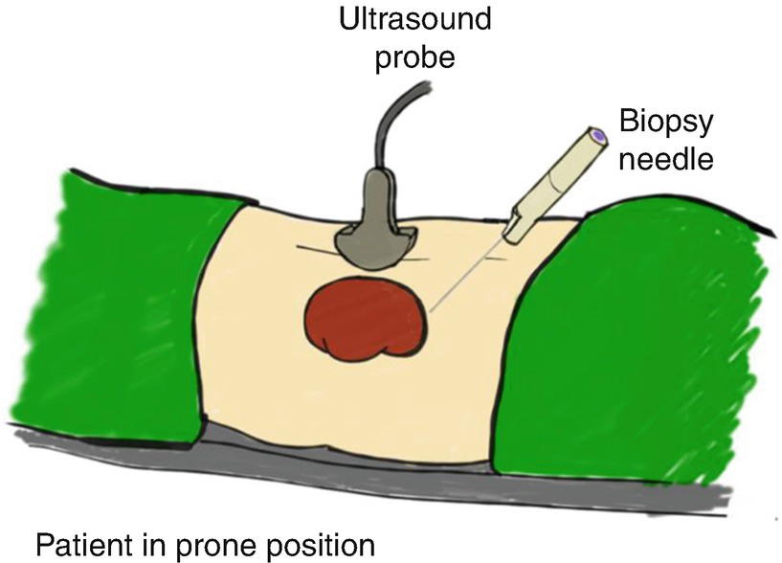

INDICATION OF RENAL BIOPSY IN THE EVALUATION OF HEMATURIA.

Slide 17
A renal biopsy may be indicated if:
  There is significant persistent proteinuria
  There is recurrent macroscopic haematuria
  Renal function is abnormal
  The complement levels are persistently abnormal.
  Lupus nephritis
  Unexplained acute renal failure

Slide 18

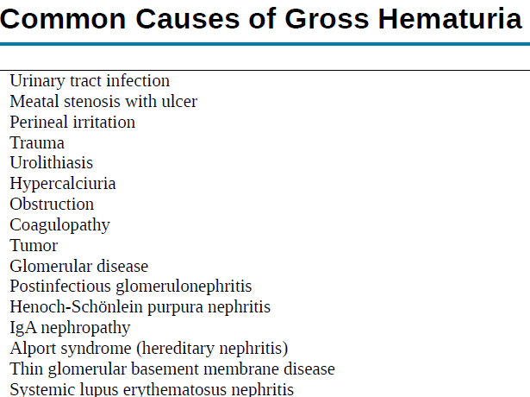
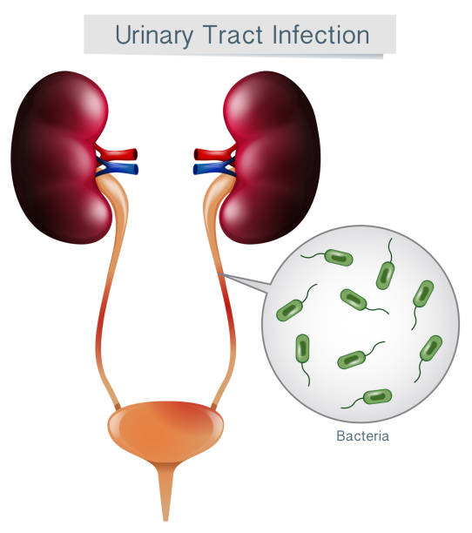
UTI is the most common cause of hematuria .

Slide 19
URINARY TRACT INFECTIONS
Most UTIs are bacterial infections of the mucosal surface of the urinary tract.
• The infection may occur anywhere from the urethra to the renal parenchyma.
•A temperature greater than 38.5 °C may help to differentiate acute pyelonephritis from lower tract UTIs.
•The most common organism causing UTI in children is Escherichia coli, accounting for up to 70 % of infections.
•Other bacterial pathogens include Pseudomonas aeruginosa (nonenteric Gram-negative), Enterococcus faecalis,Klebsiella pneumoniae, group B Streptococcus (predominantly in neonates)

Slide 20
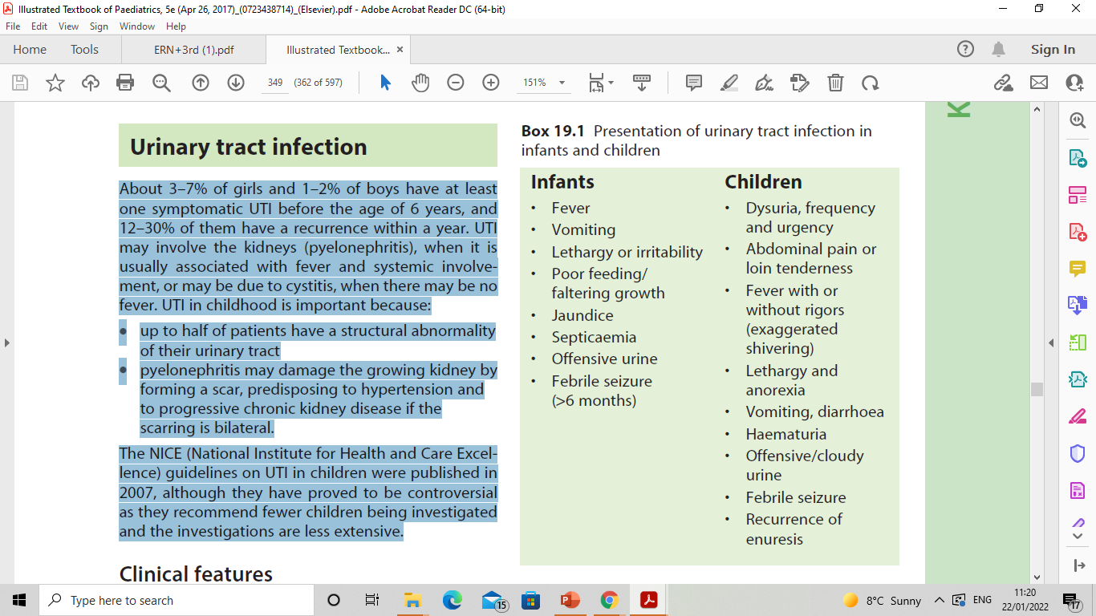
URINARY TRACT INFECTIONS
UTI may involve the kidneys (pyelonephritis), when it is usually associated with fever and systemic involvement, or may be due to cystitis, when there may be no fever. UTI in childhood is important because:
• Up to half of patients have a structural abnormality of their urinary tract
• Pyelonephritis may damage the growing kidney by forming a scar, predisposing to hypertension and to progressive chronic kidney disease if the scarring is bilateral.
A urine sample should be tested in all infants with an unexplained fever >38° C

Slide 21
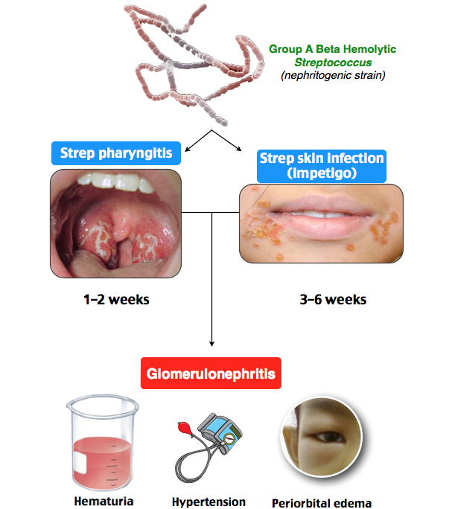
Acute post-streptococcal glomerulonephritis
Onset of reddish-brown (‘Coca Cola-coloured’) urine 10–14 days after streptococcal throat or skin infection
Deposition of immune complexes and complement in glomeruli
Clinical presentation
  Most common in children between 5 and 15 years of age
  1–2 weeks after streptococcal pharyngitis or 3–6 weeks after streptococcal pyoderma
  Nephritic presentation, various degree of edema, HTN and oliguria
  Encephalopathy and heart failure may develop
  Acute phase resolves in 6–8 weeks
  Proteinuria and HTN should normalize within 4–6 weeks after onset
  Microscopic hematuria may persist for up to 2 years, and the patient needs to be followed until its resolution

Slide 22
Investigations include:
• Throat swab
• Antistreptolysin O (ASO) titre; anti-DNAase B
• Typically ↓ C3, normal C4
• Biopsy if there is significant renal involvement – diffuse proliferative glomerulonephritis is seen, with crescents, in severe cases
Treatment :
Mainly supportive, with an excellent prognosis for recovery; in very severe cases involving renal failure, steroids have been used
Note: always check C3 and C4 .
Returns to normal 6-8 wk after the onset. If still lowered there may be another diagnosis, e.g. systemic lupus erythematosus or MCGN, which has much worse prognosis.

Slide 23
IgA nephropathy
Presents with incidental finding of persistent microscopic hematuria or with an episode of macroscopic hematuria which is typically associated with concurrent upper respiratory infection or acute gastroenteritis– these episodes may be recurrent.
• May also present as persistent microscopic hematuria
•Proteinuria is usually less than 1000 mg/24 h
•Rare: nephritic/nephrotic manifestation, facial edema, mild to moderate HTN, elevated creatinine, and blood urea nitrogen level (azotemia)
• Prognosis for childhood presentation is quite good, although 10–15% will develop proteinuria,hypertension with/without renal failure during long-term follow-up
• Treatment Blood pressure control
•Alternate day of corticosteroids, if patient presents with overt nephritic syndrome with nephrotic-range proteinuria
•ACE inhibitors are effective in reducing proteinuria, combination of ACE inhibitors and angiotensin receptor
blockers (caution: need to check renal function frequently due to synergistic reduction in GFR)
•Fish oil contains anti-inflammatory Omega 3, and was thought to protect from progression, but not evidence
based

Slide 24
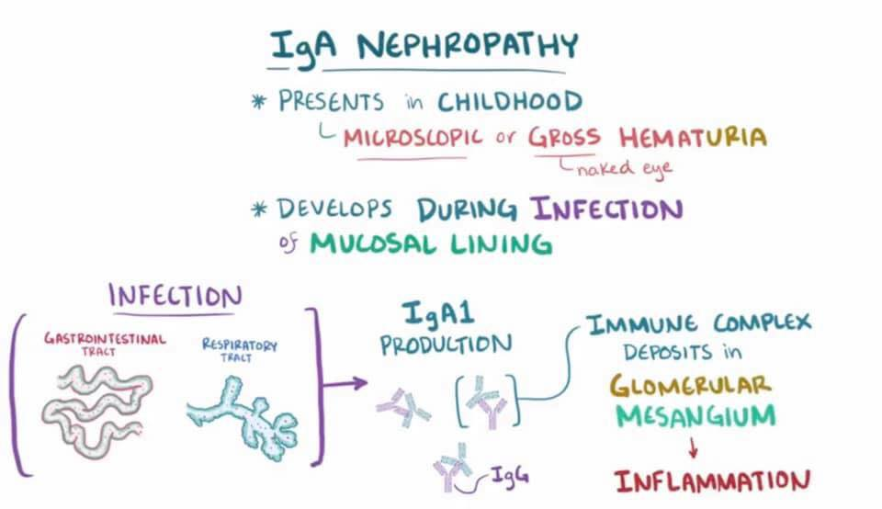
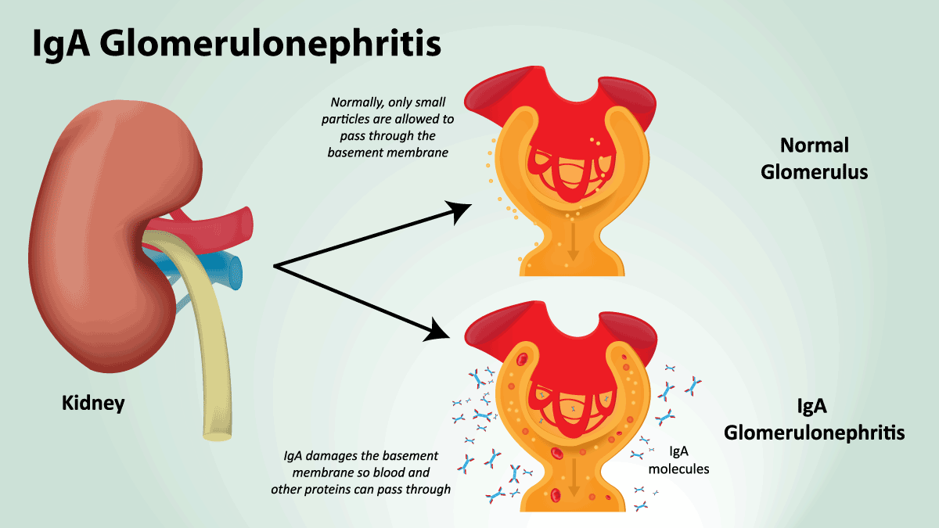

Slide 25
ALPORT SYNDROME
• Hereditary nephritis with sensorineural deafness and anterior lenticonus (conical deformity of lens of eye seen with slit-lamp)
• X-linked (most common) and autosomal recessive forms
• X-linked – males affected; female carriers all have microscopic hematuria; with lyonization some females may develop hypertension and renal disease, but with milder and later onset
• Autosomal recessive (chromosome 2) – both sexes equally severe
• Basic defect is in production of subunits for type IV collagen (two subunits coded for on X chromosome, two on chromosome 2); type IV collagen is located in kidney, eye and inner ear –hence the main clinical features
• Presents with incidental finding of microscopic hematuria, or episode of macroscopic hematuria
• Deafness around 10 years
• Hypertension in mid-teens
• Eye signs in mid–late teens (not before 12 years)
• Average age for end-stage renal failure is 21 years

Slide 26
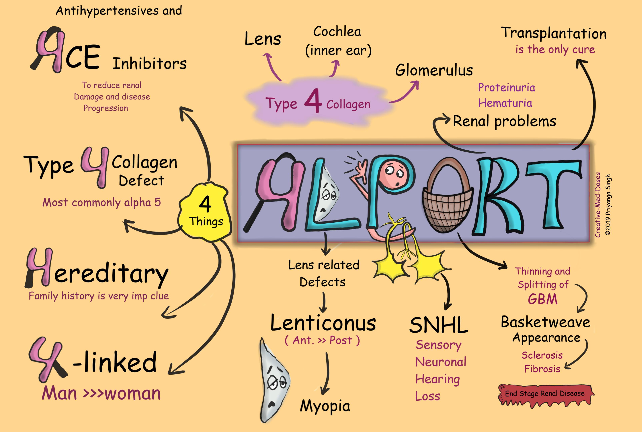

Slide 27
HENOCH–SCHÖNLEIN PURPURA
Henoch–Schönlein purpura is the combination of some of the following features:
• Characteristic skin rash on extensor surfaces
• Arthralgia
• Periarticular oedema
• Abdominal pain
• Glomerulonephritis.
It usually occurs between the ages of 3–10 years
Twice as common in boys, peaks during the winter months, and is often preceded by an upper respiratory infection.
Genetic predisposition and antigen exposure increase circulating IgA levels and disrupt IgG synthesis.
The IgA and IgG interact to produce complexes that activate complement and are deposited in affected organs, precipitating an inflammatory response with vasculitis.

Slide 28
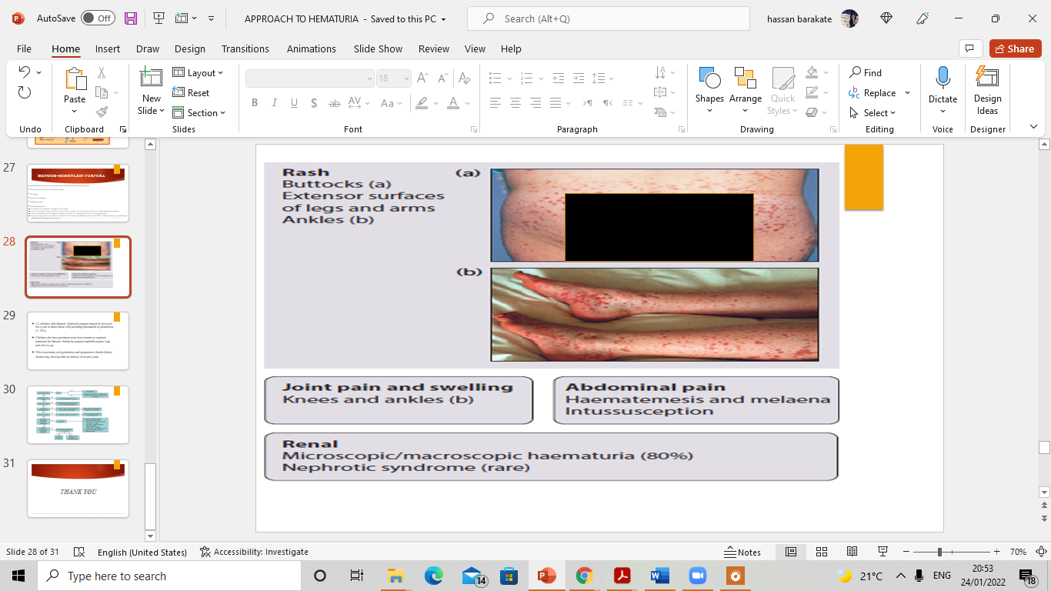

Slide 29
All children with Henoch–Schönlein purpura should be followed for a year to detect those with persisting haematuria or proteinuria (5–10%).
Children who have persistent renal involvement or required treatment for Henoch–Schönlein purpura nephritis require long-term follow-up.
This is necessary as hypertension and progressive chronic kidney disease may develop after an interval of several years.

Slide 30
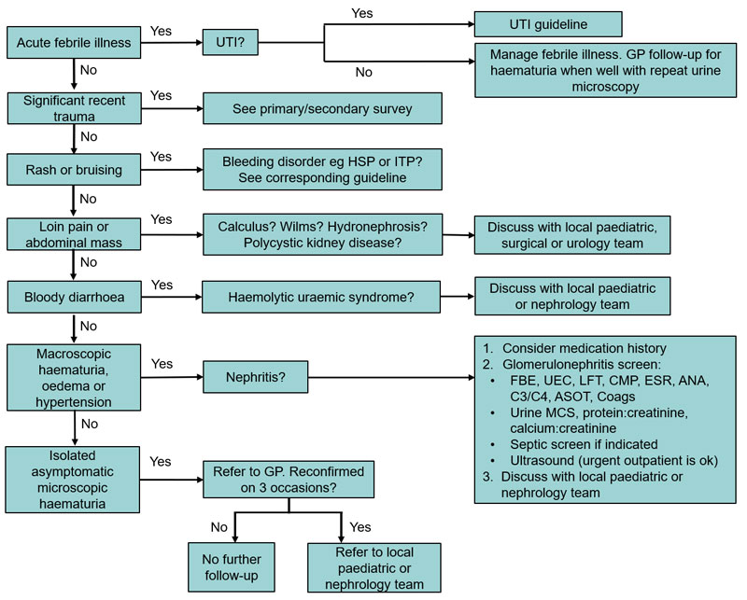

Slide 31
THANK YOU

