Slide 1

Acid base disturbance
Prepared by :
Dr.Salma ElGazzar
MRCPI-pediatrics
Master’s degree in pediatrics Alexandria University

Slide 2
OBJECTIVES
1. Recall the physiology involved in the acid base balance of the body.
2. Describe the normal values and factors that influence normal variables.
3. Identify abnormal values and its interpretation.
4. Describe and list the differential diagnosis of both respiratory acidosis and alkalosis.
5. Describe and list the differential diagnosis both of metabolic acidosis and alkalosis.

Slide 3
Introduction
DEFINITIONS
Acid
An acid is a substance that can release a hydrogen ion (H+)
Base
A base is a substance that can accept a hydrogen ion (H+)
Buffer
A buffer is a chemical that minimizes the change in pH when an acid or base is added to a solution
The main buffer in the human body is carbonic acid (H2CO3)
Carbonic acid buffers blood through the following reaction:
H+ + HCO3- ⇌ H2CO3 ⇌ H2O +CO2
Anions and cations
Anions are atoms or groups of atoms that carry a negative charge. The main anions in human blood are chloride(Cl-) and bicarbonate (HCO3-).
Cations are atoms or groups of atoms that carry a positive charge. The main cation in human blood is sodium (Na+).

Slide 4
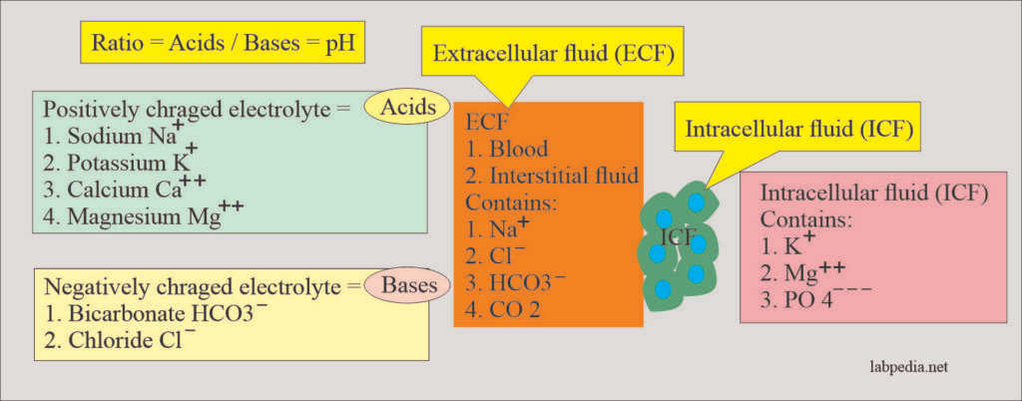
physiology of the acid base balance
Acid–base balance is regulation of the extracellular fluid environment involves the ratio of acid to base, measured clinically as pH.
Physiologically all positively charged ions are called acids, and all negatively charged ions are called bases.
https://labpedia.net/acid-base-balance-part-1-introduction-to-the-acid-base-balance/

Slide 5
Body acids are formed from end products of:
Metabolism of proteins.
Metabolism of Carbohydrates.
Metabolism of fats.
This must be balanced by the number of basic substances in the body to maintain the normal pH.
Lungs, kidneys, and bones are the major organs involved in the regulation of acid-base balance.
Body acids are of two types:
Volatile acids:
Carbonic acid (H2CO) is a weak acid, and it does not easily release the H ions.
The presence of carbonic anhydrase enzyme can eliminate CO 2 gas and waterH2O.
CO 2 is eliminated through the lungs.
Nonvolatile acids:
These are sulfuric acid, phosphoric acid, and other organic acids that are eliminated through the kidneys.
These are strong acids and readily give up their H ions.
Nonvolatile acids are secreted into the urine by the renal tubules.

Slide 6
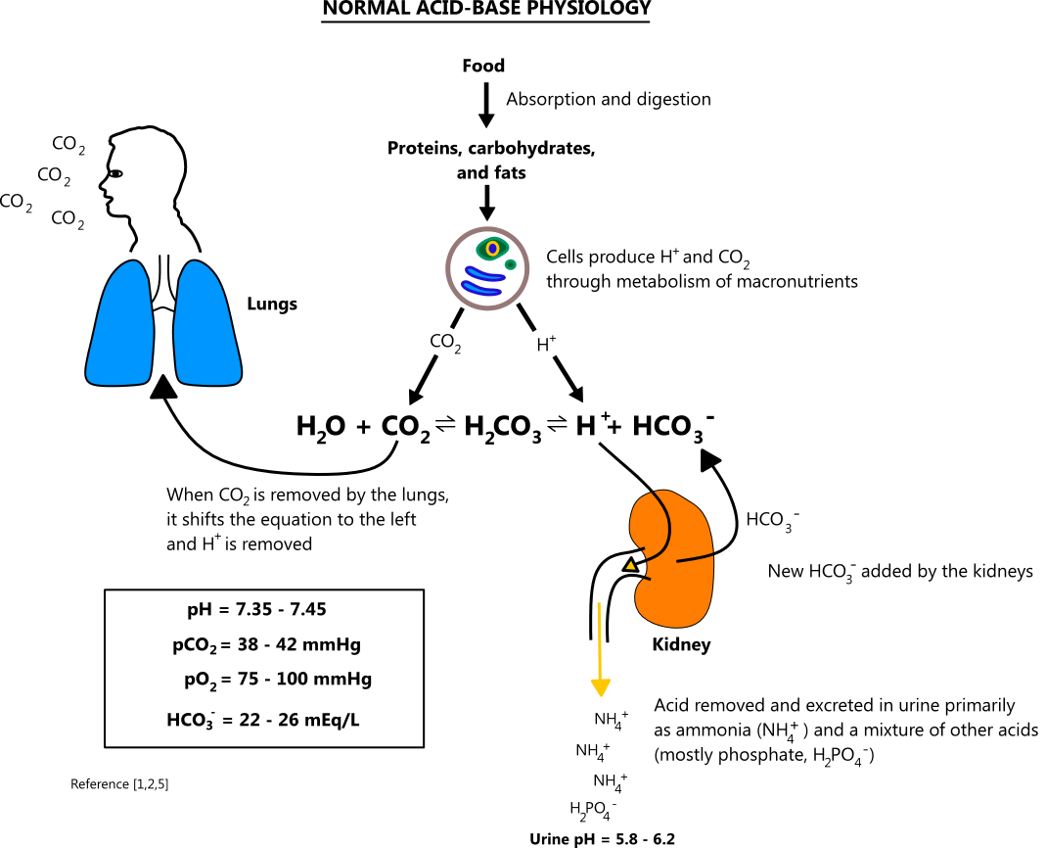
Macronutrient metabolism typically generates a net gain of acid
Carbohydrates and fats are oxidized to CO₂ and H₂O.
The CO₂ immediately reacts with H₂O in the blood to produce H⁺ and HCO₃⁻ via the following reaction: H₂O + CO₂ ⇌ H₂CO₃ ⇌ H⁺ + HCO₃⁻.
Proteins are metabolized to strong acids (e.g. H₂SO₄, HCl, H₃PO₄)
In order to maintain a normal pH, the body must buffer and eliminate the CO₂ and strong acids that are produced
CO₂ is typically eliminated through the lungs at the same rate that it is produced
The kidneys help remove strong acids by excreting H⁺, and they generate new HCO₃⁻ to replace HCO₃⁻ lost through buffering
Other chemicals buffers exist (e.g. proteins, phosphate, hemoglobin, bone minerals, etc.), but carbonic acid (H₂CO₃) is the most important one for maintaining blood pH

Slide 7
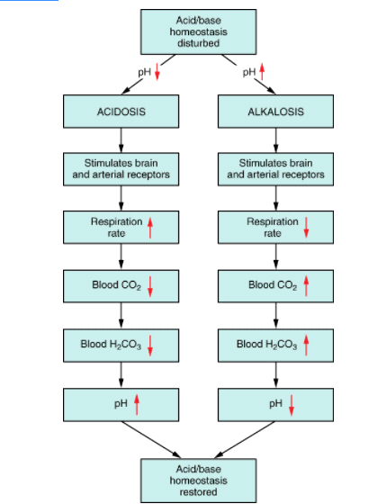
The lungs can raise pH by blowing off more CO₂, and they can lower pH by decreasing ventilation and retaining CO₂
Respiratory compensation can begin within minutes and becomes maximal in 12 - 24 hours.
If the primary disorder is from a metabolic cause, the lungs will compensate (respiratory compensation).

Slide 8
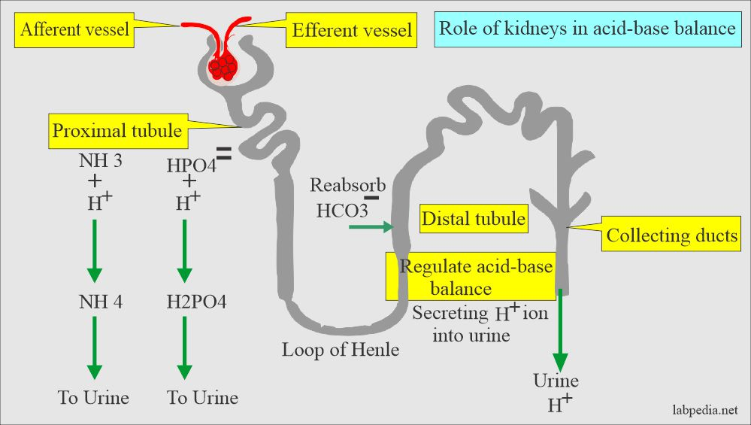
The kidneys can raise pH by increasing the production of HCO₃⁻ and excreting acid, and they can lower pH by eliminating HCO₃⁻ and retaining acid
Renal compensation has an acute and chronic phase, where the effect is smaller at first before reaching a peak in 2 - 5 days.
If the primary acid-base disorder is from a respiratory cause, the kidneys will compensate (renal compensation).

Slide 9
Definitions and normal value of ABG
Lab test | Definitions
PH | This will tell: Increased pH value indicates alkalosis Decreased value of pH indicates acidosis
pCO2 | This is the partial pressure of CO2, and it will tell: The respiration modulates this pCO2 This is the index of ventilation
pO2 | This is the partial pressure of the O2 in the arterial blood and tell: Low values indicate hypoxia pO2 is the indirect measure of O2contents of arterial blood.
Base excess | Measures the change in the concentration of a buffer base from the normal value. Normal range =+/− 2 mmol/L.
Anion gap | [Na+ + K+] − [Cl− + HCO3−]. Normal= 10 − 16 mmol/L. Reflects concentration of those anions not routinely measured, e.g. organic acids.
Blood gas measurement can identify the primary disturbance in acid-base balance.

Slide 10
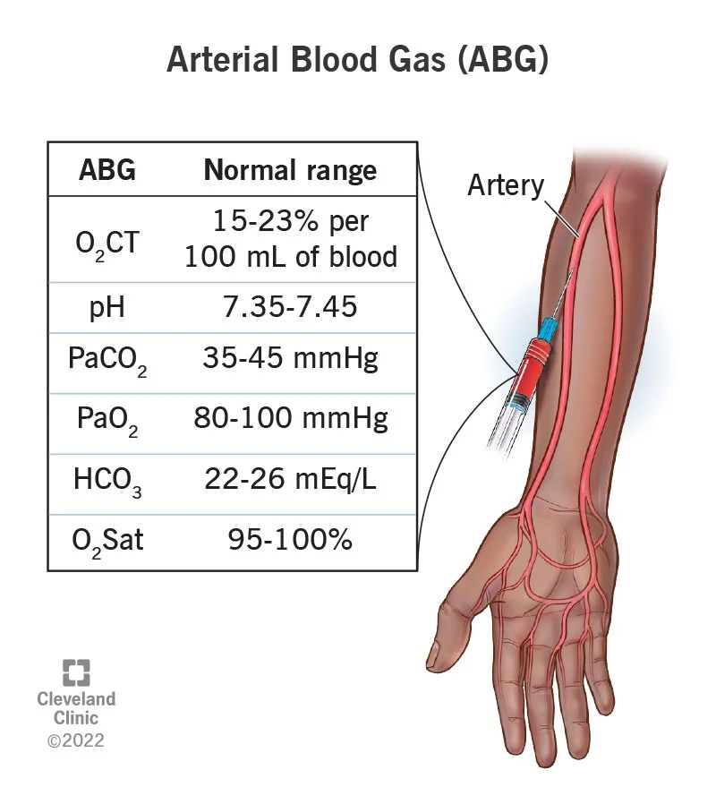

Slide 11

Abnormal values and how to interpret ABG

Slide 12
ABG interpretation
For the purpose of this guide, we have set three (3) goals that we need to accomplish when interpreting arterial blood gases. The goals are as follows:
Based on the given ABG values, determine if values interpret ACIDOSIS or ALKALOSIS.
Second, we need to determine if values define METABOLIC or RESPIRATORY.
Lastly, we need to determine the compensation if it is: FULLY COMPENSATED, PARTIALLY COMPENSATED, or UNCOMPENSATED.

Slide 13

For pH, the normal range is 7.35 to 7.45
For PaCO, the normal range is 35 to 45
For HCO, the normal range is 22 to 26

Slide 14
1-Based on the given ABG values, determine if values interpret ACIDOSIS or ALKALOSIS.
Make a 3×3 grid and label.
Based on their values, determine in which column we’ll place pH, PaCO2, and HCO3 in the grid.
determine the acidity or alkalinity of the blood with the given value of the pH
Any blood pH below 7.35 (7.34, 7.33, 7.32, and so on…) is ACIDOSIS, place it under the ACIDOSIS column.
Any blood pH above 7.45 (7.46, 7.47, 7.48, and so on…) is ALKALOSIS, place it under the ALKALOSIS column.
Acidosis | Normal | Alkalosis

Slide 15


Slide 16
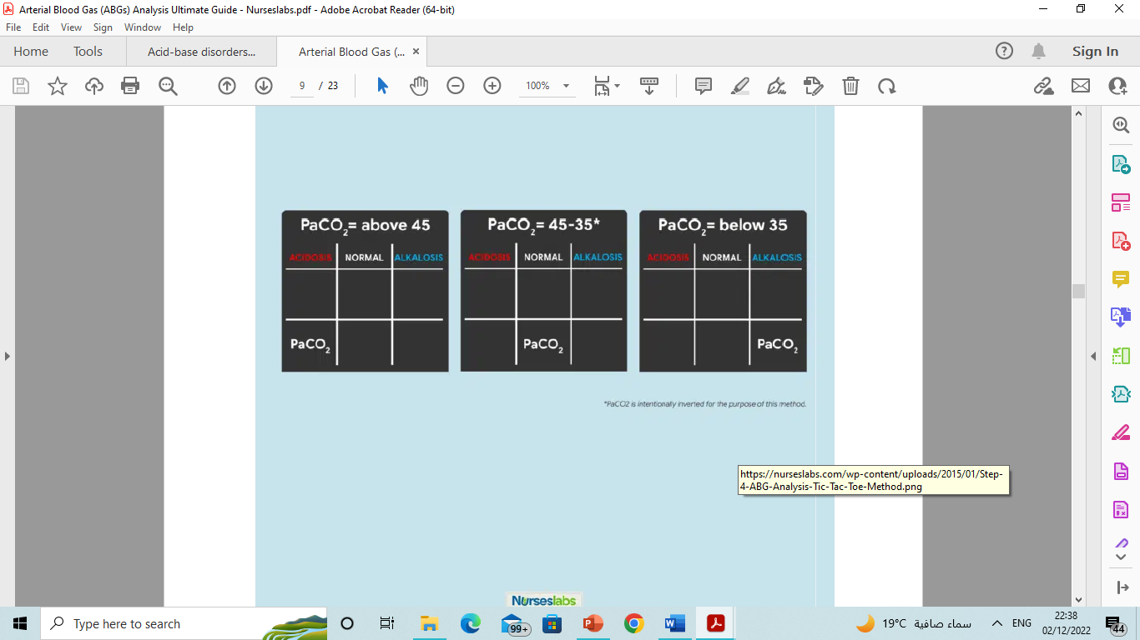
Determine if PaCO2 is under NORMAL, ACIDOSIS, or ALKALOSIS.
If PaCO2 is below 35, place it under the ALKALOSIS column.
If PaCO2 is above 45, place it under the ACIDOSIS column.
If PaCO2 is within its normal range, place it under the NORMAL column.
Acidosis | Normal | Alkalosis

Slide 17
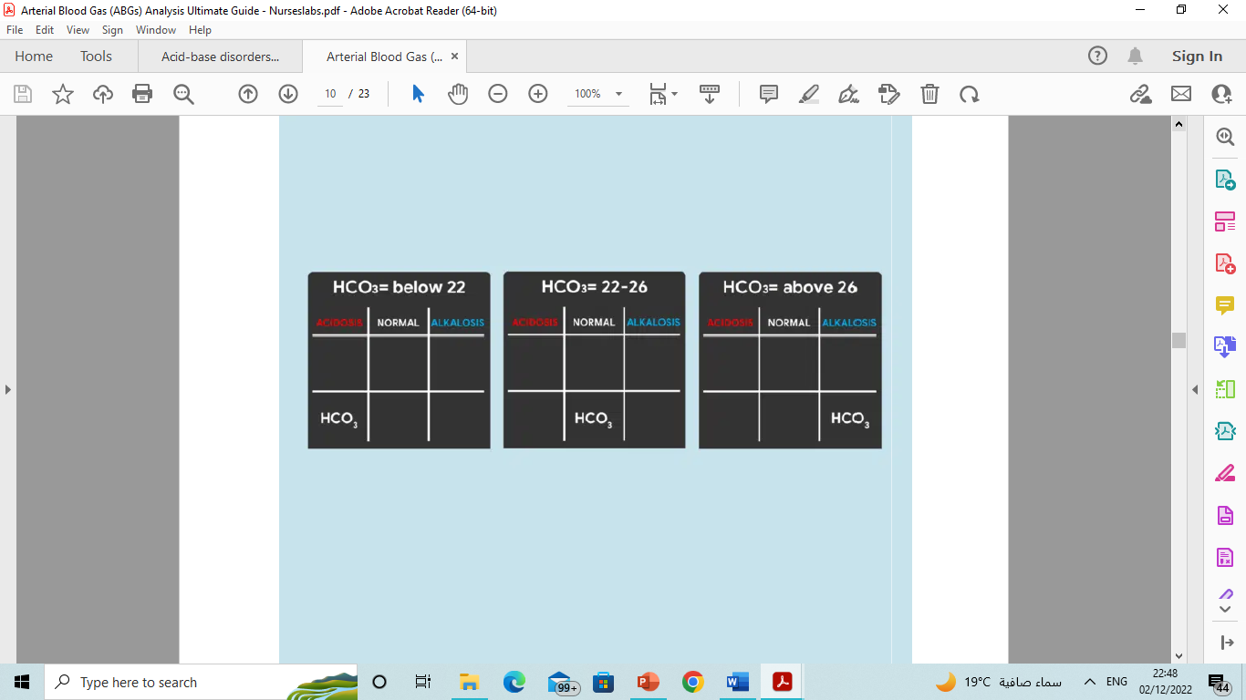
Determine if HCO is under NORMAL, ACIDOSIS, or ALKALOSIS.
Acidosis | Normal | Alkalosis
If HCO is below 22, place it under the ACIDOSIS column.
If HCO is above 26, place it under the ALKALOSIS column.
If HCO is within its normal range, place it under the NORMAL column.

Slide 18
determine if values define METABOLIC or RESPIRATORY.
Looking back again on the tic-tac-toe grid, determine if pH is under the same column as PaCO2 or HCO3 so we can accomplish our goal of determining if the ABG is RESPIRATORY or METABOLIC.
Interpret the results as follows:
  If pH is under the same column as PaCO2, it is RESPIRATORY.
  If pH is under the same column as HCO3, it is METABOLIC.
  If pH is under the NORMAL column, determine whether the value is leaning towards ACIDOSIS or ALKALOSIS and interpret accordingly.

Slide 19
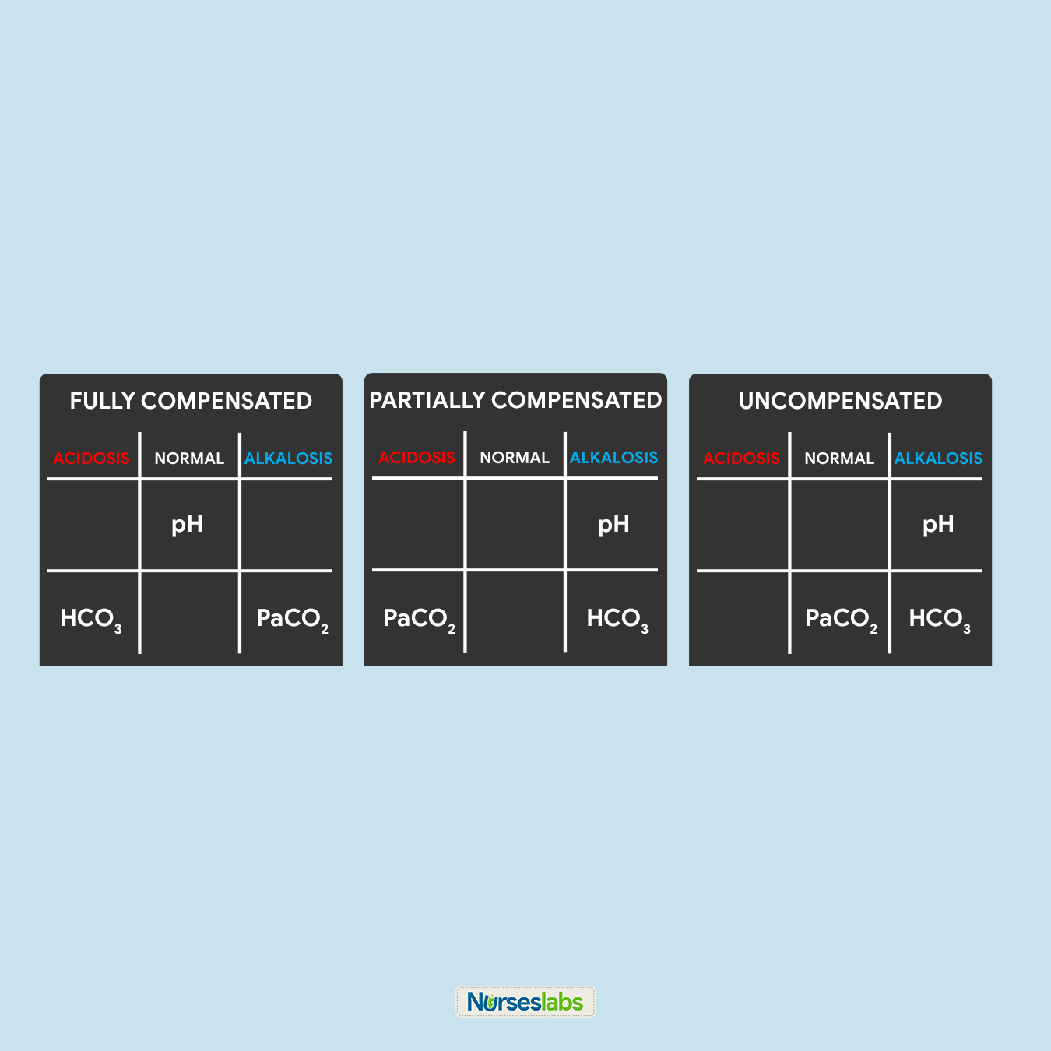
COMPENSATION.
determine the compensation :
It is FULLY COMPENSATED if pH is normal.
It is PARTIALLY COMPENSATED if all three (3) values are abnormal.
It is UNCOMPENSATED if PaCO or HCO is normal and the other is abnormal.

Slide 20
EXAMPLES
ABG Values pH: 7.45 PaCO2:41 HCO3: 25
Acidosis | Normal | Alkalosis
 | PH
 | PaCO2
 | HCO3
Interpretation: normal ABG
ABG ValuespH:7.30 PaCO2: 66 HCO3: 32
Acidosis | Normal | Alkalosis
PH
PaCO2
 |  | HCO3
Interpretation: Respiratory acidosis partially compensated

Slide 21
ABG Values pH: 7.26 PaCO2:32 HCO3: 18
Acidosis | Normal | Alkalosis
PH
 |  | PaCO2
HCO3
Interpretation: metabolic acidosis partially compensated
ABG Values pH: 7.79 PaCO2:24 HCO3: 21
Acidosis | Normal | Alkalosis
 |  | PH
 |  | PaCO2
HCO3
Interpretation: Respiratory alkalosis partially compensated

Slide 22
ABG Values pH: 7.17 PaCO2:35 HCO3: 12
Acidosis | Normal | Alkalosis
PH
 | PaCO2
HCO3
Interpretation: uncompensated metabolic acidosis
ABG Values pH: 7.54 PaCO2:24 HCO3: 25
Acidosis | Normal | Alkalosis
 |  | PH
 |  | PaCO2
 | HCO3
Interpretation: uncompensated respiratory alkalosis

Slide 23
ABG Values pH: 7.17 PaCO2:50 HCO3: 15
Acidosis | Normal | Alkalosis
PH
PaCO2
HCO3
Interpretation: mixed metabolic and respiratory acidosis

Slide 24
Metabolic acidosis
Metabolic acidosis may be with increased anion gap or with normal anion gap
Anion gap = [Na+ +K+ ]−[Cl−+HCO3− ], normal value=10–16 mmol/L.
Generally speaking, an increase in anion gap with metabolic acidosis is due to overproduction or decrease in excretion of acids.
A normal anion gap in the presence of metabolic acidosis signifies HCO3- loss rather than excess of acids.

Slide 25
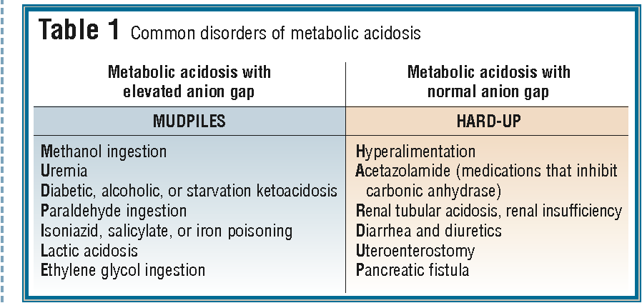

Slide 26
Respiratory acidosis
In respiratory acidosis , CO2 is not properly removed by the lungs
Causes:
CNS depression: Comatose ,drug overdose ,head injury.
Thoracic injury: Pneumothorax ,flail chest.
Airway obstruction: Asthma ,laryngospasm
Severe pneumonia
Pulmonary edema
Obesity hypoventilation syndrome.
Neuromuscular weakness : myasthenia ,Gullian-barre
Interstitial fibrosis.

Slide 27
Metabolic alkalosis
A primary increase in plasma bicarbonate and an increase in plasma pH as a result of the following:
Gastrointestinal loss, e.g. pyloric stenosis (hypochloremic hypokalemic metabolic alkalosis)
Congenital chloride diarrhoea
Furosemide therapy
Cystic fibrosis
Bartter syndrome
Hyperaldosteronism
Excess intake of base, e.g. excess ingestion of antacid medicine (rare in childhood)

Slide 28
Respiratory alkalosis
Respiratory alkalosis occurs when the lungs blow off excessive CO2
Causes:
Hyperventilation (anxiety, mechanical ventilation)
Salicylate toxicity stimulates respiratory centers in CNS
Sepsis
Hepatic encephalopathy
Hyperthyroidism
Hypoxemia
High altitude

Slide 29
Thank you

