Slide 1
CONGENITAL HEART DISEASE (A cyanotic)
DR MANSOUR ALQURASHI
CONSULTANT PEDIATRIC CARDIOLOGIST

Slide 2
Objectives
- Describe the clinical features that point to the presence of a congenital heart malformation.
- Describe the general classification of heart diseases in pediatrics.
- Differentiate cyanotic from non-cyanotic heart disease.
- Understand the anatomy and physiology of common congenital cardiac defects.
- Discusses the clinical presentation and outline the management of acyanotic and cyanotic heart diseases.

Slide 3
Common Cardiovascular Disorders in Children
Congenital Heart Defects
Congestive Heart Failure
Acquired Heart Disease

Slide 4
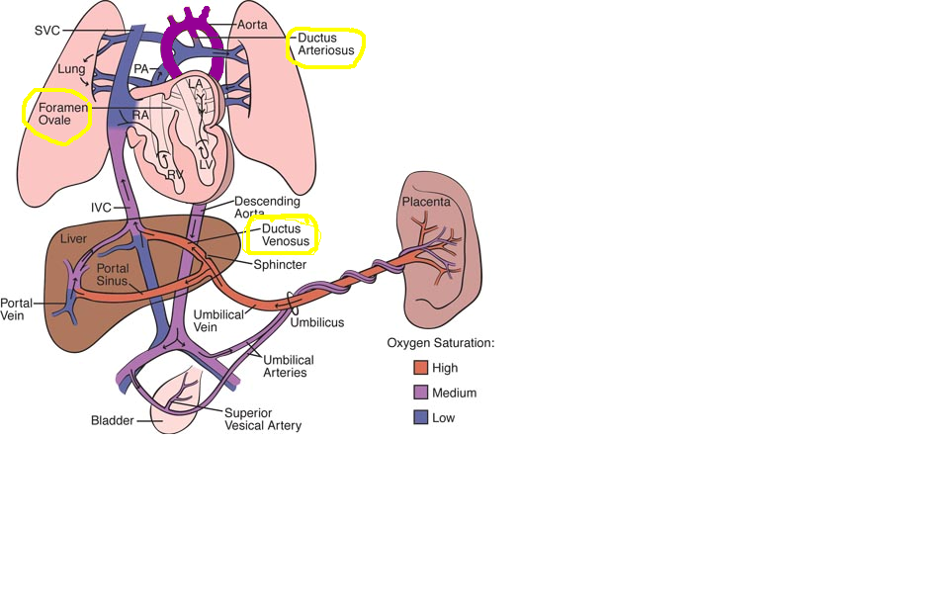
Fetal Circulation

Slide 5
Fetal Shunts
foramen ovale shunts mixed blood from right atrium to left atrium (hole in the atrial septum)
ductus arteriosus accessory (extra) artery, shunts mixed blood away from lungs to descending aorta
ductus venosus accessory (extra) vein, carries oxygenated blood from umbilical vein into lower venous system

Slide 6
Congenital Heart Disease
35 different types
Common to have multiple defects
Range from mild to life threatening and fatal
Genetic and environmental causes

Slide 7
Classification
Acyanotic
  Ventricular Septal Defect
  Atrial Septal Defect.
  PDA.
  Coarctation of Aorta
  Aortic Stenosis.
  Hypoplastic Left Ventricle
Cyanotic Defect
  Tetralogy of Fallot
  D -transposition of the great vessels
  Tricuspid atresia

Slide 8
Acyanotic Defects

Slide 9
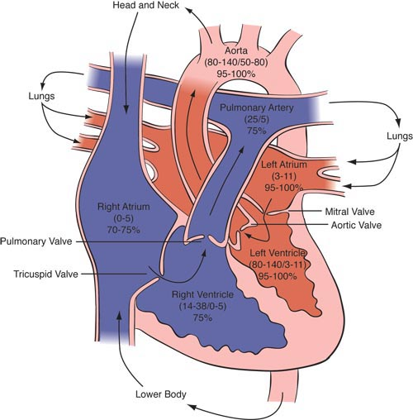
Blood Flows From High to Low Pressure
Lower Pressure
Higher pressure

Slide 10
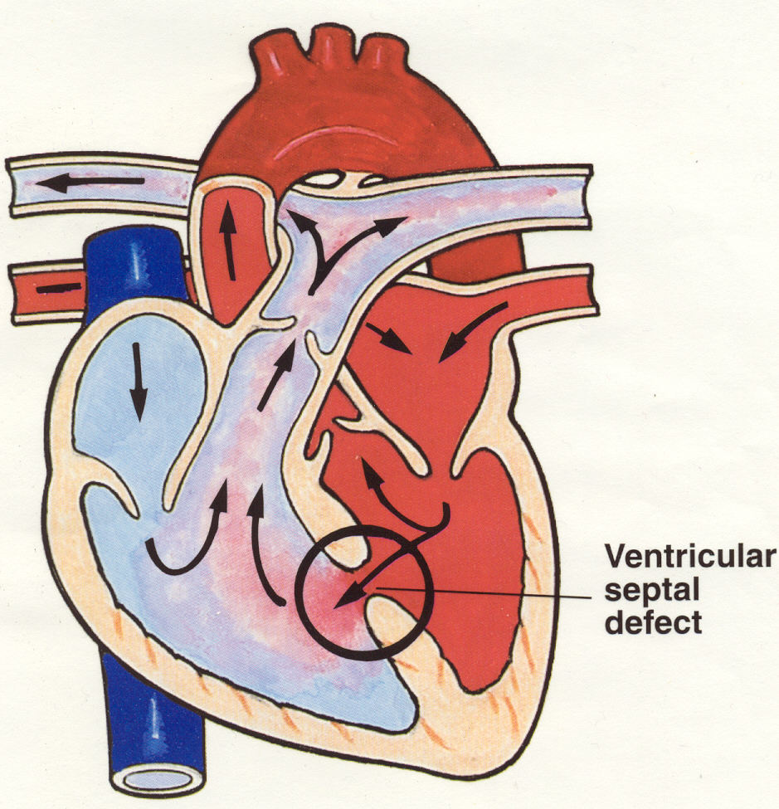
Ventricular Septal Defect (VSD)
Most common CHD.
Defect in ventricular septum.
High Pressure in LV forces oxygenated blood back to RV.

Slide 11
Ventricular Septal Defect
Small defects often close spontaneously in the first 2 years of life while large defects require surgical repair within the 1st year.

Slide 12
Symptoms of Ventricular Septal Defects
Asymptomatic
Rapid breathing.
Excessive Sweating
Poor weight gain.
Congestive Heart Failure, usually within 6 to 8 weeks of life if defect is large.
Pulmonary Hypertension if defect is large.
Eisenmenger ' s syndrome.

Slide 13
Signs of Ventricular Septal Defects
Depend on the size of the defect .
Loud harsh pansystolic heart murmur.
Palpable thrill .
Parasternal heave (RVH).
Signs of congestive heart failure.
tachycardia , tachypnea, respiratory distress (retractions), grunting, difficulty with feeding , diaphoresis ,displaced apex beat and hepatomegaly.

Slide 14
Treatment for Ventricular Septal Defects
Lasix and Captopril (ACE inhibitors).
Surgery is patching the defect by pericardium or Dacron (open heart surgery with cardiopulmonary bypass).
  Pulmonary artery banding to reduce blood flow to lungs if not stable for surgery.
Percutaneous Device closure .

Slide 15
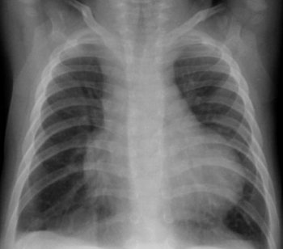
Atrioventricular Septal Defect

Slide 16
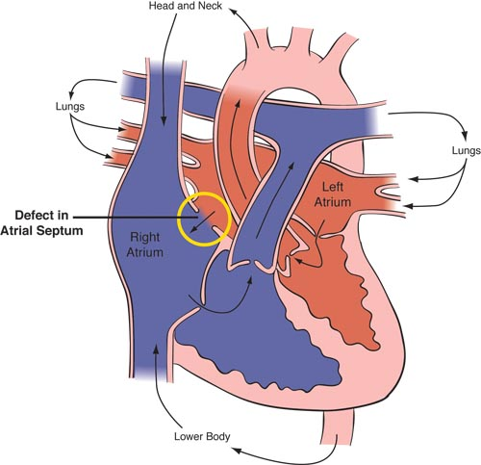
Atrial Septal Defect (ASD)
Defect in atrial septum.
Pressure in LA is greater than RA (blood flows left to right)
Oxygen rich blood leaks back to RA & RV and is then pumped back to lungs

Slide 17
Symptoms of Atrial Septal Defect
Asymptomatic.
Large defect may cause symptoms of CHF:
- Rapid breathing.
- Excessive Sweating
  Poor feeding, failure to thrive.
  In adults :
  -Fatigue and dyspnea on exertion.
-Palpitations.
-Syncope
-Stroke
-Eisenmenger ' s syndrome

Slide 18
Signs of Atrial Septal Defect
Heart murmur resulting from increased blood flow through pulmonary valve(systolic ejection murmur ).
Wide and fixed splitting of second heart sound.
Parasternal heave (RVH).
Signs of congestive heart failure.

Slide 19
Treatment of Atrial Septal Defects
Small defect (less than 5mm), may resolves spontaneously.
Medical Management ( Lasix,Captopril) for large defects with symptoms of heart failure.
Transcatheter devices, such as a septal occluder may be used.
Surgical closure is needed for large defects that cannot be closed by Transcatheter devices.
  Pulmonary artery banding to reduce blood flow to lungs if not stable for surgery.

Slide 20
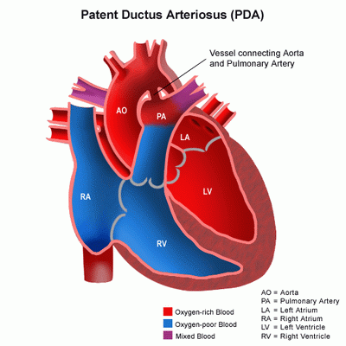
Patent Ductus Arteriosus
Pathophysiology:
  Blood flows from aorta to the pulmonary artery, creating a left to right shunt, resulting in left atrium and ventricle overload.
  Increased pulmonary blood flow can result in pulmonary hypertension and reversal of the shunt, which is known as Eisenmenger’s Syndrome. This results in flow of desaturated blood to the lower extremities.

Slide 21
Patent Ductus Arteriosus
Symptoms:
  Preterm neonate develop CHF and respiratory distress , Full term neonate may be asymptomatic.
  Infants with Large left to right shunts develop symptoms of congestive heart failure such as tachypnea, tachycardia, poor feeding and slow growth.
  Children with small patent ductus are usually asymptomatic.

Slide 22
Patent Ductus Arteriosus
Physical exam:
  Continuous murmur heard best at the left sternal border, left subclavicular thrill.
  widened pulse pressure and bounding peripheral pulses .
  poor growth.
  differential cyanosis

Slide 23
Patent Ductus Arteriosus
Treatment:
  Administration of Indomethacin (prostaglandin inhibitor) to stimulates ductus to constrict.
  Surgical division or ligation of the PDA.
  Percutaneous device closure by PDA occluder device or coil.

Slide 24
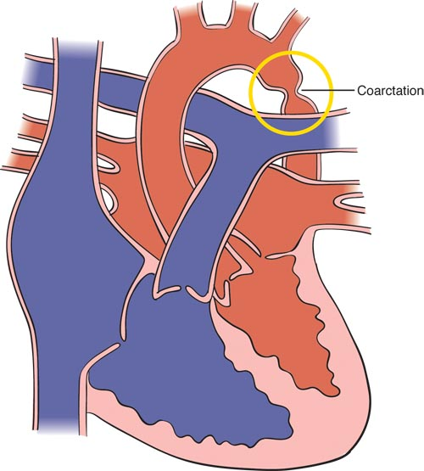
Coarctation of Aorta
Constriction of the aorta at or near the insertion site of the ductus arteriosus
Reduces cardiac output
Aortic pressure is high proximal to the constriction and low distal to the constriction-Risk for CVA
Higher pressure
Pink Blood

Slide 25
Symptoms of Severe Coarctation of Aorta
Often discovered 3-4 days after birth when the patent ductus arteriosus closes
Symptoms of shock develops very rapidly as no oxygenated blood flows to the lower extremities
Rapid breathing, sweating, and poor feeding often develops during the first week

Slide 26
Signs of Severe Coarctation of Aorta
Most babies born at term with normal length and weight
Systolic murmur usually heard
Liver may be enlarged
Left arm/leg pulses may be diminished or absent.
BP is about 20 mm/Hg higher in arms than in lower extremities.
Upper extremity hypertension.
Lower extremity cyanosis.

Slide 27
Treatment of Severe Coarctation of Aorta
  Medical Management ( Dopamine, dobutamine, , Lasix, )
  Oxygen
  Administration of PGE1 (prostaglandin) infusions ,
  to maintain ductal patency and improves perfusion to lower extremities- although will cause increased pulmonary flow
  Surgical repair .

Slide 28
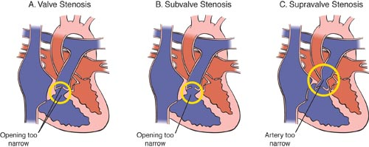
Pulmonary Stenosis

Slide 29
Signs of Severe Pulmonary Stenosis
Systolic ejection murmur with a palpable thrill
Right ventricular hypertrophy
Cyanosis from reduced pulmonary blood flow and the right to left shunt of blood at foramen ovale due to high right ventricular pressure.
Can lead to right ventricular failure, CHF

Slide 30
Treatment of Severe Pulmonary Stenosis
  Oxygen.
  Medical Management ( Lasix, ).
  Administration of PGE1 (prostaglandin) infusions , to maintain ductal patency in critical pulmonary stenosis.
  Pulmonary balloon valvuloplasty via cardiac cath.
  If unsuccessful valvotomy.

