Slide 1
CYANOTIC CONGENITAL HEART DISEASE
DR M. ALQURASHI
Notes:
07/16/96
##
*
*

Slide 2

CYANOTIC CHD

Slide 3
CYANOSIS
DEFINITION OF CENTRAL CYANOSIS
IT IS BLUE DISCOLOURATION OF THE SKIN & MUCOUS MEMBRANES.
IT IS DETECTABLE, WHEN THE DEOXYGENATED HEAMOGLOBIN IS MORE THAN 5 G/100 ML. (capillary)
[ OXYGEN SATURATION OF ARTERIAL BLOOD <85% ]
1
Notes:
07/16/96
##
*
*

Slide 4
CYANOSIS
CLASSIFICATION OF CYANOSIS IN NEWBORN
CENTRAL ( BEST AT TONGUE) :
CARDIAC.
PULMONARY.
NEUROMUSCULAR & C.N.S.
PERSISTENT PULMONARY HYPERTENSION.
METHAEMOGLOBINAEMIA..
PULMONARY ARTERIOVENOUS FISTULA.
PERIPHERAL ( FINGERS & TOES) :
PHYSIOLOGICAL ( COLD).
REDUCED CARDIAC OUTPUT.
Notes:
07/16/96
##
*
*

Slide 5
CONGENITAL HEART DISEASE
PRESENTATION (CONT..)
CYANOSIS
CYANOSIS WITH OBSTRUCTIVE PULMONARY FLOW .
TRICUSPID ATRESIA,
PULMONARY ATRESIA
CRITICAL PULMONARY STENOSIS
EBSTEIN’S ANOMALY
T.O. F.
Notes:
07/16/96
##
*
*

Slide 6
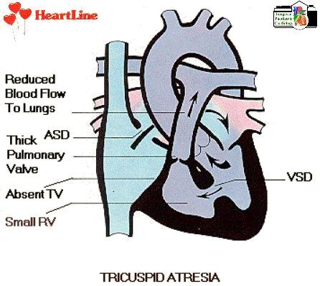

Slide 7
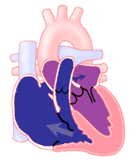
Ebstein's Anomaly

Slide 8
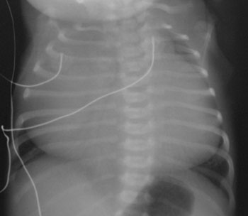
Ebstein's Anomaly

Slide 9
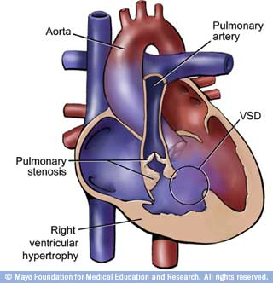
Tetralogy of Fallot

Slide 10
Tetralogy of Fallot
On Clinical Exam | ECG | X-ray
SEM at 2nd ICS transmitted to back Single S2 Mild Cyanosis OR no cyanosis Not in distress | RVH RAD | Boot shaped heart Dec PVM Right arch

Slide 11
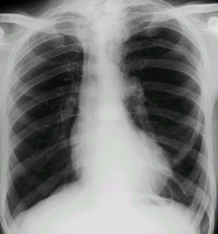
Tetralogy of Fallot

Slide 12
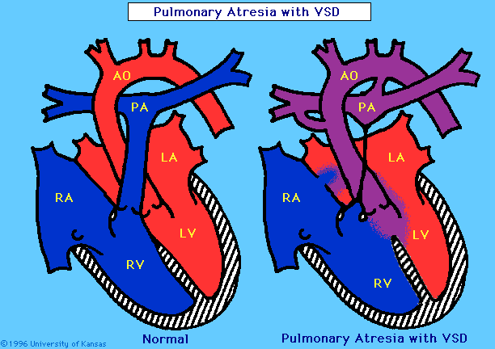

Slide 13
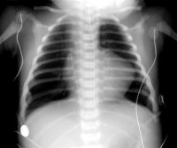
PULMONARY ATRESIA

Slide 14
CONGENITAL HEART DISEASE
PRESENTATION (CONT..)
CYANOSIS with increase pulmonary flow (CYANOSIS WITH HEART FAILURE ) :
TRANSPOSITION OF THE GREAT ARTERIES
TOTAL ANOMALOUS PULMONARY VENOUS DRAINAGE.
Notes:
07/16/96
##
*
*

Slide 15
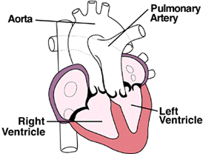
Transposition of great arteries

Slide 16
Transposition of great arteries
On Clinical Exam | ECG | X-ray
Usually no murmur Single S2 Cyanosis visibly mild may be missed Comfortable until PDA closes | RVH May be normal | Generalized cardiomegaly Narrow mediastinum Increased PVM May be normal

Slide 17
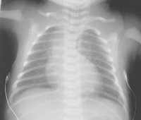
Transposition of great arteries

Slide 18
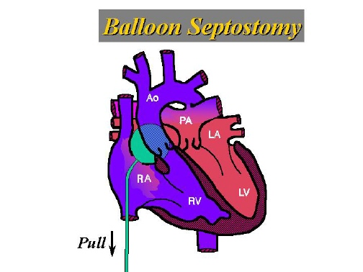
Transposition of great arteries

Slide 19
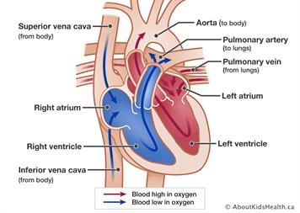

Slide 20
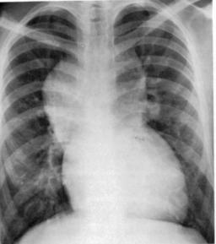
4 month old infant with heart failure. Describe chest x-ray and what is likely diagnosis?

Slide 21
CONGENITAL HEART DISEASE
PRESENTATION (CONT..)
SHOCK
COARCTATION OF THE AORTA
CRITICAL AORTIC STENOSIS
HYPOPLASTIC LEFT HEART SYNDROME
Notes:
07/16/96
##
*
*

Slide 22
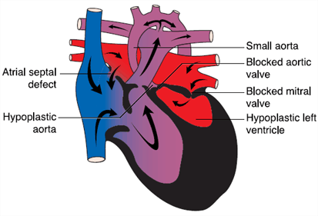
HYPOPLASTIC LEFT HEART SYNDROME

Slide 23
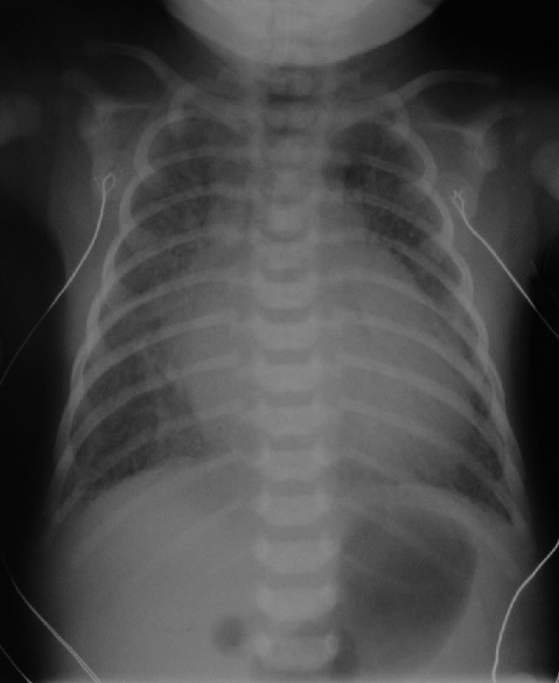
HYPOPLASTIC LEFT HEART SYNDROME

Slide 24
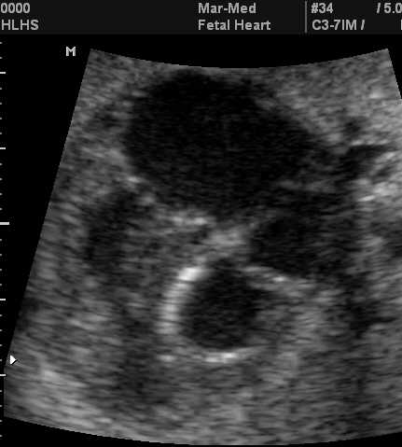
HYPOPLASTIC LEFT HEART SYNDROME

Slide 25
CONGENITAL HEART DISEASE
PROSTAGLANDIN INDICATION
CYANOTIC CARDIAC LESION WITH OBSTRUCTION TO PULMONARY BLOOD FLOW
PULMONARY ATRESIA
TRICUSPID ATRESIA .
CRITICAL PULMONARY VALVE STENOSIS
COMPLEX CYANOTIC C.H.D.
Notes:
07/16/96
##
*
*

Slide 26
CONGENITAL HEART DISEASE
INDICATION OF PROSTAGLANDIN (CONT..)
CYANOTIC LESIONS WITH CLOSED PULMONARY RECIRCULATION
TRANSPOSITION OF GREAT ARTERIES
TOTAL ANOMALOUS PULMONARY VENOUS DRAINAGE (OBSTRUCTIVE)
Notes:
07/16/96
##
*
*

Slide 27
CONGENITAL HEART DISEASE
INDICATION OF PROSTAGLANDIN (CONT..)
ACYANOTIC LESIONS WITH OBSTRUCTION OF SYSTEMIC FLOW
COARCTATION OF AORTA
INTERRUPTION OF AORTIC ARCH
CRITICAL AORTIC STENOSIS
HYPOPLASTIC LEFT HEART SYNDROME
Notes:
07/16/96
##
*
*

Slide 28
CONGENITAL HEART DISEASE
DIAGNOSTIC APPROACH
HISTORY
EXAMINATION
INVESTIGATION (CHEST X-RAY, ECG)
HYPEROXIC TEST
ECHOCARDIOGRAPHY
Notes:
07/16/96
##
*
*

Slide 29
CONGENITAL HEART DISEASE CHEST X-RAY
ABNORMAL HEART SIZE
ABNORMAL HEART POSITION
PULMONARY VASCULAR MARKINGS
ABNORMAL HEART SHAPE
BOAT-SHAPED HEART: T.O.F.,TRICUSPID ATRESIA
EGG ON SIDE: T.G.A.
SNOWMAN: T.A.P.V.D.
Notes:
07/16/96
##
*
*

Slide 30
CONGENITAL HEART DISEASE
PRESENTATION
CYANOSIS
CYANOSIS WITH DISTRESS (CYANOSIS WITH HEART FAILURE)
CONGESTIVE HEART FAILURE.
SHOCK
Notes:
07/16/96
##
*
*

