Slide 1

Chromosomal abnormalities, mode of inheritance of single gene trait
Prepared by:
Dr.Salma Elgazzar
MRCPI in pediatrics
Master’s degree in pediatrics
Lecturer of pediatrics / Almaraffa University

Slide 2
LEARNING OBJECTIVES:
Learning objectives
Understand the principles of genetic inheritance and define single gene (autosomal dominant, autosomal recessive, X-linked dominant and X-linked recessive) and multifactorial inheritance and chromosomal disorders.
List common prenatal diagnostic assessment (maternal serum screening, amniocentesis ,choriocentesis and ultrasonography ) and understand their use.
Explain the use of the family history to construct a pedigree in the evaluation of possible genetic disorders.
List the indications for obtaining chromosome studies.
Recognize the role of careful history taking and physical examination in the evaluation of a patient with structural or developmental abnormalities (e.g. facial features ,palmar crease ,measurements, symmetry).

Slide 3
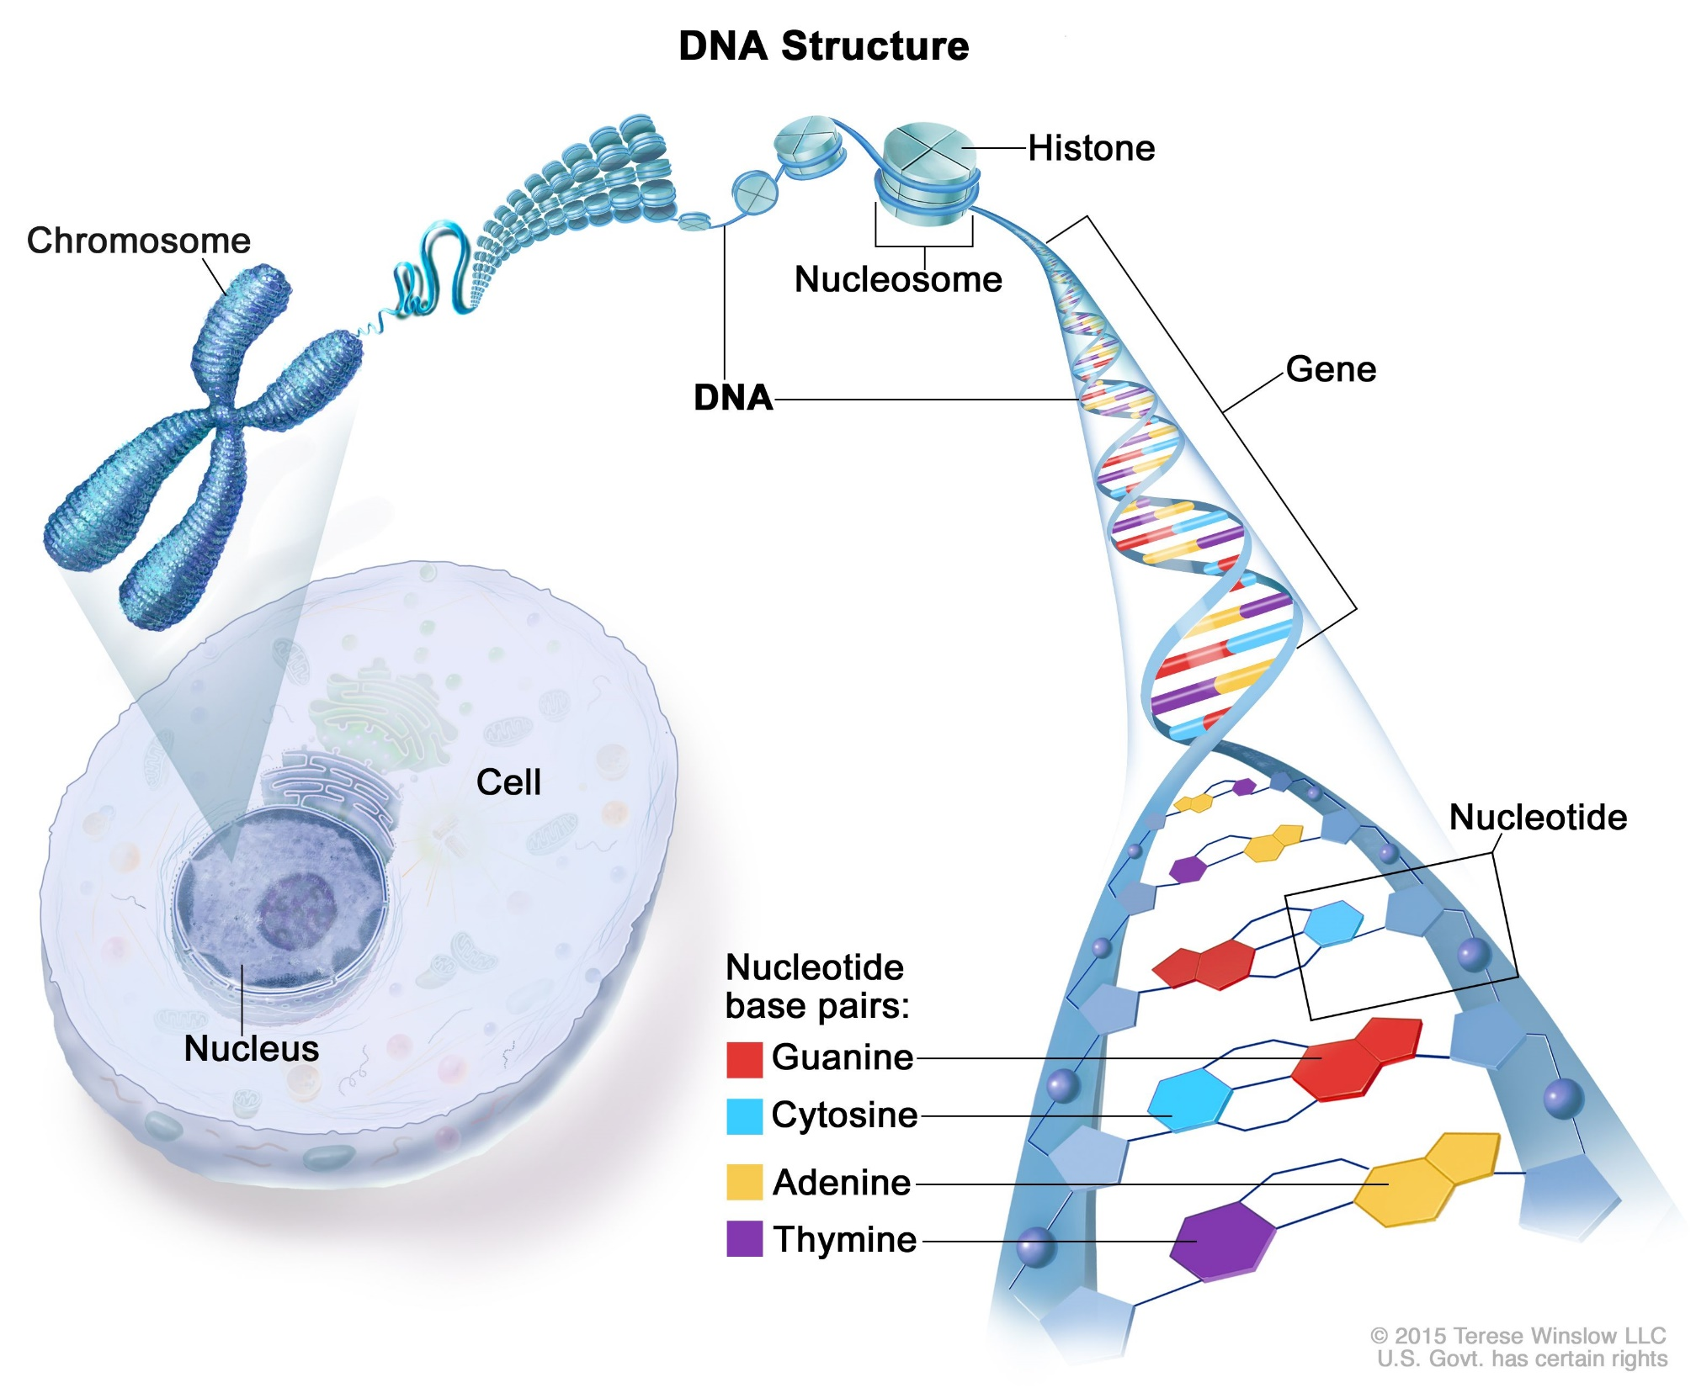

Chromosome Structure

Slide 4
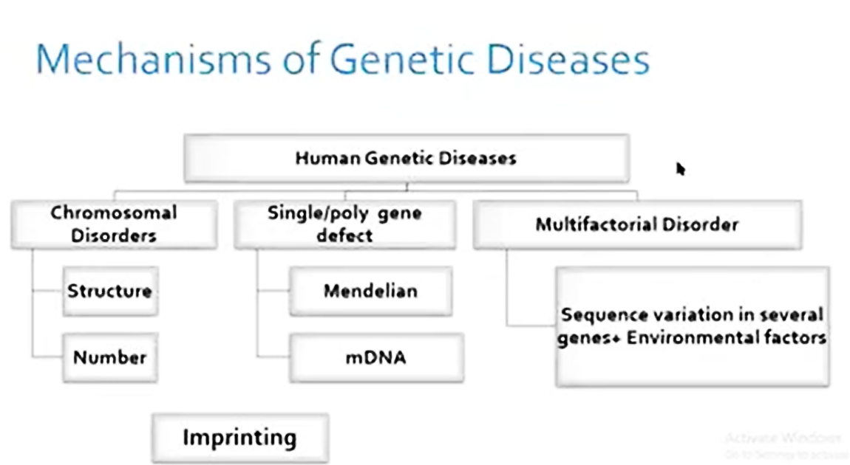
GENETIC DISORDERS
Genetic disorders are congenital Some genetic disorders also occur after birth or at any stage of life.
The vast majority are incurable and have a complete phenotypic profile.
The abnormality occurs mainly due to mutations in either gene or chromosome.
Notes:
Any alteration (deletion, addition, duplication or inversion) occurs in a gene or DNA sequence is known as gene mutation.
Any alteration or variation (deletion, addition, duplication, invention or change in number) happens in a chromosome is known as chromosomal mutation.
Besides these major two types of categories, some other type of mutations also occurs in a genome. e.g.triplet repeats expansion.

Slide 5
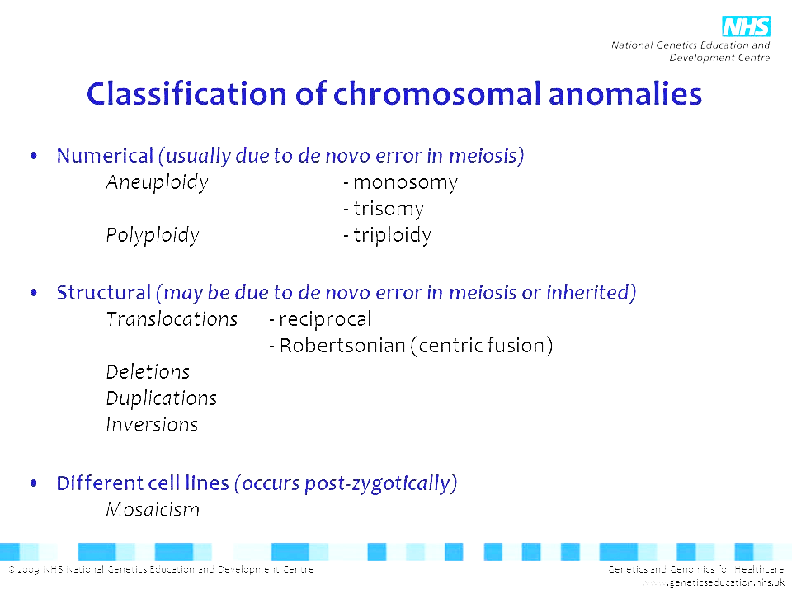
CLASSIFICATION OF CHROMOSOMAL ANOMALIES
Notes:
In some cases ,only a portion of cells that make up a person ‘s body are affected by a single –gene defect, a geneomic disorder ,or a chromosomal defect.this is referred to as mosaicism indicates that the individual’s body is made up of 2 or more distinct cell population

Slide 6
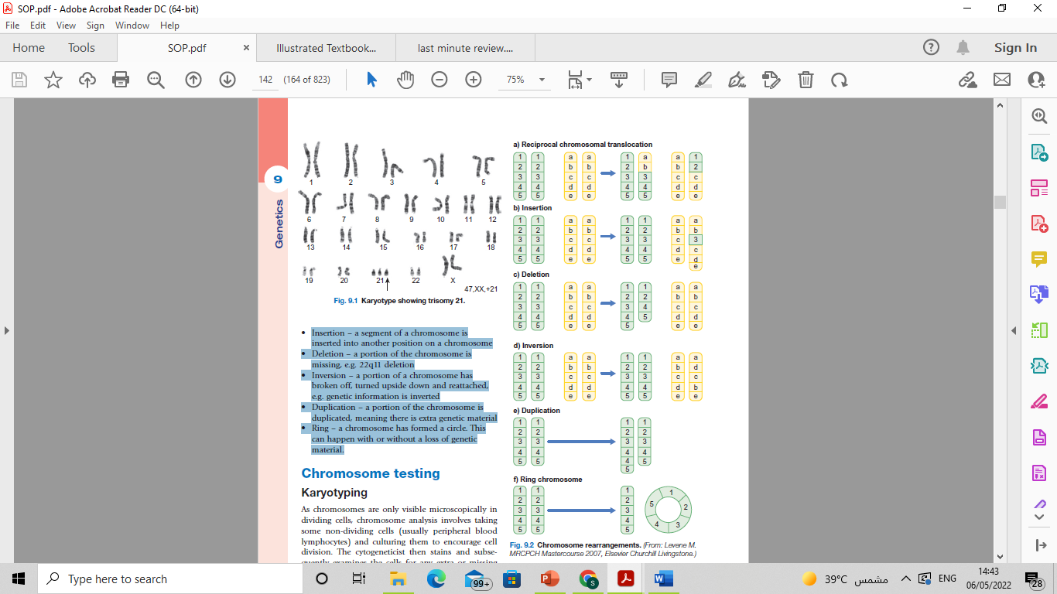

Slide 7
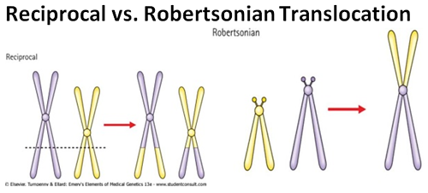

Slide 8
CLASSIFICATION OF GENE DEFECT ANOMALIES
Most heritable genetic (Mendelian) disorders are caused by mutations in a single gene from the 20,000 individual genes in the human genome.
For many disorders, the Mendelian pattern of inheritance is known.
A family tree (pedigree)is an essential part of genetic evaluation.

Slide 9
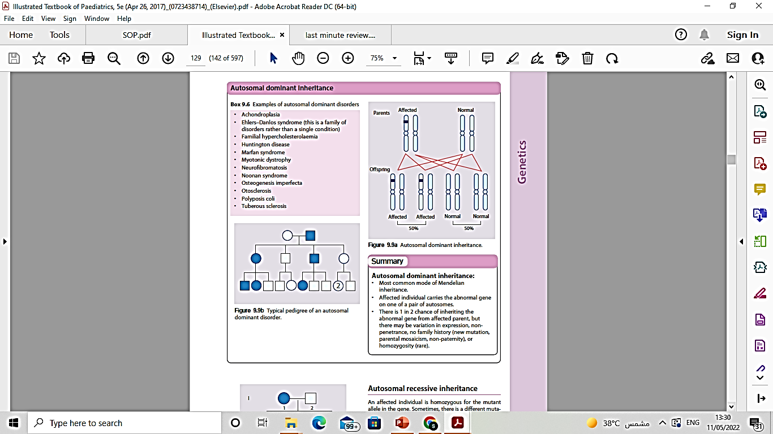
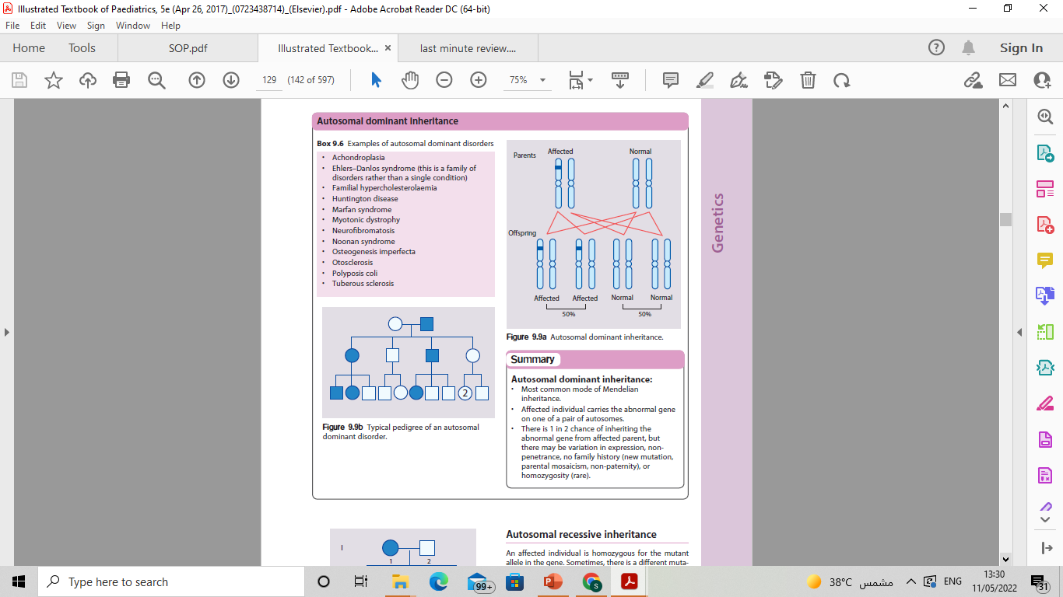
AUTOSOMAL DOMINANT
• Most common mode of Mendelian inheritance.
• Affected individual carries the abnormal gene on one of a pair of autosomes.
• In AD disorders, each child of an affected parent has a 50% chance of inheriting the mutated gene, but there may be variation in expression, non penetrance, no family history (new mutation,parental mosaicism, non-paternity), or homozygosity (rare).
Examples of autosomal dominant disorders
Achondroplasia.
Ehlers–Danlos syndrome.
Familial hypercholesterolaemia.
Marfan syndrome .
Neurofibromatosis.
Noonan syndrome
Osteogenesis imperfecta.
Notes:
Rules of Autosomal Dominant Inheritance
Trait appears in every generation.
Each child of an affected parent has a 1-in-2 chance of being affected.
Males and females are equally affected.
Male-to-male transmission occurs.
Traits generally involve mutations in genes that code for regulatory or structural proteins (collagen).

Slide 10
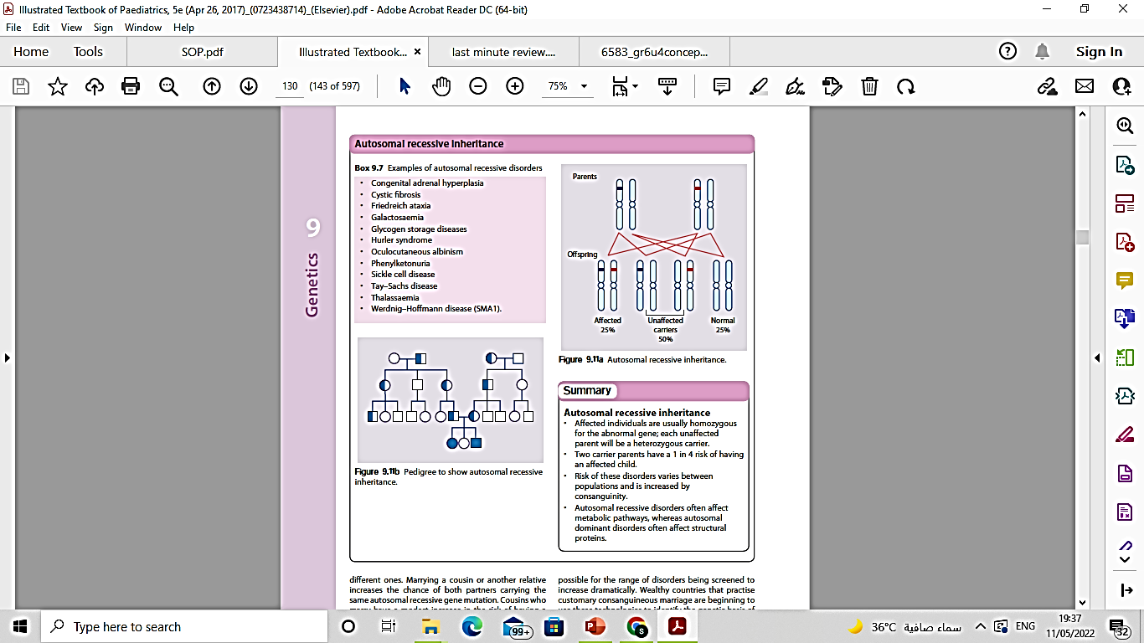
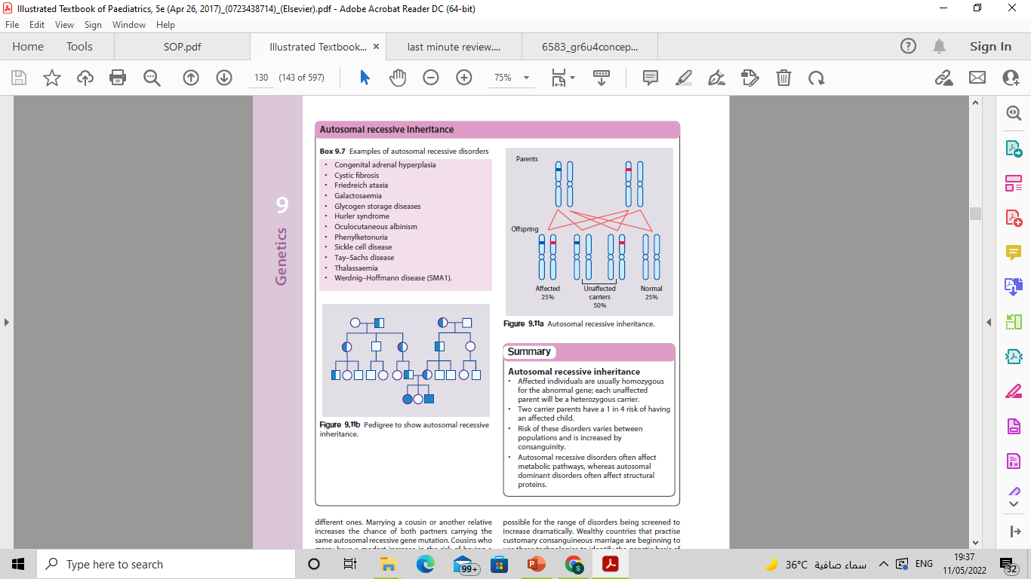
AUTOSOMAL RECESSIVE
• Affected individuals are usually homozygous for the abnormal gene; each unaffected parent will be a heterozygous carrier.
Children affected with AR disorders are usually born to unaffected parents, each of whom carries one copy of the variant.
If both members of a couple are carriers (or heterozygotes) for this variant, each of their offspring has a 25% chance of being affected
Risk of these disorders varies between populations and is increased by consanguinity.
• Examples of autosomal recessive disorders
Sickle cell disease.
Thalassemia .
Congenital adrenal hyperplasia .
Cystic fibrosis.
Friedreich ataxia
Galactosemic.
Glycogen storage diseases.
Hurler syndrome .
Oculocutaneous albinism.
Phenylketonuria.
Notes:
Autosomal recessive disorders often affect metabolic pathways, whereas autosomal dominant disorders often affect structural proteins

Slide 11
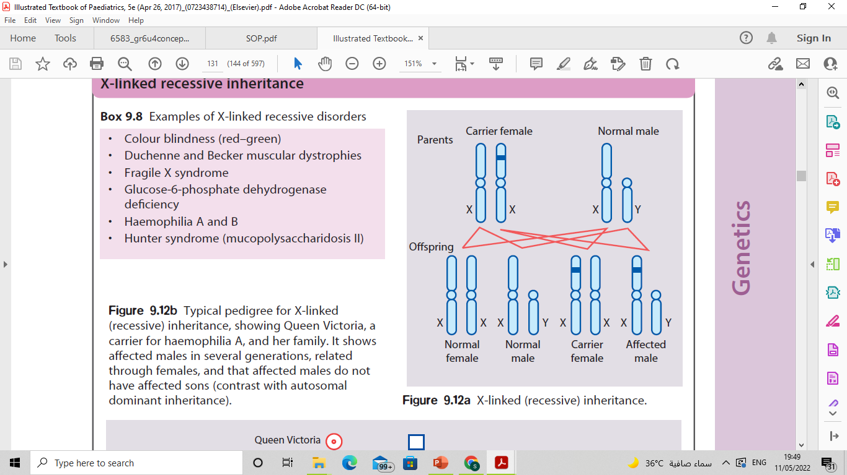
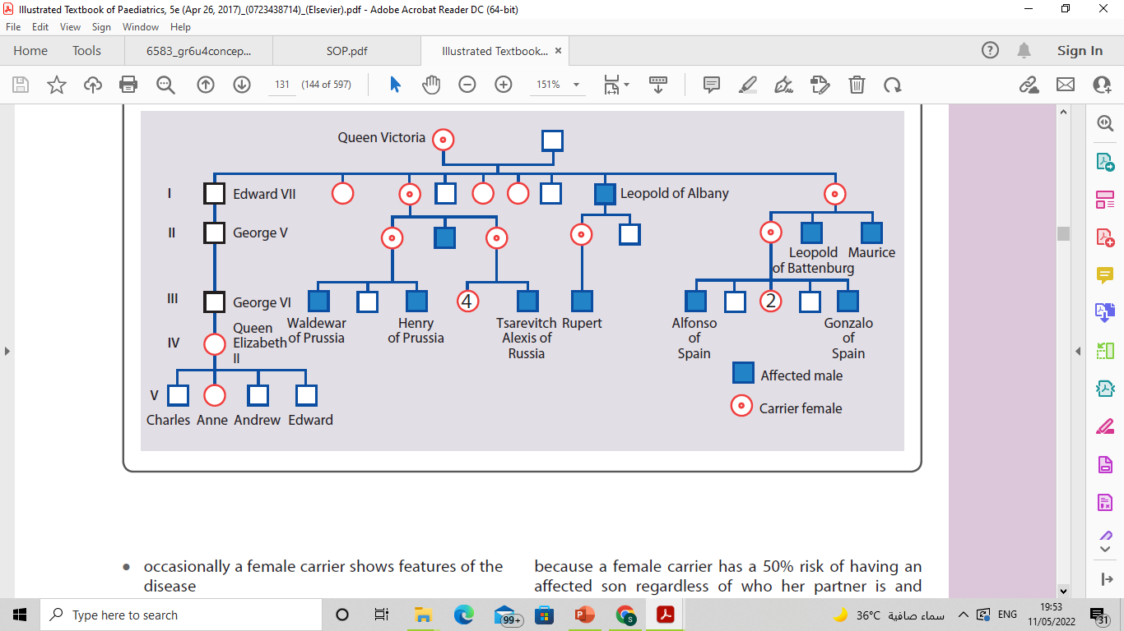
X-LINKED RECESSIVE
• Males are affected
• Female carriers are usually healthy, occasionally a female carrier shows features of the disease.
• Each son of a female carrier has a 1 in 2 (50%) risk of being affected
• Each daughter of a female carrier has a 1 in 2 (50%) risk of being a carrier
• Daughters of affected males will all be carriers
• Sons of affected males will not be affected, because a man passes a Y chromosome to his sons.
• Family history may be negative – many arise from new mutations or gonadal mosaicism.
• Identifying female carriers is important to be able to provide genetic counselling.
• Examples of X-linked recessive disorders
Hemophilia A and B
Glucose-6-phosphate dehydrogenase deficiency.
Color blindness
Duchenne muscular dystrophy
Fragile X syndrome

Slide 12
X-LINKED DOMINANT
X-linked dominant disorders are unusual.
Both males and females are affected.
In X-linked dominant disorders, a female carrying the mutation will be affected while the mutation carrying males have an even more serious condition.
E.g. mutation that causes Rett syndrome (a neurodegenerative disorder) in a girl will cause a lethal, neonatal-onset encephalopathy in males.
An example is hypophosphataemic (vitamin D-resistant) rickets.

Slide 13
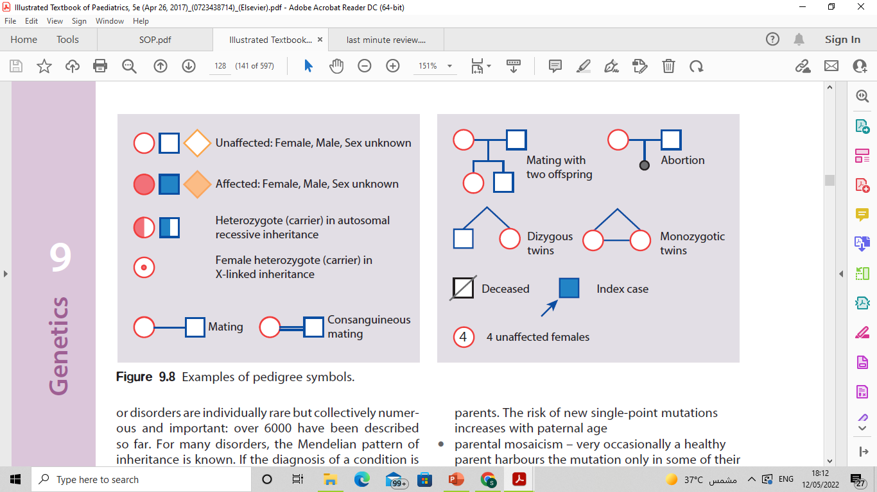
PEDIGREE
When constructing a pedigree, ask about miscarriages, stillbirths, and consanguinity. Take details from both sides of the family and record dates of birth rather than current ages.

Slide 14
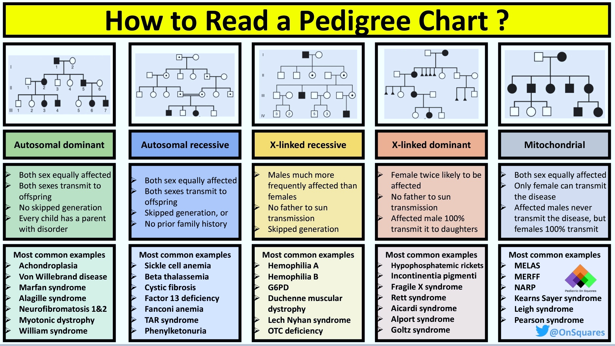
HOW TO READ A PEDIGREE CHART?

Slide 15
POLYGENIC, MULTIFACTORIAL OR COMPLEX INHERITANCE
Μανψ φαχτορσ αρε ινϖολϖεδ ιν χαυσινγ α βιρτη δεφεχτ.
• A combination of genes from both parents, in addition to environmental factors, produce the trait or condition
• Often one gender (either males or females) is affected more frequently than the other in multifactorial traits.
For example, hip dysplasia is nine times more common in females than males.
Multifactorial inheritance characteristics
•The higher the number of the affected individuals in the family, the higher the recurrence risks.
•The recurrence risk is higher if the affected individual is a member of the less commonly affected sex
e.g., Autism is more common in boys than girls but if a girl in the family has autism, it is twice as likely to recur in a sibling than if a boy is the one with autism.
• Recurrence risk is higher if the affected individual suffers the more severe form of the disease.
• Recurrence risk correlates with the prevalence in the general population.

Slide 16
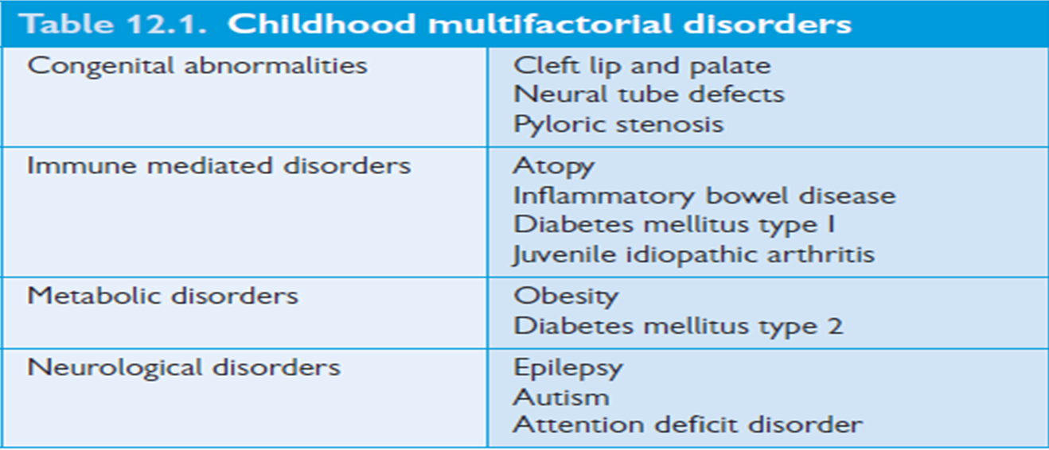

Slide 17
FAMILY HISTORY & PEDIGREE IN THE EVALUATION OF POSSIBLE GENETIC DISORDERS
Use of family history to assess genetic risk :
Key factors that suggest the presence of a genetic disorder include the following:
● Multiple affected individuals in multiple generations from either side of the individual's family.
● Disease occurrence at an earlier age than usual.
● Close degree of relatedness (ie, first- or second-degree relative) between affected relatives and the individual.
● Presence of associated conditions in the family.
Presence of consanguinity.
Multiple miscarriage
Congenital anomalies

Slide 18
Family/medical history from the referring clinician
- Collection of potentially relevant information limited to first-degree relatives (parents, siblings, children) and second-degree relatives (eg, grandparents, aunts, uncles, grandchildren, half-siblings); third-degree relatives may also be included.
- Patient concerns about disease, problems with pregnancy, occurrence of congenital anomalies, early deaths or disease onset, and determination of nongenetic risk factors for disease.
Assessment of consanguinity, in which parents share a common ancestor, can also be helpful for determining the risk for an autosomal recessive condition.
Precise medical diagnoses in family members can provide revealing information regarding symptoms, surgeries, and medication use.
The medical conditions of siblings or other relatives who have died (often the most informative information).
Notes:
The history taken should include medical and obstetric history, such as the duration of gestation, prenatal care, and maternal exposures (e.g., alcohol, prescribed or illicit drugs, cigarettes, fevers, illnesses, chemicals, radiation).
A history of stillbirths and miscarriages .
Results of noninvasive and invasive prenatal testing, including ultrasound examinations, should be obtained.
A complete family history and pedigree (ideally four generations) should be obtained to identify medical problems that may be related to the birth defect or other medical issues that can impact the family (i.e., multiple cancers).
The age of the parents is important because the incidence of chromosome aneuploidies is increased in older mothers and denovo autosomal-dominant pathogenic variants (eg, achondroplasia, neurofibromatosis type 1) are more commonly seen with older parents, with the effect being more marked for advanced paternal age. consanguinity may suggest the possibility of autosomal-recessive disorders.
Determining ethnic/racial origin may be helpful .

Slide 19
COMMON PRENATAL DIAGNOSTICASSESSMENT
The main diagnostic techniques for antenatal diagnosis :
Maternal serum screening :
e.g maternal serum alphafetoprotein which is high in neural tube defect (spina bifida) , low in trisomies like Down syndrome.
Detailed ultrasound scanning :
Fetal growth, structural malformation, amniotic fluid volume.
Chorionic villus sampling.
Fetal blood sampling.
Amniocentesis .
Non-invasive prenatal testing
Notes:
Examples of maternal serum screening tests: PAPP-A alpha fetoprotein, estriol, HCG and inhibin A.

Slide 20
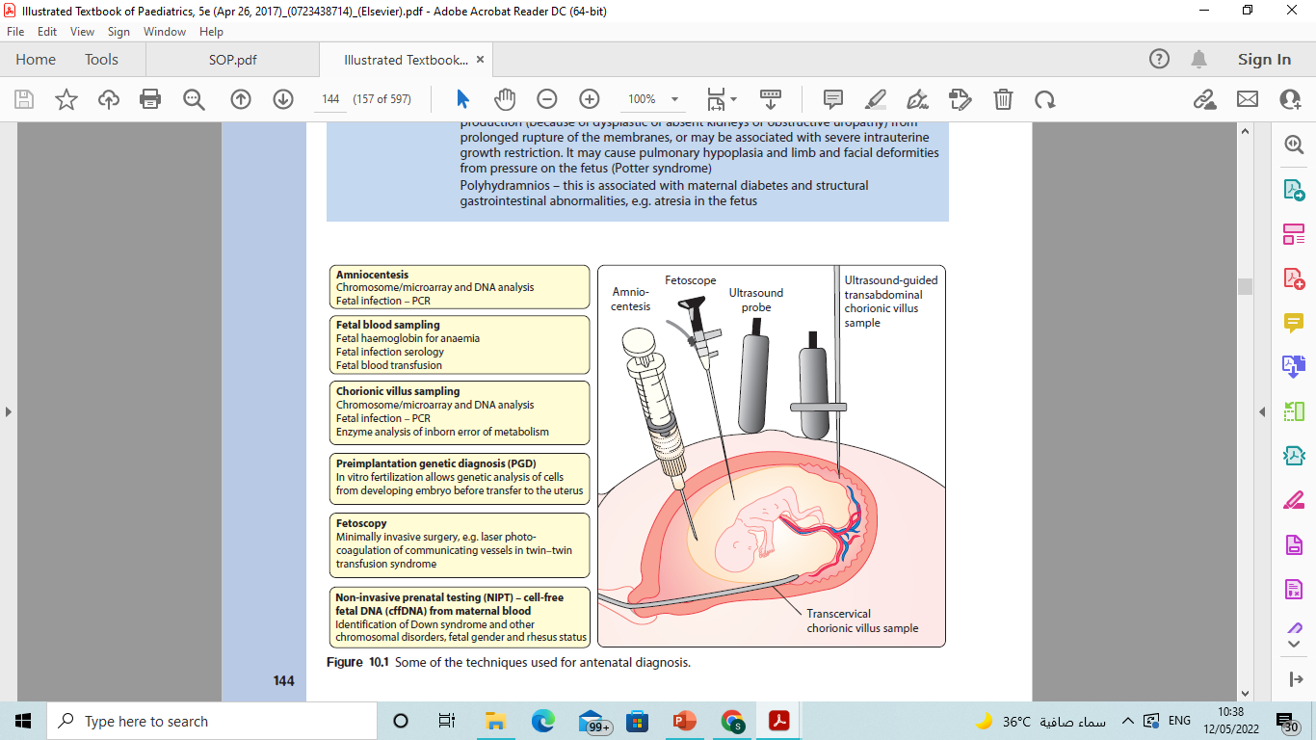
COMMON PRENATAL DIAGNOSTIC ASSESSMENT
Notes:
Chorionic villus sampling (CVS). This test is typically performed in the first trimester, between 10 and 13 weeks of pregnancy. The risk of pregnancy loss (miscarriage) from a CVS is very low.
Amniocentesis. perform this test in the second trimester, after 15 weeks of pregnancy. This test also carries a very low risk of miscarriage.

Slide 21
PHYSICAL EXAMINATION
A thorough physical examination should be performed.
The standard measurements : head circumference (occipital frontal circumference), height/length, and weight. Arm span and lower segment/upper segment .
Measurements of craniofacial structures :
ear length, inner canthal distance, outer canthal distance, interpupillary distance, palpebral fissures length, and philtrum length (extends from the nasal septum to the upper vermilion border).
length of hands, feet, and digits to look for brachydactyly or arachnodactyly.
In newborns and fetuses, the placenta and umbilical cord should also be examined. Two-vessel cord is associated with congenital heart defects.
Examination of family members may assist with the evaluation of some abnormalities. One example is Treacher-Collins syndrome, an autosomal-dominant disorder in which a parent can have minimal microtia or mild underdevelopment of malar facial structures that may have been missed on previous examinations.

Slide 22
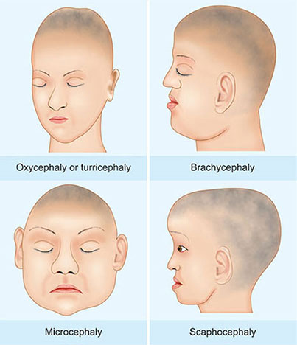
The physical exam is a powerful tool for the geneticist and the clinician.
Cranium size and appearance:
Microcephaly .
Macrocephaly .
Brachycephaly .
Plagiocephaly .

Slide 23
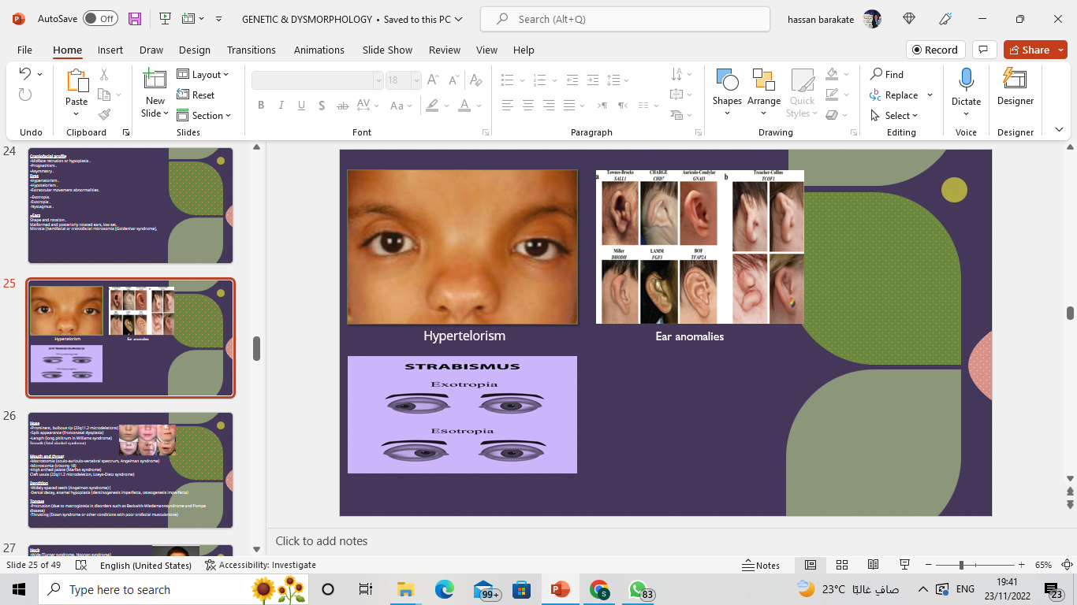
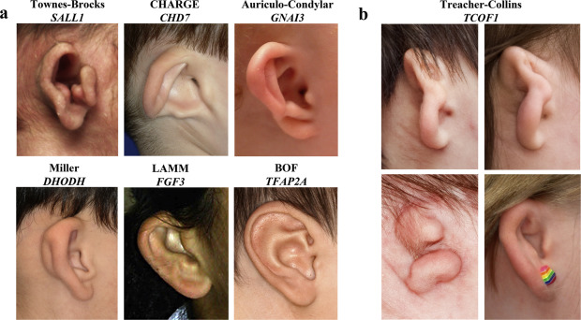
Craniofacial profile
•Midface retrusion or hypoplasia .
•Prognathism .
•Asymmetry .
Eyes
•Hypertelorism .
•Hypotelorism .
•Extraocular movement abnormalities.
-Esotropia.
-Exotropia .
-Nystagmus .
●Ears
Shape and rotation .
Malformed and posteriorly rotated ears, low set.
Microtia (hemifacial or craniofacial microsomia [Goldenhar syndrome],

Slide 24
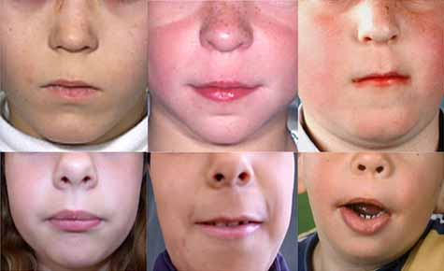
Nose
•Prominent, bulbous tip .
•Split appearance .
•Length (long philtrum in Williams syndrome)
Smooth (fetal alcohol syndrome)
Mouth and throat
•Macrostomia .
•Microstomia (trisomy 18)
•High arched palate (Marfan syndrome)
Cleft uvula .
Dentition
-Widely spaced teeth .
-Dental decay, enamel hypoplasia .
Tongue
-Protrusion .
-Thrusting (Down syndrome or other conditions with poor orofacial musculartone)

Slide 25
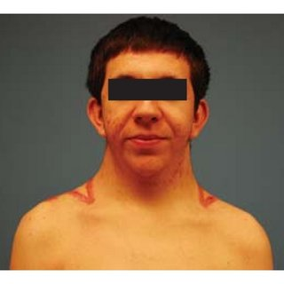
Neck
•Wide (Turner syndrome, Noonan syndrome)
•Short (Down syndrome)
•Webbing (Turner syndrome, Noonan syndrome)
Chest
•Pectus excavatum (Noonan syndrome)
•Pectus carinatum (Marfan syndrome)
•Wide-spaced nipples (Down syndrome, Turner syndrome, Noonan syndrome)
Cardiovascular
•Cardiomyopathies .
•Arrhythmias .)
•Structural heart defects – Atrial septal defect (Holt-Oram syndrome),atrioventricular canal or ventricular septal defect (trisomy 21), ventricular septaldefect (CHARGE association)
•Aortic hypoplasia (Turner syndrome), supravalvular aortic stenosis (Williamssyndrome)
•Aortic dilatation (Marfan syndrome)
Abdomen
•Hepatomegaly with or without splenomegaly .

Slide 26
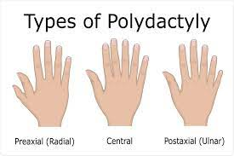
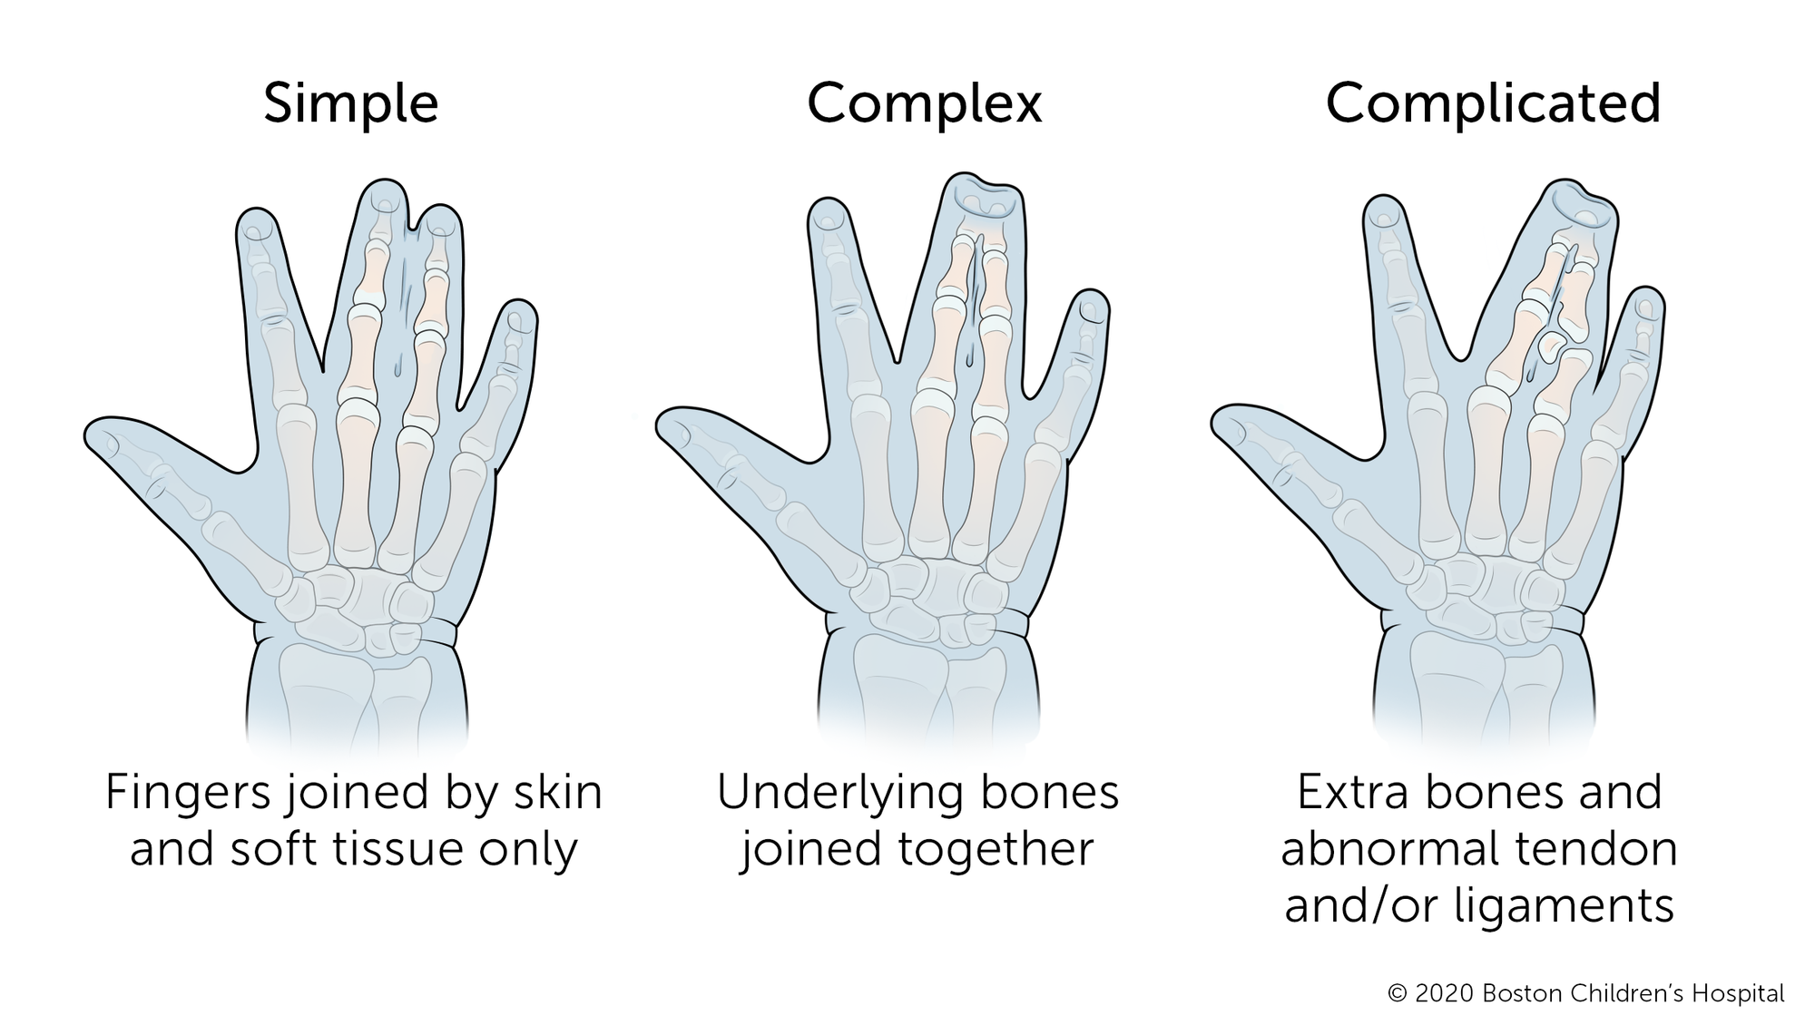
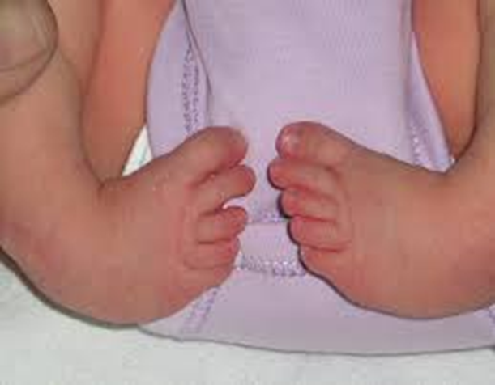
Extremities
Limited range of motion .
contractures .
Hands and feet
-Polydactyly (chromosome abnormalities [trisomy 13])
-Syndactyly .
-Arachnodactyly (Marfan syndrome)
-Broad thumbs and toes
-Clubfoot .
Skin, hair, and nails
•Sparse hair .
•Hair color lighter than expected .
"

Slide 27
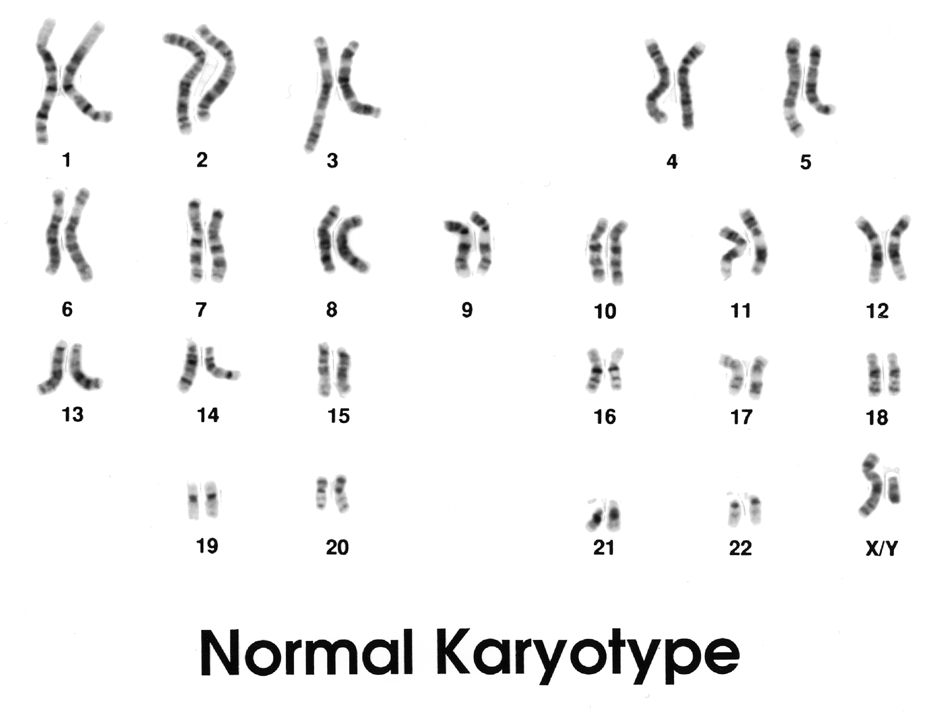
CHROMOSOMAL STUDIES
Karyotyping
A karyotype is a photomicrograph of an individual’s chromosomes arranged in a standard format showing the number, size,and shape of each chromosome.
The karyotype can identify abnormalities of the number or structure of the chromosomes.
A karyotype may be done on white blood cells, amniocytes or skin fibroblasts.

Slide 28
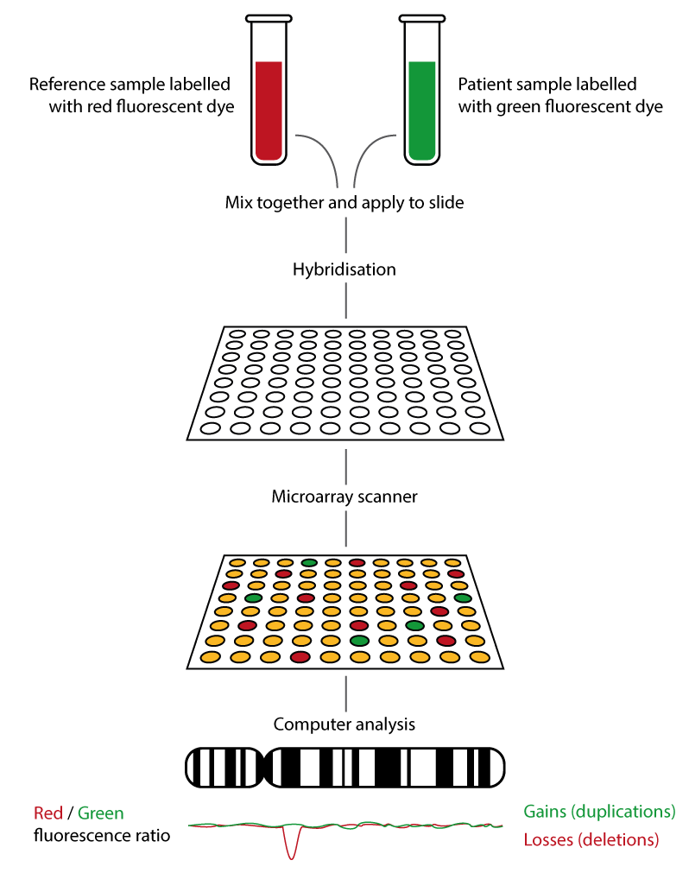
Array comparative genomic hybridization (aCGH)
Array CGH, or microarray), is a relatively new technique which looks for chromosomal copy number variations (CNVs) by comparing a patient’s DNA to normal control DNA.
It has taken over from karyotype as the first line test for most chromosome abnormalities in paediatric practice.
In CGH, the patient DNA is labelled green and the normal control DNA is labelled red. Thousands of different probes (fragments of DNA) which bind specifically to regions spanning the whole genome are immobilized on a slide, the array.
Array CGH is typically able to detect deletions and duplications larger than approximately 50,000 bases.
This is a resolution more than 100 times higher than karyotyping and allows the detection of microdeletions or duplications as well as other larger chromosome copy number abnormalities, including aneuploidies.

Slide 29
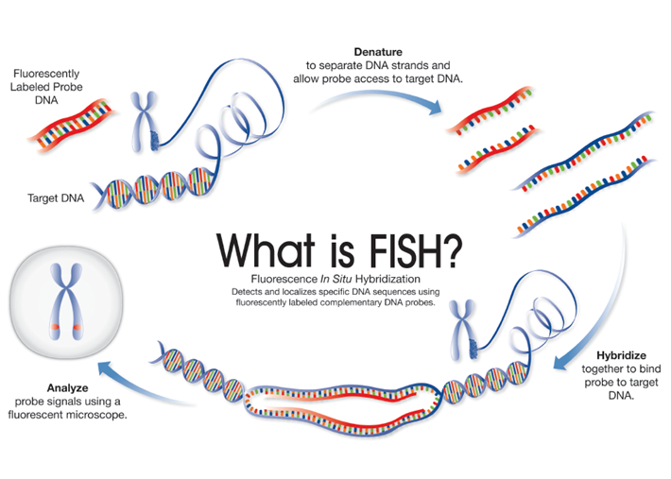
Fluorescence in situ hybridization (FISH)
FISH is a technique that uses fluorescently labelled DNA sequences (probes) to assess specific regions of interest, such as genes and centromeres using fluorescent microscopy.
The DNA sequence of the FISH probe is complementary to the region of interest.
When using a FISH probe, if the region of interest is present, the probe will bind (hybridize) to the target DNA sequence, which can then be visualized using fluorescent microscopy – indicating the presence of the gene/centromere etc.
If the region of interest has been deleted, the probe will not bind to the target DNA and so will not be visualized.

Slide 30
THANK YOU

