Slide 1
Communication skills in pediatrics prepared by :
Dr.Salma Elgazzar
MRCPI pediatrics
Masters’ in pediatrics/Alexandria university

Slide 2

Definition
Communication skills in pediatrics involve interactions between pediatricians, patients, and their parents.

Slide 3

Effective communication in pediatrics can:
- Increase diagnostic accuracy.
- Improve patient adherence to treatment.
- Reduce litigation.
- Enhance patient satisfaction.
- Improve overall health outcomes.
Communication skills are essential in pediatric practice and, like all other medical skills, can be learned and improved through training and regular practice.

Slide 4

Important tools for effective communications in pediatrics
Make the environment comfortable
Rapport (warm up the child and his parents to you)
Body language.
Communicate on the level of both children and parents.
Empathic Statements communicate concern about the patient.
Reflective listening communicates that the clinician has truly "heard" the patient's concerns by reflecting on the patient's intrinsic message.
Silent Listening.
Open-ended statements are neutral statements that encourage patients to share and elaborate on their concerns.
Permitting Patients to Ask Questions

Slide 5
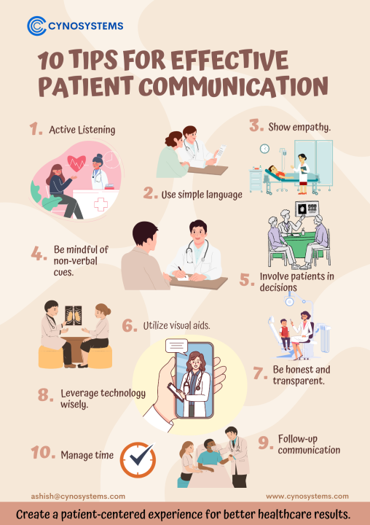
Clarification.
Summarizing.
Providing Information.
Positive Feedback.
Reassurance.
Follow up .

Slide 6
Structured approach for communication
Introducrion
Rapport (warm up to you)
Clarify your role
Conduct of the interview
Ckeck prior knowledge
Touching patient’s & parents’ concern
Appropriate explanation & negotiation
Accuracy of information
Summary
Give a written information
Follow up

Slide 7
Scenario 1
Mona is the mother of Yehia, who is 2 days old. She started breastfeeding him, but now she is suffering from breast engorgement and has decided to stop breastfeeding completely. Please advise Mrs. Mona about the causes of this problem and how to deal with it. Also, highlight the great benefits of continuing breastfeeding for her baby.

Slide 8
Information giving scenario
Introduction
Introduce yourself to Mr. Mona and congratulate her for giving birth to Yehia.
Rapport (warm up to you)
Warm up with her and try to maintain rapport throughout the meeting
Clarify your role
Today, we are here to discuss managing breast engorgement to support continued breastfeeding and to explore the benefits of breastfeeding.
Conduct of the interview
Check prior knowledge
Ask an initial question about the benefits of breastfeeding and knowledge on breast engorgement.Clear appropriate explanation
Explain to the mother:
There are great benefits to breastfeeding for the baby and the mother.
Explain to her the causes of breast engorgement.
"Don’t forget to check her follow-up of what you are telling.“

Slide 9
Educate the mother on how to deal with breast engorgement through the following tips:
The mother must remove the breast milk.
If the baby can attach well and suckle, then she should breastfeed as frequently as the baby is willing.
If the baby is not able to attach and suckle effectively, she should express her milk by hand or with a pump a few times until the breasts are softer, so that the baby can attach better, and then get him or her to breastfeed frequently.
She can apply warm compresses to the breast or take a warm shower before expressing, which helps the milk to flow.
She can use cold compresses after feeding or expressing, which helps to reduce the oedema.
Summary
Summarise what you have told her, offer written advice, and allow her to ask questions
Give written information &Offer connecting her with group of breastfed mothers to exchange experiments.
Referrals if needed
Follow up

Slide 10
Scenario 2
Yara is the mother of Ahmed, a 5-month-old boy who is exclusively breastfed. Yara has been experiencing severe sore nipples for the past 2 weeks, which has been affecting her ability to feed her baby. Please explain to Yara how to manage sore nipples and maintain breastfeeding.

Slide 11
Scenario 3
Hanan is the mother of Lama, a 3-month-old girl who is exclusively breastfed. Hanan has finished her maternity leave and will return to work next week. She is considering stopping breastfeeding and switching to formula feeding. Please discuss with Mrs. Hanan the possibility of maintaining breastfeeding while working, and explain how she can do so effectively.

Slide 12
Thank you

