Slide 1
DIARRHEA DISEASES
DR.Mansour ALQurashi

Slide 2
DEFINITION
Diarrhea is defined as the passage of three or more loose or liquid stools per day (or more frequent passage than is normal for the individual).
Frequent passing of formed stools is not diarrhea, nor is the passing of loose, "pasty" stools by breastfed babies.
ACUTE DIARRHEA LAST LESS THAN 14 DAYS,

Slide 3
CAUSES OF DIARRHOEA DEATHS
Diarrheal disease is the second leading cause of death in children under five years old Causes of death include :
severe dehydration and fluid loss .
Septic bacterial infections.
Children who are malnourished or have impaired immunity as well as people living with HIV are most at risk of life-threatening diarrhoea.

Slide 4
Complications of acute diarrhea
Dehydration and electrolyte imbalance.
Persistent diarrhea .
Lactose intolerance.
Malnutrition.

Slide 5
Clinical Types of Diarrhoea
Acute watery diarrhoea – lasts several hours or days, and includes cholera.
Acute bloody diarrhoea – also called dysentery.
Persistent diarrhoea – lasts 14 days or longer.

Slide 6
CAUSES OF DIARRHOEA
Infection in the intestinal tract
Rotavirus is the most common cause of acute childhood diarrhea, usually resolves in 3-9 days.
Other common viruses : Adenovirus , norovirus and astroviruses .
Campylobacter, salmonella, shigella and E -coli ( common causes ).
Giardia and entamoeba histolytica cause chronic diarrhea and less commonly acute diarrhea.

Slide 7
CAUSES OF DIARRHOEA
Malnutrition:
Makes children more vulnerable to diarrhoea.
Each diarrhoeal episode, makes their malnutrition even worse
Children who die from diarrhoea often suffer from underlying malnutrition.
Diarrhoea is a leading cause of malnutrition in children under five years old.

Slide 8
CAUSES OF DIARRHOEA ..cont
Other causes:
Diarrhoeal disease can spread from person-to-person, aggravated by poor personal hygiene.
Food is another major cause of diarrhoea when it is prepared or stored in unhygienic conditions.
Unsafe domestic water storage and handling is important risk factor.
Fish and seafood from polluted water also contribute to the disease.
A significant proportion of diarrhoeal disease can be prevented through safe drinking-water and adequate sanitation and hygiene.

Slide 9
Classification according to mechanism of diarrhea
Osmotic:
Due to non-absorbable solutes in gut. e.g lactose intolerance .
Secretory:
a) Activation of intracellular mediators (cAMP, cGMP, and calcium) . e.g Cholera & E.coli enterotoxins.
b) Congenital defects of Na-H exchange, Cl -HCO3 exchange, and Na-bile acid transport proteins (secretory diarrhea presenting at birth) eg: Cong. chloride diarrhea.
Inflammatory (Mucosal damage). e.g bacterial , viral , parasitic infections.

Slide 10
OSMOTIC
If a child drinks solutions with excessive sugar or salt ,these can draw water from the body into the bowel and can cause osmotic diarrhea .
It can also be the result of maldigestion (e.g., pancreatic disease or coeliac disease). The nutrients are left in the lumen pull in the water.
It can be caused by osmotic laxatives.
In healthy children too much Magnesium , vitamin C , undigested lactose can cause osmotic diarrhea .
Lactose intolerance ,Fructose malabsorption cause osmotic diarrhea .
In most of these cases osmotic diarrhea will stop when offending agent eg milk or sorbitol is discontued .

Slide 11
SECRETORY:
Secretory diarrhea means that there is an increase in the active secretion or inhibition of absorption .
There is little to no structural damage.
The most common cause is a cholera toxin that stimulate the secretion of anions, especially chloride ions.
Therefore, to maintain a charge balance in the lumen ,sodium is carried with it , along with water.
Intestinal fluid secretion is isotonic with plasma even during fasting.
It continues even when there is no oral food intake .

Slide 12
INFLAMMATORY (Mucosal damage):
It occurs when there is damage to the mucosal lining or brush border which leads to a passive loss of protein-rich fluids and a decrease ability to absorb these lost fluids .
Features of the other types of diarrhea can be found in this type of diarrhea.
It can be caused by bacterial ,viral, parasitic infections, or autoimmune inflammatory bowel disease .
Other causes include tuberculosis ,colon cancer and enteritis.

Slide 13
INFLAMMATORY (Mucosal damage):
EXUDATIVE DIARRHEA occurs with the presence of blood and pus in the stool. e.g Crohn’s disease or Ulcerative colitis and other severe infections such as E.coli .
DYSENTERY:
Shigella is the most common cause of dysentery (gross blood in the stool is the hallmark of dysentery and may be accompanied by abdominal cramps and fever).
Other causes include Entamoeba Histolytica, and salmonella .
.

Slide 14
Classification according to Age of onset
At birth or in 1st 24 H of life after the first feeding .
Congenital chloride diarrhea (h/o polyhydramnios) .
Congenital Lactase deficiency.
Early onset (before 3 month of age).
Cow’s/soy milk allergy (blood streaks & emesis. +ve WBC in stool ).
Malrotation/volvulus (Emesis + diarrhea, Malabsorption/ Protein loss).
2 nd Lactase deficiency : watery, acidic (fermentation), sugar containing stools.
Infectious ( rotavirus, salmonella) manifested with Fever, crampy abdomnal pain . Blood/ mucous in stool.

Slide 15
Classification according to Age of onset
Onset by 3 month to preschool age.
Toddler’s diarrhea (normal growth ,no malnutrition, no dehydration).
Celiac disease
Cystic fibrosis.
Onset in later childhood & adolescence.
Infections and post infections.
juices.
Crohn disease and ulcerative colitis.

Slide 16
Diagnosis
History.
Age of onset: e.g early onset suggest congenital/genetic disorders
Relationship to dietary changes: e.g Secretory will not stop if NPO
Nature of stool. e.g foul smell, greasy in fat malabsorption.
Associated symptoms: e.g arthritis/skin lesion in IBD
Exposure: e.g family, day care or travel in infection by Giardia
Past health: e.g antibiotic ,surgery of bowel
Family history. e.g protein intolerance, CF, Celiac disease, IBD,

Slide 17
Diagnosis
Physical examination:
General nutrition & growth: poor growth
Vital signs: Hypertension ,fever ,hydration
Abdominal exam: Abd. Mass, Abd. Distension, Organomegaly, Abnormal Genitalia, Perianal tags/fistulae, Rectal prolapse
Additional findings: odema ,Pallor , jaundice ,rash, wheezing clubbing , Iritis and arthritis.
Neurological exam: Ataxia , hyporeflexia

Slide 18
Investgations for acute diarrhea
Blood tests: CBC,ESR, Electrolytes, BUN and creatinine .
LFT
Stool exam: pH , Reducing substances , Smear for WBC, fat, ova & parasites , Occult blood
Stool cultures.

Slide 19
DIAGNOSTIC APPROACH
The following types of diarrhea may indicate further investigations :
Diarrhea since birth.
Moderate or severe diarrhea in infant or young children.
Associated with blood .
Continues for more than 3 days .
Associated with non-cramping abdominal pain , fever, weight loos.
In travelers.
In food handlers ( the potential to infect others ).
In institutions ( hospitals, child care centers )
Suspected celiac disease or inflammatory bowel disease.
Failure to thrive.

Slide 20
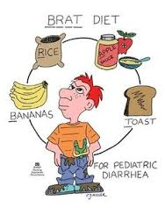
MANAGEMENT
In many cases , replacing lost fluid and salts is the only treatment needed . (Oral rehydration therapy or intravenously )
Diet restrictions such as the Brat diet (for 2 days only)
Research does not support the limiting of milk to children ( no effect on duration of diarrhea)

Slide 21
TREATMENT
Zinc supplements for 10 -14 day, reduce the duration of a diarrhea episode by 25% and are associated with a 30% reduction in stool volume.
Nutrient-rich foods: the vicious circle of malnutrition and diarrhea can be broken by continuing to give nutrient-rich foods – including breast milk – during an episode and by giving a nutritious diet to children when they are well.
Management of persistent diarrhea or when there is blood in stool.

Slide 22
PREVENTION
Safe drinking-water,
Use of improved sanitation.
Hand washing with soap can reduce disease risk.
Exclusive breastfeeding for the first six months of life.
Good personal and food hygiene.
Health education about how infections spread.
Rotavirus and Cholera vaccination.
Probiotics decrease the risk of diarrhea in those taking antibiotics.

Slide 23
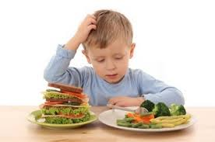
QUESTIONS
???

Slide 24
Chronic Diarrhea
Chronic diarrhea (persistent ) – lasts 14 days or longer
In the underdeveloped parts of the world, chronic diarrhea or protracted diarrhea occurs as a sequela in about one in every 200 children with acute gastroenteritis.

Slide 25
Risk Factors for developing chronic diarrhea
Malnutrition: (developing countries).
Lack of breast feeding.
Zinc deficiency.
Infection with enteropathogenic E. coli.
Immune deficiency: e.g. HIV , combined immune deficiency.
History of IUGR .
A recent acute diarrheal episode.
Recent antibiotic use.
First-degree relatives with Celiac disease, cystic fibrosis and inflammatory bowel disease (IBD).

Slide 26
Common causes of chronic diarrhea
Diarrhea following infection (post infectious diarrhea):
–Giardia can lead to chronic diarrhea.
Chronic nonspecific diarrhea:
– Seen in toddlers and is usually dietary in origin, such as from drinking too much juice.
Celiac disease (gluten intolerance).
Inflammatory bowel disease (ulcerative colitis and Crohn disease).

Slide 27
Common causes of chronic diarrhea
Lactose intolerance :
- Diarrhea ,abdominal pain and distention, excessive burping and gas.
Irritable bowel syndrome:
A common cause of diarrhea in teenagers.
Diarrhea after antibiotic use :
Antibiotic associated colitis (Clostridium difficile).
Malnutrition.
Food allergies:
– Diarrhea ,skin rashes, abdominal pain, poor growth, nausea and vomiting.

Slide 28
MALABSORPTION:
Is the inability to absorb food fully ,mostly from disorders in the small bowel, but also due to maldigestion from disease of the pancreas.
Causes include:
Enzyme deficiencies or mucosal abnormality, as in food allergy and food intolerance :
Celiac disease (Gluten intolerance).
Lactose intolerance ( intolerance to milk sugar , more common in non-europeans).
Fructose malabsorption.

Slide 29
MALABSORPTION: CONT,,,
2. PERNICIOUS ANEMIA, DUE TO THE INABILITY TO ABSORB VITAMIN B₁₂
LOSS OF PANCREATIC SECRETIONS, WHICH MAY BE DUE TO CYSTIC FIBROSIS OR PANCREATITIS
STRUCTURAL DEFECTS, LIKE SHORT BOWEL SYNDROME (SURGICALLY REMOVED BOWEL) AND RADIATION FIBROSIS, SUCH AS USUALLY FOLLOWS CANCER TREATMENT AND OTHER DRUGS, INCLUDING AGENTS USED IN CHEMOTHERAPY.
CERTAIN DRUGS, LIKE ORLISTAT, WHICH INHIBITS THE ABSORPTION OF FAT.

Slide 30
INFLAMMATORY BOWEL DISEASE
ULCERATIVE COLITIS:
IS MARKED BY CHRONIC BLOODY DIARRHEA AND INFLAMMATION MOSTLY AFFECTS THE DISTAL COLON NEAR THE RECTUM.
CROHN'S DISEASE:
TYPICALLY AFFECTS FAIRLY WELL DEMARCATED SEGMENTS OF BOWEL IN THE COLON AND OFTEN AFFECTS THE END OF THE SMALL BOWEL.

Slide 31
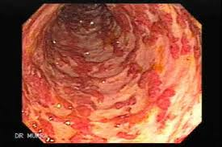
ULCERATIVE COLITIS:

Slide 32
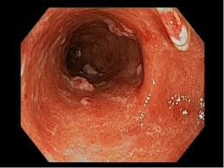
ULCERATIVE COLITIS:

Slide 33
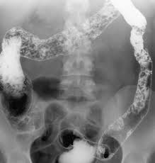
ULCERATIVE COLITIS:

Slide 34
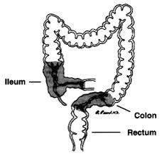
CROHN'S DISEASE:

Slide 35
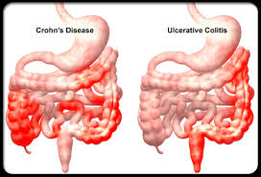
CROHN'S DISEASE:

Slide 36
IRRITABLE BOWEL SYNDROME
USUALLY PRESENTS WITH ABDOMINAL DISCOMFORT RELIEVED BY DEFECATION AND UNUSUAL STOOL (DIARRHEA OR CONSTIPATION) FOR AT LEAST 3 DAYS A WEEK OVER THE PREVIOUS 3 MONTHS.
SYMPTOMS OF DIARRHEA-PREDOMINANT IBS CAN BE MANAGED THROUGH A COMBINATION OF DIETARY CHANGES, SOLUBLE FIBER SUPPLEMENTS, AND/OR MEDICATIONS SUCH AS LOPERAMIDE OR CODEINE.
ABOUT 30% OF PATIENTS WITH DIARRHEA-PREDOMINANT IBS HAVE BILE ACID MALABSORPTION DIAGNOSED WITH AN ABNORMAL SEHCAT TEST.

Slide 37

Other causes of chronic diarrhea
Microscopic colitis, (IBD) : Changes are only seen on histological examination of colonic biopsies.
Bile salt malabsorption (Primary bile acid diarrhea) ,excessive bile acids in colon produce a secretory diarrhea .
Hormone-secreting tumors: e.g. Serotonin.
Chronic mild diarrhea in infants and toddlers may occur with no obvious cause and with no other ill effects ( toddlers diarrhea)
Congenital chloride diarrhea .

Slide 38
Investigations for Chronic Diarrhea
Sweat chloride test
Stool electrolytes & osmolality.
72-hr stool collection for fat determination.
Breath hydrogen test.
Celiac disease antibodies
Stool alpha1-antitrypsin.
Endoscopic studies with biopsies.
Barium studies.
Hormonal & neurotransmittal studies (such as vasoactive intestinal polypeptied, gastrin, secretin).

Slide 39
TREATMENT
Treatment of underlying cause.
Antibiotics may be prescribed for children with specific bacterial or parasitic illnesses.
Probiotics.
Medications that slow down bowel movements (occasionally).

Slide 40
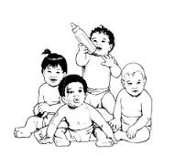
THANK YOU

Slide 41
Celiac Disease

Slide 42
INTRODUCTION
Celiac disease also known as gluten-sensitive enteropathy .
It is the most common genetically related food intolerance, worldwide. Celiac disease is a multifactorial, autoimmune disorder that occurs in genetically susceptible individuals.
It is triggered by a well-identified environmental factor (gluten and related prolamin present in wheat, rye, and barley).
Gluten is a form of protein found in some grains. The damage to the intestine makes it hard for the body to absorb nutrients, especially fat, calcium, iron, and folate.

Slide 43
Pathophysiology
Celiac disease is an autoimmune disease, and the enzyme tissue transglutaminase (tTG) is the autoantigen against which the abnormal immune response is directed.
Gluten is the single major environmental factor that triggers celiac disease, which has a narrow and highly specific association with class II haplotypes of HLA DQ2.
This causes inflammation in the intestines and damages the villi, the hair-like structures on the lining of the small intestine, causing malabsorption .

Slide 44
Presentations of celiac disease
Currently, 5 possible presentations of celiac disease are recognized, as follows:
Typical: This presentation is primarily characterized by GI signs and symptoms.
Atypical: GI signs and symptoms are minimal or absent, and various extraintestinal manifestations are present.
Silent: The small intestinal mucosa is damaged, and celiac disease autoimmunity can be detected with serology; however, no symptoms are present.

Slide 45
Potential: Patients have a positive specific autoimmune serology and may or may not be symptomatic, but the mucosa morphology is normal. These individuals have genetic compatibility with celiac disease and full-blown celiac disease may develop at a later stage in some or all of these individuals.
Latent: Individuals with normal mucosal morphology who “have had a gluten-dependent enteropathy at some point in their life.” This subset of patients is the rarest of the group.

Slide 46
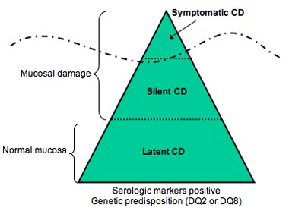

Slide 47
Symptoms of Celiac Disease
Asymptomatic or minimally symptomatic celiac disease is probably the most common form of the disease, especially in older children and adults .

Slide 48
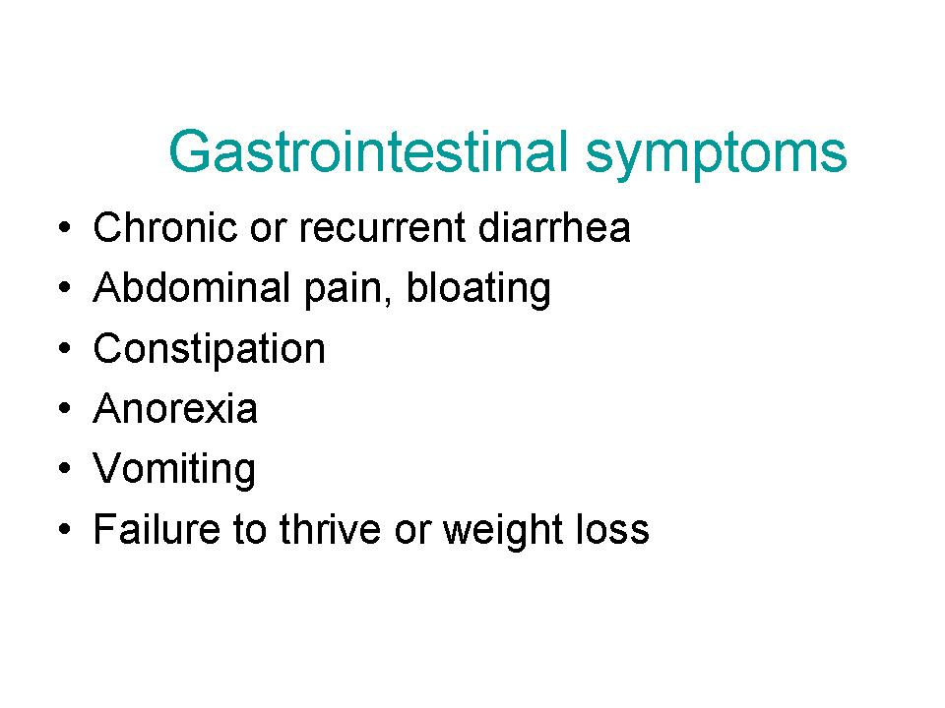

Slide 49
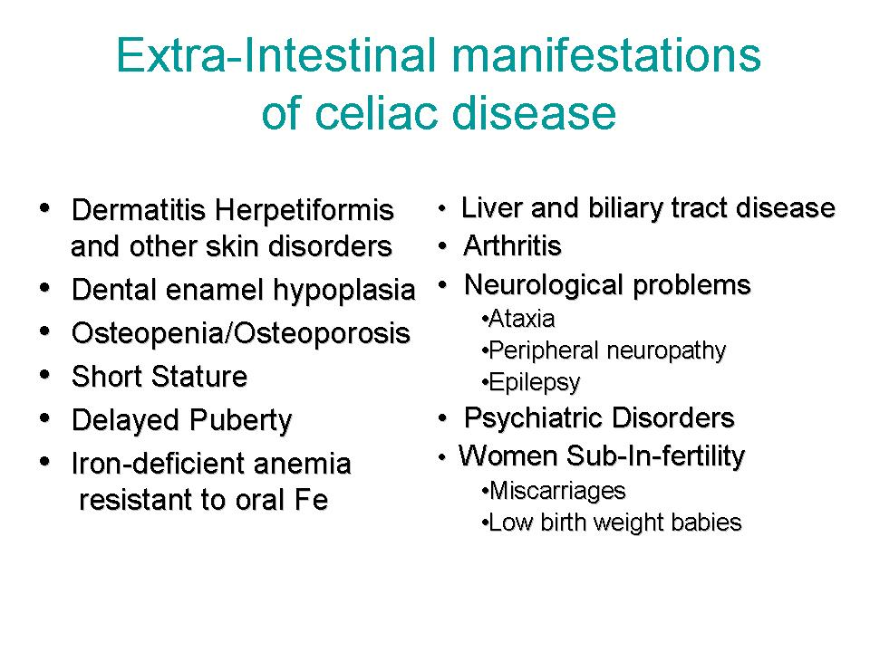

Slide 50
Physical Finding
Examination findings depend on extent of celiac disease.
Dry mucosal membranes with vomiting or diarrhea indicate the degree of dehydration.
Oral aphthae (aphthous ulcers) are more frequent than in normal population.
Dental enamel hypoplasia is a highly specific but relatively uncommon finding.
Bloating of the abdomen .
Potbelly and muscle wasting.
Failure to thrive.

Slide 51
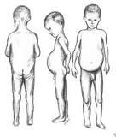

Slide 52
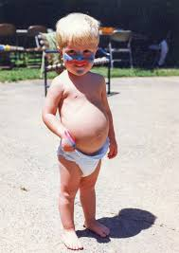

Slide 53
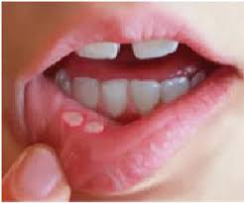
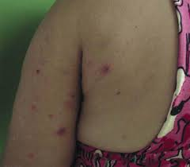

Slide 54
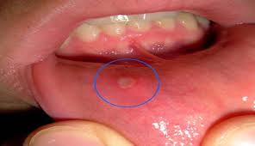

Slide 55
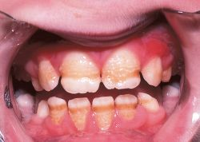

Slide 56
Health Problems Accompany Celiac Disease
Osteoporosis, which leads to fractures. It occurs due to decrease calcium and vitamin D absorption.
Miscarriage or infertility in adult females .
Birth defects, such as neural tube defects caused by poor absorption of folic acid.
Seizures.
Intestinal T-cell lymphoma.
Other autoimmune diseases :
Thyroid disease
Type 1 diabetes
Lupus. Rheumatoid arthritis, Sjögren's syndrome

Slide 57


Slide 58
epidemiology
Prevalence among the general population is 3.% in Saudi Arabia. Globally coeliac diseases affects 1% .
The prevalence of CD in Down’s syndrome patients was 10 % in Saudi Arabia.
Most studies indicate a prevalence female : male , ranging from 1.5:1 to 3:1.
Classic GI pediatric cases usually appear in children aged 9-18 months.

Slide 59
Prognosis
Evidence suggests that the risk of mortality is increased in proportion to the diagnostic delay .
subjects who do not follow a gluten-free diet have an increased risk of mortality, as high as 6 times that of the general population.
The increased death rates are most commonly due to intestinal malignancies that occur within 3 years of diagnosis.

Slide 60
Differential Diagnoses
Autoimmune enteropathy
Cystic Fibrosis
Inflammatory Bowel Disease
Irritable Bowel Syndrome
Protein Intolerance.

Slide 61
Diagnosis..
Duodenal mucosa histology changes in celiac disease (CD) are documented while on a gluten-containing diet and are characterized by a progressive deterioration of the villous architecture associated with a progressive increase in crypt length and density. Biopsy samples are now almost universally obtained by endoscopy.
Multiple biopsy samples (at least 4) are recommended because celiac disease may be patchy and areas of villous atrophy may be adjacent to normal areas.
In addition, biopsy from the duodenal bulb is also recommended, as about 2-3% of celiac children may have changes only in that part of the duodenum

Slide 62
Intestinal biopsy of pt with chronic diarrhea ,abdominal distention?
What is the diagnosis?

Slide 63
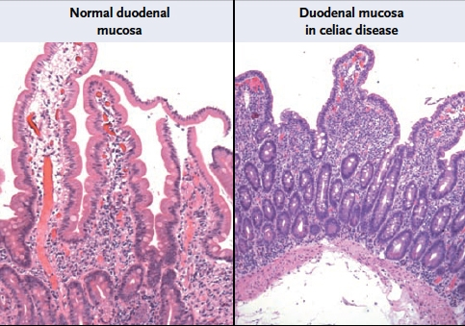

Slide 64
In clinical practice, it is thus recommended to obtain first serologic tests for celiac disease (namely the anti-TTG-Ig A) and then to proceed with the intestinal biopsy to diagnose the condition in positive cases.
Serology, especially TTG, also has a major role in monitoring response to treatment.

Slide 65
TREATMENT
Medical Care
Total lifelong avoidance of gluten ingestion is the cornerstone treatment for patients with celiac disease (CD).
Wheat, rye, and barley are the grains that contain toxic peptides. They should be eliminated as completely as possible, although daily intake doses larger than 10 mg are likely needed to cause mucosal reaction.
Lactose is often eliminated in the initial phases of dietary treatment as well. This is because lactase deficiency is thought to accompany the flat mucosa.

Slide 66
GI symptoms in patients with symptomatic celiac disease who adhere to a gluten-free diet typically resolve within a few weeks; these patients experience the normalization of nutritional measures, improved growth in height and weight (with resultant normal stature), and normalization of hematological and biochemical parameters.
Furthermore, treatment with a gluten-free diet reverses the decrease in bone mineralization and the risk for fractures . Symptomatic children treated with a gluten-free also improve their sense of physical and psychological well being.

Slide 67


Slide 68


Slide 69
Cystic Fibrosis

Slide 70
Background
Cystic fibrosis (CF) is a disease of exocrine gland function that involves multiple organ systems but chiefly results in chronic respiratory infections, pancreatic enzyme insufficiency, and associated complications

Slide 71
Pathophysiology
Cystic fibrosis is caused by defects in the CF gene, which codes for a protein transmembrane conductance regulator (CFTR).
CFTR functions as a chloride channel and is regulated by cAMP.
Mutations in the CFTR gene result in abnormalities of cAMP-regulated chloride transport across epithelial cells on mucosal surfaces.
Cystic fibrosis is an autosomal recessive disease.
Its estimated heterozygote frequency in white people is up to 1 in 20. Median survival age is 36.9 years.

Slide 72
History
Median age at diagnosis of cystic fibrosis is 6-8 months.
Neonates may present with meconium ileus or, rarely anasarca.
Patients younger than 1 year present:
wheezing, coughing, recurring respiratory infections , pneumonia.
steatorrhea, failure to thrive, or both.
Patients diagnosed later in childhood are more likely to have pancreatic sufficiency and often present with chronic cough and sputum production.
Approximately 10% of patients with cystic fibrosis remain pancreatic sufficient; these patients tend to have a milder course.

Slide 73
GIT manifestations in neonate
Meconium ileus occurs in 7-10% of patients with CF.
Simple meconium ileus present with abdominal distension at birth, progressing to failure to pass meconium, bilious vomiting, and progressive abdominal distension.
Complicated meconium ileus present more dramatically at birth with severe abdominal distention, accompanied by abdominal wall erythema and edema.
Intestinal obstruction at birth (eg, volvulus, intestinal atresia, perforation, meconium peritonitis).
Delayed passage of meconium (>24-48 hours after birth) .
Prolonged Cholestatic jaundice.

Slide 74
GIT manifestations in infants and children
Pancreatic insufficiency :
Fat-soluble vitamin deficiency and malabsorption of fats, proteins, and carbohydrates .
Malabsorption results in steatorrhea, characterized by frequent, poorly formed, large, bulky, foul-smelling, greasy stools that float in water. Some patients have anorexia without obvious steatorrhea.
Failure to thrive. flatulence or foul-smelling flatus, recurrent abdominal pain, and abdominal distention
Intussusception (ileocecal).
Rectal prolapse.
Jaundice or GIT bleeding as a result of hepatobiliary involvement.

Slide 75
Respiratory tract manifestations
Chronic or recurrent cough : dry and hacking at the beginning and produce mucoid (early) and purulent (later) sputum.
Prolonged symptoms of bronchiolitis in infants.
Paroxysmal cough followed by vomiting .
Recurrent wheezing, recurrent pneumonia, atypical asthma, pneumothorax, hemoptysis, and digital clubbing are all complications.
Dyspnea on exertion, history of chest pain, recurrent sinusitis, nasal polyps, and hemoptysis.

Slide 76
Urogenital tract manifestations
Undescended testicles or hydrocele .
Males are frequently sterile because of the absence of the vas deferens.
In females decreased fertility ,secondary sexual development is often delayed.
Amenorrhea may occur in females with severe nutritional or pulmonary involvement

Slide 77
Physical Examination ..respiratory system
Rhinitis
Nasal polyps
Tachypnea
Respiratory distress with retractions
Wheeze or crackles
Cough (dry or productive of mucoid or purulent sputum)
Increased anteroposterior diameter of chest
Clubbing
Cyanosis
Hyperresonant chest upon percussion .
Crackles are heard acutely in associated pneumonitis or bronchitis and chronically with bronchiectasis.

Slide 78
Physical Examination ..GIT system
Swelling of submandibular gland or parotid gland.
Abdominal distention.
Hepatosplenomegaly (fatty liver and portal hypertension).
Rectal prolapse.
Dry skin (vitamin A deficiency).
Cheilosis (vitamin B complex deficien.
Scoliosis/ Kyphosis.

Slide 79
Differential Diagnoses
Acute Sinusitis
Bronchiolitis
Failure to Thrive
Asthma
Bronchiectasis
Celiac Disease (Sprue)
Primary Ciliary Dyskinesia
Short Stature

Slide 80
Diagnostic Confirmation
Requirements for a CF diagnosis include either positive genetic testing or positive sweat chloride test findings (>60 mEq/L) and 1 of the following:
Typical chronic obstructive pulmonary disease
Documented exocrine pancreatic insufficiency
Positive family history (usually affected sibling).
Prenatal testing:
Noninvasive CFTR analysis involves a technique for recovering DNA from cells obtained by buccal brushing.
Amniocentesis .
Neonatal testing: immunoreactive trypsinogen (IRT) elevated in infants with cystic fibrosis and genetic testing.

Slide 81
OTHER Tests for CF
Comprehensive metabolic panel (CMP) : Urea ,electrolyets ,Ca.LFT
Complete blood count (CBC)—another test for general health and to help detect infections
Glucose and hemoglobin A1c—to detect, diagnose and monitor diabetes
Amylase and lipase—to detect problems with the pancreas
Fecal fat—to identify malabsorption and pancreatic insufficiency
Semen analysis—to detect infertility
Sputum cultures—to help diagnose lung infections
Chest X-rays, upper GI and small bowel series, and lung function tests.

Slide 82
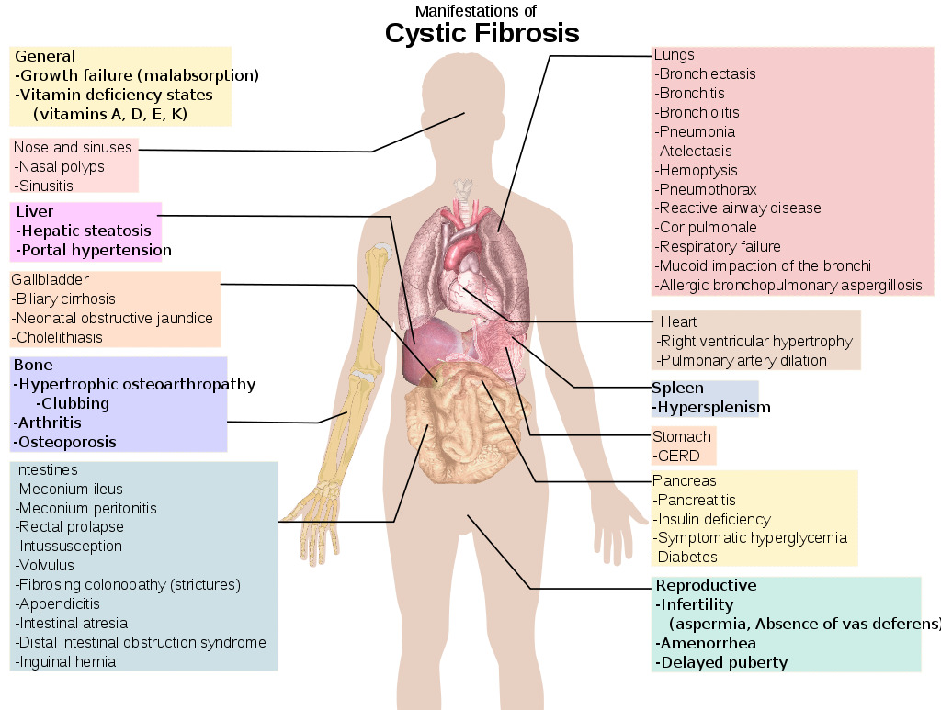

Slide 83
Treatment
The primary goals of CF treatment include the following:
Maintaining lung function as near to normal as possible by controlling respiratory infection and clearing airways of mucus.
Administering nutritional therapy (ie, enzyme supplements, multivitamin and mineral supplements) to maintain adequate growth.
Managing complication

Slide 84


