Slide 1
Fluid & electrolyte disturbance
Dr Faten Zaidan

Slide 2
Fluid content according to age
Total body water (TBW) vary with age:
Preterm = 80-85%
Term = 75%
Infant= 65%
Older children & adult male= 60%
Adult female=50%
After birth term infants loses approximately 5%-15% of their body weight in the 1st week of life.
TBW ↓ to 60% by 1st yr of life
Female has less fluid content because of more fat cells

Slide 3
Regulation of Body Fluids
Body fluid Homeostasis is maintained through
A. Fluid intake
B. Hormonal regulation
  1. Antidiuretic hormone(ADH)
    2. Renin-Angeotensin-Aldosterone Mechanism
      3. Natriuretic Peptides
C. Fluid output

Slide 4
Regulation of Body Fluids
Body fluid Homeostasis is maintained through
A. Fluid intake controlled by hypothalamus
B. Hormonal regulation
  1. Antidiuretic hormone(ADH/vasopressin) > Increase reabsorption of water and causes vasoconstriction leading to increase intravascular volume
  2. Renin-Angeotensin-Aldosterone Mechanism
  3. ANB + BNP > shut down thirst centre, inhibits renin secretion, inhibits aldosterone , leading to sodium and water loss (mimicking diuresis)
C. Fluid output

Slide 5
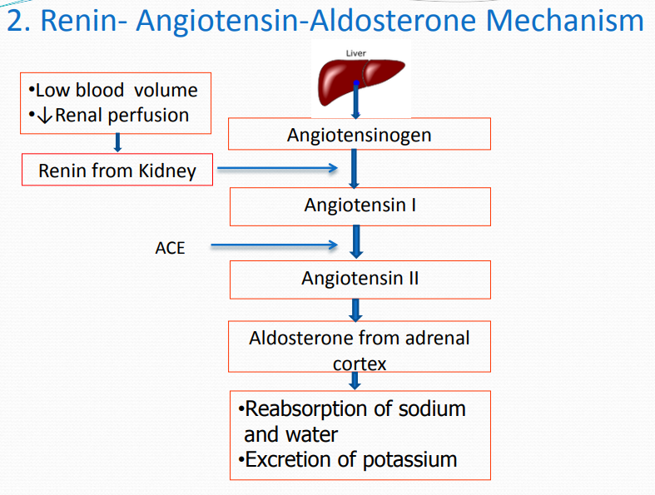
2-Aldosterone
End product of RAAS
It increases the expression of ATPase pumps in the nephron that causes an increase in water reabsorption through sodium cotransport.
The renin –angiotensin aldosterone system is activated by high plasma osmolarity, low blood volume, low blood pressure, and stimulation of the sympathetic nervous system.

Slide 6
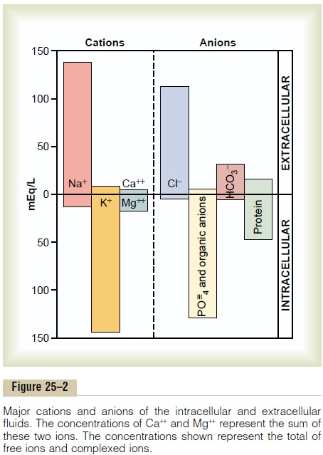
Electrolyte distribution
Main cation in extracellular fluid is Sodium
(N=135 - 145 mEq/L)
Regulated by RAAS
Main cation in intracellular fluid is Potassium
(K= 3.6 - 5.2 mmol/L)
Regulated by dietary intake and renal excretion

Slide 7
Causes of dehydration
Most common : Gastroenteritis
Other causes
Phototherapy
Increased respiratory rate
Fever
Vomiting
Drainage tubes, blood loss
burn

Slide 8
Classification
Dehydration can be classified based on the degree of fluid loss
Mild
5% in infants and 3% in children> 1 year
Moderate
10% in infants and 6% in children>1 year
Severe
15% in infants and 9% in children>1 year

Slide 9
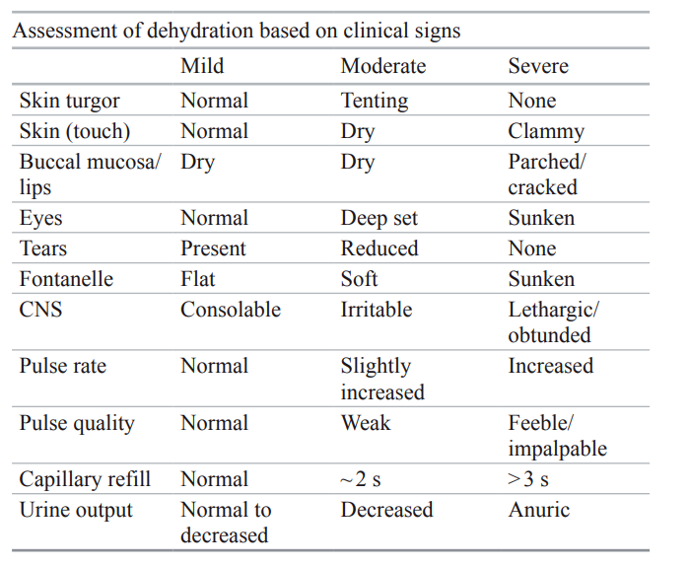

Slide 10
Early detectable signs
Tachycardia
Dry mucous membranes
Cold peripheries
Decreased urine
Thirst
Decreased activity

Slide 11
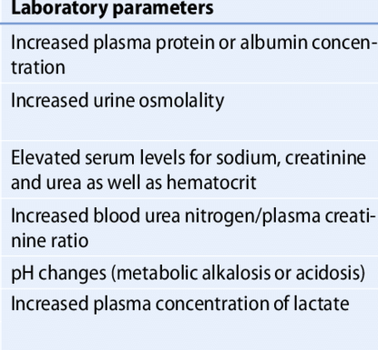
laboratory indications of dehydration
Hypoglycaemia is present in moderate to severe dehydration

Slide 12
approach
General principle is to replace the deficit and ongoing losses and continue to provide maintenance fluid requirement
In mild dehydration , we can initiate therapy with oral solutions
However if patient is having clinical signs indicating moderate to severe dehydration, or oral therapy failed, intravenous therapy will be initiated
Patient with hemodynamic instability characterized by severe dehydration, for e.g., increased capillary refill time and low blood pressure, will need initial fluid bolus with isotonic solutions, such as normal saline

Slide 13
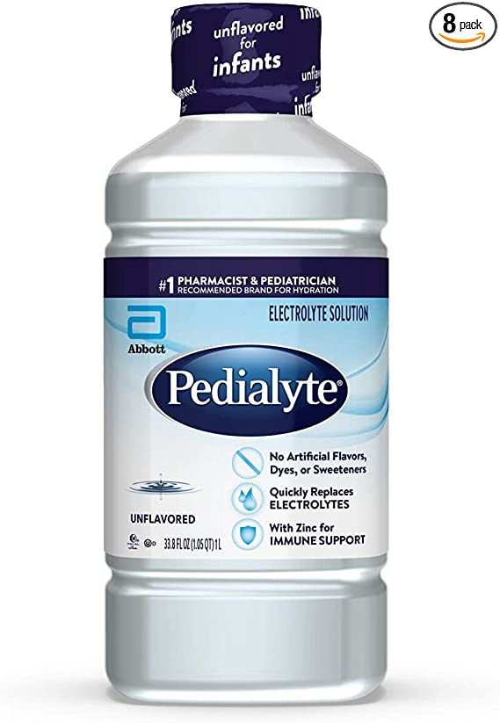
Oral Rehydration Therapy ORT
ORT is recommended as the initial therapy of choice (Pedialyte)
It is the frequent administration of small volumes on a regular schedule.
If the patient is performing oral rehydration therapy (ORT) well, they can be discharged to home to continue the fluid replacement.
Method:
10 mL of Pedialyte administered with a syringe over a 5-minute period is one method of ORT. The volume can be increased as tolerated and the interval can be shortened.
Or , easier way, give 50-100ml/kg within 4 hours
If patient is having emesis , Ondansetron may be used before oral intake

Slide 14
ORT may fail, Why ?
patient refusal
parental noncompliance
persistent emesis
losses greater than the amount of fluid given
Therefore , we move into intravenous fluid therapy
We give boluses first
Boluses should be made with isotonic fluids (normal saline or lactated Ringer)
The bolus volume is 20 mL/kg.
Indications to stop IVF therapy and encourage oral intake
Normalizing vital signs
Oral intake by the patient
Resolving of signs/symptoms of dehydration
Discharge

Slide 15
Emergency Treatment
The presence of severe dehydration and shock requires aggressive fluid resuscitation.
The clinician will initially give boluses of isotonic fluids , then give the maintenance .
If there is no IV line secured, Intraosseaous line should be inserted with hesitation.
Maximum amount of fluid boluses allowed is 60ml/kg
If there is haemorrhage or fluid boluses did not improve vital signs (decreased blood pressure, increased heart rate), blood products can be used to restore intravascular volume.
Now we will see how to do the calculations
Three things to consider in dehydration management
Boluses/Fluid deficit
Maintenance
Electrolyte (Sodium)

Slide 16
Fluid Calculations
1- Acute Resuscitation
Normal Saline or Ringer Lactate 10-20 mL/kg boluses over 5-10 minutes in case of hypovolemia.
In case of cardiogenic shock or distributive shock , fluids must be 5-10 ml/kg over 20 minutes.
2-Calculate maintenance
using Holliday Segar Rule
3- Calculate Fluid Deficit
Either we calculate it through the decreased weight (not practical)
pre-illness wt. (kg) − postillness wt. (kg)
Or we calculate it through the percentage of dehydration present
5% dehydration requires 50 mL/kg fluid replacement.
10% dehydration is 100 mL/kg.

Slide 17
Fluid Calculations
4- Subtract fluid boluses given in resuscitation phase from Fluid Deficit
5- Calculate replacement over 24 hours
First 8 hours : 50% Deficit + Maintenance
Next 16 hours : 50% Deficit + Maintenance
6- Determine Sodium Concentration
Hypernatremic dehydration ( Na > 145)
Hyponatremic dehydration ( Na < 135)
Isotonic dehydration ( Na = 135-145)
7-Add Potassium Chloride to IVF after patient passes urine

Slide 18
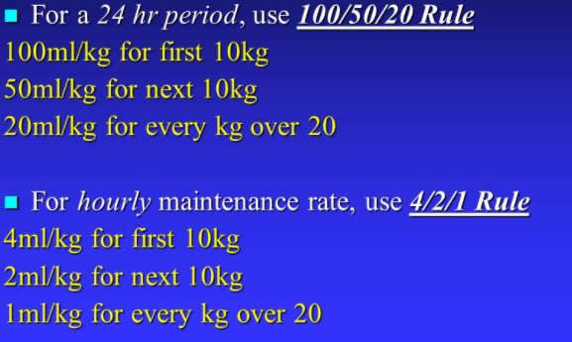
Holliday-Segar Rule
Example
35 kg , 11 years old boy
10 * 4 = 40
10 * 2 = 20
15 * 1 = 15
Total :
75 ml/kg/hr
75*24=1800 ml/day

Slide 19
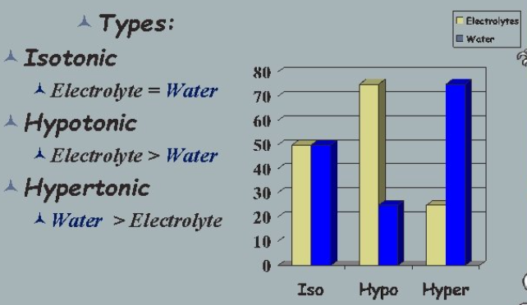
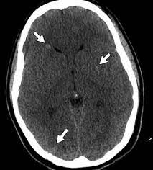
Hyponatraemic dehydration
Na level is less than 135 meq/L
Symptoms :
Lethargy, weakness, seizures , headache, nausea, vomiting, hyporeflexia, disorientation, confusion
When correcting hyponatremic dehydration:
Replace half of the deficit of fluid and electrolyte over 8 h and remaining over 16 h.
The goal of the therapy is not to increase the Na+ level by more than 10–20 mEq/L (8mmol/l) in 24 hours to avoid Cerebral edema
Cerebral edema is caused due to influx of water into the intracellular space resulting in cellular swelling (movement of water into brain cells)

Slide 20
Hyponatraemic dehydration
Causes
Iatrogenic:
Intravenous fluid administration (hypotonic solution)
Diuertics
Diluted formula feed
Desmopressin
SIADH
CNS infections
Head injury
Extrarenal sodium loss
Gastroenteritis
Skin (sweating, burns)
Renal sodium loss
Interstitial nephritis
CSW
Others
Nephrotic syndrome
DKA
Psychogenic polydipsia

Slide 21
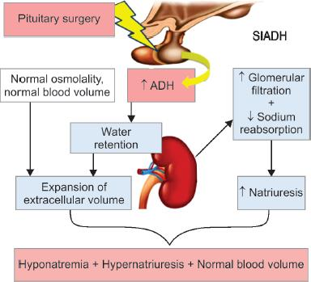
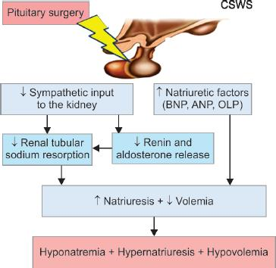
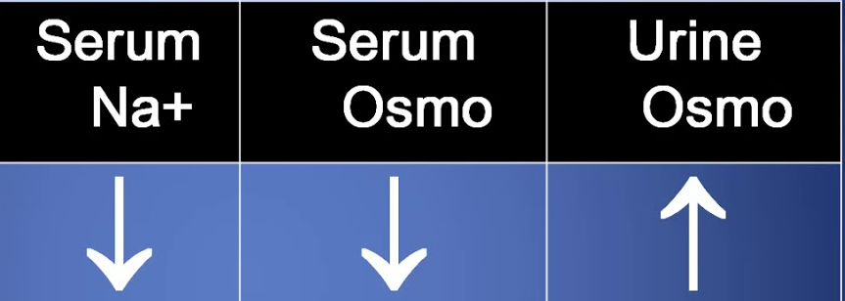
Inability to suppress ADH by the brain
Brain injury causing BNP secretion
Urine output | Volemia
Normal | Normal
Urine output | Volemia
increased | Low

Slide 22
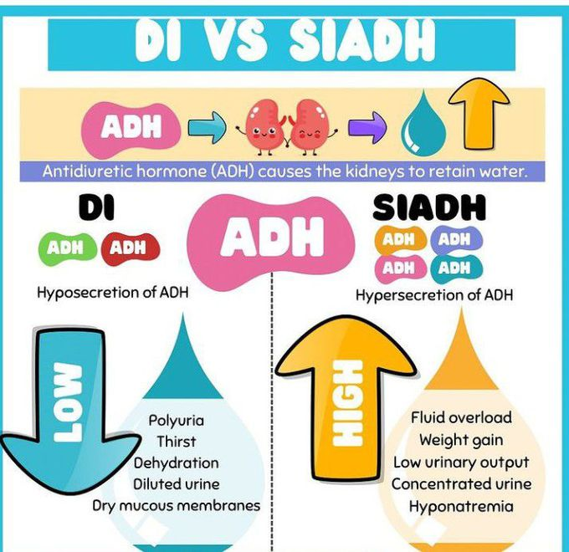

Slide 23
Hypernatremic dehydration
Na level is more than 145 meq/L
Presentation may be nonspecific:
Irritable, lethargic, with doughy skin and a high-pitched cry, eventually having seizures
CNS signs are first to develop due to intracellular dehydration of neurons
Replacement is done slowly over 48 h with the aim of a fall in serum Na of less than 0.5 mmol/l/hr.
Goal is to avoid a rapid drop of the serum Na+, which is a risk factor for central pontine demyelination and manifests as seizures.

Slide 24
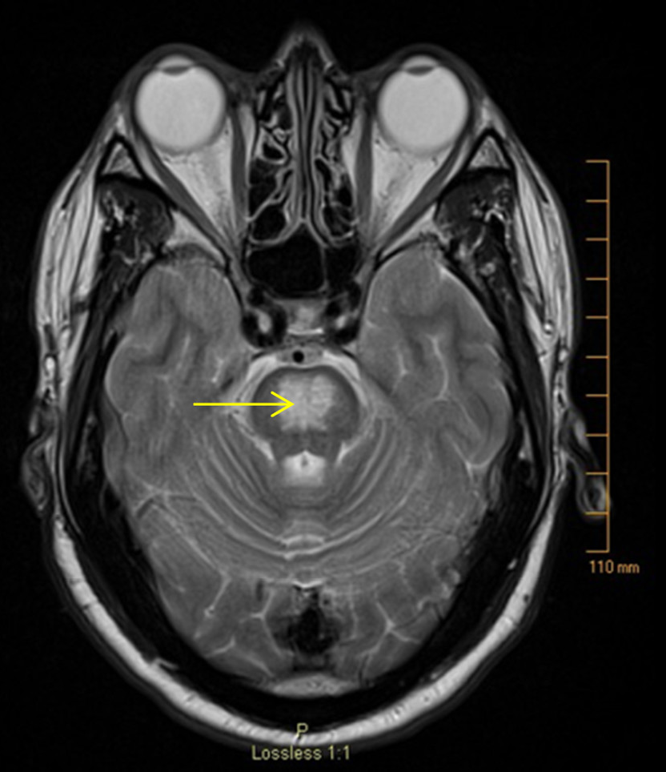
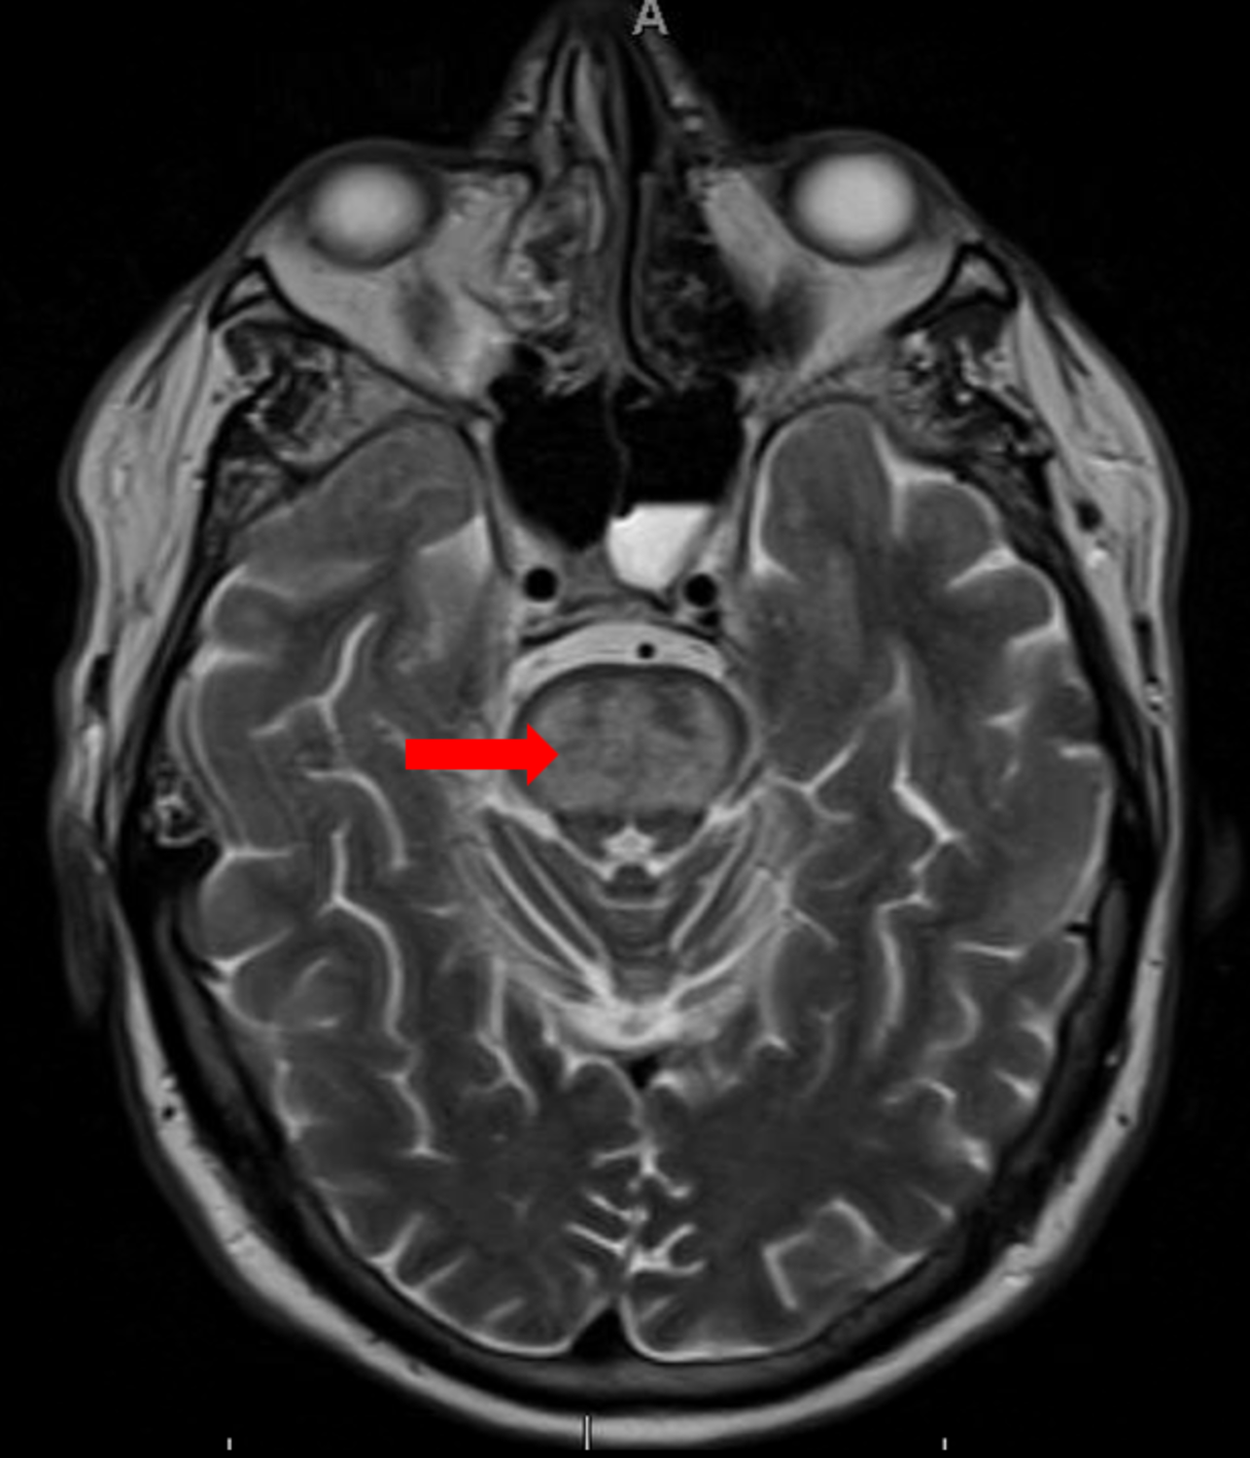
Central pontine myelinosis
normal

Slide 25
Hypernatremic dehydration
Causes:
Water and sodium loss
Gastroenteritis
Burns
DM
Water deficit
DI
Phototherapy
Inadequate intake (failed breastfeeding)
Excessive sodium intake
Inappropriately prepared infant formula
Salt poisoning
Hypertonic IV
hyperaldosteronism

Slide 26
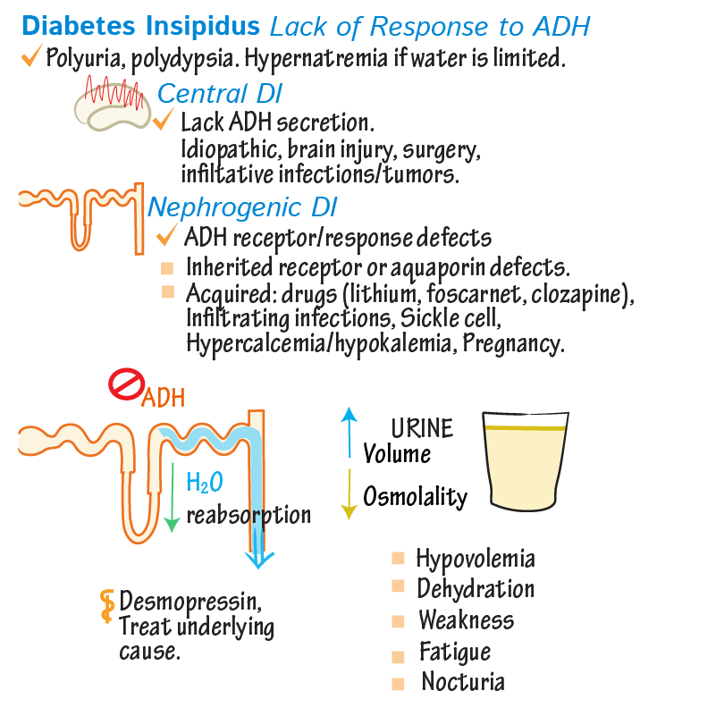
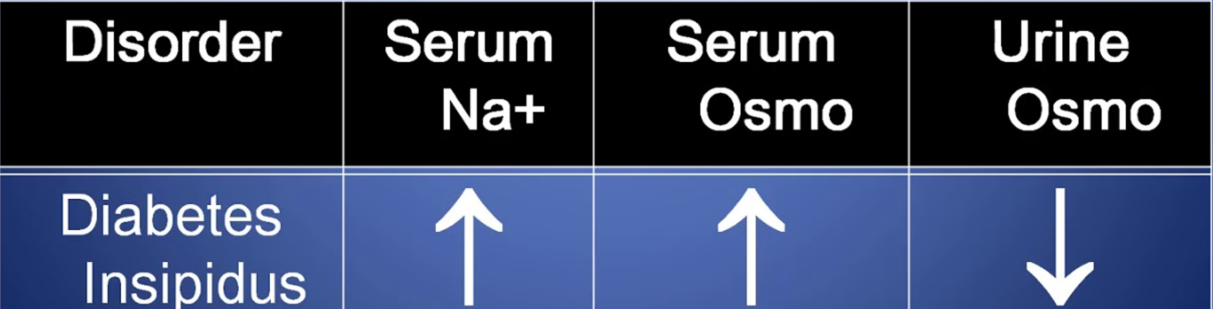

Slide 27
Hyperkalemia
Causes
1- Potassium shifts from the ICF to the ECF
Metabolic acidosis
Strenuous exercise
Insulin deficiency
Hyperglycemia
2- Medications:
Potassium-sparing diuretics (spironolactone)
Potassium supplements (e.g., potassium chloride)
(ACE) inhibitors
Chemotherapeutic agents
3-impaired renal potassium excretion
Renal failure
Renal tubular acidosis (RTA)
adrenal insufficiency
congenital adrenal hyperplasia (CAH)
4- Movement of potassium out of cells during or after specimen collection (Pseudohyperkalemia):
Hemolysis
Tumour lysis syndrome

Slide 28
Hyperkalemia
Serum K+ > 5.5 mEq/L
➢ Mild: S K+ = 5.5-6.5 mEq/L
➢ Moderate : S K+ = 6.5-8.00mEq/L
➢ Severe: S K+ >8 mEq/L
Lab tests
Chemistry for other electrolytes
Glucose level
Urinalysis, urine potassium, and creatinine
ECG

Slide 29
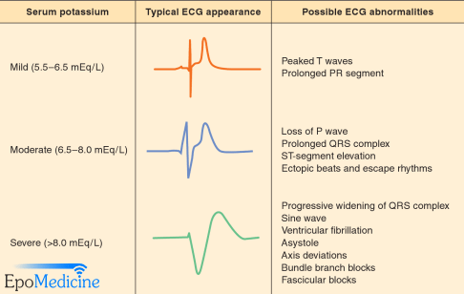
Hyperkalemia
Clinical Features
muscle weakness, decreased deep tendon reflexes, ileus, tingling of the mouth and extremities, malaise, and tetany.
ECG changes:
Prolong PR interval
Peaked T wave
wide QRS complex
absent P
Asystole, VF

Slide 30
Hyperkalemia
Treatment:
First line:
Salbutamol nebulisation: it will shift K into the cells.
Effect will appear within 20-30 minutes
Second line
Insulin and Glucose infusion: it will shift K into cells
Effect will appear within 10-20 minutes
Third line:
Furosemide: excrete K through renal tubukes
Effect will appear within 60-120 minutes
Calcium Gluconate should be given in moderate to severe hyperkalemia to stabilize cardiac conduction.
Calcium Resonium (Kayexalate) is given to antagonise K effect.
Effect will appear within 60-120 minutes

Slide 31
hypokalemia
Definition: level below 3.4 mmol/l
Causes
Malnutrition (severe)
Increased gastrointestinal losses (e.g., vomiting, diarrhea
Increased skin losses (e.g., excessive sweating, burns)
Increased renal losses (e.g., Fanconi syndrome, RTA, diuretic therapy)
alkalosis (metabolic and respiratory)
excess insulin (it causes increases cellular uptake of potassium)
Medications
    Diuretics (except for potassium-sparing ones) Insulin
    Albuterol

Slide 32
hypokalemia
Presentation
Neuromuscular signs
weakness, paralysis, tetany, ileus, ureteral aperistalsis, lethargy, confusion, autonomically mediated hypotension, and rhabdomyolysis
Cardiovascular signs
elevated blood pressure, bradyarrhythmia, and tachyarrhythmia
Renal and metabolic abnormalities
(hypokalemic nephropathy), and impaired insulin secretion (glucose intolerance)
Lab tests
Chemistry for other electrolytes
Glucose level
Urinalysis, urine potassium, and creatinine
ECG

Slide 33
treatment
Orally :
Bananas, tomatoes, and most other fruits, Prune juice and orange juice
Oral supplements: 2mmol/kg/day in divided doses
Severe or symptomatic hypokalemia
IV potassium, dose not to exceed 0.3 to 0.5 mEq/kg/hour.
Very important
Ensure intact urine output prior to administration of intravenous potassium.
Close cardiac monitoring is critical.

Slide 34
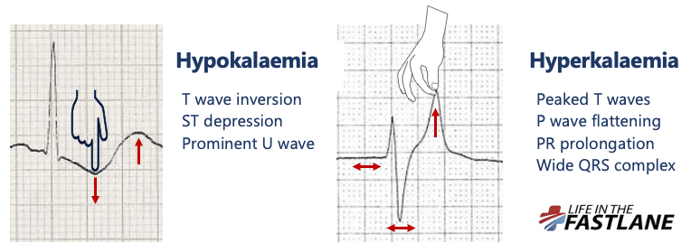
Ecg findings
Prolonged PR

Slide 35
Thank you

