Slide 1
Growth and Short stature
Dr Faten Zaidan

Slide 2
Head Circumference
Brain growth is most rapid during the first two years of life
HC increase 10 cm in first year
  1-3 months : 2cm/month
  4-6 months : 1cm/month
  6-12 months : 0.5cm/month
2-3 cm in the 2nd year
5-6 cm throughout the remainder of childhood

Slide 3
Length/Height
Birth length increases 50% by 1 year
Birth Length doubles by 4 years of age
Birth length triples by 13 years of age
After 2 years of age , average height increases 5 cm/year until adolescent

Slide 4
Weight
Birth weight is regained by 10-14 days of life
Birth weight doubles by 4months of age
Triples by 12 months of age
Quadruples by 2 years of age
After 2 years of age, normal weight gain is 2.5 kg per year until adolescent

Slide 5
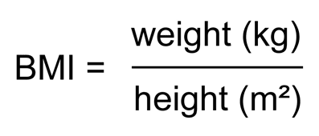
Definitions
Length: stature of supine child ( < 2years old)
Height: stature of standing child (>2 years old
Short stature: length or height below 3rd percentile
Tall stature: length or height above 97th percentile
Underweight: weight below 3rd percentile
Overweight: weight between 110-120% od expected median percentile of the reference population
Obesity: weight more than 120% of expected median percentile of reference population. Expressed as BMI
Growth velocity: annual linear growth rate
Bone age: Reflects bone maturation: the time at which long and short bone ossificates (chondrocyte in the cartilaginous growth plate proliferate -linear bone growth- and transforms to osteoblasts to form a bone -ossification)

Slide 6
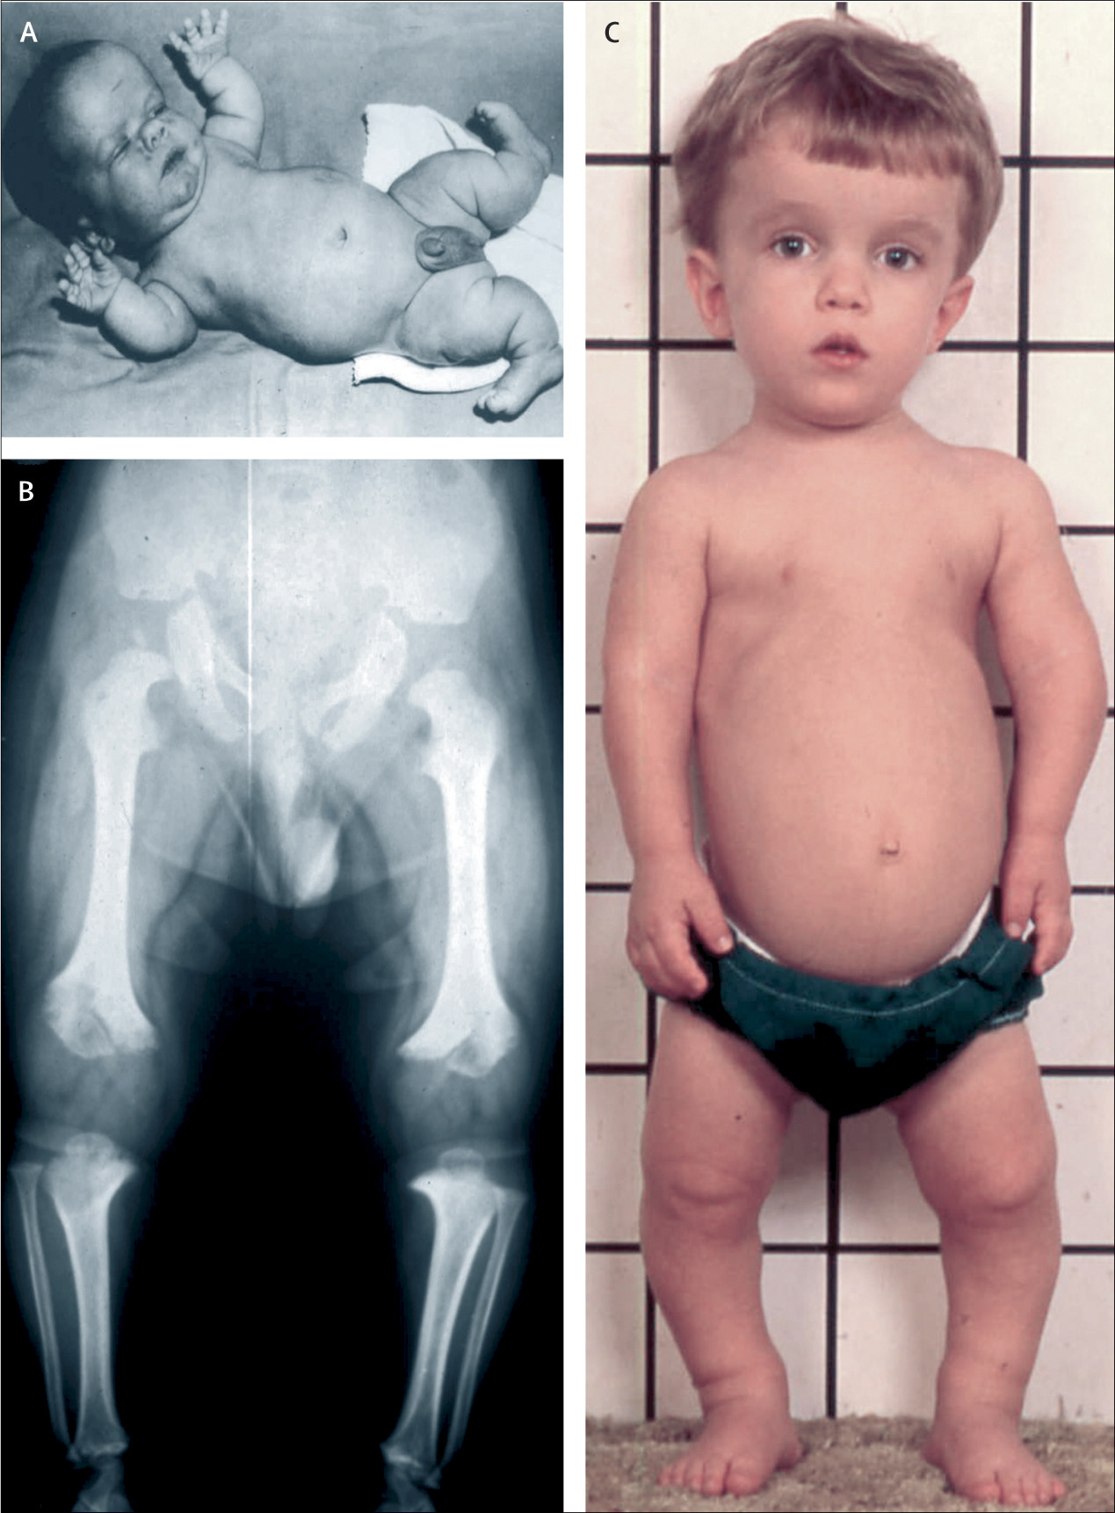

Causes of Short stature
Primary Causes:
Genetic (Familial) Short Stature (Normal Variant)
Growth hormone deficiency
Constitutional (Normal Variant)
Secondary Causes
Small for gestational age
Syndromes (ex. Laron Syndrome)
Endocrinopathies (ex. Hypothyroidism, growth hormone deficiciency, hypoparathyroidism)
Social deprivation (psychosocial dwarfism)
Nutritional deficiency: Undernutrition (marasmus, Kwashiorkor, anorexia nervosa, zinc deficiency)
Psychosocial dwarfism: Extreme emotional deprivation can result in failure to thrive with short stature
IUGR or small for gestational age: Patient will remain short if they did not catch-up their growth by age 2 years.
Systemic disease/Chronic illness
Chromosomal abnormalities/genetic syndromes: Turner Syndrome, Prader-Willi Syndrome, Noonan syndrome
Skeletal dysplasia: achondroplasia
Endocrinopathy: thyroid hormone deficiency, growth hormone deficiency, Cushing Syndrome
SHOX gene
Achondroplasia

Slide 7
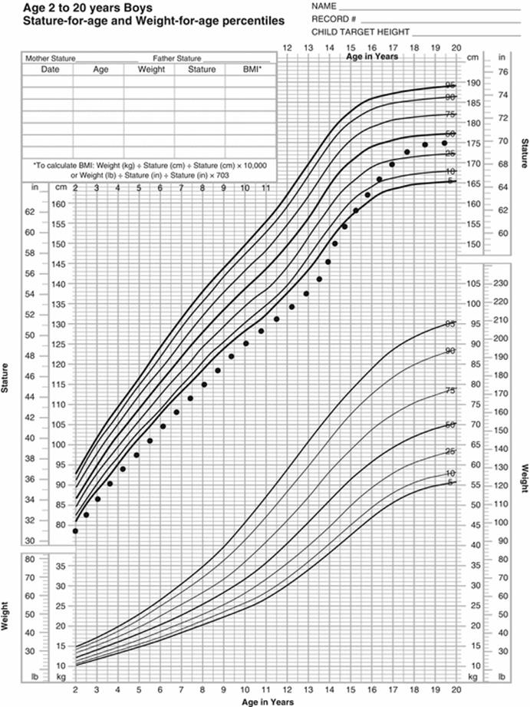
Constitutional growth delay
Patients have normal growth velocity
Normal growth occurs during the initial 4-12 months of age, then slows down that the height and weight is less than the 3rd percentile. By 2-3 years old , normal growth velocity resumes at >5cm/year.
Delayed bone age
Family history of delayed puberty
Growth hormone is normal

Slide 8
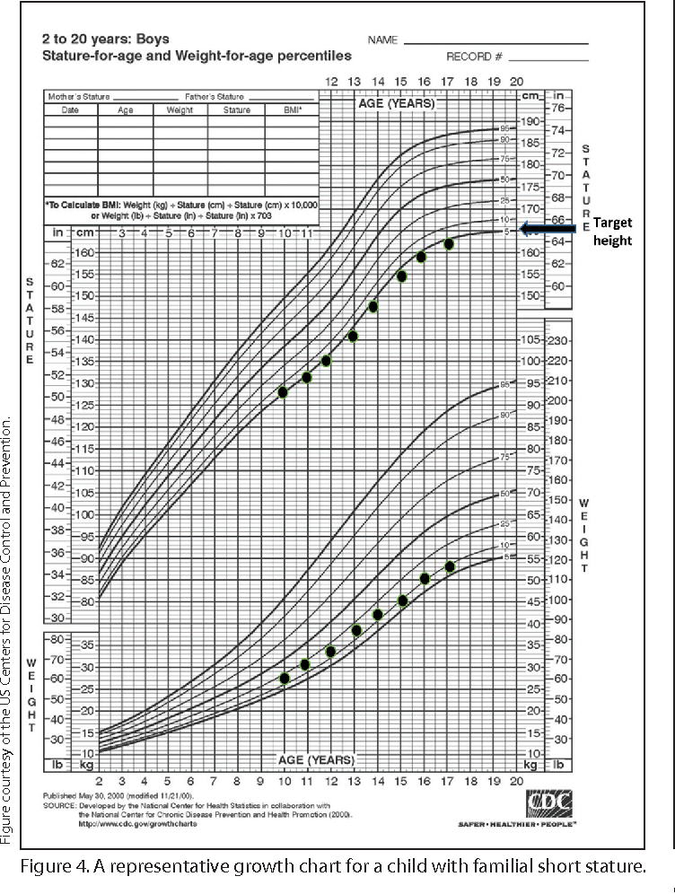
Genetic Short stature
Normal growth velocity
Normal bone age
Family history of short stature

Slide 9
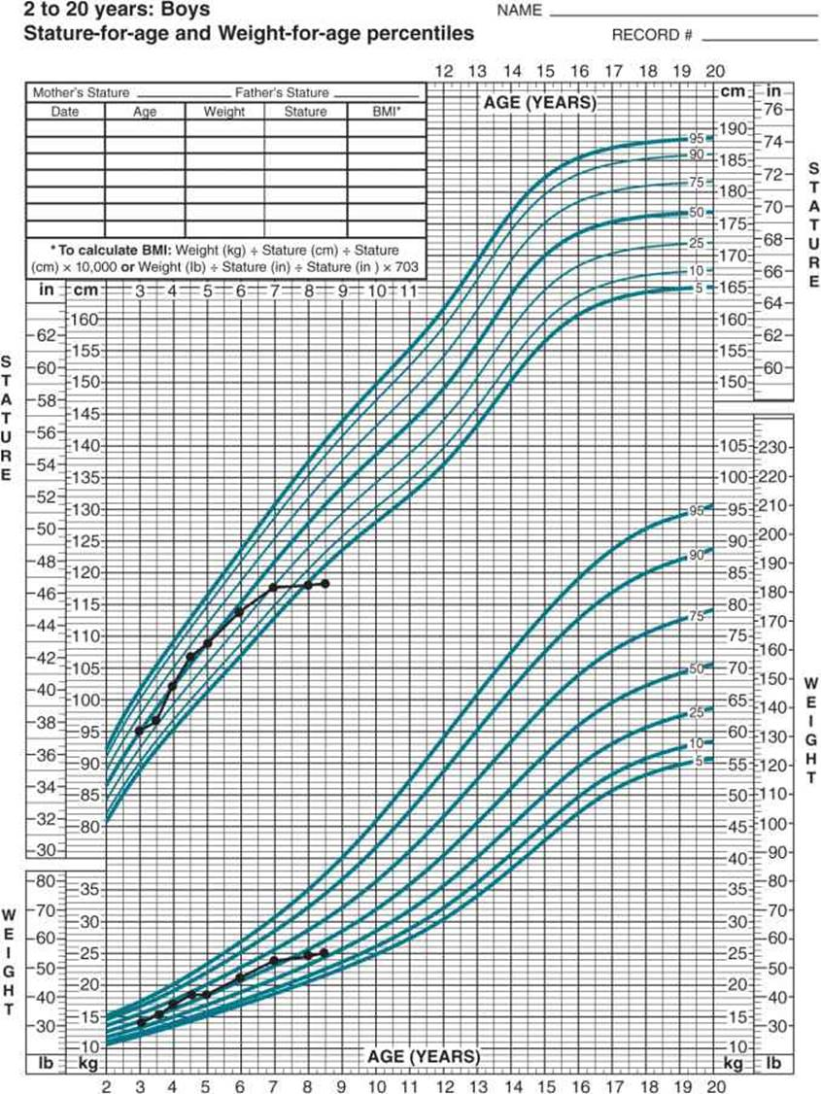
Growth hormone Deficiency
Decrease in growth velocity
Delayed bone age
Family history of growth hormone deficiency
Depressed growth hormone

Slide 10
History
Onset
Previous measurements of both weight an dheight , calculate growth velocity
Evidence of chronic disease
Evidence of endocrinopathies
Birth weight and mode of delivery
Family history of:
  Short stature
  Family disease
  Social deprivation
  Parents heigh ( to calculate midparental height)
  Midparental height is used to determine the expected height the child must reach

Slide 11
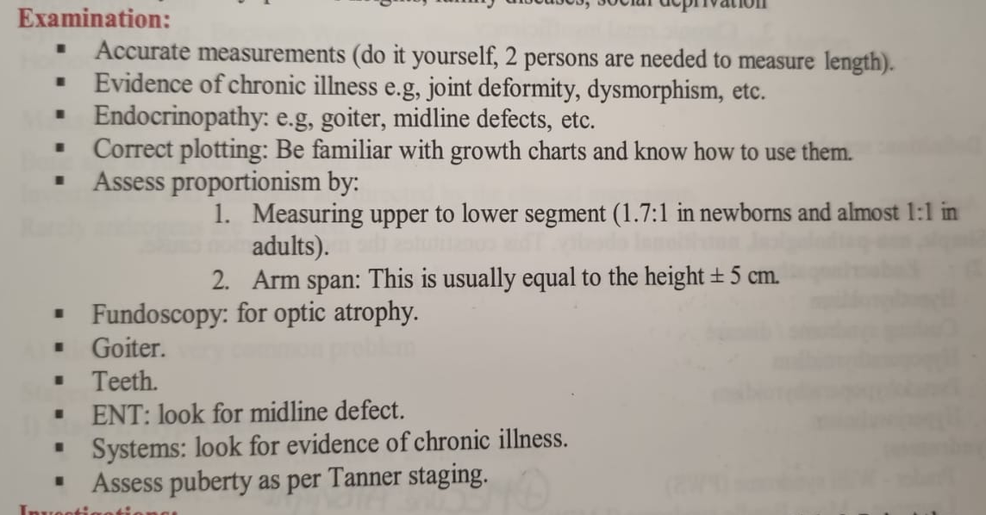
Physical Examination

Slide 12

Upper/Lower Ratio
Upper to lower segment ratio is measure for short stature case to see if upper segment of body is proportionate or disproportionate to lower segment of body
At birth, Ratio is 1.7:1
Trunk is longer than legs
At 1 year old, Ration is 1.4:1
At 10 years old, Ratio is 1:1
Trunk is equal to legs
When do we see upper segment is larger than the lower segment:
Rickets, Turner, Achondroplasia
When do we see upper segment is smaller than the lower segment:
Marfan Syndrome

Slide 13
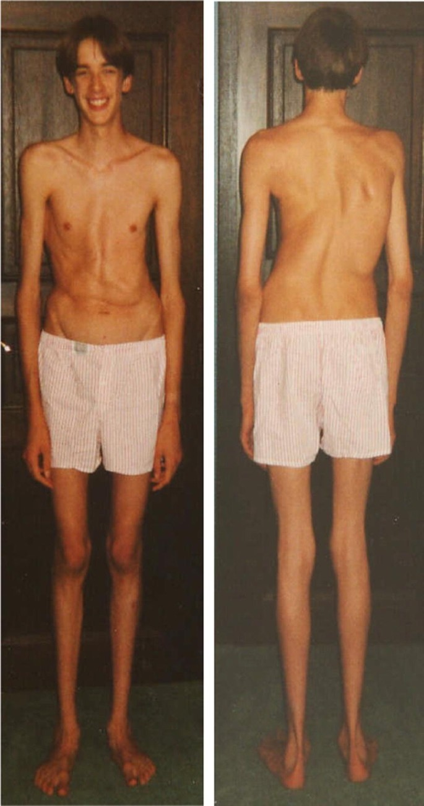
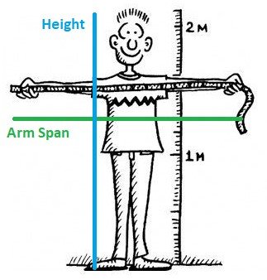
Arm span
Arm Span (AS) : distance between the tips of the fingers when the patient holds both arms outstretched horizontally while standing against a solid surface
At birth, AS is less than length by about 2.5 cm.
By 10 years of age, AS is equal to height
after 10 years in boys and 12 years in girls, AS exceeds height by up to 5 cm.
If AS is exceeding height by more than 5 cm
Consider pathologic causes of tall stature such as Marfan Syndrome

Slide 14
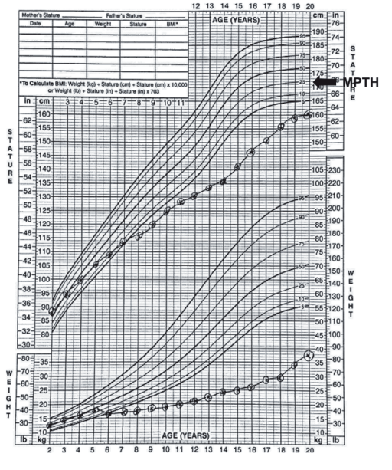
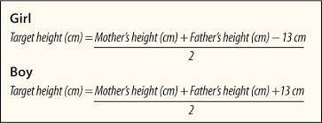
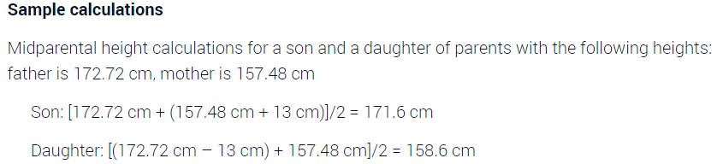
Mid-Parental Height
Normally should be +/- 10 cm

Slide 15
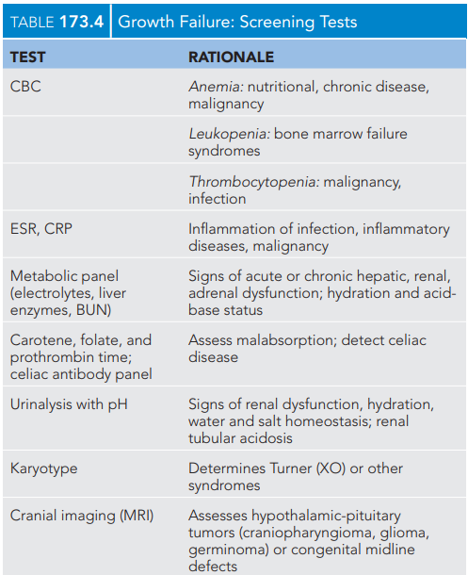
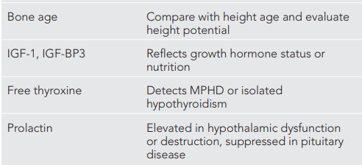
Investigations

Slide 16
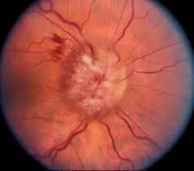
Growth hormone therapy
Eight indications for Growth
hormone therapy as per FDA :
Noonan Syndrome
GH deficiency
Turner syndrome
Chronic renal failure
Idiopathic short stature
SGA
Prader Willi Syndrome
SHOX gene abnormality
Criteria for discontinuing GH treatment
Decision by the patient/parent to discontinue.
Growth rate less than 2 cm/year.
Bone age of 14 years in girls and 16 years in boys.
Adverse effects of GH
Pseudotumor cerebri
Slipped capital femoral epiphysis
Gynecomastia
Worsening scoliosis
Insulin resistance

Slide 17
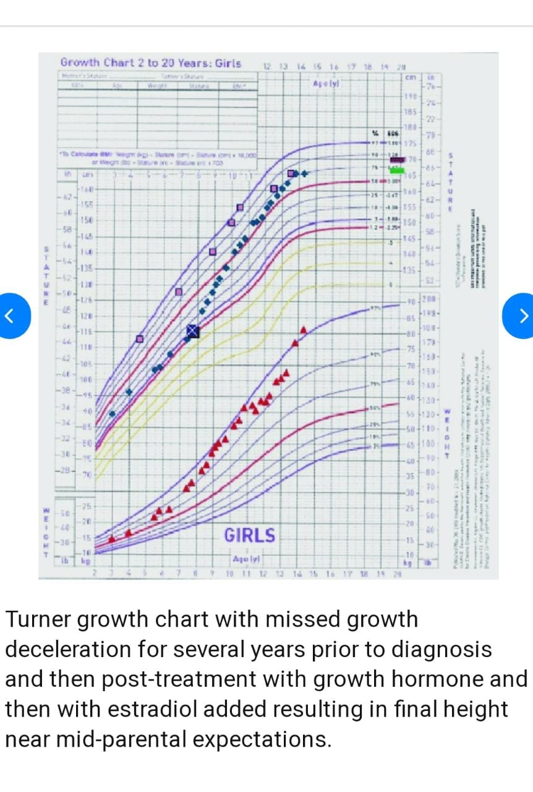
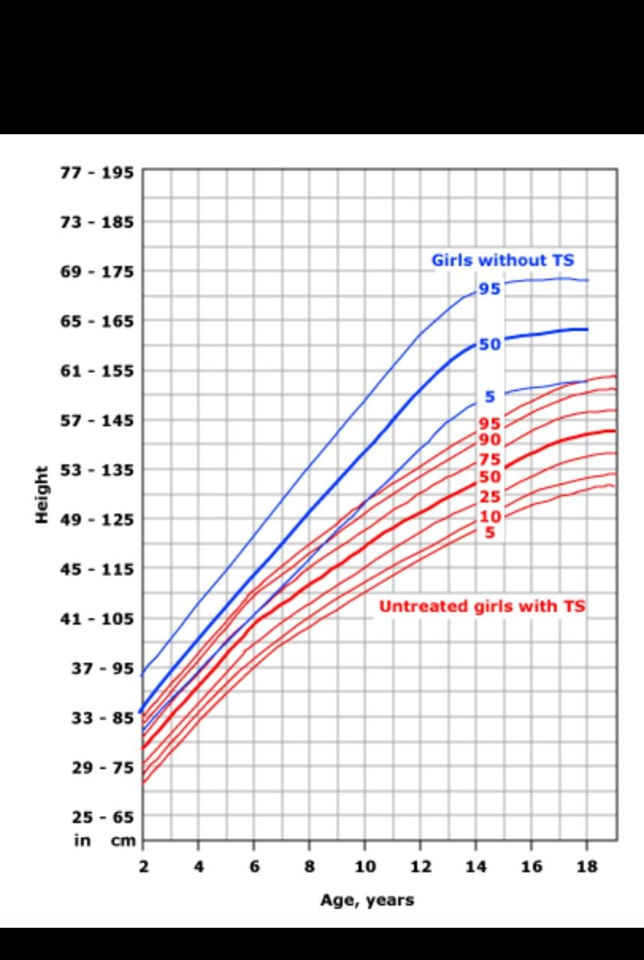
Special Growth chart of turner syndrome

Slide 18
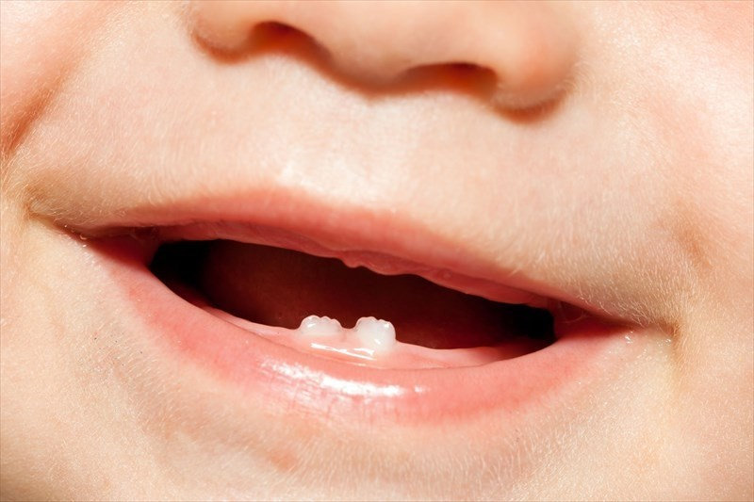
Teething
Eruption of Deciduous dentition primary/Baby Teeth starts at age of 6-8 months
By age of three years , all teeth should be erupted
Total number of primary teeth is 20 teeth
Permanent (Secondary teeth) starts ate age of 6 years.
Total number of permanent teeth is 32 teeth
Symptoms:
LOW GRADE fever
Irritability
Drooling
Gum rubbing and increased biting
Ear rubbing
Decreased appetite MILDLY
Myths:
Diarrhea, Sleep disturbance, vomiting, cough, fever above 38 C are symptoms of teeth eruption, These symptoms are abnormal and needs doctor’s evaluation,

Slide 19
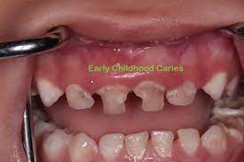

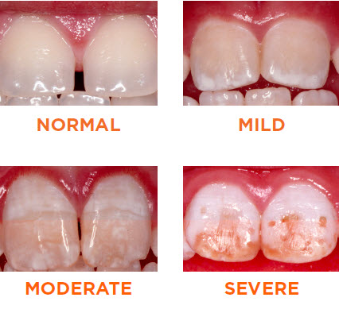
Teeth Brushing
Brushing should start when the first tooth starts to erupt TO PREVENT EARLY DENTAL CARIES. Children with morbidities, intellectual disabilities and special needs are the most prone to poor oral hygiene and dental caries.
Toothpaste should be containing fluoride because it strengthens dental enamel, protects dental enamel due to its resistance to chemical and physical damage, and protect against osteoporosis later in life.
Excess fluoride will result in fluorosis: Brown and white spots on teeth. Therefore,
1- infants should not receive fluoride supplements before 6 months of age.
2- Toothpastes should be chosen based on amount of fluoride it contains (most companies produce toothpaste with little fluoride).
3- The fluoride content of human milk is low and is not influenced significantly by maternal intake.

Slide 20
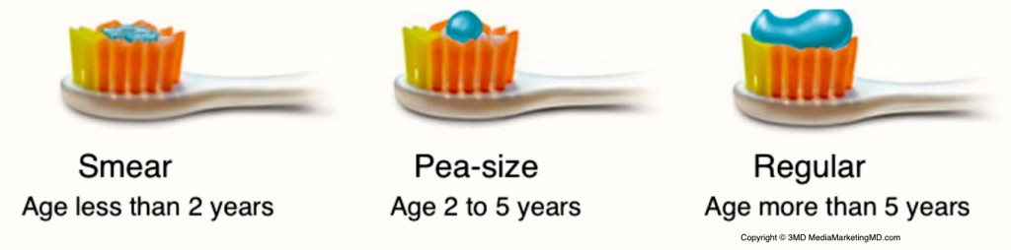
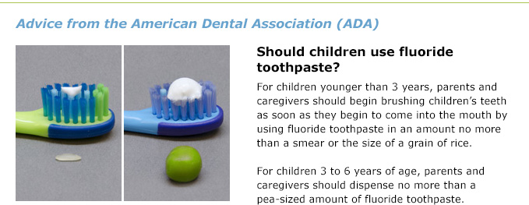
What is the amount of toothpaste allowed ?

Slide 21
Delayed teething
Delayed teething is defined as eruption after age of 15-18 months
Causes
Exclusively breast fed baby who is not supplemented with Vitamin D
Endocrinopathies (Hypothyroidism, Hypopituitarism)
Genetic (Down Syndrome, PERT Syndrome, Achondroplasia)
Poor socioeconomic status
Poor infant's sun exposure
Poor Maternal sun exposure during pregnancy

Slide 22


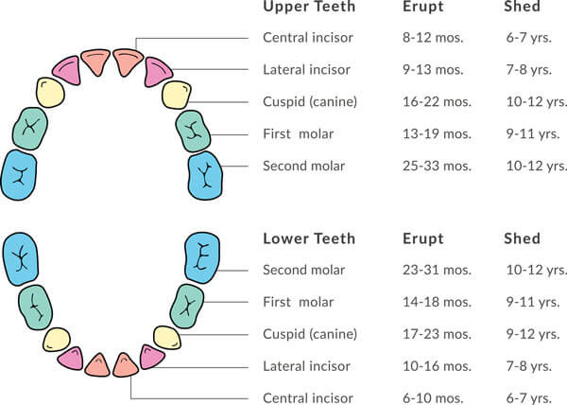


Slide 23
Thank you

