Slide 1
DR MANSOUR ALQURASHI
MBBS,DCH,MRCP,ABP,FRCP,FPC
Associate professor of Clinical Pediatrics
College of Medicine, Imam University, Riyadh.
Post-infectious glomerulonephritis

Slide 2
LEARNING OBJECTIVES
Background
Pathophysiology
Histologic Findings
Clinical
  History
  Physical
  Lab
Differential Diagnosis
Treatment
Follow Up

Slide 3
Background
Glomerulonephritis: inflammation of the glomerulus, manifested by proliferation of cellular elements, is secondary to an immunologic mechanism
Most cases are associated with postinfectious state
4-12yr with peak 5-6years
Male:Female 1.7-2:1
Prognosis is good

Slide 4
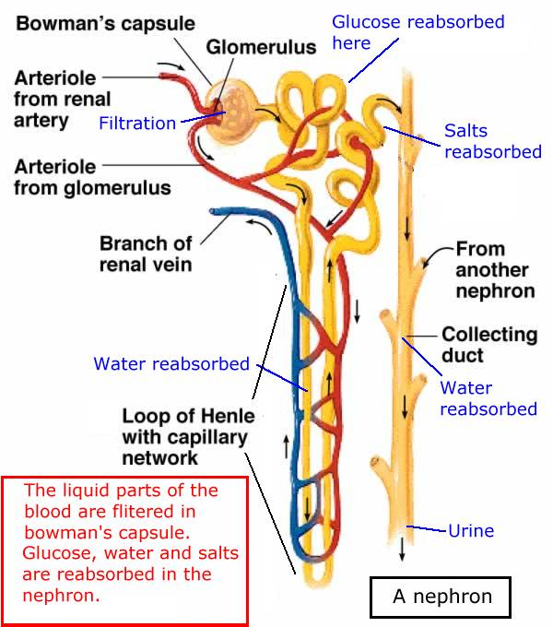

Slide 5
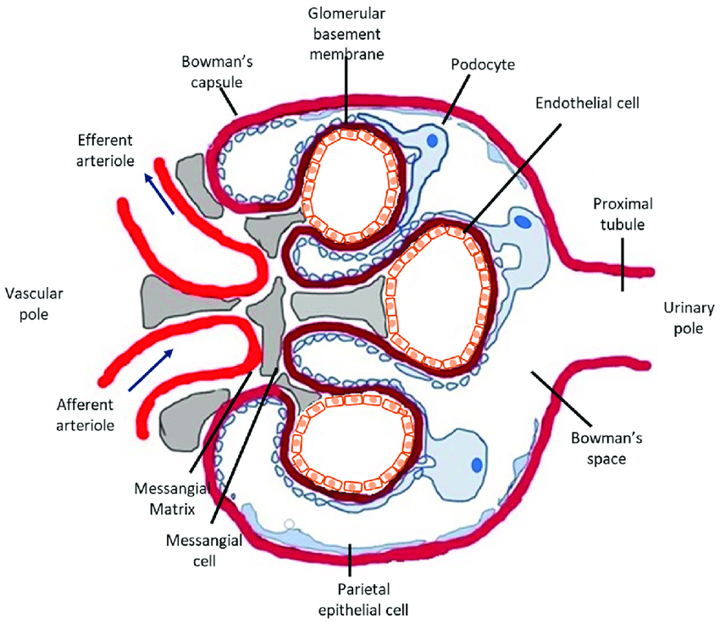

Slide 6
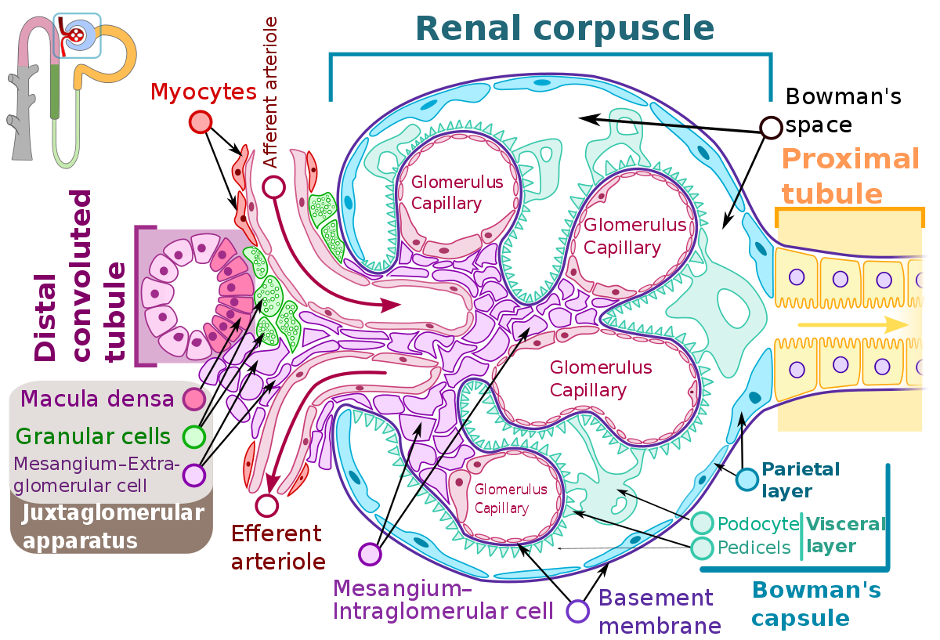

Slide 7
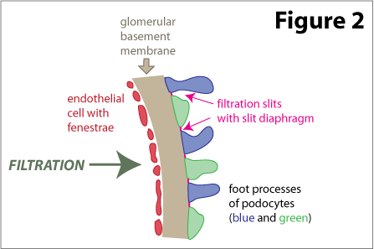
FILTRATION BARRIER AT THE GLOMERULUS
3 Layers
Capillary endothelium
of glomerulus
Basement memb. of
glomerulus
Visceral epithelium of
Bowman’s capsule
(podocytes w/foot
processes)

Slide 8
Pathogenesis
Strep antigens trigger antibodies that cross-react to glomeruli
Circulating immune complexes get filtered by glomerulus & get stuck
Immune complexes activate complement
Diffuse & generalized damage to glomeruli
↓ GFR due to inflammation, damage to BM
↓ RBF in proportion to GFR, so filtration fraction normal
Tubular function is preserved
Plasma renin and aldosterone are normal

Slide 9
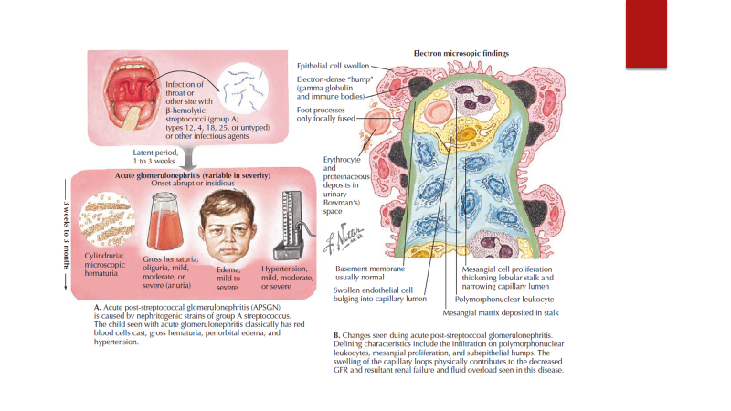

Slide 10
Incidence and spectrum changing
  epidemic form declined in industrialised countries
    post-streptococcal glomerulonephritis 28 - 47%
    Staph aureus ( epidermidis ) 12 - 24%
    Gram negative bacteria 10 - 22%
    bacterial endocarditis, shunt infections, atypical PIGN
  acute endocapillary glomerulonephritis with mesangial and capillary granular immune deposition

Slide 11
General Symptoms
Fever
Headache
Malaise
Anorexia
Nausea and vomiting
Pallor due to edema and/or anemia
Confusion
Lethargy
Enlargement of the liver

Slide 12
Signs and Symptoms
Gross Hematuria: (25-33% ) dark brown or smoky urine.
Oliguria: urine output is < 400 ml/day.
Edema: (85%) starts in the eye lids and face then the lower and upper. limbs then becomes generalized; may be migratory.
Hypertension: (60-80% ) usually mild to moderate.
CNS (i.e. Seizures ) 10%.
Nephrotic syndrome : rare
ARF/ Acute renal necrosis : Not uncommon , due to injury of capillary or capillary thrombosis
Hypertensive encephalopathy, heart failure and acute pulmonary edema may occur in severe cases

Slide 13
Clinical features - Examination
State of patient
Routine observations
  temperature, HR, SBP, RR, SaO₂
  core-peripheral temperature
Serial plot of weights, heights
State of hydration
  peripheral perfusion, JVP, oedema
Signs of cardiac failure
Clinical clues of multi-system disease
  rash, arthropathy, arthritis, oral lesions
Palpable kidneys or bladder or masses

Slide 14
Mixed nephritic and nephrotic
Nephritic syndrome
Nephrotic syndrome

Slide 15
Mixed nephritic and nephrotic
Nephritic syndrome
Haematuria
Proteinuria
Oliguria
Hypertension
Nephrotic syndrome

Slide 16
Mixed nephritic and nephrotic
Nephritic syndrome
Haematuria
Proteinuria
Oliguria
Hypertension
Nephrotic syndrome
Proteinuria
  > 40mg/m²/hour
  > 1g/m²/day
Hypoalbuminaemia
  < 25g/l
Oedema
(Hyperlipidaemia)

Slide 17
Mixed nephritic and nephrotic
Nephritic syndrome
Commonest cause
  PIGN / PSGN or post-infectious glomerulonephritis
Nephrotic syndrome
Commonest cause
  MCNS or minimal change nephrotic syndrome

Slide 18
Mixed nephritic and nephrotic
Nephritic syndrome
Commonest cause
  PIGN / PSGN or post-infectious glomerulonephritis
Nephrotic syndrome
Commonest cause
  MCNS or minimal change nephrotic syndrome
Commonest cause of mixed nephritic and nephrotic syndrome is post-infectious GN

Slide 19
Investigations
Full blood count, blood film and ESR
Coagulation screen
Serum electrolytes
  U&Es, Cl, CO₂, urea, creatinine, glucose
  LFTs, CK, urate, bone profile
  Ca, Mg, PO₄, ALP, albumin
Blood culture and CRP
Complement assays
  C₃, C₄ and C₃ nephritic factor (C3 : Decreased for few weeks.)
Immunoglobulins including IgA
ASOT and antiDNAase B (Measured at 2-3 weak intervals)
ANA, dsDNA, qDNA, ENA, ANCA, ACIgM/G
Autoimmune profile and anti-GBM Ab.
Culture from Pharynx and skin may be positive

Slide 20
Urine tests
Urinalysis
Urine M,C&S
Urine electrolytes
Fractional excretion of sodium (FE_{Na})
  = U_{Na} x P_{Cr}
  P_{Na} x U_{cr}
  For evaluation of acute kidney failure .
  Note that microscopic haematuria can persist for years following the acute episode.

Slide 21
Renal ultrasound scan
  bilateral echogenic kidneys
Percutaneous renal biopsy
  confirm PIGN
  exclude MPGN
  consider crescentic GN.
The indications for renal biopsy are:
  severe renal dysfunction at presentation
  rapidly progressive acute renal failure
  atypical presentation
  delayed recovery
    macroscopic haematuria for >1 month
    low C3 levels for >6 months
    heavy proteinuria for > 6 months

Slide 22
Differential Diagnosis
Hypocomplementemia
PIGN
    Bacteria (GAS, S. viridans, pneumococcus, S. aureus, S. epi, atypical mycobacterium, meningococcus, Brucella, Leptospirosis, Propionibacterium)
    Viruses (VZV, EBV, CMV, rubeola)
    Parasites (Toxo, Trich, Riskettsia)
Membranoproliferative GN
SLE
Cryoglobulinemia
Bacterial Endocarditis
Shunt nephritis
Normal complement
HUS
IgA Nephropathy
HSP
Alport’s / TBMD
Nephrotic Syndrome

Slide 23
Treatment
Treat the underlying infections when acute GN is associated with chronic infections.
Antimicrobial therapy
  Antibiotics (eg, penicillin) are used to control local symptoms and to prevent spread of infection to close contacts.
  Antimicrobial therapy does not appear to prevent the development of GN, except if given within the first 36 hours.
Loop diuretic therapy
  Loop diuretics may be required in patients who are edematous and hypertensive in order to remove excess fluid and to correct hypertension.
  Relieves edema and controls volume, thereby helping to control volume-related elevation in BP.
Vasodilator drugs (eg, nitroprusside, nifedipine, hydralazine, diazoxide) may be used if severe hypertension or encephalopathy is present
Diet:
  Sodium and fluid restriction
  Protein restriction for azotemic patients
Activity: Recommend bed rest until signs of glomerular inflammation and circulatory congestion subside.

Slide 24
Follow Up
Prognosis usually excellent
    0.5% mortality due to pulmonary edema or pneumonia
    <1% progress to CKD stage 5.
Follow-up
  Must ensure that HTN controlled, Edema resolved, hematuria/ proteinuria resolved, Cr normalized
    Gross hematuria resolves within 2 weeks
    Complement low for 6-8 weeks
    Proteinuria remains upto 6 months
    Hematuria remains upto 2 years

Slide 25
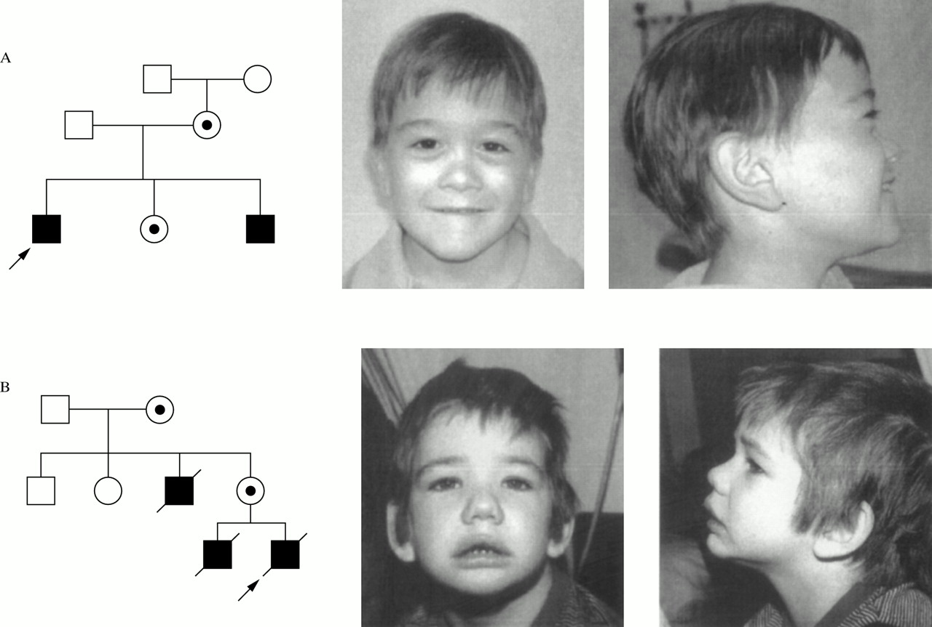

Slide 26
Alport syndrome
a group of inherited, heterogeneous disorders involving the basement membranes of the kidney (Type IV collagen ).
Hematuria - Most common and earliest manifestation of Alport syndrome
Proteinuria - Develops in males with XLAS and in males and females with ARAS and ADAS
Hypertension - Usually present in males with XLAS and in males and females with ARAS and ADAS
Sensorineural deafness 50-90%
Anterior lenticonus, retinopathy

