Slide 1
Introduction FOR history taking
DR MANSOUR ALQURASHI

Slide 2
Pediatric History
Learning Objectives:
1.To understand the differences in obtaining a medical history on a pediatric patient compared to an adult.
2.To understand all the ramifications of the parent as historian in obtaining medical history in pediatric patient.
3.To understand the appropriate wording of open-ended and directed questions ,and appropriate use of each type of question .
4.To obtain an accurate and complete history of pediatric patient in different age groups. (<1, 1-5 y., >5y).

Slide 3
Pediatrics
B Definition: ranch of medicine that
Branch of medicine that deals with medical care of children.*.
(Birth till 18 yeas of age ).
(deals with medical care of children
Branch of medicine that deals with medical care

Slide 4
Approach
Introduce yourself to patient’s companion (usually the mother).
Get the respect of the mother in order to get the confidence of the child.

Slide 5
Items of Pediatrics History
Date of history.
Name of patient.
Informant :- Mother, father, grandmother, school teacher,…..
Reliability:- Good, fair, poor.
History taken by :- Your name and title.
Patient’s profile:-
Age (including date of birth)
Sex
Address (usually name of city, town or village).
Referred from …….
Significant medical conditions.

Slide 6
Items of Pediatrics History
7. Chief complaints (Presenting Complain) :-
Who is concerned (pt., mother, school teacher...)?
When did you notice that your child has changed?
OR what he is complaining of?
OR what do you think he is sick with?
Use, when possible, patient’s or patient’s mother own words.
Arrange complaints according to significance to child’ health.
Onset / Course/ Duration of each complaint.

Slide 7
Items of Pediatrics History
The main problem or complaints for which the child has been brought for medical attention:
    Fever—5 days.
    Vomiting—4 days.
DIARRHEA.
ABDOMINAL PAIN.
COUGH.
HEADACHE.

Slide 8
Items of Pediatrics History
8. History of present illness:-
Start with one of the following sentences:-
  The patient was doing well until ……..
  The history of this child dates back to…..
  The patient was in his usual state of health until…..
Analysis of symptoms respecting the chronological order of symptoms.
Sequence of events.
Other associated symptoms.
Important negative symptoms related to the complaints.

Slide 9
Items of Pediatrics History
History of Present illness
Progress of disease ; order and date of onset of new symptoms.
Aggravating and alleviating factors.
Significant medical attention and medications given and over what period.
In acute infection ,statement of type and degree of exposure and interval since exposure.

Slide 10
Outline of Specific Pediatric History Items
A. Antenatal
B. Perinatal:
C. Neonatal :
D. Growth , development and behavior.
E. Nutrition
F. Past illnesses
G. Immunizations
H. Allergies and test. reactions.
I. Accidents and Injuries.

Slide 11
Antenatal
Antenatal care: - booked/ un- booked? , where? frequency of visits.
Prenatal exposure to illicit drugs, toxins, or infections; maternal diabetes; acute maternal illness; trauma; radiation exposure and fetal movements.(The prenatal period refers to the period of time from fertilization to birth.)
Medications during pregnancy (timing/dose/duration)
Maternal thyroid or seizure disorder.
Polyhydramnios/ Oligohydramnios.
Maternal severe proteinuria or high blood pressure.
Bleeding in third trimester.
Multiple gestation.
Chorioamnionitis.

Slide 12
Perinatal History
Perinatal period: 22 completed weeks of gestation and ends 7 completed days after birth.
Place of delivery.
Presentation of the child( e.g breech or face presentation)
Mode of delivery: - NSVD, assisted vaginal, C/S. Obstetrical complications
Gestational age.
Birth weight and other birth measurements (Lt, HC)
Resuscitation
Apgar Score or condition at birth in mother’s words.
Maternal risk factors for sepsis (PROM, maternal UTI, maternal fever…)
Baby & mother’s blood groups.

Slide 13
NEONATAL
When the baby passed urine/ meconium?
Respiratory distress, anemia, jaundice, cyanosis, convulsions, infection, congenital anomalies
If he/she was admitted in hospital :
Length of hospital stay.
Complications (eg, intubation time, presence of intracranial hemorrhage ultrasonogram, feeding difficulties, apnea, bradycardia.

Slide 14
Developmental History
Growth is increase in the size of the organ.
Development is increase in the function of the organ.
Ask about physical growth (Wt., Ht, HC) especially if records available.
Developmental milestones.
Gross Motor Fine Motor
Social/Adaptive Language/Speech
Age at attainment of important milestones (walking, talking, self-care)
Relationships with siblings, peers, adults
School grade and performance
behavioral problems (Sleep disturbance , phobias, Pica, Abnormal bowel habits ,stool holding, Bed wetting and Unusual behavior)

Slide 15
Nutrition
Breast feeding or milk formula.
Type and amount of semi solid/ solid foods, & when added.
Any vitamin or iron supplementation.
Difficulty encountered during feeding ,eg NGT feeding.
Any known food allergy.
Type of diet
change in feeding habits.

Slide 16
Past medical history
Infections:age,types, number,severity.
Contagious diseases;age ,complication.
Past hospitalizations. operations age.
Allergies : to drugs or food ,type of reaction.
Medications patient is currently taking.(Names,dosages).
Accidents and Injuries.

Slide 17
Immunizations
Place of vaccination
What schedule .
Additional vaccines
Always ask for vaccination card.(Up-to-date ?! )
Any vaccine side effects.
It is important to record the details of vaccines given to the child in chronological order.

Slide 18
Family History
A. Father and mother (age and health)
B.Marital relationship/ consanguinity pattern
C.Siblings. Age,health,significant illnesses.(The pedigree chart).
D.Birth of abnormal children( e.g LBW.IUGR,Dysmorphic, with a motor deficit, mental retardation, or Congenital malformations).
E. Stillbirth,miscarriages,age of death and cause of death.
F. TB.allergy,blood dis.,mental or CNS.,diabetes,cvs,kidney dis.,…..ect.
G. Health of contacts.

Slide 19
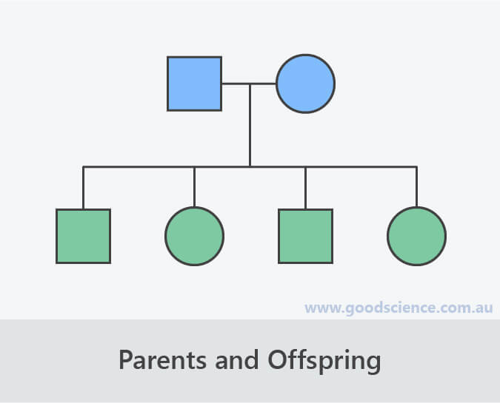
The pedigree chart

Slide 20
Social History
Address, home condition (sunny, ventilation, rooms…)
Health insurance.
Parental education & occupation.
Family income & socioeconomic status and allowances.
Smoking at home. alcohol and drugs.
Who is taking care of child in the home?
Impact of the disease on the child, siblings ,father and mother.
Safety: Child car seats, smoke detectors, bicycle helmets.

Slide 21
Adolescent history
[ HEADS history]
Home
Education
Activities
Drugs.
Sexual activity.(53)

Slide 22
Review of Systems
General :
  Overall health.
  Weight loss.
  Behavioral changes.
  Fever.
  Fatigue.

Slide 23
Review of Systems
Skin:
  Rashes/bruising.
  Lumps/bumps.
  Nail/hair changes.
Eyes:
  Visual problems
  Eye pain.
Ear, nose, throat:
  Frequency of colds.
  Sore throat.
  Earache.

Slide 24
Review of Systems
Lungs:
  Cough
  shortness of breath
  Wheezing
Cardiovascular:
  Chest pain/Palpitation.
  Exercise intolerance .
  Syncope.

Slide 25
Review of Systems
Gastrointestinal:
  Nausea/vomiting
  Spitting up
  Diarrhea
  Recurrent abdominal pain
  Constipation
  Blood in stools.

Slide 26
Review of Systems
Genitourinary:
  Dysuria
  Hematuria
  Polyuria
  Vaginal discharge

Slide 27
Review of Systems
Musculoskeletal:
  Weakness
  Joint pain
  Gait abnormalities
  Scoliosis
Neurological:
  Headache
  Seizures

Slide 28
Review of Systems
Endocrine:
  Growth delay
  Polyphagia (Extreme, insatiable hunger)
  Polydipsia (Excessive thirst/fluid intake)
  Menses duration/ Amount of flow

Slide 29
Pediatric History compered to an adult History
I. Content Differences ;
A. Prenatal and birth history.
B. Developmental history
C. Social history of family –environmental risks
D. Immunization history
II.Parent as Historian
A. Parent’s interpretation of signs ,symptoms.
1.children above the age 4 may be able to provide some of their own history.
2.Reliability of parent's observations varies.
3.Adjust wording of questions varies. (pain vs .limping)

Slide 30
Continue history differences…
B. Observation of parent-child interactions
1.Distraction to parents may interfere with history taking .
2.Quality of relationship .
C. Parental behaviors /emotions are important.
1.Parental guilt –nonjudgmental/reassurance
2.The irate parent ; causes 2.

Slide 31
THANK YOU

