Slide 1
Prematurity Complications
Dr Faten Zaidan

Slide 2
objectives
Today we will cover:
Meconium aspiration syndrome
Respiratory distress syndrome
Diaphragmatic hernia
Pulmonary air leaks
Transient tachypnoea of newborn
Necrotizing Enterocolitis
Intraventricular Hemorrhage

Slide 3

Meconium aspiration
one of the most common etiologies of respiratory failure in newborn.
Occurs in term infants and SGA. Passage of meconium in utero is occurring because of relaxation of anal sphincter
Clinical presentation
Yellow-green staining of fingernails, umbilical cord, and skin may be observed
Meconium plugs the airways causing atelectasis. Meconium impairs surfactant production and function. It irritates the airways, causing chemical pneumonitis and possible secondary bacterial infection.
Symptoms include Cyanosis. Nasal flaring, End-expiratory grunting. Intercostal retractions. Tachypnea
Barrel chest in the presence of air trapping, Auscultated rales and rhonchi , air leak
Severe MAS causes marked persistent pulmonary hypertension (PPHN) develops and leads to right-to-left shunt at PFO & PDA with severe cyanosis. Almost 50% of meconium aspiration syndrome infants require mechanical ventilation.

Slide 4
Meconium aspiration
Risk factors
Placental insufficiency
Maternal hypertension
Oligohydramnios
Fetal distress / hypoxia
Maternal drug abuse (eg cocaine)
Maternal infection/chorioamnionitis
Complications
Chemical pneumonitis (antibiotic = ampicillin and gentamicin)
RDS
pneumothorax

Slide 5
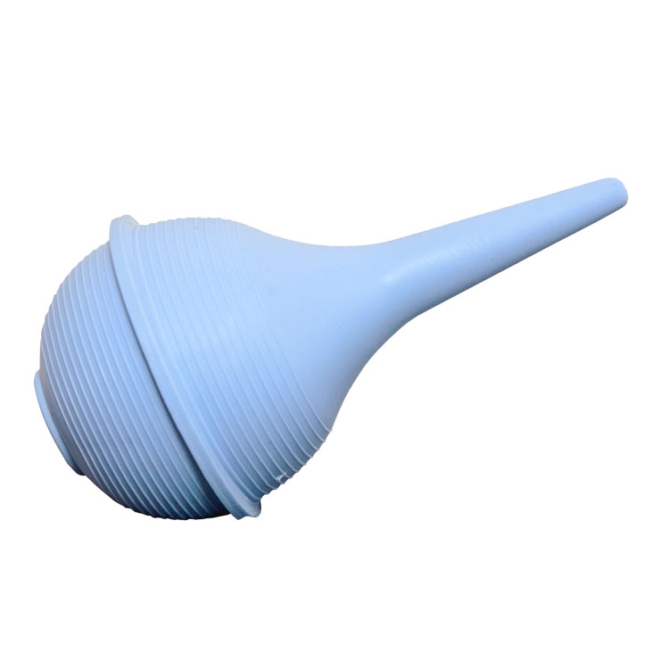
Meconium aspiration
Management
Infants who are depressed at birth should be closely observed in a neutral thermal environment (incubator).
Monitor blood glucose, calcium, renal function and electrolytes.
Clear secretions and meconium from mouth and nose using a bulb syringe or a large-bore suction catheter
Continue routine neonatal resuscitation steps if the patient is active
Do not electively intubate !
If no response , and hypoxia occurred:
Oxygen therapy.
Surfactant therapy commonly used.
Mechanical ventilation

Slide 6
Management
Medications to be used:
Antibiotics.
  Differentiating between bacterial pneumonia and meconium aspiration by clinical course and chest x-ray may be difficult. So antibiotics (Ampicillin and gentamicin) is usually indicated.
  Blood cultures should be obtained to identify infections
2. Endotracheal Surfactant may improve oxygenation and reduce pulmonary complications and the need for (ECMO).
Complications
Air leak. (dangerous)
  PPHN (dangerous)
  Echocardiography should be performed to ascertain the degree of PPHN; and to exclude congenital heart disease.
Pulmonary sequelae: Higher incidence of pneumonia,

Slide 7
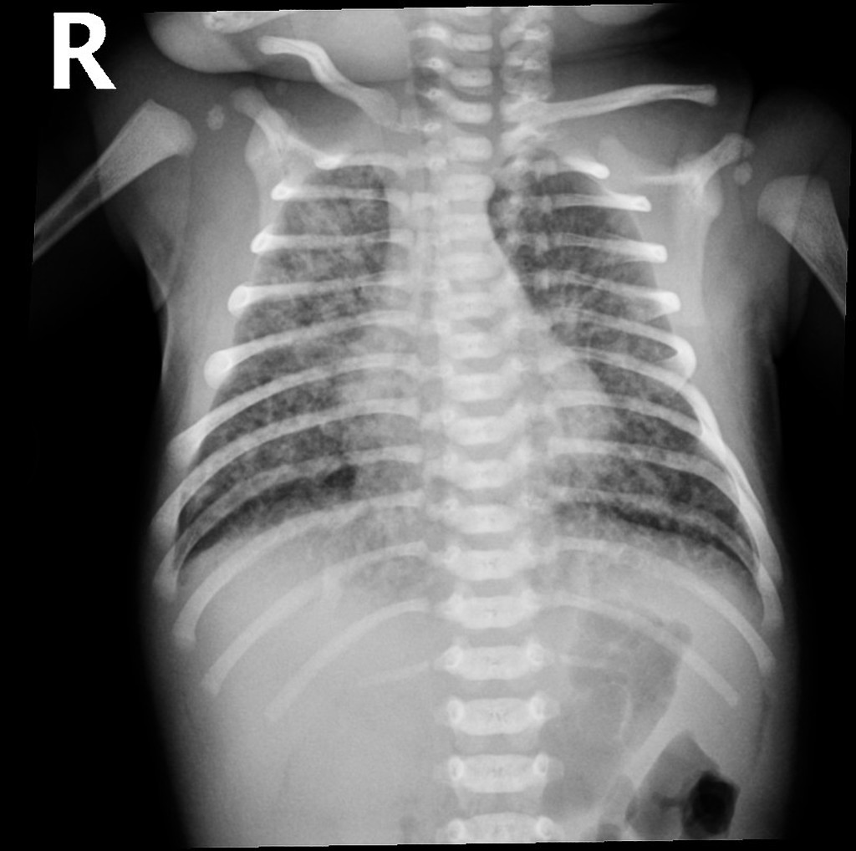
Hyperinflation,
Consolidation,
Patchy infiltrates
If severe, air leak and pneumomediastinum may occur
Lines going from inside to outside

Slide 8
Diaphragmatic hernia
Occurs when the diaphragm fails to completely close during development allowing for abdominal contents to enter the chest cavity. 85 % occur on the left side and 15 % occur on the right side.
Ipsilateral lung is hypoplastic, there will be contralateral shift of the mediastinum, resulting in contralateral lung hypoplasia
There are several types of diaphragmatic hernia:
  Bochdalek hernia (left): The most common type of congenital diaphragmatic hernia is a postero-lateral hernia and accounts for 70% of cases have good prognosis.
  Morgagni hernia (right): The Morgagni defect occurs posterior to the sternum due to failure of sternal and costal fibers to fuse, account for 25% poor prognosis.
  Hiatal hernia: The hiatus hernia occurs through the esophageal hiatus

Slide 9
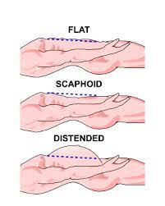
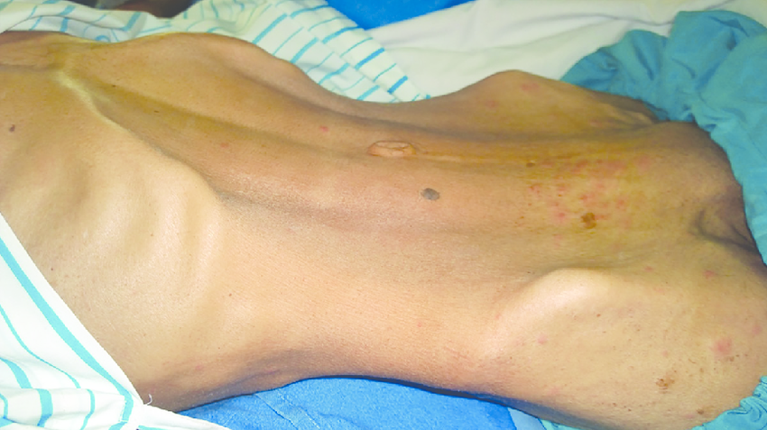
Diaphragmatic hernia
Symptoms occur immediately after birth
Respiratory distress and irregular chest movements
Decreased or absent breath sounds on the hernia side, and heart sounds displaced to the opposite side cyanosis
Bowel sound may be heard in the chest with a decrease in breath sound bilaterally.
scaphoid abdomen
Diagnoses
antenatally by US
Post delivery - Imaging studies :
Chest radiography: to confirm diagnosis of congenital diaphragmatic hernia
Cardiac and renal ultrasonography: to rule out associated anomalies
Complications
Persistent pulmonary hypertension
Lung Hypoplasia

Slide 10
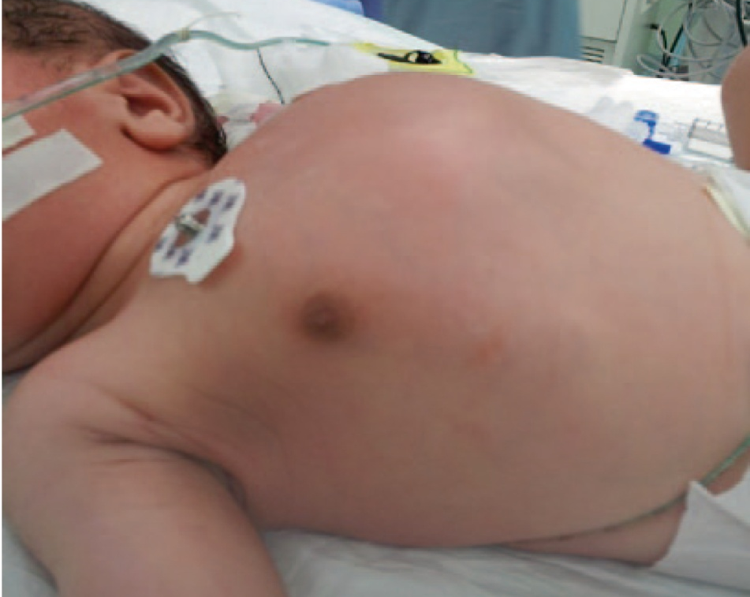
A newborn with left congenital diaphragmatic hernia. Note the scaphoid abdomen and the barrel-shaped chest.

Slide 11
Diaphragmatic hernia
Management
Avoiding mask ventilation (contraindicated)
Immediate Endotracheal intubation after birth
Immediately after intubation, Placement of orogastric tube and connecting it to continuous suction to prevent bowel distention and further lung compression.
Continuous monitoring of oxygenation, BP, and perfusion.
Vasoactive agents (e.g., dopamine, dobutamine, milrinone).
Echocardiogram is a critically important imaging study, and it guides therapeutic decision by measuring pulmonary and systemic artery pressure.
Supportive management: Surgical correction.

Slide 12
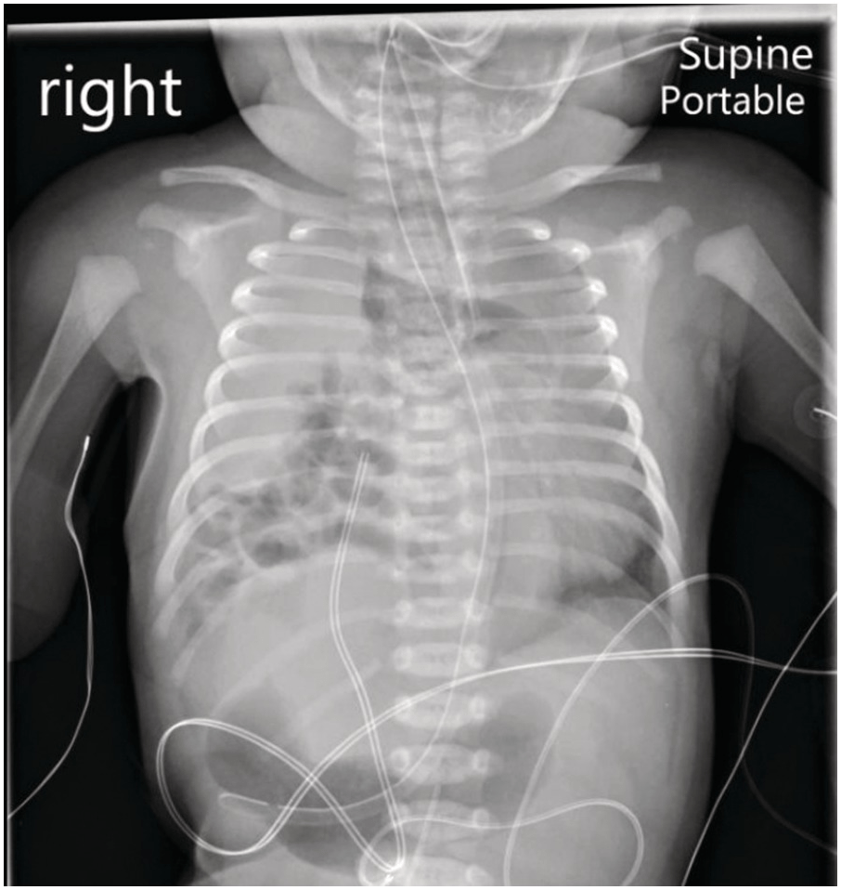
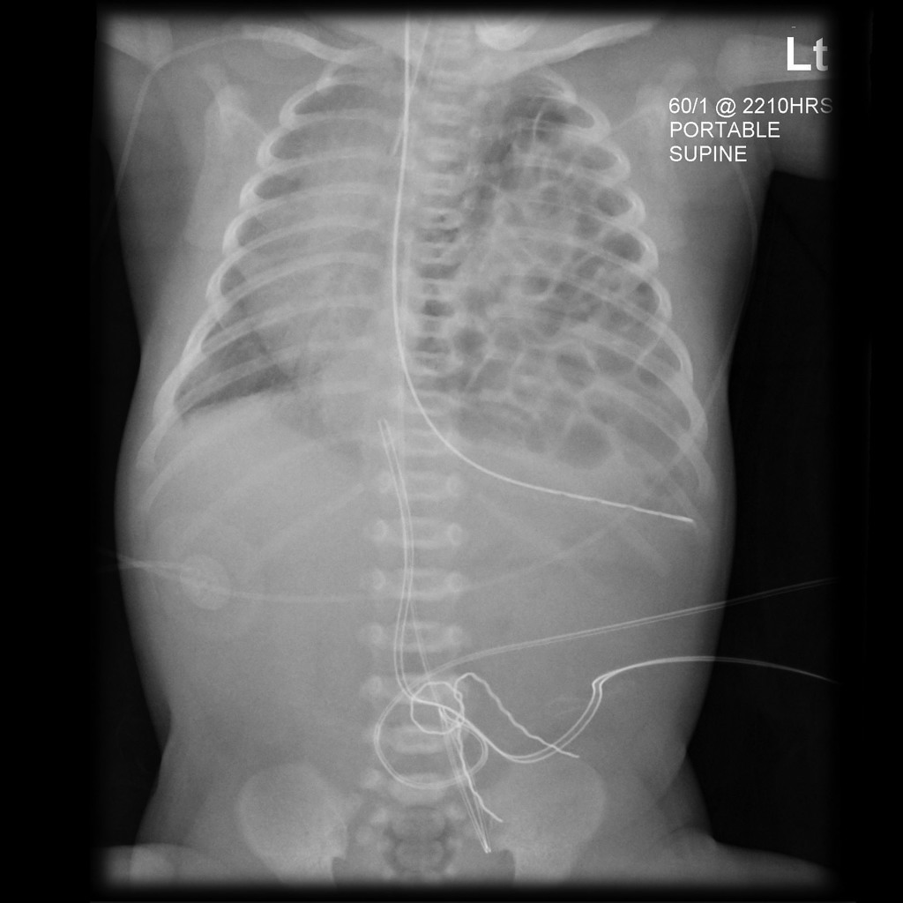
Right Diaphragmatic Hernia
Left Diaphragmatic Hernia

Slide 13
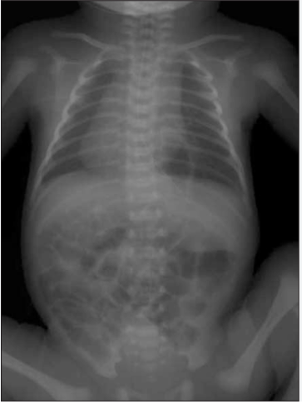
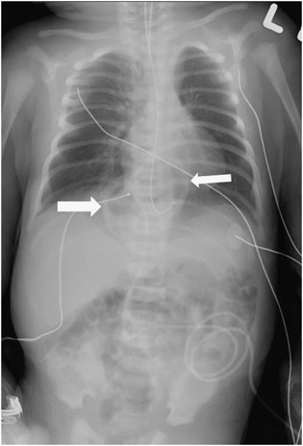
Hiatal hernia

Slide 14
Diagnosis
A. Prenatal ultrasound Diagnosis
Diagnosis earlier in gestation may correlate with a poorer prognosis due to severity of the condition.
Presence of liver in the thorax correlates with increased severity and poorer prognosis.
B. Postnatal Diagnosis:
The diagnosis is made or confirmed by radiograph.
Echocardiography, and appropriate studies for associated malformations, should be done.

Slide 15
Complications
pulmonary hypoplasia
pulmonary hypertension
associated anomalies especially CHD include congenital heart disease (CHD), neural tube defects, skeletal anomalies, intestinal atresias, and renal anomalies.
Factors associated with better prognosis are herniation of bowel into chest after 2nd trimester, absence of liver herniation, and absence of coexisting anomalies.
The later the onset of postnatal symptoms, the higher the survival rate and better prognosis.

Slide 16
Pulmonary air leaks
Occurs in infants with underlying lung disease. It referred to a collection of gas outside pulmonary compartment.
Asymptomatic pneumothorax is more common than symptomatic pneumothorax
Transpulmonary pressures that exceed the strength of the terminal airways and alveoli can damage the respiratory epithelium. The air enters the interstitium, causing pulmonary interstitial emphysema. Then dissection of air toward the visceral pleura and/or the hilum through the peribronchial and perivascular spaces.
Rupture of the pleural surface allows the air to decompress:
  Into the pleural space > Pneumothorax.
  Into the mediastinum > Pneumomediastinum
  Into the pericardium > Pneumopericardium
  Into the fascial and neck skin > Subcutaneous emphysema
  Into the retroperitoneum and peritoneum > Pneumoperitoneum
  Into the scrotum or labial folds > Pneumoscrotum
  Into the pulmonary veins > Air embolism (Pneumocardium)
Notes:
Displacement of intubation
O
Pneumothorax
E

Slide 17
Risk factors in premature infants :
Respiratory distress syndrome (RDS),
Mechanical ventilation.
Meconium aspiration
Neonatal sepsis.
Surfactant therapy for RDS has markedly decreased the incidence of pneumothorax.
Risk factors in term infants:
Aspiration of meconium, blood, or amniotic fluid.
Pneumonia.
Congenital lung malformations. (congenital lobar emphysema)
Mechanical ventilation.

Slide 18
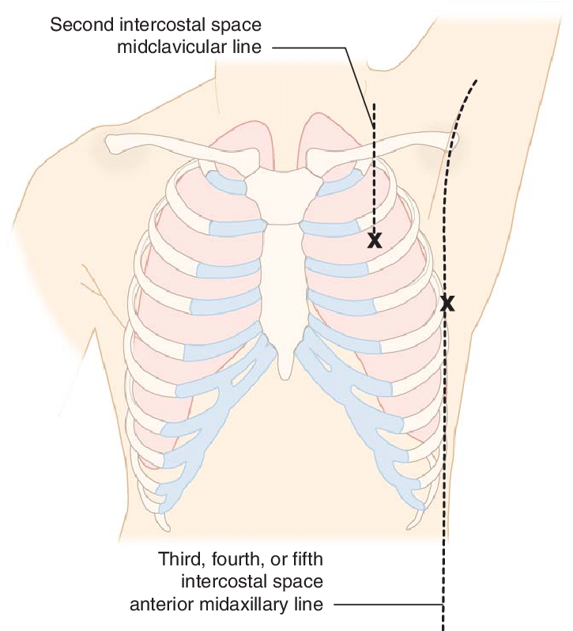
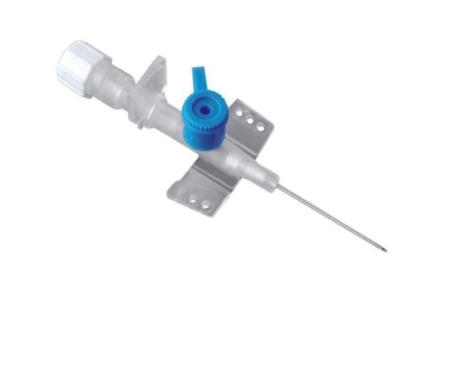
Pneumothorax
Treatment
In asymptomatic patients, short coarse of oxygen is given (8-12 hours) helps in absorbing the air in the pleural cavity
Repeated chest xray is done to follow up improvement
In symptomatic patients,
22 gauge angiocatheter is placed perpendicularly to the chest wall in the 2nd intercostal space in the midclavicular line or in the 5th intercostal space in midaxillary line

Slide 19
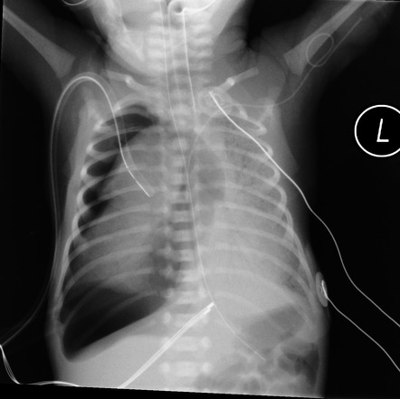
Tension right pneumothorax.
in case of large pneumothorax,
Mediastinum and heart may be pushed to the other side absent of breath sounds in the ipsilateral side , shifting of cardiac impulse to the contralateral side

Slide 20
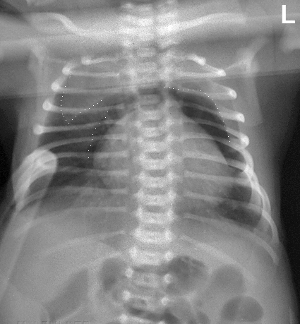
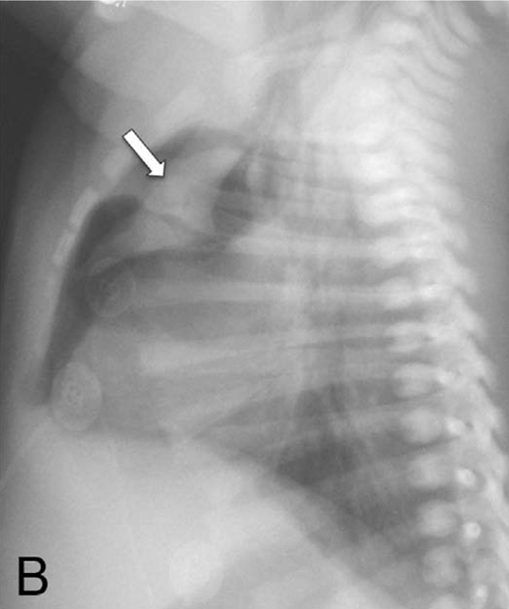
Newborn with mild respiratory distress; had pneumomediastinum elevating the thymus “spinnaker sail” sign.

Slide 21
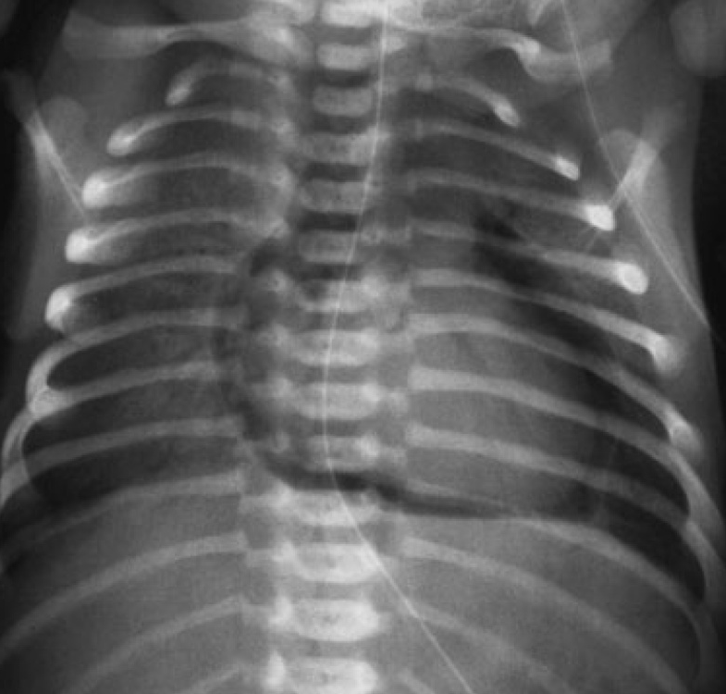
Pneumopericardium with air completely surrounding the heart, demarcating the pericardial sac.

Slide 22
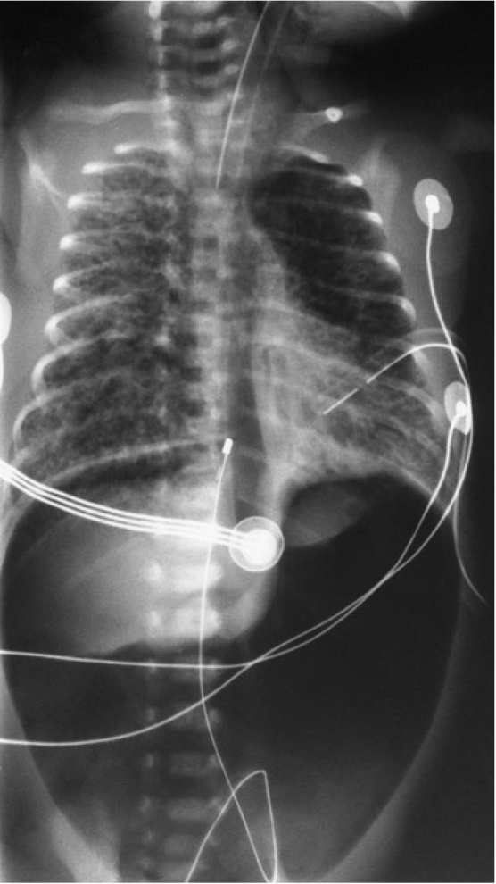
Pneumoperitoneum.

Slide 23
Transient tachypnea of the newborn
TTN is a self-limited disease and common condition in term and late preterm infants. Transient tachypnea of the newborn is the result of a delay in clearance of fetal lung liquid
Common with C-section delivery.
Symptoms
present within the first few hours of life with
increased oxygen requirement, tachypnoea, nasal flaring, grunting, retractions, cyanosis in extreme cases
Resolves usually within 40 h after birth.
Prolonged course >48 h or clinical deterioration may suggest other diagnosis.

Slide 24
Risk factors
Prematures (34–36 wks), prelabour cesarean section.
Delayed cord clamping or cord milking, promoting placental-fetal transfusion, leads to an elevation in the central venous pressure.
Macrosomia and multiple gestations.
Maternal administration of large amounts of IVF or heavy analgesia.
Treatment
Supportive as it is self limited , Oxygen (nasal Cannula) if needed
Diagnosis
Clinically, should resolve within 48 hours
If other diagnosis is suspected, investigations include full septic workup (antibiotics may be initiated) CBC and deferential, Regular blood-gas measurements, Chest radiography

Slide 25
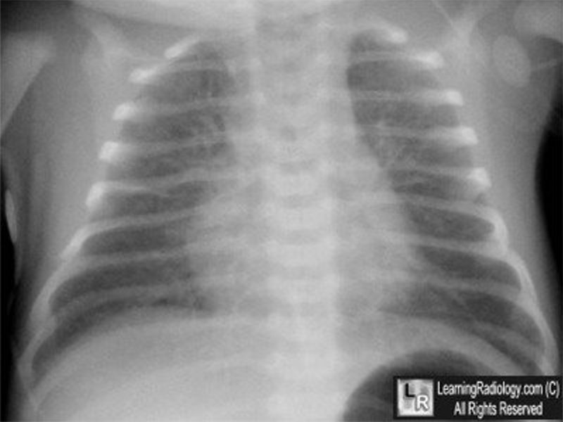
Prominent perihilar streaking reflecting fluid in the interstitium
Patchy infiltrates
Fluids in the horizontal fissure
Hyperinflated lung

Slide 26
respiratory distress syndrome (RDS)
“Hyaline membrane disease (HMD)”
the most common cause of respiratory failure in the premature newborn.
Occurs almost exclusively in premature infants. The incidence and severity of respiratory distress syndrome are related inversely to the gestational age of the newborn infant.
Respiratory distress syndrome develops in premature infants because of impaired surfactant synthesis and secretion leading to lung atelectasis.
Surfactant is a mixture of lipids and proteins produced by type II pneumocytes in the lung epithelium. The absence of surfactant in the alveoli causes an increase in surface tension with consequent atelectasis at the end of expiration.
If not treated, such atelectasis leads to increased work of breathing, intrapulmonary shunting, ventilation perfusion mismatch, hypoxia, and eventual respiratory failure.
Subsequently, serum proteins that inhibit surfactant function leak into the alveoli and with other components form the hyaline membrane.

Slide 27
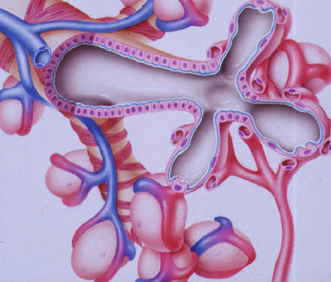
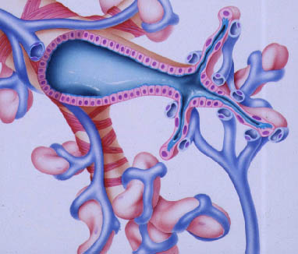
Surfactant is stored in type II alveolar cells and composed of
• Dipalmitoyl Phosphatidylcholine
• Phosphatidylglycerol 90%
• Apoproteins
• Cholesterol
Normal Expiration
With Surfactant
Abnormal Expiration Without Surfactant

Slide 28
respiratory distress syndrome (RDS)
Clinical Features
Signs and symptoms appear immediately after birth or within 6 hours of life then reaches peak at 24-48 hours.
Tachypnea usually >60 breath cycle per minute
Expiratory grunting (from partial closure of glottis)
Subcostal and intercostal retractions
Cyanosis
Nasal flaring
If diseases progressed, apnea and hypotension may occur indicating need for mechanical ventilation
Diagnosis
Chest radiographs : Bilateral, diffuse, reticular granular, or ground glass appearances − Air bronchograms (prominent air bronchograms represent aerated bronchioles superimposed on a background of collapsed alveoli) − Poor lung expansion
Blood gas: Hypoxia − Respiratory/Metabolic acidosis − Hypercarbia

Slide 29
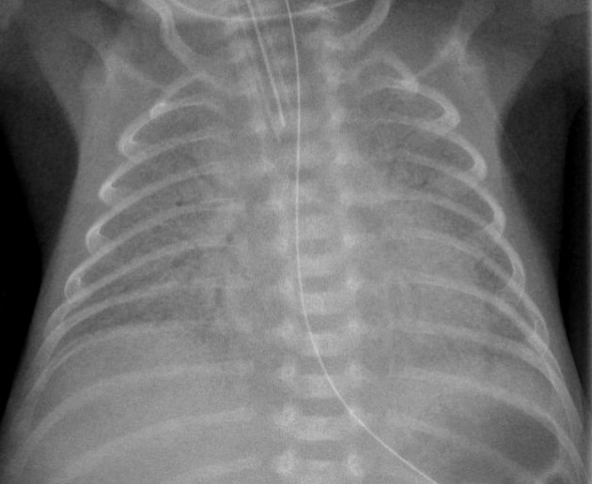
Low lung volume,
Air bronchogram,
Diffuse fine atelectasis (ground glass appearance)
Near-total atelectasis will show complete opacification of lungs (White Lung due to no air in the lungs)
1 or 2 = RDS

Slide 30
respiratory distress syndrome (RDS)
Antenatal Diagnosis/Prediction
Fetal lung test for lung maturity prediction:
Lecithin/sphingomyelin ratio in amniotic fluid (lecithin is at twice as sphingomyelin)
Elevated phosphatidylglycerol level in amniotic fluid
Complications:
intraventricular hemorrhage/Periventricular Hemorrhage
PDA (Patent Ductus Arteriosus)
pulmonary hemorrhage
pneumothorax and air leak
Chronic Lung Disease (Bronchopulmonary Dysplasia, the lung is not dependent, 02 is required) كثير بالشميسي
Retinopathy of Prematurity

Slide 31
respiratory distress syndrome (RDS)
Risk factors
Prematurity
C-section
Hypoxia, acidosis
2nd born twin
Infant of Diabetic mother
Family history of RDS
Antepartum Hemorrhage

Slide 32
respiratory distress syndrome (RDS)
Treatment
Admission to NICU
Connect to Oxygen (CPAP will open the alveoli)
Correct hypoxemia and acidosis, reduce metabolic demands
Chest Xray
Intravenous fluids
Intratracheal Surfactant (2 doses 24 hours apart)
Mechanical Ventilation for severe cases
Prevention surfactant endotracheal
Antenatal steroids (betamethasone or dexamethasone) 24-34 WOG who are at risk of premature delivery will enhance lung maturation and rapid alveolisation

Slide 33
Intraventricular hemorrhage
It is a predominant disorder of preterm infants.
It originates in the periventricular subependymal germinal matrix with subsequent entrance of blood into the ventricular system.
Symptoms
Apnea
Bradycardia
Acidosis
Seizures
Diagnosis
Ultrasonography through anterior fontanelle.

Slide 34
Intraventricular hemorrhage
Risk factors
Extreme prematurity
RDS
Ventilated preterm infants
Seizures
Sudden elevation of arterial BP
Complications
Hydrocephalus
Developmental impairment
Cerebral palsy
Seizures

Slide 35
Necrotizing enterocolitis
GI medical/surgical emergency
An acute inflammatory disease characterized by variable damage to the intestinal tract ranging from mucosal injury to full-thickness necrosis and perforation.
The main cause of NEC still unclear
Symptoms
Feeding intolerance
Hematochezia
Abdominal distention
decreased bowel sounds and motion
Abdominal wall erythema (advanced stages)
Apnea and lethargy
Decreased peripheral perfusion
Shock (in advanced stages) delayed treatment

Slide 36
Necrotizing enterocolitis
Diagnosis
Laboratory:
Hyponatremia • Metabolic acidosis • Thrombocytopenia • Leukopenia or leukocytosis • Prolonged PT and (aPTT) • decreasing fibrinogen
Radiography:
Abdominal Xray
Dilated loops, Thickened bowel walls, Pneumatosis intestinalis (air in intestinal walls)
Pneumoperitoneum (emergency requiring surgical intervention)
Portal gas (present in the portal venous system, considered to be a poor prognostic sign)

Slide 37
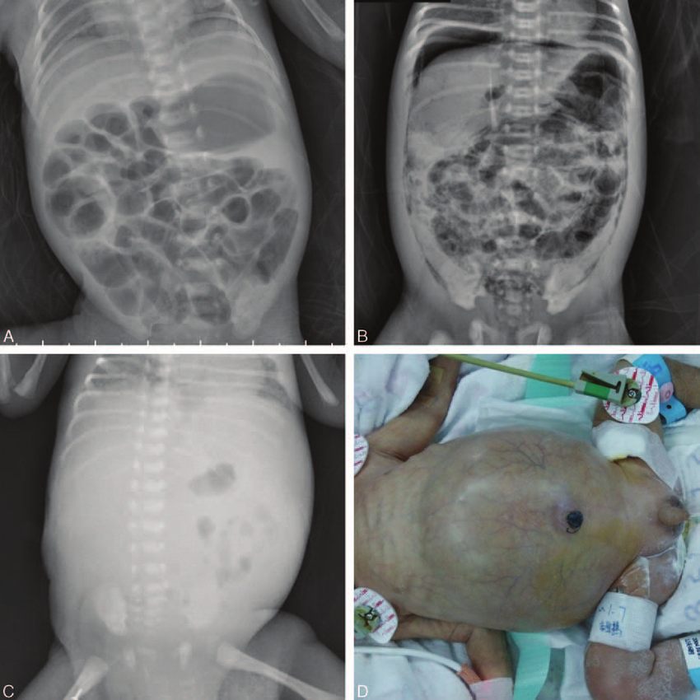
(A) Dilated loops
Thickened bowel walls
(B) Pneumatosis intestinalis (air in intestinal walls)
Pneumoperitoneum
Portal gas (present in the portal venous system)
Pneumoperitoneum is emergency requiring surgical intervention
Portal gas represents air is considered to be a poor prognostic sign.

Slide 38
Necrotizing enterocolitis
Management
Nothing by mouth and IV fluids (NBO) moooooost important
Rapid nasogastric decompression
Start IV antibiotics after cultures; for 3 weeks
Total parenteral nutrition (TPN)
paediatric surgery consultation immediately
Indication for surgery
Intestinal perforation with free air the peritoneal space
Cellulitis of abdominal wall
If the infant keeps deteriorating despite the medical treatment

Slide 39
Thank you

