Slide 1
Routine care and resuscitation of newborn
Dr Faten Zaidan

Slide 2
Fetal Physiology and the Transition to Extrauterine Life

Slide 3
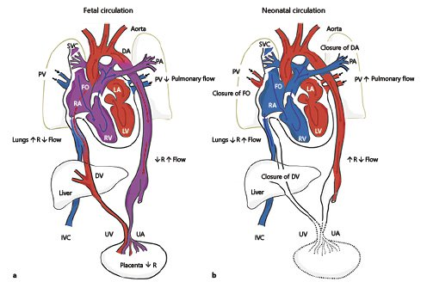
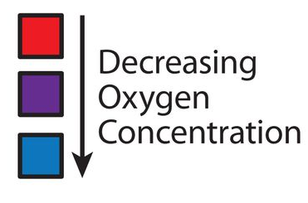
Oxygenated Blood from the placenta goes to the umbilical vein. Then UV in the liver splits into two branches , one for the liver and the other becomes ductus venosus. Blood goes then through the ductus venosus to inferior vena cava and get mixed with deoxygenated blood.
Mixed Blood goes from IVC to right atrium
Also, Blood from SVC goes to right atrium.
From the right atrium , blood goes to the right ventricle , then to pulmonary arteries to the lungs.
Remember that pressure in Pulmonary vessels and lungs are very high due to fluid in alveoli.
Because of the very high pressure in the right side of the heart , some blood goes from the right atrium to left atrium through foramen ovale
Also, Blood from Pulmonary veins goes to the letf atrium
From the left atrium to the left ventricle , blood goes to the aorta
Also, Because of the high pressure in the pulmonary artery, blood pass to the aorta through a branch from pulmonary artery to the aorta, named Ductus Arteriosus.
Blood goes from the aorta to umbilical artery then to the low-resistant placenta.
Intrauterine pulmonary blood flow is initially limited because of high pulmonary vascular resistance and the right-to-left shunting across the patent foramen ovale and patent ductus arteriosus.
Notes:
You can watch the following video for demonstration
Fetal circulation right before birth | Circulatory system physiology | NCLEX-RN | Khan Academy

Slide 4
Blood supply from placenta is cut
Ductus venosus closes due to unuse
Pressure of the Right side of the heart falls
Therefore, foramen ovale closes
Pulmonary resistance falls because fluids are getting absorbed from the alveoli and replaced with air (infant started breathing)
Blood goes from right ventricle to the pulmonary artery to get oxygenated in the lung
Oxygenated Blood goes from pulmonary vein to the left atrium then left ventricle then aorta then IVC to the rest of the body
Due to decrease pressure in pulmonary vessels, ductus arteriosus closes.

Slide 5
Important Physiologic Changes During Transition to Extrauterine Life
Increased systemic vascular resistance with separation from the low-resistance placental vasculature
Closure of right-to-left shunts
Foramen ovale (closes when left atrial pressure greater than right atrial pressure)
Ductus arteriosus (left-to-right flow within minutes of ventilation, then closure over days)
Increased metabolic rate leading to higher glucose needs
Increased catecholamine levels to support blood pressure
Thyroid hormones surge after birth, possibly in response to the relatively cold extrauterine environment

Slide 6
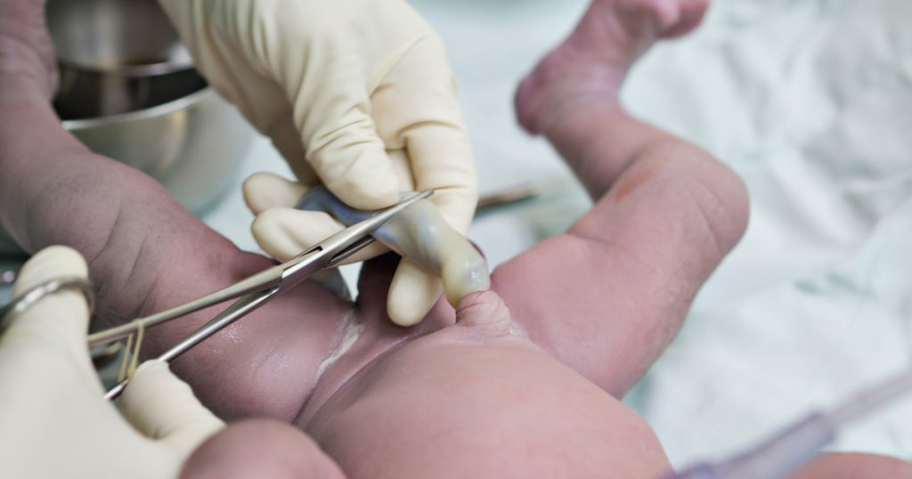
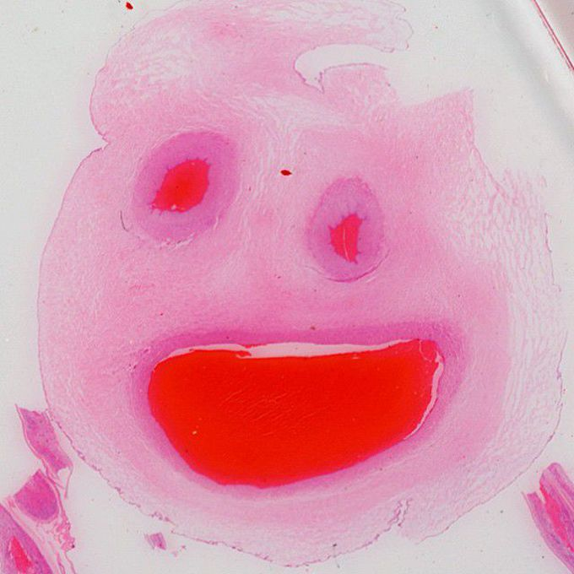
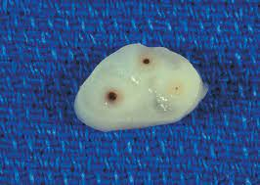
routine care of newborns
1- Umbilical cord should be cut within 30 sec after delivery
Umbilical cord
Contains 2 arteries and one vein (Smiley face)
Average length ~55cm
30% of congenital anomalies preset with single umbilical artery
Most common : Trisomy 18
If Single umbilical artery is present , do renal US and echo to check for other anomalies

Slide 7
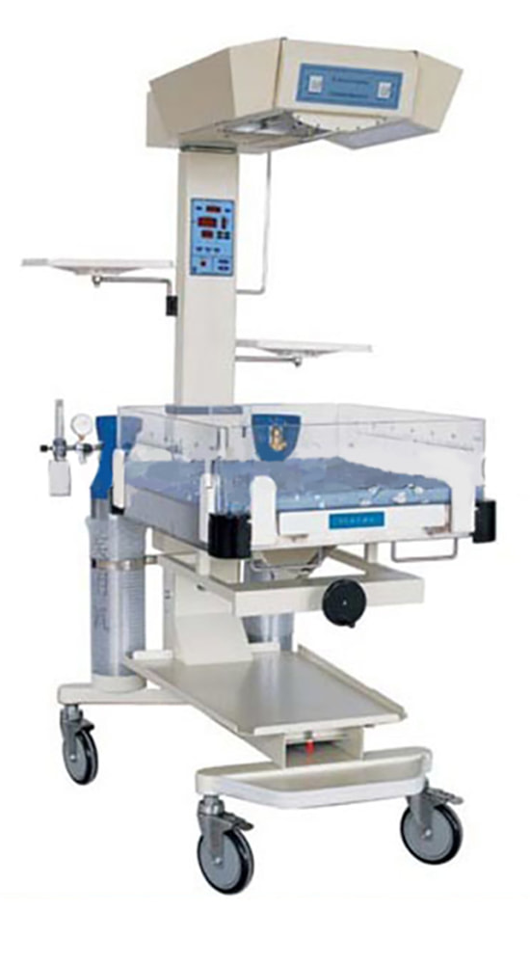
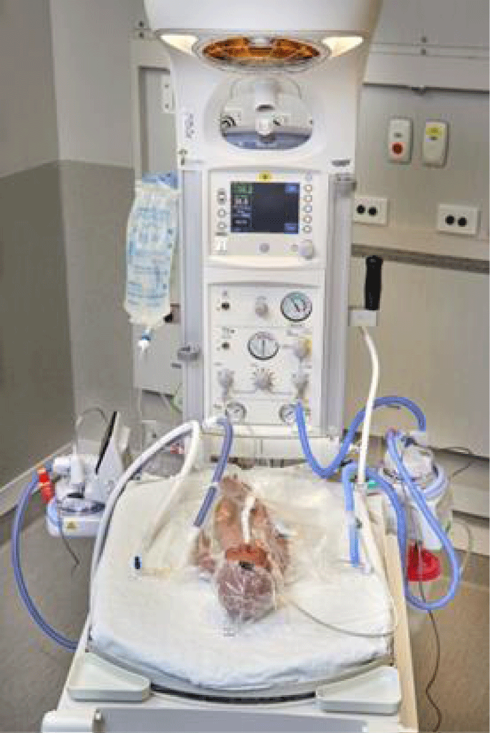
routine care of newborns
2- place him/her under the radiant warmer to keep infant warm
INFANT RADIANT WARMERS

Slide 8
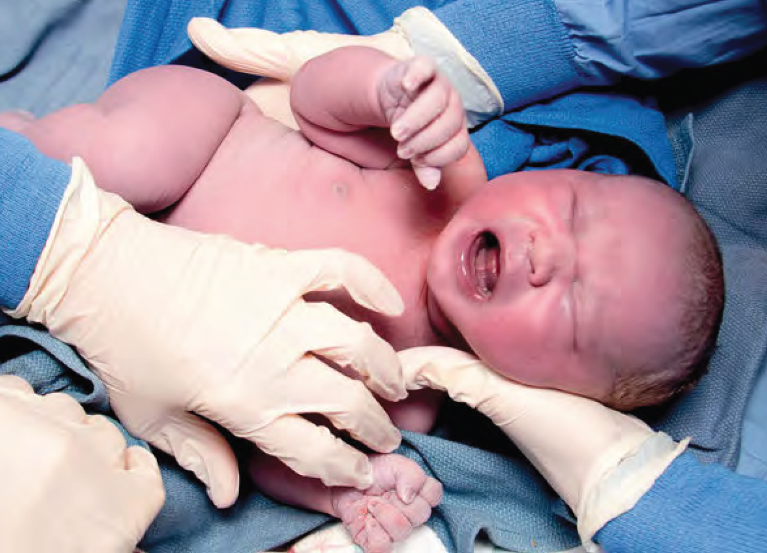
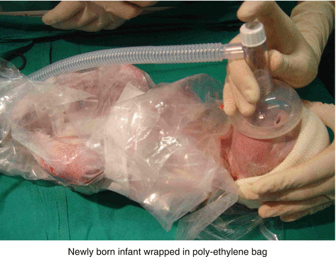

routine care of newborns
2- Dry the infant thoroughly immediately after delivery with clean towel to prevent heat loss.
Maintain a warm delivery room.
Place the infant under a pre-warmed radiant warmer.
Cover extremely preterm infants (<1500 g) with a plastic bag up to the neck, and place a portable warming pad under the layers of towel on the resuscitation table

Slide 9
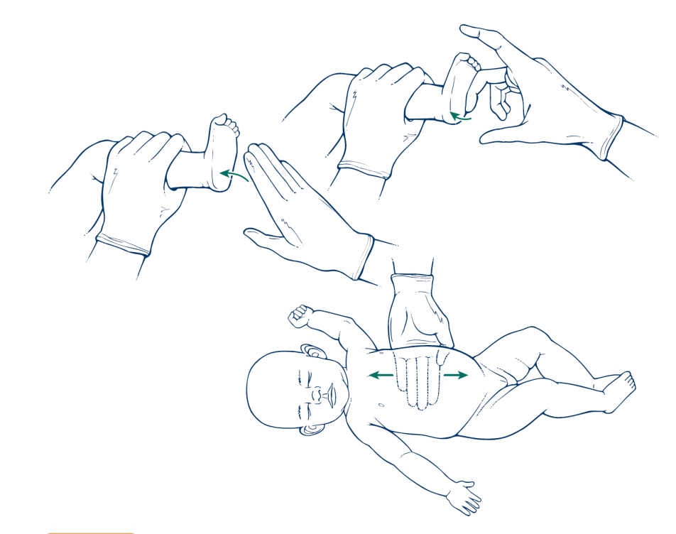
routine care of newborns
3- Stimulate the infant by rubbing the back and the feet to make him cry support spontaneous respiration
Acceptable methods of stimulating a baby to breathe

Slide 10
routine care of newborns
4- calculate APGAR score
After delivery of infant , we check for Good muscle tone, Good crying effort, adequate Breathing, and Pink Central color. We also follow up oxygen saturation. Based on that we identify the APGAR SCORE.
The Apgar score is assigned at 1, 5, and 10 minutes of age
It gives an objective retrospective idea of how much resuscitation required at birth, and the infant’s response to resuscitative efforts.
During resuscitation, assessment of respiratory activity and heart rate provides the quickest and most accurate evaluation of the need for continuing resuscitation.

Slide 11
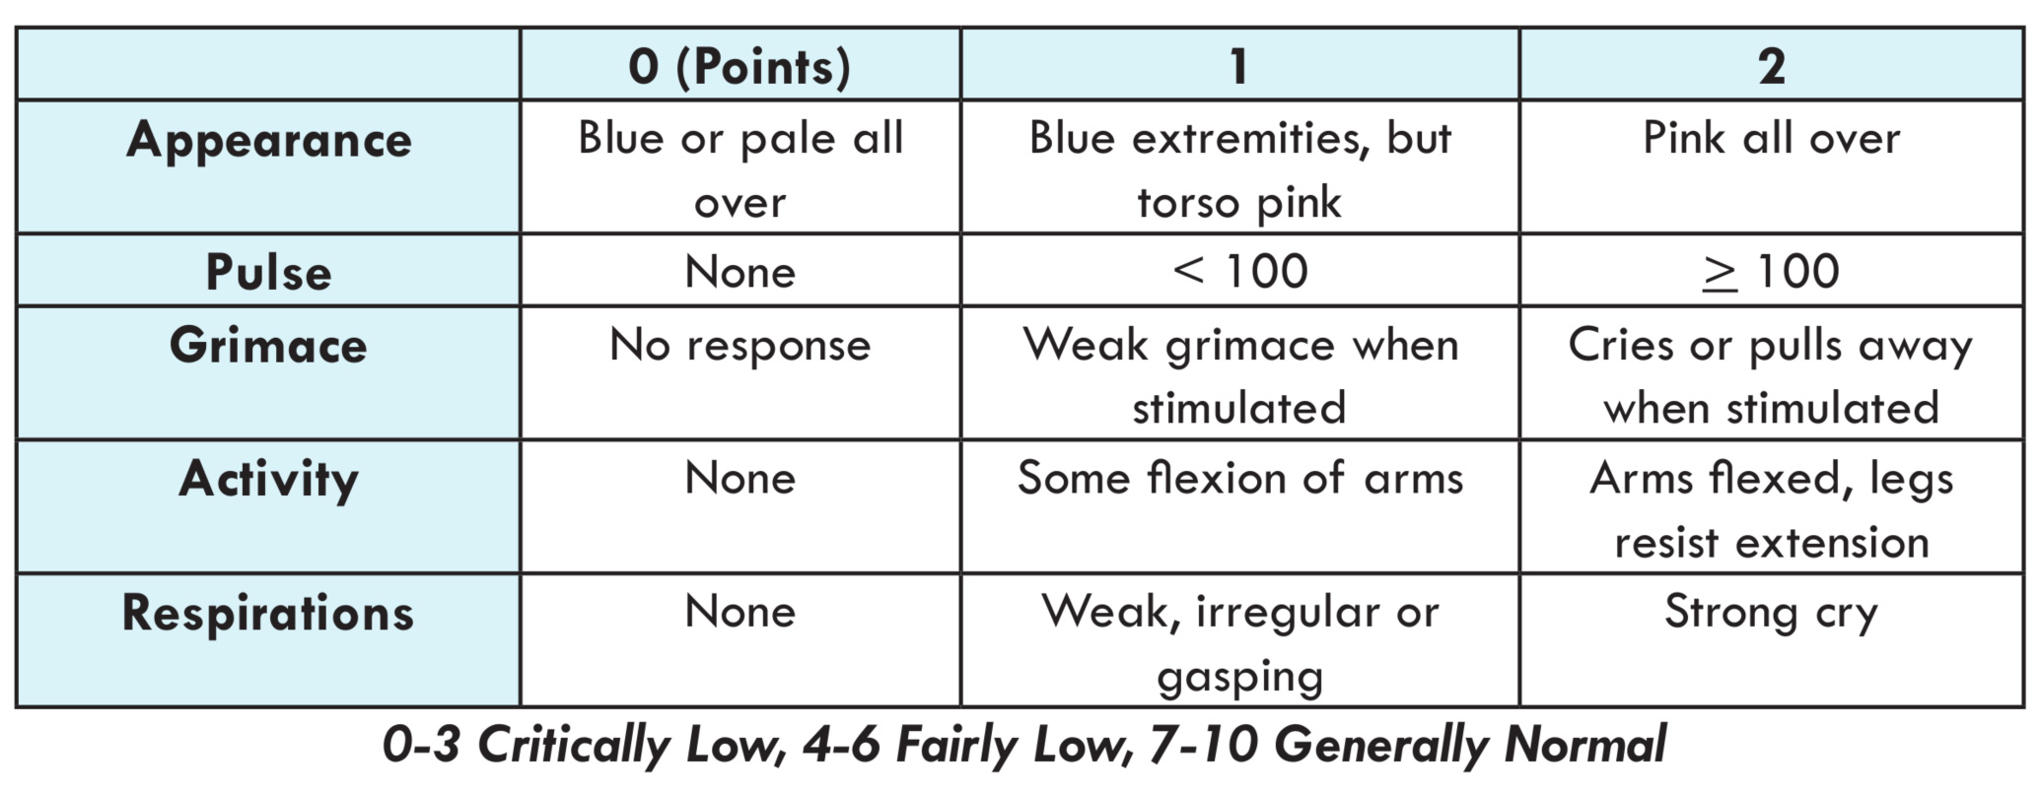
APGAR Score
active

Slide 12
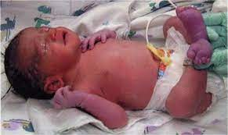
acrocyanosis

Slide 13
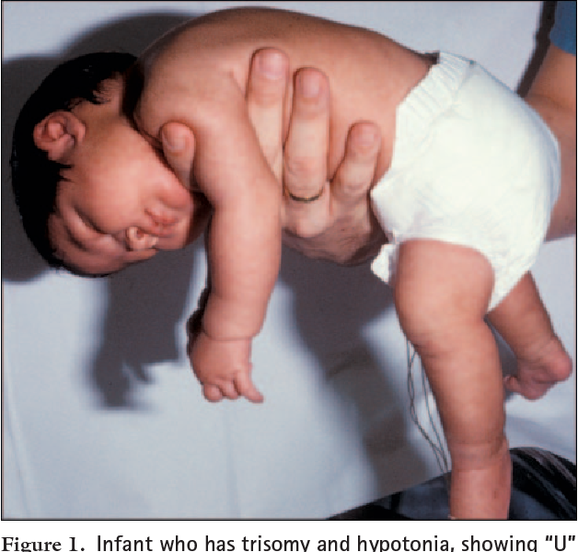
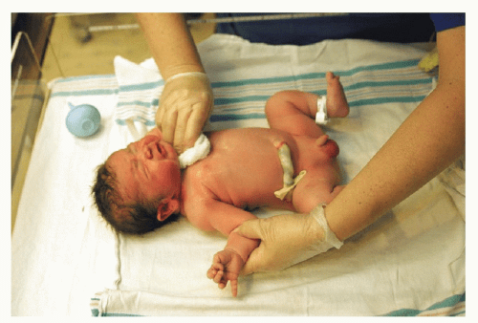

Slide 14
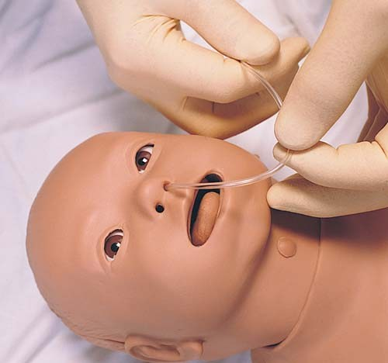
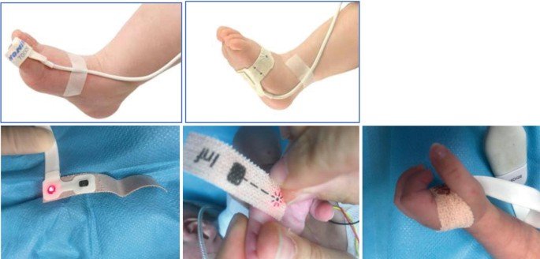
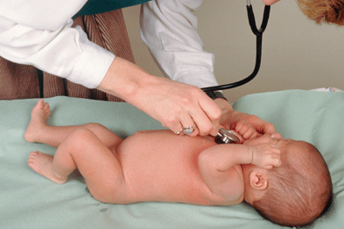
routine care of newborns
5- Position airway
6- Suction the oral cavity and the nostrils superficially
Deep pharyngeal stimulation with a suction catheter may cause bradycardia and apnea that are probably of vagal nerve in origin, and this should be avoided.
7- Do full examination from head to toe
8- Skin-to-skin contact with the mother

Slide 15
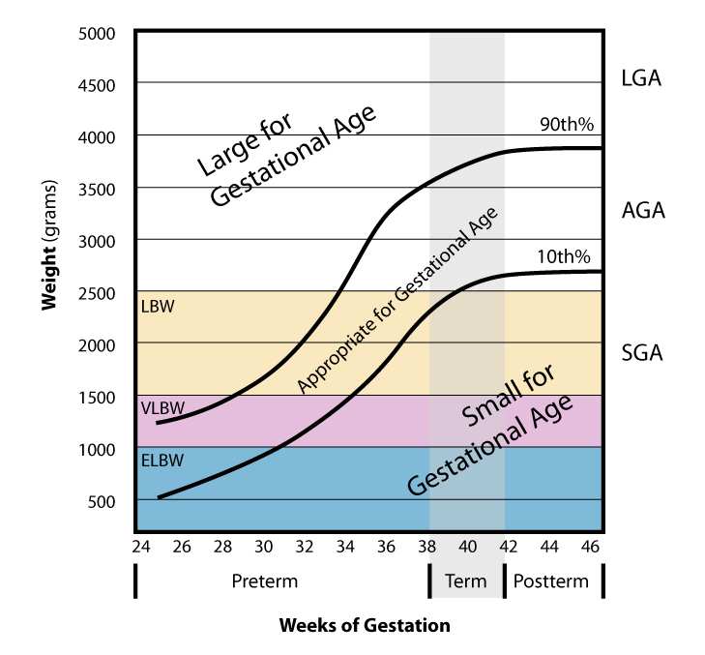
Gestational Age
Gestational Age: the number of weeks in pregnancy since the 1st day of the last normal menstrual cycle
Preterm ≤ 36 wk and 6 days
Term 37 wk and 0 days to 41 wk and 6 days
Post-term ≥ 42 wk
Appropriate for gestational age (AGA): infant with a birth weight between 10th and 90th percentile for the given gestational age
Small for Gestational age (SGA) infant with a birth weight < 10th percentile for the given gestational age
Large for Gestational age (LGA) infant with a birth weight >90th percentile for the given gestational age

Slide 16
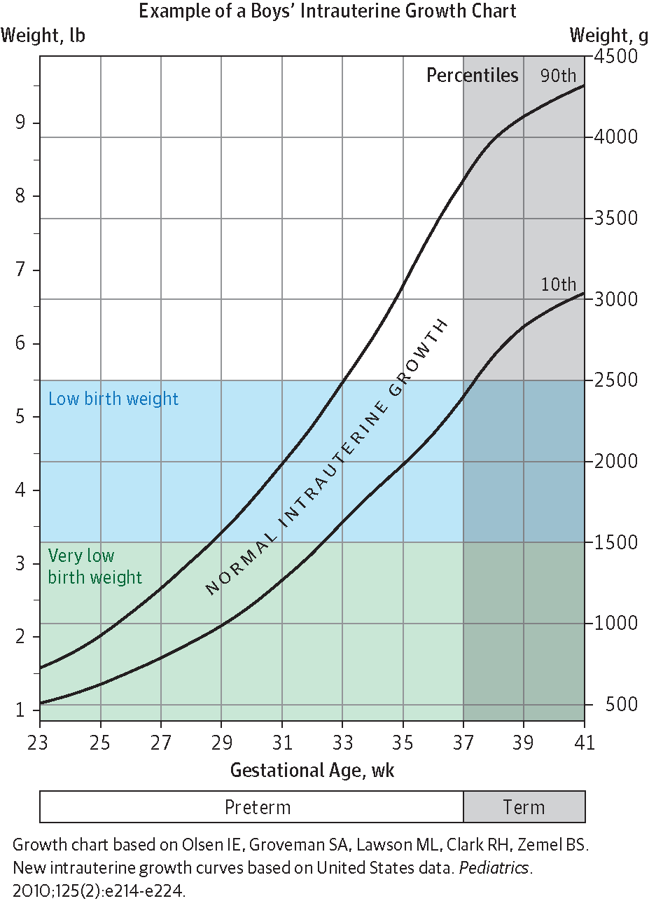
Birth Weight
Normal 2500 gr -3500 gr
Low Birth Weight (LBW):
infant whose birth weight is < 2500 g
Very low birth weight (VLBW):
infant whose birth weight is < 1500 g
Extremely Low Birth Weight (LBW):
infant whose birth weight is < 1000 g
Large birth weight:
infant whose birth weight is ≥ 4000 gr
Extremely Low Birth Weight

Slide 17
Intrauterine growth Restriction
IUGR: Fetal weight < 10th percentile for gestational age
Risk Factors :
Maternal Hypertension
Smoking
Malnutrition
Ethanol ingestion
Uterine and Placental Malformations causing decrease in uteroplacental flow
Symmetric | Asymmetric
Occurs as result of growth inhibition early in pregnancy | Occurs as result of nutrient supply restriction in utero
Early onset | Late onset
Causes : TORCH, chromosomal disorders, congenital malformations | Causes: chronic hypoxia, malnutrition, chronic hypertension, renal disease
Growth of head and abdomen decreased equally: | Head stays normal but abdominal growth slows down

Slide 18
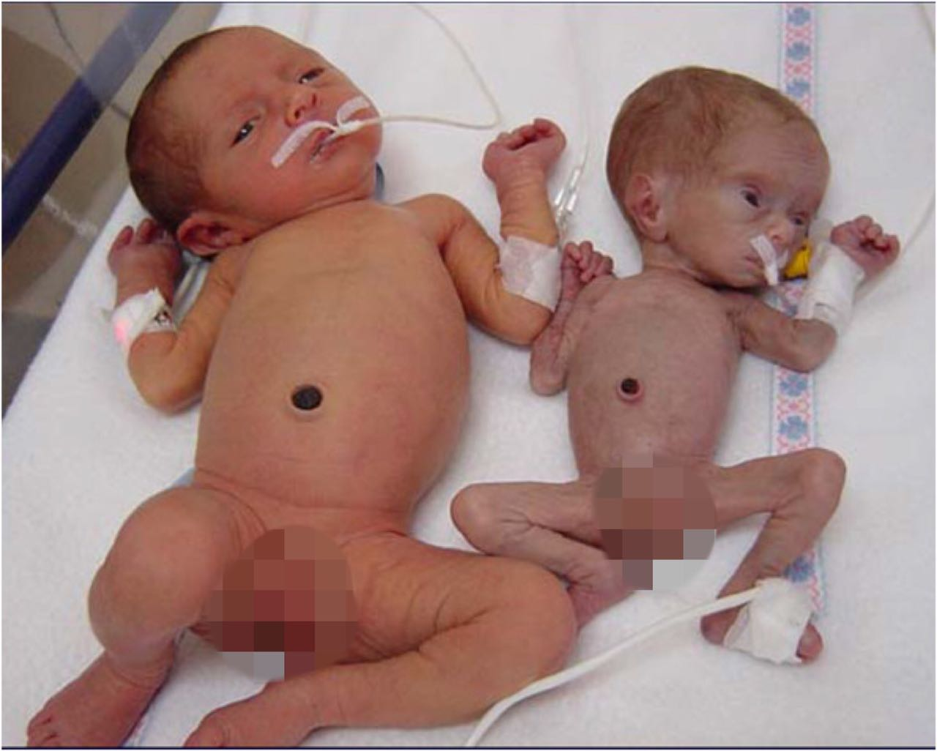
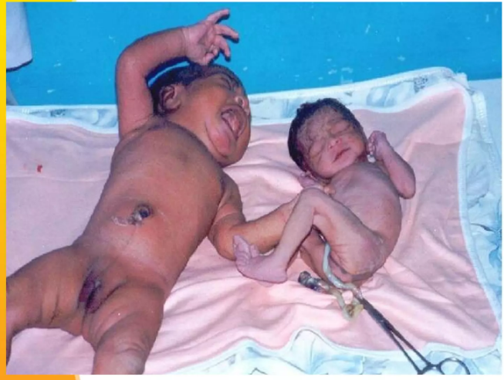
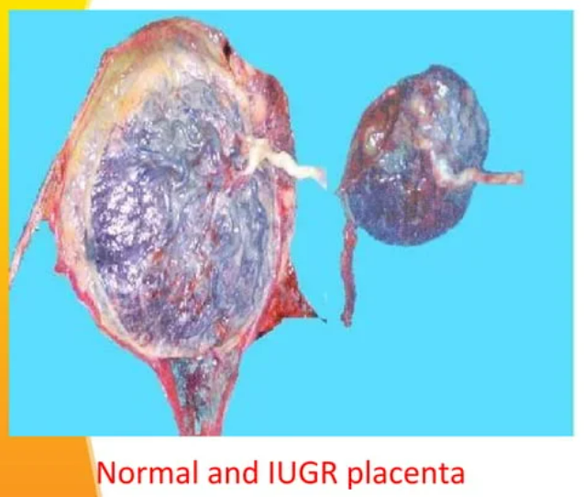
Appropriate & IUGR?

Slide 19
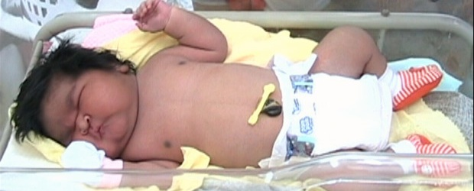
Large for gestational age

Slide 20
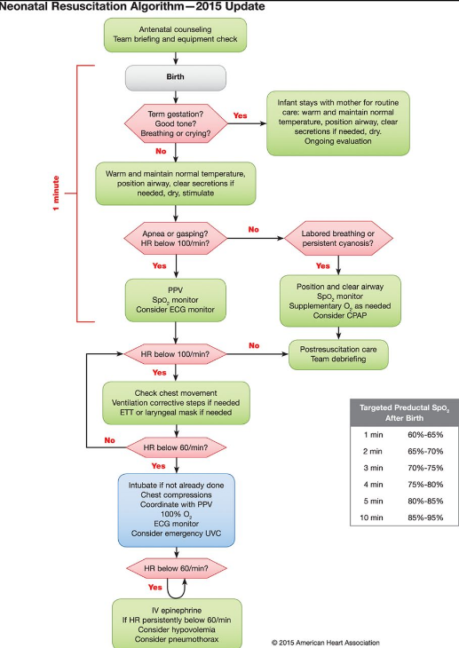
Neonatal Resuscitation
Positive pressure ventilation (PPV) is noninvasive airway method that delivers oxygen continuously creating positive pressure during inspiration. Therefore bronchioles and alveoli are prevented from collapsing at the end of expiration.
! The stomach should be emptied during and after bag-and-mask ventilation by orogastric suctioning.

Slide 21
Neonatal Resuscitation
Endotracheal intubation is performed as indicated, and when PPV is not efficient

Slide 22
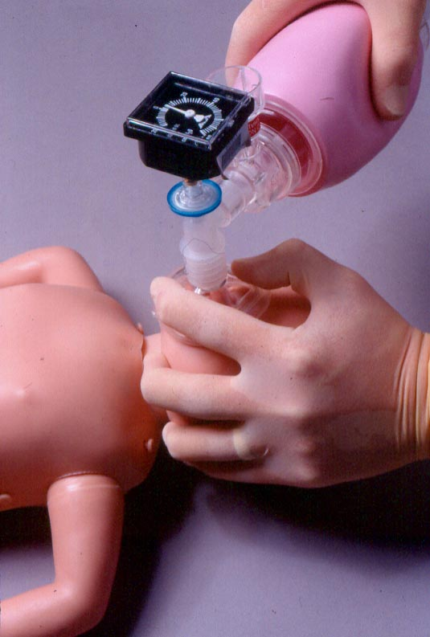
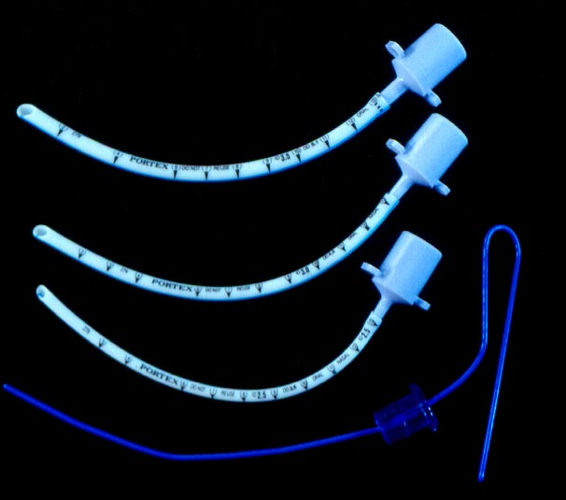
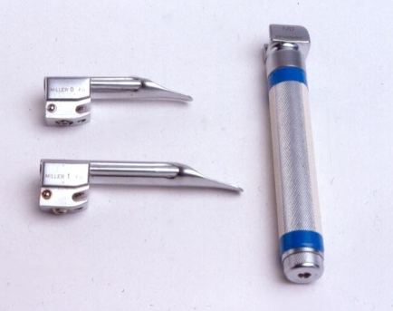
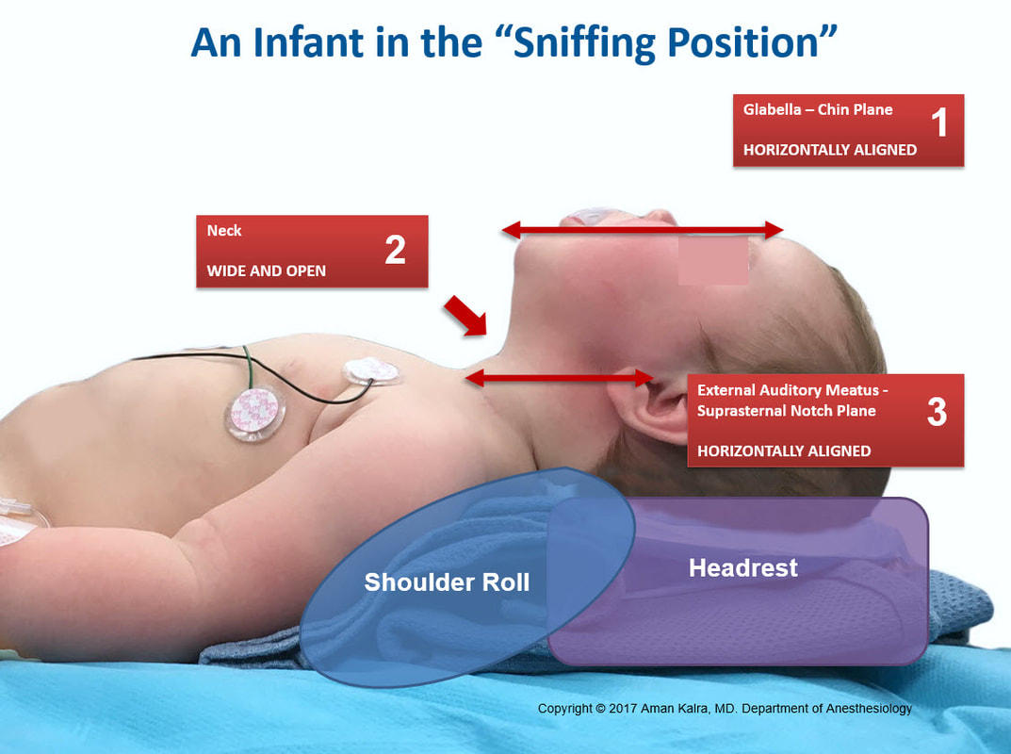
E and C hand positioning for good seal
Baby in sniffing position
Bag-and-mask ventilation of the neonate.

Slide 23
Neonatal Resuscitation
If pulse is < 60 beats/min despite 30 seconds of positive-pressure ventilation, chest compression should be initiated.
Chest compressions Techniques:
  Thumbs Technique
  2-finger technique
Palpate for the central pulse in Brachial artery
The sternum is compressed ⅓ of the antero-posterior diameter (4 cm or 1.5 in) of the chest at a regular rate
If single rescuer, compression to breathing ratio is 30:2
If two rescuers, compression to breathing ratio is 15:2

Slide 24
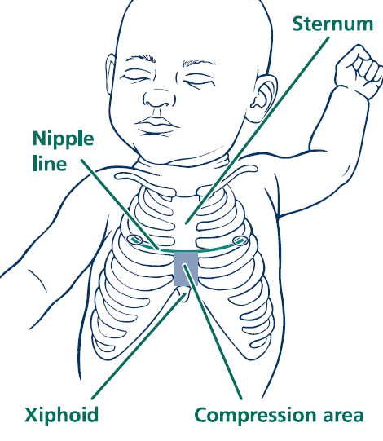
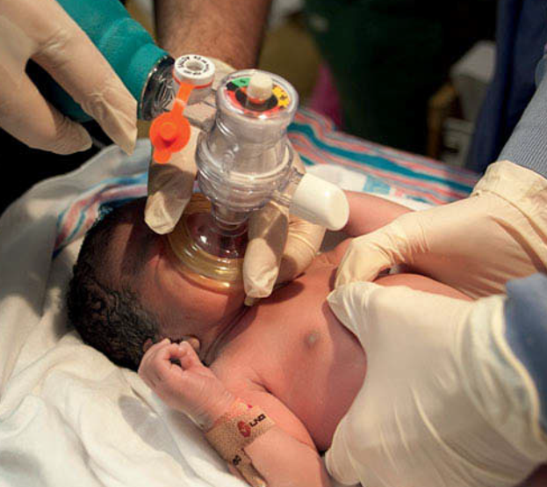
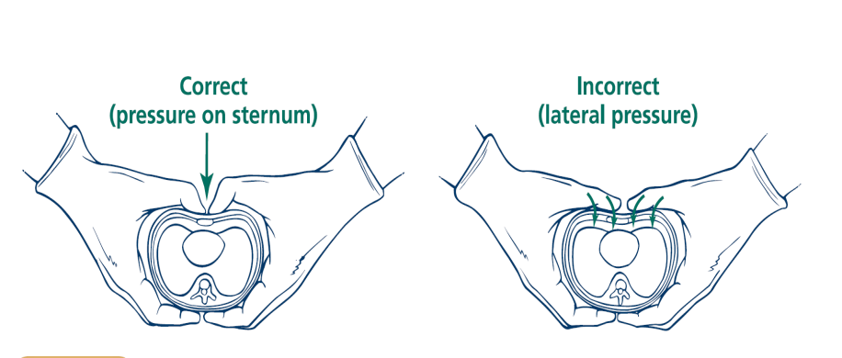
Thumb Technique: thumbs are placed on the lower third of the sternum, between the xiphoid and the line drawn between the nipples, encircling the chest

Slide 25
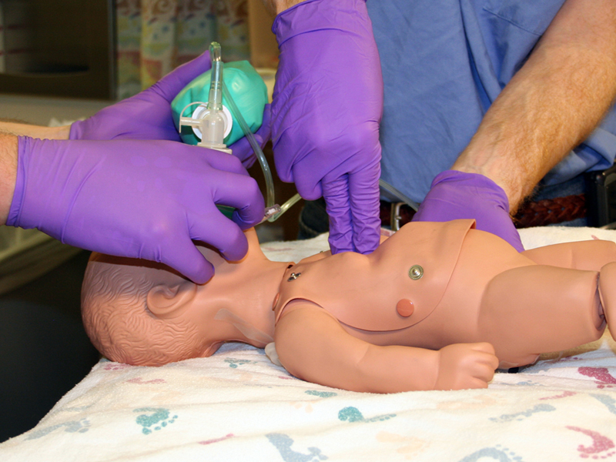

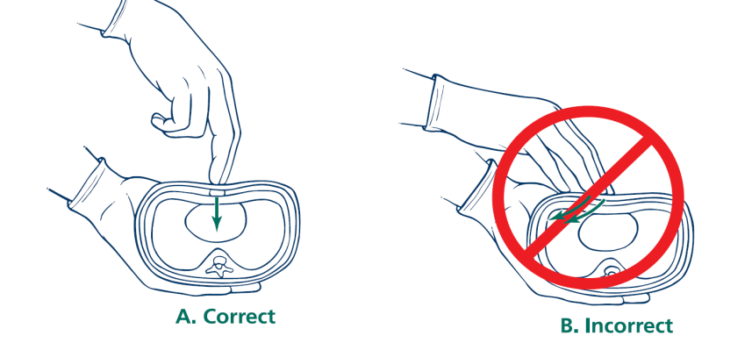
2-finger technique: the middle and ring fingers of one hand can be placed on the sternum while the other hand supports the back

Slide 26
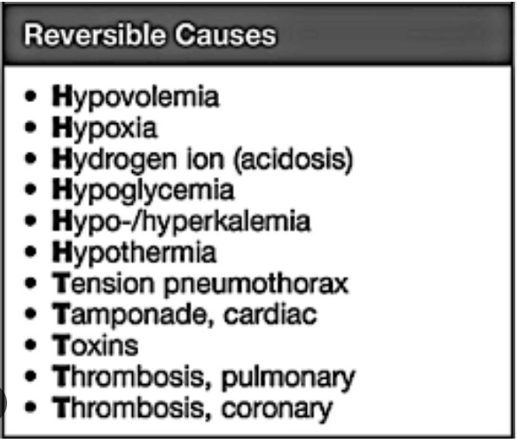
in every cpr cycle, look for the reversible/treatable causes of cardiac arrest the most common case of bradycardia in children is hypoxia.

Slide 27
Neonatal Resuscitation
Epinephrine recommendations
Route:
Intravenous (preferred)/Intraosseous or Endotracheal every 3 to 5 minutes.
Dose:
0.01mg/kg of 10,000 solution IV/IO (equal to 0.1 ml/kg) followed by 3 ml normal saline flush.
Endotracheal tube dose is 0.1 mg/kg/dose (1ml/kg)

Slide 28
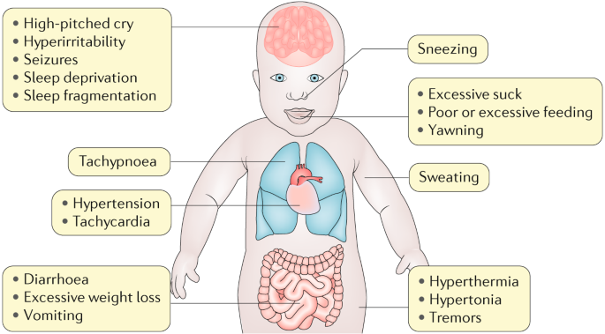
Other medications: Naloxone
Naloxone is an opioid (narcotic antagonist) that is administered to an infant with neonatal Abstinence Syndrome secondary to mothers with opioid misuse (heroin/methadone)
The intravenous or intramuscular dosage for naloxone is 0.1 mg/kg to be repeated every 5 minutes, as necessary.

Slide 29
Upon discharge
Three things are given to every neonate upon delivery:
1-pottasium: single intramuscular dose or three oral doses to prevent hemorrhagic disease of newborn
2- Hepatitis B vaccine. Hepatitis B immunoglobulin is added to babies whose mothers are hepatitis B positive
3- tetracycline/erythromycin ophthalmic drops to prevents gonorrheal conjunctivitis

Slide 30
Benign skin conditions in newborn

Slide 31
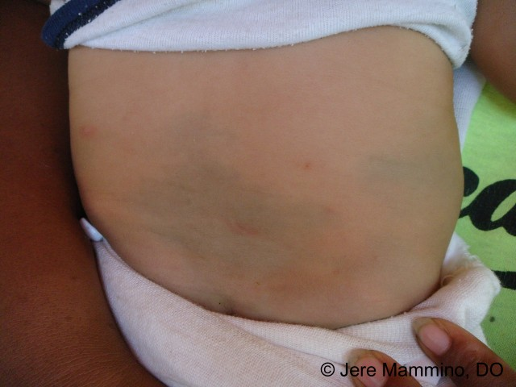
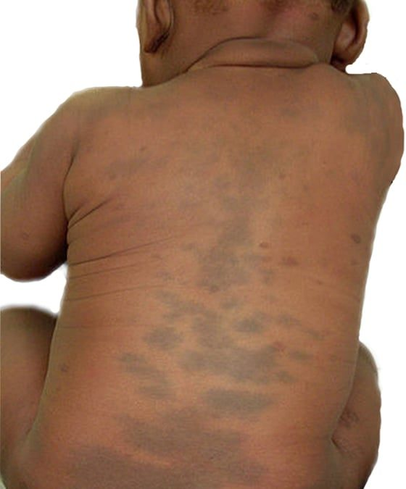
Mangolian spot
Dark blue-grey lesions
most commonly seen in darker-skinned infants.
The sacrum is the most commonly affected area.
Other areas affected : Back, shoulders, neck
These lesions tend to fade over several months to years
No treatment is needed

Slide 32
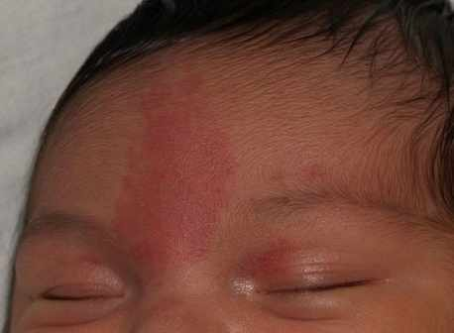
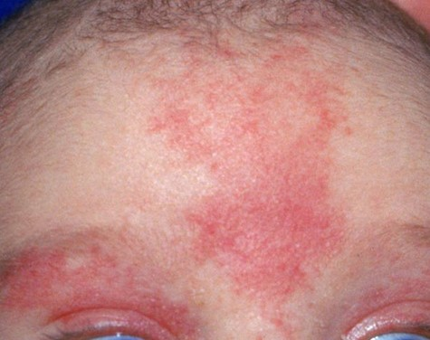
Salmon patch
Known as nevus simplex, stork bite, or angel kiss
Pale pink blanching macules and patches
Usually fades by months upto 2 years but may become prominent with crying, or straining

Slide 33
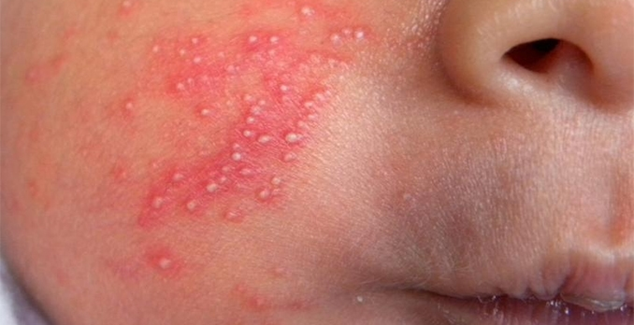
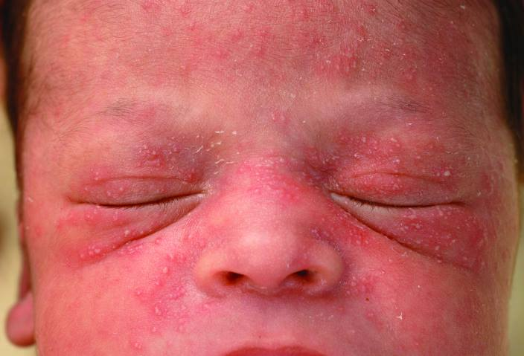
Erythema toxicum neonatorum
Yellowish papulovesicular lesions surrounded with irregular surrounding erythema
May be present at face, trunk , proximal extrimities . BUT palm and soles are intact
Fades within 2-3 weeks
Sterile pustule will reveal eosinophils.
Self-limited and requires only reassurance.

Slide 34
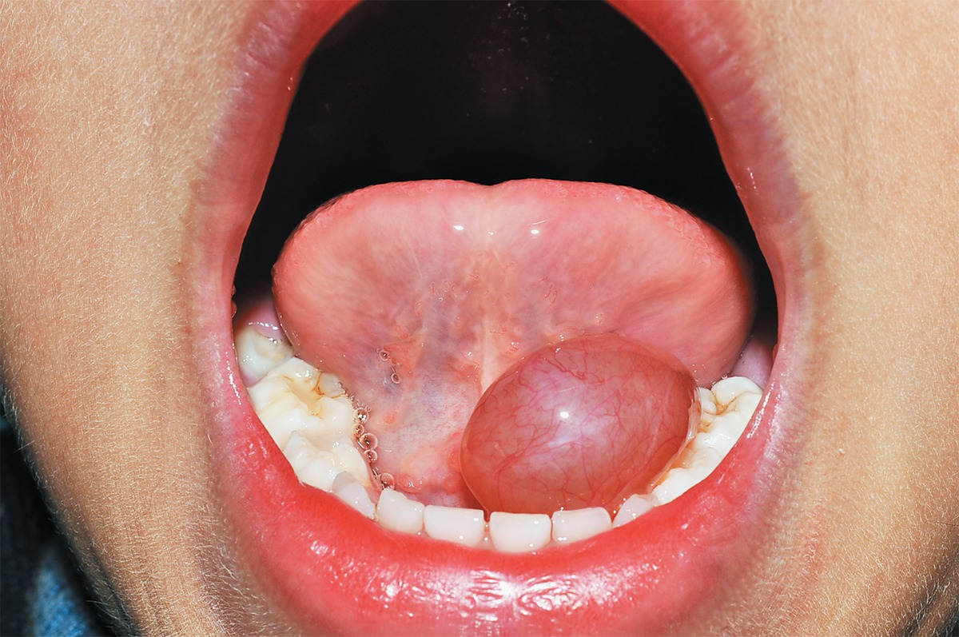
Ranula
Benign mass originating in the floor of the mouth :
sublingual dilatation of a salivary gland
Treatment : Excision
It may interfere with feeding

Slide 35
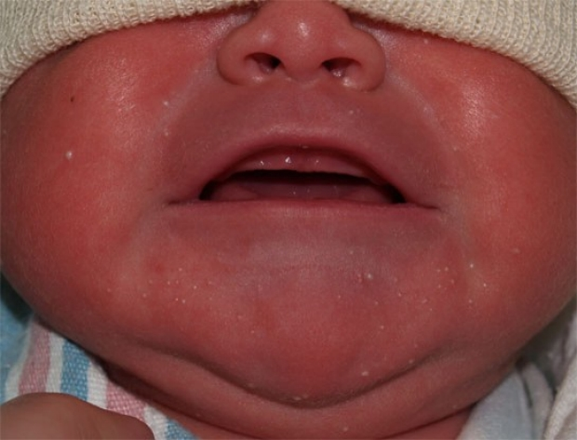
Milia
white globules on the chin, cheeks and forehead
Resolves within 1-2 weeks
No treatment

Slide 36
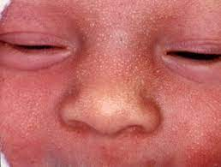
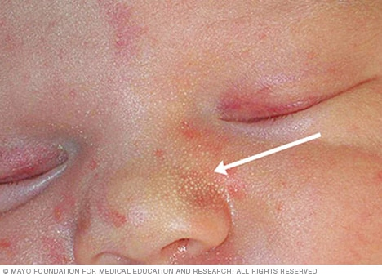
Sebacous Hyperplasia
Yellow to white papules
Typically on nose, cheeks and forehead
Resolves within 1-2 weeks
Causse: Maternal androgens

Slide 37
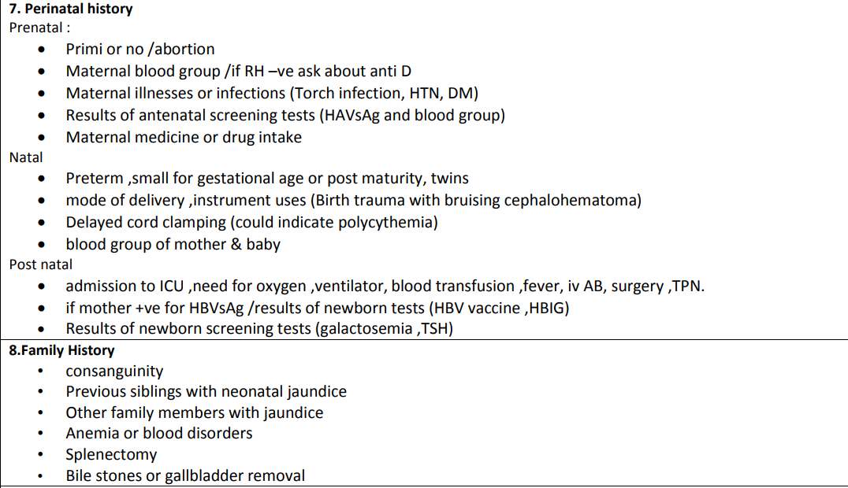
history

Slide 38
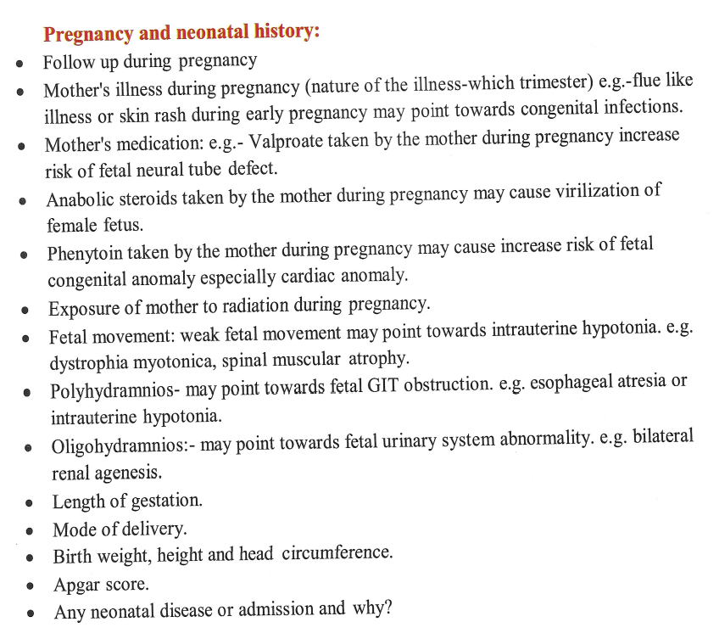
history
Nutritional History
Breast fed or bottle fed
For how long
Which formula
What volume does he take at each feed
Frequency of feed
Time of weaning and introducing solids and cereals

Slide 39
Thank you

