Slide 1
Childhood Nutritional disorder
Dr. Mansour ALQurashi

Slide 2
Introduction
- Malnutrition is a condition that develops when the body does not get the proper amount of protein, calories, vitamins and other nutrients .
- It occurs in children who are either undernourished or over nourished.
Children who are over nourished may become over weight or obese.
Children who are under nourished are more likely to have severe long term consequences.

Slide 3
Etiology
1- Dietary errors.
2 – Infection : T.B, pyelonephritis.
3- Gastroenteritis
4- parasitic infestations : Ascaris, ankylostoma ,giardia.
5-Congenital anomalies : V.S.D, renal agenesis, pyloric stenosis .
6-Metabolic diseases : Galactosemia, Fructose intolerance.
7- Prematurity .
8- Some cases of mental retardation.
9- Low socio economic status .
10-Endocrine causes ( DM. hyperthyroidism ).

Slide 4
Protein – energy malnutrition
1- Marasmus
Definition:
It is a form of under nutrition characterized by failure to gain weight due to
inadequate caloric intake.
Incidence:
commonly in infants between the age of 6 mo. - 2years .

Slide 5
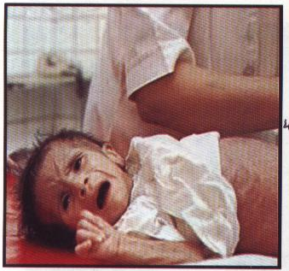
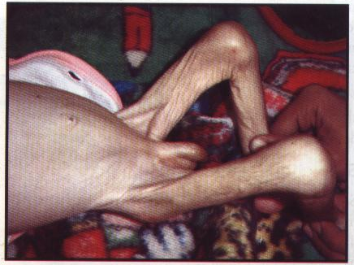
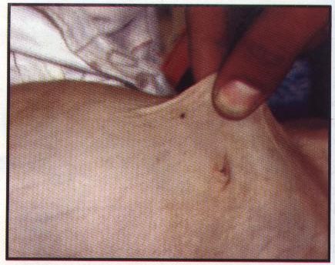



Assessment of Infant with marasmus
failure a to thrive ,loss of weight (weight < 60%of expected)
loss of subcutaneous fat : measured at many parts of the body according to the degress:-
1 st degree : s.c fat in the abd. wall
2 nd degree : s.c fat in the abd. wall and limbs
3 rd degree : s.c fat in the abd. wall and limbs and face

Slide 6
Assessment of Infant with marasmus (Cont.)
Muscle wasting ( thin muscles and prominence of bony surfaces )
G.I.T disturbances as anorexia in advanced cases, hungry, constipation or diarrhea.
Liability to infection
Hypovolemia
Weak feeble pulse, subnormal temp, pulse rate
Senile face
Pallor

Slide 7
Complications of Marasmus
Intercurrent infection : Broncho pneumonia . is the cause of death
Gastroenteritis.
Hemorrhagic tendency, purpura.
Hypothermia.
Hypoglycemia.
Edema (marasmic kwashiorkor ).

Slide 8
Investigations for Marasmic Infant
1.Blood analysis : W.B.C ,Electrolytes , Sugars,
ketones , Plasma proteins .
2. Urine analysis: culture, sugar, ketones, ca,
phosphate, amino acids.
3.Stool analysis for parasites.
4. X- ray for chest and heart.
5. Tuberculin test for T.B.

Slide 9
PREVENTION
  Proper diet ( balanced nutritional diet ).
  Encourage breast feeding up to weaning.
  Proper weaning.
  Proper vaccination as measles , T.B. whooping cough.
  Education regarding the cheap sources of balanced diet, family planning.
  Proper follow up of the growth rate.
  Early treatment of defects or associated diseases.

Slide 10
Treatment
A- Proper dietary management:-
Adequate balanced feeding. teaching about nutritional needs,preparation of diet, technique of administration of food.
If there is vomiting or anorexia, give IV fluids or naso gastric tube feeding.
Gradual increase the amount and concentration of formula (total calories is120-200cal kg /d).
B – Treatment of the cause.
C- Emergency treatment for complications.
D – Blood transfusion.
E – Vitamins and minerals supplementation

Slide 11
Kwashiorkor
Definition
It is a form of malnutrition characterized by slow rate of growth due to deficient of protein intake, high CHO diet and vitamins & minerals deficiency (adequate supply of calories).
Incidence
Commonly in toddlers between the age 1-3years, following or with weaning.

Slide 12
Etiology
Un balanced diet (of protein, CHO.)
improper weaning (during and post weaning period )
faulty management of marasmic baby
Ignorance poverty due to lack of basic health education
precipitating factors as(acute infection with measles, diarrhea and malaria, parasitic infestations)

Slide 13
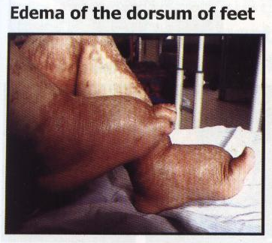
Assessment
    1- Essential features (cardinal manifestation):
  Growth retardation :-
  Weight is diminished (60-80%) of expected
  Edema :
It is due to hypo proteinemia. It is starts in the feet and lower parts of the legs) then becomes generalized edema . The cheeks become bulky, pale, waxy in appearance (doll-like-cheeks)

Slide 14
1- Essential features
      - Diminished muscle fat ratio:
    Generalized (muscle wasting) with subcutaneous fat
      - Fatty liver :
      It is detected by liver biopsy
      - Mental changes :
      The infant has apathy never smile, looks sad his cry is weak

Slide 15
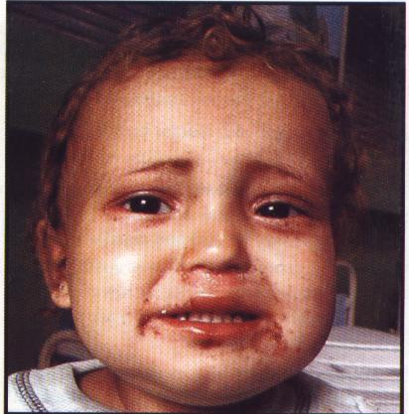
2-Early features
(usual manifestation)
    Hair changes : The hair is sparse , dys pigmentation( reddish or greyish),atrophic ,easily pickable.
    G.I.T Manifestations: Anorexia ,vomiting in severe cases, diarrhea .

Slide 16
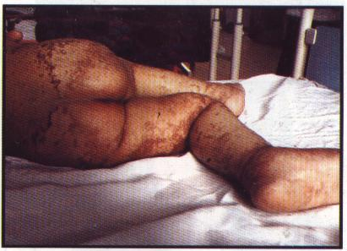
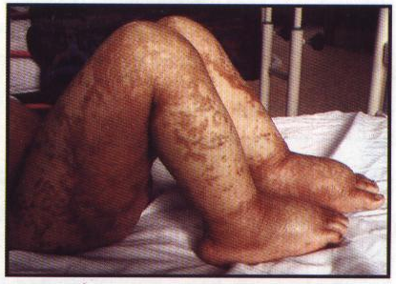
3-Occasional or variable features
    - Vitamins and minerals defection and vit.D , A,C minerals as iron, zinc, Mg,
      Hepatomegaly.
      Skin changes (dermatitis in areas due to pigmentation ,napkin dermatitis, petechiae over the abdomen, fissures,ulceration
      Poor resistance and liability to infections

Slide 17
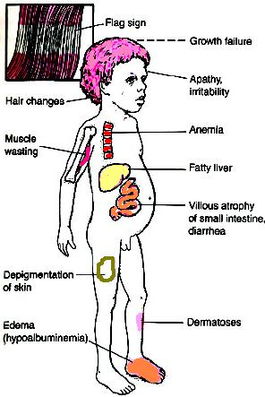

Slide 18
Complication of kwashiorkor
CVS: hypovolemic shock. HF due to anemia and infection.
GIT : atrophy of the pancreas with subsequent glucose intolerance, atrophy of the mucosa of the small intestine, lactase deficiency, ileus, bacterial overgrowth ( septicemia ). Gastroenteritis. Fatty liver.
Loss of immune function, antioxidant function, subsequent infections, UTI,septic shock, and death. Both bacterial and fungal.
Endocrinopathies : insulin levels are decreased; growth hormone is increased, but insulin-like growth factor levels are reduced. This leads to insulin intolerance. Hypoglycemia
Metabolic disturbances and hypothermia,Acidosis.
Impaired cellular functions, including endothelial dysfunction
Electrolyte abnormalities.
Hemorrhagic tendency, purpura

Slide 19
Investigations for kwashiorkor
1. Blood analysis: (Albumin < 2.5gmld) , total protein, amino acids, Enzymes (amylase ,lipase, alkaline phosphate, , Glucose (hypoglycemia) , k (hypokalemia ), Creatinine blood levels,ABG.
2. Low pancreatic and intestinal enzymes
3. Urine analysis, culture for infection
4. Stool analysis for parasites
5. Chest x-ray
6. Tuberculin test

Slide 20
Treatment of Kwashiorkor
Food with more proteins and more calories.
Long term vitamin and mineral supplements.
Calories need to be increased slowly because the patient’s diet lacked any significant nutrition for a long period.
If there is a delay in the treatment, the child might stay with permanent physical and mental disabilities. If the condition is not treated, it might turn fatal.

Slide 21
Thank you

