Slide 1
NEONATAL JAUNDICE
Prepared by :
DR. SALMA ELGAZZAR
MRCPI in pediatrics
Master’s degree in Pediatrics Alexandria University

Slide 2
OBJECTIVES:
1. Define hyperbillirubenimeia.
2. Recall the physiological steps in the metabolism of billrubin.
3. List the key component from the history and physical examination in patient with jaundice.
4. Differentiate between physiological and pathological causes of jaundice.
5. Discuses the differential diagnosis of both direct and indirect hyperbillrubinemia.
6. Define and enumerate the laboratory findings in cholestatic jaundice.
7. List the commonest causes of cholestatic jaundice in infancy and childhood.
8. Discuss the pathogenesis, clinical presentation and outline the management of billiary atresia.
9. Elaborate on the different treatment modalities in jaundice and list the common indications and side effects of each.
10. Describe the most fatal complications of hyperbillrubinemia.

Slide 3
DEFINITION
Jaundice is yellow discoloration of the skin, sclera and mucous membranes due to increased level of bilirubin in the blood. Jaundice is clinically observed in the newborn when the total serum bilirubin reaches 5-7 mg/dl (86 μmol per L)
Over 60% of term and 80% of preterm infants develop jaundice in the first week of life, few have significant underlying disease.

Slide 4
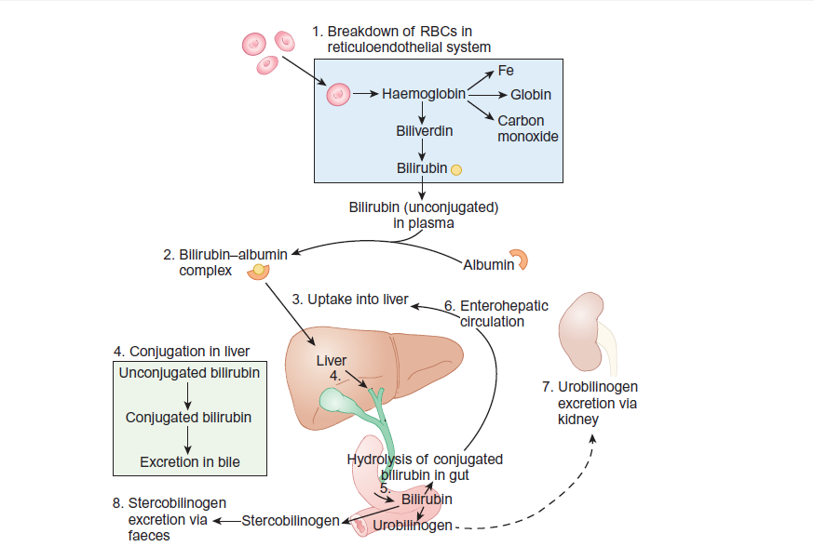
Metabolism of bilirubin

Slide 5
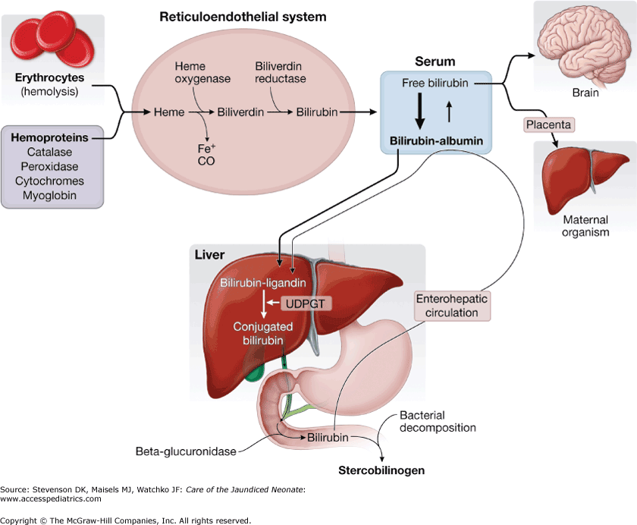

Slide 6
PATHOGENESIS OF HYPERBILIRUBINEMIA
1-Increased bilirubin production due to high red cell turn over.
2-Delayed bilirubin clearance.
3-Conjugated hyperbilirubinemia.

Slide 7
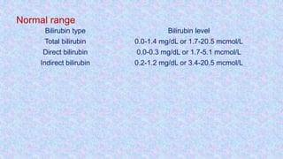
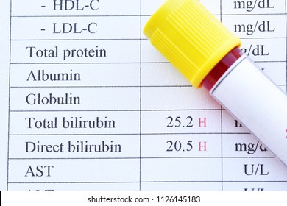
classification of jaundice

Slide 8
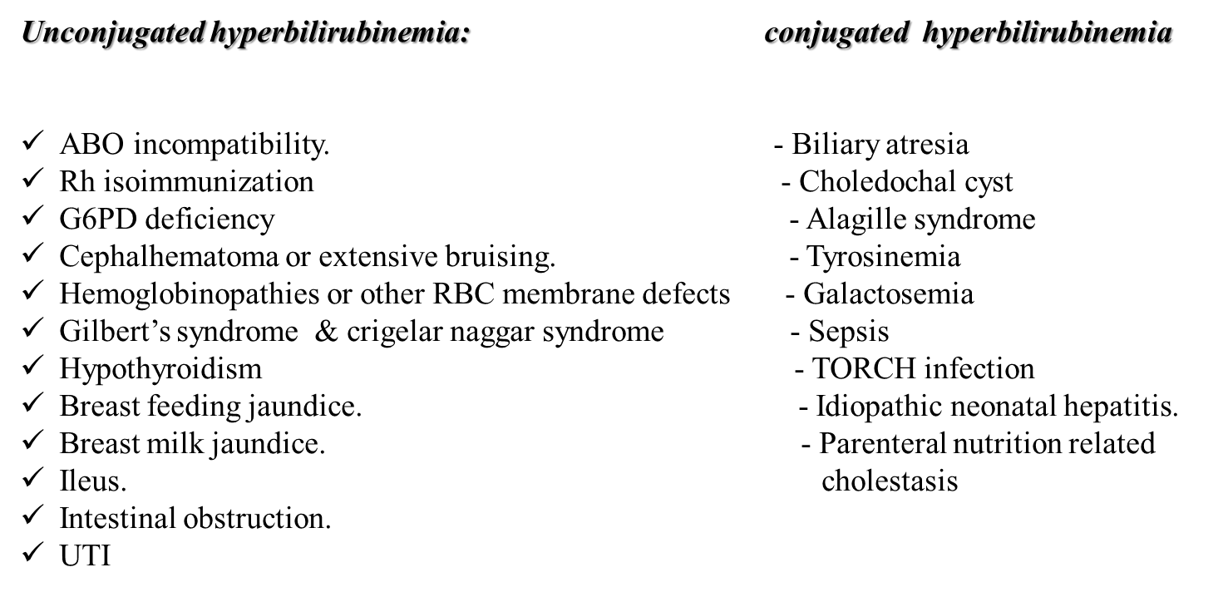
CAUSES OF HYPERBILIRUBINEMIA

Slide 9
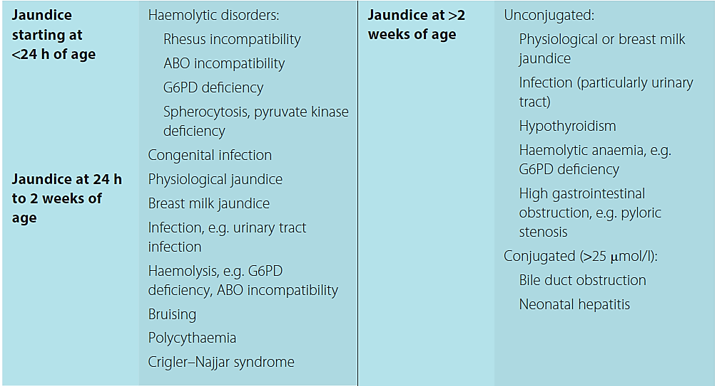
CAUSES OF HYPERBILIRUBINEMIA

Slide 10
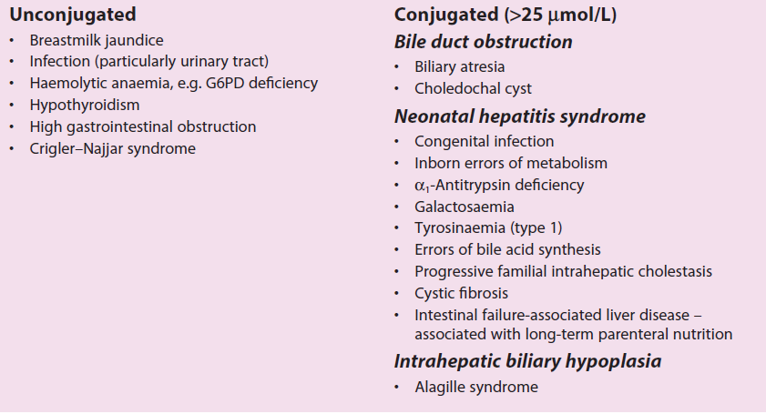
CAUSES OF PROLONGED (PERSISTENT) NEONATAL JAUNDICE
Notes:
Jaundice in babies >2 weeks old (3 weeks if preterm) is called persistent or prolonged neonatal jaundice.

Slide 11
HISTORY
Onset of jaundice
Blood group of mother and baby.
Flu-like illness or skin rash during pregnancy (congenital infection) Maternal drug intake.
Birth trauma with bruising and/or fractures
Delayed cord clamping.
Family history of neonatal jaundice.
Loss of stool color.
Greater than average weight loss
Symptoms of hypothyroidism
Symptoms of metabolic disease (eg, galactosemia)
Exposure to total parental nutrition
Types of feeds –breast or bottle.
Use of drugs and herbal remedies in the lactating mother

Slide 12
EXAMINATION
look particularly for the following signs :
Jaundice :first appears in the sclera and face and progresses cephalocaudally, appearing last on the feet and soles.
Examination of blanched skin in natural light may be
helpful.
It is more difficult to detect in preterm and dark skinned
infants.
Dermal pressure may reveal the anatomic progression of jaundice(face, approximately 5 mg/dL; midabdomen,15 mg/dL; soles, 20 mg/dL).

Slide 13
General: dysmorphic features ( Alagille syndrome,) ,obese and plethoric (infant of diabetic mother )
Head: microcephaly (congenital infections), cephalhematoma ,large fontanelle (hypothyroidism)
Eye: cataract (galactosemia) ,chorioretinitis (congenital infections)
Mouth :large protruding tongue(hypothyroidism)
Skin: bruises ,purpura, petechiae (congenital infections)
Abdomen: hepatosplenomegaly (congenital infections, hemolytic anemia).
Umbilicus : infection, hernia (hypothyroidism)

Slide 14
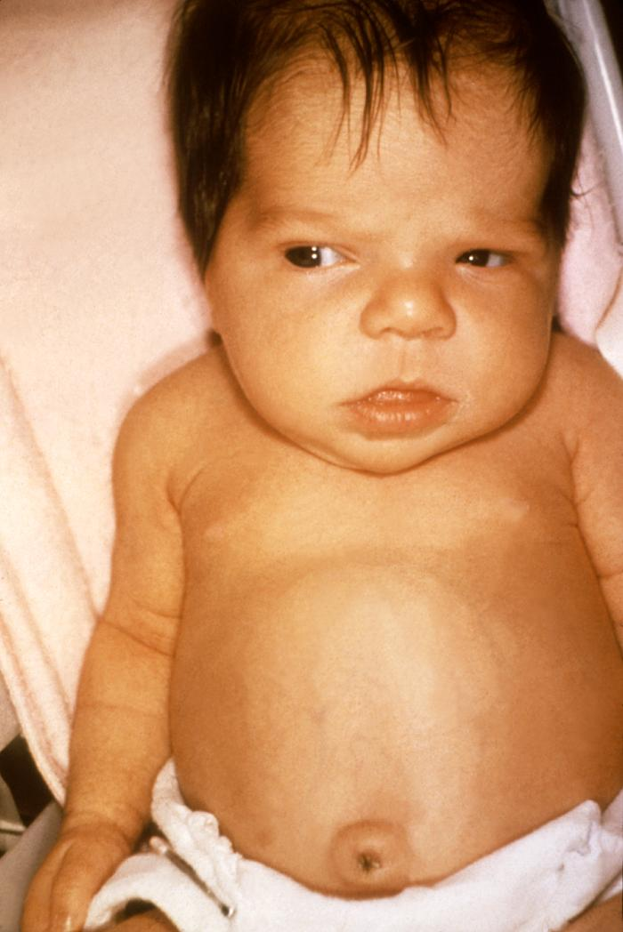
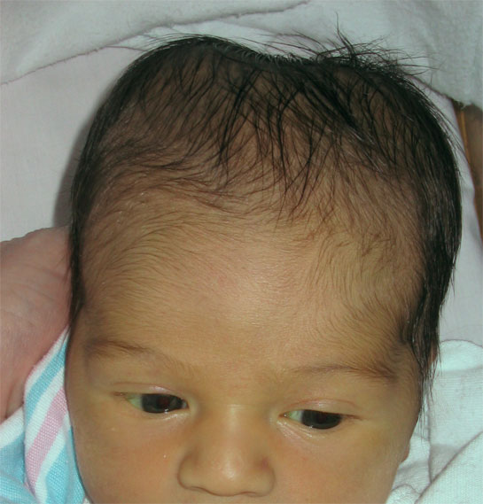

Slide 15
INVESTIGATIONS
Serum bilirubin
Hematocrit
Blood group and Rh type of mother and baby
Direct agglutination (Coombs) test
Investigations to determine the underlying pathology should include:
  • Full blood count
  • Peripheral blood film
  • Sepsis work-up to include culture of blood, urine, and cerebrospinal fluid (as indicated)
  • G6PD levels depending on ethnicity of parents

Slide 16
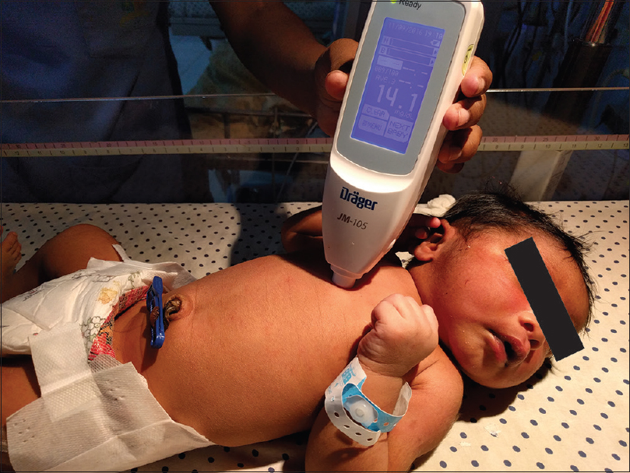
The transcutaneous bilirubin meter
Notes:
The transcutaneous bilirubin meter :
Can be used in babies of 35 weeks’ gestation or more after 24 hours of age.
It uses multi wavelength reflectance.
There is good correlation with serum bilirubin level up to 250 μmol/L.
It is a useful screening tool and can be helpful in community and postnatal wards.
The value should be plotted on the nomogram to assess the risk level and if treatment is indicated

Slide 17
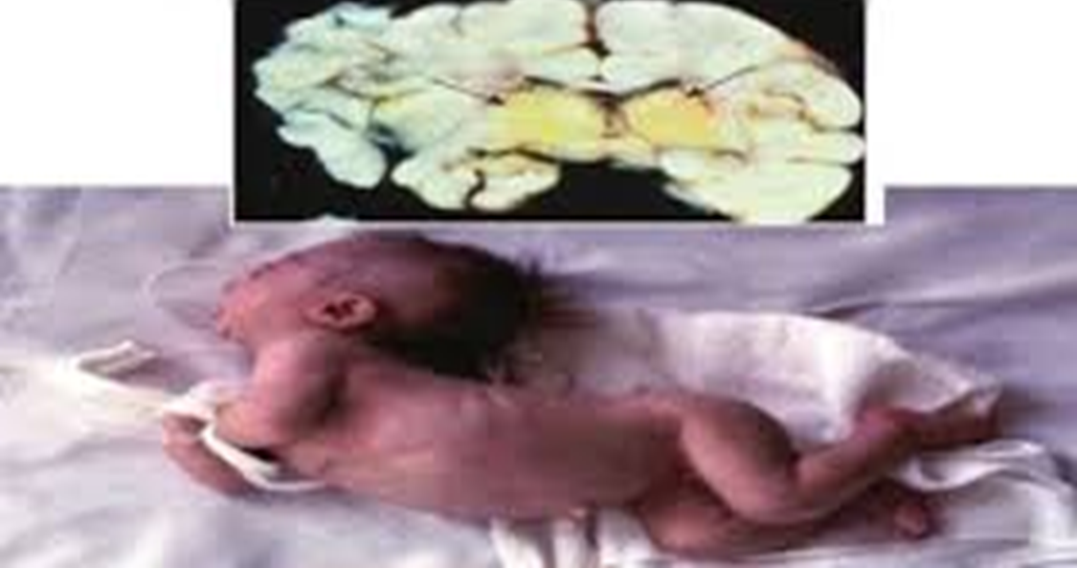
COMPLICATIONS
Kernicterus
  Kernicterus is brain damage caused by unconjugated bilirubin deposition in basal ganglia and brain stem nuclei
  Bilirubin can cross the blood-brain barrier and enter the brain tissue if it is unconjugated and unbound to albumin, or if there is damage to the blood-brain barrier.
  Acute bilirubin toxicity in a term infant if:
    No signs of hemolysis and the TSB concentration is greater than 25 mg/dL.
    TSB concentration is above 20 mg/dL, in a term infant who has hemolysis
  Clinical presentation
Poor suck
High-pitched cry
Stupor, hypotonia
Seizures
Hypertonia of extensor muscles
Opisthotonos
Retrocollis
Fever
Choreoathetotic cerebral palsy
Sensorineural hearing loss
Tremor
Upward gaze
Dental dysplasia
Notes:
Premature infants are more liable to kernicterus at a lower level of bilirubin because:
Low serum albumin
No subcutaneous fat, so most bilirubin passes the blood brain barrier to lipids of CNS
More liable to asphyxia & acidosis leads to decrease binding of bilirubin to albumin and increase permeability of brain cell membranes to bilirubin
More liable to hypoglycemia leads to excess free fatty acids in circulation & decrease binding of bilirubin

Slide 18
Difference between physiological and pathological jaundice
Indicators of pathological jaundice in newborn infants:
Early onset of clinical jaundice in the first 24 hours of age
Rapid rise of serum bilirubin at a rate faster than 5mg/dL/24 hr.
Sick newborn with jaundice
Serum bilirubin > 250μmol/l by 48h of age or > μ300 mol/l by 72h of age (serum bilirubin is >12 mg/dL in a full-term infant (especially in the absence of risk factors) or 10-14 mg/dL in a preterm infant)
Failure to respond to phototherapy
Prolonged jaundice> 14 days in term infants and >21 days in preterm infants
Conjugated bilirubin level of >μ25 mol/l (>2 mg/dL at any time)
Pale chalky stools and dark urine.
Notes:
The distinction between physiologic and pathologic jaundice relates to the timing, rate of rise, and extent of hyperbilirubinemia

Slide 19
COMMON CAUSES OF UNCONJUGATED HYPERBILIRUBINEMIA
1-PHYSIOLOGICAL JAUNDICE
MECHANISM:
High rate of bilirubin production and an impaired ability to extract bilirubin from the body.
Bilirubin production also is increased as a result of elevated hematocrit and RBC volume per body weight and a shorter life span of the RBCs (70–90 days).
Infants have immature hepatic uridine-diphosphoglucuronic glucuronosyltransferase (UDPGT), a key enzyme involved in the conjugation of bilirubin that facilitates excretion from the body.

Slide 20
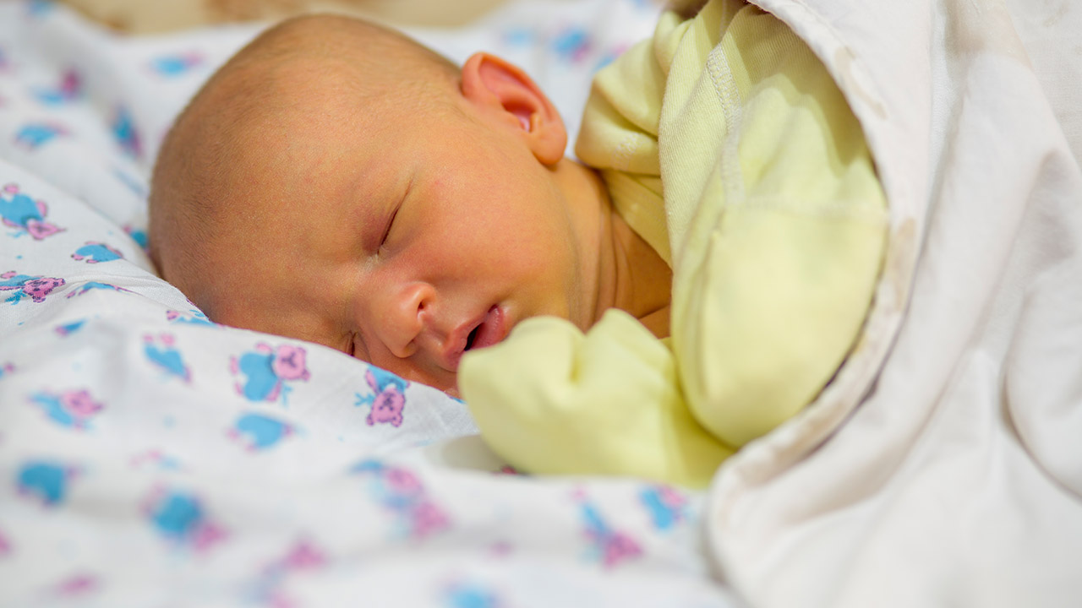

Slide 21
DIAGNOSTIC CRITERIA IN THE FULL TERM
Unconjugated hyperbilirubinemia that occurs after the first postnatal day.
It can last up to 1 week.
The TSB concentration peaks at approximately 5.5 mg/ dL (94.1 μmol/L) by the third postnatal day .
By 96 h of age, 95 % of infants have TSB concentrations of less than 12 mg/dL.
Bilirubinemia > 17 mg/dL is not physiologic
It usually fades by 7-14 days (by 3 weeks in preterm infants).
No accompanied anemia
The baby looks healthy
Urine & stools are normal.

Slide 22
2-Jaundice associated with breast milk
Early Onset Breast Feeding Jaundice (breast feeding jaundice) “suboptimal intake hyperbilirubinemia.”
Causes
• Breastfeeding exaggerates physiologic jaundice in the first postnatal week because of caloric deprivation, leading to an increased in enterohepatic circulation.
• Mild dehydration and delayed passage of meconium also play roles.
Prevention
• Successful breastfeeding decreases the risk of hyperbilirubinemia.
• Infants need to be fed at least 8–12 times in the first few days after birth .
• The best way to judge successful breastfeeding is to monitor infant weight, urine output, and stool output
• Newborns should have six wet diapers and three to four yellow, seedy stools per day by the fourth day after birth.
• Breastfed infants should lose no more than 10 % of their body weight by the third or fourth postnatal day.

Slide 23
Late Onset Human Milk Jaundice“breast milk jaundice syndrome.”
Background
• Usually occurs from the 6th through the 14th day after birth and may persist for 1–3 months.
• It is suggested that beta-glucuronidases and non-esterified fatty acids in the human milk inhibit enzymes that conjugate bilirubin in the liver.
Management
• Treatment for breast milk jaundice is not necessary unless the infant's total serum bilirubin level exceeds the phototherapy guidelines
The first step of management is phototherapy
If the total serum bilirubin level remains below 12 mg/dL, the recommendation is to continue breastfeeding.

Slide 24
If the total serum bilirubin level is higher than 12 mg/dL but below the phototherapy level, and further investigation shows no hemolysis evidence, the recommendations are also to continue breastfeeding.
When the bilirubin is greater than 20, a brief 24-hour cessation of breastfeeding may be beneficial.

Slide 25
3- Hemolytic disease of the newborn(Rh or ABO incompatibility)
Jaundice appearing during 1st 24 hours, hemolytic disease of the newborn should be suspected until proved otherwise
Rhesus hemolytic disease
Rh incompatibility that develops between Rh-negative mother previously sensitized to the Rh D antigen and her Rh positive fetus.
Initial exposure of the mother to the Rh antigen occurs during birth, abortion, or ectopic pregnancy.
Re-exposure to the Rh antigen will cause elevation of maternal specific IgG-Rh antibody,
These antibodies pass through the placenta and attach to fetal erythrocyte causing extravascular hemolysis.
Affected infants are usually identified antenatally and monitored and treated if necessary .
Antibodies may develop to rhesus antigens other than D and to the Kell and Duffy blood groups, but hemolysis is usually less severe.
Rho(D) immune globulin (RhoGAM) immunoprophylaxis at 28 weeks gestation in the absence of sensitization or within 72 h of suspected Rh antigen exposure or both will reduce the risk of sensitization to < 1 %.

Slide 26
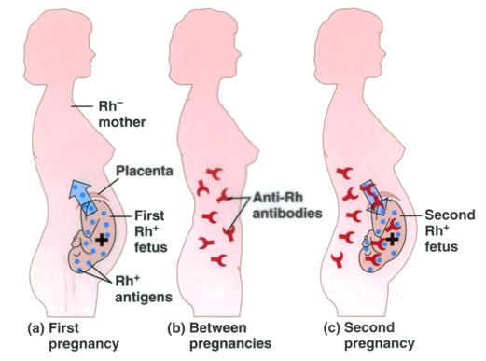

Slide 27
ABO incompatibility
This is now more common than rhesus hemolytic disease.
Most ABO antibodies are IgM and do not cross the placenta, but some group O women have an IgG anti-A-haemolysin in their blood, which can cross the placenta and haemolyse the red cells of a group A infant.
Occasionally, group B infants are affected by anti-B haemolysins. Hemolysis can cause severe jaundice but it is usually less severe than in rhesus disease.
The infant’s haemoglobin level is usually normal or only slightly reduced .
The direct antibody test (Coombs’ test), which demonstrates antibody on the surface of red cells, is positive.
The jaundice usually peaks in the first 12 hours to 72 hours.

Slide 28
Diagnosis
Blood type and Rh factor in the mother and infant
Reticulocyte count
Direct Coombs’ test
Blood smear
Bilirubin level (fractionated and total)

Slide 29
4- other hemolytic causes of unconjugated hyperbilirubinemia:
Glucose-6-phosphate dehydrogenase (G6PD) deficiency
X-linked recessive disorder .
Those affected tend to be Mediterranean or Middle or Far Eastern or African in origin.
Low levels of glucose-6-phosphate dehydrogenase.
They may develop hemolytic anemia in response to a number of stressors, e.g. infection, certain medications, fava beans when older.
It is diagnosed by measuring G6PD activity in red blood cells.
Spherocytosis
This is considerably less common than G6PD deficiency
There is often, but not always, a family history.
The disorder can be identified by recognizing spherocytes on the blood film.

Slide 30
5- Syndromes:
Crigler–Najjar (type 1 and 2) syndrome :
Is due to deficiency of enzyme uridine diphosphate glucuronyltransferase(ugt).
Autosomal recessive disorder .
Both types present in the early neonatal period with a rapid rise in serum bilirubin to very high levels despite phototherapy.
Kernicterus can develop.
Type 1 is more severe.
Gilbert syndrome
Autosomal recessive condition in which UGT1A1 activity decreases mildly in hepatocytes, typically resulting in a benign unconjugated hyperbilirubinemia.
The likelihood of severe hyperbilirubinemia is increased if the infant also has G6PD deficiency

Slide 31
CONJUGATED HYPERBILIRUBINEMIA (cholestasis)
Conjugated hyperbilirubinemia is defined biochemically as a conjugated bilirubin level of ≥ 2 mg/dL (>25 μmol/L) and > 20 % of the total bilirubin.
CAUSES
Intrauterine infection TORCH
Neonatal hepatitis
Biliary atresia
Cholydochal cyst
Parenteral nutrition related
Metabolic:
  Galactosemia, cystic fibrosis, α1-antitrypsin deficiency
Intrahepatic cholestasis:
  familial &syndromic

Slide 32
INVESTIGATIONS OF CHOLESTASIS
A-INVESTIGATIONS TO ESTABLISH THE PRESENCE OF CHOLESTASIS:
Increased total & direct serum bilirubin (conjugated hyperbilirubinemia)
Increased liver enzymes:
ALT,AST,GGT,alkaline phosphatase.
Decrease liver synthetic functions:
Serum proteins,albumin,prothrombin time &INR
B- INVESTIGATIONS TO IDENTIFY THE CAUSE OF CHOLESTASIS:
Liver biopsy is the most reliable method for differentiation between idiopathic hepatitis and extrahepatic biliary atresia.
HIDA scan
TORCH screening by specific IgM antibodies and may be PCR
Reducing substance in urine →galactosemia
Sepsis screen →sepsis
Metabolic workup:
Galactose 1-phosphate uridyl transferase
Serum antitrypsin level

Slide 33
BILIARY ATRESIA
Biliary atresia is the commonest cause of neonatal liver disease and indication for liver transplantation in children.
Biliary atresia, also known as extrahepatic ductopenia and progressive obliterative cholangiopathy, is a childhood disease of the liver in which one or more bile ducts are abnormally narrow, blocked, or absent.
CLINICAL PRESENTATION
Mild jaundice and pale stools (the color may fluctuate but becomes increasingly pale as the disease progresses).
They have normal birthweight followed by faltering growth.
Hepatomegaly is often present initially.
Splenomegaly develops due to portal hypertension.

Slide 34
INVESTIGATIONS
Blood tests may include:
Raised conjugated bilirubin .
Abnormal liver function test.
Coagulation tests
Viral tests – some viruses can cause liver damage
Tests for some metabolic diseases (such as enzyme deficiencies) that can cause early jaundice and liver test abnormalities
Tests for cystic fibrosis, such as a sweat test
IMAGING
A fasting abdominal ultrasound may demonstrate a contracted or absent gallbladder,though it may be normal.
Biliary excretion or “HIDA” scan
The diagnosis is confirmed by a cholangiogram (ERCP (endoscopic retrograde cholangiopancreatography), or operative.
Percutaneous liver biopsy is valuable procedure in the evaluation .

Slide 35
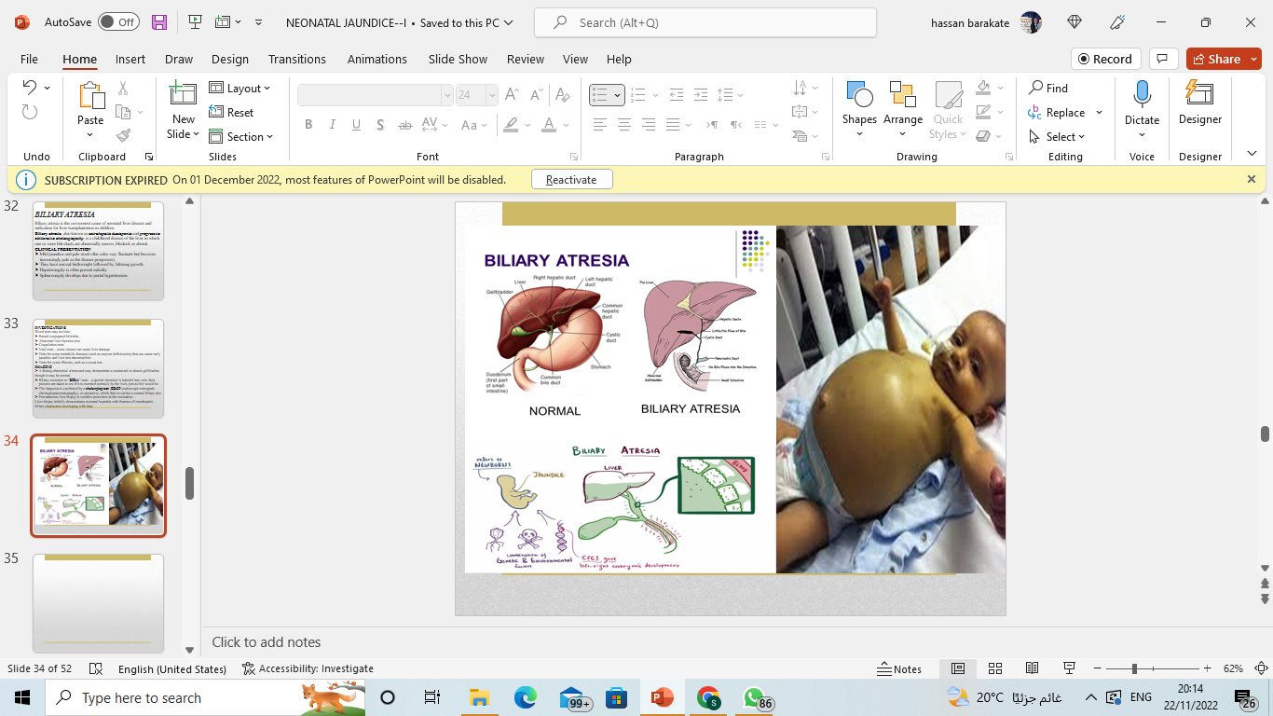

Slide 36
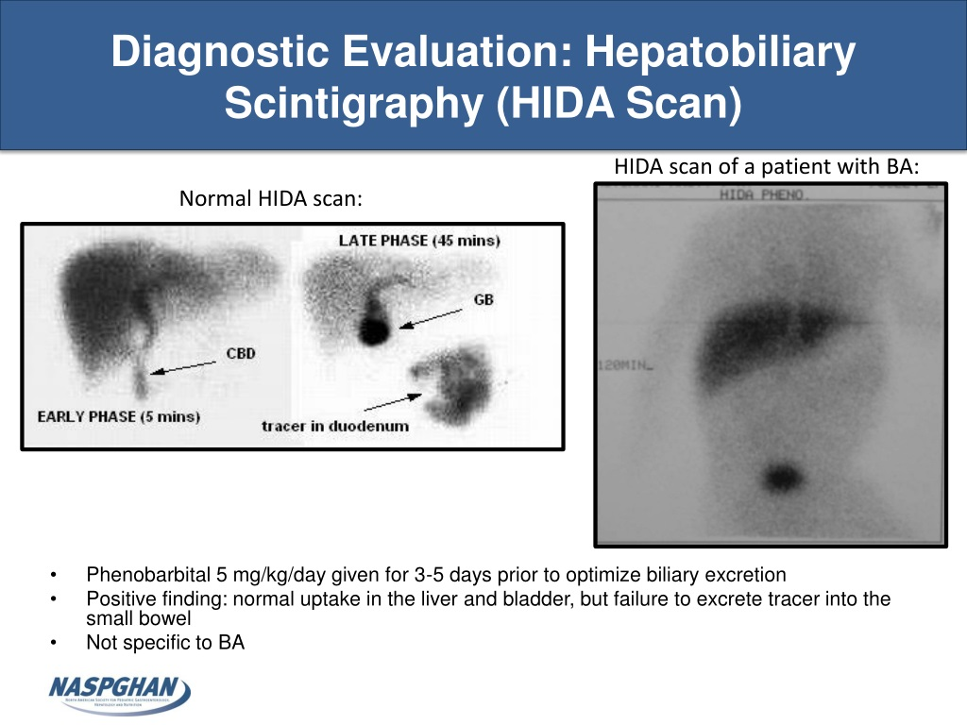
Hepatobiliary scintigraphy (HIDA Scan)

Slide 37
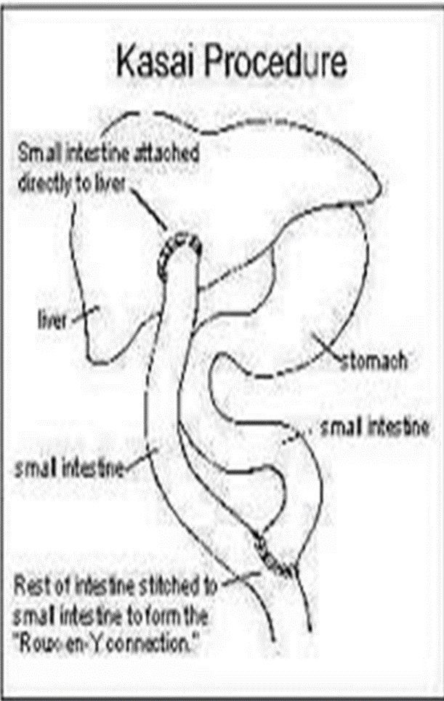
Treatment
Palliative surgery with a Kasai hepatoportoenterostomy(a loop of jejunum is anastomosed to the cut surface of the porta hepatis) bypasses the fibrotic ducts and facilitates drainage of bile from any remaining patent ductules.
Early surgery increases the success rate, with 80% clearing the jaundice if performed before 60 days.
Even with successful clearance of jaundice, the disease progresses in most children who may develop cholangitis and cirrhosis with portal hypertension.
Nutrition and fat-soluble vitamin supplementation is essential.
If the Kasai is unsuccessful, liver transplantation is considered.
Biliary atresia is the single most common indication for liver transplantation in the pediatric age group.

Slide 38
TREATMENT OF NEONATAL JAUNDICE

Slide 39
The type of treatment depends on the bilirubin level and its rate of rise, gestational age, and if other risk factors are present.
Feeding
More frequent feeding.
Phototherapy
Clinical jaundice and indirect hyperbilirubinemia are reduced by exposure to
high-intensity light in the visible spectrum. Bilirubin absorbs light maximally in
the blue range (420-470 nm).
Phototherapy works by converting bilirubin into a water soluble compound called lumirubin, which is excreted in the urine or bile.
Continuous multiple (intensive) phototherapy is given if the bilirubin is rising rapidly or has reached a high level
Complications of phototherapy
Insensible water loss (increase fluid intake or the volume and frequency of feeding).
Phototherapy may be associated with loose stool.
Retinal damage (covering the eye is a routine during phototherapy).
Temperature instability as the infant is undressed,
A macular rash, and bronze discoloration of the skin if the jaundice is conjugated.

Slide 40
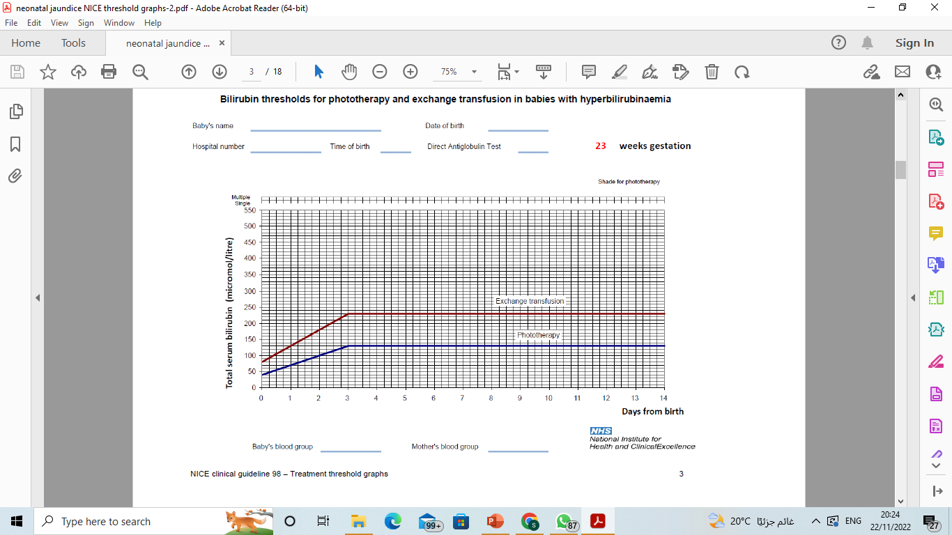

Slide 41
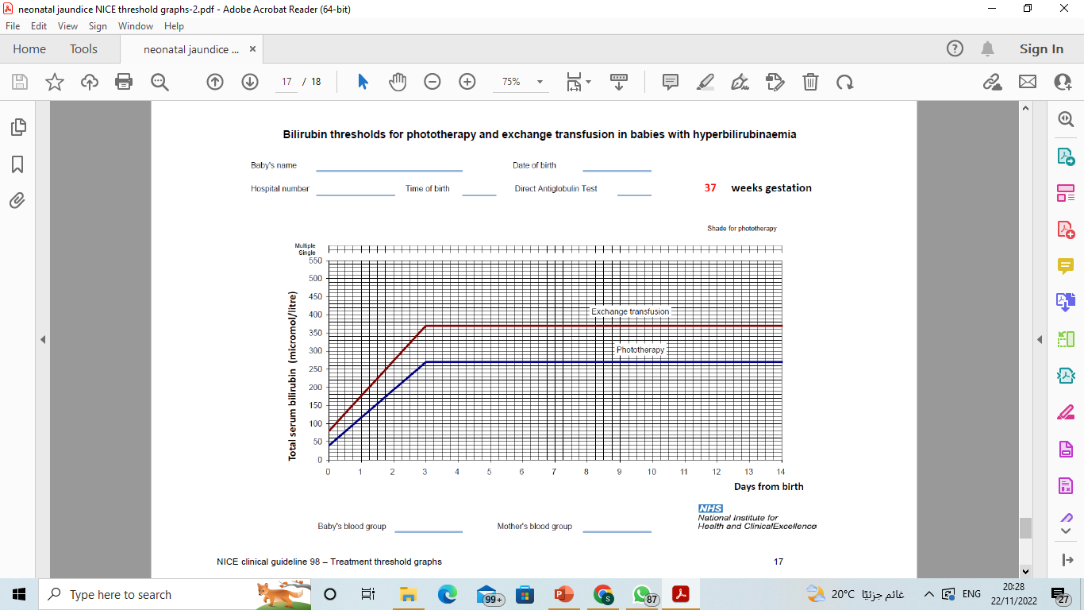

Slide 42
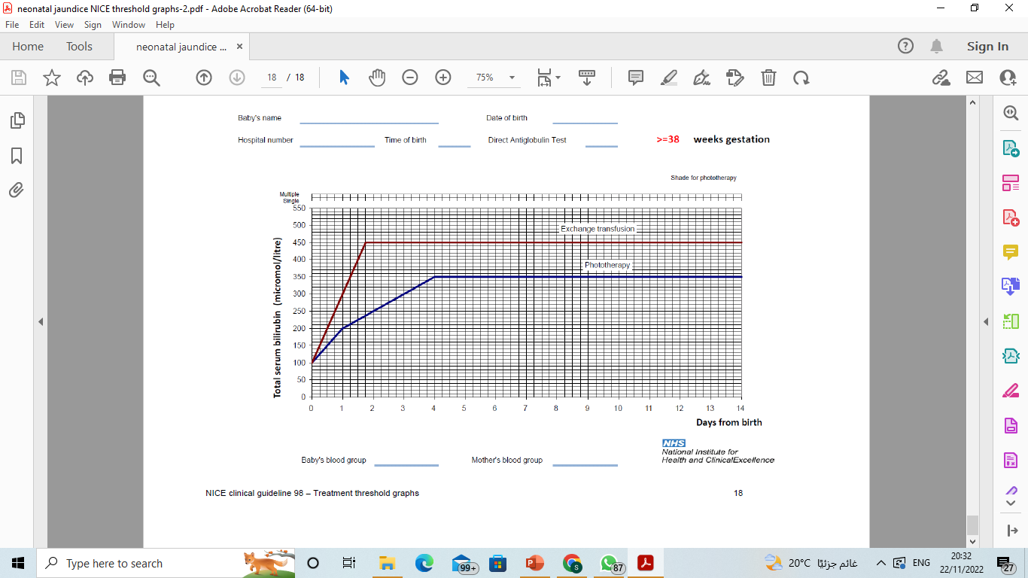

Slide 43
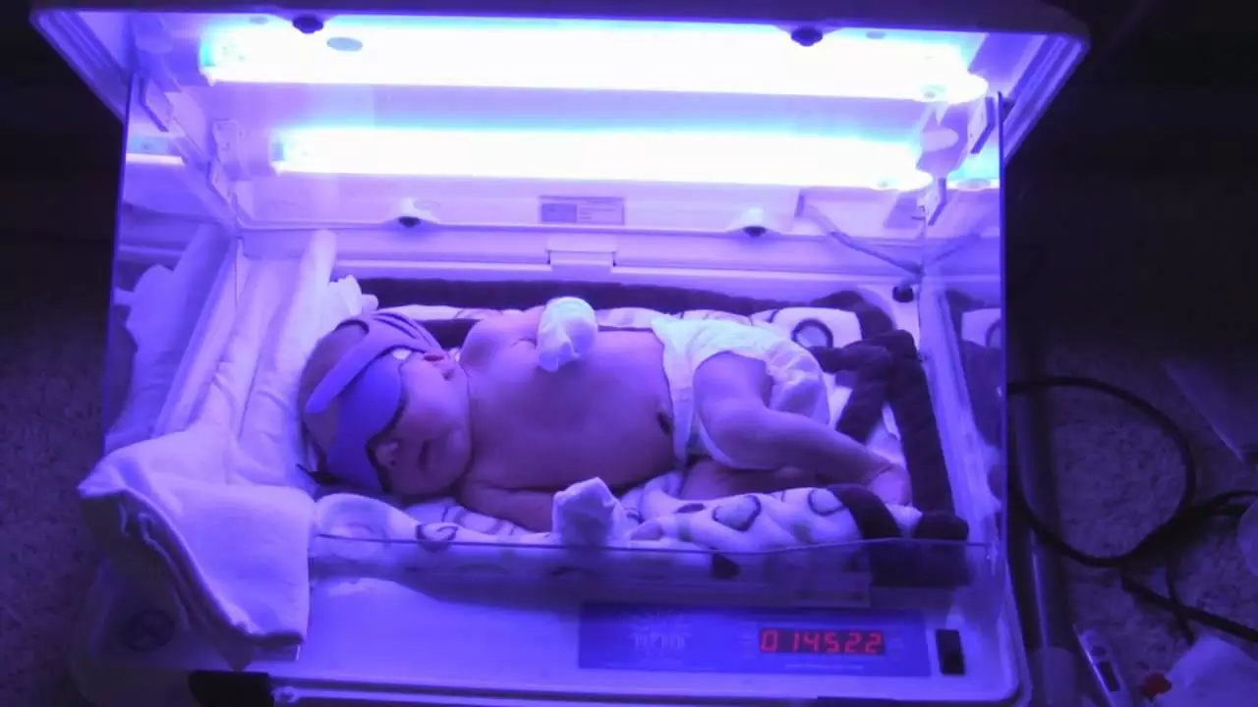
PHOTOTHERAPY

Slide 44
Exchange transfusion
Required if the bilirubin rises to levels that are considered potentially dangerous.
Blood is removed from the baby in small aliquots (usually from an arterial line or the umbilical vein) and replaced with donor blood (via peripheral or umbilical vein).
Usually, twice the infant’s blood volume (2 × 90 ml/kg) is exchanged.
Donor blood should be as fresh as possible and screened to exclude cytomegalovirus, hepatitis B and C and HIV infections.
The procedure does carry some risk of morbidity and mortality.
Phototherapy has been very successful in reducing the need for exchange transfusion.
In infants with rhesus hemolytic disease or ABO incompatibility unresponsive to intensive phototherapy, intravenous immunoglobulin reduces the need for exchange transfusion.

Slide 45
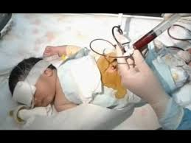
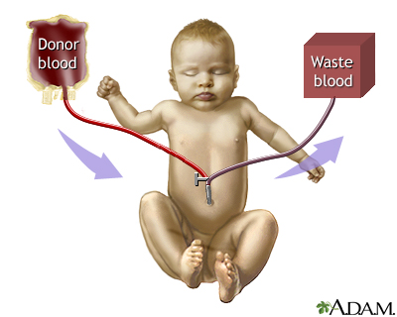

Slide 46
PHARMACOLOGICAL TREATMENT OF JAUNDICE
PHENOBARBITONE
Phenobarbitone induces hepatic UGT enzyme and hence the conjugation of the bilirubin.
It may also increase the hepatic uptake of bilirubin.
It acts very slowly and does not lower serum bilirubin levels fast enough to be clinically helpful.
INTRAVENOUS IMMUNOGLOBULIN
High-dose intravenous immunoglobulin (IVIG) is effective in reducing the bilirubin levels and reduces the need for exchange transfusion in neonates with Rhesus or ABO immune hemolytic disease.
Used as an adjunct to intensive phototherapy if the serum bilirubin continues to increase more than 8.5 μmol/L/hour.
In isoimmune haemolysis, red blood cells are destroyed by an antibody dependent cytotoxic mechanism mediated by Fcreceptor-bearing cells of the neonatal reticuloendothelial system.
The mechanism of IVIG action is nonspecific blockade of Fc receptors, which reduces red cell breakdown.
Maternal IVIG administration also reduces fetal hemolysis.

Slide 47
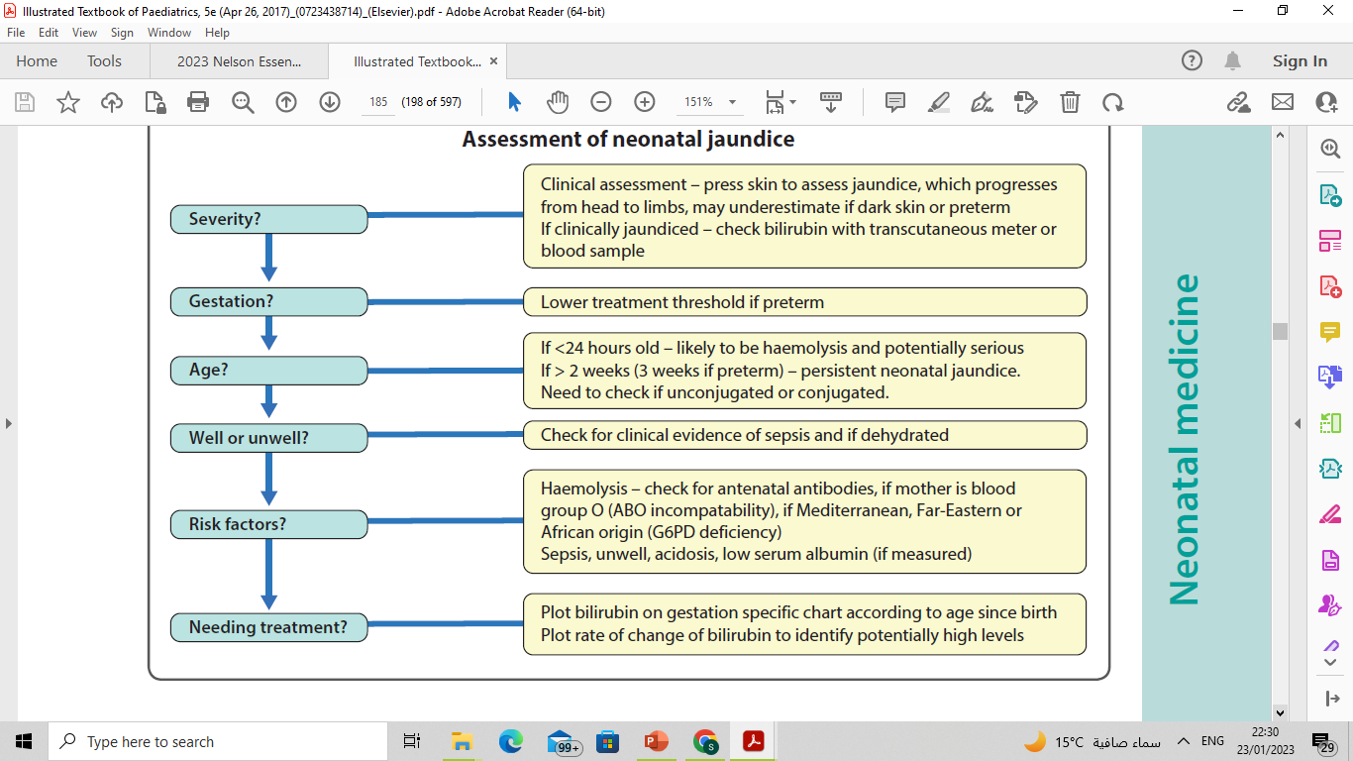

Slide 48
THANK YOU

