Slide 1
HISTORY
&
EXAMINATION OF THE BREAST
S. AHMED KHAN MBBS, FCPS
Assoc. Prof. of Surgery

Slide 2
Axillary Lymph Nodes
Level I: Lateral to the pectoralis minor muscle
Level II: Posterior to the pectoralis minor muscle
Level III: Medial to the pectoralis minor muscle
Rotter's nodes: Between the pectoralis major and the minor muscles

Slide 3
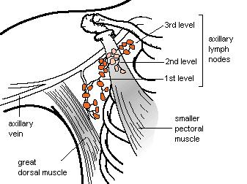

Slide 4
Changes in the Breast During Menstrual Cycle
Increase in size in 2nd half of the cycle
Slightly painful and tender during later part of menstrual cycle
Pre-existing complain may get worse
Pre-existing lump may increase in size

Slide 5
History
Common complaints:
Lump ( most common)
Pain/ tenderness (Mastalgia)
Change in the breast size
Change in the nipple
Discharge from the nipple

Slide 6
Presentation of Breast Diseases
Painless lumps:
- Carcinoma,
- Fibroadenoma, - - Fat necrosis,
- Cysts
Painful lumps:
- Fibroadenosis,
- Abscess

Slide 7
Presentation of Breast Diseases
Breast pain: Fibroadenosis (fibrocystic disease)
Premenstrual pain

Slide 8
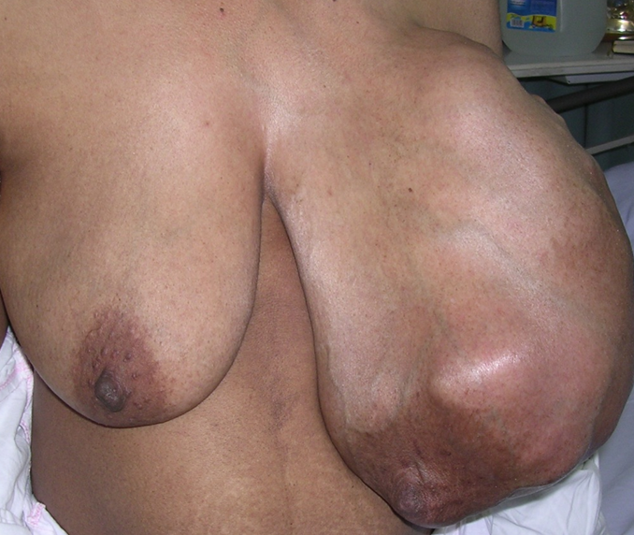
Presentation of Breast Diseases
Changes in breast size
Giant fibroadenoma,
Phylloides tumour,
Benign hypertrophy (bilateral)

Slide 9
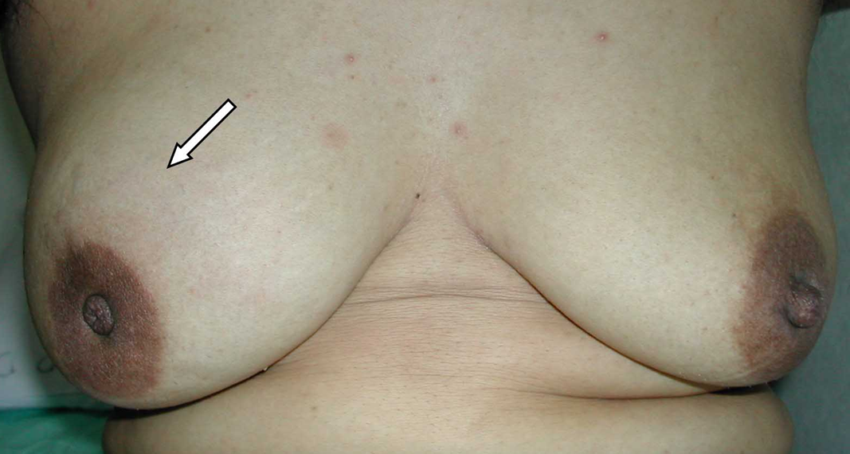
Presentation of Breast Diseases
Changes in nipple:
Carcinoma(retraction)
Paget’s disease (ulceration),

Slide 10
Presentation of Breast Diseases
Discharge from nipple:
Red: Duct papilloma, carcinoma,
Yellow/ Green: Fibrocystic disease, duct ectasia, White/Milky: Galactorrhea

Slide 11
History
History taking follows the standard pattern
Detailed analysis of complaints
Important areas of history: menstrual , pregnancy, lactation(Breast feeding), family, previous breast problems

Slide 12
History of a Lump
When noticed (duration)?
How noticed?
Any change in the lump since first noticed?
Any change in the breast/ nipple?
Any associated symptom ? Pain, discharge
Any relationship with menstrual cycle?
Any history of trauma??

Slide 13
History of Pain
Site
Duration
Onset and severity
Relationship to menstrual cycle (cyclical or non-cyclical)
Aggravating factors
Relieving factors

Slide 14
History of Discharge
Duration
Colour of discharge: blood (red), serum (brown, green, straw coloured), pus, milky
Spontaneous or on pressure
Unilateral/ bilateral
Any change in the nipple
Other accos: symptom (pain)

Slide 15
Past Medical/ Surgical History
Breast problem
Mammogram
Breast biopsy
Exposure to radiation (face, chest)- risk factor
Other medical /surgical history
Obesity (BMI >25) - risk factor

Slide 16
Menstrual History
Age of menarche
Age at menopause
*early menarche (<12 year) , late menopause (>55 year)- increases risk for carcinoma
Last menstrual period
Regularity of menstrual cycle
Breast changes during menstrual cycle

Slide 17
History of Pregnancy
Age at 1st pregnancy- younger age (<18) is protective - >30 years- increased risk
Number of pregnancy- protective
Lactational history- protective

Slide 18
Medications
Oral contraceptives- not known risk
Hormone replacement therapy- increased risk
Other medications

Slide 19
Family History
At least two generations
Breast, gynecologic(ovarian), colon, prostate, gastric, or pancreatic cancer
Their Age at diagnosis of these tumours.

Slide 20
Clinical Examination
Explain to your patient
Patient’s permission
Privacy
Nurse’s presence
Semi-recumbent position (45°) , supine, sitting
Expose upper half of the patient, both breasts exposed
Arms by the sides

Slide 21
Inspection of the Breast
Stand in front of the patient
4 quadrants
Symmetry & size of breasts (underlying lump)
Any obvious mass or lump
Skin changes- redness (infection, inflammatory carcinoma), edema (peau d’orange), dimpling, ulceration (carcinoma)

Slide 22
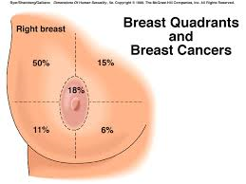

Slide 23
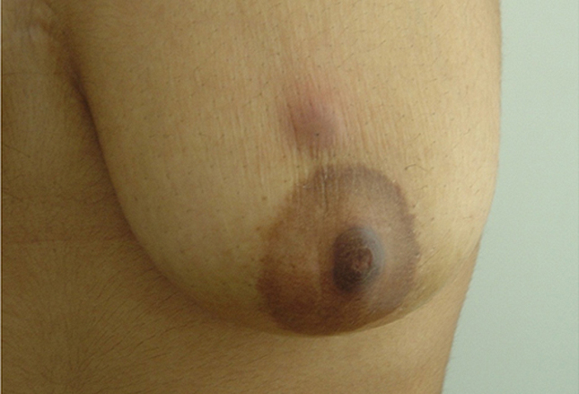

Slide 24
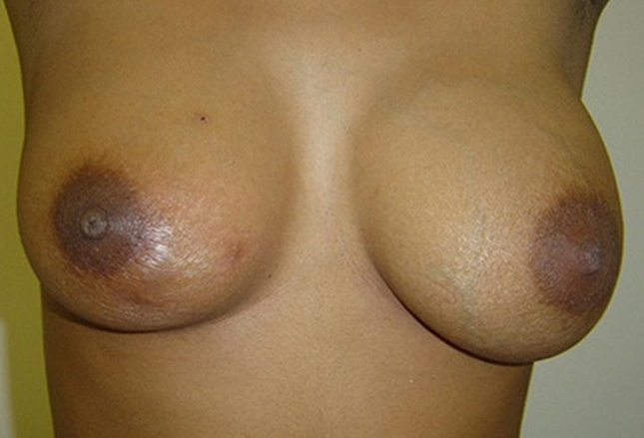

Slide 25
Skin dimpling in the lower inner quadrant of the left breast associated with breast cancer

Slide 27
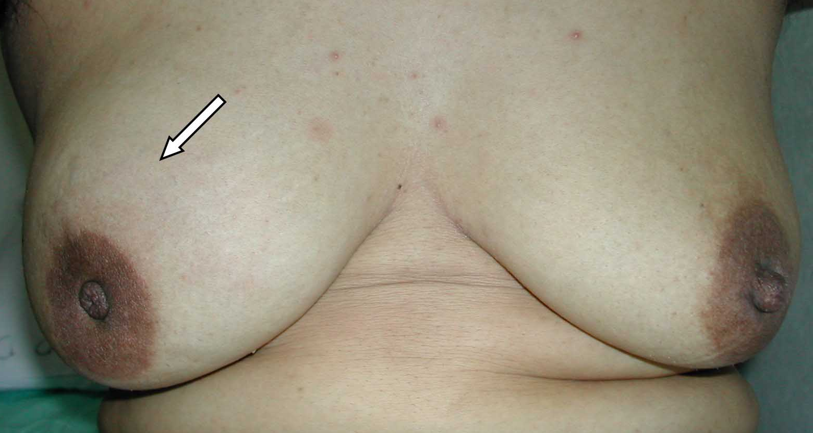

Slide 28
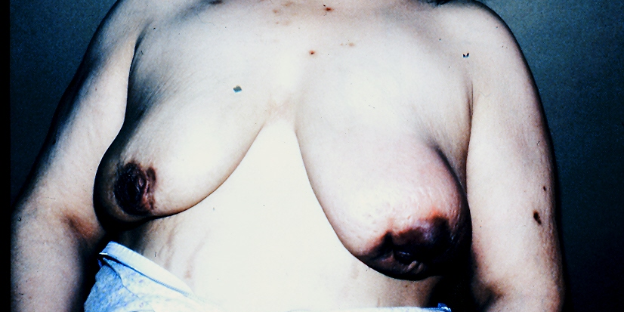

Slide 29
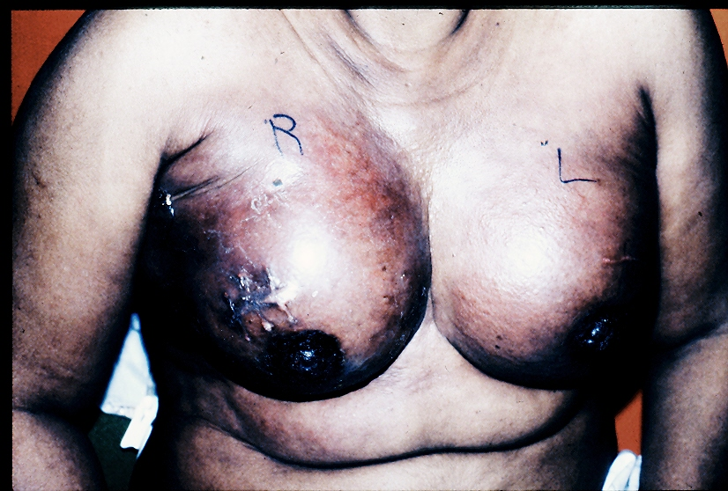

Slide 30
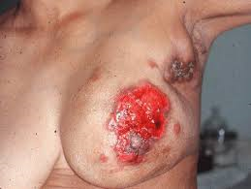

Slide 31
Inspection of the Breast
Changes in the nipple/ areola: raised level, retraction(carcinoma, duct ectasia), ulceration ( Paget’s disease)
Discharge from the nipple- spontaneous
Raise arms above the head- inspect breasts & axillae and note any change
Inspect supraclavicular area

Slide 32
Palpation of the Breast
Semi-recumbent position
Ask for any painful area
Normal side first
Palpate with palmer surface of the fingers for presence of lump
Lump characteristics: site, size, shape, surface, mobility, temperature, tenderness, texture, edge, attachment to skin or deep tissue
For these characteristics- use pulp of your fingers

Slide 33
Palpation of the Breast
Site: More carcinoma develop in upper outer quadrant
Size: Variable, Large mass- giant fibroadenoma, Phylloides tumor
Shape: Well defined- fibroadenoma, ill defined- carcinoma
Mobility: Fibroadenoma freely mobile
Temperature: Raised in inflammation, inflammatory carcinoma
Tenderness: Inflammatory –abscess
Texture: Hard- carcinoma, firm- fibroadenoma, fluctuant- cyst
Attachment: Carcinoma, sometime inflammatory lesions

Slide 34
Palpation of the Breast
Skin tethering- tumour infiltration of Cooper’s ligament pulling on the skin. Skin dimples when tumour is moved to one side or arm raised above the head
Skin fixation- when tumour is directly fixed to skin. Skin cannot be moved/pinched separately
Muscle attachment- patient’s both hands resting on hips, test lump mobility before & after muscle contraction ( ask patient to press against hips)

Slide 35
Palpation of the Nipple
Any retraction/ ulceration
Palpate for a mass underneath the affected nipple
Nipple discharge- blood (red), serum (brown, green, straw coloured), pus, milky
Pathological discharge: Bloody, spontaneous, unilateral
Discharge spontaneous or on pressure of a segment of areola
Any mass associated with discharging duct

Slide 36
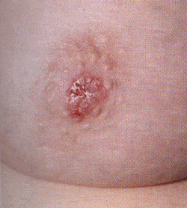
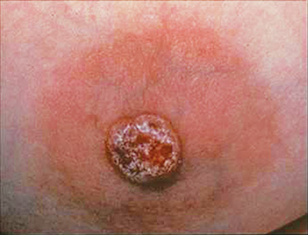

Slide 37
Palpation for the Lymph Nodes
Axilla, supraclavicular, infraclavicular lymph nodes
Patient sitting upright
Rt. Axilla: Hold patient’s right elbow in your right hand. Palpate the axilla with your left hand. For the apex of axilla press the finger pulp upward and medially.
Lt. axilla- reverse

Slide 38
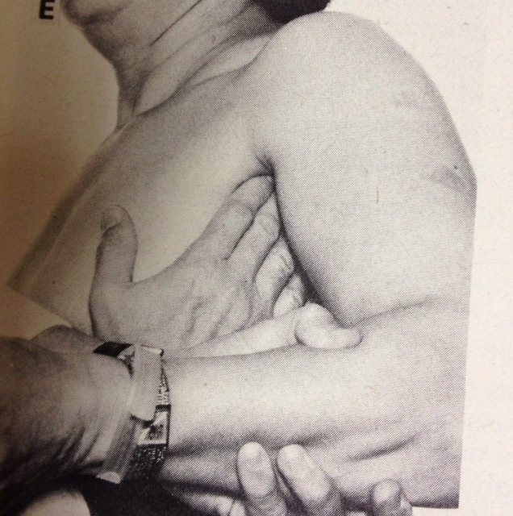

Slide 39
Palpation for the Lymph Nodes
Palpate for supraclavicular, infraclavicular lymph nodes
Size, number, and fixation of lymph nodes
Examine arm for any swelling

Slide 40
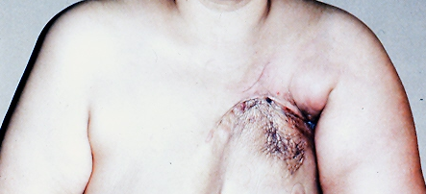

Slide 41
General Examination
Full general examination like any other patient
Concentrate on:
  Chest: any effusion
  Abdomen: hepatomegaly, ascites
  Spine: pain, tenderness, limitation of movement

Slide 42
Thank You!

